Slide 1

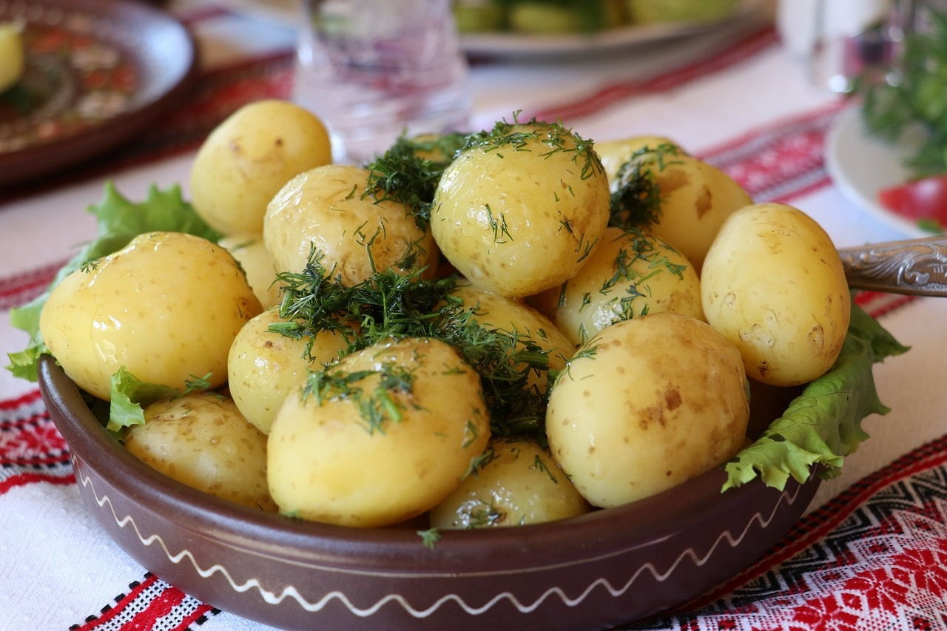
Exploring the Legacy of Marko Cheremshyna
A Journey Through Ukrainian Modernist Literature and Cultural Significance

Slide 2
Table of contents
Title Slide: Marko Cheremshyna - A Genius of Ukrai…
Who Was Marko Cheremshyna?
Historical Context in Late 19th/Early 20th Century…
Literary Innovations: Modernist Narrative Techniqu…
Linguistic Mastery and Hutsul Dialect Preservation
Thematic Explorations in Marko Cheremshyna's Works
Narrative Techniques: Interior Monologue and Strea…
Cultural Significance and Marginalized Experiences
Comparative Context to European Modernism
Key Literary Works Overview
01
02
03
04
05
06
07
08
09
10

Slide 3
Table of contents
Legacy and Influence on Ukrainian Literature
Critical Analysis of Marko Cheremshyna's Works
Interactive Learning: Discussion Questions and Res…
Multimedia Resources for Further Exploration
Conclusion and Significance of Cheremshyna's Work
Color Palette and Design Recommendations
Technical Specifications for PowerPoint Presentati…
Interactive Elements for Engaging Audience
Incorporating Hutsul Folk Art Elements
High-Quality Historical and Contemporary Images
11
12
13
14
15
16
17
18
19
20

Slide 4
Table of contents
Clean and Modern Typography
QR Codes for Additional Resources
Infographics for Complex Concepts
21
22
23

Slide 5

Title Slide: Marko Cheremshyna - A Genius of Ukrainian Modernist Literature
Marko Cheremshyna: A Genius of Ukrainian Modernist Literature
Exploring Literary Modernism in Early 20th Century Ukraine
Exploring the Legacy of Marko Cheremshyna

Slide 6

Who Was Marko Cheremshyna?
Born Ivan Semanюk in 1874
Hutsul region of Western Ukraine
Pseudonym representing cultural roots
Key Highlight: Transformative literary figure
Exploring the Legacy of Marko Cheremshyna

Slide 7
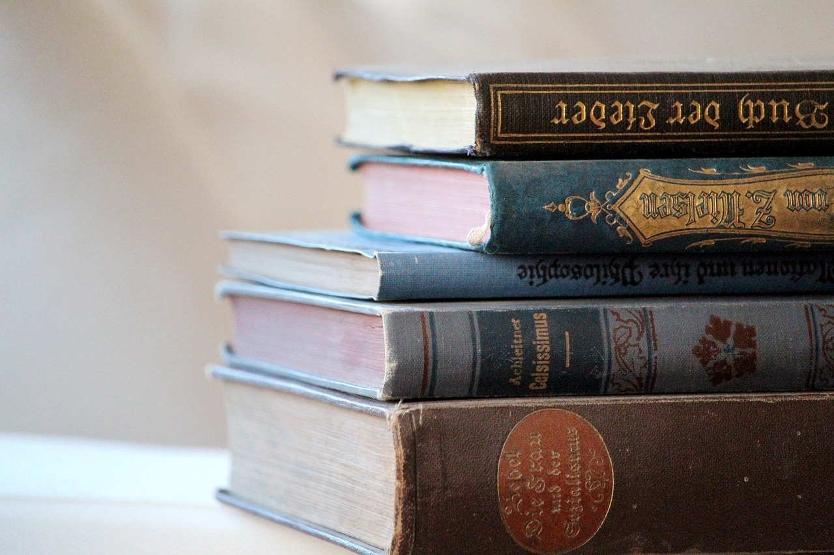
Historical Context in Late 19th/Early 20th Century Ukraine
Austro-Hungarian Imperial Control
Socio-Political Landscape
Ukraine was under the control of the Austro-Hungarian Empire during the late 19th and early 20th centuries.
This period was marked by significant political and social changes.
The socio-political environment was characterized by a struggle for national identity and autonomy.
Various political movements emerged, advocating for independence and social reforms.
Cultural Resistance through Literature
Literature became a powerful tool for cultural resistance.
Writers and poets used their works to express nationalistic sentiments and preserve Ukrainian culture.
Exploring the Legacy of Marko Cheremshyna

Slide 8

Literary Innovations: Modernist Narrative Techniques
Literary Innovations
Modernist Narrative Techniques
Psychological Realism
Impressionistic Writing Style
Linguistic Complexity
Exploring the Legacy of Marko Cheremshyna

Slide 9
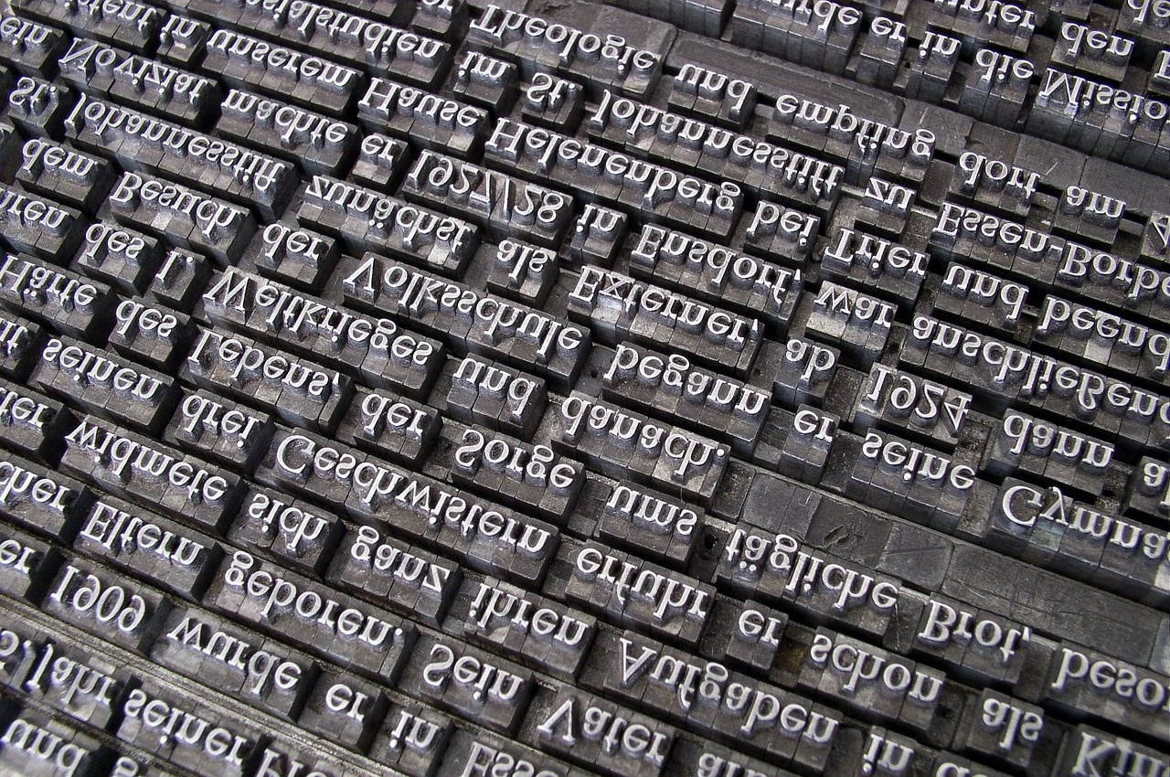
Linguistic Mastery and Hutsul Dialect Preservation
Preservation of Hutsul Dialect
Cultural Resistance through Language
Cheremshyna's dedication to capturing and preserving the unique linguistic nuances of the Hutsul region.
Utilizing the Hutsul dialect as a form of cultural resistance against external influences.
Symbolic Representation
Unique Narrative Voice
The Hutsul dialect as a symbolic representation of regional identity and heritage.
How the preservation of the Hutsul dialect contributes to Cheremshyna's distinctive narrative voice.
Exploring the Legacy of Marko Cheremshyna

Slide 10

Thematic Explorations in Marko Cheremshyna's Works
Peasant Life Experiences
Depiction of rural life in the Carpathian Mountains
Exploration of traditional customs and rituals
Contrast between urban and rural existence
Social Struggles
Critique of social hierarchies and injustices
Representation of class disparities
Advocacy for social reform and equality
National Identity
Emphasis on Ukrainian cultural heritage
Reflection of national pride and resilience
Symbolism of Ukrainian independence movements
Psychological Landscapes
Inner turmoil and emotional depth of characters
Exploration of human psyche and motivations
Symbolic representation of mental states
Exploring the Legacy of Marko Cheremshyna

Slide 11
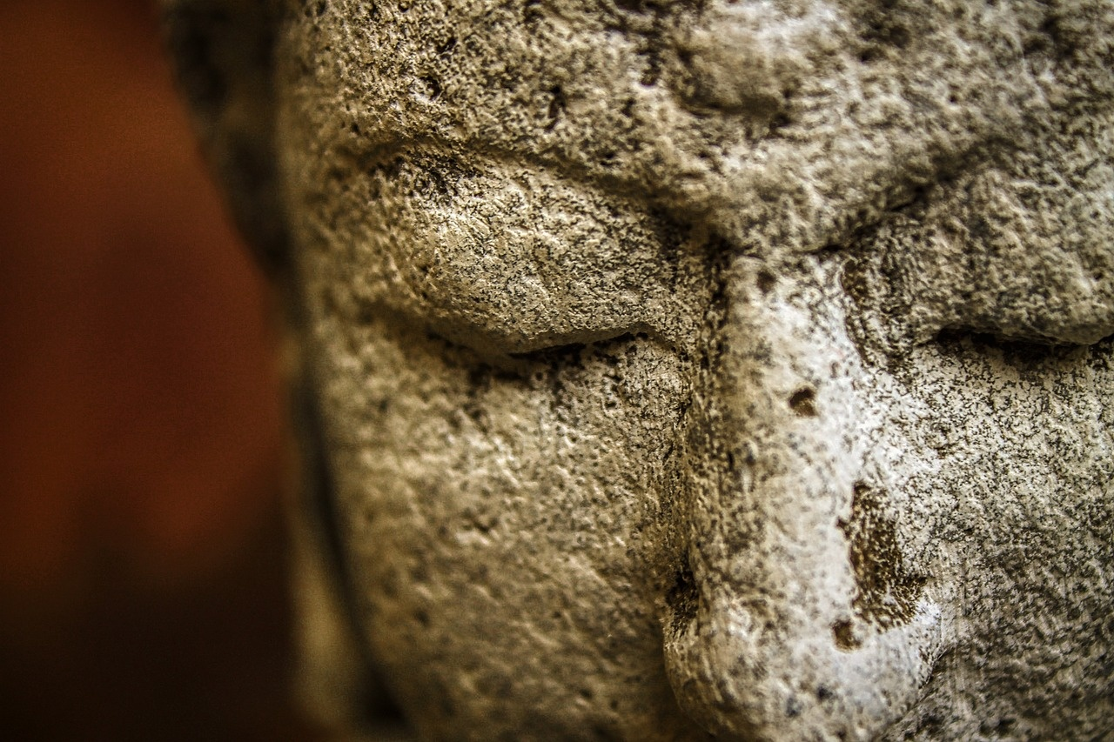
Narrative Techniques: Interior Monologue and Stream of Consciousness
Interior Monologue
Stream of Consciousness
Delving into characters' inner thoughts and emotions.
Revealing subconscious desires and conflicts.
Providing insights into characters' motivations and fears.
Capturing the continuous flow of characters' thoughts.
Reflecting the chaotic and fragmented nature of human consciousness.
Breaking traditional narrative structures for a more immersive reading experience.
Impact on Storytelling
Symbolic Representations
Enhancing psychological depth and character development.
Creating a sense of immediacy and intimacy with the characters.
Challenging conventional storytelling techniques and engaging readers in a unique way.
Using interior monologue and stream of consciousness to convey deeper symbolic meanings.
Connecting characters' inner worlds to broader thematic explorations.
Adding layers of complexity and richness to the narrative tapestry.
Exploring the Legacy of Marko Cheremshyna

Slide 12
Cultural Significance and Marginalized Experiences
Documenting Marginalized Experiences
Preserving Cultural Memory
Social Commentary
Literary Resistance
1
2
3
4
Shedding light on the struggles of rural communities and giving voice to the silenced narratives of the Hutsul people
Capturing the essence of traditional customs and beliefs and immortalizing the disappearing folklore of the Carpathian region
Critiquing societal inequalities and injustices and challenging the dominant narratives of the time through literature
Using storytelling as a tool for cultural preservation and resistance, and resisting assimilation to preserve the unique identity of the Hutsul community
Exploring the Legacy of Marko Cheremshyna

Slide 13
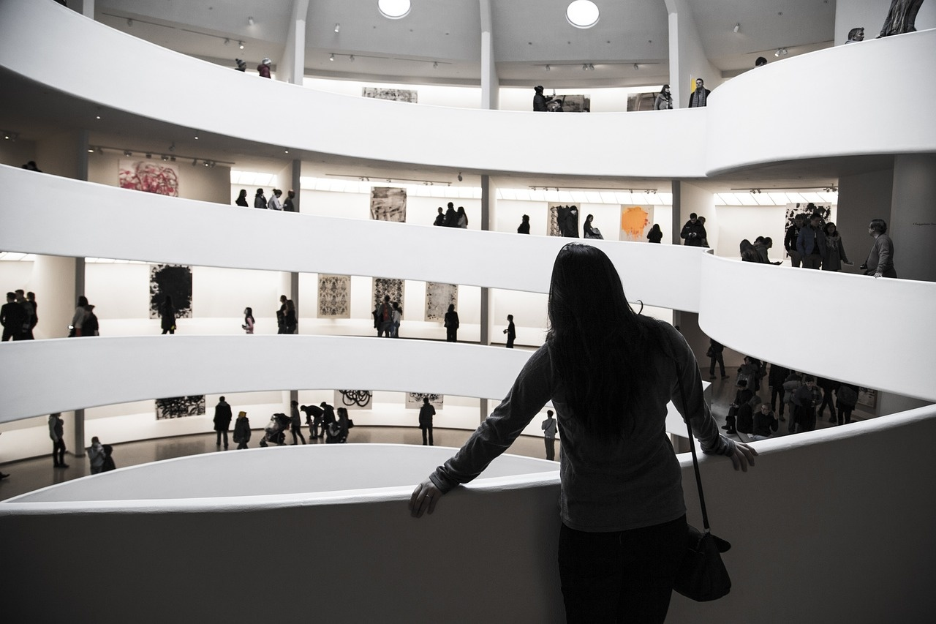
Comparative Context to European Modernism
Influence of Symbolism
Exploration of Existential Themes
Cheremshyna's work reflects the Symbolist movement in Europe.
Similar to European Modernists, Cheremshyna delves into existential questions.
Innovative Narrative Structures
Cultural Identity
Cheremshyna's use of stream of consciousness mirrors European Modernist techniques.
Both European Modernists and Cheremshyna explore cultural identity in their works.
Exploring the Legacy of Marko Cheremshyna

Slide 14

Key Literary Works Overview
Carpathian Echoes (1902)
Exploration of Hutsul folklore and traditions
Symbolic representation of nature's influence on human experiences
Whispers of the Past (1910)
Delving into themes of memory and nostalgia
Psychological depth in character portrayals
Shadows of the Soul (1915)
Examination of inner turmoil and existential crises
Symbolism of light and darkness in human nature
Echoes of the Mountains (1920)
Reflections on the impact of war on rural communities
Cultural preservation through storytelling
Exploring the Legacy of Marko Cheremshyna

Slide 15
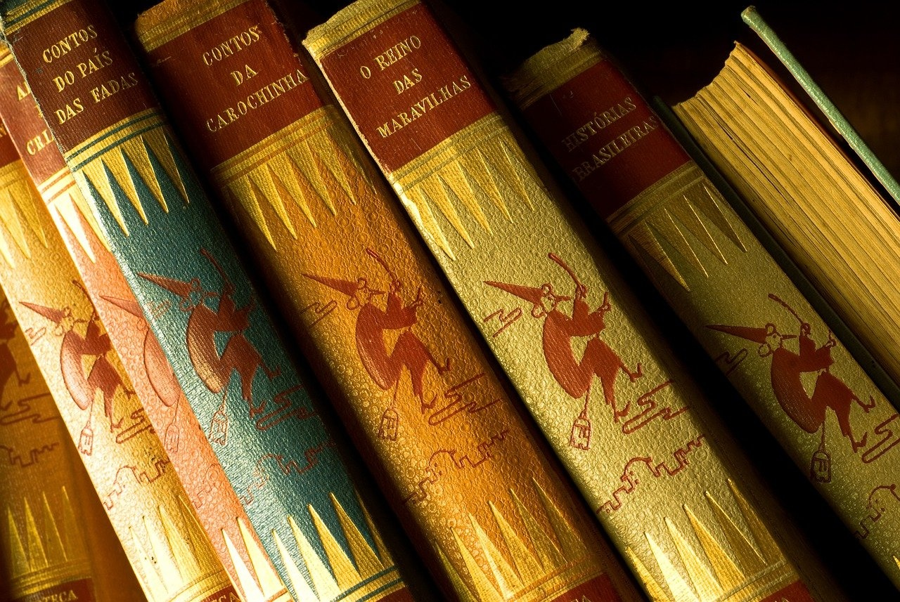
Legacy and Influence on Ukrainian Literature
Literary Innovations
Introduction of modernist narrative techniques.
Emphasis on psychological realism in storytelling.
Utilization of an impressionistic writing style.
Mastery of linguistic complexity in prose.
Linguistic Mastery
Preservation of the Hutsul dialect in literary works.
Development of a unique narrative voice.
Language as a tool for cultural resistance and preservation.
Symbolic representation through linguistic choices.
Thematic Explorations
Exploration of peasant life experiences in depth.
Representation of social struggles within Ukrainian society.
Contribution to the formation of national identity through literature.
Delving into psychological landscapes of characters and settings.
Narrative Techniques
Implementation of interior monologue to delve into character psyche.
Use of stream of consciousness for immersive storytelling.
Adoption of multi-perspective storytelling for diverse viewpoints.
Symbolic representations to convey deeper meanings in narratives.
Cultural Significance
Documenting marginalized experiences within Ukrainian culture.
Preserving cultural memory through literary works.
Providing social commentary on contemporary issues.
Contribution to literary resistance movements in Ukraine.
Exploring the Legacy of Marko Cheremshyna

Slide 16
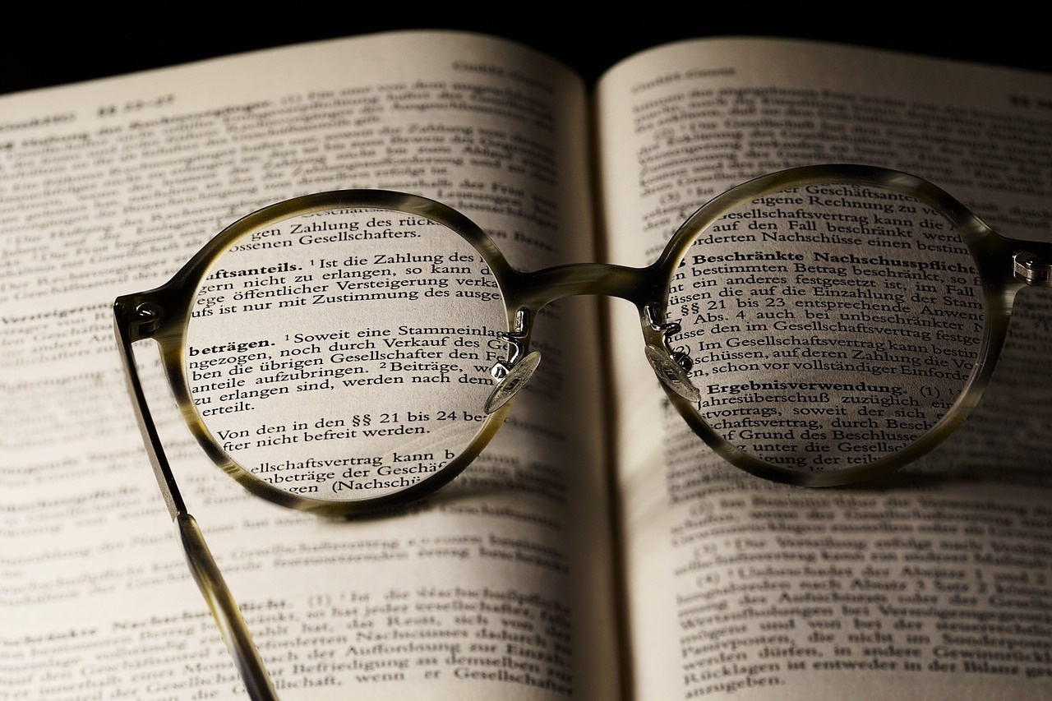
Critical Analysis of Marko Cheremshyna's Works
Psychological Depth
Social Critique
Exploration of characters' inner thoughts and emotions
Delving into complex human psyche
Uncovering subconscious motivations
Criticism of societal norms and structures
Reflection on class disparities and injustices
Challenging traditional values and beliefs
Linguistic Innovation
Cultural Representation
Experimentation with language and form
Pushing boundaries of literary expression
Creating new modes of communication
Portrayal of Ukrainian cultural identity
Preservation of folklore and traditions
Capturing essence of Hutsul heritage
Exploring the Legacy of Marko Cheremshyna

Slide 17

Interactive Learning: Discussion Questions and Research Opportunities
Discussion Questions
Research Opportunities
How did Marko Cheremshyna's use of modernist narrative techniques contribute to the evolution of Ukrainian literature?
In what ways did Cheremshyna's thematic explorations reflect the socio-political landscape of early 20th-century Ukraine?
Discuss the significance of linguistic mastery in Cheremshyna's works and its impact on preserving cultural identity.
Explore the influence of Austro-Hungarian Imperial control on Cheremshyna's literary innovations.
Investigate the role of linguistic complexity in conveying psychological realism in Cheremshyna's writing.
Analyze the thematic parallels between Cheremshyna's works and other European modernist literature.
Creative Interpretation Suggestions
Create a modernist-inspired short story or poem that pays homage to Cheremshyna's narrative techniques.
Design a visual representation of Cheremshyna's symbolic use of language in his works.
Develop a multimedia presentation showcasing the cultural significance of Cheremshyna's legacy in Ukrainian literature.
Exploring the Legacy of Marko Cheremshyna

Slide 18

Multimedia Resources for Further Exploration
Recommended Readings
Digital Archives
"Marko Cheremshyna: A Literary Journey" by Natalia Kovalenko
"Modernist Perspectives: Marko Cheremshyna and Ukrainian Literature" by Ivan Petrov
Explore digitized manuscripts and letters by Marko Cheremshyna on the National Library website
Access audio recordings of Cheremshyna's works on the Ukrainian Literature Archive
Research Platforms
Additional Learning Materials
Utilize the Ukrainian Literary Studies Database for in-depth analysis of Cheremshyna's works
Join academic forums on Ukrainian modernist literature for scholarly discussions
Watch documentaries on Ukrainian modernism featuring Marko Cheremshyna on educational platforms
Access online exhibitions showcasing Cheremshyna's impact on Ukrainian culture
Exploring the Legacy of Marko Cheremshyna

Slide 19

Conclusion and Significance of Cheremshyna's Work
Literary Legacy
Marko Cheremshyna's work stands as a testament to the power of literature in preserving cultural memory and documenting marginalized experiences.
Cultural Preservation
Through his linguistic mastery and thematic explorations, Cheremshyna contributed significantly to the preservation of Ukrainian cultural identity and heritage.
Social Commentary
His narrative techniques and thematic explorations provided insightful social commentary on peasant life experiences, social struggles, and national identity.
Innovative Storytelling
Cheremshyna's use of modernist narrative techniques and linguistic complexity paved the way for innovative storytelling in Ukrainian literature.
Global Influence
His unique perspective within European modernism and global literary movements showcases the universal relevance of his work and its impact on future generations of writers.
Exploring the Legacy of Marko Cheremshyna

Slide 20
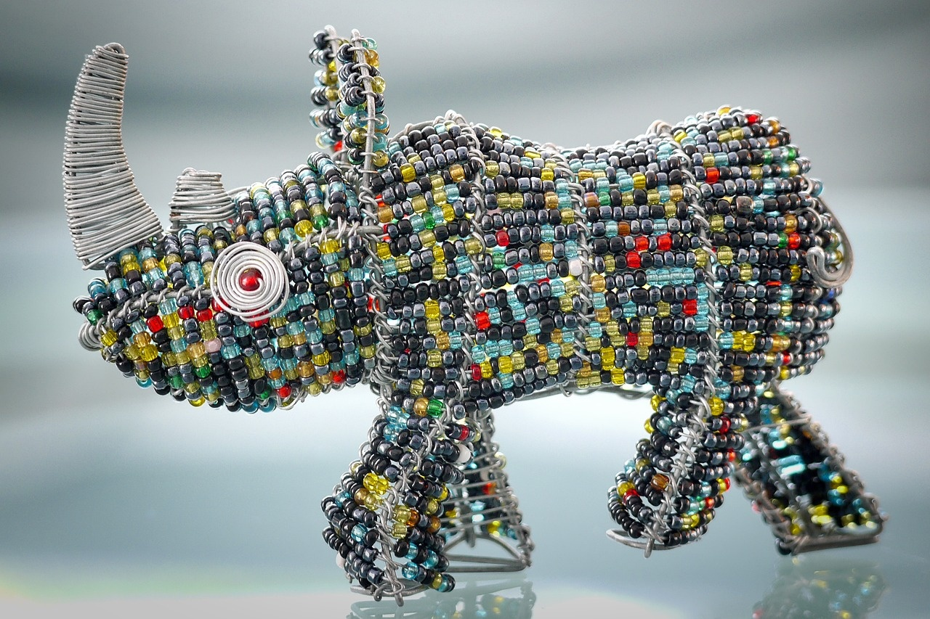
Color Palette and Design Recommendations
Color Palette Inspiration
Ukrainian traditional colors: Blue and Yellow
Incorporate shades of blue representing the sky and water, symbolizing freedom and unity
Use vibrant yellow hues symbolizing prosperity and hope
Hutsul Folk Art Elements
Integrate geometric patterns and motifs inspired by Hutsul embroidery
Include floral designs and symbols of nature for authenticity
Use intricate detailing to reflect the rich cultural heritage
Typography and Design
Opt for clean, modern typography for readability
Consider using traditional Ukrainian fonts for a cultural touch
Ensure contrast between text and background for clarity
Image Selection
Utilize high-quality historical photographs of Ukraine's landscapes
Include contemporary images of literary landmarks for relevance
Incorporate portraits of Marko Cheremshyna for personal connection
Infographics and Visuals
Create infographics to illustrate complex literary concepts
Use visual representations of linguistic innovations for clarity
Incorporate maps to showcase geographical influences
Exploring the Legacy of Marko Cheremshyna

Slide 21

Technical Specifications for PowerPoint Presentation
Slide Size
16:9 Widescreen
Font
Sans-serif for readability
Color Scheme
Blue, Yellow (Ukrainian flag colors)
Transition
Subtle, professional transitions
Animation
Minimal, purposeful animations
Exploring the Legacy of Marko Cheremshyna

Slide 22

Interactive Elements for Engaging Audience
Polling Questions
Engage the audience by asking thought-provoking questions related to Marko Cheremshyna's works and themes.
Live Q&A Session
Encourage audience participation by allowing them to ask questions in real-time and interact with the presenter.
Interactive Quizzes
Test the audience's knowledge about Marko Cheremshyna with fun and informative quizzes throughout the presentation.
Virtual Reality Experience
Transport the audience into the world of Marko Cheremshyna through a virtual reality experience showcasing key settings from his literary works.
Interactive Timeline
Display a timeline of Marko Cheremshyna's life and works, allowing the audience to explore and interact with different milestones.
Exploring the Legacy of Marko Cheremshyna

Slide 23
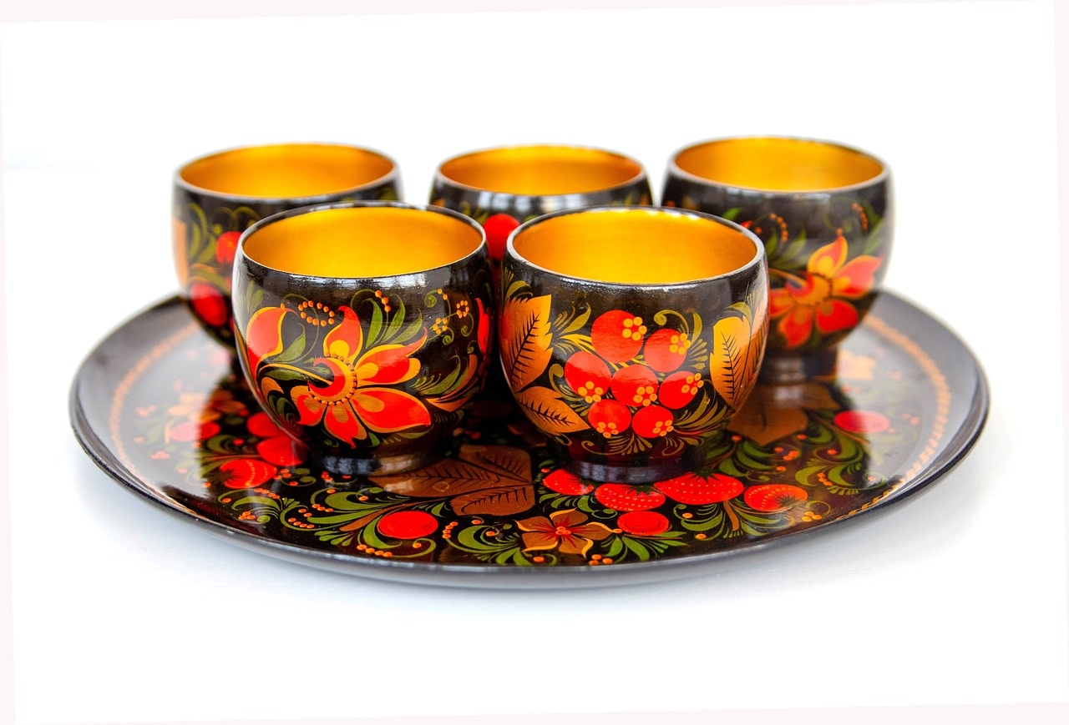
Incorporating Hutsul Folk Art Elements
Carpathian Motifs
Integrate intricate geometric patterns inspired by Carpathian mountain landscapes.
Wood Carvings
Include ornate wood carvings depicting traditional Hutsul symbols like the "tree of life."
Embroidery Designs
Incorporate vibrant floral motifs and intricate stitchwork characteristic of Hutsul embroidery.
Color Palette
Utilize earthy tones like deep greens, browns, and blues reminiscent of Hutsul craftsmanship.
Ceramic Art
Feature hand-painted ceramic pieces showcasing Hutsul folklore and mythology.
Exploring the Legacy of Marko Cheremshyna

Slide 24

High-Quality Historical and Contemporary Images
Rare photograph of Marko Cheremshyna
In his study, surrounded by books and manuscripts.
Illustration of a Carpathian village
Capturing the essence of the setting in Cheremshyna's works.
Painting of a Hutsul wedding ceremony
Showcasing the cultural richness of the region.
Vintage postcard of a traditional Hutsul house
Reflecting the architectural heritage of Western Ukraine.
Modern photograph of the Carpathian Mountains
A source of inspiration for Cheremshyna's vivid descriptions.
Exploring the Legacy of Marko Cheremshyna

Slide 25
Clean and Modern Typography
Clean and Modern Typography
Font Selection
Font Size
White Space
1
2
3
4
Utilizing sleek fonts and minimalist design for enhanced readability and visual appeal.
Opt for sans-serif fonts for a contemporary look and improved legibility on screen.
Maintain consistency in font sizes for hierarchy and emphasis within the presentation.
Incorporate ample white space around text elements for a clean and uncluttered layout.
Exploring the Legacy of Marko Cheremshyna

Slide 26

QR Codes for Additional Resources
Recommended Readings
Digital Archives
Explore Marko Cheremshyna's key works and critical analyses in "Marko Cheremshyna: A Literary Genius" by Dr. Natalia Kovalenko.
Access rare manuscripts, letters, and photographs of Cheremshyna on the National Library of Ukraine's online database.
Research Platforms
Additional Learning Materials
Utilize academic databases like JSTOR and Project MUSE for in-depth scholarly articles on Cheremshyna's literary contributions.
Engage with interactive timelines, audio recordings of Cheremshyna's works, and video lectures on Ukrainian modernist literature.
Exploring the Legacy of Marko Cheremshyna

Slide 27

Infographics for Complex Concepts
Visual Metaphors
Use symbols and icons to represent abstract ideas.
Comparison Charts
Highlight differences and similarities in a clear visual format.
Flowcharts
Illustrate processes and sequences step by step.
Mind Maps
Organize interconnected concepts visually for better understanding.
Statistical Graphs
Present data in graphs like bar charts, pie charts, and line graphs.
Exploring the Legacy of Marko Cheremshyna

