Slide 1


Mastering 'Going to' for Future Predictions and Intentions
A Comprehensive Guide to Using 'Going to' in Everyday English Communication

Slide 2
Table of Contents
Introduction to Going to for Predictions and I…
What is Going to?
Predictions with Going to
Intentions with Going to
Difference between Going to and Will
Common Errors
Practice Exercises
Real-Life Scenarios
Role-Play Activities
Group Discussions
Authentic Materials
Feedback and Correction
Conclusion
04
05
06
07
08
09
10
11
12
13
14
15
16

Slide 3
Table of Contents
Next Steps
Reflection Questions
Final Thoughts
17
18
19

Slide 4

Introduction to Going to for Predictions and Intentions
Welcome to the Lesson
Importance of the Topic
Learning Outcomes
Welcome to our lesson on "Understanding and Using 'Going to' for Predictions and Intentions in Everyday Life"!
This topic is essential for effective communication in everyday life, enabling learners to discuss future plans, make decisions, and engage in conversations about upcoming events.
By the end of this lesson, learners will be able to understand the difference between "going to" and "will" for future actions, use "going to" correctly in sentences, and apply it in real-life scenarios.
4
Mastering 'Going to' for Future Predictions and Intentions

Slide 5
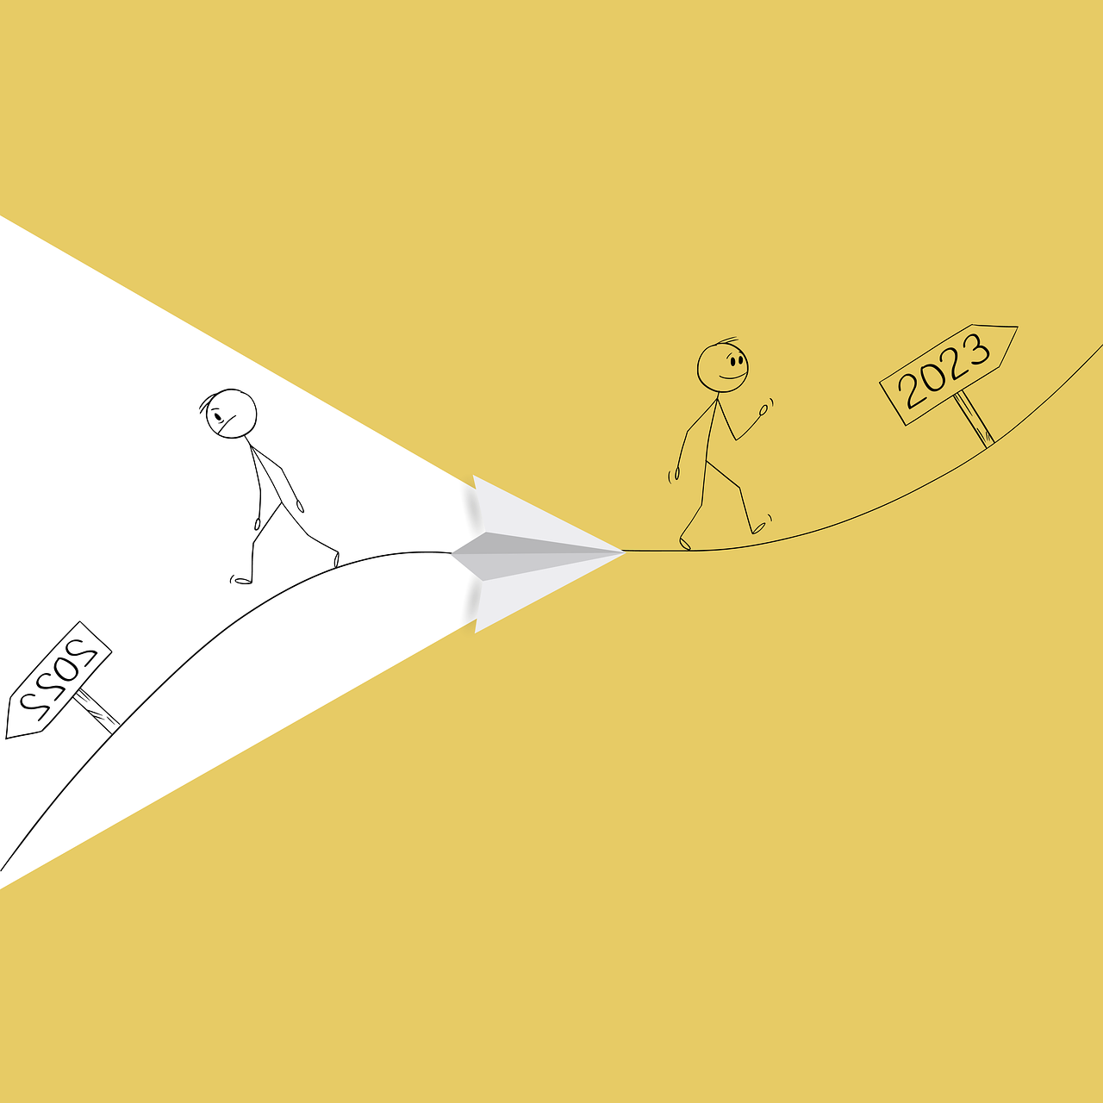
What is Going to?
Definition of 'Going to'
Formation of 'Going to'
Examples of 'Going to'
'Going to' is used to talk about future plans and predictions.
It is formed with the present continuous tense of the verb 'go' (am, is, are) + going + to + the base form of the main verb.
For example, 'I am going to study tonight' or 'It is going to rain.'
5
Mastering 'Going to' for Future Predictions and Intentions

Slide 6

Predictions with Going to
Purpose of 'Going to'
'Going to' is used to make predictions about the future based on evidence we have now.
Examples of Usage
For instance, 'Look at those clouds, it's going to rain' or 'I've been feeling unwell, I'm going to see a doctor.'
Comparison with 'Will'
This usage is distinct from 'will,' which can be used for both predictions and spontaneous decisions.
6
Mastering 'Going to' for Future Predictions and Intentions

Slide 7
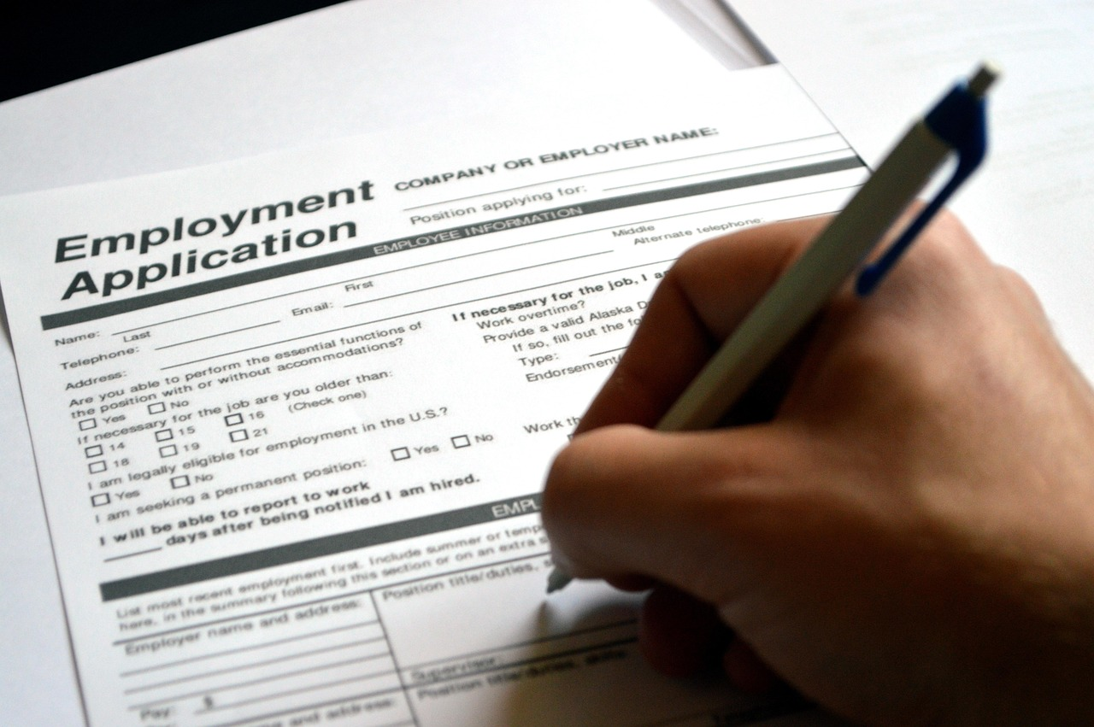
Intentions with Going to
Using 'Going to' for Future Intentions
When expressing intentions or plans for the future, 'going to' is used to indicate what someone has already decided to do.
Examples of 'Going to' in Action
For example, 'I'm going to apply for a job next week' or 'We're going to travel to Europe next summer.'
Significance of 'Going to' in Future Planning
This highlights the importance of 'going to' in discussing future plans and decisions.
7
Mastering 'Going to' for Future Predictions and Intentions

Slide 8
Difference between Going to and Will
Key Difference
Usage of "Going to"
Usage of "Will"
While both "going to" and "will" can be used to talk about the future, there is a key difference.
"Going to" is used for planned actions or predictions based on evidence.
"Will" can be used for both planned actions and spontaneous decisions.
For example, "I'm going to the store" (planned action) versus "I'll get some milk" (spontaneous decision).
8
Mastering 'Going to' for Future Predictions and Intentions

Slide 9
Common Errors
Confusion Between 'Going to' and 'Will'
Incorrect Usage for Spontaneous Decisions
Awareness for Correct Usage
One common error is confusing 'going to' with 'will.'
Another error is using 'going to' for spontaneous decisions instead of 'will.'
Learners should be aware of these common errors to use 'going to' correctly.
9
Mastering 'Going to' for Future Predictions and Intentions

Slide 10

Practice Exercises
Sentence Completion Exercise
Using 'Going To' for Intentions
Practice Instructions
Complete the sentence: "By next year, I ____________________ my degree."
Answer: am going to finish
Practice using "going to" in sentences to express intentions.
Make predictions about future events.
Engage in exercises to strengthen your understanding of 'going to'.
Focus on expressing future intentions and predictions.
10
Mastering 'Going to' for Future Predictions and Intentions

Slide 11

Real-Life Scenarios
Using 'Going to' for Making Plans
Discussing Future Events with 'Going to'
Practicing 'Going to' for Communication Skills
"Going to" can be used in various real-life scenarios, such as making plans.
For example, "We're going to meet at 5 pm."
"Going to" is helpful when discussing future events.
For example, "I'm going to apply for a job next month."
Learners should practice using "going to" in these scenarios.
This helps develop their communication skills.
11
Mastering 'Going to' for Future Predictions and Intentions

Slide 12

Role-Play Activities
Practicing Contextual Usage
Examples of Role-Play Scenarios
Building Communication Skills
Role-play activities can help learners practice using "going to" in different contexts.
For example, making plans for a weekend getaway or discussing future career plans.
Learners should engage in these activities to develop their communication skills and build confidence in using "going to" correctly.
12
Mastering 'Going to' for Future Predictions and Intentions

Slide 13

Group Discussions
Encouraging Practice Through Group Discussions
Group discussions can encourage learners to practice using "going to" in conversations.
Using Prompts and Scenarios
Provide prompts or scenarios, such as discussing future plans or predicting upcoming events.
Developing Critical Thinking and Communication
Learners should engage in these discussions to develop their critical thinking and communication skills.
13
Mastering 'Going to' for Future Predictions and Intentions

Slide 14

Authentic Materials
Introduction to Authentic Materials
Authentic materials, such as news articles or social media posts, can provide learners with real-life examples of 'going to' in use.
Example of 'Going to' in Context
For example, 'The company is going to launch a new product next year.'
Analyzing Practical Applications
Learners should analyze these materials to understand the practical application of 'going to' in different contexts.
14
Mastering 'Going to' for Future Predictions and Intentions

Slide 15
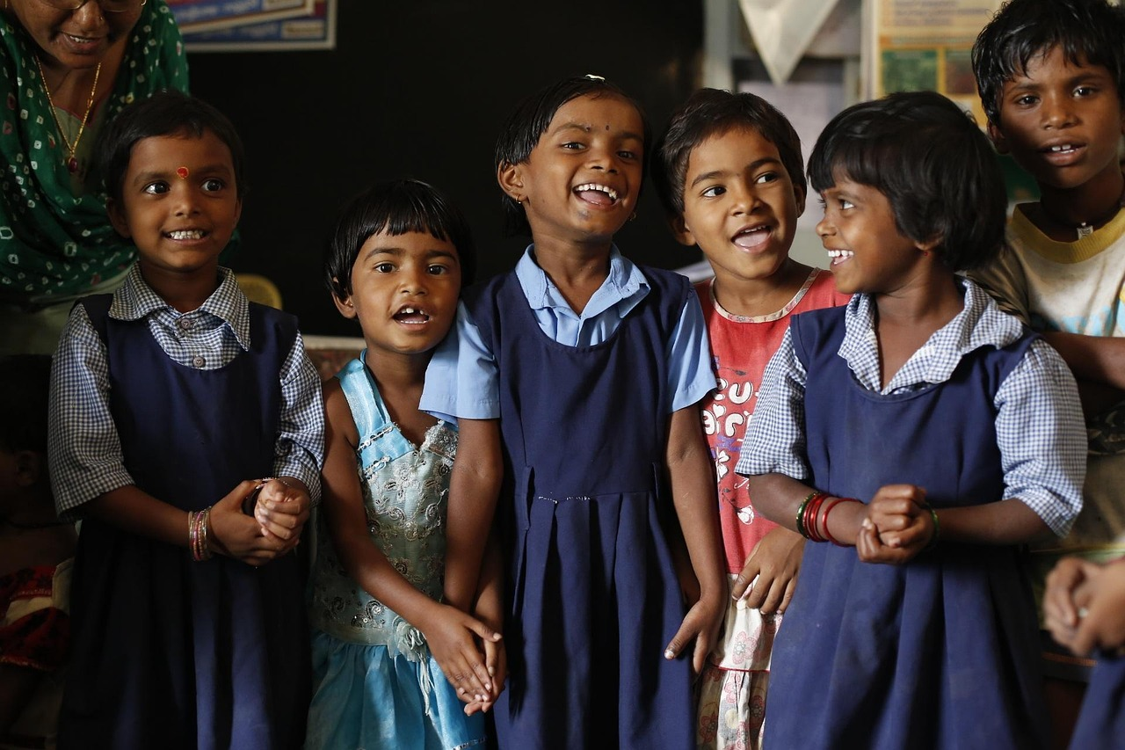
Feedback and Correction
Feedback on 'Going to' Usage
Encouraging Self and Peer Feedback
Guidance for Improvement
Provide learners with feedback and correction on their use of 'going to' during activities and discussions.
Encourage self-correction and peer feedback.
Offer guidance on how to improve their usage of 'going to' in different contexts.
15
Mastering 'Going to' for Future Predictions and Intentions

Slide 16

Conclusion
Valuable Skill for Communication
Practice for Proficiency
Consistency is Key
Mastering the use of 'going to' for predictions and intentions is a valuable skill for effective communication in everyday life.
Learners should continue to practice and reinforce their understanding of 'going to' to become more proficient in expressing their future plans and intentions.
Remember, the key to mastering 'going to' is consistent practice and application in real-life situations.
16
Mastering 'Going to' for Future Predictions and Intentions

Slide 17

Next Steps
Progress to Advanced Topics
Building on the Foundation
Practice in Real-Life Scenarios
Following this lesson, learners can progress to more advanced topics, such as "Talking About Future Plans and Dreams" or "Describing Future Events and Schedules."
These lessons will build on the foundation established in this lesson, introducing more complex language structures and encouraging learners to express their long-term goals and ambitions.
Learners should continue to practice and apply their knowledge of "going to" in real-life scenarios to reinforce their understanding.
17
Mastering 'Going to' for Future Predictions and Intentions

Slide 18

Reflection Questions
Effective Strategies for Learner Engagement
What strategies were most effective in engaging learners and promoting their understanding of 'going to' for predictions and intentions?
Opportunities for Authentic Practice
How can we provide more opportunities for learners to practice using 'going to' in authentic contexts?
Adapting Lesson Plans for Diverse Learners
What adjustments can be made to the lesson plan to better support learners with varying levels of English proficiency and learning styles?
18
Mastering 'Going to' for Future Predictions and Intentions

Slide 19
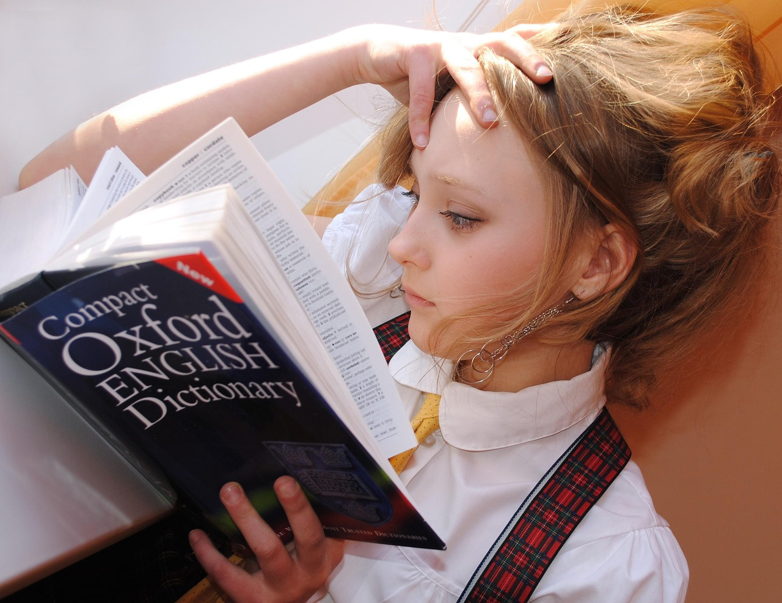
Final Thoughts
Importance of 'Going to' in English
Understanding and using 'going to' for predictions and intentions is a fundamental skill in English language learning.
Practice for Proficiency
Learners should continue to practice and reinforce their understanding of 'going to' to become more proficient in expressing their future plans and intentions.
Consistency is Key
Remember, the key to mastering 'going to' is consistent practice and application in real-life situations.
19
Mastering 'Going to' for Future Predictions and Intentions

