Slide 1
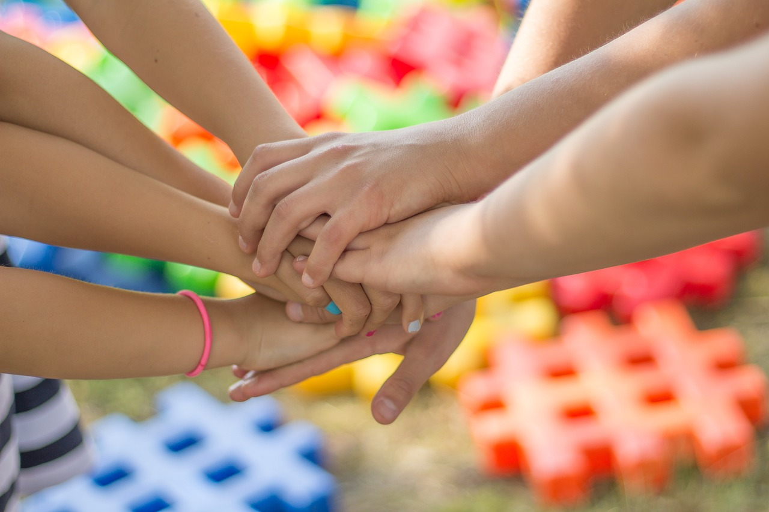
Understanding and Preventing Bullying: The Role of Bystanders and Empathy
Creating Supportive and Inclusive School Environments through Awareness and Action

Slide 2
Table of Contents
Introduction to Bullying and Bystander Interve…
What is Bullying?
The Impact of Bullying
The Role of Bystanders
Empathy and Understanding
Bystander Intervention Strategies
Creating a Positive School Culture
Upstanders vs. Bystanders
Why is Empathy Important?
How to Develop Empathy
Role-Playing Activity: Bystander Intervention
Group Discussion: Creating a Positive School C…
Conclusion
04
05
06
07
08
09
10
11
12
13
14
15
16

Slide 3
Table of Contents
Call to Action
Additional Resources
Assessment and Evaluation
Extension Activity: Bullying Prevention Campai…
Extension Activity: Role-Playing Scenarios
Conclusion and Final Thoughts
17
18
19
20
21
22

Slide 4
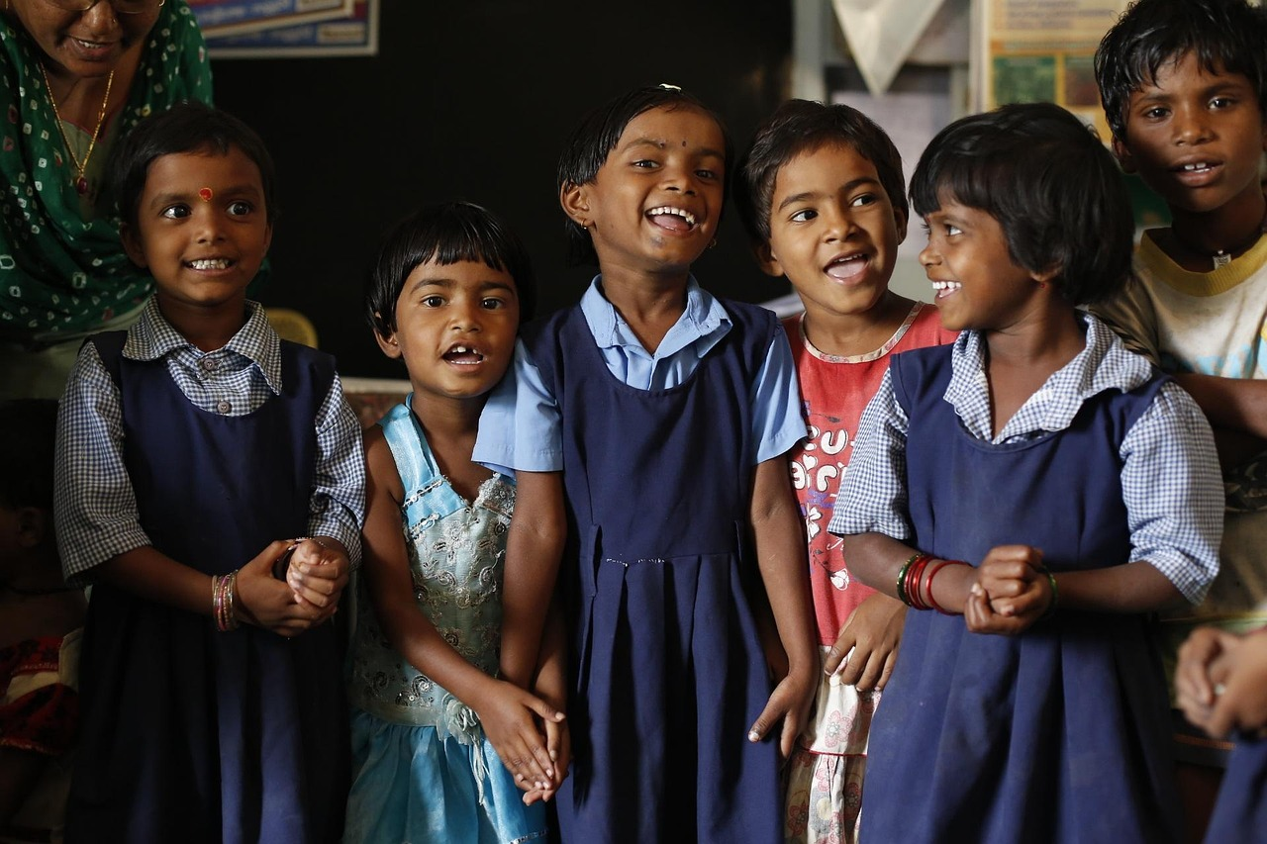
Introduction to Bullying and Bystander Intervention
Understanding Bullying
Role of Bystanders
Importance of Empathy
Bullying is a form of aggressive behavior that involves the intentional and repeated harm or intimidation of an individual or group.
It can have long-lasting effects on the mental and emotional well-being of those targeted.
Bystanders play a crucial role in preventing bullying, and their actions can have a significant impact on the well-being of others.
Their intervention can either stop the bullying or unintentionally encourage it, depending on their response.
Empathy is essential for creating a supportive environment where everyone feels valued and respected.
It fosters understanding and helps in building connections that discourage bullying behaviors.
4
Understanding and Preventing Bullying: The Role of Bystanders and Empathy

Slide 5
What is Bullying?
Forms of Bullying
Physical Bullying
Verbal and Social Bullying
Cyberbullying
Bullying can take many forms, including physical, verbal, social, and cyberbullying.
Each form has unique characteristics and impacts on individuals.
Physical bullying involves physical contact or violence.
This can include hitting, pushing, or other aggressive actions.
Verbal bullying involves name-calling, teasing, or threats.
Social bullying involves excluding or isolating an individual.
Cyberbullying involves using technology to harass or intimidate.
This can occur through social media, messaging apps, or other online platforms.
5
Understanding and Preventing Bullying: The Role of Bystanders and Empathy

Slide 6
The Impact of Bullying
Emotional Consequences
Social Impact
Academic Challenges
Victims of bullying may experience anxiety, depression, and decreased academic performance.
Bystanders who witness bullying may feel guilty, helpless, or fearful.
Bullying can have serious emotional, social, and academic consequences for individuals and the school community.
The school community may experience a negative and hostile environment.
Victims of bullying may experience decreased academic performance.
The school community may face challenges in maintaining a positive learning environment.
6
Understanding and Preventing Bullying: The Role of Bystanders and Empathy

Slide 7
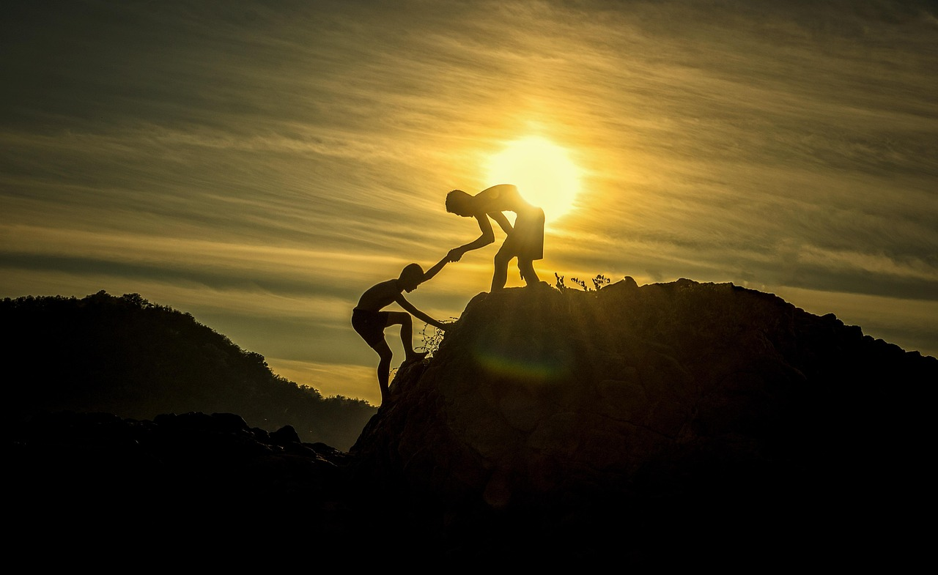
The Role of Bystanders
Bystanders' Positive Impact
The Risk of Negative Influence
Creating a Supportive Environment
Bystanders can play a crucial role in preventing bullying by intervening, reporting incidents, and supporting victims.
They can help to de-escalate situations, provide emotional support, and create a positive and inclusive environment.
Bystanders can also contribute to the problem by joining in or encouraging the behavior.
This can escalate the bullying and make it harder for victims to seek help.
By taking action, bystanders can foster a culture of respect and safety.
Their involvement can significantly reduce the prevalence of bullying in schools and communities.
7
Understanding and Preventing Bullying: The Role of Bystanders and Empathy

Slide 8
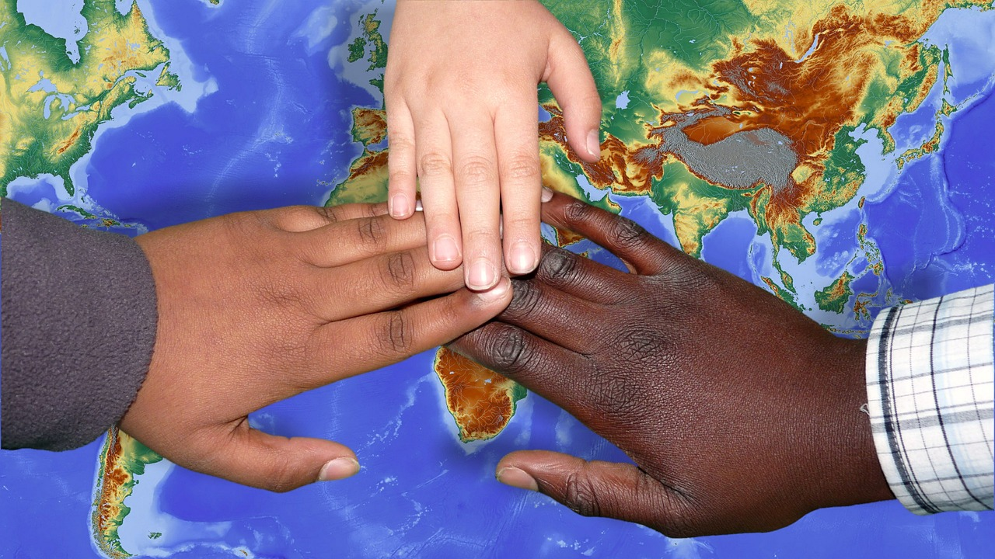
Empathy and Understanding
Empathy's Role in Relationships
Empathy's Role in Relationships
Empathy and Bullying Awareness
Empathy is essential for building strong, positive relationships with peers.
It fosters mutual respect and understanding in social interactions.
Empathy is essential for building strong, positive relationships with peers.
It fosters mutual respect and understanding in social interactions.
By developing empathy, students can better understand the experiences and perspectives of others.
This includes recognizing and supporting those who may be victims of bullying.
8
Understanding and Preventing Bullying: The Role of Bystanders and Empathy

Slide 9
Bystander Intervention Strategies
01
Direct Intervention
Direct intervention involves confronting the bully and standing up for the victim.
This approach requires courage and immediate action to address the situation.
02
Indirect Intervention
Indirect intervention involves supporting the victim and reporting the incident to authorities.
This method allows bystanders to help without direct confrontation.
03
Seeking Help from Authorities
Seeking help from authorities involves reporting the incident to a teacher, counselor, or other school official.
This ensures that the situation is handled by responsible adults.
04
Using Technology for Reporting
Bystanders can also use technology to report incidents or seek help.
This modern approach provides a discreet and efficient way to address bullying.
9
Understanding and Preventing Bullying: The Role of Bystanders and Empathy

Slide 10

Creating a Positive School Culture
1
The Essence of a Positive School Culture
A positive school culture promotes kindness, respect, and inclusivity.
Students can create a positive school culture by being kind, respectful, and inclusive.
2
Role of Educators in Shaping Culture
Teachers and administrators can create a positive school culture by establishing clear policies and procedures.
Providing support and resources, and promoting empathy and understanding are key actions for educators.
3
Collaborative Efforts for Inclusivity
Both students and educators play a vital role in fostering a positive school environment.
Their combined efforts ensure a culture of kindness, respect, and inclusivity.
10
Understanding and Preventing Bullying: The Role of Bystanders and Empathy

Slide 11

Upstanders vs. Bystanders
Role of Upstanders
Role of Bystanders
Upstanders take a stand against bullying and support those who are being targeted.
They actively intervene to make a positive difference in bullying situations.
Bystanders may witness bullying but do not take action to stop it.
Their inaction can unintentionally empower the bully and prolong the situation.
11
Understanding and Preventing Bullying: The Role of Bystanders and Empathy

Slide 12

Why is Empathy Important?
1
Creating a Supportive Environment
Empathy helps to create a supportive environment where everyone feels valued and respected.
This fosters a sense of belonging and mutual understanding.
2
Preventing Bullying
Empathy helps to prevent bullying by encouraging students to consider the feelings and perspectives of others.
This awareness can lead to more compassionate interactions.
3
Building Positive Relationships
Empathy helps to build strong, positive relationships with peers.
It strengthens connections and promotes collaboration.
12
Understanding and Preventing Bullying: The Role of Bystanders and Empathy

Slide 13

How to Develop Empathy
Understanding Perspectives
Active Listening Skills
Empathy in Action
Listen to others and try to understand their perspectives.
Put yourself in someone else's shoes and imagine how they might feel.
Practice active listening and ask open-ended questions.
Encourage others to share their thoughts and feelings.
Put yourself in someone else's shoes to imagine their emotions.
Listen attentively to grasp different perspectives.
13
Understanding and Preventing Bullying: The Role of Bystanders and Empathy

Slide 14

Role-Playing Activity: Bystander Intervention
Group Activity Setup
Purpose of Role-Playing
Divide students into small groups and assign each group a scenario involving bullying.
Each group will role-play the scenario to practice bystander intervention strategies.
The activity aims to help students understand and apply bystander intervention strategies.
Through role-playing, students can explore effective ways to address bullying situations.
14
Understanding and Preventing Bullying: The Role of Bystanders and Empathy

Slide 15
Group Discussion: Creating a Positive School Culture
Discussion Questions
Encouraging Participation
Ask students to discuss the following questions: What are some ways to create a positive school culture?
How can we promote kindness, respect, and inclusivity in our school community?
Encourage students to share their thoughts and ideas.
Provide feedback and guidance during the discussion.
15
Understanding and Preventing Bullying: The Role of Bystanders and Empathy

Slide 16
Conclusion
Role of Bystanders in Bullying Prevention
Importance of Empathy in Supportive Environments
Bullying is a serious issue that affects many students.
Bystanders play a crucial role in preventing it.
Empathy is essential for creating a supportive environment.
It ensures everyone feels valued and respected.
16
Understanding and Preventing Bullying: The Role of Bystanders and Empathy

Slide 17

Call to Action
Taking Action Against Bullying
Promoting Positive School Culture
Encourage students to take action against bullying and promote a positive school culture.
Provide resources and support for students who may be experiencing bullying or who want to get involved in bullying prevention efforts.
Encourage students to take action against bullying and promote a positive school culture.
Provide resources and support for students who may be experiencing bullying or who want to get involved in bullying prevention efforts.
17
Understanding and Preventing Bullying: The Role of Bystanders and Empathy

Slide 18
Additional Resources
1
2
3
Explore Additional Resources
Share Personal Perspectives
Engage in Prevention Efforts
Provide students with additional resources, such as books, articles, or websites, to learn more about bullying and bystander intervention.
These resources can help deepen their understanding and equip them with practical tools to address these issues.
Encourage students to share their own experiences and perspectives on bullying and bystander intervention.
This exchange of ideas can foster empathy and create a supportive environment for open dialogue.
Provide students with opportunities to get involved in bullying prevention efforts, such as joining a club or organization or participating in a community service project.
Active participation can empower students to make a tangible difference in their communities.
18
Understanding and Preventing Bullying: The Role of Bystanders and Empathy

Slide 19
Assessment and Evaluation
01
02
Student Understanding Assessment
Lesson Effectiveness Evaluation
Assess student understanding of the material through quizzes, class discussions, and written assignments.
Evaluate the effectiveness of the lesson in promoting empathy and understanding and reducing bullying behavior.
Assess student understanding of the material through quizzes, class discussions, and written assignments.
Evaluate the effectiveness of the lesson in promoting empathy and understanding and reducing bullying behavior.
19
Understanding and Preventing Bullying: The Role of Bystanders and Empathy

Slide 20
Extension Activity: Bullying Prevention Campaign
01
Designing a Bullying Prevention Campaign
Ask students to design a bullying prevention campaign that includes a slogan, poster, and social media post.
Encourage creativity and originality in their campaign designs.
02
Sharing and Feedback
Encourage students to share their campaigns with the class.
Provide constructive feedback and guidance to improve their ideas.
20
Understanding and Preventing Bullying: The Role of Bystanders and Empathy

Slide 21
Extension Activity: Role-Playing Scenarios
01
02
Role-Playing Scenarios
Group Activity Instructions
Provide students with a series of role-playing scenarios that illustrate different types of bullying.
Ask students to work in groups to act out the scenarios and practice bystander intervention strategies.
Students will collaborate in groups to enact the given scenarios.
The activity focuses on developing effective bystander intervention strategies.
21
Understanding and Preventing Bullying: The Role of Bystanders and Empathy

Slide 22
Conclusion and Final Thoughts
Key Points and Reflections
Promoting Positive School Culture
Summarize the key points of the lesson and provide final thoughts and reflections.
Encourage students to continue to think critically about bullying and bystander intervention.
Encourage students to take action to promote a positive school culture.
Reflect on the importance of fostering an environment that discourages bullying.
22
Understanding and Preventing Bullying: The Role of Bystanders and Empathy

