Slide 1


Understanding Town and Country Locations
Exploring Geographic Concepts, Map Skills, and Cultural Significance for Beginner EALD Learners

Slide 2
Table of Contents
Introduction to Town and Country Locations
What are Town and Country Locations?
Map Skills
Vocabulary Building
Geographic Features
Cultural Significance
Urban and Rural Areas
Map Skills Activity
Listening and Speaking Activity
Writing Activity
Independent Practice
Assessment and Evaluation
Conclusion
04
05
06
07
08
09
10
11
12
13
14
15
16

Slide 3
Table of Contents
Extension Activities
Parent Engagement
Safety Considerations
Reflection Questions
Next Steps
17
18
19
20
21

Slide 4

Introduction to Town and Country Locations
Introduction to Town and Country
Lesson Objectives
Geographic Concepts
Introduction to the topic of town and country locations for beginner EALD learners.
Importance of understanding geographic concepts and vocabulary.
Overview of the lesson objectives and outcomes.
Focus on building foundational knowledge for learners.
Understanding the significance of geographic concepts.
Learning key vocabulary related to town and country locations.
4
Understanding Town and Country Locations

Slide 5

What are Town and Country Locations?
Definition of Town and Country Locations
Examples of Urban and Rural Areas
Town and country locations refer to urban and rural areas, respectively.
These terms help distinguish between densely populated areas and those with sparse populations.
Urban areas include cities and towns with significant infrastructure.
Rural areas are characterized by open spaces, farms, and small villages.
Key Features of Town and Country Locations
Importance of Understanding Town and Country Differences
Town locations often have buildings, roads, and commercial centers.
Country locations are marked by natural landmarks, such as forests and rivers.
Recognizing the differences aids in planning and development.
It also helps in appreciating the unique characteristics of each location.
5
Understanding Town and Country Locations

Slide 6

Map Skills
Introduction to Map Skills
Basic Map Features
Introduction to map skills and vocabulary.
Understanding map symbols, scales, and legends.
Identifying basic features on a simple map, such as roads, buildings, and natural landmarks.
Understanding how these features are represented visually.
Navigating Locations
Practical Applications of Map Skills
Importance of map skills in navigating town and country locations.
Using maps effectively to plan routes and explore areas.
Map skills are essential for both personal and professional use.
They help in interpreting geographical data and making informed decisions.
6
Understanding Town and Country Locations

Slide 7

Vocabulary Building
Key Vocabulary for Town and Country
Contextual Vocabulary Practice
Flashcards and Visual Aids
Introduction to key vocabulary related to town and country locations, such as 'urban,' 'rural,' 'city,' and 'village'.
Using flashcards and pictures to facilitate vocabulary building.
Practicing vocabulary in context through sentences and conversations.
Importance of vocabulary building in communicating geographic concepts.
Using flashcards and pictures to facilitate vocabulary building.
Practicing vocabulary in context through sentences and conversations.
Geographic Communication
Examples of Vocabulary in Use
Importance of vocabulary building in communicating geographic concepts.
Examples of vocabulary in use, such as 'The city is a busy urban area with many buildings and roads.'
Examples of vocabulary in use, such as 'The city is a busy urban area with many buildings and roads.'
Introduction to key vocabulary related to town and country locations, such as 'urban,' 'rural,' 'city,' and 'village'.
7
Understanding Town and Country Locations

Slide 8
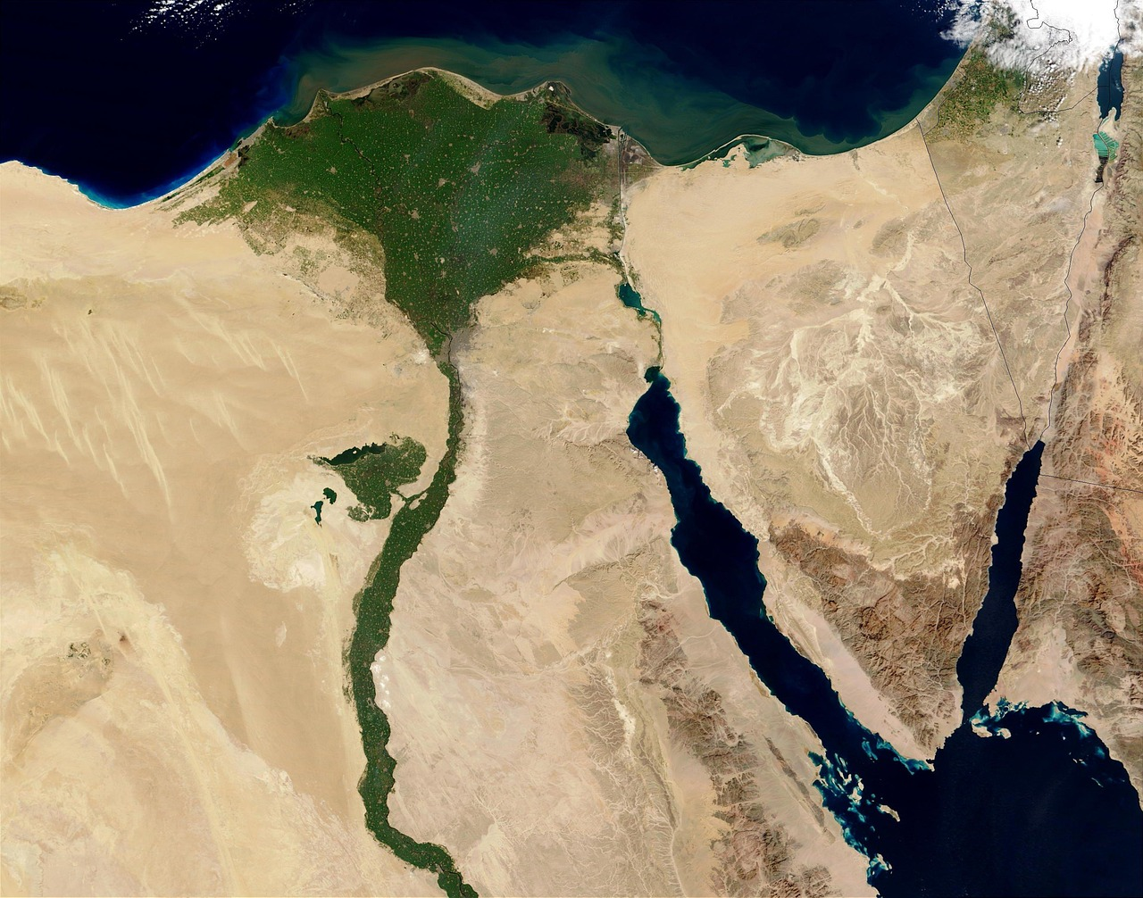
Geographic Features
Types of Geographic Features
Mapping Geographic Features
Introduction to different types of geographic features, such as mountains, rivers, and coastlines.
Understanding the impact of geographic features on town and country locations.
Identifying and describing geographic features on a map.
Importance of geographic features in shaping the character and economy of a town or country location.
Impact on Locations
Introduction to Geographic Features
Understanding the impact of geographic features on town and country locations.
Importance of geographic features in shaping the character and economy of a town or country location.
Introduction to different types of geographic features, such as mountains, rivers, and coastlines.
Identifying and describing geographic features on a map.
8
Understanding Town and Country Locations

Slide 9

Cultural Significance
Cultural Significance of Locations
Unique Cultural Identity
Introduction to the cultural significance of town and country locations.
Understanding the impact of human activities on the environment and cultural heritage.
Appreciating the unique cultural identity of different town and country locations.
Exploring how these identities shape the experiences of residents and visitors.
Human Activities and Heritage
Cultural Awareness
Understanding the impact of human activities on the environment and cultural heritage.
Recognizing the need for sustainable practices to preserve these aspects.
Importance of cultural awareness in navigating town and country locations.
Fostering respect and appreciation for diverse cultural expressions.
9
Understanding Town and Country Locations

Slide 10

Urban and Rural Areas
Characteristics of Urban Areas
Characteristics of Rural Areas
Comparing Urban and Rural Areas
Urban areas are characterized by high population density.
They also feature diverse economies with various industries and services.
Rural areas typically have low population density.
Economic activities in these areas are often limited and focused on agriculture or resource-based industries.
Urban and rural areas differ significantly in terms of population density and economic opportunities.
While urban areas are bustling and diverse, rural areas are quieter and more specialized.
Understanding Urban and Rural Differences
Examples of Urban and Rural Areas
Recognizing the differences between urban and rural areas is crucial for effective planning and development.
This understanding helps address the unique needs and challenges of each area.
Cities like New York and Tokyo are examples of urban areas.
Countryside regions, such as the American Midwest, represent rural areas.
10
Understanding Town and Country Locations

Slide 11

Map Skills Activity
Understanding Map Features
Navigating Locations with Maps
Real-Life Applications of Map Skills
Identifying basic features on a simple map, such as roads, buildings, and natural landmarks.
These features are essential for interpreting and utilizing maps effectively.
Using map skills to navigate a town or country location.
This activity helps in developing practical navigation abilities.
Importance of map skills in real-life scenarios.
These skills are crucial for tasks like travel planning and emergency preparedness.
11
Understanding Town and Country Locations

Slide 12

Listening and Speaking Activity
Listening to Descriptions
Describing Locations
Skills in Communication
Listening to a short audio description of a town or country location.
This activity helps in understanding geographic concepts through auditory learning.
Describing a town or country location to a partner using vocabulary learned earlier.
This encourages the use of learned terms in practical communication.
Importance of listening and speaking skills in communicating geographic concepts.
These skills are essential for effective exchange of ideas about locations.
12
Understanding Town and Country Locations

Slide 13

Writing Activity
Describing a Location
Writing a short paragraph describing a town or country location of choice.
Using vocabulary and sentence structures learned earlier.
Enhancing Communication
Importance of writing skills in communicating geographic concepts.
Writing helps convey ideas about places effectively.
Skill Development
Writing activities improve understanding of geographic vocabulary.
They also strengthen sentence construction abilities.
13
Understanding Town and Country Locations

Slide 14

Independent Practice
01
Labeling Diagrams
Labeling a simple diagram of a town or country location using vocabulary learned earlier.
This activity helps students connect visual elements with learned terms.
02
Creating Maps
Creating a simple map of a town or country location.
This task encourages creativity and spatial understanding.
03
Descriptive Writing
Writing a short paragraph describing a town or country location of choice.
This exercise enhances descriptive language skills and personal expression.
04
Reinforcing Learning
Importance of independent practice in reinforcing learning.
Independent tasks solidify knowledge and build confidence.
14
Understanding Town and Country Locations

Slide 15

Assessment and Evaluation
01
Understanding Vocabulary and Map Skills
Assessing student understanding of vocabulary and map skills.
This helps in identifying areas where students need improvement.
02
Describing and Navigating Locations
Evaluating student ability to describe and navigate town and country locations.
This ensures students can apply their knowledge in real-world scenarios.
03
Significance of Assessment and Evaluation
Importance of assessment and evaluation in measuring student progress.
It provides insights into the effectiveness of teaching methods.
04
Methods of Assessment and Evaluation
Examples of assessment and evaluation methods, such as quizzes and class discussions.
These methods encourage active participation and gauge understanding.
15
Understanding Town and Country Locations

Slide 16
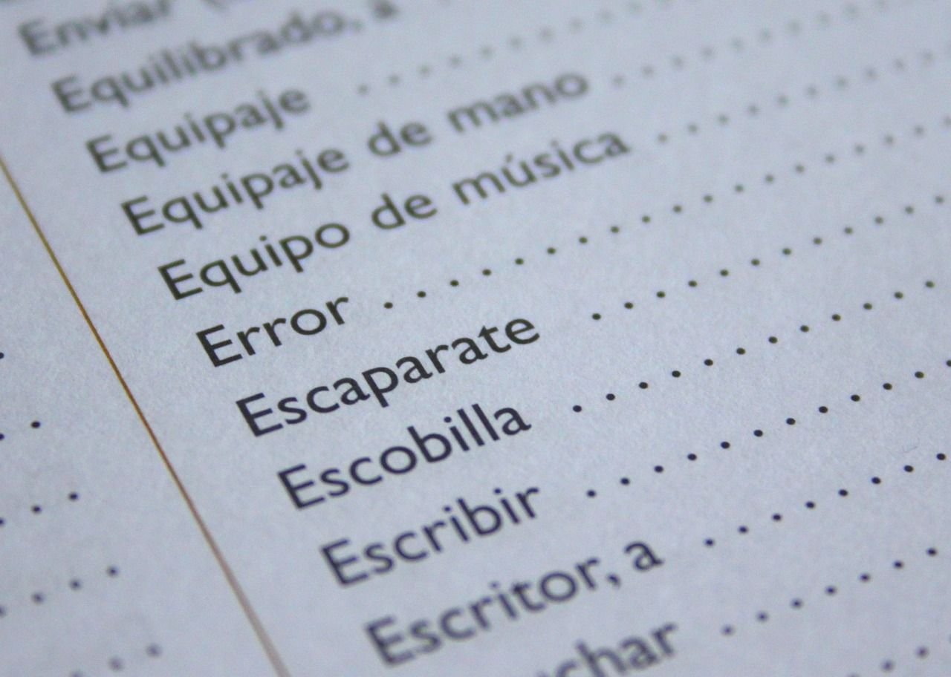
Conclusion
Key Concepts and Vocabulary
Daily Life Applications
Future Exploration
Summary of key concepts and vocabulary learned.
Understanding these terms enhances comprehension of town and country dynamics.
Importance of understanding town and country locations in daily life.
This knowledge aids in making informed decisions and navigating environments effectively.
Future lessons and topics to explore.
These will build upon the foundational knowledge of town and country locations.
16
Understanding Town and Country Locations

Slide 17

Extension Activities
Research and Presentation
Researching a town or country location and creating a multimedia presentation.
This activity encourages exploration and the use of technology to share findings.
Sustainable Design
Designing a sustainable town or country location.
This fosters creativity and awareness of environmental considerations.
3D Modeling
Creating a 3D model of a town or country location.
This hands-on activity enhances spatial understanding and design skills.
Deeper Learning
Importance of extension activities in promoting deeper learning and application.
These activities help students connect theoretical knowledge to real-world scenarios.
17
Understanding Town and Country Locations

Slide 18

Parent Engagement
Promoting Parent Involvement
Strategies for promoting parent involvement and support.
Importance of parent-teacher communication and homework support.
Parent-Teacher Communication
Importance of parent-teacher communication and homework support.
Examples of parent engagement activities, such as volunteering in the classroom.
Engagement Activities
Examples of parent engagement activities, such as volunteering in the classroom.
Strategies for promoting parent involvement and support.
18
Understanding Town and Country Locations

Slide 19

Safety Considerations
1
Creating a Safe Learning Environment
Importance of creating a safe and inclusive learning environment.
Strategies for promoting student well-being and safety.
2
Emergency Preparedness
Examples of safety considerations, such as emergency procedures.
The role of first aid in ensuring student safety.
3
Promoting Student Well-Being
Strategies for promoting student well-being and safety.
Importance of creating a safe and inclusive learning environment.
19
Understanding Town and Country Locations

Slide 20

Reflection Questions
1
Engaging Beginner EALD Learners
What strategies were most effective in engaging beginner EALD learners and promoting their participation in the lesson?
This question encourages reflection on teaching methods tailored to beginner EALD students.
2
Differentiating for Mixed-Ability Groups
How can the lesson be differentiated further to meet the needs of mixed-ability groups?
This question focuses on adapting lessons to cater to diverse learning abilities.
3
Applying Knowledge in Real-Life Scenarios
What opportunities can be provided for students to apply their knowledge of town and country locations in real-life scenarios?
This question explores practical applications of the lesson content for students.
20
Understanding Town and Country Locations

Slide 21

Next Steps
Exploring Future Lessons
Reflecting on Key Takeaways
Investigating Environments
Introduction to future lessons and topics to explore.
This sets the stage for continued learning and discovery.
Importance of building on key takeaways and reflection questions.
This encourages deeper understanding and personal growth.
Examples of next steps, such as exploring urban environments and investigating rural environments.
This provides practical applications for further exploration.
21
Understanding Town and Country Locations

