Slide 1

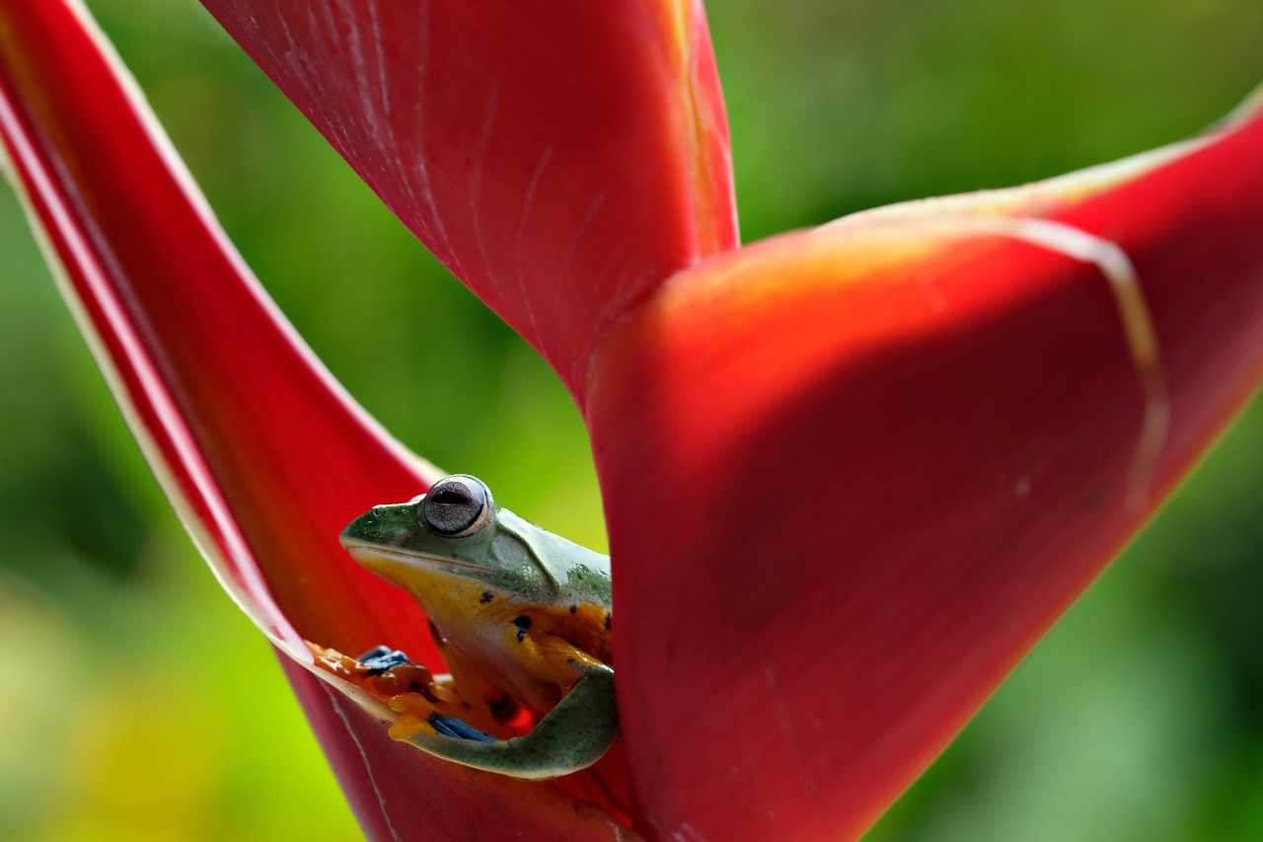
Understanding Food Chains and Ecosystems
Exploring Energy Flow, Nutrient Cycles, and Human Impact on Ecological Balance

Slide 2
Table of Contents
Introduction to Food Chains
What is a Food Chain?
Components of a Food Chain
Energy Flow in a Food Chain
Nutrient Cycle in a Food Chain
Types of Food Chains
Human Impact on Food Chains
Case Study: Grassland Ecosystem
Case Study: Ocean Ecosystem
Importance of Food Chains
Conclusion
Interactive Activity: Build a Food Chain
Interactive Activity: Food Chain Game
04
05
06
07
08
09
10
11
12
13
14
15
16

Slide 3
Table of Contents
Assessment and Evaluation
Extension Activity: Research a Food Chain
Extension Activity: Create a Food Web
Conclusion and Next Steps
17
18
19
20

Slide 4
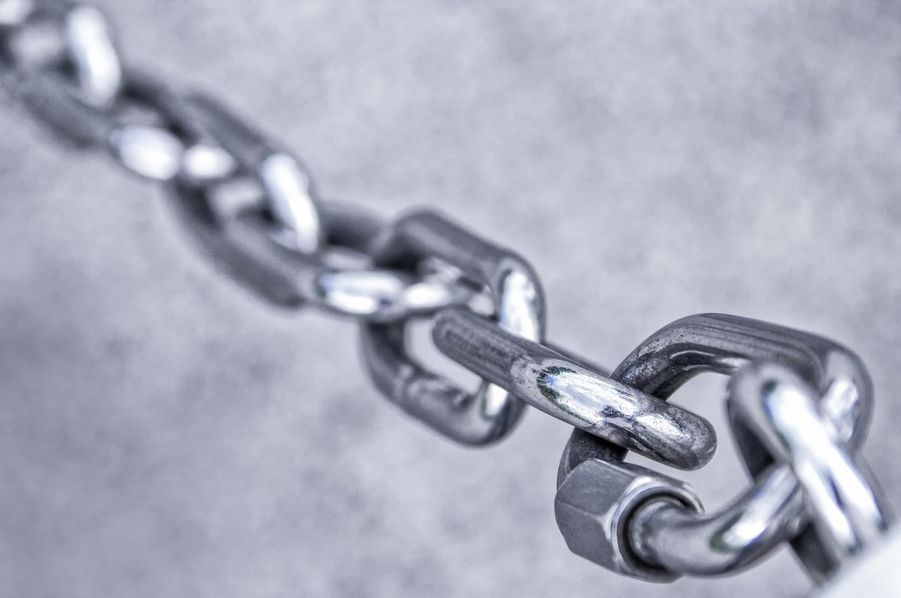
Introduction to Food Chains
Understanding Food Chains
Importance of Food Chains
Energy Flow in Ecosystems
Food chains are the relationships between plants and animals in an ecosystem.
They show how energy and nutrients flow from one living thing to another.
Understanding food chains is essential for maintaining a healthy ecosystem.
They help us comprehend the balance and interdependence of living organisms.
Food chains illustrate the transfer of energy and nutrients.
This process is vital for the survival and growth of all living beings.
4
Understanding Food Chains and Ecosystems

Slide 5
What is a Food Chain?
Definition of a Food Chain
Components of a Food Chain
A food chain is a series of events where one organism is eaten by another.
It starts with a producer (plant) and ends with a decomposer (bacteria or fungi).
The food chain begins with producers like plants that create energy.
It concludes with decomposers such as bacteria or fungi that break down organic matter.
5
Understanding Food Chains and Ecosystems

Slide 6
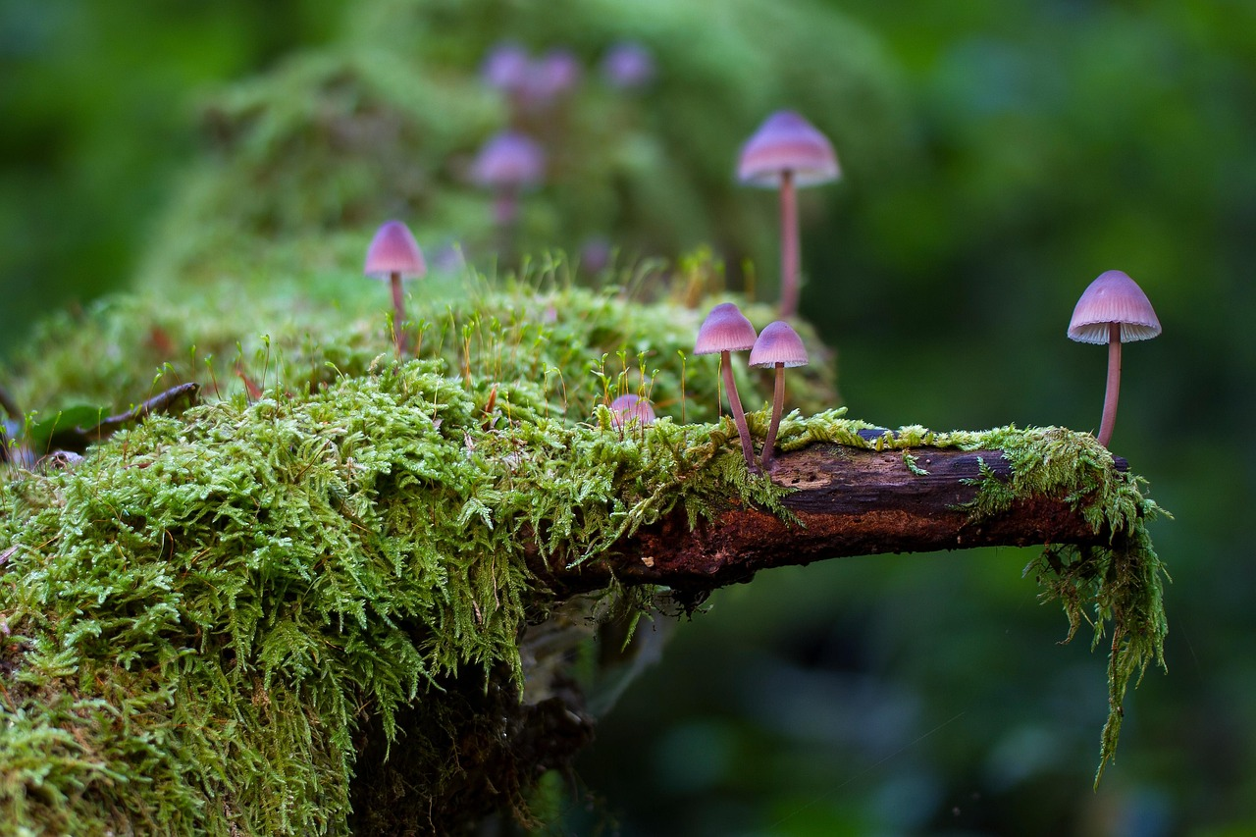
Components of a Food Chain
Producers
Consumers
Producers, such as plants, make their own food through photosynthesis.
They form the base of the food chain by providing energy for other organisms.
Consumers, primarily animals, eat other organisms to obtain energy.
They can be herbivores, carnivores, or omnivores depending on their diet.
Decomposers
Scavengers
Decomposers, like bacteria and fungi, break down dead organisms into nutrients.
These nutrients are then returned to the soil, supporting plant growth.
Scavengers are animals that feed on dead organisms.
They play a crucial role in cleaning up the environment by consuming carcasses.
6
Understanding Food Chains and Ecosystems

Slide 7
Energy Flow in a Food Chain
Energy Transfer in the Food Chain
Energy Loss at Each Level
The 10% Rule
Energy flows from one organism to another through eating and being eaten.
This transfer is essential for the survival of organisms at each level of the food chain.
Energy is lost at each level, making it less available to the next level.
This loss limits the amount of energy that can be passed on.
This is known as the '10% rule.'
Only about 10% of the energy is transferred to the next level in the food chain.
7
Understanding Food Chains and Ecosystems

Slide 8
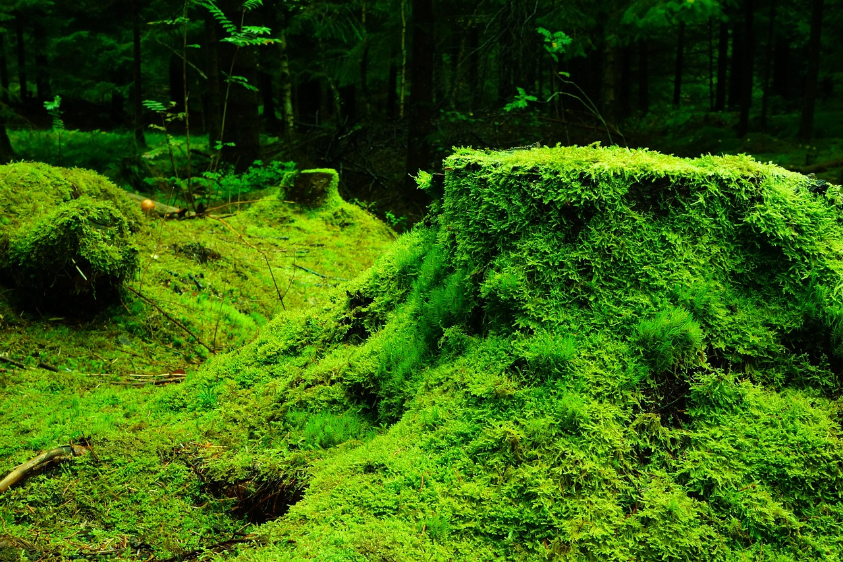
Nutrient Cycle in a Food Chain
Decomposition and Consumption
Role in Plant Growth
Ecosystem Balance
Nutrients are cycled through the ecosystem through decomposition and consumption.
This process ensures the transfer of essential elements within the food chain.
Nutrients are essential for plant growth and development.
They provide the necessary components for plants to thrive and sustain life.
Nutrient cycles maintain the balance of the ecosystem.
They regulate the availability of resources and support biodiversity.
8
Understanding Food Chains and Ecosystems

Slide 9
Types of Food Chains
1
2
3
Grazing Food Chain
Detritus Food Chain
Parasitic Food Chain
Starts with a plant.
Ends with a herbivore.
Starts with a dead organism.
Ends with a decomposer.
Starts with a host.
Ends with a parasite.
9
Understanding Food Chains and Ecosystems

Slide 10
Human Impact on Food Chains
1
Disruption by Human Activities
Human activities can disrupt food chains, such as pollution and habitat destruction.
These disruptions can have cascading effects on ecosystems.
2
Impact of Overexploitation
Overhunting and overfishing can deplete populations and disrupt the balance.
This can lead to the collapse of certain species within the food chain.
3
Effects of Climate Change
Climate change can alter the distribution and abundance of species.
Such changes can destabilize food chains and ecosystems.
10
Understanding Food Chains and Ecosystems

Slide 11
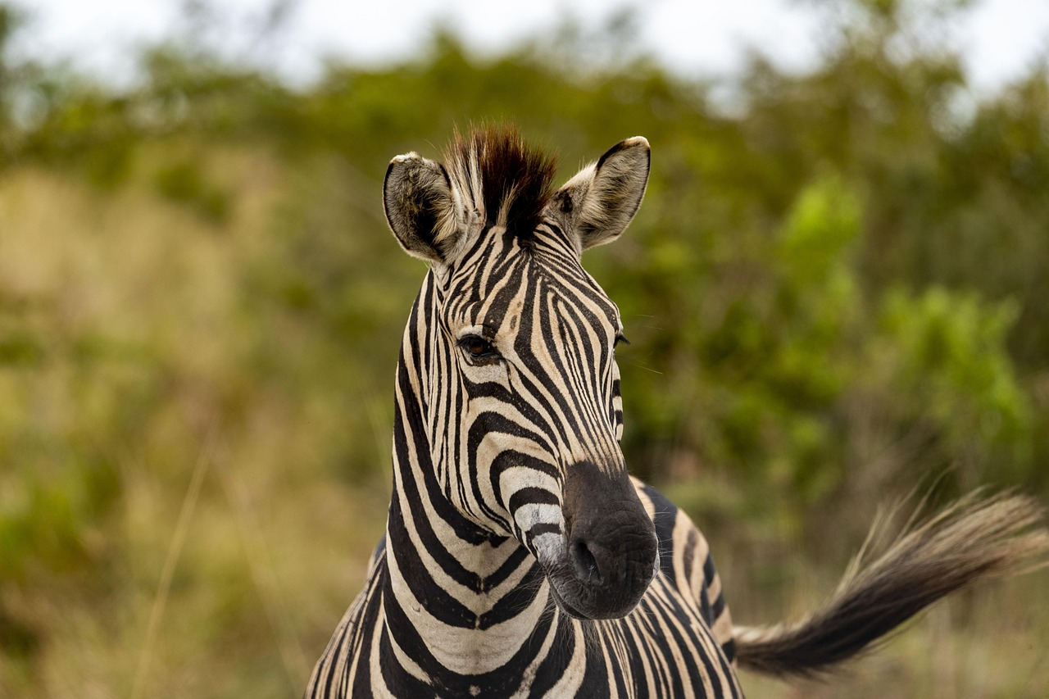
Case Study: Grassland Ecosystem
Complex Relationships in Grassland Ecosystems
The Food Chain in Grasslands
Impact of Human Activities
The grassland ecosystem is a complex network of relationships between plants and animals.
These interactions form the foundation of the ecosystem's stability and functionality.
The food chain starts with grasses and ends with predators like wolves and hawks.
This hierarchy ensures energy transfer and maintains ecological balance.
Human activities like agriculture and urbanization can disrupt the balance of the ecosystem.
Such disruptions can lead to loss of biodiversity and ecosystem degradation.
11
Understanding Food Chains and Ecosystems

Slide 12
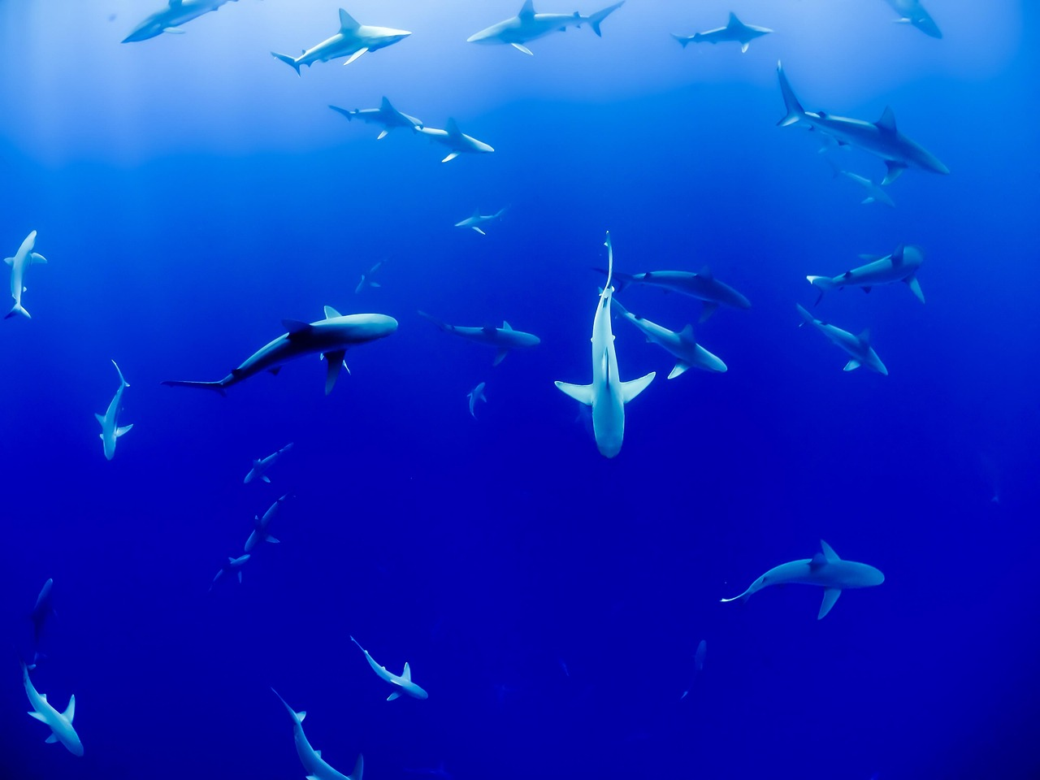
Case Study: Ocean Ecosystem
1
The Complexity of Ocean Ecosystems
The ocean ecosystem is a vast and complex network of relationships between plants and animals.
It encompasses diverse species interacting in intricate food chains and habitats.
2
The Ocean Food Chain
The food chain starts with phytoplankton and ends with apex predators like sharks and whales.
These connections are vital for maintaining the balance of marine life.
3
Human Impact on Marine Balance
Human activities like overfishing and pollution can disrupt the balance of the ecosystem.
Such disruptions threaten the survival of various species and the health of the ocean.
12
Understanding Food Chains and Ecosystems

Slide 13
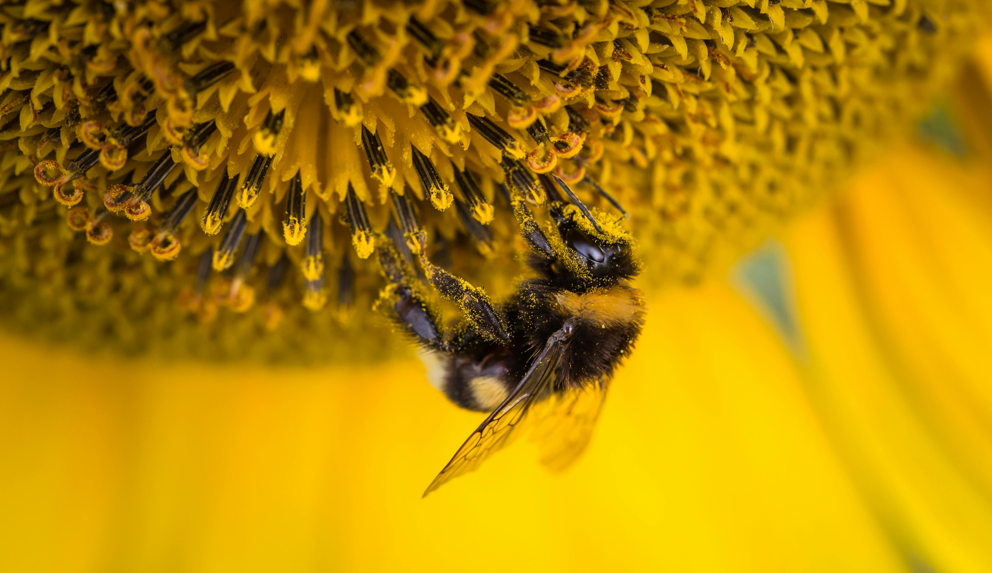
Importance of Food Chains
1
Ecosystem Balance
Food chains maintain the balance of the ecosystem.
They ensure the stability and sustainability of ecological interactions.
2
Source of Energy
Food chains provide a source of food and energy for organisms.
They enable the transfer of energy across different levels of the ecosystem.
3
Biodiversity Support
Food chains support biodiversity and ecosystem services.
They contribute to the survival and coexistence of various species.
13
Understanding Food Chains and Ecosystems

Slide 14
Conclusion
01
02
Importance of Food Chains
Understanding Interconnectedness
Food chains are essential for maintaining a healthy ecosystem.
They ensure the balance and flow of energy among living organisms.
Understanding food chains can help us appreciate the interconnectedness of living things.
This knowledge fosters awareness of the roles each organism plays in the environment.
14
Understanding Food Chains and Ecosystems

Slide 15

Interactive Activity: Build a Food Chain
Group Activity
Interactive Learning
Students can work in groups to build a food chain using cards or diagrams.
They can explore the relationships between organisms and the flow of energy and nutrients.
This activity encourages collaboration and critical thinking.
It helps students understand ecological concepts in a hands-on manner.
15
Understanding Food Chains and Ecosystems

Slide 16

Interactive Activity: Food Chain Game
Role-Playing in the Food Chain
Interactive Learning Experience
Students can play a game where they take on the roles of different organisms in a food chain.
They can learn about the challenges and benefits of being a producer, consumer, or decomposer.
This activity helps students understand ecological relationships through role-playing.
It encourages critical thinking about the dynamics of food chains.
16
Understanding Food Chains and Ecosystems

Slide 17
Assessment and Evaluation
1
Methods of Student Assessment
Students can be assessed through quizzes, tests, and projects.
These methods help gauge their understanding and application of concepts.
2
Self-Evaluation by Students
They can evaluate their own understanding of food chains and ecosystems.
This encourages self-reflection and deeper learning.
3
Role of Teachers in Evaluation
Teachers can provide feedback and guidance to support student learning.
Their input helps students improve and achieve their learning goals.
17
Understanding Food Chains and Ecosystems

Slide 18
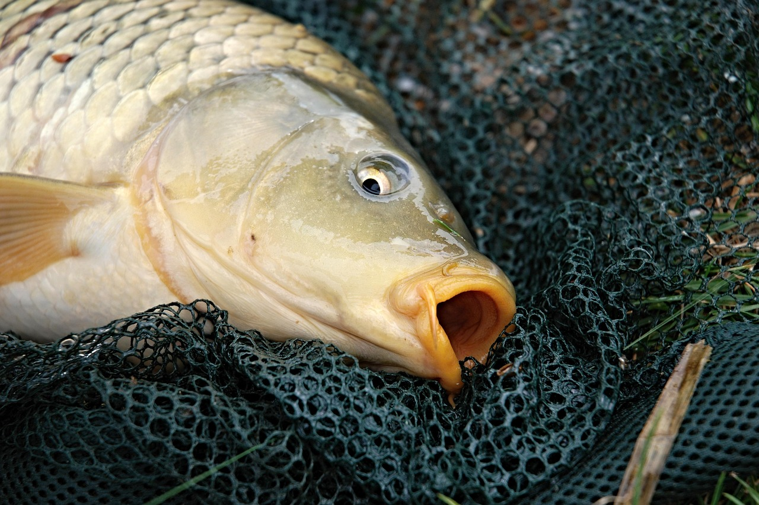
Extension Activity: Research a Food Chain
Exploring Food Chain Relationships
Impact of Human Activities on Ecosystems
Students can research a specific food chain and create a presentation or report.
They can explore the relationships between organisms and the impact of human activities on the ecosystem.
Students can research a specific food chain and create a presentation or report.
They can explore the relationships between organisms and the impact of human activities on the ecosystem.
18
Understanding Food Chains and Ecosystems

Slide 19

Extension Activity: Create a Food Web
Creating a Food Web Diagram
Exploring Ecosystem Complexity
Students can create a food web diagram showing the relationships between organisms.
This activity helps visualize how species interact within an ecosystem.
They can explore the complexity and interconnectedness of ecosystems.
This encourages a deeper understanding of ecological relationships.
19
Understanding Food Chains and Ecosystems

Slide 20

Conclusion and Next Steps
Understanding Food Chains
Exploring Ecology and Conservation
Students have learned about the basic concepts and definitions of food chains.
They can apply their knowledge to real-world scenarios.
Students can explore further topics in ecology.
They can delve into conservation efforts.
20
Understanding Food Chains and Ecosystems

