Slide 1

Exploring Whole Numbers and Their Applications
A Comprehensive Guide to Understanding Basic Operations and Real-World Uses

Slide 2


Table of contents
Introduction to Whole Numbers and Basic Operations
What are Whole Numbers?
Basic Arithmetic Operations
Properties of Whole Numbers
Applications of Whole Numbers and Basic Operations
Real-World Examples
Practice Problems
Interactive Activities
Conclusion
Next Steps
Reflection Questions
Additional Resources
Final Thoughts
01
02
03
04
05
06
07
08
09
10
11
12
13

Slide 3
Table of contents
Assessment
Extension Activities
Conclusion and Final Thoughts
Final Assessment
Certificate of Completion
References
Appendix
14
15
16
17
18
19
20

Slide 4

Introduction to Whole Numbers and Basic Operations
Introduction to Whole Numbers
Basic Arithmetic Operations
Learning Outcomes
Welcome to the world of whole numbers and basic operations!
Whole numbers include all positive integers and zero.
In this lesson, we will explore fundamental arithmetic operations.
These operations are addition, subtraction, multiplication, and division.
By the end of this lesson, you will demonstrate a solid grasp of whole numbers.
You will be able to perform basic operations confidently.
1
Exploring Whole Numbers and Their Applications

Slide 5

What are Whole Numbers?
Definition
Examples
Whole numbers are non-negative integers starting from 0.
They include all positive integers without fractions or decimals.
Whole numbers include 0, 1, 2, 3, and so on.
These numbers follow a clear pattern and continue infinitely.
Applications
Properties
Whole numbers are used in counting objects, such as apples or books.
They are essential in fields like finance and statistics for measuring quantities.
The commutative property means the order of addition does not change the sum.
The associative property indicates that grouping numbers does not affect the sum.
2
Exploring Whole Numbers and Their Applications

Slide 6

Basic Arithmetic Operations
Addition
Subtraction
Addition is the operation of combining two or more numbers.
It helps to find the total or sum of those numbers.
Subtraction is the operation of finding the difference between two numbers.
It determines how much one number is less than another.
Multiplication
Division
Multiplication is the operation of repeated addition.
It allows us to quickly calculate the total of equal groups.
Division is the operation of sharing or grouping a quantity into equal parts.
It helps to determine how many times one number is contained within another.
3
Exploring Whole Numbers and Their Applications

Slide 7
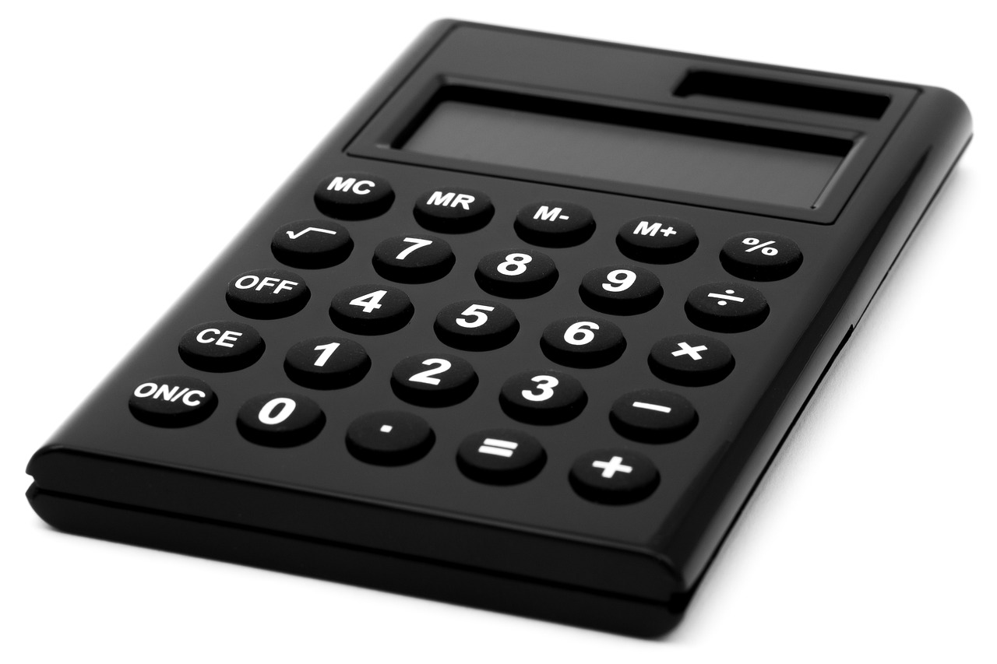
Properties of Whole Numbers
Commutative Property
Associative Property
Distributive Property
The commutative property indicates that changing the order of numbers does not affect the outcome of the operation.
For example, 3 + 5 is the same as 5 + 3.
The associative property states that how numbers are grouped does not change the result.
For instance, (2 + 3) + 4 equals 2 + (3 + 4).
The distributive property states that multiplying a number by a sum or difference distributes the multiplication across each term.
For example, a(b + c) equals ab + ac.
4
Exploring Whole Numbers and Their Applications

Slide 8

Applications of Whole Numbers and Basic Operations
STEM Applications
Measurement Fundamentals
Whole numbers and basic operations are essential for calculations and data analysis in STEM fields.
They support various scientific and engineering processes.
Whole numbers measure distances, weights, and quantities.
They are fundamental concepts in algebra and geometry.
Essential Operations
Real-World Examples
Basic operations like addition and multiplication are vital for solving equations.
They are essential for performing calculations with whole numbers.
Real-world applications include calculating grocery costs and measuring distances.
They are also used to determine the number of people in a group.
5
Exploring Whole Numbers and Their Applications

Slide 9

Real-World Examples
Grocery Costs
Travel Time
Group Size
The total cost for 3 apples, 2 bananas, and 1 orange is $5.50.
Traveling 5 miles at 2 miles per hour takes 2.5 hours.
There are 3 groups of 4 people, totaling 12 individuals.
6
Exploring Whole Numbers and Their Applications

Slide 10

Practice Problems
Essential Practice
Sample Problems
Engaging with practice problems is vital for mastering whole numbers and basic operations.
These exercises build understanding and enhance problem-solving skills.
Here are basic arithmetic problems to practice: 2 + 2, 5 - 3, 4 x 6, and 12 ÷ 4.
These problems are fundamental for developing mathematical proficiency.
Online Resources
Worksheets Usage
Various online platforms provide interactive practice problems for learners.
These resources often offer instant feedback to monitor your progress.
Worksheets are effective tools for practicing and reinforcing your knowledge.
They can be used for individual study or group activities.
7
Exploring Whole Numbers and Their Applications

Slide 11
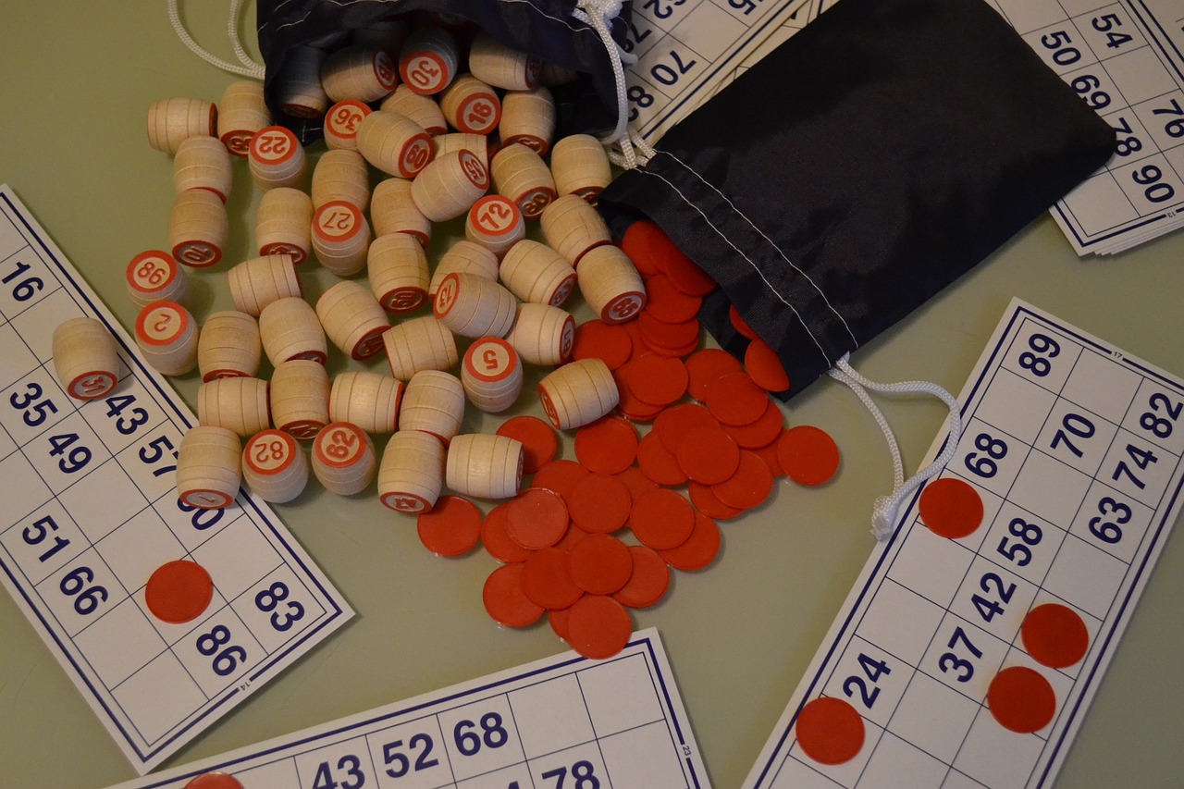
Interactive Activities
Math Bingo
Scavenger Hunt
Math War
Players match numbers on their cards with those called out.
This game enhances number recognition in an enjoyable way.
Participants solve math clues to discover hidden items.
This activity promotes teamwork while applying math concepts in real-world scenarios.
In this card game, players compete to solve math problems quickly.
It fosters quick thinking and reinforces arithmetic skills through competition.
8
Exploring Whole Numbers and Their Applications

Slide 12

Conclusion
Mastering Basics
Foundation for Advancement
Practice with Purpose
Whole numbers and basic operations are fundamental concepts in mathematics.
Mastering these concepts is essential for future learning.
By understanding these basics, you will be equipped to tackle advanced topics.
A strong foundation enhances problem-solving and critical thinking skills.
Reinforce your understanding through interactive activities.
Use real-world examples to make learning relevant.
9
Exploring Whole Numbers and Their Applications

Slide 13
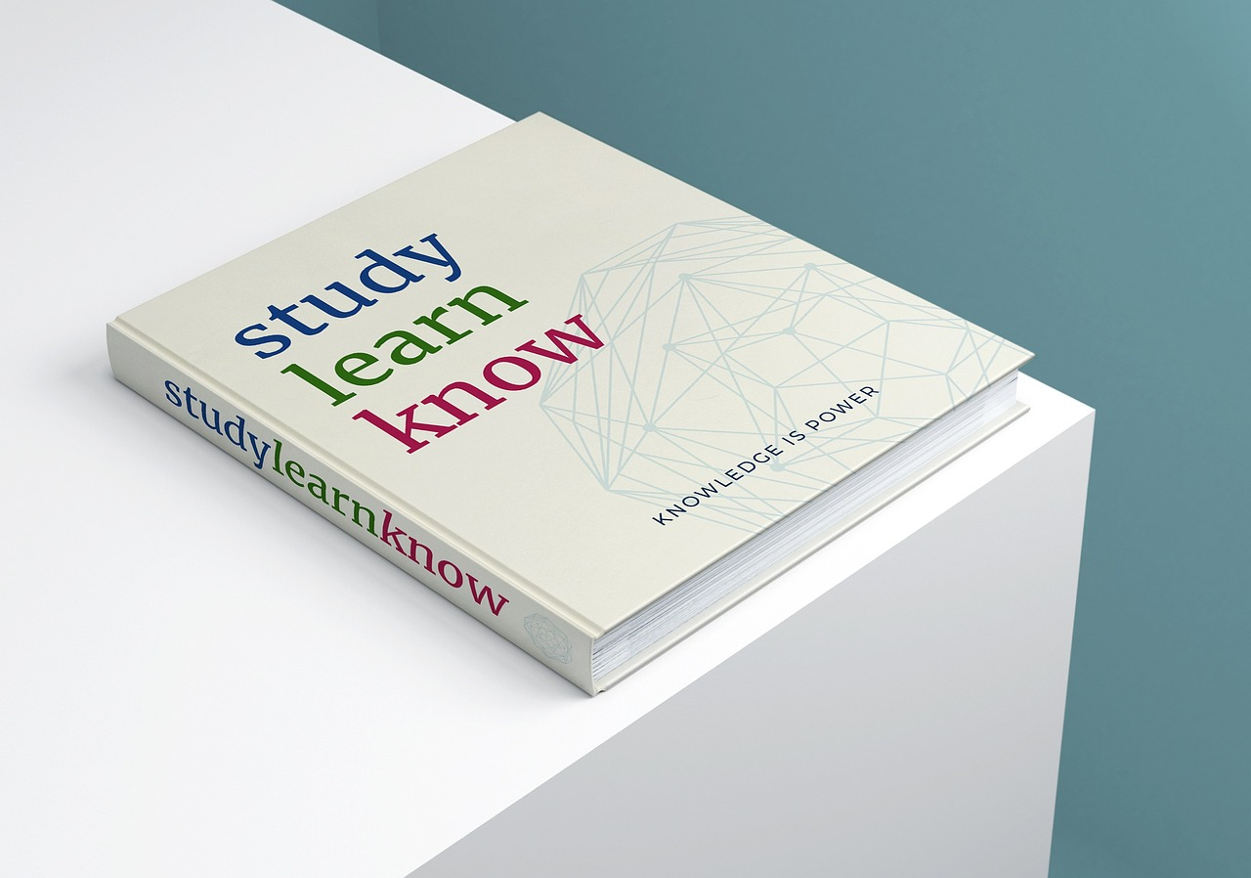
Next Steps
Advanced Topics
Learning Resources
Practice Regularly
Explore advanced topics in mathematics, including fractions, decimals, and algebra.
These concepts will enhance your understanding of the subject.
Utilize online resources and textbooks to deepen your knowledge.
These materials offer valuable explanations and practice opportunities.
Consistent practice is crucial for mastering mathematical concepts.
It helps build a solid foundation for effective problem-solving.
10
Exploring Whole Numbers and Their Applications

Slide 14

Reflection Questions
Key Learnings
Real-World Applications
Overcoming Challenges
I learned to identify whole numbers and perform basic operations.
These skills are essential for solving mathematical problems.
Whole numbers and basic operations are crucial in budgeting.
They help in making informed decisions in everyday life.
I faced challenges in applying these concepts to complex problems.
I plan to practice more and seek assistance to enhance my understanding.
11
Exploring Whole Numbers and Their Applications

Slide 15

Additional Resources
Online Tools
Textbook Practice
Embrace Mistakes
Use online platforms for interactive learning.
They provide instant feedback and personalized practice.
Engage with textbooks that offer structured exercises.
These resources strengthen your understanding of fundamental concepts.
Seek help when facing challenges.
Mistakes are valuable opportunities for growth.
12
Exploring Whole Numbers and Their Applications

Slide 16

Final Thoughts
Practice Regularly
Embrace Curiosity
Build a Strong Foundation
Regular practice enhances your math skills.
Engage with a variety of problems to deepen your understanding.
Adopt a mindset of continuous learning in mathematics.
Explore new concepts to uncover exciting opportunities.
Tackle diverse math problems to strengthen your problem-solving skills.
A solid foundation boosts your confidence in tackling challenges.
13
Exploring Whole Numbers and Their Applications

Slide 17

Assessment
Take a Quiz
Use Online Resources
Regular Review
Take a quiz to evaluate your grasp of whole numbers and basic operations.
Worksheets can further enhance your understanding.
Explore online platforms or textbooks for extra practice.
These resources can deepen your comprehension of mathematical concepts.
Consistent review is vital for reinforcing your math skills.
Make it a habit to practice regularly for a solid foundation.
14
Exploring Whole Numbers and Their Applications

Slide 18

Extension Activities
Challenging Problems
Advanced Topics
Practice Regularly
Engage with intricate problems to enhance your skills.
Discover practical uses of whole numbers in daily life.
Utilize specific online platforms to explore advanced math concepts.
Focus on areas like fractions, decimals, and algebra for deeper insights.
Regular practice solidifies your grasp of mathematical ideas.
This consistency fosters a robust foundation for effective problem-solving.
15
Exploring Whole Numbers and Their Applications

Slide 19

Conclusion and Final Thoughts
Fundamental Concepts
Mastering Basics
Practice and Reinforce
Whole numbers and basic operations are essential for effective problem-solving in mathematics.
They form the basis for critical thinking skills.
Mastering these concepts is vital for preparing for advanced topics.
A strong foundation supports future learning endeavors.
Regular practice is essential for understanding mathematical concepts.
Seek help when needed to enhance your learning experience.
16
Exploring Whole Numbers and Their Applications

Slide 20

Final Assessment
Final Assessment Options
Exploring Learning Materials
Establishing a Study Routine
You can choose to take a final quiz to evaluate your understanding of whole numbers.
Alternatively, completing a worksheet can also help reinforce your skills.
Utilize online resources and textbooks to enhance your practice.
These materials are designed to deepen your comprehension of mathematical concepts.
Regular review is essential for mastering mathematics.
Creating a consistent study schedule will strengthen your foundational knowledge.
17
Exploring Whole Numbers and Their Applications

Slide 21

Certificate of Completion
Lesson Completed
Solid Understanding
Embrace Continuous Learning
Congratulations on finishing the lesson on whole numbers!
You have successfully completed all required tasks.
You have a strong grasp of these essential concepts.
Now, you're ready to tackle more advanced mathematical topics.
Stay curious and explore the world of mathematics.
This subject offers endless opportunities for growth and discovery.
18
Exploring Whole Numbers and Their Applications

Slide 22
References
Khan Academy
Mathway
National Council of Teachers of Mathematics (NCTM)
Khan Academy offers interactive exercises and instructional videos that clearly explain basic operations.
These resources help learners understand whole numbers effectively.
Mathway provides a platform for solving whole number problems efficiently.
Users can input queries and receive instant step-by-step solutions.
NCTM establishes standards for teaching whole numbers and basic operations.
It offers guidelines and resources to enhance mathematics education.
19
Exploring Whole Numbers and Their Applications

Slide 23
Appendix
Practice Resources
Solution Answers
Math Glossary
Find various online platforms for practice.
These resources support your understanding of math concepts.
Review answers to practice problems here.
This section lets you verify your answers and learn from mistakes.
Consult the glossary for definitions of key terms.
This tool helps clarify concepts and expand your vocabulary.
20
Exploring Whole Numbers and Their Applications

