Slide 1
Mastering Three-Digit Numbers: A Comprehensive Guide
Exploring Place Value, Applications, and Engaging Learning Strategies

Slide 2
Mastering Three-Digit Numbers: A Comprehensive Guide
2
Table of Contents
Introduction to Three-Digit Numbers
What is Place Value?
Reading and Writing Three-Digit Numbers
Comparing Three-Digit Numbers
Using Visual Aids to Understand Place Value
Real-World Applications of Three-Digit Numbers
Games and Activities to Practice Three-Digit N…
Assessment and Feedback
Conclusion
Key Takeaways
Next Steps
Reflection Questions
Parent Engagement
04
05
06
07
08
09
10
11
12
13
14
15
16

Slide 3
Mastering Three-Digit Numbers: A Comprehensive Guide
3
Table of Contents
Safety Considerations
Teaching Tips
Homework Assignments
Extension Activities
Example Questions
Formative Assessment
Summative Assessment
17
18
19
20
21
22
23

Slide 4
Mastering Three-Digit Numbers: A Comprehensive Guide
4
Introduction to Three-Digit Numbers
Place Value
Three-Digit Structure
Arithmetic Relevance
A three-digit number has three digits, such as 456.
Each digit represents a specific place value: hundreds, tens, and ones.
In the number 582, the digit 5 represents hundreds, 8 represents tens, and 2 represents ones.
This structure helps us understand the value of each digit in the number.
Knowing three-digit numbers is essential for basic arithmetic.
This knowledge is crucial for solving everyday math problems.

Slide 5

Mastering Three-Digit Numbers: A Comprehensive Guide
5
What is Place Value?
Digit Value
Position Matters
Example Breakdown
The place value of a digit depends on its position in a number.
Digits can represent values in the hundreds, tens, or ones places.
The position of a digit determines its value.
For example, in 456, the digit 4 represents the hundreds place.
In 456, the place value of 4 is 400.
The place values of 5 and 6 are 50 and 6.

Slide 6

Mastering Three-Digit Numbers: A Comprehensive Guide
6
Reading and Writing Three-Digit Numbers
Place Value Basics
Reading Numbers
Writing Digits
In a three-digit number, each digit has a specific place value: hundreds, tens, and units.
These positions define the total value of the number.
To read a three-digit number, we need to know the place value of each digit.
For example, 456 is read as 'four hundred fifty-six'.
To write a three-digit number, we need to understand the place value of each digit.
We place the digits in their correct positions to accurately represent the number.

Slide 7
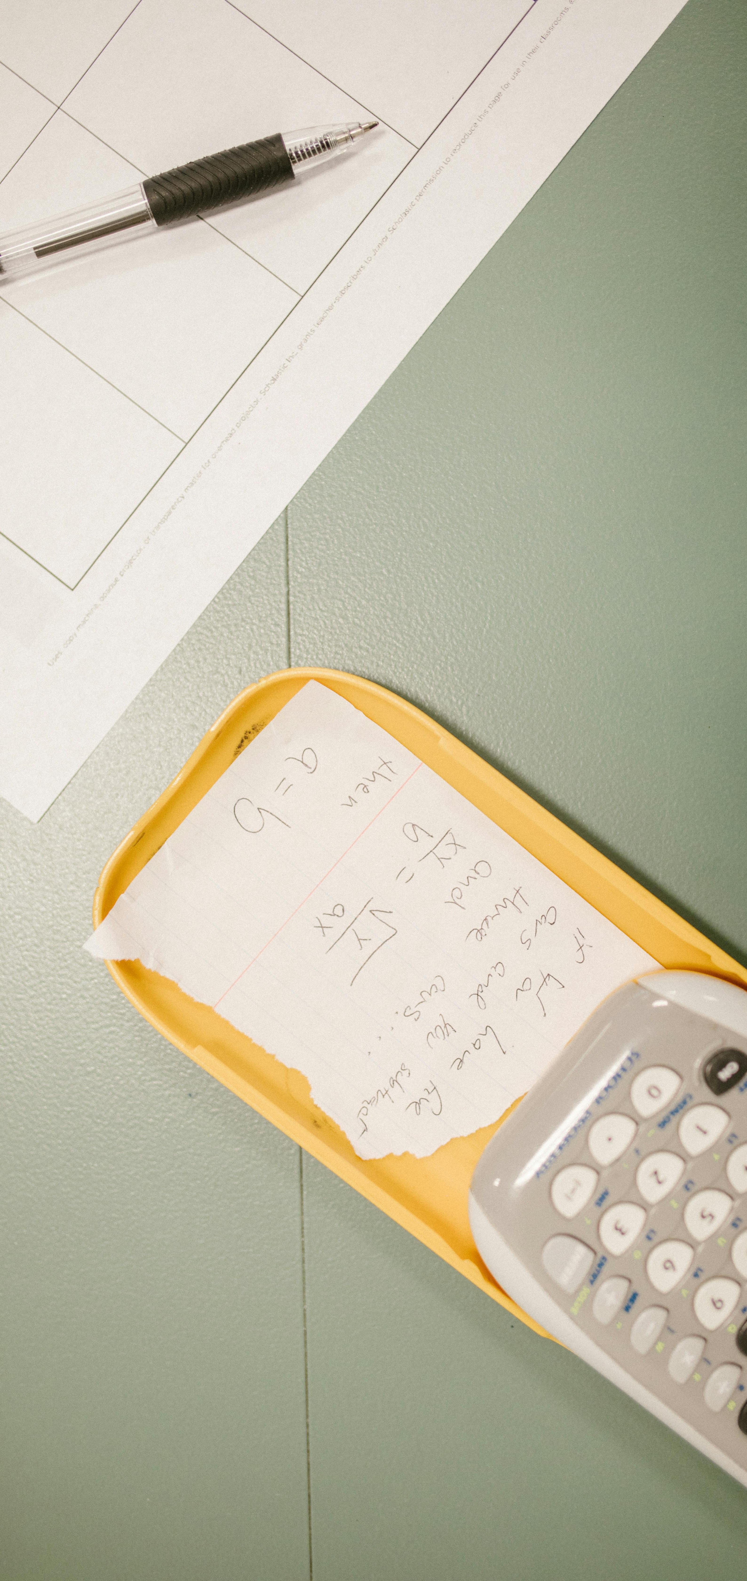
Mastering Three-Digit Numbers: A Comprehensive Guide
7
Comparing Three-Digit Numbers
Place Value Comparison
Digit Evaluation
Greater Number Rule
To compare three-digit numbers, look at each digit's place value.
For example, compare 456 and 457 by examining the hundreds, tens, and ones.
The number with the greater digit in the same place value is larger.
Always start from the leftmost digit when comparing.
If the hundreds are the same, compare the tens next.
Continue until a difference is found or all digits are compared.

Slide 8

Mastering Three-Digit Numbers: A Comprehensive Guide
8
Using Visual Aids to Understand Place Value
Hundreds Chart
Base-Ten Blocks
Number Lines
Hundreds charts help students grasp the concept of place value.
They visually display numbers in a grid format, highlighting numerical patterns.
Base-ten blocks effectively represent three-digit numbers.
They show the relationship between digits and their place values.
Number lines assist in comparing and ordering three-digit numbers.
They visually represent the size of numbers, aiding in comparison.

Slide 9
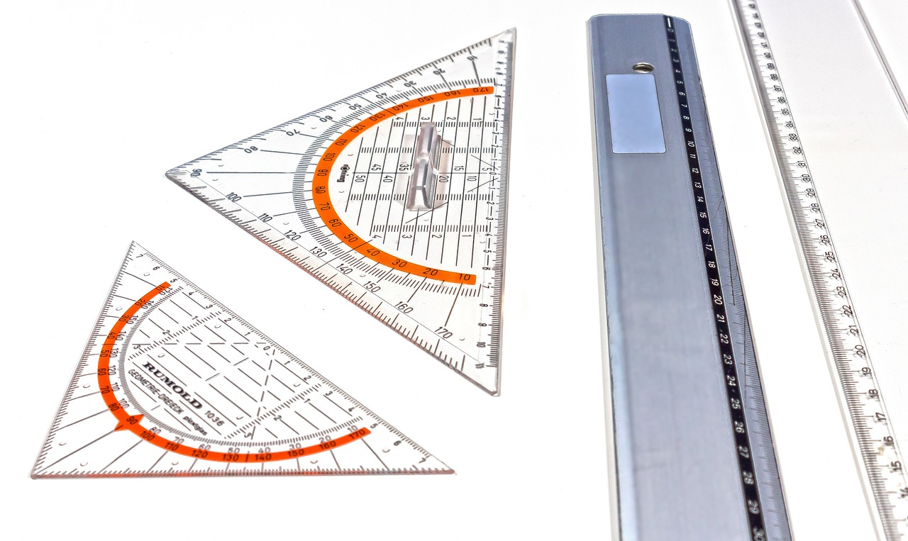
Mastering Three-Digit Numbers: A Comprehensive Guide
9
Real-World Applications of Three-Digit Numbers
Length Measurements
Financial Calculations
Scientific Measurements
Three-digit numbers are often used to measure lengths.
For example, a bridge might be 250 feet long.
Three-digit numbers represent costs in everyday finance.
A bicycle can cost $350, showcasing this application.
In science, three-digit numbers are crucial for measuring weights.
A sample might weigh 450 grams in a laboratory setting.

Slide 10

Mastering Three-Digit Numbers: A Comprehensive Guide
10
Games and Activities to Practice Three-Digit Numbers
Value Comparison
Bingo Challenge
Scavenger Hunt
In Place Value War, players draw cards to compare three-digit numbers.
The player with the highest number wins the round.
In Three-Digit Bingo, players mark off numbers on their cards as they are called.
The first to complete a row or column wins the game.
In the Three-Digit Number Scavenger Hunt, players search for items with three-digit numbers around them.
They record these numbers to practice reading and identifying them.

Slide 11

Mastering Three-Digit Numbers: A Comprehensive Guide
11
Assessment and Feedback
Quiz Insights
Discussion Feedback
Targeted Guidance
Quizzes assess understanding of three-digit numbers.
They provide immediate feedback on place value comprehension.
Class discussions enhance understanding of three-digit numbers.
Observations during discussions clarify students' comprehension.
Feedback helps students identify strengths and weaknesses.
This guidance highlights areas for improvement.

Slide 12
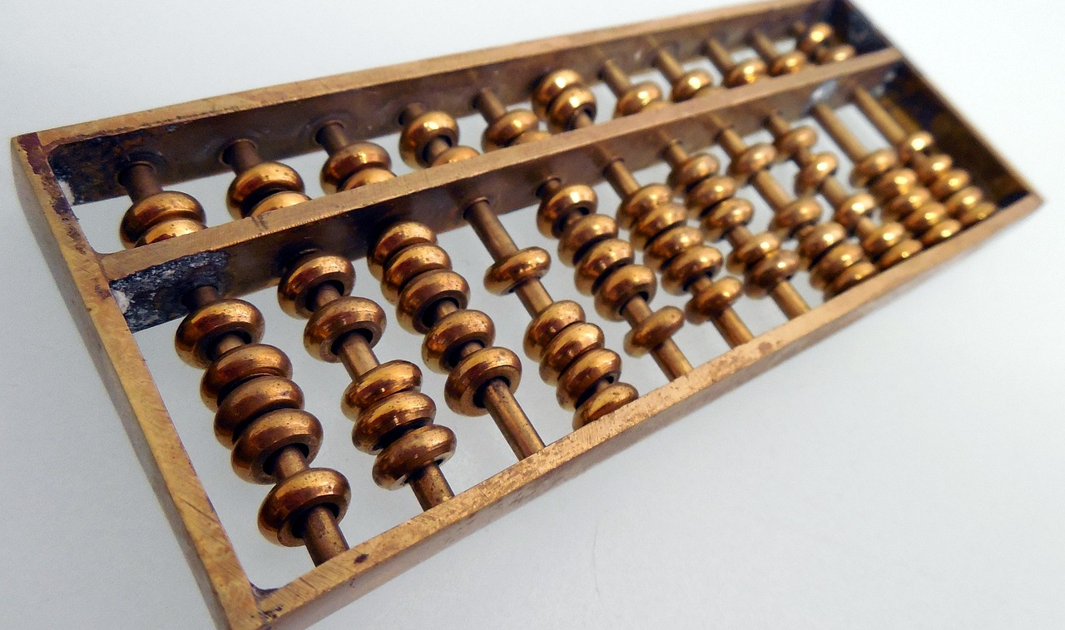
Mastering Three-Digit Numbers: A Comprehensive Guide
12
Conclusion
Place Value Mastery
Real-World Applications
Future Learning Goals
Mastering three-digit numbers is essential for arithmetic.
Students will confidently read and compare these numbers.
Place value skills enable students to solve everyday problems.
This knowledge aids in interpreting practical numbers.
Students will deepen their understanding of three-digit numbers in future lessons.
This foundation is crucial for advanced math topics.

Slide 13

Mastering Three-Digit Numbers: A Comprehensive Guide
13
Key Takeaways
Place Value Mastery
Number Comparison Skills
Real-World Applications
Students can read and write three-digit numbers, grasping the significance of each digit's position.
This foundational skill is essential for understanding more complex math concepts.
Students compare three-digit numbers to identify which is larger or smaller.
They do this by evaluating the value of each digit in its place.
Students apply their knowledge of three-digit numbers in everyday scenarios like budgeting and shopping.
This practical use reinforces their learning and highlights its importance.

Slide 14
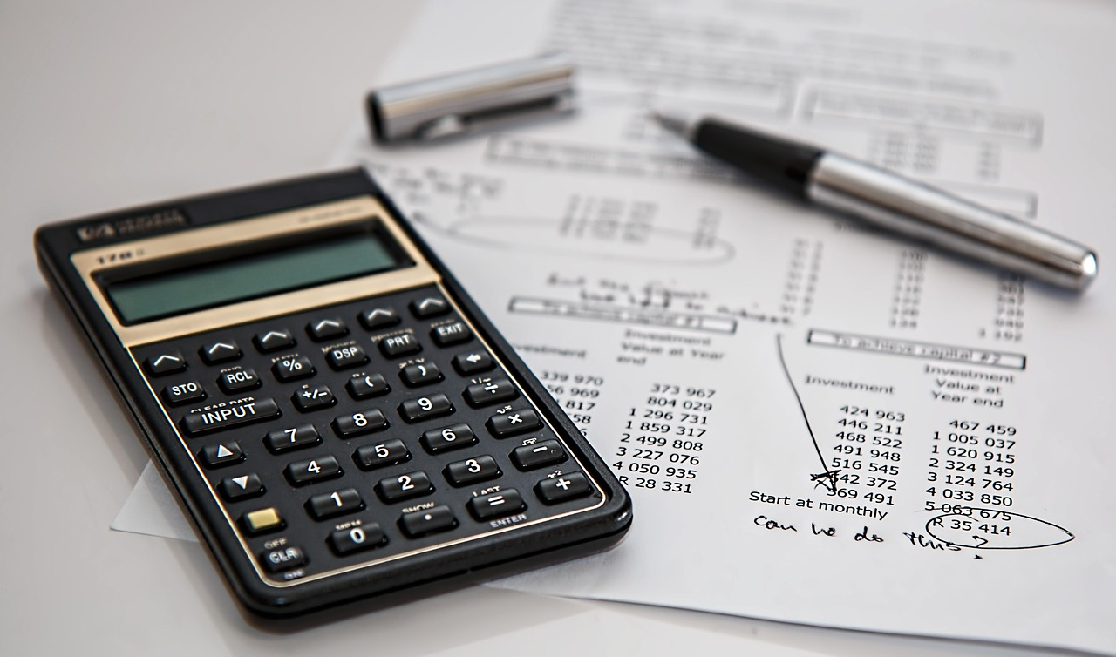
Mastering Three-Digit Numbers: A Comprehensive Guide
14
Next Steps
Four-Digit Numbers
Rounding Techniques
Multi-Digit Operations
Students will explore four-digit numbers and their place value.
They will also compare these numbers.
Students will learn to round multi-digit numbers.
They will practice estimating to improve their skills.
Students will engage with multi-digit addition and subtraction.
They will apply their place value knowledge to solve related problems.

Slide 15

Mastering Three-Digit Numbers: A Comprehensive Guide
15
Reflection Questions
Understanding Place Value
Engagement Strategies
Lesson Adjustments
Assess students' understanding of place value.
Evaluate their ability to apply this concept to three-digit numbers.
Evaluate the effectiveness of instructional strategies in engaging students.
Determine if the activities facilitated meaningful learning experiences.
Identify necessary adjustments to support struggling students.
Consider modifications to improve comprehension of three-digit numbers.

Slide 16

Mastering Three-Digit Numbers: A Comprehensive Guide
16
Parent Engagement
Home Practice
Teacher Feedback
Conferences
Parents can explore three-digit numbers through engaging activities at home.
This helps reinforce what children learn in school.
Parents should share their insights with teachers to enhance their child's math learning.
This collaboration helps tailor educational strategies to meet individual needs.
Parents can attend conferences to discuss their child's math progress.
These meetings are valuable opportunities to strategize for improvement.

Slide 17

Mastering Three-Digit Numbers: A Comprehensive Guide
17
Safety Considerations
Safe Environment
Accommodate Needs
Clear Expectations
Teachers must create a safe and supportive classroom.
Regularly inspect for hazards and maintain cleanliness.
Recognize and support students with special needs.
Providing necessary accommodations promotes inclusivity.
Establish clear rules for classroom behavior.
Students should respect personal space to foster a positive atmosphere.

Slide 18

Mastering Three-Digit Numbers: A Comprehensive Guide
18
Teaching Tips
Visual Aids
Real-World Practice
Engaging Activities
Incorporate tools like hundreds charts and base-ten blocks to clarify place value.
These aids help students grasp abstract concepts more effectively.
Encourage students to read and write three-digit numbers in real-life situations.
This practice reinforces their understanding of place value.
Integrate games and interactive activities to make learning enjoyable.
These strategies enhance student participation and motivation.

Slide 19

Mastering Three-Digit Numbers: A Comprehensive Guide
19
Homework Assignments
Practice Place Value
Feedback for Growth
Parental Involvement
Assign homework focused on reading and writing three-digit numbers.
Apply place value concepts to real-world situations.
Provide feedback on homework to guide student improvement.
Use this feedback to shape future lessons.
Encourage parents to practice three-digit numbers with their children.
Discuss place value concepts during home activities.

Slide 20

Mastering Three-Digit Numbers: A Comprehensive Guide
20
Extension Activities
Complex Challenges
Interactive Tech
Student Creations
Challenge students with activities that require them to apply their knowledge of three-digit numbers.
These tasks enhance critical thinking and problem-solving skills.
Incorporate math apps and online games to engage students in learning about three-digit numbers.
These tools make practicing place value enjoyable and effective.
Encourage students to design their own games focused on three-digit numbers and place value.
Sharing these creations promotes collaboration and creativity in the classroom.

Slide 21

Mastering Three-Digit Numbers: A Comprehensive Guide
21
Example Questions
Value of 5
Number Comparison
Write in Words
In the number 456, the digit 5 is in the tens place, representing fifty.
Between 345 and 456, the number 456 is greater. It exceeds 345 by 111.
The number 247 can be expressed in words as two hundred forty-seven. This includes two hundred for the hundreds, forty for the tens, and seven for the units.

Slide 22

Mastering Three-Digit Numbers: A Comprehensive Guide
22
Formative Assessment
Monitor Progress
Targeted Feedback
Identify Needs
Use formative assessments like quizzes to monitor students' progress.
They gauge understanding effectively.
Provide feedback on formative assessments.
This enhances future instruction and learning outcomes.
Identify support needs through formative assessments.
This allows for targeted instruction.

Slide 23

Mastering Three-Digit Numbers: A Comprehensive Guide
23
Summative Assessment
Assess Understanding
Feedback Loop
Evaluate Effectiveness
Use tests and projects to assess students' grasp of three-digit numbers.
These evaluations reflect learning at the end of the unit.
Give students feedback on their assessments to highlight strengths and weaknesses.
This feedback helps shape future lessons and teaching methods.
Review assessment results to gauge the lesson's success.
Make necessary adjustments to improve student learning outcomes.

