Slide 1

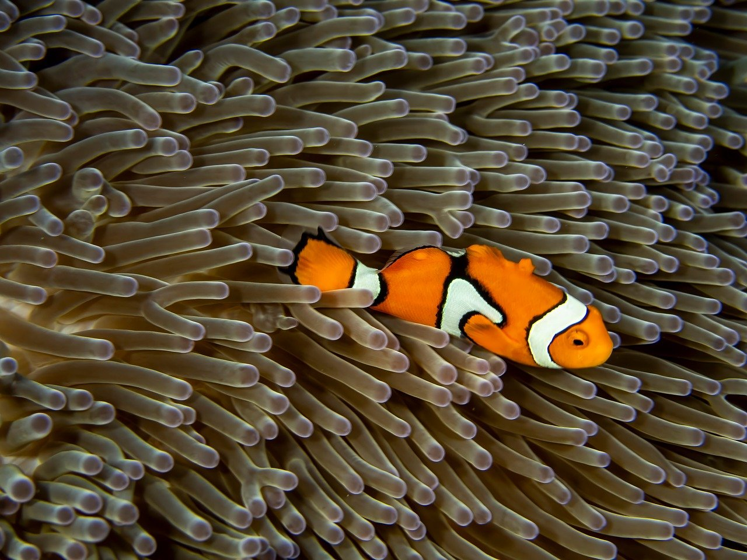
Marine Conservation: Protecting Our Oceans for Future Generations
Understanding, Educating, and Taking Action to Preserve Marine Ecosystems and Promote Sustainability

Slide 2
Table of Contents
Introduction to Marine Conservation
Why is Marine Conservation Important?
Causes and Effects of Marine Pollution
Importance of Protecting Marine Habitats
Eco-Friendly Practices
Strategies for Reducing Plastic Waste
Creating a Plan for Marine Conservation
Implementing the Plan
Evaluating the Plan
Conclusion
Key Takeaways
Next Steps
Resources
04
05
06
07
08
09
10
11
12
13
14
15
16

Slide 3
Table of Contents
Field Experiment Activities
STEM Activities
Parent Engagement
Conclusion and Final Thoughts
17
18
19
20

Slide 4
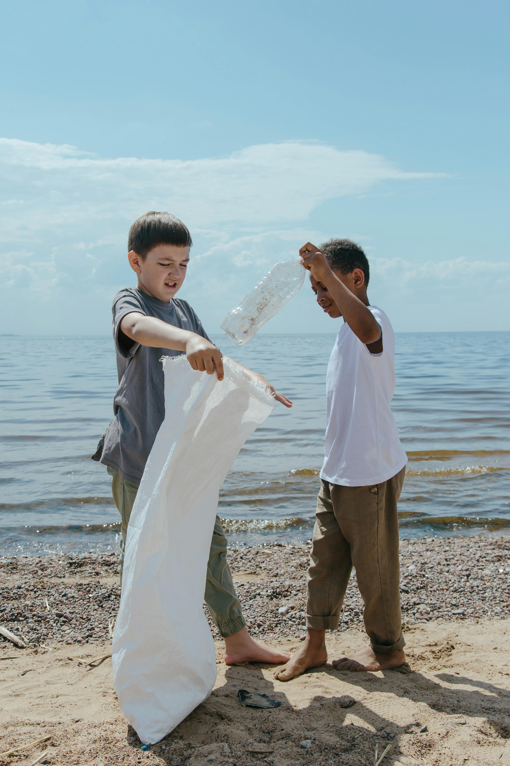
Introduction to Marine Conservation
Understanding Marine Conservation
The Role of Education
Why It Matters
Marine conservation is the practice of protecting and preserving the world's oceans and marine ecosystems.
The importance of marine conservation cannot be overstated, as the health of our oceans has a direct impact on the health of our planet.
This lesson plan aims to educate and inspire 11-year-old students to take action in promoting marine conservation.
By learning about sustainability, students can contribute to the preservation of marine ecosystems.
Healthy oceans are essential for the overall health of our planet.
Marine conservation efforts ensure the survival of diverse marine life and ecosystems.
4
Marine Conservation: Protecting Our Oceans for Future Generations

Slide 5
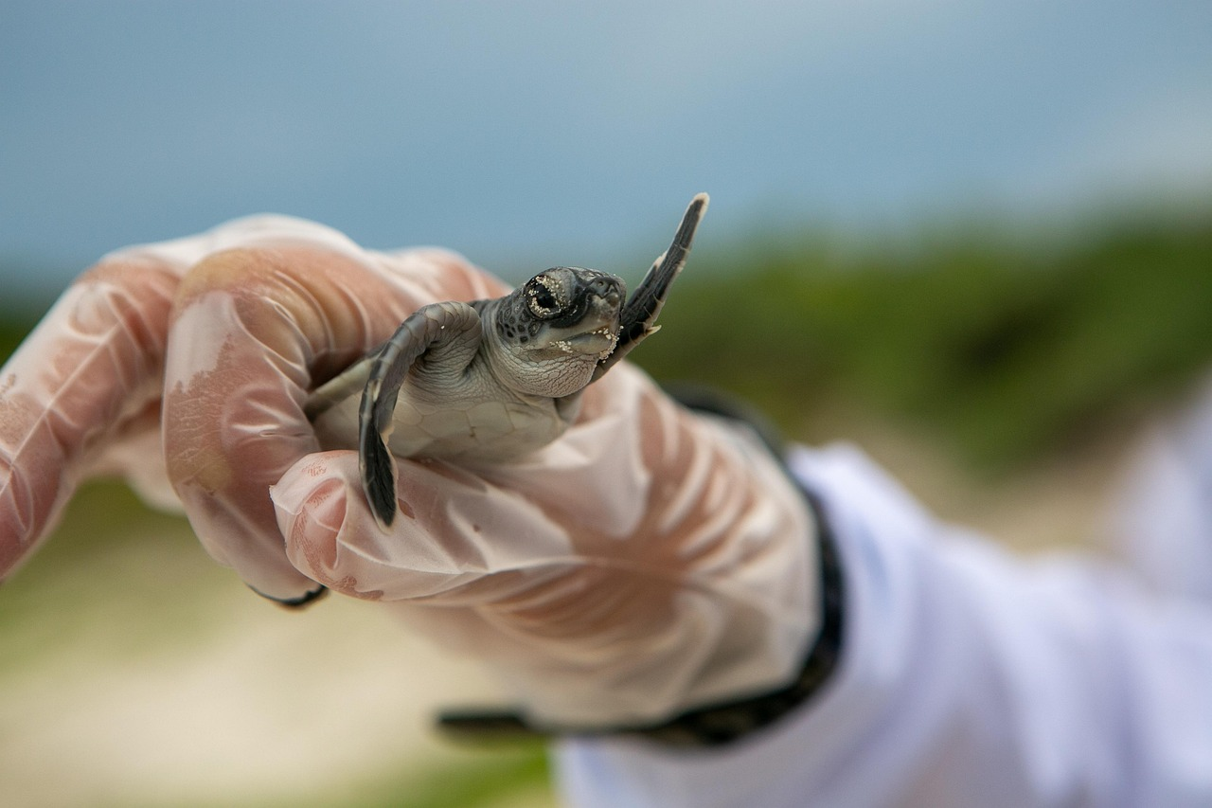
Why is Marine Conservation Important?
Benefits of Marine Ecosystems
Climate Regulation
Marine ecosystems provide a range of benefits, including food, recreation, and tourism.
They are vital for supporting human livelihoods and economies.
Marine ecosystems are also important for regulating the climate and weather patterns.
They play a crucial role in maintaining the Earth's environmental balance.
Human Impact on Oceans
The Need for Action
Human activities, such as pollution, overfishing, and habitat destruction, can have devastating impacts on marine ecosystems.
These actions threaten the biodiversity and sustainability of our oceans.
It is essential that we take action to protect our oceans and preserve the health of our planet.
Conservation efforts are critical to ensuring the future of marine life and human well-being.
5
Marine Conservation: Protecting Our Oceans for Future Generations

Slide 6
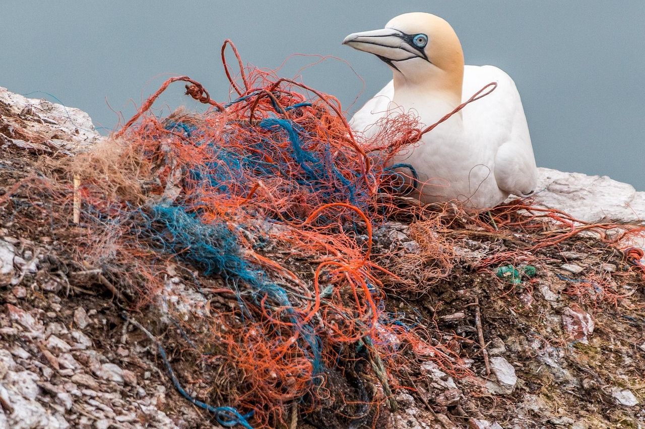
Causes and Effects of Marine Pollution
Major Threats to Marine Ecosystems
Impact on Marine Life and Food Chain
Marine pollution is a major threat to marine ecosystems, with causes including plastic waste, oil spills, and chemical runoff.
Human activities, such as littering and improper waste disposal, contribute to marine pollution.
The effects of marine pollution include harm to marine life, contamination of the food chain, and damage to habitats.
Marine organisms are often exposed to toxic substances, leading to long-term ecological consequences.
Role of Human Activities in Pollution
Solutions to Mitigate Marine Pollution
Human activities, such as littering and improper waste disposal, contribute to marine pollution.
These actions exacerbate the accumulation of pollutants in oceans and coastal areas.
Reducing plastic waste and promoting sustainable practices can help mitigate the effects of marine pollution.
Efforts to clean up oceans and enforce environmental regulations are essential for preserving marine ecosystems.
6
Marine Conservation: Protecting Our Oceans for Future Generations

Slide 7
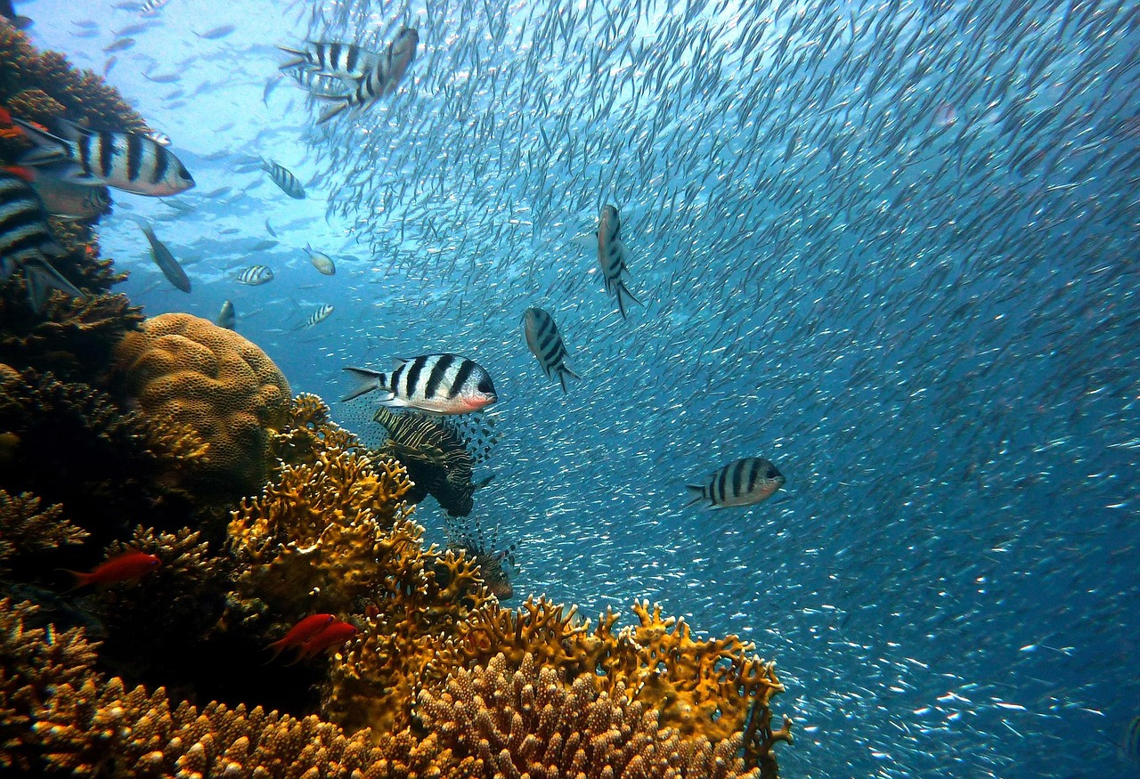
Importance of Protecting Marine Habitats
01
Marine Habitats and Biodiversity
Marine habitats, such as coral reefs and estuaries, are essential for maintaining biodiversity and supporting marine life.
These ecosystems provide shelter, food, and breeding grounds for countless marine species.
02
Impact of Human Activities
Human activities, such as coastal development and fishing, can damage or destroy marine habitats.
Such destruction leads to a decline in marine biodiversity and disrupts ecosystem balance.
03
Significance of Protection
Protecting marine habitats is crucial for preserving the health of marine ecosystems.
It also supports the livelihoods of people who depend on these ecosystems for food and income.
04
Strategies for Conservation
Establishing marine protected areas and promoting sustainable fishing practices can help protect marine habitats.
These measures ensure the long-term survival of marine ecosystems and their inhabitants.
7
Marine Conservation: Protecting Our Oceans for Future Generations

Slide 8
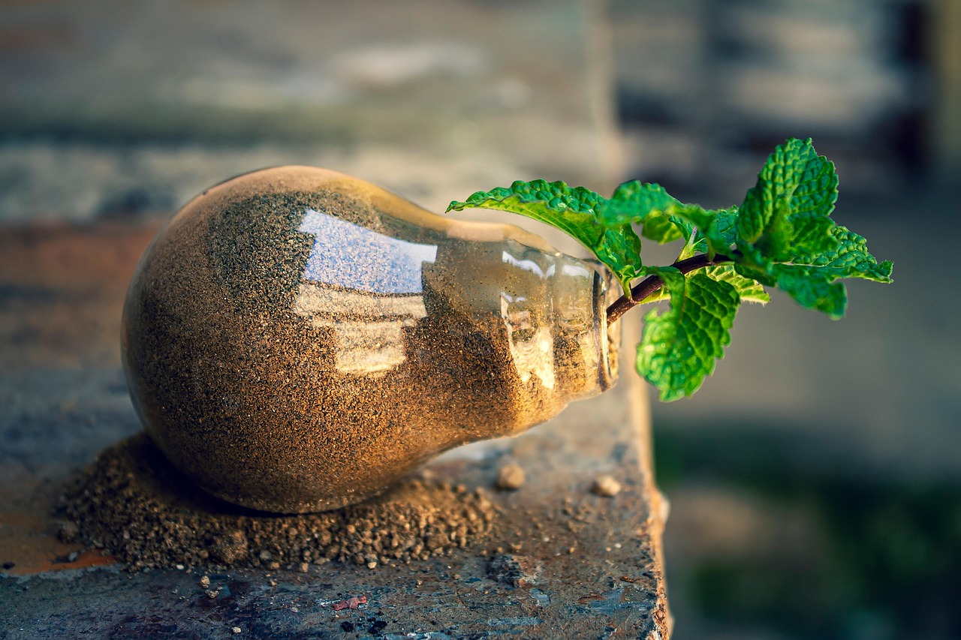
Eco-Friendly Practices
01
Reducing Energy Consumption
Eco-friendly practices, such as reducing energy consumption and using public transportation, can help reduce our impact on the environment.
Individuals can make a positive impact by adopting eco-friendly practices and promoting sustainability in their daily lives.
02
Marine Conservation Efforts
Supporting sustainable seafood and reducing plastic use can also promote marine conservation.
Communities can also work together to promote eco-friendly practices and support marine conservation efforts.
03
Promoting Sustainability
Individuals can make a positive impact by adopting eco-friendly practices and promoting sustainability in their daily lives.
Eco-friendly practices, such as reducing energy consumption and using public transportation, can help reduce our impact on the environment.
04
Community Collaboration
Communities can also work together to promote eco-friendly practices and support marine conservation efforts.
Supporting sustainable seafood and reducing plastic use can also promote marine conservation.
8
Marine Conservation: Protecting Our Oceans for Future Generations

Slide 9
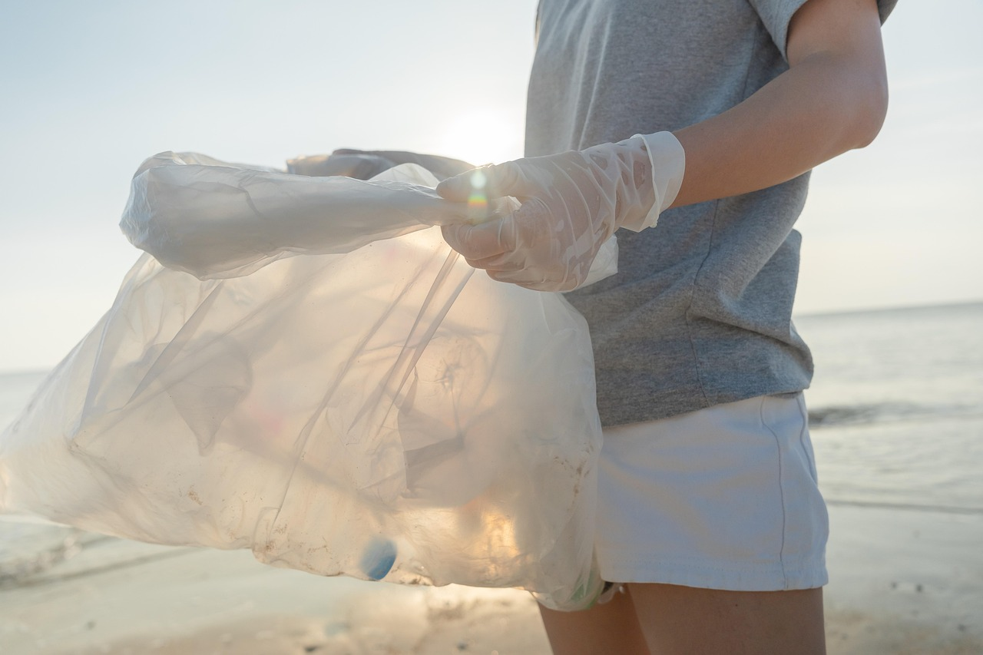
Strategies for Reducing Plastic Waste
01
The Importance of Reducing Plastic Waste
03
Individual Actions to Minimize Plastic Use
Reducing plastic waste is essential for protecting marine ecosystems and promoting sustainability.
It helps to preserve biodiversity and reduce pollution in our environment.
Individuals can make a positive impact by reducing their use of plastic bags, water bottles, and straws.
Small changes in daily habits can collectively lead to significant environmental benefits.
02
Effective Strategies for Plastic Waste Reduction
04
Community Efforts for Sustainable Practices
Strategies for reducing plastic waste include recycling, composting, and reducing single-use plastics.
These methods can significantly decrease the amount of plastic entering landfills and oceans.
Communities can work together to implement recycling programs and promote sustainable practices.
Collaborative efforts can create long-term solutions for managing plastic waste effectively.
9
Marine Conservation: Protecting Our Oceans for Future Generations

Slide 10
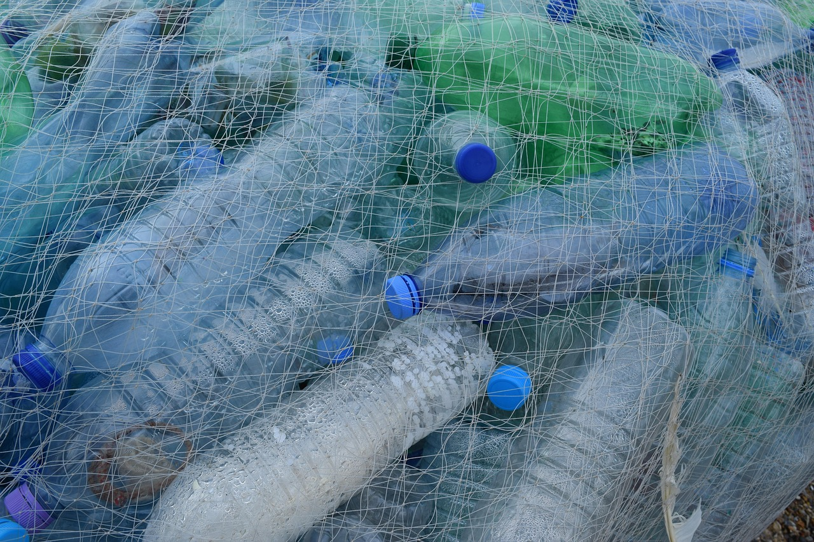
Creating a Plan for Marine Conservation
Developing a Community Plan
Strategies for Marine Conservation
Students will create a plan for promoting marine conservation and sustainability in their local community.
The plan should address key environmental challenges and propose actionable solutions.
The plan should include strategies for reducing plastic waste, protecting marine habitats, and supporting eco-friendly practices.
These strategies should be practical and tailored to the specific needs of the community.
Community-Centric Approach
Comprehensive Action Plan
Students should consider the needs and interests of their community when developing their plan.
Engaging local stakeholders and understanding community dynamics are essential for success.
The plan should be comprehensive and include specific actions and goals for promoting marine conservation.
Clear objectives and measurable outcomes will ensure the effectiveness of the conservation efforts.
10
Marine Conservation: Protecting Our Oceans for Future Generations

Slide 11
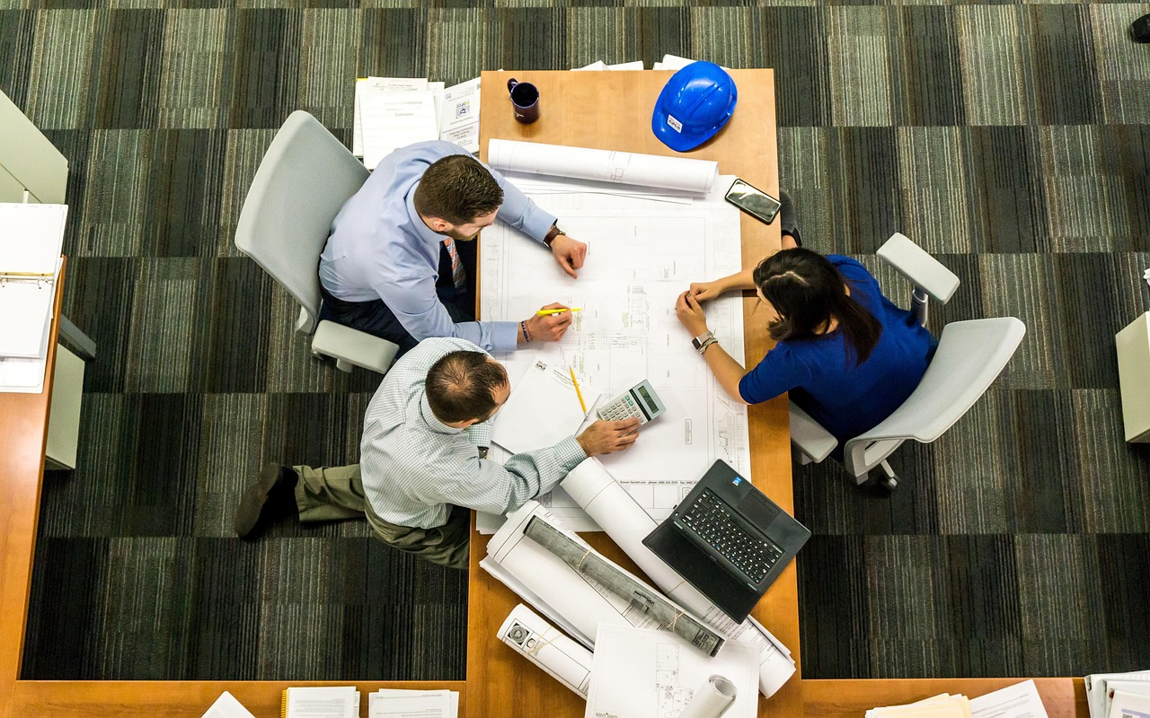
Implementing the Plan
Collaborative Efforts
Resource Planning
Students will work together to implement their plan for promoting marine conservation and sustainability.
The implementation should include specific actions and tasks for each member of the group.
Students should consider the resources and support needed to implement their plan.
This ensures that all necessary tools and assistance are accounted for during the execution.
Monitoring Progress
Evaluating Effectiveness
The implementation should be monitored to track its progress.
This helps in identifying areas that need adjustments or improvements.
The implementation should be evaluated to ensure its effectiveness.
This step is crucial for understanding the impact of the plan and making necessary refinements.
11
Marine Conservation: Protecting Our Oceans for Future Generations

Slide 12
Evaluating the Plan
Evaluating Plan Effectiveness
Challenges and Successes
Informing Future Actions
Focus on Marine Conservation Goals
Students will evaluate the effectiveness of their plan for promoting marine conservation and sustainability.
The evaluation should include an assessment of the plan's impact on reducing plastic waste, protecting marine habitats, and supporting eco-friendly practices.
Students should consider the challenges and successes of implementing their plan.
This reflection will help identify areas for improvement and celebrate achievements.
The evaluation should inform future plans and actions for promoting marine conservation.
Students can use insights gained to develop more effective strategies.
The evaluation process emphasizes the importance of reducing plastic waste and protecting marine habitats.
It also highlights the need to support eco-friendly practices for sustainability.
12
Marine Conservation: Protecting Our Oceans for Future Generations

Slide 13
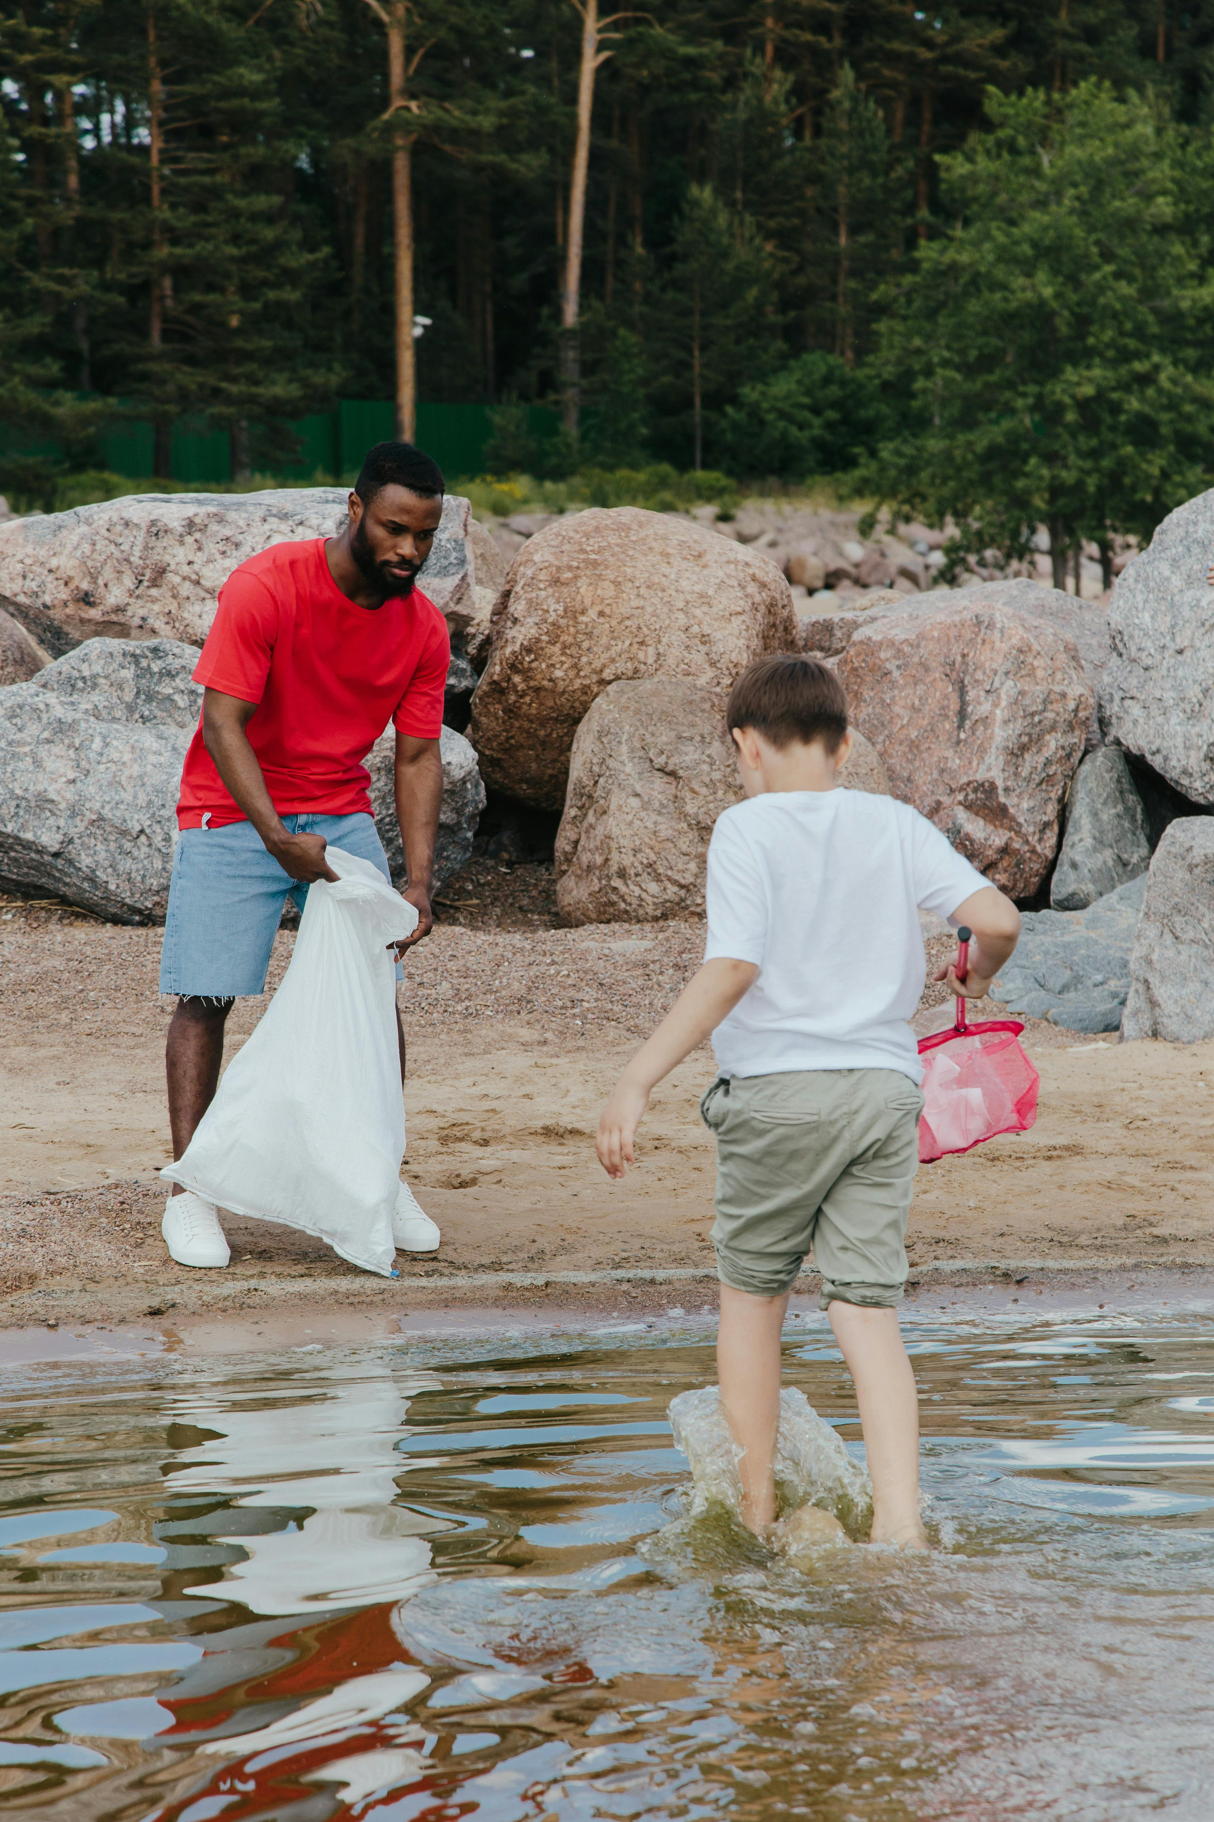
Conclusion
The Importance of Marine Conservation
Educational Insights on Sustainability
Collaborative Efforts for Ocean Health
Marine conservation is a critical issue that requires the active participation of individuals, communities, and governments.
By working together, we can make a positive impact on the health of our oceans and the planet.
Students have learned about the importance of marine conservation.
They have also explored strategies for promoting sustainability.
Marine conservation emphasizes the need for collective action.
This collaboration ensures the preservation of marine ecosystems for future generations.
13
Marine Conservation: Protecting Our Oceans for Future Generations

Slide 14
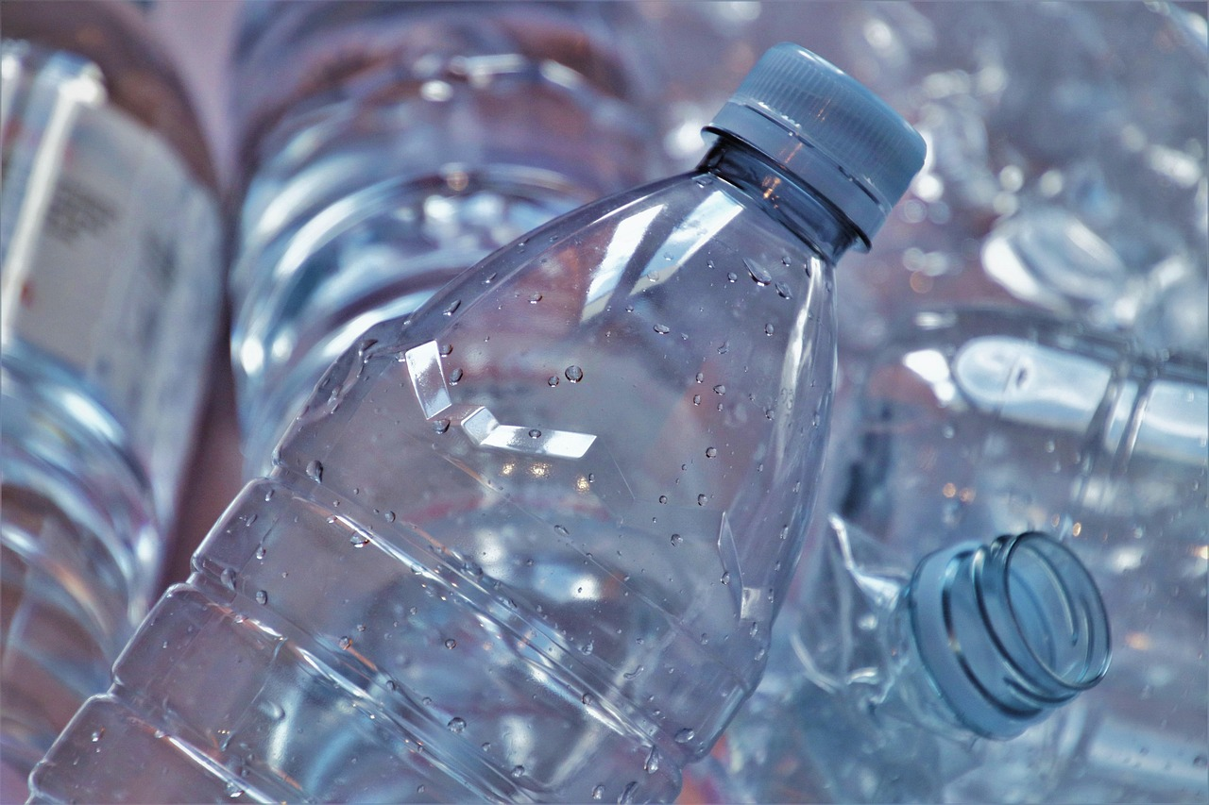
Key Takeaways
1
Reducing Plastic Waste
Reducing plastic waste is essential for protecting marine ecosystems.
It helps in minimizing pollution and safeguarding aquatic life.
2
Preserving Marine Habitats
Protecting marine habitats is crucial for preserving biodiversity and supporting marine life.
Healthy habitats ensure the survival of diverse species.
3
Promoting Eco-Friendly Practices
Supporting eco-friendly practices can help promote marine conservation and sustainability.
These practices contribute to a healthier and more balanced marine environment.
14
Marine Conservation: Protecting Our Oceans for Future Generations

Slide 15

Next Steps
Developing a Conservation Plan
Community Engagement and Feedback
Ongoing Learning and Impact
Students will continue to work on their plan for promoting marine conservation and sustainability.
This involves creating actionable steps to address environmental challenges.
Students will share their plan with their community and gather feedback.
This process will help refine their ideas and ensure broader support.
Students will continue to learn about marine conservation and sustainability and explore ways to make a positive impact.
This includes staying informed and identifying new opportunities for environmental advocacy.
15
Marine Conservation: Protecting Our Oceans for Future Generations

Slide 16

Resources
Interactive Marine Conservation Games
Educational Resources on Marine Conservation
National Geographic Kids offers interactive games, videos, and articles.
These resources focus on marine conservation and sustainability.
Marine Conservation Institute is a non-profit organization.
It provides educational materials and resources on marine conservation.
Understanding Plastic Pollution
Exploring Oceans Virtually
Plastic Pollution Coalition is a non-profit organization.
It offers educational resources and materials on plastic pollution.
Google Earth is a digital tool for exploring the ocean.
Students can learn about ecosystems in a virtual environment.
16
Marine Conservation: Protecting Our Oceans for Future Generations

Slide 17
Field Experiment Activities
01
Beach Cleanup Initiative
Organize a beach cleanup event where students can collect and analyze the types of trash they find.
This activity helps raise awareness about pollution and encourages community involvement.
02
Marine Debris Survey
Conduct a survey of marine debris in a local waterway or ocean, and analyze the results to identify patterns and trends.
This survey provides valuable data for understanding the impact of human activities on marine ecosystems.
03
Water Quality Testing
Test the water quality of a local waterway or ocean, and analyze the results to identify areas for improvement.
This activity promotes environmental stewardship and highlights the importance of clean water sources.
04
Marine Life Survey
Conduct a survey of marine life in a local waterway or ocean, and analyze the results to identify patterns and trends.
This survey helps in monitoring biodiversity and assessing the health of aquatic ecosystems.
17
Marine Conservation: Protecting Our Oceans for Future Generations

Slide 18
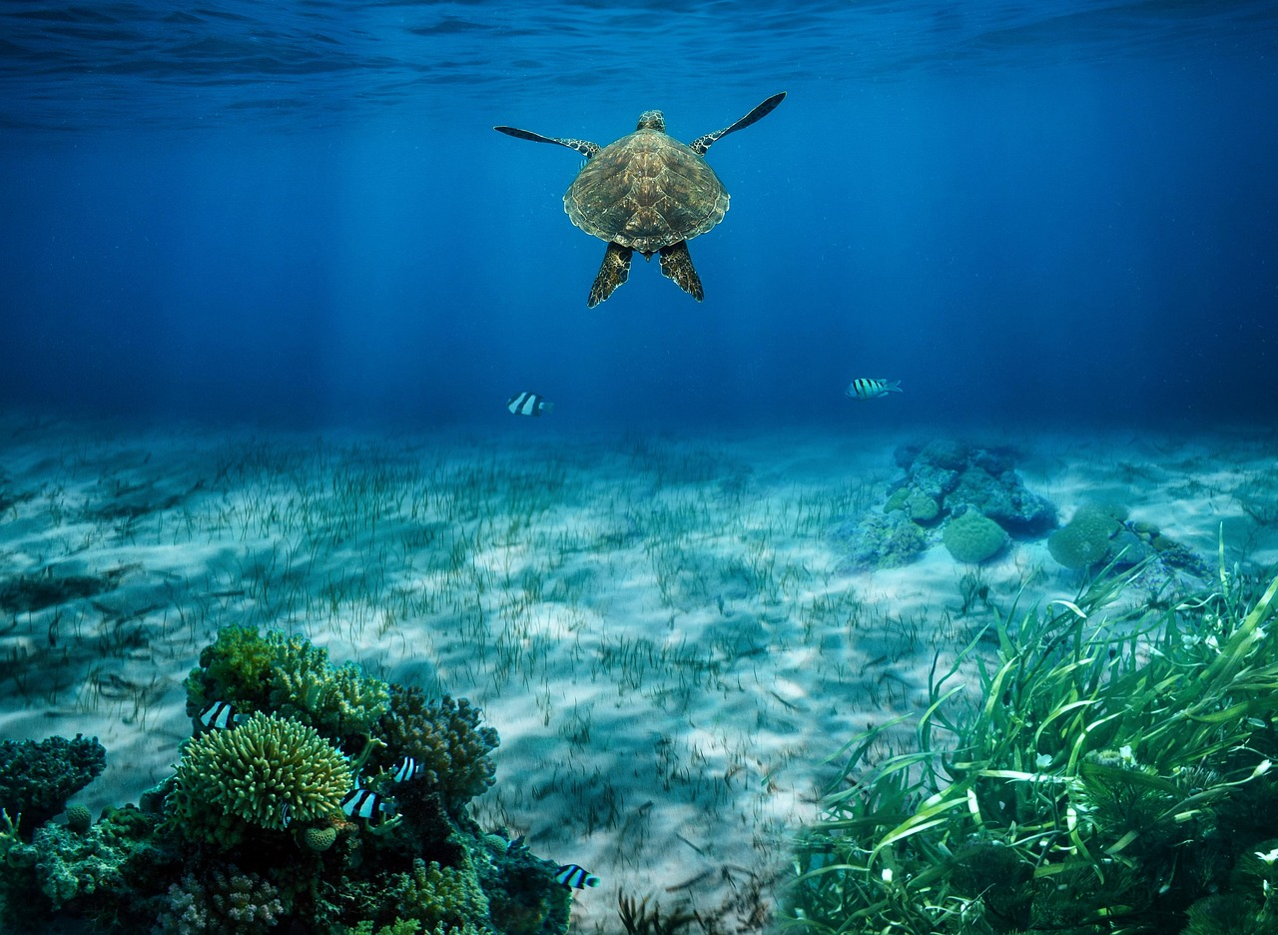
STEM Activities
Marine Ecosystem Modeling
Water Quality Monitoring
Create a model of a marine ecosystem, including the relationships between different species and their habitats.
This activity helps in understanding the interdependence of marine life and their environments.
Monitor the water quality of a local waterway or ocean, and analyze the results to identify areas for improvement.
This hands-on activity promotes awareness of environmental health and pollution control.
Marine Debris Analysis
Sustainable Fishing Methods
Analyze the types and amounts of marine debris in a local waterway or ocean, and identify patterns and trends.
This analysis aids in recognizing human impact on marine environments and finding solutions.
Learn about sustainable fishing methods, such as catch-and-release fishing, and participate in a fishing trip to practice these methods.
This activity emphasizes the importance of conservation and responsible fishing practices.
18
Marine Conservation: Protecting Our Oceans for Future Generations

Slide 19
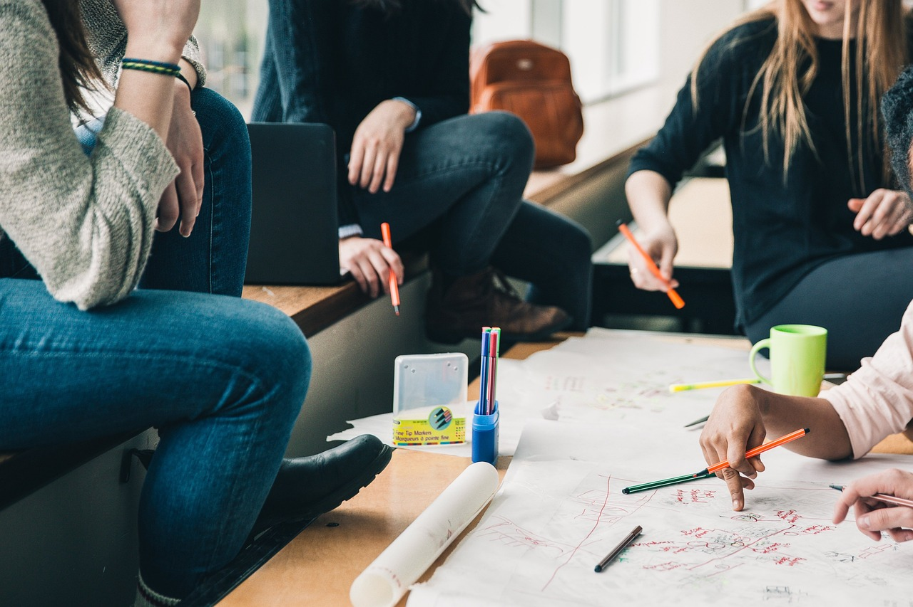
Parent Engagement
Parent-Student Marine Conservation Project
Marine Conservation Workshop
Parent-Teacher Marine Conservation Committee
Parents and students will work together to develop and implement a marine conservation project in their local community.
This initiative fosters collaboration and environmental awareness among families.
The school will host a marine conservation workshop for parents.
Parents will learn about the importance of marine conservation and sustainability.
The school will establish a parent-teacher marine conservation committee.
Parents and teachers will collaborate to develop and implement marine conservation initiatives.
19
Marine Conservation: Protecting Our Oceans for Future Generations

Slide 20
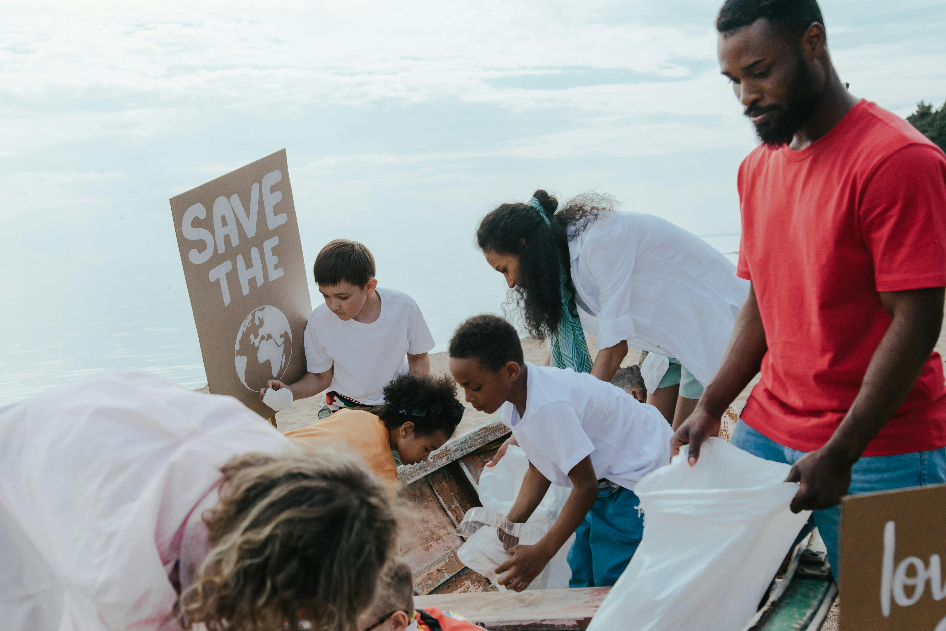
Conclusion and Final Thoughts
1
The Importance of Marine Conservation
Marine conservation is a critical issue that requires the active participation of individuals, communities, and governments.
By working together, we can make a positive impact on the health of our oceans and the planet.
2
Educational Insights on Sustainability
Students have learned about the importance of marine conservation.
They have also explored strategies for promoting sustainability.
3
Collaborative Efforts for Ocean Health
Marine conservation emphasizes the need for collective action.
This collaboration ensures the preservation of marine ecosystems and the planet's well-being.
20
Marine Conservation: Protecting Our Oceans for Future Generations

