Slide 1
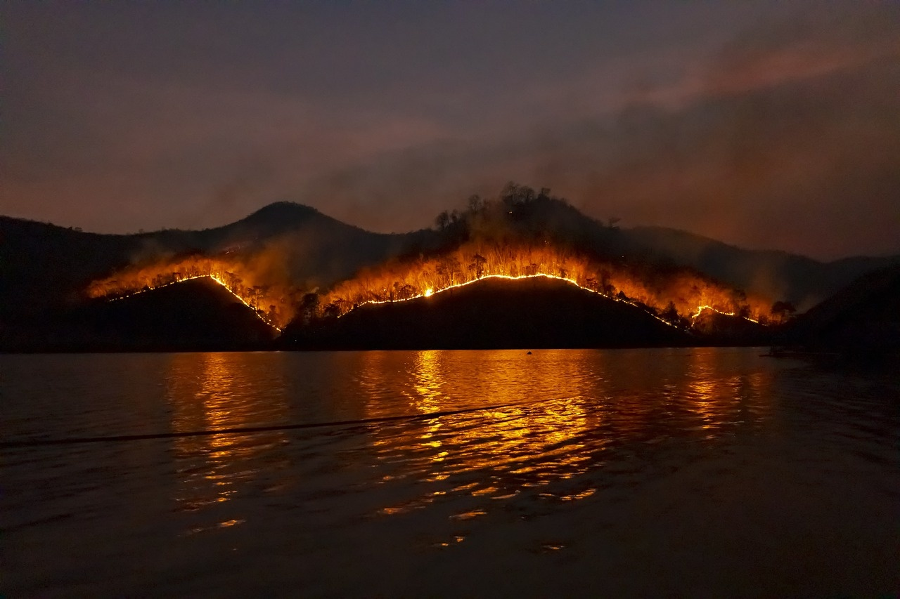
Understanding and Addressing Wildfires
Exploring the Impact, Challenges, and Solutions

Slide 2
Table of contents
01
02
03
04
05
06
07
08
09
10
11
Introduction
Fire Origin
Fire Spread Mechanics
Social Impact
Technological Limitations
Reconstruction Strategies
Long-Term Consequences
Scientific Understanding
Comparative Analysis
Conclusion and Reflection
Key Focus Points

Slide 3
Table of contents
12
13
14
15
16
17
18
19
20
Detailed Content
Key Exploration Areas
Focus Dimensions
Exploration Components
Key Analysis Areas
Focus Components
Exploration Areas
Key Reflection Points
Comprehensive Recommendations

Slide 4
1
Introduction
01
02
03
04
Date of Fire
Location
Background Knowledge Required
Teaching Strategy
September 2-6, 1666
London, England
Medieval urban architectural structures
Social hierarchy in 17th-century England
Basic understanding of wooden construction techniques
Use high-contrast visual maps
Incorporate dyslexia-friendly design elements
Provide tactile timeline representations
Understanding and Addressing Wildfires

Slide 5
2
Fire Origin
01
02
03
Thomas Farriner's Bakery on Pudding Lane
Precise location and circumstances of fire start
Meteorological conditions contributing to fire spread
Origin of the Great Fire of London
Key details about the bakery and its operations
Exact spot where the fire began
Events leading up to the ignition
Weather conditions in 1666 London
Impact of wind and dry conditions on fire spread
Understanding and Addressing Wildfires

Slide 6
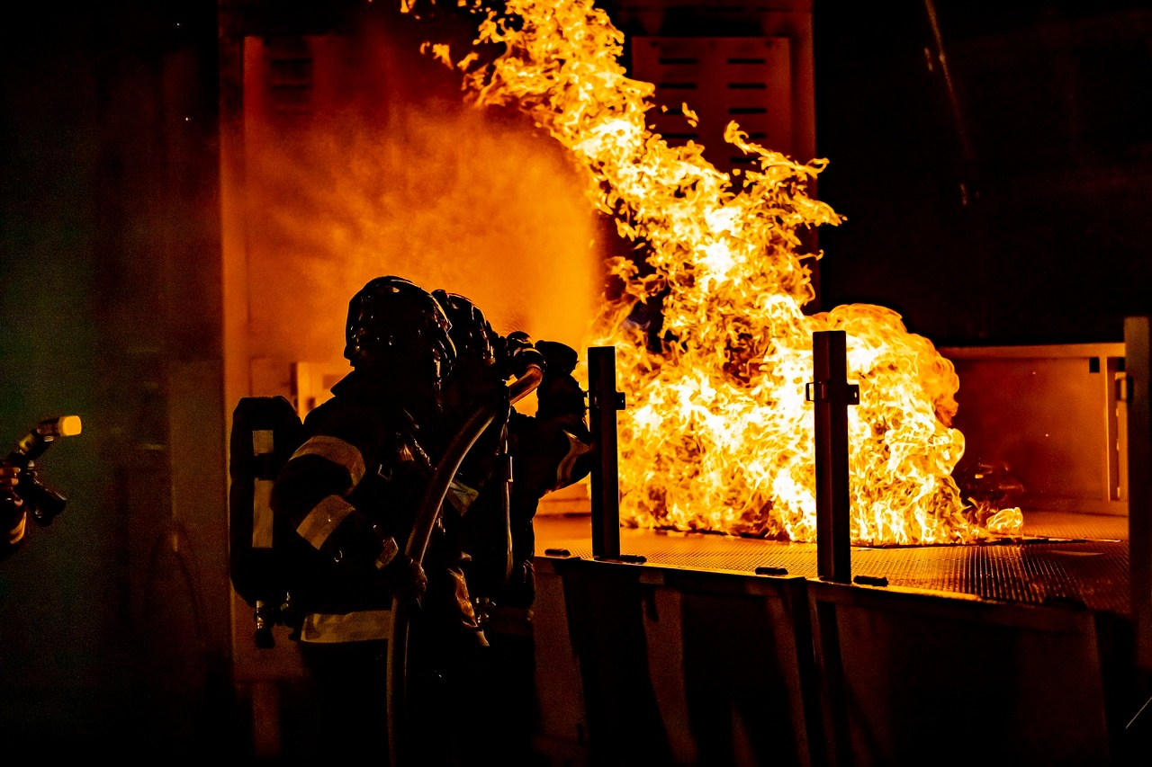
3
Fire Spread Mechanics
01
Wind Conditions
02
Building Proximity
Wind speed and direction significantly influence fire spread.
Higher wind speeds can carry embers over long distances, igniting new fires.
Understanding local wind patterns is crucial for predicting fire behavior.
Close proximity of buildings can facilitate rapid fire spread.
Fire can jump from one building to another, especially in densely populated areas.
Urban planning must consider safe distances between structures to mitigate fire risks.
03
Flammable Construction Materials
Certain materials, like wood and synthetic polymers, are highly flammable.
Using fire-resistant materials can significantly reduce fire spread.
Building codes often specify the use of non-combustible materials in high-risk areas.
Understanding and Addressing Wildfires

Slide 7
4
Social Impact
01
02
03
Population Displacement
Economic Disruption
Community Resilience
Thousands left homeless
Migration to surrounding areas
Loss of businesses and livelihoods
Impact on trade and commerce
Volunteer efforts in rebuilding
Strengthening of social bonds
Understanding and Addressing Wildfires

Slide 8
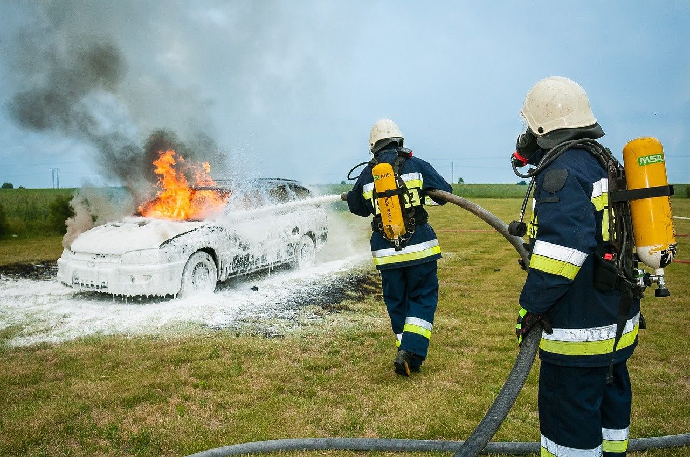
5
Technological Limitations
01
Firefighting capabilities in 1666
02
Communication challenges
Limited water supply
Manual firefighting equipment
Lack of organized fire brigades
No telecommunication systems
Slow dissemination of information
Reliance on messengers
03
Resource management
Scarcity of firefighting resources
Inefficient allocation of available resources
Dependence on local community efforts
Understanding and Addressing Wildfires

Slide 9
6
Reconstruction Strategies
01
02
03
Urban Redesign Principles
Architectural Innovations
Christopher Wren's Contributions
Incorporating wider streets for better ventilation and firebreaks
Implementing stone and brick construction for fire resistance
Introduction of fireproof materials like slate and tile roofs
Adoption of new building codes emphasizing safety and durability
Leading architect in the post-fire reconstruction efforts
Designing iconic landmarks such as St. Paul's Cathedral
Understanding and Addressing Wildfires

Slide 10

7
Long-Term Consequences
01
Urban Development Changes
02
Building Regulation Evolution
Expansion of fire-resistant building materials
Implementation of wider streets for better fire prevention
Introduction of stricter fire safety codes
Establishment of fire brigades for quicker response
03
Cultural Memory Transformation
Commemoration of the Great Fire in art and literature
Shift in architectural styles towards fire-resistant designs
Understanding and Addressing Wildfires

Slide 11

8
Scientific Understanding
Fire Dynamics
Understanding the behavior of fire in different environments
Factors influencing fire spread and intensity
Material Science
Study of how materials react to fire and heat
Importance of material selection in fire-resistant construction
Combustion Principles
Chemical reactions involved in the process of combustion
Effects of oxygen, heat, and fuel on fire development
Understanding and Addressing Wildfires

Slide 12

9
Comparative Analysis
01
Modern Fire Prevention
02
Technological Advancements
Utilization of advanced fire detection systems
Implementation of strict building codes and regulations
Integration of fire-resistant materials in construction
Development of firefighting drones for rapid response
Use of satellite technology for early fire detection
Adoption of AI-powered predictive modeling for fire risk assessment
03
Safety Regulation Evolution
Establishment of national fire safety standards
Regular fire drills and emergency preparedness training
Continuous improvement of evacuation protocols
Understanding and Addressing Wildfires

Slide 13
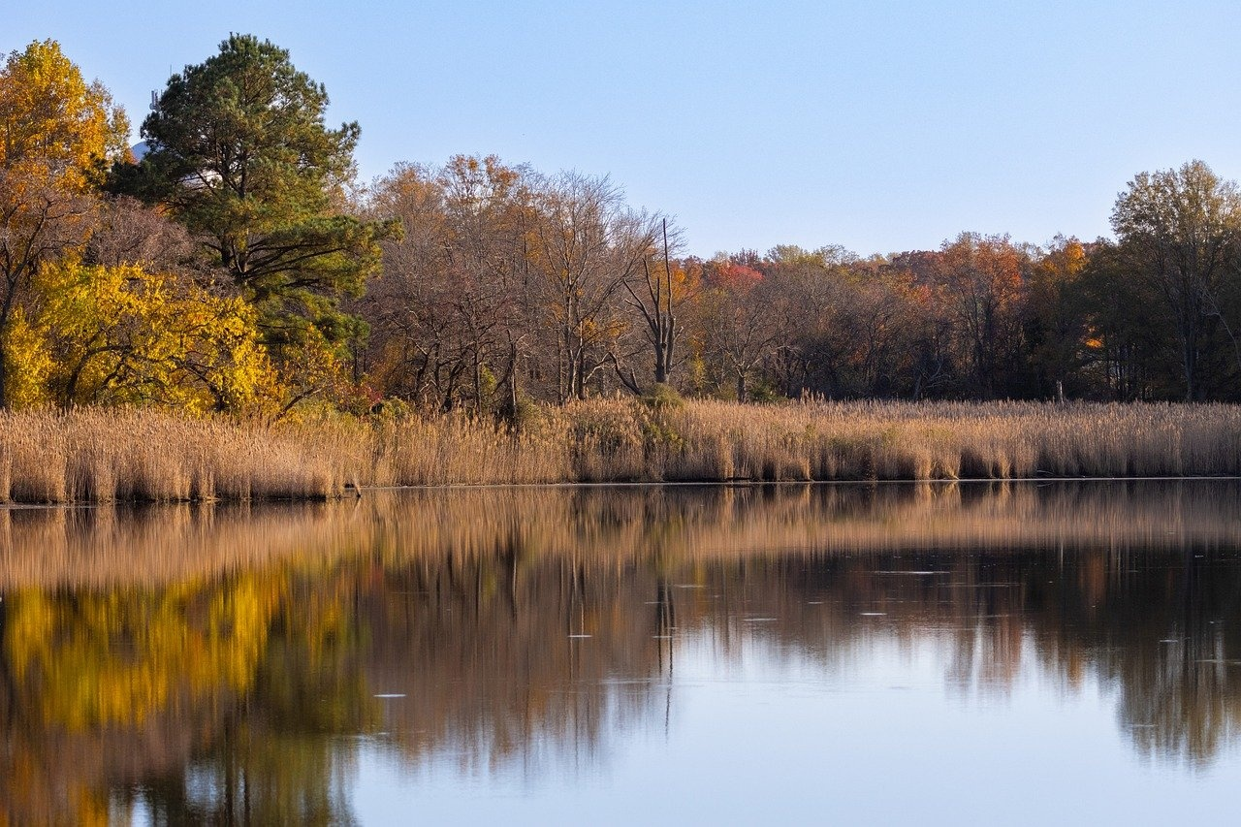
10
Conclusion and Reflection
Lessons Learned
Importance of urban planning in disaster prevention
Significance of community resilience in times of crisis
Historical Resilience
London's ability to rebuild and transform after devastation
Impact of the Great Fire on future city planning and architecture
Urban Transformation Principles
Emphasis on fire safety regulations and building materials
Integration of technological advancements in disaster management
Understanding and Addressing Wildfires

Slide 14

11
Key Focus Points
Date of Fire
September 2-6, 1666
Location
London, England
Medieval Urban Architectural Structures
Narrow streets
Timber-framed houses
Overhanging upper floors
Social Hierarchy in 17th-Century England
Monarchy and nobility
Merchants and tradesmen
Servants and laborers
Wooden Construction Techniques
Timber framing
Wattle and daub
Thatch roofing
Understanding and Addressing Wildfires

Slide 15
12
Detailed Content
01
02
03
04
Date of Fire
Location
Background Knowledge Required
Teaching Strategy
September 2-6, 1666
London, England
Medieval urban architectural structures
Social hierarchy in 17th-century England
Basic understanding of wooden construction techniques
Use high-contrast visual maps
Incorporate dyslexia-friendly design elements
Provide tactile timeline representations
Understanding and Addressing Wildfires

Slide 16
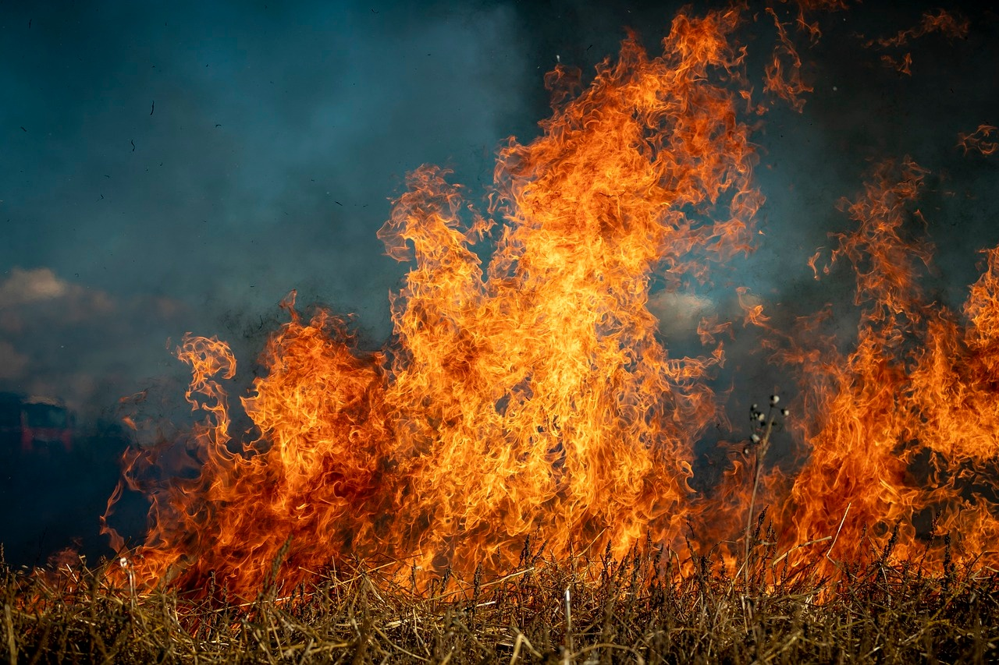
13
Key Exploration Areas
01
Fire Behavior Analysis
02
Impact on Ecosystems
Study of fire spread patterns
Influence of weather conditions
Fuel types and their impact
Effects on flora and fauna
Soil and water quality changes
Long-term ecological consequences
03
Human Factors and Wildfire Management
Role of human activities in wildfire ignition
Community preparedness and response
Policy and management strategies
Understanding and Addressing Wildfires

Slide 17
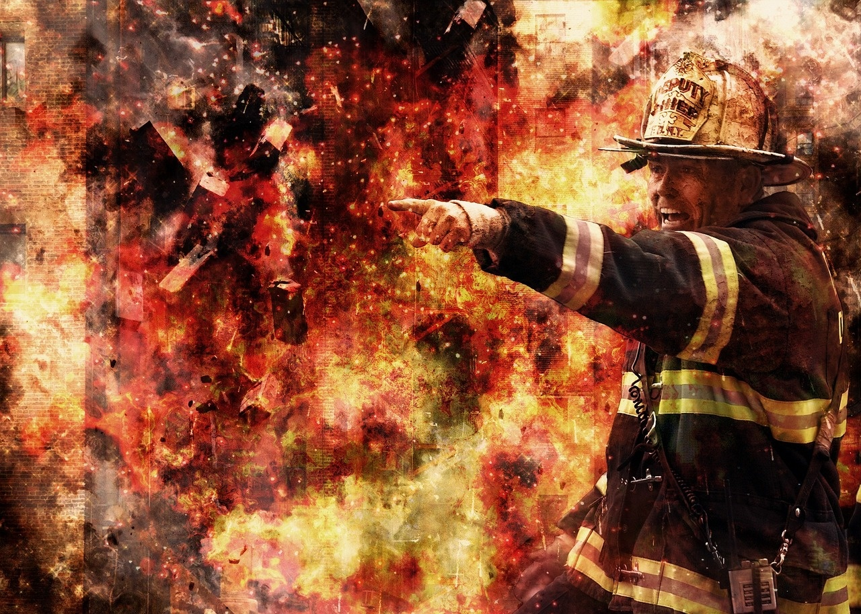
14
Focus Dimensions
01
Wildfire Prevention
02
Early Detection Systems
Implement controlled burns to reduce fuel loads
Enforce fire bans during high-risk periods
Promote fire-resistant landscaping in vulnerable areas
Deploy satellite monitoring for real-time detection
Utilize drones for aerial surveillance
Install ground-based sensors in high-risk zones
03
Community Preparedness
04
Effective Firefighting Strategies
Conduct regular fire drills and evacuation exercises
Distribute educational materials on fire safety
Establish community fire watch programs
Invest in advanced firefighting equipment
Train specialized wildfire response teams
Develop coordinated response plans with local agencies
Understanding and Addressing Wildfires

Slide 18
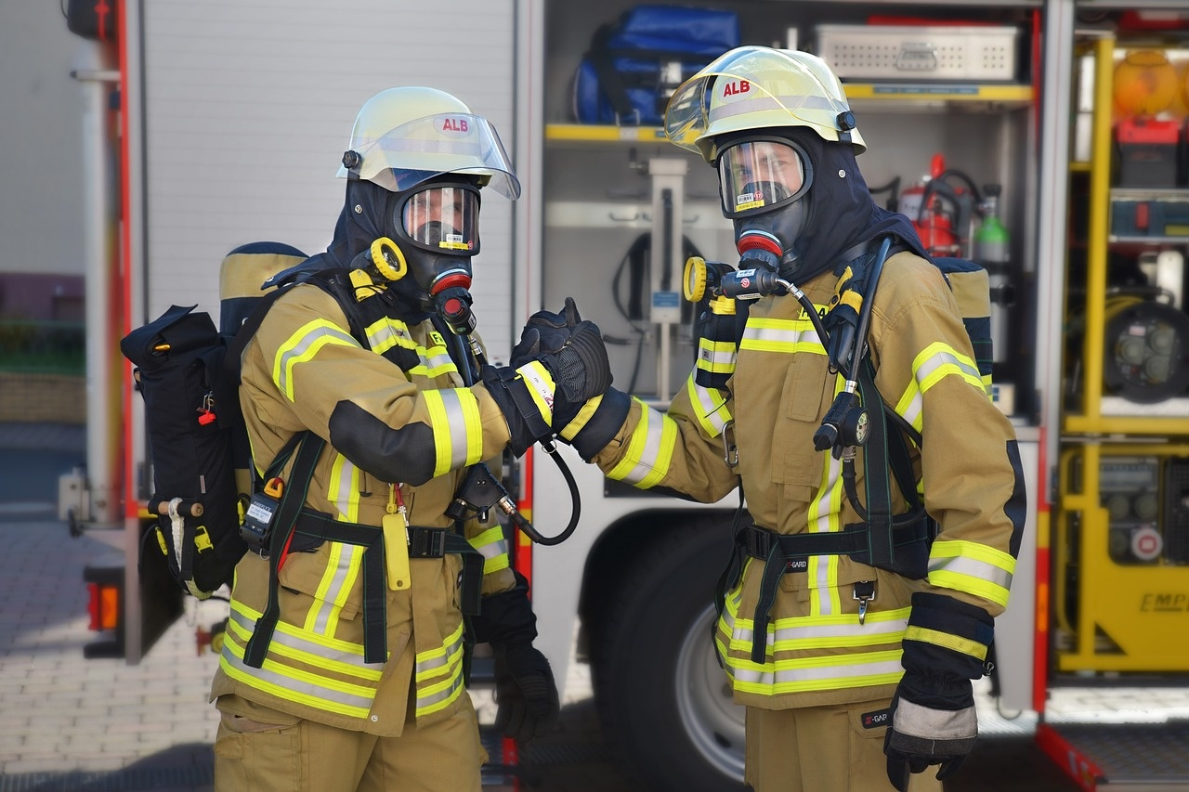
15
Exploration Components
01
Firefighting Capabilities in 1666
02
Communication Challenges
Limited equipment and techniques
Volunteer-based response system
Lack of efficient communication networks
Reliance on word of mouth and physical messengers
03
Resource Management
Scarcity of water sources for firefighting
Challenges in mobilizing manpower and equipment
Understanding and Addressing Wildfires

Slide 19

16
Key Analysis Areas
Exploration Components
Urban redesign principles
Architectural innovations
Christopher Wren's contributions
Background Knowledge Needed
Architectural design principles
Urban planning methodologies
Construction technology advancements
Instructional Techniques
3D model building activities
Digital reconstruction simulations
Collaborative design workshops
Understanding and Addressing Wildfires

Slide 20
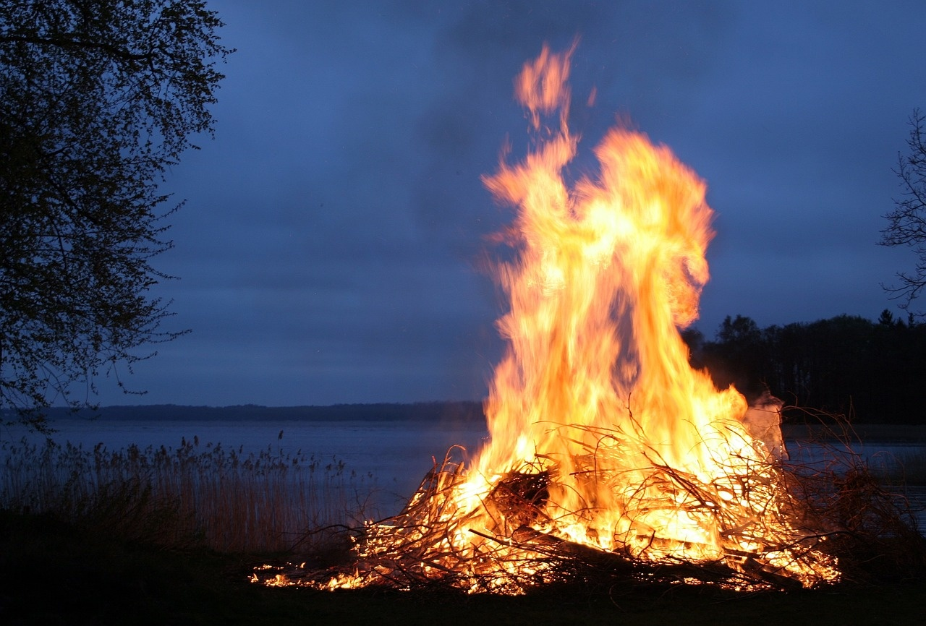
17
Focus Components
01
Fire Dynamics
02
Material Science
Study of how fires start, spread, and develop.
Understanding the behavior of fire in different environments.
Key factors: heat transfer, flame spread, and fire growth.
Analysis of materials and their properties.
Impact of different materials on fire behavior.
Key factors: flammability, thermal conductivity, and structural integrity.
03
Combustion Principles
Fundamentals of combustion reactions.
Types of combustion: complete and incomplete.
Key factors: fuel, oxygen, and heat.
Understanding and Addressing Wildfires

Slide 21

18
Exploration Areas
Key Focus Areas
Fire Behavior Studies
Ecosystem Impacts
Human Factors Analysis
Prevention Strategies
Background Knowledge Required
Understanding of fire ecology
Knowledge of climate change effects on wildfires
Familiarity with community risk assessment
Awareness of firefighting techniques and technologies
Teaching Strategies
Field trips to wildfire-affected areas
Guest lectures from wildfire experts
Interactive simulations of fire spread
Group discussions on prevention measures
Understanding and Addressing Wildfires

Slide 22
19
Key Reflection Points
01
02
03
Lessons Learned
Historical Resilience
Urban Transformation Principles
Understanding past mistakes to avoid future ones
Importance of community involvement
Adaptation to changing circumstances
Survival through economic downturns
Rebuilding after natural disasters
Maintaining cultural heritage
Sustainable development
Inclusive urban planning
Technological integration
Understanding and Addressing Wildfires

Slide 23
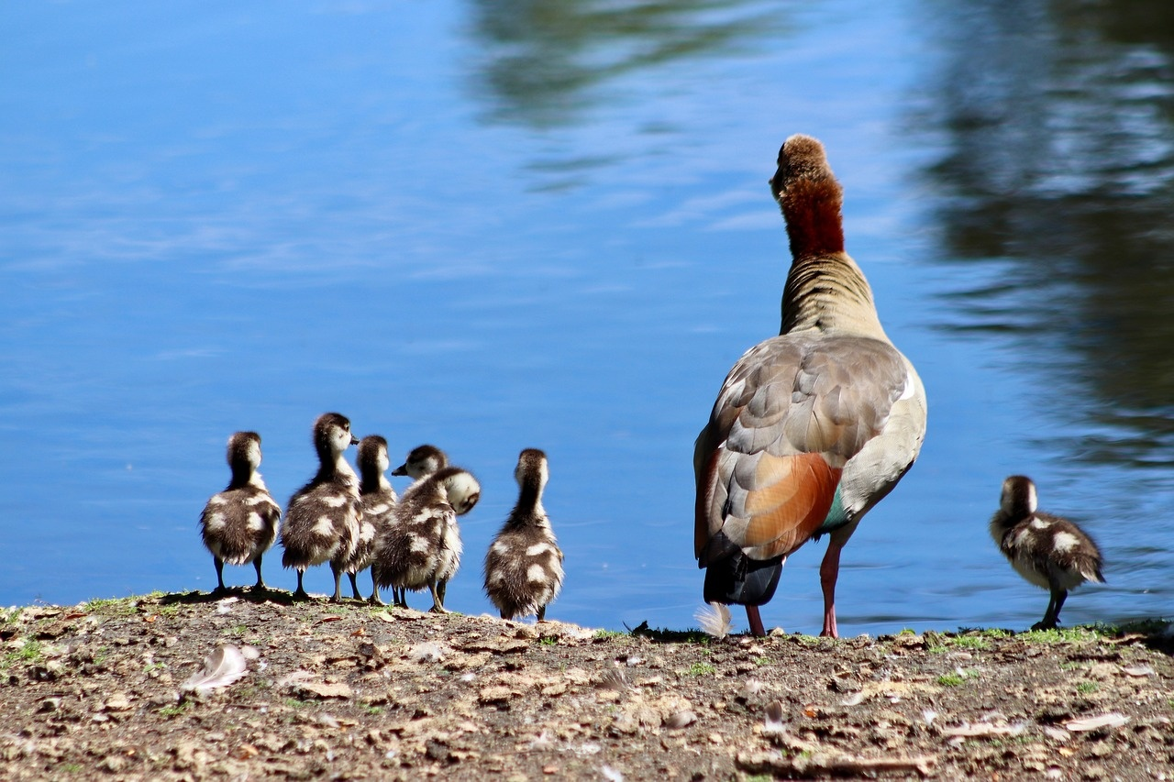
20
Comprehensive Recommendations
01
Utilize Dyslexia-Friendly Design Principles
02
Incorporate Multi-Sensory Learning Approaches
Implement clear typography and high contrast color schemes.
Provide text-to-speech compatibility for accessibility.
Engage students with tactile timeline representations.
Use sensory-rich storytelling approaches for enhanced understanding.
03
Offer Flexible Engagement Options
04
Support Diverse Learning Needs
Allow for interactive problem-solving scenarios.
Provide adaptable presentation modes to support diverse learning needs.
Incorporate visual representation of societal transformation.
Offer alternative format options for varied learning preferences.
Understanding and Addressing Wildfires

