Slide 1

Creating Exciting Stories and Interactive Conversations
Enhancing Creativity, Communication, and Social Skills through Storytelling and Dialogue

Slide 2
Table of Contents
Welcome to Creating Exciting Stories and Inter…
Why Storytelling and Conversations are Importa…
Lesson Introduction: Unleashing Creativity
Icebreaker Activity: Sharing Favorite Stories
Storytelling Basics: Elements of a Story
Creative Writing: Bringing Stories to Life
Role-Playing Conversations: Practicing Communi…
Group Discussion: Reflecting on Conversations
Conclusion and Feedback: Celebrating Progress
Guided Practice: Story Sequencing and Conversa…
Independent Practice: Creative Writing and Con…
Subject Knowledge: The Power of Storytelling
Common Errors and Challenges
04
05
06
07
08
09
10
11
12
13
14
15
16

Slide 3
Table of Contents
FAQs: Answering Your Questions
Objectives and Outcomes: What You Will Learn
Vocabulary Building: Key Terms
Resources and Materials: What You Need
Prior Knowledge and Skills: What You Already K…
Conclusion: Celebrating Your Progress
Next Steps: Continuing Your Journey
17
18
19
20
21
22
23

Slide 4

Welcome to Creating Exciting Stories and Interactive Conversations!
Introduction to Creative Storytelling
Learning Outcomes
Purpose of the Lesson
This lesson plan is designed to introduce 8-year-old students to the world of creative storytelling and interactive conversations.
The key learning objectives include enhancing vocabulary, improving communication skills, and fostering creativity through storytelling.
By the end of this lesson, students will be able to create simple stories, engage in basic conversations.
They will also demonstrate an understanding of the importance of interaction in everyday life.
The lesson aims to make storytelling and conversations exciting and accessible for young learners.
It focuses on building essential skills that contribute to personal and social development.
4
Creating Exciting Stories and Interactive Conversations

Slide 5
Why Storytelling and Conversations are Important
Cognitive and Social Development
Interactive Conversations
Engaging Activities
Building Essential Skills
Storytelling helps develop cognitive skills, enhances imagination, and prepares students for social interactions.
These skills are essential for building relationships, resolving conflicts, and achieving goals.
Interactive conversations teach students how to listen, respond, and engage with their peers in a respectful and meaningful way.
These interactions foster mutual understanding and collaboration among students.
By incorporating a variety of engaging activities and exercises, the lesson plan ensures that students remain captivated throughout.
This approach makes the learning process enjoyable and effective.
Storytelling and conversations equip students with tools for effective communication and problem-solving.
These foundational skills are crucial for personal and academic success.
5
Creating Exciting Stories and Interactive Conversations

Slide 6
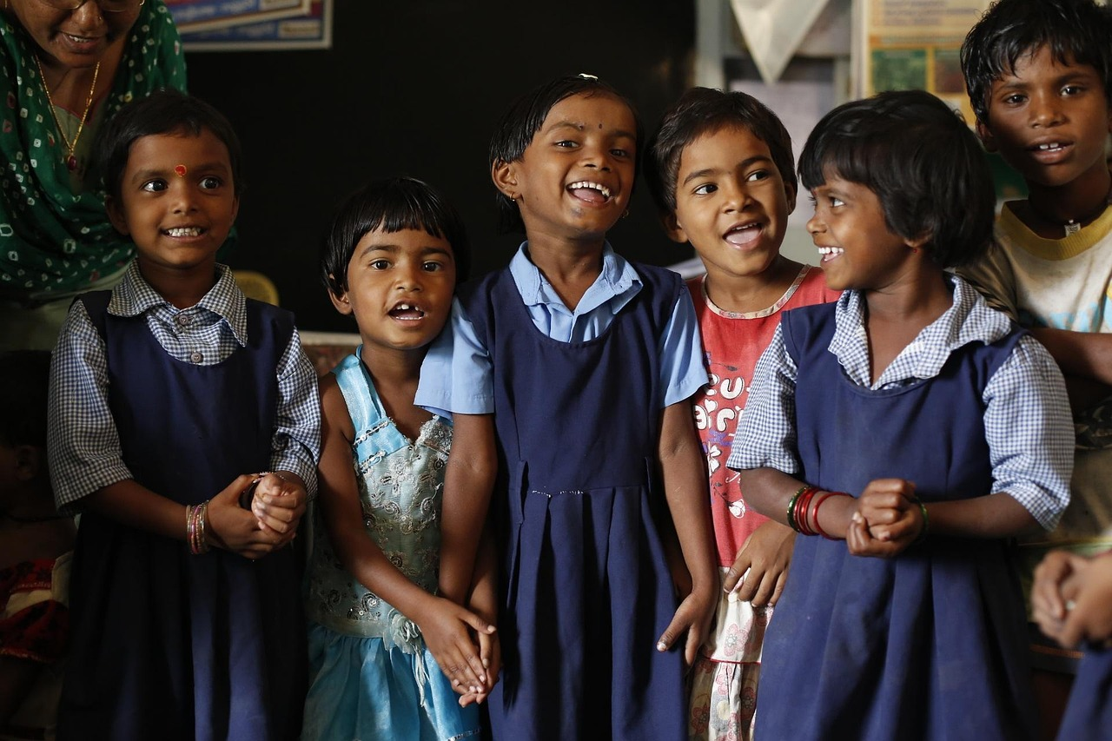
Lesson Introduction: Unleashing Creativity
Welcome to Storytelling
Create and Act
Engage with Friends
Welcome to the exciting world of storytelling and conversations!
This lesson is all about unleashing your creativity and learning how to talk to others in a fun and interesting way.
You will get to create your own stories.
Act them out and bring your imagination to life.
Have conversations with your friends.
Learn to make interactions more enjoyable and engaging.
6
Creating Exciting Stories and Interactive Conversations

Slide 7

Icebreaker Activity: Sharing Favorite Stories
Engaging Start to the Lesson
Purpose of the Icebreaker
To hook students into the lesson, we will start with a fun icebreaker activity where everyone gets to share their favorite story or a time when they had a really interesting conversation.
This will not only help students feel more comfortable with each other but also give us an idea of what they already know about storytelling and conversations.
The activity aims to create a relaxed and open environment for students.
It also serves as a way to gauge their prior knowledge and experiences related to storytelling and conversations.
7
Creating Exciting Stories and Interactive Conversations

Slide 8

Storytelling Basics: Elements of a Story
Structure of a Story
Key Components
A story typically has a beginning, middle, and end.
By understanding the structure of a story, students can create their own compelling narratives.
It includes characters, setting, and plot.
These elements are essential to crafting a cohesive and engaging story.
Descriptive Language
Creative Expression
Students will learn how to use descriptive language to bring their stories to life.
This skill helps in painting vivid pictures and evoking emotions in the reader.
Understanding storytelling basics empowers students to express their creativity.
They can develop unique narratives that captivate their audience.
8
Creating Exciting Stories and Interactive Conversations

Slide 9

Creative Writing: Bringing Stories to Life
Engaging in Creative Writing
Developing Writing Skills
Exploring Personal Experiences
Students will participate in a creative writing exercise where they start writing their own story using the elements discussed.
They will be encouraged to think about their favorite characters, places they've been, or things they've experienced.
This activity will help students develop their writing skills.
It encourages them to think creatively and express themselves in a unique and personal way.
Students will draw inspiration from their own experiences to create compelling stories.
This approach allows them to connect deeply with their writing and enhance their storytelling abilities.
9
Creating Exciting Stories and Interactive Conversations

Slide 10
Role-Playing Conversations: Practicing Communication Skills
Safe Environment for Role-Playing
Active Listening and Thoughtful Responses
Confidence and Effective Interaction
Students will practice their communication skills in a safe and controlled environment through role-playing conversations.
This activity provides a structured setting for meaningful interactions.
They will learn how to listen actively, respond thoughtfully, and engage in meaningful interactions.
These skills are essential for building effective communication.
This activity will help students build their confidence and ability to interact with others effectively.
It fosters personal growth and enhances interpersonal skills.
10
Creating Exciting Stories and Interactive Conversations

Slide 11

Group Discussion: Reflecting on Conversations
Exploring Conversation Dynamics
Understanding Active Listening and Empathy
Students will participate in a group discussion on what makes a conversation interesting.
They will reflect on their own communication styles and think critically about effective conversation strategies.
Students will develop a deeper understanding of the importance of active listening.
They will also explore the role of empathy in fostering meaningful conversations.
11
Creating Exciting Stories and Interactive Conversations

Slide 12
Conclusion and Feedback: Celebrating Progress
Reflecting on Learning and Enjoyment
Feedback and Skill Development
The lesson will conclude with a reflection on what students have learned and enjoyed.
Students will have the opportunity to share their thoughts and experiences from the session.
Students will receive feedback on their participation and creativity, emphasizing the progress they've made.
The feedback will highlight the skills they have developed throughout the lesson.
12
Creating Exciting Stories and Interactive Conversations

Slide 13

Guided Practice: Story Sequencing and Conversation Starters
Engaging Storytelling Activities
Mastering Story Sequencing
Students will participate in guided practice activities, such as story sequencing and conversation starters.
These activities will help students develop their storytelling and conversation skills in a fun and interactive way.
Students will learn how to sequence events in a story.
This skill will enhance their ability to organize and narrate stories effectively.
Initiating Conversations
Building Interaction Skills
Students will practice initiating conversations using open-ended questions.
This will encourage them to engage in meaningful and thoughtful interactions.
Students will also practice responding thoughtfully during conversations.
This will help them build confidence and improve their communication skills.
13
Creating Exciting Stories and Interactive Conversations

Slide 14
Independent Practice: Creative Writing and Conversation Journal
Creative Writing Practice
Conversation Reflection
Personal Expression Development
Students will write their own stories, allowing them to practice their creative writing skills independently.
This activity encourages them to think critically about storytelling and what makes their narratives effective.
Students will reflect on their conversations, analyzing what makes them effective.
This journaling exercise helps them develop critical thinking and communication skills.
Through these activities, students will express themselves in a unique and personal way.
This process aids in enhancing their creative and writing abilities.
14
Creating Exciting Stories and Interactive Conversations

Slide 15
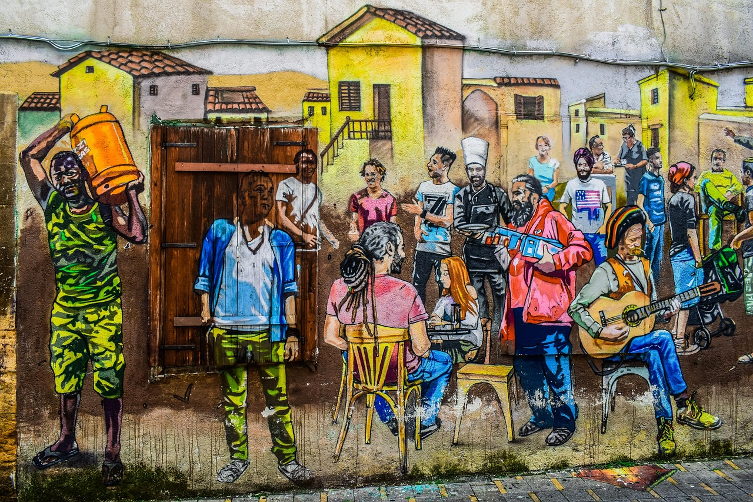
Subject Knowledge: The Power of Storytelling
1
The Universal Language of Storytelling
Storytelling is a universal language that has the power to inspire, educate, and entertain.
It is a fundamental part of human communication, allowing us to share our experiences, cultures, and values with others.
2
The Essence of Human Connection
Storytelling allows us to connect deeply by sharing our unique experiences.
It bridges cultural and personal gaps, fostering understanding and empathy.
3
Crafting Meaningful Narratives
Effective storytelling involves creating a narrative that is engaging, coherent, and meaningful.
This skill transforms simple communication into a powerful tool for impact.
15
Creating Exciting Stories and Interactive Conversations

Slide 16

Common Errors and Challenges
01
Overuse of Clichés
One common error is relying too heavily on clichés and overused plot devices.
This can make storytelling predictable and less engaging.
02
Neglecting Pacing and Structure
Another challenge is neglecting the importance of pacing and plot structure.
Proper pacing ensures the story flows smoothly and keeps the audience interested.
03
Conversation Challenges
Students may also struggle with dominating conversations or interrupting others.
These habits can hinder effective communication and collaboration.
04
Improving Storytelling Skills
By being aware of these potential pitfalls, students can take steps to improve their storytelling and conversation skills.
This awareness fosters growth and enhances their ability to connect with others.
16
Creating Exciting Stories and Interactive Conversations

Slide 17

FAQs: Answering Your Questions
1
Generating Story Ideas
Q: How can I come up with ideas for my stories?
A: Try brainstorming, free writing, or drawing inspiration from real-life events or personal experiences.
2
Enhancing Story Engagement
Q: How can I make my stories more engaging and interactive?
A: Use descriptive language, create believable characters, and incorporate pacing and plot structure.
3
FAQs: Answering Your Questions
Q: How can I come up with ideas for my stories?
A: Try brainstorming, free writing, or drawing inspiration from real-life events or personal experiences.
17
Creating Exciting Stories and Interactive Conversations

Slide 18
Objectives and Outcomes: What You Will Learn
Creating Simple Stories and Conversations
Understanding Interaction in Everyday Life
Developing Vocabulary and Communication Skills
Applying Storytelling Elements
By the end of this lesson, students will be able to create simple stories and engage in basic conversations.
This skill will help them express themselves effectively in everyday scenarios.
Students will demonstrate an understanding of the importance of interaction in everyday life.
This knowledge will enhance their ability to connect and communicate with others.
Students will develop their vocabulary and improve their communication skills.
These improvements will support their ability to articulate ideas and thoughts clearly.
Students will be able to apply the elements of storytelling to create their own short stories.
This activity will foster creativity and encourage imaginative thinking.
18
Creating Exciting Stories and Interactive Conversations

Slide 19

Vocabulary Building: Key Terms
01
Narrative
A story or account of events.
It forms the backbone of storytelling.
02
Character
A person or animal in a story.
They drive the narrative forward.
03
Setting
The time and place in which a story takes place.
It provides context and atmosphere.
04
Plot
The sequence of events in a story.
It outlines the structure and flow of the narrative.
19
Creating Exciting Stories and Interactive Conversations

Slide 20

Resources and Materials: What You Need
Digital Tools for Storytelling
Physical Materials for Creativity
Role-Playing for Communication Skills
Digital tools, such as Storybird or Book Creator, can be used to create and share stories.
These platforms enable users to craft engaging narratives and share them with others.
Physical materials, such as paper, pencils, and markers, can be used for writing and drawing.
These tools are essential for hands-on creative activities and artistic expression.
Role-playing scenarios and conversation starters can be used to practice communication skills.
These activities help individuals develop interpersonal skills and confidence in social interactions.
20
Creating Exciting Stories and Interactive Conversations

Slide 21
Prior Knowledge and Skills: What You Already Know
01
Understanding Storytelling Basics
Students should have a basic understanding of storytelling and conversation skills.
They should be able to identify the elements of a story, such as characters, setting, and plot.
02
Engaging in Conversations
Students should also be able to engage in basic conversations.
They should use active listening and responding skills effectively.
03
Creative Thinking Skills
Students should be able to think creatively.
They should express themselves in a unique and personal way.
04
Expressing Personal Ideas
Students should demonstrate their ability to share personal ideas.
They should do so in a manner that reflects their individuality and creativity.
21
Creating Exciting Stories and Interactive Conversations

Slide 22

Conclusion: Celebrating Your Progress
Celebrating Your Achievement
Embracing Continuous Growth
Congratulations on completing the lesson on creating exciting stories and interactive conversations!
This milestone reflects your dedication and growth in mastering these skills.
Remember to keep practicing your skills, and don't be afraid to try new things and take risks in your writing and conversations.
Your journey of improvement and creativity is just beginning, so keep exploring and innovating.
22
Creating Exciting Stories and Interactive Conversations

Slide 23
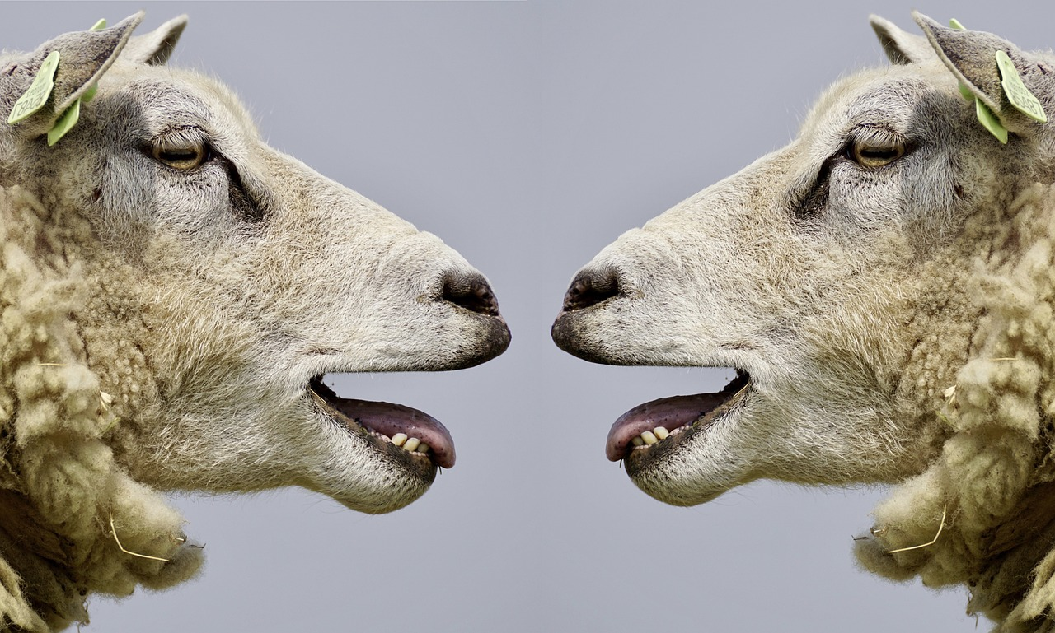
Next Steps: Continuing Your Journey
Exploring Advanced Techniques
Consider continuing your learning journey by exploring more advanced storytelling and conversation techniques.
This will help you refine and expand your communication skills.
Applying Skills in Real Life
You can also try applying your skills in real-life situations, such as in conversations with friends or family members.
This practice will make your storytelling and conversations more natural and engaging.
Embracing Creativity and Fun
Don't forget to have fun and be creative in your storytelling and conversations!
Enjoying the process will make your journey more fulfilling and rewarding.
23
Creating Exciting Stories and Interactive Conversations

