Slide 1
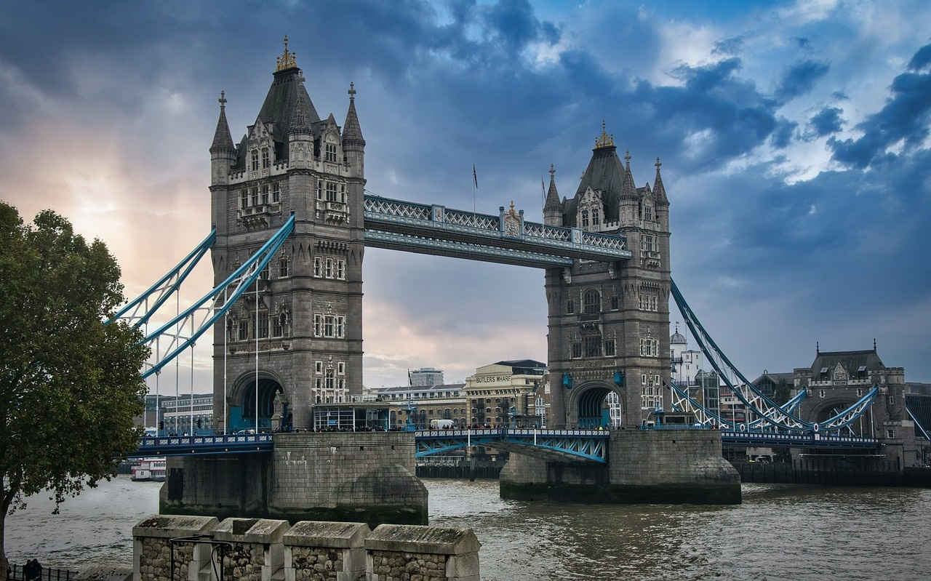
Exploring the Great Fire of London
A Comprehensive Journey Through History, Science, and Society

Slide 2
Table of contents
01
02
03
04
05
06
07
08
09
10
11
The Great Fire of London: A Historical Catastrophe of 1666
The Fire Triangle: Understanding the Great Fire's Spread
Rebuilding London: Architectural Revolution
The Human Story Behind the Great Fire
From Primitive to Progressive: Firefighting Evolution
Engaging Historical Exploration
Lessons from the Great Fire
Our Takeaways
Expanding Our Historical Understanding
Connecting Past, Present, and Future
Medieval London social structures

Slide 3
Table of contents
12
13
14
15
16
17
18
19
20
Technological innovation trajectories
Urban planning and reconstruction strategies
Subject Knowledge - Historical Context of the Great Fire of…
Subject Knowledge - Scientific Understanding of Fire Dynami…
Subject Knowledge - Architectural and Urban Planning Implic…
Subject Knowledge - Social and Economic Impact
Subject Knowledge - Technological Firefighting Advancements
Activities - Interactive Learning Experiences (5-minute seg…
Reflection - Understanding Historical Transformation

Slide 4
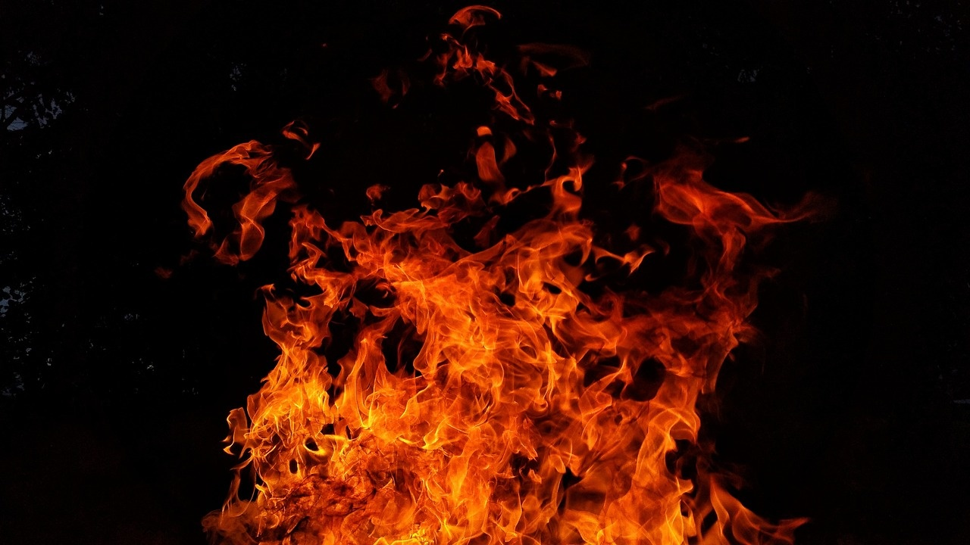
1
The Great Fire of London: A Historical Catastrophe of 1666
Date
September 2-6, 1666
Location
London, England
Precise Origin
Thomas Farriner's Bakery on Pudding Lane
City Characteristics
Densely populated
Predominantly wooden buildings
Narrow, tightly packed streets
Geographical Conditions
Exceptionally dry summer
Wooden infrastructure
Limited firefighting capabilities
Exploring the Great Fire of London

Slide 5
2
The Fire Triangle: Understanding the Great Fire's Spread
01
02
03
04
05
Fire Triangle Components
Temperature Dynamics
Combustion Process
Spread Mechanisms
Factors Accelerating Fire Spread
Fuel: Abundant timber buildings
Oxygen: Concentrated through narrow streets
Heat: Initial spark from bakery oven
Peak temperatures: Up to 1,100 degrees Celsius
Rapid heat transfer mechanisms
Chemical breakdown of carbon-based materials
Oxygen combination releasing massive energy
Thermal radiation
Convection currents
Conductive heat transfer
Wind conditions
Proximity of wooden structures
Lack of fire breaks
Exploring the Great Fire of London

Slide 6
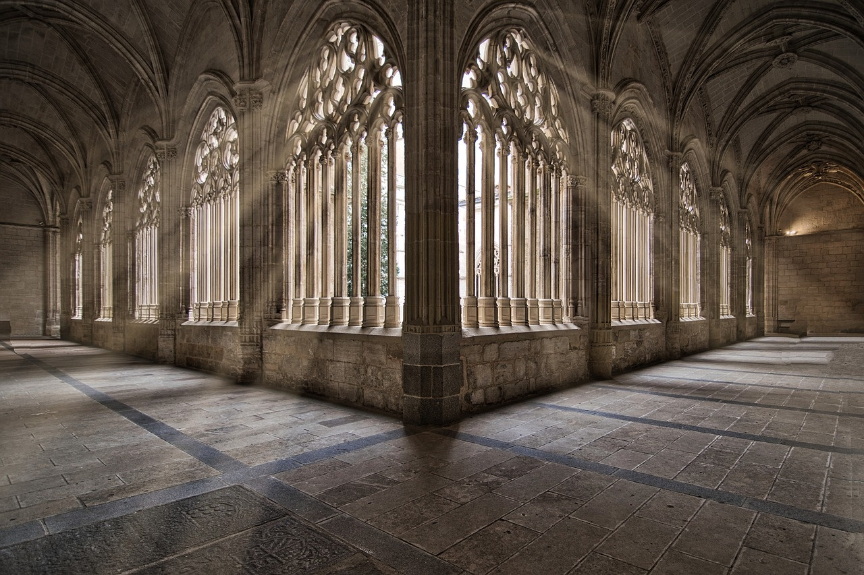
3
Rebuilding London: Architectural Revolution
01
Architectural Innovations
02
Sir Christopher Wren's Contributions
Mandatory stone and brick construction
Wider street designs
Improved drainage systems
Comprehensive urban planning
New building regulations
Systematic city reconstruction
03
Urban Design Principles
04
Long-term Impacts
Better building foundations
Strategic public space placement
Enhanced water management systems
Introduction of building insurance
Advanced fire prevention strategies
Modern urban planning foundations
Exploring the Great Fire of London

Slide 7
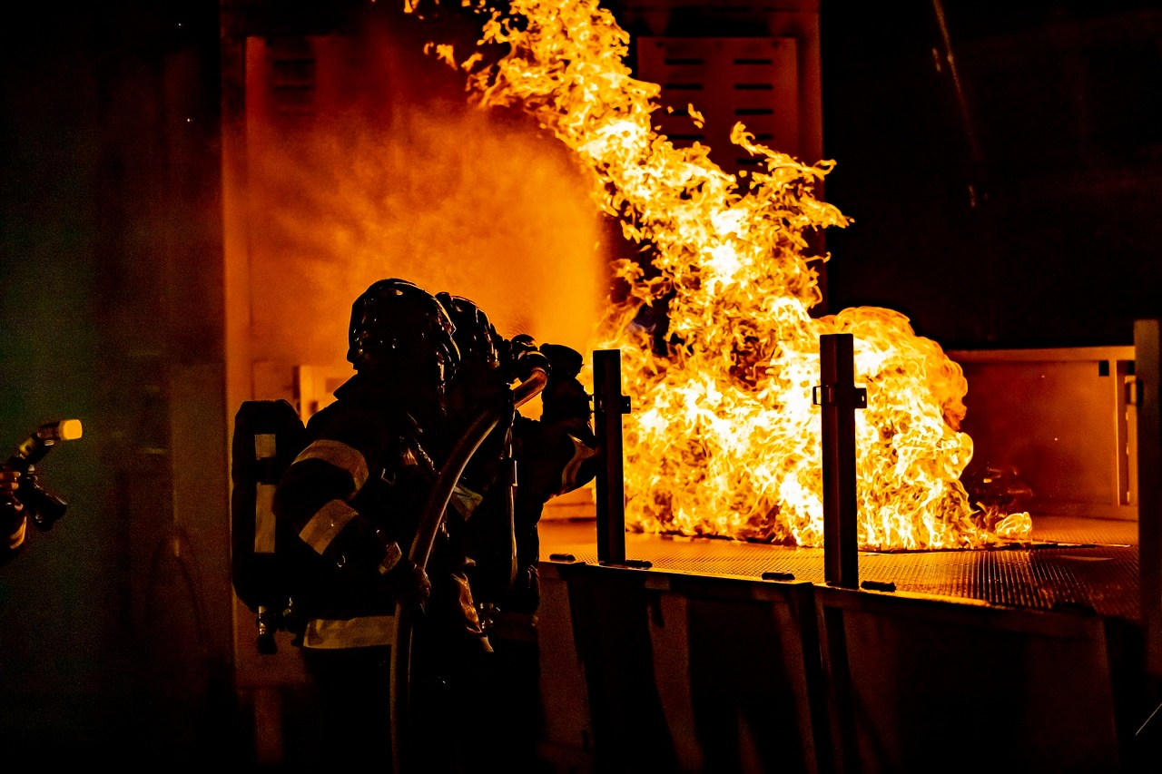
4
The Human Story Behind the Great Fire
Population Displacement
100,000 people left homeless
Massive population movement
Disruption of social hierarchies
Economic Consequences
Destruction of trade networks
Collapse of small businesses
Economic restructuring
Social Mobility
Opportunities for rebuilding
Breaking traditional economic barriers
Demonstration of community resilience
Psychological Impact
Collective trauma
Community adaptation
Resilience and reconstruction efforts
Exploring the Great Fire of London

Slide 8
5
From Primitive to Progressive: Firefighting Evolution
01
02
03
04
Pre-Fire Firefighting Methods
Post-Fire Innovations
Modern Firefighting Technologies
Key Technological Shifts
Leather buckets
Basic hand pumps
Limited water resources
Advanced water pumping systems
Organized firefighting units
Improved emergency response protocols
Sophisticated water distribution
Advanced protective equipment
Systematic urban fire prevention strategies
Transition from reactive to preventive approaches
Development of professional fire services
Integration of scientific understanding
Exploring the Great Fire of London

Slide 9
6
Engaging Historical Exploration
01
02
03
Activity 1: Historical Detective Work
Activity 2: London City Model Building
Activity 3: Fire Spread Simulation
Analyze primary source documents
Use replica historical materials
Develop critical thinking skills
Reconstruct historical urban landscape
Understand architectural challenges
Collaborative group work
Hands-on scientific exploration
Understand fire dynamics
Safe, controlled learning environment
Exploring the Great Fire of London

Slide 10
7
Lessons from the Great Fire
Impact on Urban Design
Community Resilience
Historical Significance
1
2
3
The fire led to mandatory stone and brick construction, wider streets, and improved drainage systems.
Despite the devastation, Londoners came together to rebuild and implement advanced fire prevention strategies.
The Great Fire showcases the importance of adapting to challenges and fostering innovation in urban planning.
Exploring the Great Fire of London

Slide 11
8
Our Takeaways
1
2
3
4
Historical Cause and Effect
Innovation in Urban Planning
Community Resilience
Technological Adaptation
Understanding historical cause and effect relationships
Recognizing the importance of innovation in urban planning and architecture
Appreciating the resilience and strength of communities in times of crisis
Embracing technological adaptation for improved disaster response and prevention
Exploring the Great Fire of London

Slide 12
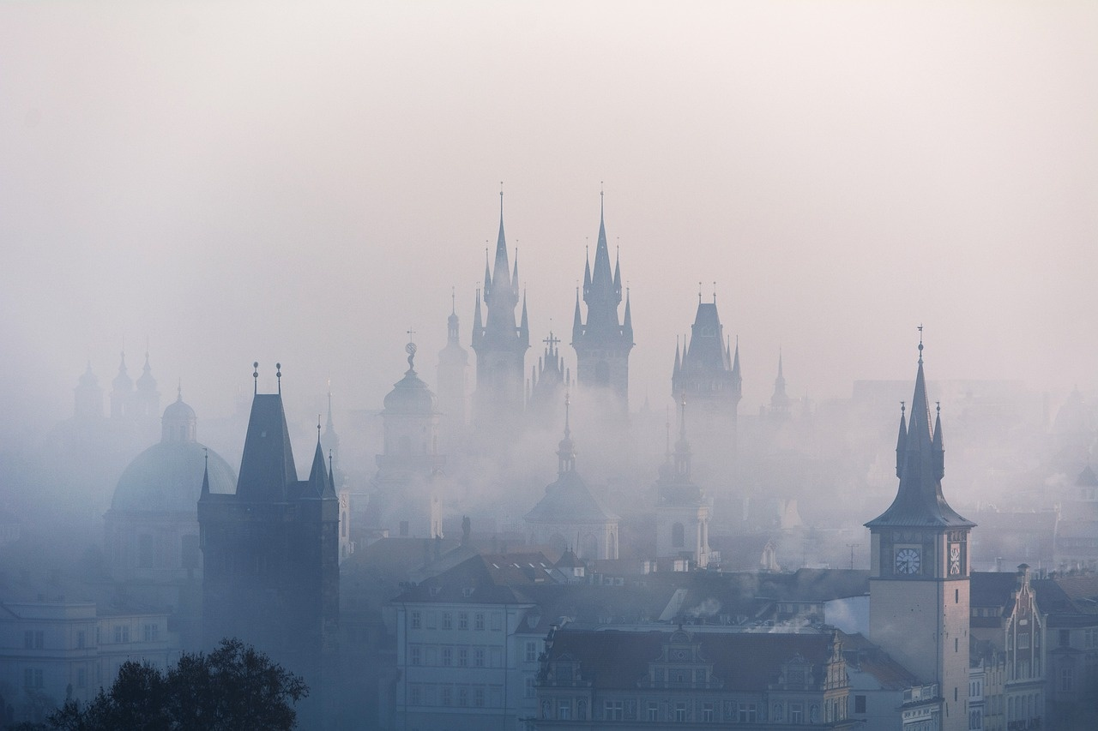
9
Expanding Our Historical Understanding
01
Medieval London Social Structures
02
Technological Innovation Trajectories
Feudal system and class hierarchy
Roles of guilds and trade associations
Impact of religion on daily life
Advancements in agriculture
Development of trade and commerce
Influence of foreign technologies
03
Urban Planning and Reconstruction Strategies
Medieval city layout and design
Rebuilding after the Great Fire of London
Evolution of public infrastructure
Exploring the Great Fire of London

Slide 13
10
Connecting Past, Present, and Future
Emergency response development
Cultural resilience studies
Interdisciplinary historical research
1
2
3
Future learning pathway focusing on enhancing emergency response strategies.
Future learning pathway focusing on understanding and fostering cultural resilience.
Future learning pathway focusing on integrating various disciplines in historical research.
Exploring the Great Fire of London

Slide 14
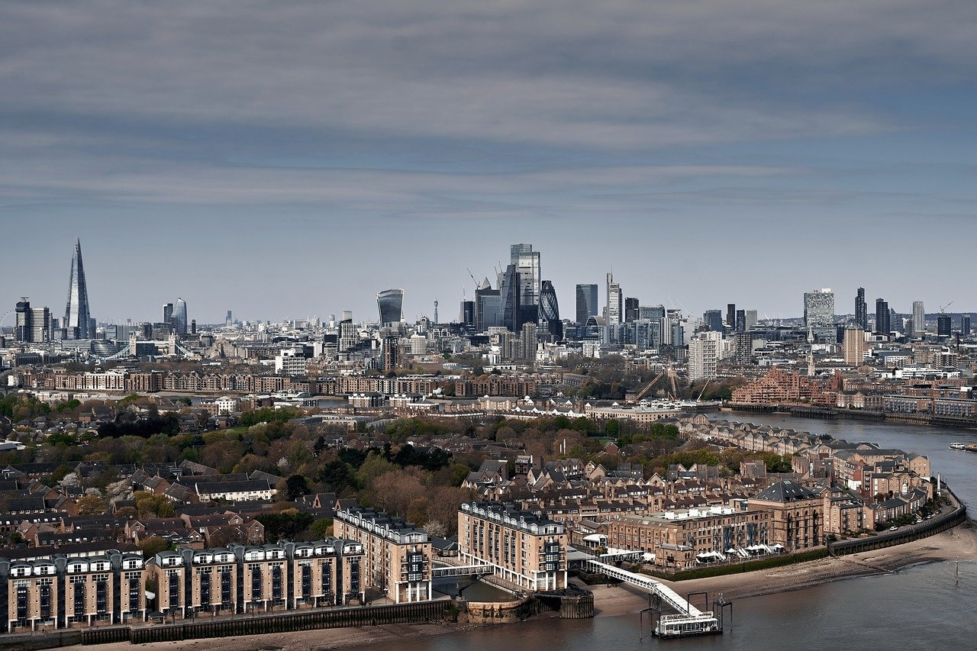
11
Medieval London social structures
01
Feudal System
02
Guild System
Dominant social structure in medieval London
Hierarchical system with kings, nobles, knights, and peasants
Guilds played a crucial role in regulating trade and craftsmanship
Organized into different guilds based on professions
03
Religious Influence
04
Urban Development
Churches and monasteries held significant power and influence
Religious institutions played a central role in daily life
Growth of towns and cities led to the emergence of urban social structures
Distinct neighborhoods and communities within London
Exploring the Great Fire of London

Slide 15
12
Technological innovation trajectories
01
02
03
04
Pre-Fire Firefighting Methods
Post-Fire Innovations
Modern Firefighting Technologies
Key Technological Shifts
Leather buckets
Basic hand pumps
Limited water resources
Advanced water pumping systems
Organized firefighting units
Improved emergency response protocols
Sophisticated water distribution
Advanced protective equipment
Systematic urban fire prevention strategies
Transition from reactive to preventive approaches
Development of professional fire services
Integration of scientific understanding
Exploring the Great Fire of London

Slide 16
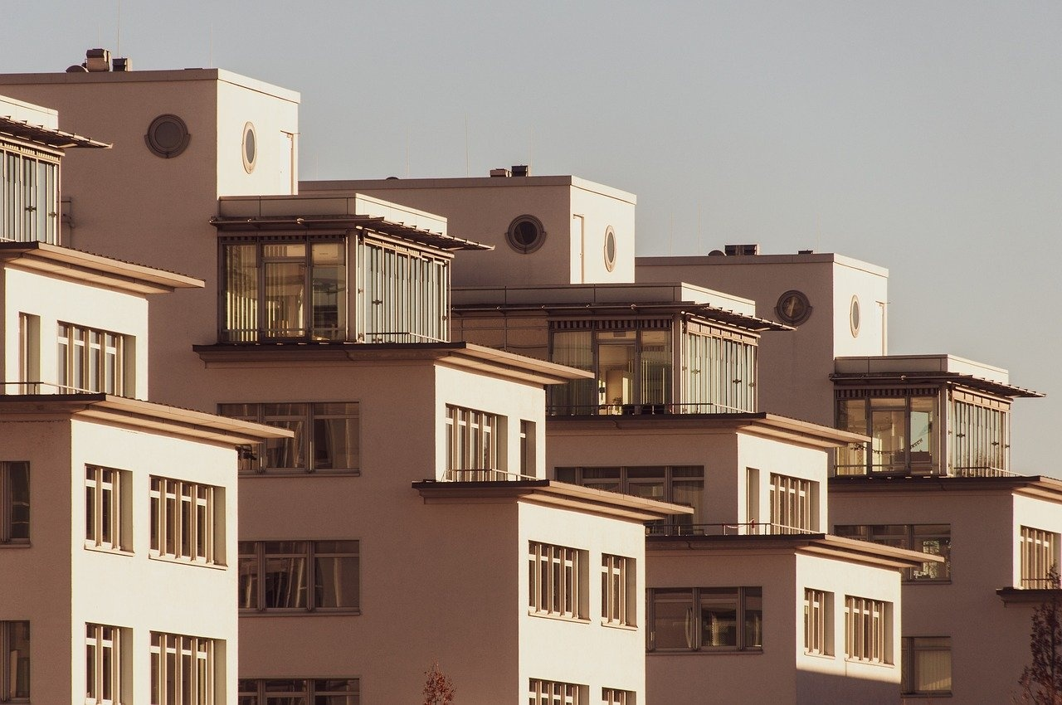
13
Urban planning and reconstruction strategies
01
Architectural Innovations
02
Sir Christopher Wren's Contributions
Mandatory stone and brick construction
Wider street designs
Improved drainage systems
Comprehensive urban planning
New building regulations
Systematic city reconstruction
03
Urban Design Principles
04
Long-term Impacts
Better building foundations
Strategic public space placement
Enhanced water management systems
Introduction of building insurance
Advanced fire prevention strategies
Modern urban planning foundations
Exploring the Great Fire of London

Slide 17
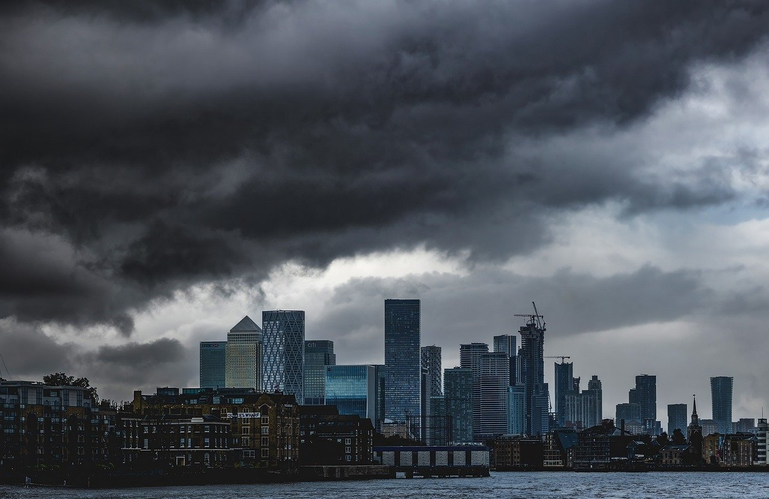
14
Subject Knowledge - Historical Context of the Great Fire of London
Date
September 2-6, 1666
Location
London, England
Precise Origin
Thomas Farriner's Bakery on Pudding Lane
City Characteristics
Densely populated
Predominantly wooden buildings
Narrow, tightly packed streets
Geographical Conditions
Exceptionally dry summer
Wooden infrastructure
Limited firefighting capabilities
Exploring the Great Fire of London

Slide 18
15
Subject Knowledge - Scientific Understanding of Fire Dynamics
01
02
03
04
05
Fire Triangle Components
Temperature Dynamics
Combustion Process
Spread Mechanisms
Factors Accelerating Fire Spread
Fuel (Abundant timber buildings)
Oxygen (Concentrated through narrow streets)
Heat (Initial spark from bakery oven)
Peak temperatures: Up to 1,100 degrees Celsius
Rapid heat transfer mechanisms
Chemical breakdown of carbon-based materials
Oxygen combination releasing massive energy
Thermal radiation
Convection currents
Conductive heat transfer
Wind conditions
Proximity of wooden structures
Lack of fire breaks
Exploring the Great Fire of London

Slide 19
16
Subject Knowledge - Architectural and Urban Planning Implications
01
02
03
04
Architectural Innovations
Sir Christopher Wren's Contributions
Urban Design Principles
Long-term Impacts
Mandatory stone and brick construction
Wider street designs
Improved drainage systems
Comprehensive urban planning
New building regulations
Systematic city reconstruction
Better building foundations
Strategic public space placement
Enhanced water management systems
Introduction of building insurance
Advanced fire prevention strategies
Modern urban planning foundations
Exploring the Great Fire of London

Slide 20

17
Subject Knowledge - Social and Economic Impact
01
Population Displacement
02
Economic Consequences
100,000 people left homeless
Massive movement of population within and outside London
Disruption of social hierarchies
Destruction of trade networks and markets
Collapse of small businesses and livelihoods
Economic restructuring and recovery efforts
03
Social Mobility
04
Psychological Impact
Opportunities for rebuilding and urban renewal
Breaking traditional economic barriers for marginalized communities
Demonstration of community resilience and solidarity
Collective trauma experienced by Londoners
Community adaptation and coping mechanisms
Resilience and reconstruction efforts in the aftermath
Exploring the Great Fire of London

Slide 21
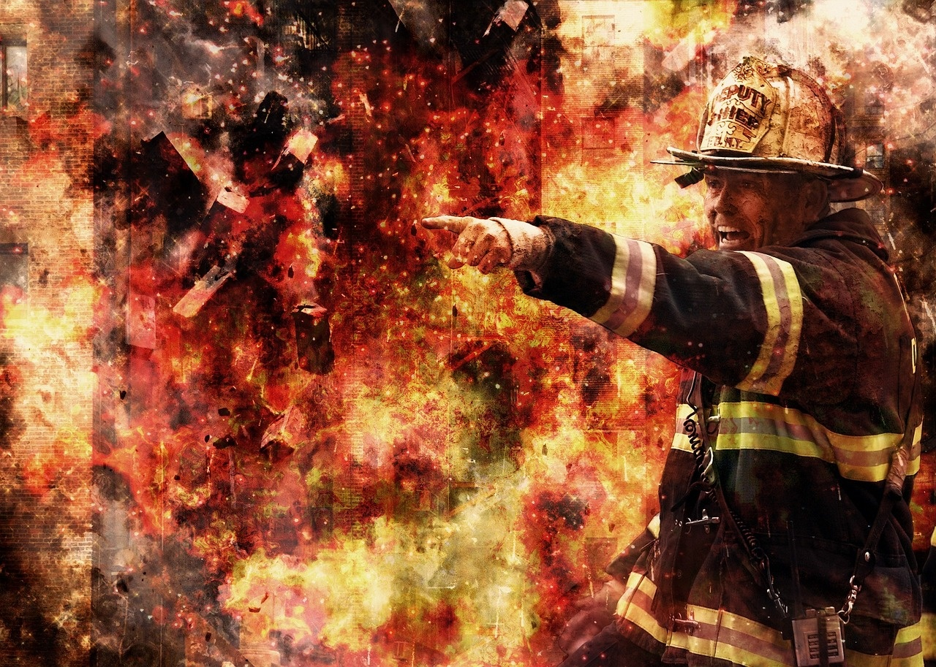
18
Subject Knowledge - Technological Firefighting Advancements
Pre-Fire Firefighting Methods
Leather buckets
Basic hand pumps
Limited water resources
Post-Fire Innovations
Advanced water pumping systems
Organized firefighting units
Improved emergency response protocols
Modern Firefighting Technologies
Sophisticated water distribution
Advanced protective equipment
Systematic urban fire prevention strategies
Key Technological Shifts
Transition from reactive to preventive approaches
Development of professional fire services
Integration of scientific understanding
Exploring the Great Fire of London

Slide 22
19
Activities - Interactive Learning Experiences (5-minute segments)
01
02
03
Activity 1: Historical Detective Work
Activity 2: London City Model Building
Activity 3: Fire Spread Simulation
Analyze primary source documents
Use replica historical materials
Develop critical thinking skills
Reconstruct historical urban landscape
Understand architectural challenges
Collaborative group work
Hands-on scientific exploration
Understand fire dynamics
Safe, controlled learning environment
Exploring the Great Fire of London

Slide 23
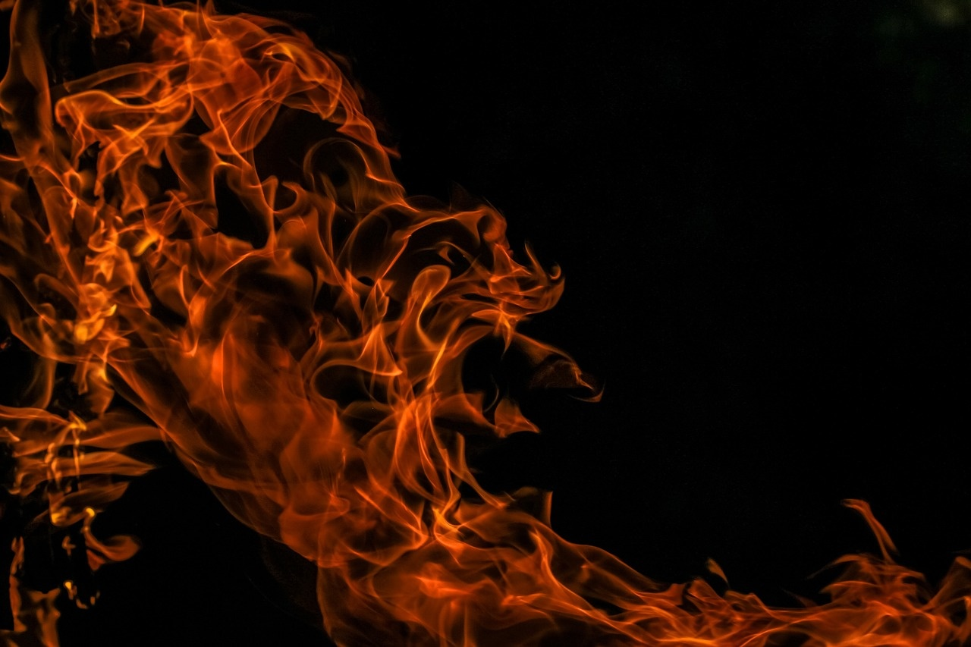
20
Reflection - Understanding Historical Transformation
Lessons from the Great Fire
How did the fire change London forever?
What can we learn about community resilience?
How do historical events shape modern urban design?
Exploring the Great Fire of London

