Slide 1


Understanding Our World: The Power of Social Studies and Global Awareness
Exploring Cultures, History, and Global Challenges to Become Informed Global Citizens

Slide 2
Table of Contents
Introduction to Social Studies and Global Awar…
Why Social Studies and Global Awareness Matter
Cultural Competence and Empathy
Global Issues and Challenges
Geography and Map Skills
Historical Context
Critical Thinking and Research Skills
Global Citizenship
Real-World Applications
Conclusion
Next Steps
Reflection Questions
Additional Resources
04
05
06
07
08
09
10
11
12
13
14
15
16

Slide 3
Table of Contents
Assessment and Evaluation
Conclusion and Final Thoughts
Final Reflection
17
18
19

Slide 4
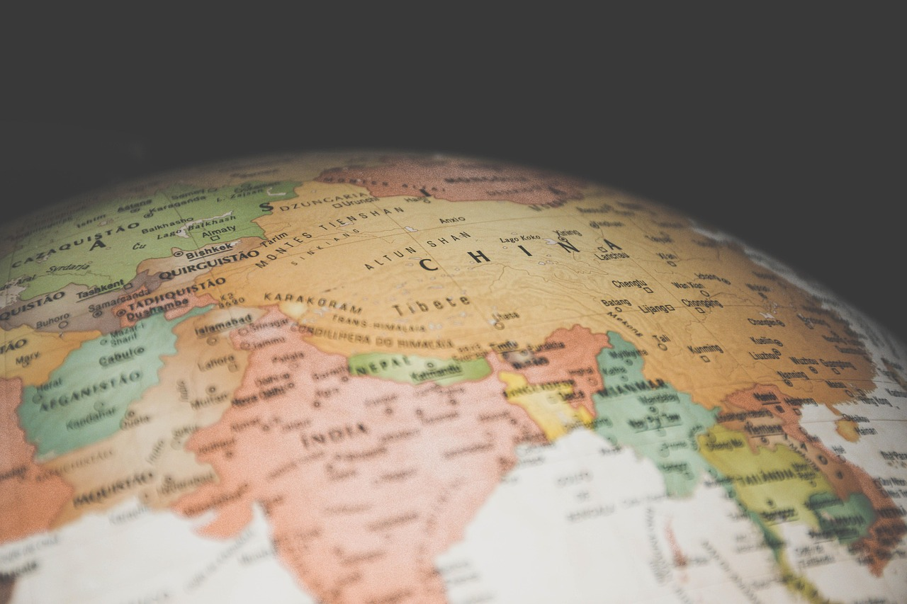
Introduction to Social Studies and Global Awareness
Welcome to Social Studies
The Importance of Global Awareness
Building a Strong Foundation
Welcome to the world of social studies and global awareness!
In this lesson, we will explore the importance of understanding different cultures, historical events, and global issues.
Understanding different cultures and global issues is crucial.
It helps us become informed and active global citizens.
By the end of this lesson, you will have a solid foundation in social studies.
This foundation will enable you to engage with the world as an informed global citizen.
4
Understanding Our World: The Power of Social Studies and Global Awareness

Slide 5
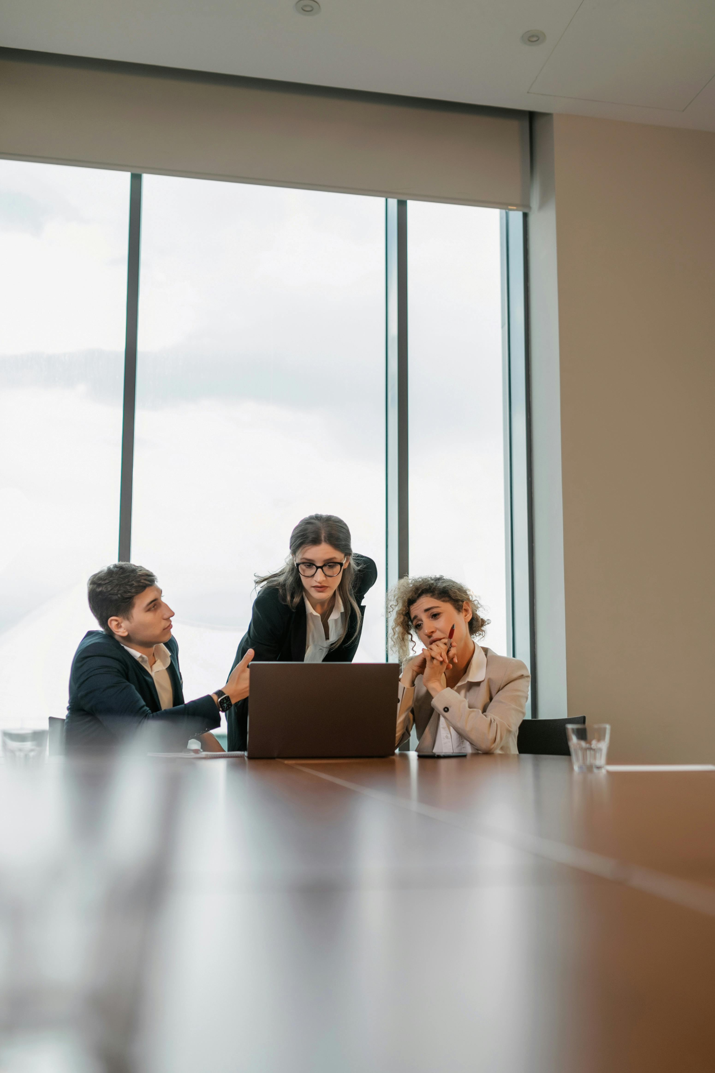
Why Social Studies and Global Awareness Matter
Understanding Our World
Appreciating Human Diversity
Social studies and global awareness help us understand the complexities of the world and our place within it.
They enable us to develop essential skills such as critical thinking, communication, and collaboration.
By studying social studies and global awareness, we can gain a deeper appreciation for the diversity and richness of human experiences.
This understanding fosters empathy and respect for different cultures and perspectives.
Innovative Problem Solving
Making a Positive Impact
Social studies and global awareness empower us to develop innovative solutions to real-world problems.
These solutions can address pressing issues and contribute to societal progress.
Through social studies and global awareness, we can make a positive impact in our communities and the world at large.
This impact is achieved by applying our knowledge and skills to create meaningful change.
5
Understanding Our World: The Power of Social Studies and Global Awareness

Slide 6
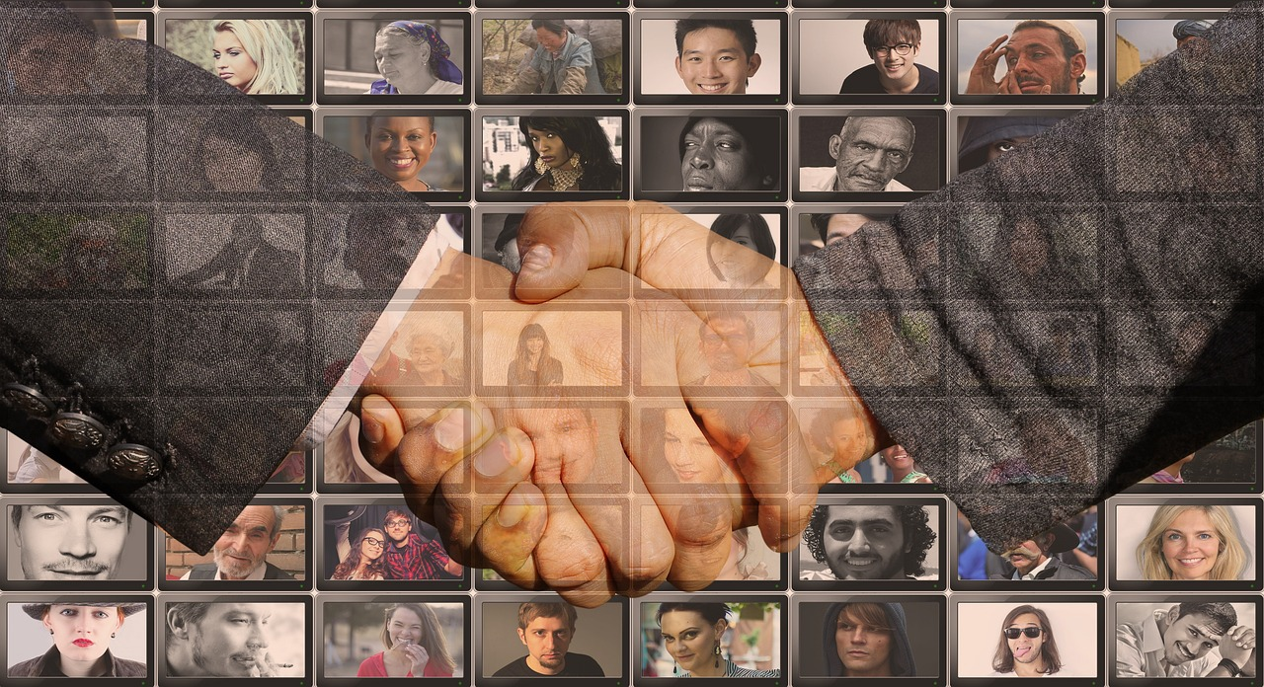
Cultural Competence and Empathy
Understanding Cultural Competence
The Role of Empathy
Impact of Cultural Competence and Empathy
Cultural competence refers to the ability to understand and appreciate different cultures and perspectives.
It enables individuals to navigate and respect diverse cultural contexts effectively.
Empathy is the capacity to understand and share the feelings of others.
It fosters meaningful connections and mutual understanding among individuals.
By developing cultural competence and empathy, we can engage effectively with people from diverse backgrounds.
This contributes to creating a more just and equitable world.
6
Understanding Our World: The Power of Social Studies and Global Awareness

Slide 7
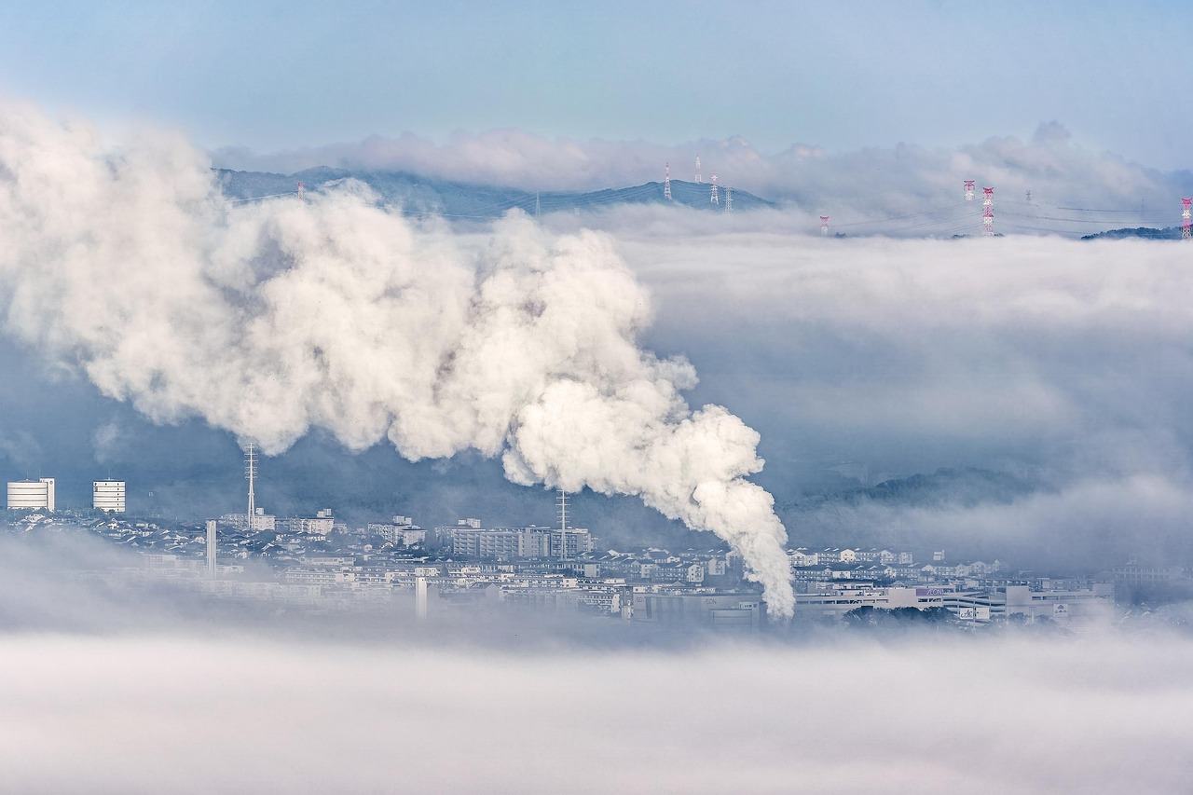
Global Issues and Challenges
Impact of Global Issues
Collaborative Solutions
Global issues such as climate change, poverty, and inequality affect us all.
We need to understand the causes and consequences of these issues to develop innovative solutions.
By working together, we can address these challenges and create a more sustainable and equitable world.
As global citizens, we have a responsibility to take action and make a positive impact.
Understanding Causes and Consequences
Role of Global Citizens
We need to understand the causes and consequences of these issues to develop innovative solutions.
Global issues such as climate change, poverty, and inequality affect us all.
As global citizens, we have a responsibility to take action and make a positive impact.
By working together, we can address these challenges and create a more sustainable and equitable world.
7
Understanding Our World: The Power of Social Studies and Global Awareness

Slide 8
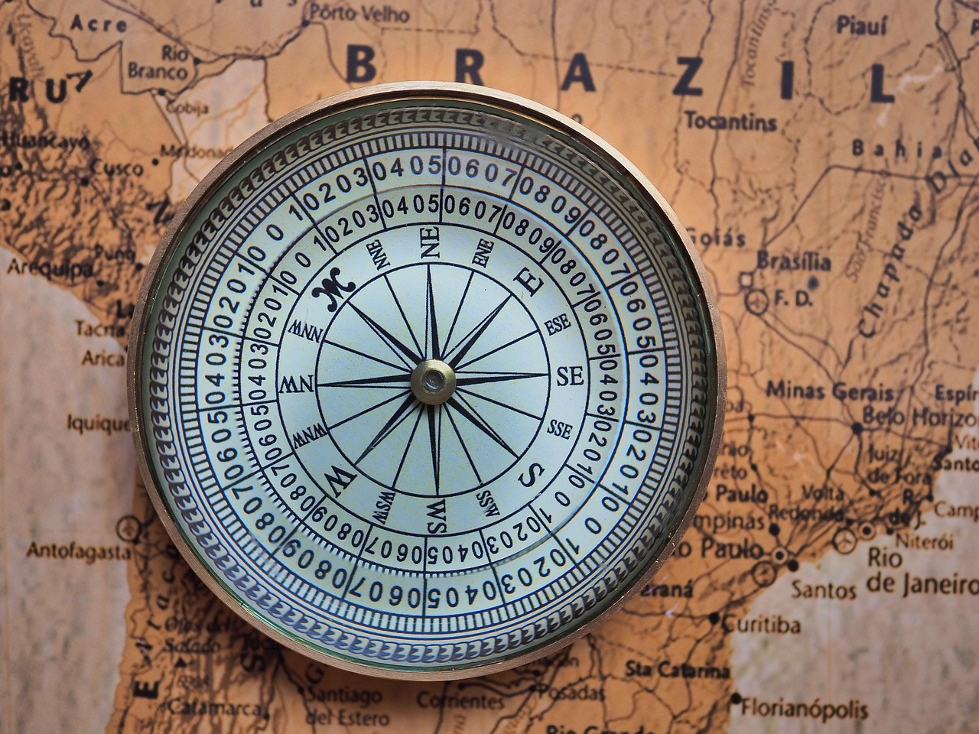
Geography and Map Skills
Understanding Geography
Geography is the study of the Earth's physical and human environments.
It helps us comprehend the interaction between natural landscapes and human activities.
Importance of Map Skills
Map skills are essential for understanding the world and its complexities.
They enable us to interpret spatial information and navigate effectively.
Benefits of Learning Geography and Map Skills
By learning geography and map skills, we can navigate the world and make informed decisions.
This knowledge empowers us to address global challenges and plan for the future.
8
Understanding Our World: The Power of Social Studies and Global Awareness

Slide 9
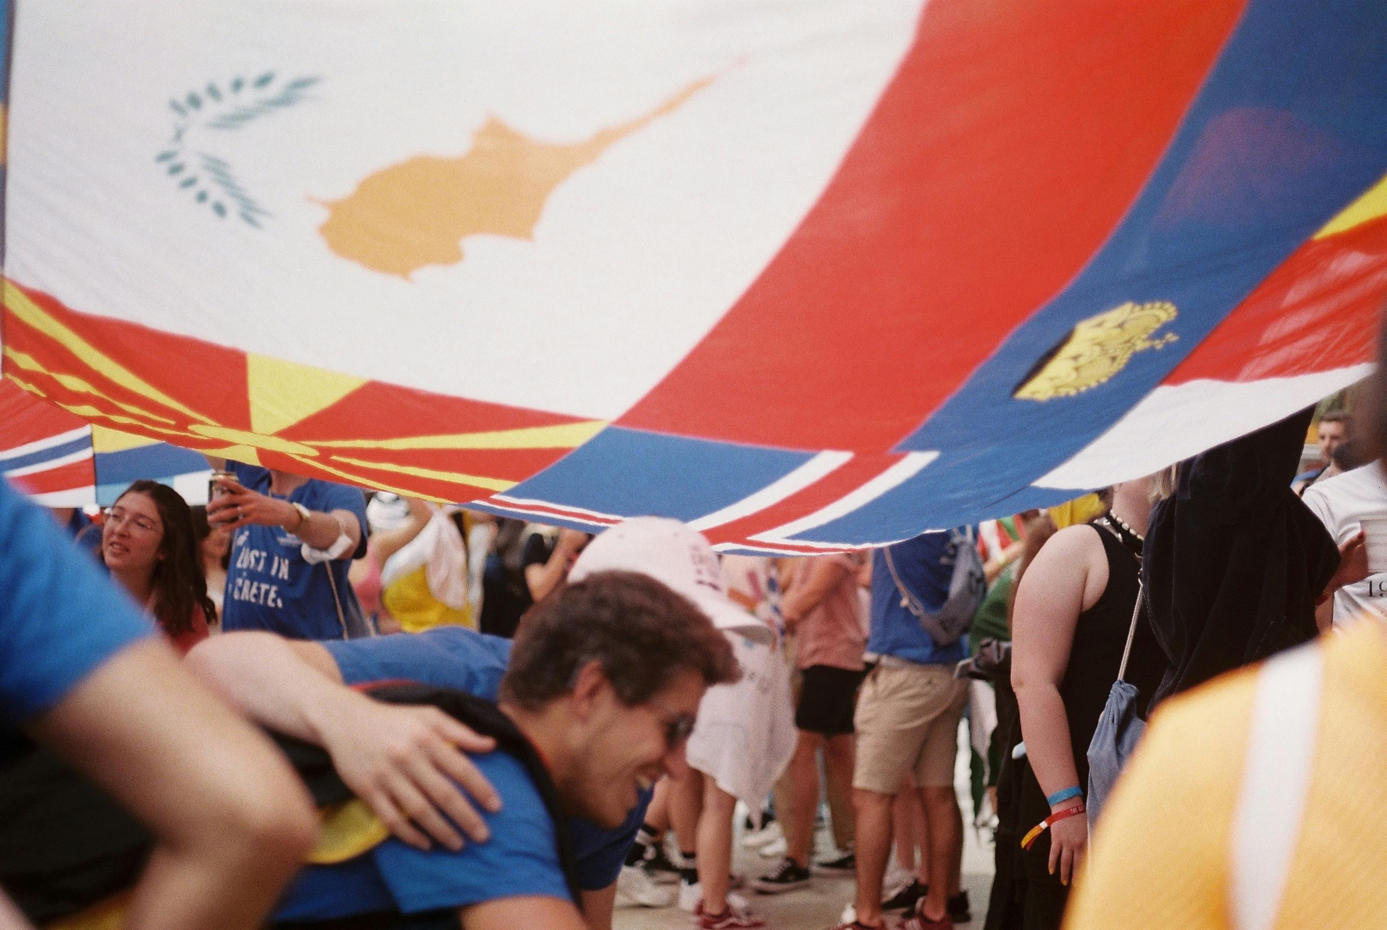
Historical Context
Impact of Historical Events
Historical events shape our understanding of the world and its complexities.
By studying historical context, we can gain a deeper appreciation for the diversity and richness of human experiences.
Understanding Current Events
We can also develop a more nuanced understanding of current events.
Historical context helps us analyze global issues with greater depth.
Appreciation for Human Diversity
Studying history reveals the richness of human experiences.
It fosters a deeper appreciation for the diversity of cultures and perspectives.
9
Understanding Our World: The Power of Social Studies and Global Awareness

Slide 10
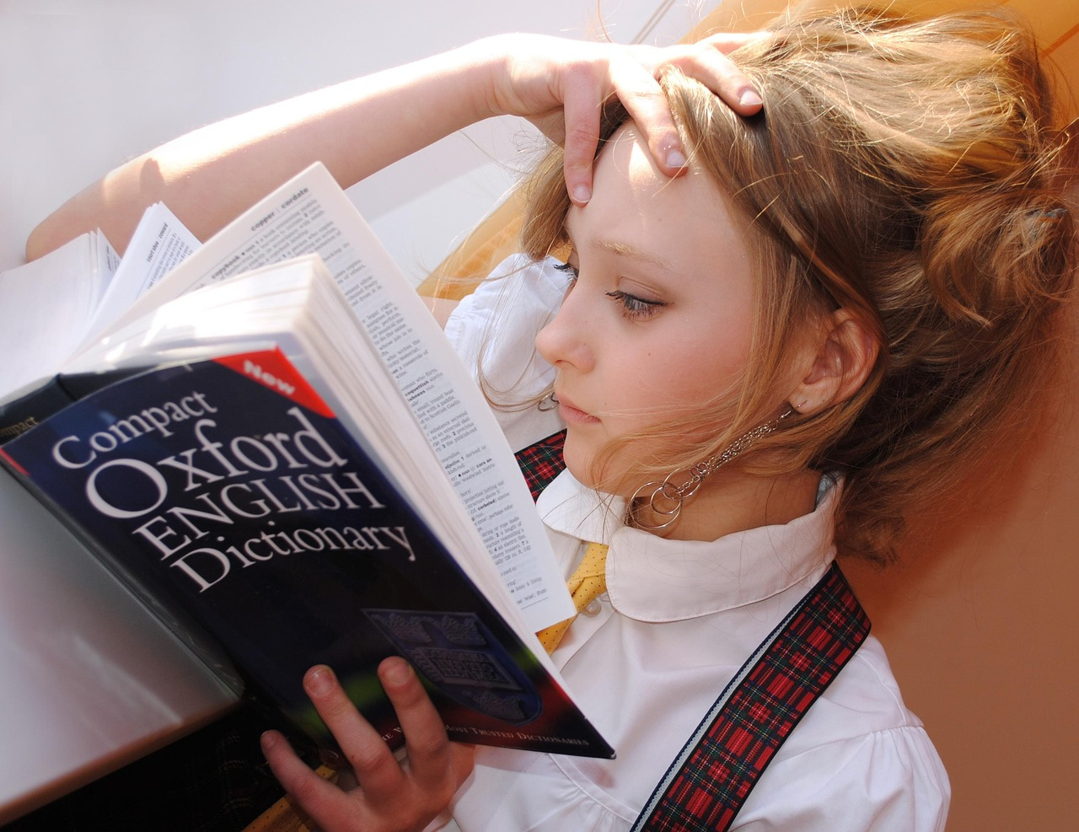
Critical Thinking and Research Skills
Understanding Critical Thinking
Importance of Research Skills
Benefits of Combined Skills
Critical thinking is the ability to analyze information and evaluate evidence.
It helps in assessing the validity and reliability of arguments and claims.
Research skills are essential for gathering and interpreting data.
They enable us to explore and understand complex topics effectively.
By developing critical thinking and research skills, we can make informed decisions.
These skills also foster innovative solutions to challenges.
10
Understanding Our World: The Power of Social Studies and Global Awareness

Slide 11
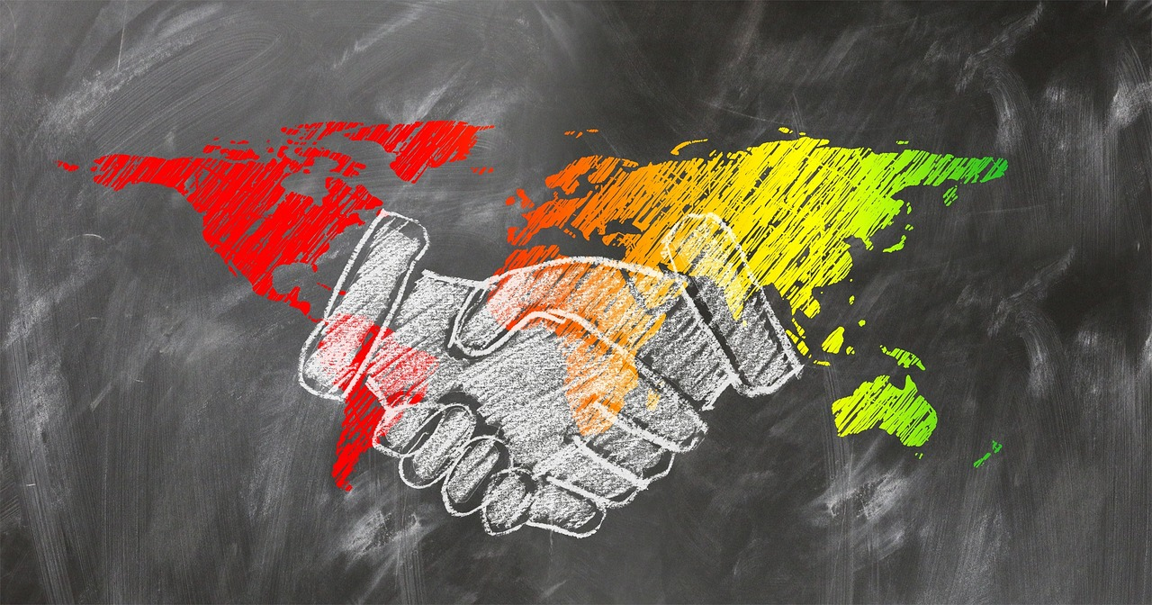
Global Citizenship
Understanding Global Citizenship
The Role of Global Citizens
Creating a Just World
Global citizenship refers to the responsibility to engage with global issues and challenges.
As global citizens, we have a duty to take action and make a positive impact.
As global citizens, we have a duty to take action and make a positive impact.
By developing global citizenship, we can create a more just and equitable world.
By developing global citizenship, we can create a more just and equitable world.
Global citizenship refers to the responsibility to engage with global issues and challenges.
11
Understanding Our World: The Power of Social Studies and Global Awareness

Slide 12
Real-World Applications
Career Opportunities
Community Impact
Global Citizenship
Practical Applications
Social studies and global awareness can be applied in careers such as international business, diplomacy, and education.
These fields benefit from a deep understanding of cultural and global dynamics.
Skills in social studies and global awareness enable individuals to make a positive impact in their communities.
This includes fostering understanding and collaboration on local and global issues.
Developing social studies and global awareness helps individuals become active and informed global citizens.
This involves engaging with diverse perspectives and contributing to global solutions.
Social studies and global awareness have many real-world applications.
These skills are essential for navigating and addressing complex global challenges.
12
Understanding Our World: The Power of Social Studies and Global Awareness

Slide 13
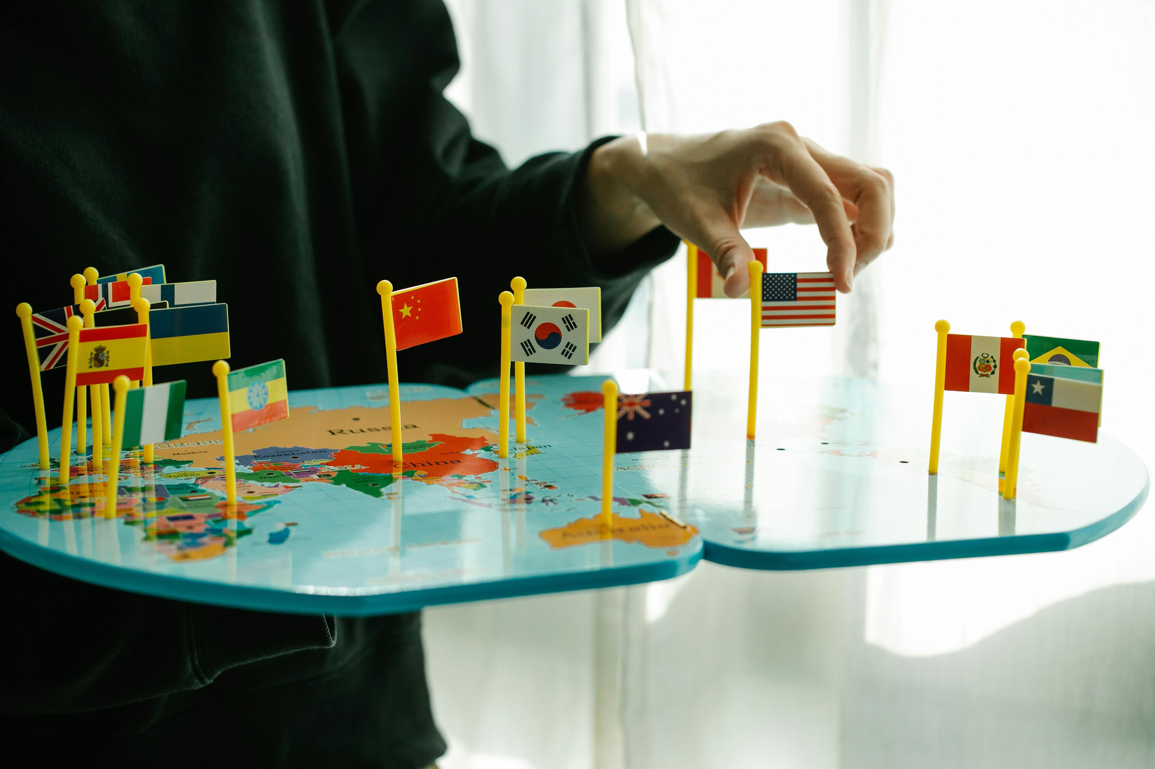
Conclusion
Understanding Global Complexities
Making a Positive Impact
In conclusion, social studies and global awareness are essential for understanding the complexities of the world and our place within it.
By developing these skills, we can become active and informed global citizens.
Equipped with global awareness, we can make a positive impact in our communities and the world at large.
These skills empower us to contribute meaningfully to society.
13
Understanding Our World: The Power of Social Studies and Global Awareness

Slide 14
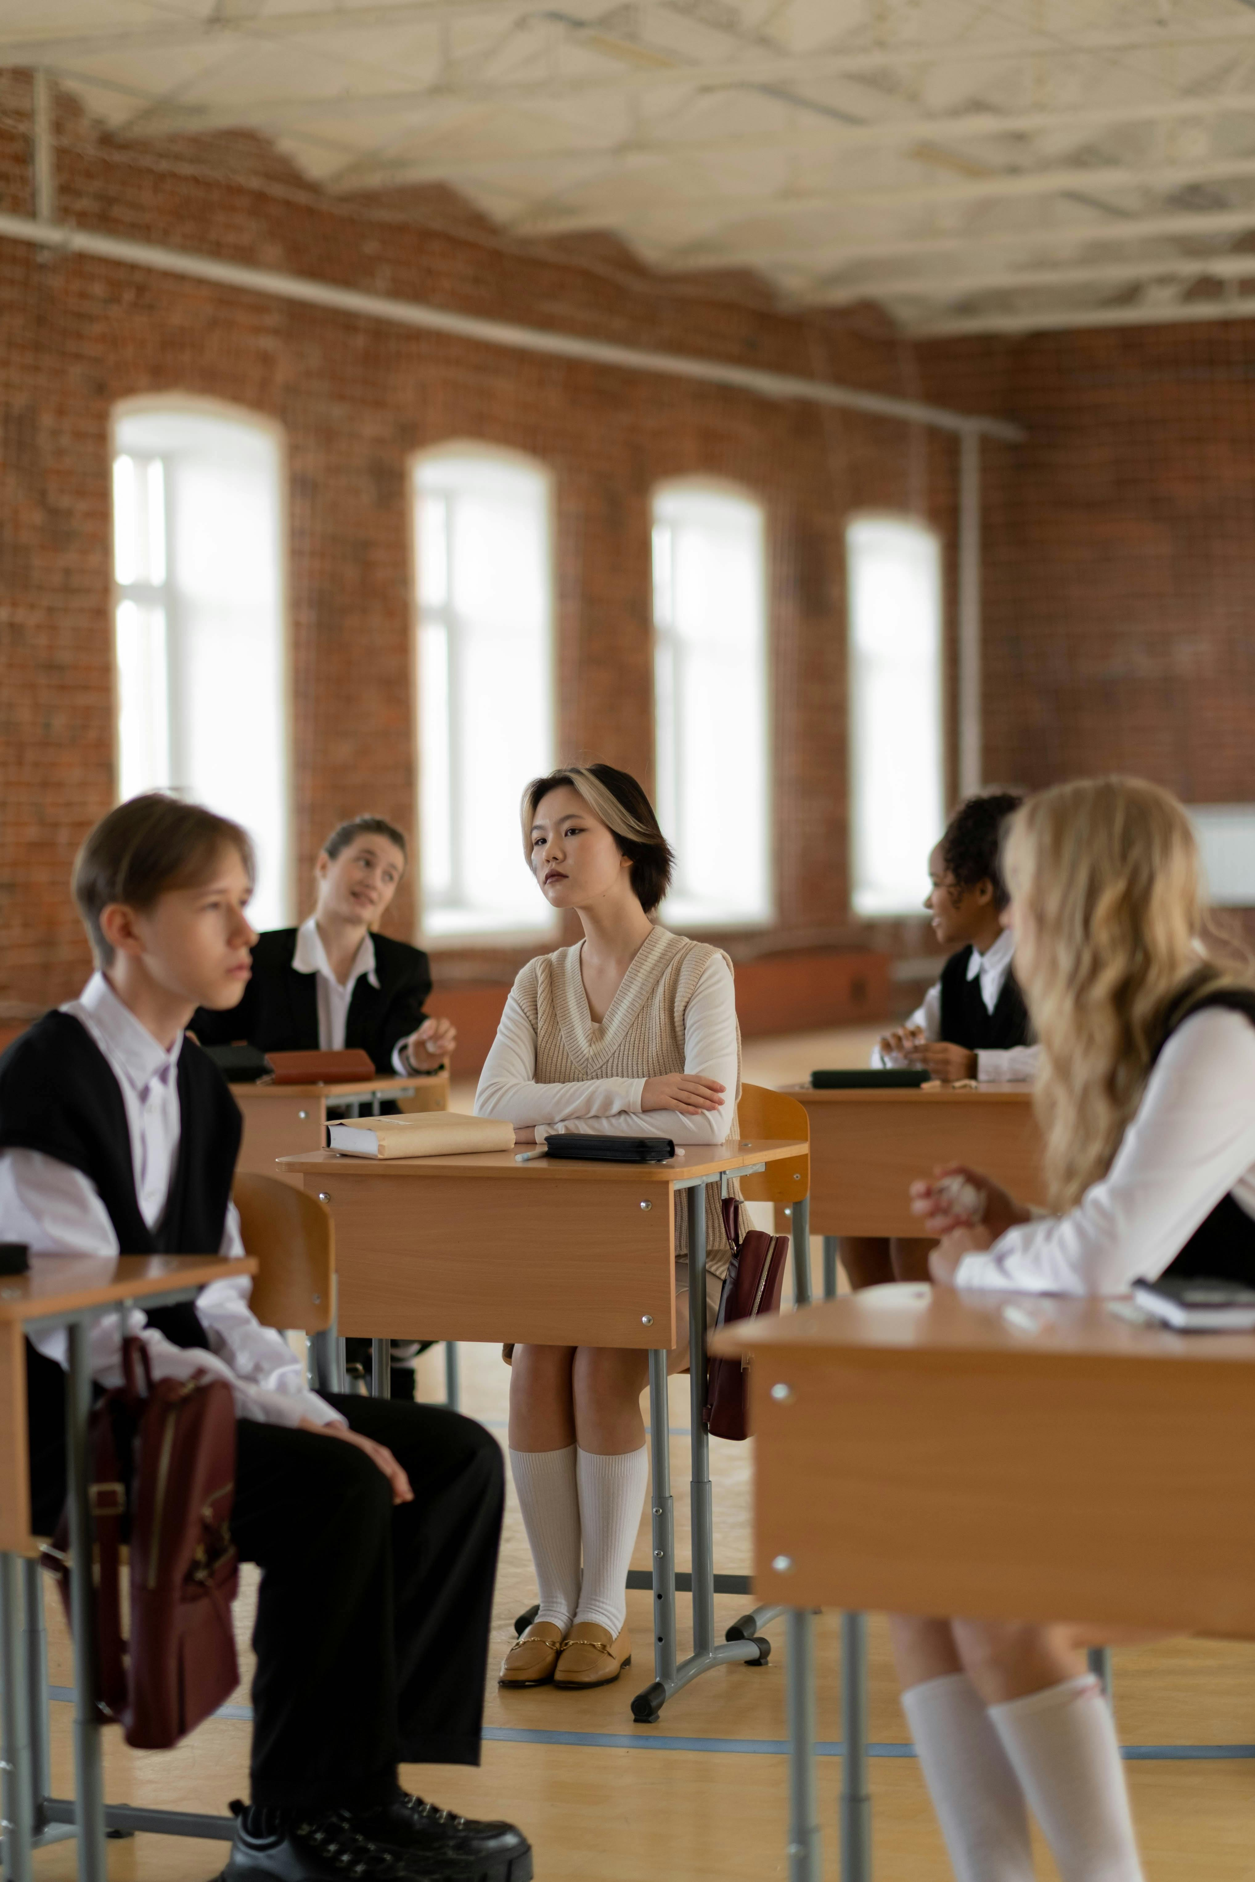
Next Steps
Exploring Cultural Diversity
Developing Essential Skills
Our next lesson will explore cultural diversity and identity in more depth.
We will analyze case studies and examples from around the world.
We will develop essential skills such as empathy, critical thinking, and communication.
These skills are crucial for understanding and engaging with diverse perspectives.
14
Understanding Our World: The Power of Social Studies and Global Awareness

Slide 15
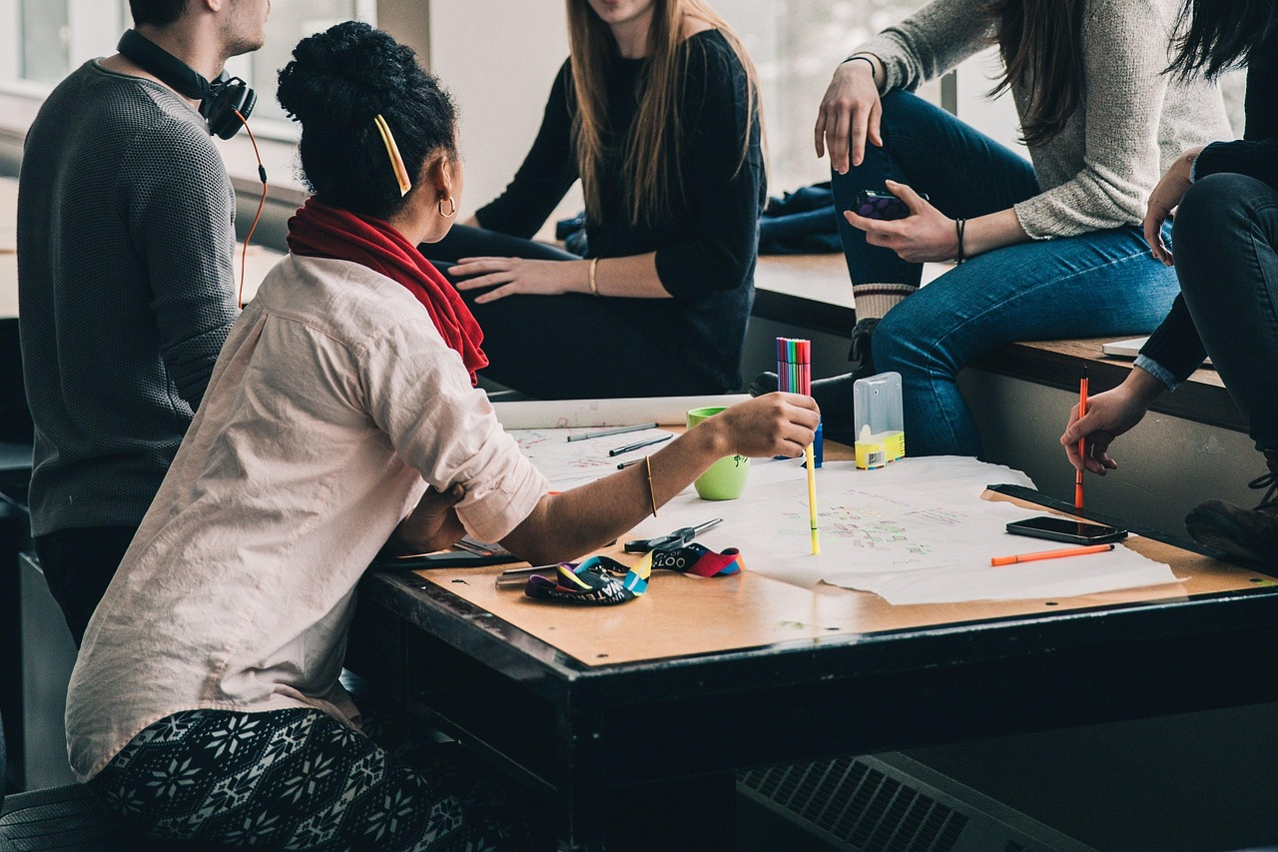
Reflection Questions
Lesson Insights
Applying Knowledge
Future Challenges and Opportunities
What did you learn from this lesson?
Reflect on the key takeaways and knowledge gained from the discussion.
How can you apply social studies and global awareness in your everyday life?
Consider ways to integrate these concepts into your daily actions and decisions.
What challenges and opportunities do you think we will face in the future, and how can we address them?
Explore strategies to tackle upcoming issues and leverage potential opportunities.
15
Understanding Our World: The Power of Social Studies and Global Awareness

Slide 16
Additional Resources
Online Learning Platforms
Books and Articles
Critical Evaluation and Creativity
For further learning, you can explore online resources such as National Geographic and the United Nations.
These platforms offer a wealth of information on social studies and global awareness.
You can also read books and articles on social studies and global awareness.
These materials provide in-depth insights into global issues and cultural understanding.
Remember to always evaluate sources critically and think creatively.
This approach ensures a deeper understanding and fosters innovative thinking.
16
Understanding Our World: The Power of Social Studies and Global Awareness

Slide 17
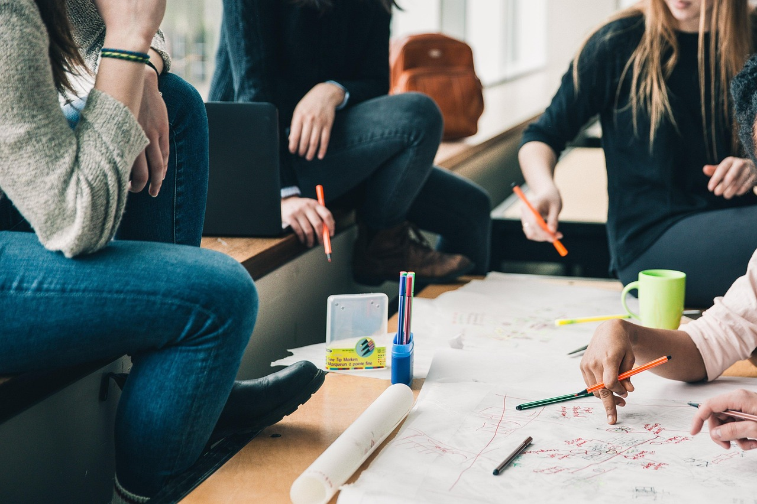
Assessment and Evaluation
Assessment Methods
Your understanding of social studies and global awareness will be assessed through quizzes, discussions, and projects.
These methods aim to gauge your comprehension and engagement with the subject matter.
Evaluation Criteria
You will be evaluated on your ability to think critically, communicate effectively, and work collaboratively.
These skills are essential for success in both academic and real-world settings.
Continuous Improvement
Remember to always ask questions and seek feedback to improve your learning.
This proactive approach will help you refine your skills and deepen your understanding.
17
Understanding Our World: The Power of Social Studies and Global Awareness

Slide 18
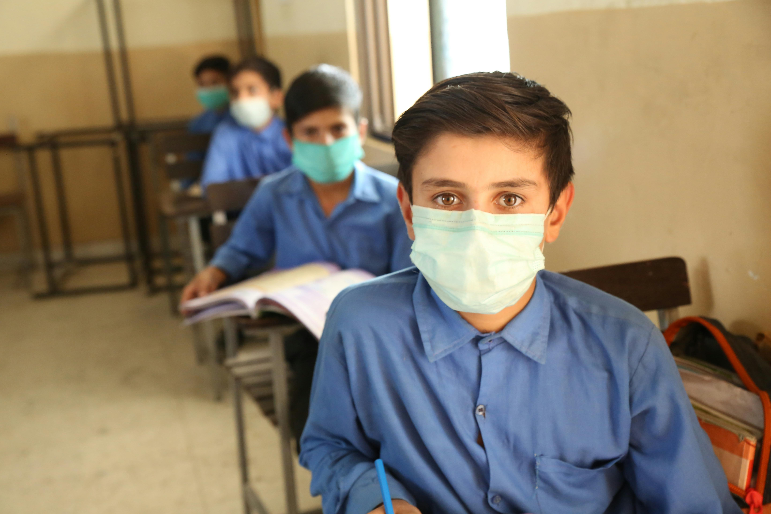
Conclusion and Final Thoughts
Importance of Social Studies and Global Awareness
Encouragement for Lifelong Learning
In conclusion, social studies and global awareness are essential for understanding the complexities of the world and our place within it.
They provide the tools to navigate and appreciate the diverse perspectives and challenges of our interconnected world.
Remember to always stay curious, think critically, and engage with the world around you.
These habits foster personal growth and contribute to a more informed and empathetic society.
18
Understanding Our World: The Power of Social Studies and Global Awareness

Slide 19
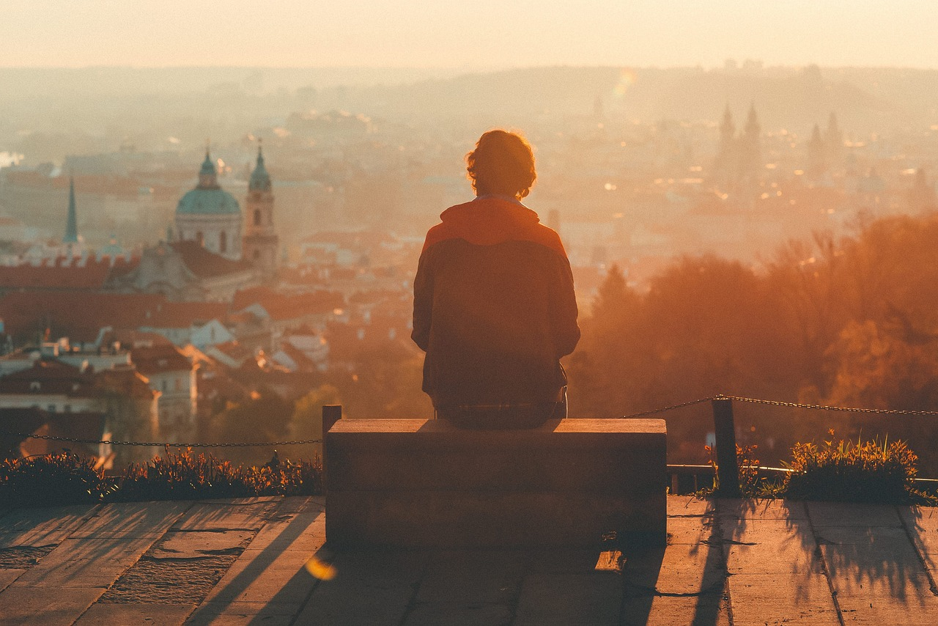
Final Reflection
Reflecting on Learning
Take a moment to reflect on what you have learned.
Consider how you can apply it in your life.
19
Understanding Our World: The Power of Social Studies and Global Awareness

