Slide 1

Exploring Language Fundamentals
A Comprehensive Guide to Nouns, Verbs, and Interactive Learning Strategies

Slide 2
Table of contents
01
02
03
04
05
06
07
08
09
10
11
Title Slide: Navigating Language Foundations
Lesson Objectives
What are Nouns?
Types of Nouns
What are Verbs?
Types of Verbs
Noun-Verb Interaction
Interactive Learning Strategies
Guided Practice Activities
Assessment Strategies
Digital Integration

Slide 3
Table of contents
12
13
14
15
16
17
Parent and Home Support
Safety and Inclusivity
Key Takeaways
Reflection and Next Steps
Design Recommendations
Accessibility Considerations

Slide 4

1
Title Slide: Navigating Language Foundations
Navigating Language Foundations: Nouns and Verbs
An Exploratory Journey for 14-Year-Old Language Learners
Exploring Language Fundamentals

Slide 5

2
Lesson Objectives
01
Understand fundamental grammatical components
02
Identify and classify nouns and verbs
Introduction to basic language structure
Recognizing different word types in sentences
03
Develop language skills through interactive learning
04
Key Icons
Engaging activities to enhance language proficiency
Noun icon (person/thing symbol)
Verb icon (action movement symbol)
Exploring Language Fundamentals

Slide 6

3
What are Nouns?
What are Nouns?
Definition: Words representing people, places, things, or ideas
Visual Examples:
"Teacher" (person)
"London" (place)
"Computer" (thing)
Exploring Language Fundamentals

Slide 7
4
Types of Nouns
01
02
03
Types of Nouns
Interactive Visual
Tactile learning suggestions
Common Nouns
Proper Nouns
Concrete Nouns
Abstract Nouns
Sorting activity with examples
Use tactile objects to represent each type of noun for hands-on learning.
Exploring Language Fundamentals

Slide 8

5
What are Verbs?
01
Definition
02
Example
Verbs are words that describe actions, states, or occurrences.
"Run" (action), "Exist" (state), "Become" (occurrence)
03
Action-based demonstrations
04
SEN Support
Engage students in acting out different verbs to understand their meanings better.
Provide physical movement cards to help students associate actions with verbs effectively.
Exploring Language Fundamentals

Slide 9

6
Types of Verbs
01
Action Verbs
02
Linking Verbs
Words that express physical or mental actions.
Example: "Run," "Jump," "Think."
Verbs that connect the subject to a subject complement.
Example: "Is," "Seem," "Become."
03
Regular Verbs
04
Irregular Verbs
Verbs that follow a standard conjugation pattern.
Example: "Walked," "Played," "Talked."
Verbs that do not follow the standard conjugation pattern.
Example: "Go," "Eat," "See."
Exploring Language Fundamentals

Slide 10

7
Noun-Verb Interaction
Noun-Verb Interaction
Understanding how nouns and verbs collaborate in sentences
Importance of subject-verb agreement for clear communication
Building sentences with nouns as subjects and verbs as actions
Demonstrating noun-verb pairs in simple sentence structures
Enhancing language fluency through proper noun-verb usage
Exploring Language Fundamentals

Slide 11
8
Interactive Learning Strategies
01
Multisensory Approach
02
Tactile Word Cards
03
Physical Movement Activities
Engage multiple senses for enhanced learning
Incorporate visual, auditory, and kinesthetic elements
Use physical word cards for hands-on learning
Enhance memory retention through touch and manipulation
Incorporate movement to reinforce language concepts
Active learning through gestures and actions
04
Digital Learning Tools
05
Adaptive Technology Integration
Utilize interactive apps and online resources
Enhance engagement and accessibility for diverse learners
Customize learning experiences based on individual needs
Utilize technology to cater to different learning styles
Exploring Language Fundamentals

Slide 12
9
Guided Practice Activities
01
Noun and Verb Sorting Station
02
Body Movement Verb Exploration
03
Noun Detective Hunt
Engage in hands-on sorting activities to differentiate between nouns and verbs.
Utilize visual aids and color-coded materials for enhanced learning.
Incorporate physical movement to act out various verbs.
Encourage kinesthetic learning through interactive exercises.
Participate in a fun scavenger hunt to identify nouns in real-world settings.
Enhance observational skills and reinforce noun recognition.
04
Interactive Sentence Building
05
Sensory Verb Exploration
Collaborate with peers to construct sentences using nouns and verbs.
Foster teamwork and communication skills in language practice.
Explore verbs through sensory experiences like touch, smell, and sound.
Stimulate multiple senses for a comprehensive understanding of verb usage.
Exploring Language Fundamentals

Slide 13
10
Assessment Strategies
01
Visual Checklist Review
02
Peer Verification
03
Digital Quiz
Utilize visual aids to assess understanding
Check off completed tasks for clarity
Collaborative assessment among peers
Encourages discussion and feedback
Interactive assessment tool
Immediate feedback for learners
04
Concept Mapping
05
Performance-Based Assessment
Visual representation of knowledge
Helps identify connections and gaps
Evaluate skills through practical tasks
Demonstrates application of language fundamentals
Exploring Language Fundamentals

Slide 14
11
Digital Integration
01
Interactive Grammar Mapping
02
Augmented Reality Word Hunt
03
Grammar Game-Based Learning
04
Digital Storytelling Platform
05
Adaptive Vocabulary Builder
Exploring Language Fundamentals

Slide 15
12
Parent and Home Support
01
Family Language Learning Kit
02
Grammar Game Night Suggestions
03
Digital Learning Companion
04
Collaborative Learning Strategies
05
Supportive Home Learning Environment Visuals
Exploring Language Fundamentals

Slide 16
13
Safety and Inclusivity
01
Classroom Safety Protocols
02
Emotional Support Strategies
03
Sensory Considerations
Emergency procedures clearly outlined
Safety equipment readily accessible
Counseling services available
Positive reinforcement techniques implemented
Quiet areas for sensory breaks
Sensory-friendly classroom environment
04
Communication Guidelines
05
Inclusive Learning Environment Icons
Clear communication expectations set
Alternative communication methods supported
Visual cues for diverse learners
Symbolic representation of inclusivity
Exploring Language Fundamentals

Slide 17
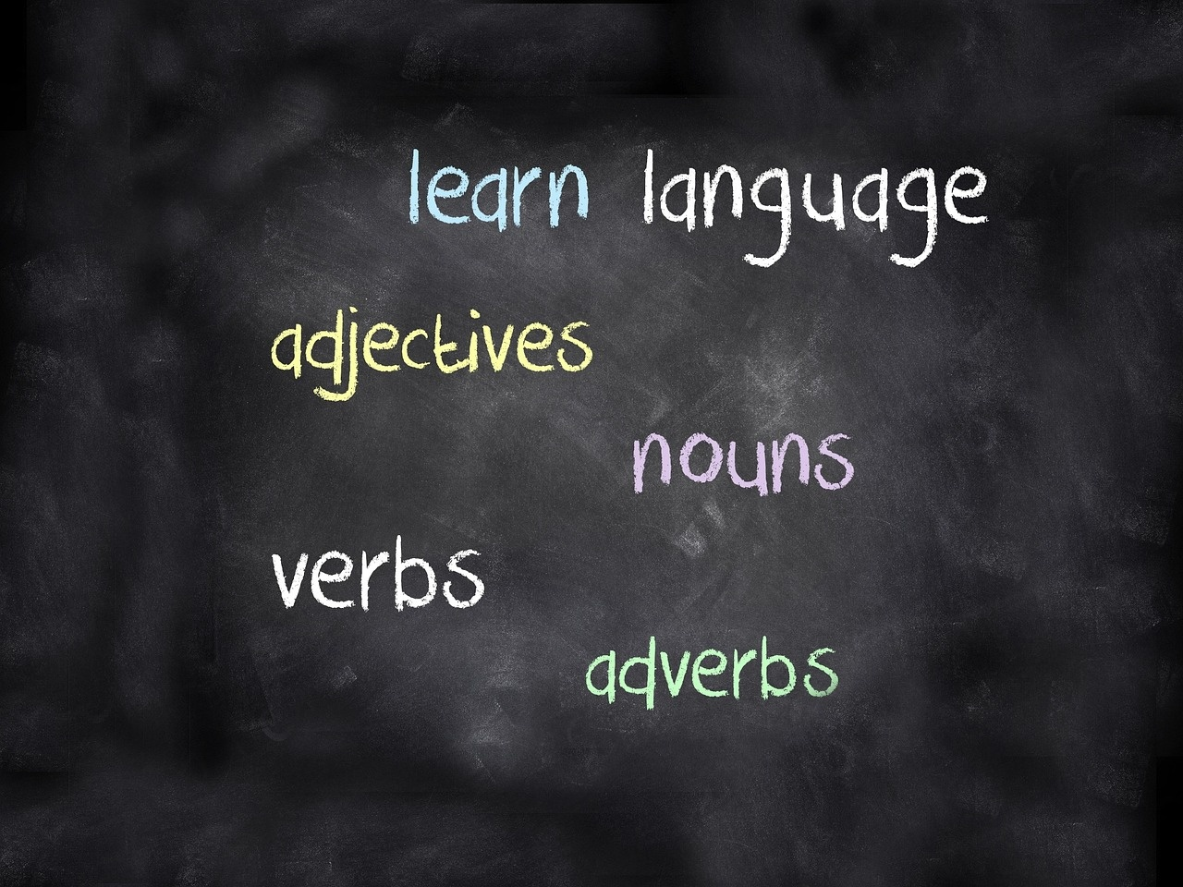
14
Key Takeaways
01
Understanding Language Structure
02
Developing Grammatical Identification Skills
Fundamentals are essential for effective communication.
Recognizing nouns and verbs enhances language proficiency.
03
Creative Language Expression
04
Visual Aids and Interactive Activities
Allows for more engaging and impactful communication.
Significantly improve language learning outcomes.
Exploring Language Fundamentals

Slide 18
15
Reflection and Next Steps
01
Reflect on the lesson objectives achieved
02
Evaluate student engagement and participation
03
Consider adjustments for improved learning outcomes
Understanding fundamental grammatical components
Identifying and classifying nouns and verbs
Developing language skills through interactive learning
Interactive activities effectiveness
Tactile learning impact
Digital tools utilization
Tailoring activities to different learning styles
Incorporating more multisensory approaches
Enhancing digital integration for diverse learners
04
Plan for advanced learning pathways
05
Encourage ongoing practice and application
Introducing more complex grammar concepts
Expanding vocabulary and language structures
Setting goals for continued language exploration
Providing resources for independent study
Suggesting language practice opportunities
Reinforcing key concepts through varied exercises
Exploring Language Fundamentals

Slide 19
16
Design Recommendations
01
Clean, Educational Color Palette
02
Language-Related Imagery
03
High Contrast for Readability
Choose colors that are easy on the eyes
Use colors that are associated with learning and education
Ensure the palette is cohesive and consistent
Incorporate images of books, letters, and educational tools
Use culturally diverse images to represent different languages
Ensure images are relevant to the content
Use dark text on a light background or vice versa
Ensure there is enough contrast between text and background
Test readability on different devices
04
Extensive Use of Icons and Visual Aids
05
Consistent, Engaging Design Theme
Use icons to represent key points and ideas
Incorporate charts, graphs, and infographics
Ensure visual aids are simple and easy to understand
Maintain a consistent style throughout the presentation
Use engaging and interactive elements
Ensure the design theme aligns with the educational purpose
Exploring Language Fundamentals

Slide 20
17
Accessibility Considerations
01
Large, Clear Fonts
02
High Color Contrast
03
Simple, Clean Layouts
Use fonts that are easy to read.
Ensure text size is large enough for visibility.
Choose colors that stand out from each other.
Ensure text color contrasts well with background.
Avoid cluttered designs.
Use ample white space to separate content.
04
Multiple Visual Learning Supports
05
Adaptive Design for Different Learning Needs
Incorporate images, charts, and videos.
Use icons and symbols to support text.
Ensure content is accessible on various devices.
Provide alternative formats for different learning preferences.
Exploring Language Fundamentals

