Slide 1

Understanding Food Chains and Ecosystem Dynamics
Exploring Energy Flow, Species Interactions, and Conservation Efforts

Slide 2
Understanding Food Chains and Ecosystem Dynamics
2
Table of Contents
Introduction to Food Chains
What is a Food Source?
Herbivores, Carnivores, and Omnivores
Simple Food Chain Example
Importance of Food Chains
Human Impact on Food Chains
Energy Transfer in Food Chains
Food Webs
Real-World Examples
Conservation Efforts
Conclusion
Key Takeaways
Reflection Questions
04
05
06
07
08
09
10
11
12
13
14
15
16

Slide 3
Understanding Food Chains and Ecosystem Dynamics
3
Table of Contents
Next Steps
Additional Resources
Assessment and Feedback
Conclusion and Final Thoughts
17
18
19
20

Slide 4
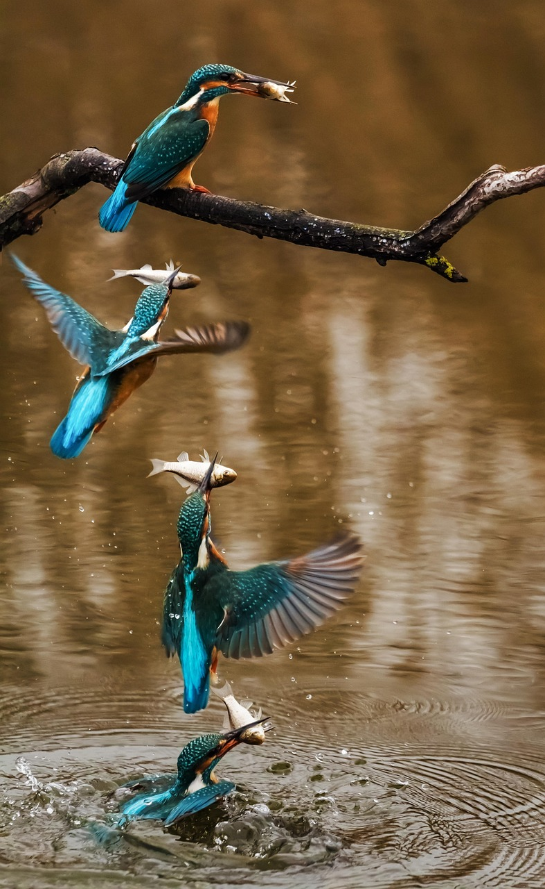
Understanding Food Chains and Ecosystem Dynamics
4
Introduction to Food Chains
Understanding Food Chains
Ecosystem Balance
Energy Flow in Nature
Food chains are series of events where one organism is eaten by another.
They show the flow of energy and nutrients from one species to another.
Understanding food chains helps us appreciate the balance within ecosystems.
They highlight the interdependence of various species.
Food chains illustrate how energy moves through different organisms.
This process is essential for maintaining ecological harmony.

Slide 5
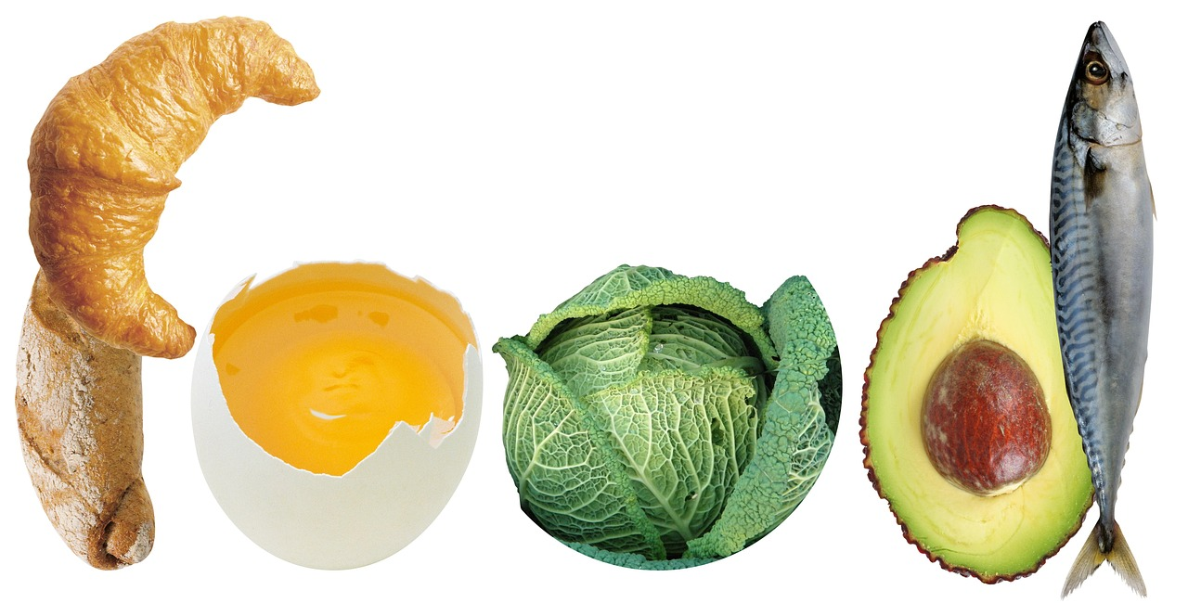
Understanding Food Chains and Ecosystem Dynamics
5
What is a Food Source?
Definition of a Food Source
Examples of Food Sources
A food source is any substance or organism that provides energy and nutrients to another organism.
It is essential for the survival and growth of living beings.
Examples include plants, animals, and fungi.
These organisms play a crucial role in the food chain.

Slide 6
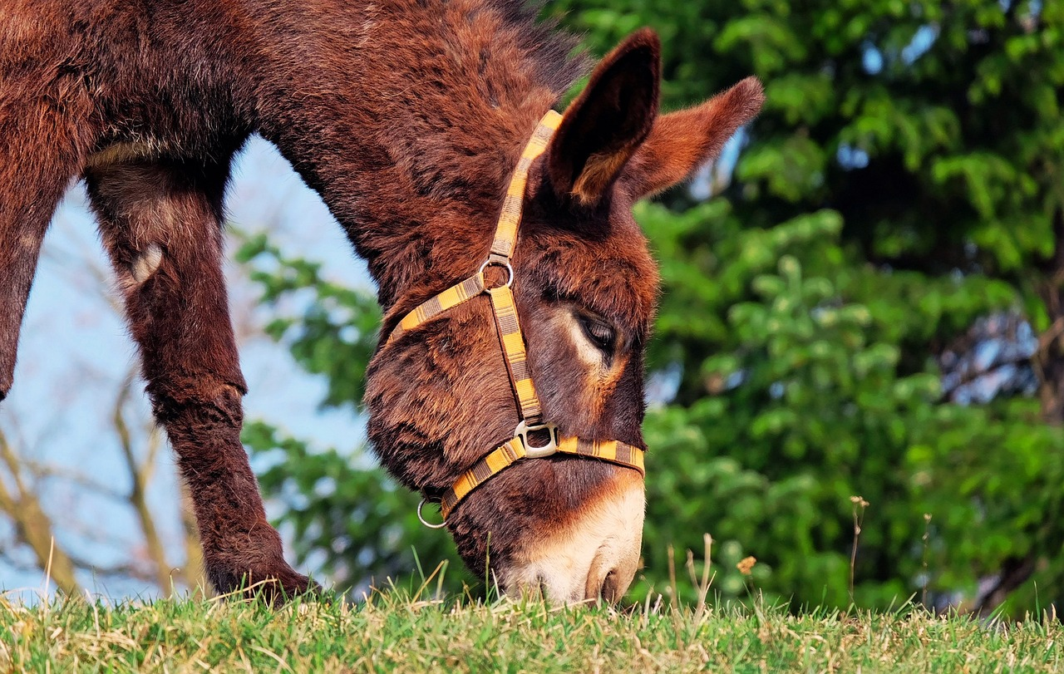
Understanding Food Chains and Ecosystem Dynamics
6
Herbivores, Carnivores, and Omnivores
Herbivores
Carnivores
Omnivores
Herbivores are animals that eat only plants.
Examples include deer and rabbits.
Carnivores are animals that eat only other animals.
Examples include lions and tigers.
Omnivores are animals that eat both plants and other animals.
Examples include humans and bears.

Slide 7
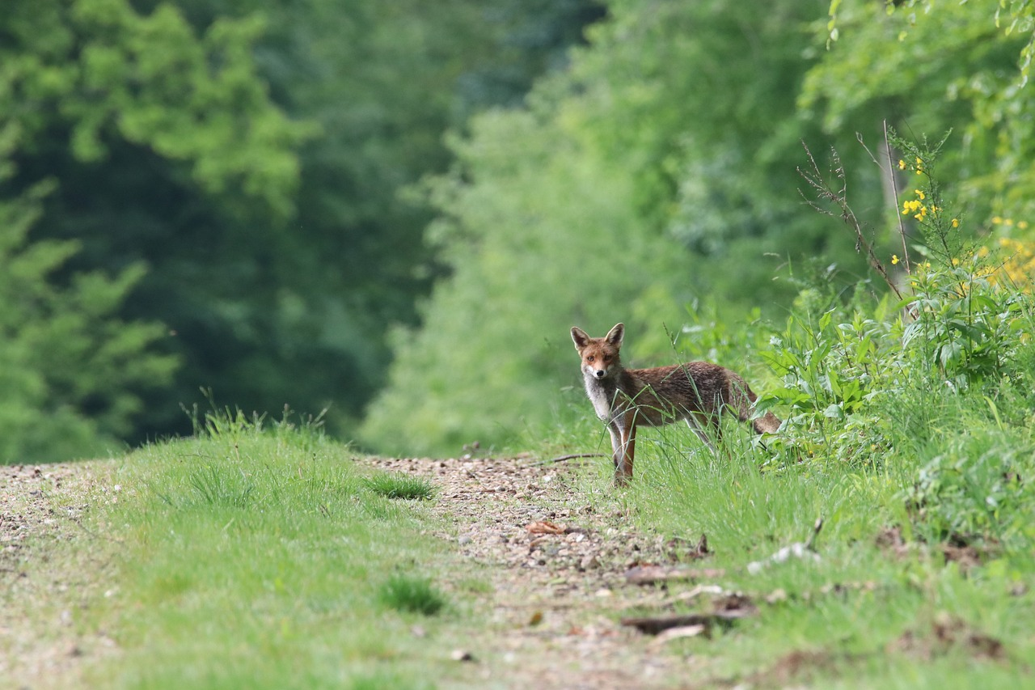
Understanding Food Chains and Ecosystem Dynamics
7
Simple Food Chain Example
Simple Food Chain Example
Example: Grass (producer) -> Rabbit (herbivore) -> Fox (carnivore).
This illustrates the flow of energy in an ecosystem.

Slide 8
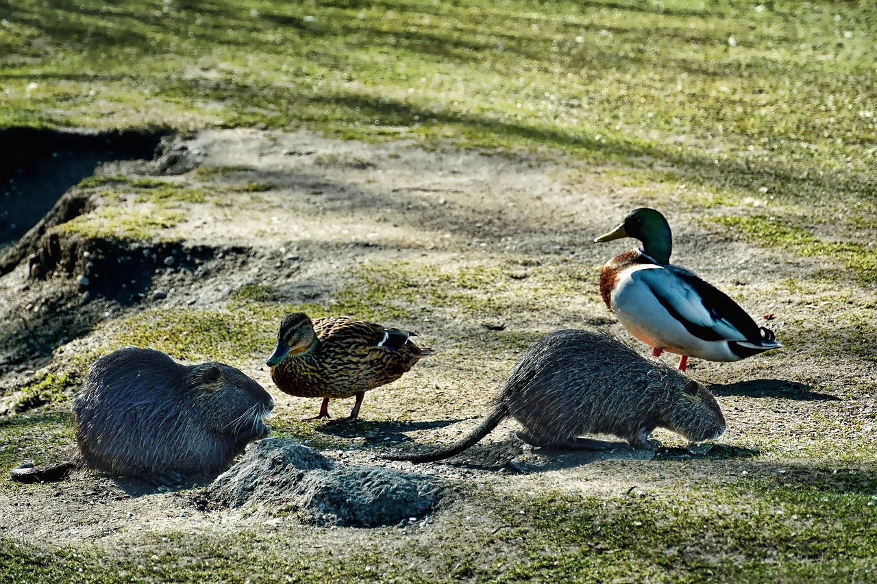
Understanding Food Chains and Ecosystem Dynamics
8
Importance of Food Chains
Understanding Ecosystem Balance
Species and Environmental Interactions
Food chains help us understand the balance of ecosystems.
They show how species interact with each other and their environment.
Food chains help us understand the balance of ecosystems.
They show how species interact with each other and their environment.

Slide 9
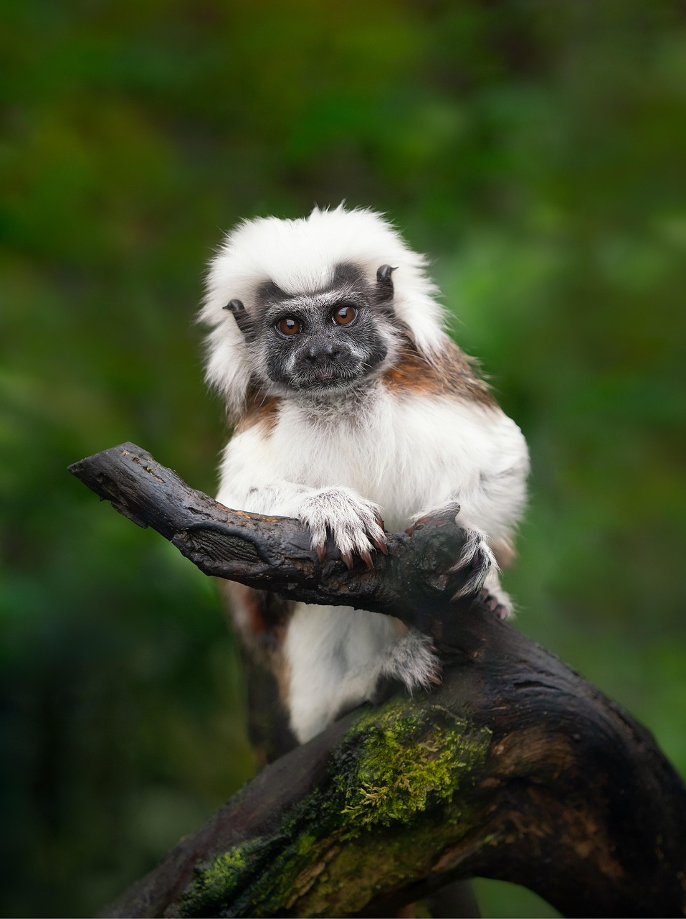
Understanding Food Chains and Ecosystem Dynamics
9
Human Impact on Food Chains
Impact of Human Activities
Role of Conservation Efforts
Importance of Understanding Food Chains
Human activities can affect food chains, such as through pollution and habitat destruction.
These disruptions can lead to imbalances in ecosystems and threaten biodiversity.
Conservation efforts play a crucial role in mitigating the negative impacts on food chains.
By protecting habitats and reducing pollution, we can help restore ecological balance.
Understanding food chains helps us appreciate the interconnectedness of ecosystems.
This knowledge underscores the importance of conservation for maintaining biodiversity.

Slide 10
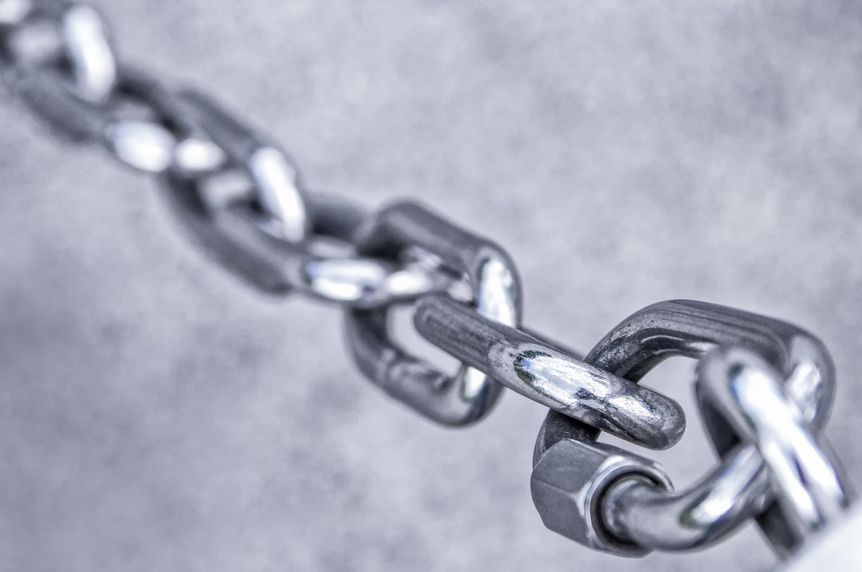
Understanding Food Chains and Ecosystem Dynamics
10
Energy Transfer in Food Chains
Energy Flow in Food Chains
Energy is transferred from one organism to another in a food chain.
This transfer is essential for the survival of organisms at different levels.
Efficiency of Energy Transfer
Only a small amount of energy is transferred from one level to the next.
Most of the energy is lost as heat or used for life processes.

Slide 11
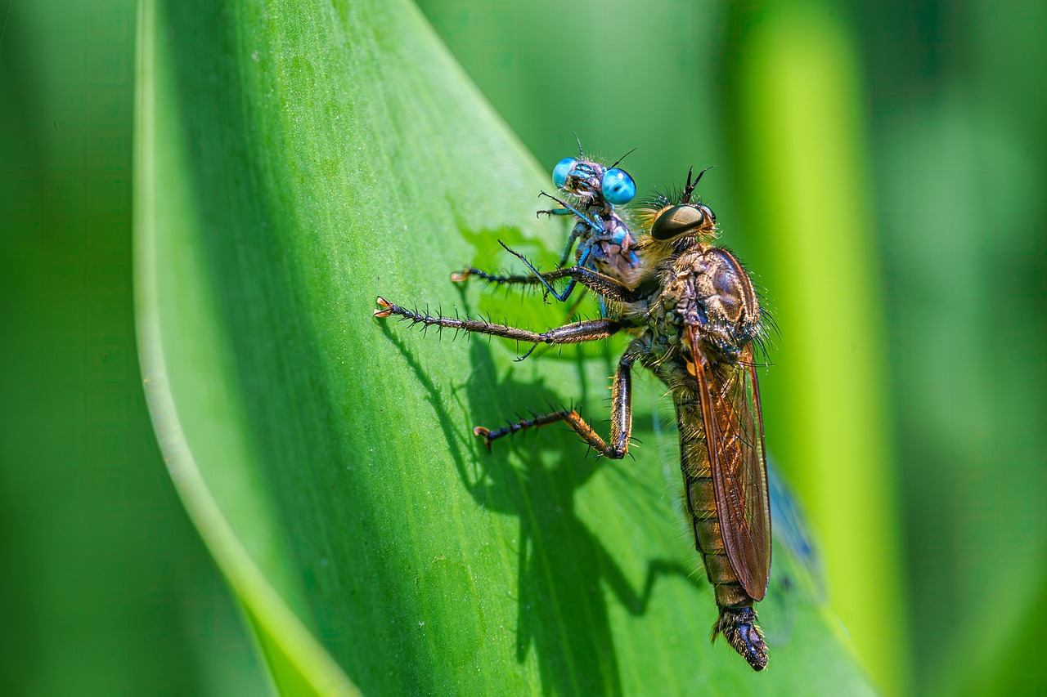
Understanding Food Chains and Ecosystem Dynamics
11
Food Webs
Understanding Food Webs
Interactions in Ecosystems
Food webs show the complex relationships between species in an ecosystem.
They include multiple food chains and show how species interact with each other.
Food webs show the complex relationships between species in an ecosystem.
They include multiple food chains and show how species interact with each other.

Slide 12
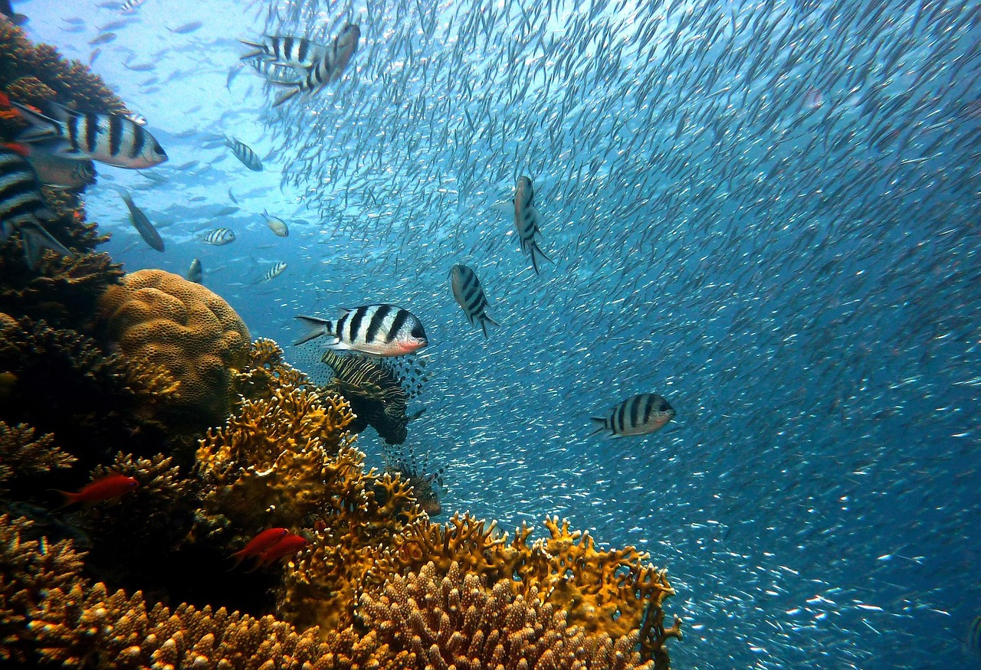
Understanding Food Chains and Ecosystem Dynamics
12
Real-World Examples
Coral Reef Ecosystem
Example: Coral reef ecosystem with multiple food chains.
Species interactions within the coral reef ecosystem.
Forest Ecosystem
Example: Forest ecosystem with complex relationships.
Interactions between plants and animals in the forest ecosystem.

Slide 13
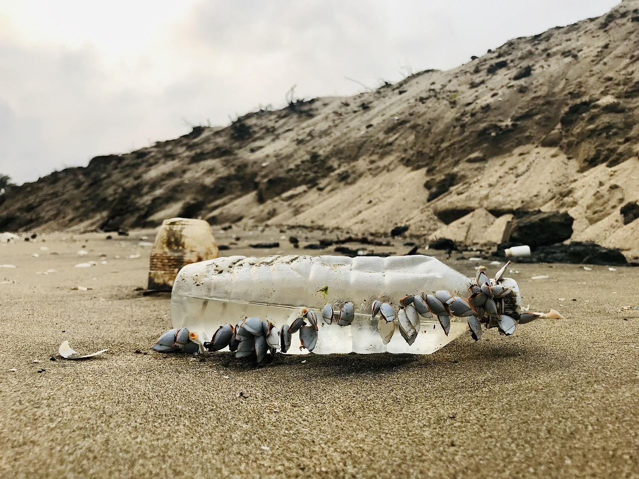
Understanding Food Chains and Ecosystem Dynamics
13
Conservation Efforts
Protecting Habitats and Ecosystems
Protecting habitats and ecosystems helps maintain food chains.
This effort ensures the stability of biodiversity and ecological balance.
Reducing Pollution and Climate Change
Reducing pollution and climate change helps conserve species.
Such actions mitigate threats to wildlife and their natural environments.
Understanding Food Chains for Sustainability
Understanding food chains informs conservation efforts and promotes sustainability.
It highlights the interconnectedness of species and the importance of preserving ecosystems.

Slide 14

Understanding Food Chains and Ecosystem Dynamics
14
Conclusion
Interdependence in Ecosystems
Conservation and Sustainability
Food chains show the interdependence of species in ecosystems.
Understanding these connections highlights the delicate balance within nature.
Understanding food chains helps us appreciate the importance of conservation and sustainability.
This knowledge encourages actions to protect ecosystems and biodiversity.

Slide 15

Understanding Food Chains and Ecosystem Dynamics
15
Key Takeaways
Energy Flow in Food Chains
Roles of Different Consumers
Impact of Human Activities
Food chains show the flow of energy and nutrients between species.
This process is essential for maintaining balance in ecosystems.
Herbivores, carnivores, and omnivores play important roles in ecosystems.
Each type of consumer contributes to the stability and diversity of food chains.
Human activities can impact food chains and ecosystems.
These impacts can lead to disruptions in ecological balance and biodiversity.

Slide 16
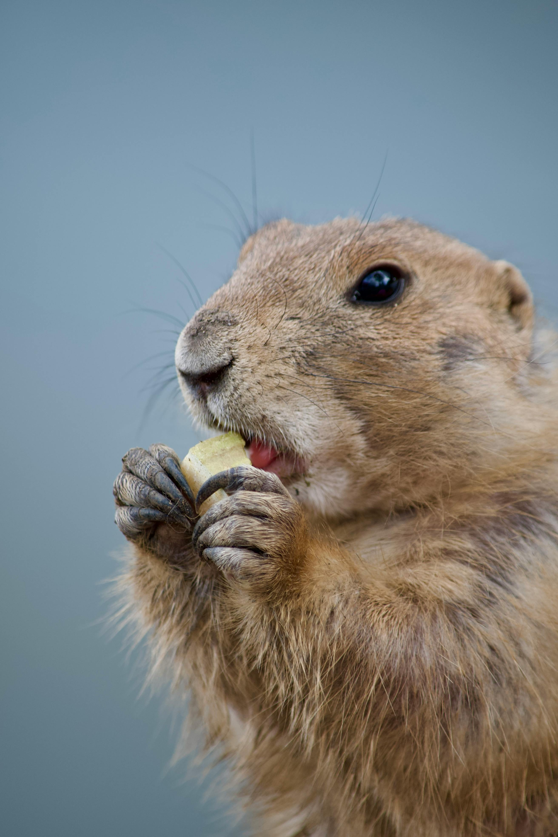
Understanding Food Chains and Ecosystem Dynamics
16
Reflection Questions
Understanding Ecosystems
Conservation Efforts
How do food chains help us understand ecosystems?
What can we do to help conserve species and ecosystems?
How do food chains help us understand ecosystems?
What can we do to help conserve species and ecosystems?

Slide 17
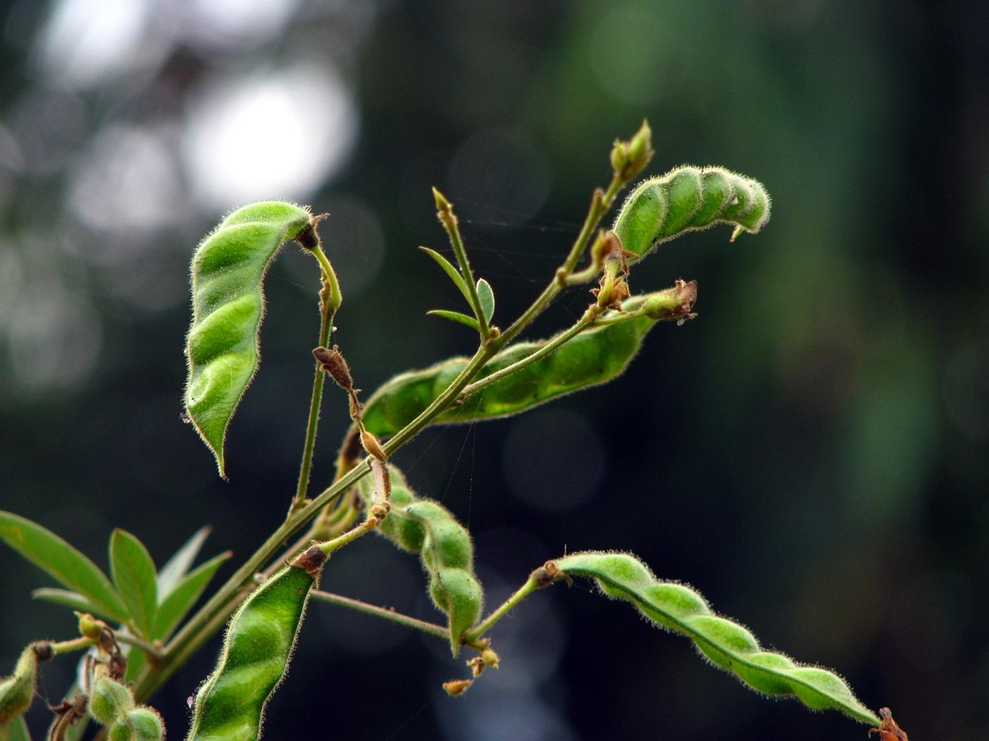
Understanding Food Chains and Ecosystem Dynamics
17
Next Steps
Understanding Food Webs
Learn more about food webs and complex ecosystems.
Explore ways to reduce human impact on food chains and ecosystems.
Sustainable Ecosystem Practices
Learn more about food webs and complex ecosystems.
Explore ways to reduce human impact on food chains and ecosystems.

Slide 18

Understanding Food Chains and Ecosystem Dynamics
18
Additional Resources
Books and Articles
Books and articles on food chains and ecosystems.
These resources provide foundational knowledge and insights into ecological interactions.
Online Educational Resources
Online resources and educational websites for further learning.
These platforms offer interactive tools and up-to-date information on ecosystems.

Slide 19

Understanding Food Chains and Ecosystem Dynamics
19
Assessment and Feedback
Quizzes and Assignments
Feedback and Discussion
Quizzes and assignments to assess understanding.
These tools help gauge the depth of knowledge acquired.
Feedback and discussion to promote further learning.
Engaging in dialogue fosters a deeper comprehension of the material.

Slide 20
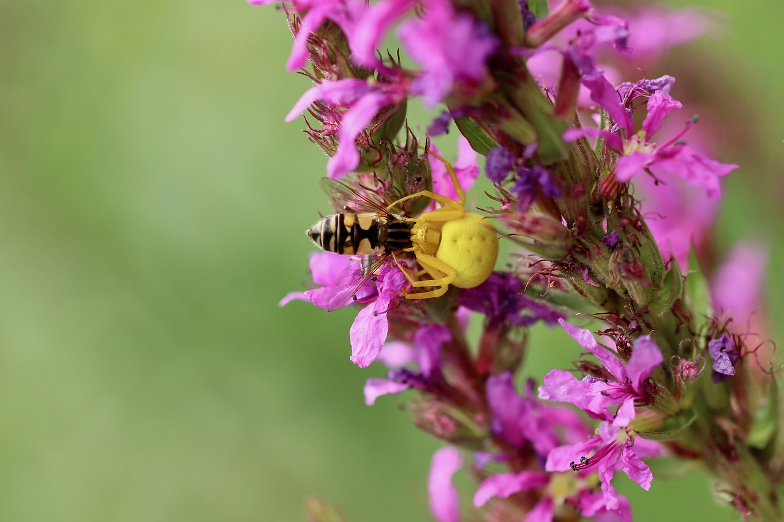
Understanding Food Chains and Ecosystem Dynamics
20
Conclusion and Final Thoughts
Understanding Food Chains
Understanding food chains is essential for appreciating the balance and interdependence of ecosystems.

