Slide 1

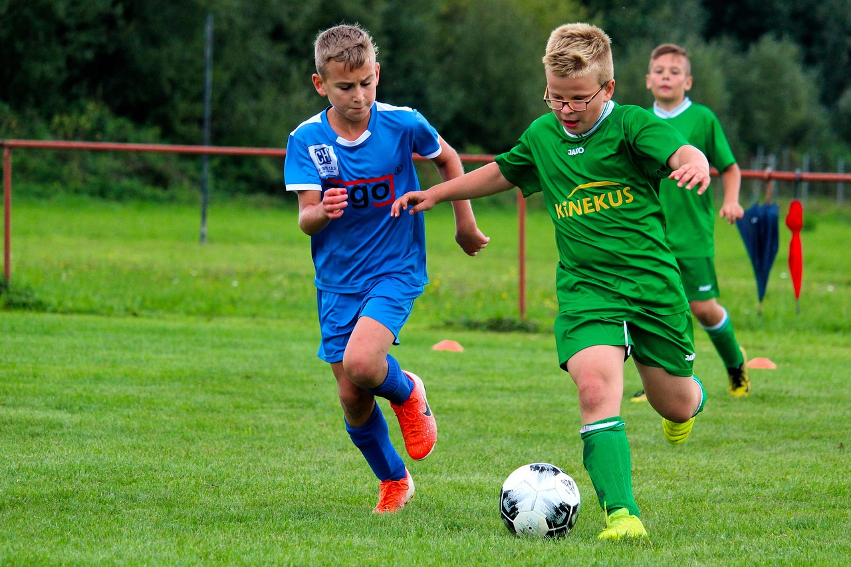
Fitness Fundamentals and Healthy Habits for Active Living
Promoting Physical Health, Mental Well-being, and Lifelong Healthy Practices

Slide 2
Table of Contents
Welcome to Fitness Fundamentals and Healthy Ha…
What is Fitness?
Healthy Habits for Active Living
Benefits of Regular Physical Activity
Importance of Nutrition and Meal Planning
Stress Management and Mindfulness
Setting Fitness Goals and Tracking Progress
Overcoming Obstacles and Staying Motivated
Conclusion and Next Steps
Interactive Activity: Fitness Scavenger Hunt
Interactive Activity: Healthy Plate Creation
Interactive Activity: Fitness Charades
Assessment and Evaluation
04
05
06
07
08
09
10
11
12
13
14
15
16

Slide 3
Table of Contents
Conclusion and Final Thoughts
References and Resources
Appendix: Additional Resources
Glossary of Terms
Index
Credits and Acknowledgments
Final Slide: Thank You!
17
18
19
20
21
22
23

Slide 4

Welcome to Fitness Fundamentals and Healthy Habits for Active Living
Importance of Fitness and Healthy Habits
Lesson Plan Objectives
Interactive Learning Activities
Introduction to the importance of fitness and healthy habits for 11-year-old students.
Understanding how these practices contribute to overall well-being and development.
Overview of the lesson plan and its objectives.
Highlighting the key goals to be achieved during the session.
Engaging and interactive activities to promote learning and participation.
Encouraging students to actively take part in fitness and healthy habit exercises.
4
Fitness Fundamentals and Healthy Habits for Active Living

Slide 5
What is Fitness?
Definition and Components of Fitness
Significance of Regular Physical Activity
Activities That Promote Fitness
Mental and Social Benefits of Fitness
Fitness encompasses cardiovascular endurance, strength, flexibility, and body composition.
These components collectively contribute to an individual's physical health and performance.
Engaging in regular physical activity is crucial for maintaining overall health and wellbeing.
It helps prevent chronic diseases and enhances quality of life.
Physical activities like walking, running, swimming, and dancing are effective in improving fitness.
These activities cater to different preferences and fitness levels, making them accessible to many.
Fitness activities contribute to better mental health by reducing stress and improving mood.
They also foster social connections through group exercises and shared experiences.
5
Fitness Fundamentals and Healthy Habits for Active Living

Slide 6
Healthy Habits for Active Living
01
Balanced Diets and Nutrition
Importance of balanced diets and nutrition for optimal health.
A well-rounded diet supports physical and mental wellbeing.
02
Hydration, Sleep, and Stress Management
Benefits of healthy habits such as hydration, sleep, and stress management.
These habits are essential for maintaining energy and reducing health risks.
03
Examples of Healthy Habits
Examples of healthy habits that promote overall wellbeing (eating a variety of fruits and vegetables, getting enough sleep, practicing mindfulness).
Incorporating these habits can lead to a more fulfilling and healthier lifestyle.
04
Tips for Developing Healthy Habits
Tips for developing healthy habits and making informed choices.
Small, consistent changes can lead to long-term positive outcomes.
6
Fitness Fundamentals and Healthy Habits for Active Living

Slide 7
Benefits of Regular Physical Activity
01
02
03
04
05
Physical Health Benefits
Mental Health Benefits
Social Benefits
Examples of Social Physical Activities
Tips for Daily Physical Activity
Regular physical activity reduces the risk of chronic diseases and improves cardiovascular health.
Engaging in exercise strengthens the body and promotes overall physical well-being.
Exercise helps reduce stress and anxiety, contributing to improved mental health.
Physical activity is known to enhance mood and foster emotional resilience.
Participating in physical activities can improve social connections and boost self-esteem.
Group exercises and team sports provide opportunities for meaningful interactions.
Team sports and group fitness classes are excellent ways to promote social connections.
These activities encourage collaboration and build a sense of community.
Incorporate physical activity into daily life by walking or cycling to work.
Setting aside time for regular exercise routines can make staying active easier.
7
Fitness Fundamentals and Healthy Habits for Active Living

Slide 8

Importance of Nutrition and Meal Planning
Definition and Importance of Nutrition
Benefits of Meal Planning
Nutrition is the process of providing or obtaining the food necessary for health and growth.
It plays a crucial role in maintaining optimal health and preventing chronic diseases.
Meal planning and preparation promote healthy eating habits and portion control.
It helps individuals make better food choices and save time during busy schedules.
Healthy Meal Planning Strategies
Tips for Informed Food Choices
Incorporating a variety of food groups and limiting sugary drinks and snacks are effective strategies.
These practices ensure a balanced diet and reduce the risk of nutritional deficiencies.
Making informed food choices involves reading labels and understanding nutritional content.
Developing healthy eating habits can lead to long-term health benefits and improved well-being.
8
Fitness Fundamentals and Healthy Habits for Active Living

Slide 9
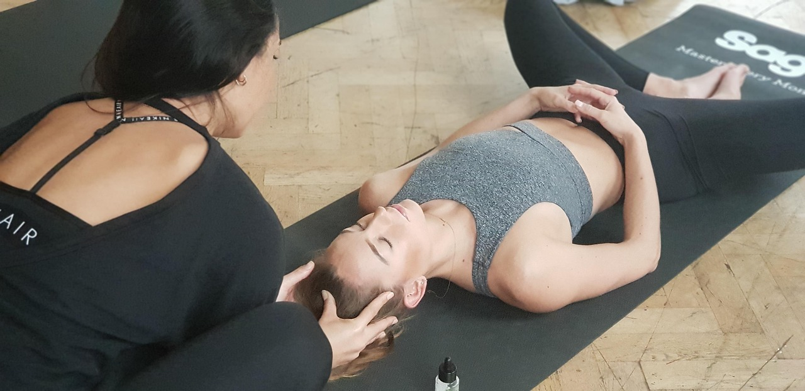
Stress Management and Mindfulness
Understanding Stress and Its Effects
Benefits of Stress Management Techniques
Definition of stress and its impact on overall health.
Stress can affect mental, emotional, and physical well-being.
Benefits of stress management techniques (deep breathing, meditation, yoga).
These practices can reduce anxiety and improve overall health.
Mindfulness Practices for Daily Life
Incorporating Mindfulness into Routine
Examples of mindfulness practices (mindful eating, mindful movement).
These practices help individuals stay present and focused.
Tips for incorporating stress management and mindfulness into daily life.
Simple changes can lead to long-term benefits for mental health.
9
Fitness Fundamentals and Healthy Habits for Active Living

Slide 10

Setting Fitness Goals and Tracking Progress
01
The Importance of Realistic Goals
Setting realistic and achievable fitness goals is crucial for long-term success.
Unrealistic goals can lead to frustration and a higher likelihood of giving up.
02
Tracking Progress for Success
Monitoring your progress helps you stay on track and measure your achievements.
It provides valuable insights into what works and what needs adjustment.
03
Fitness Tracking Methods
Examples of fitness tracking methods include fitness journals and mobile apps.
These tools can help you organize your routines and monitor your improvements.
04
Staying Motivated and Overcoming Obstacles
Staying motivated requires a positive mindset and a focus on your goals.
Overcoming obstacles involves identifying challenges and finding practical solutions.
10
Fitness Fundamentals and Healthy Habits for Active Living

Slide 11

Overcoming Obstacles and Staying Motivated
01
Common Obstacles to Fitness
Lack of time and motivation are frequent barriers to maintaining fitness and healthy habits.
These challenges can make it difficult to establish a consistent routine.
02
Strategies for Overcoming Obstacles
Finding a workout buddy and rewarding progress are effective ways to stay on track.
These strategies help create accountability and celebrate achievements.
03
The Role of Self-Care and Self-Compassion
Prioritizing self-care and practicing self-compassion are essential for long-term success.
They allow individuals to approach fitness with a positive and sustainable mindset.
04
Tips for Staying Motivated
Engaging in enjoyable activities and setting realistic goals can boost motivation.
These tips help maintain enthusiasm and commitment to healthy habits.
11
Fitness Fundamentals and Healthy Habits for Active Living

Slide 12
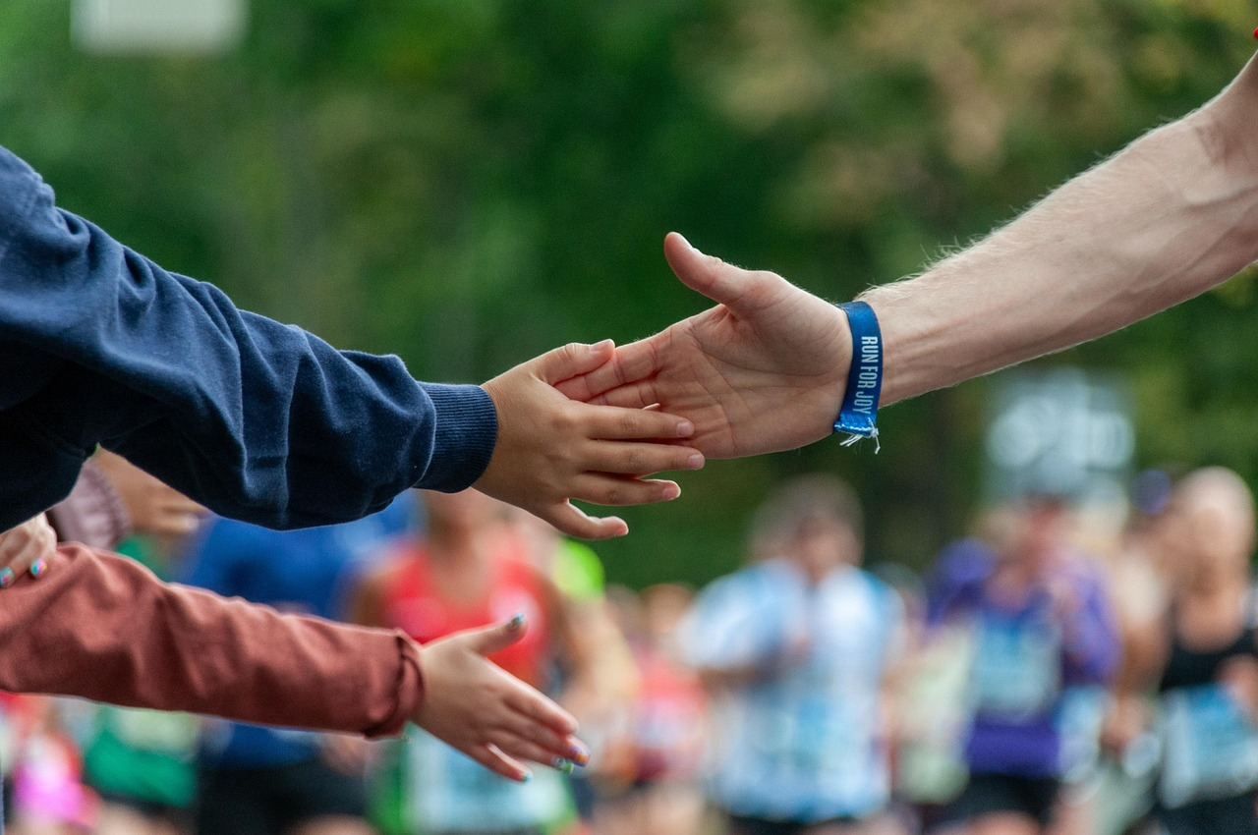
Conclusion and Next Steps
Key Takeaways
Healthy Habits
Support Resources
Summary of key takeaways from the lesson
Encouragement to continue learning and practicing fitness fundamentals and healthy habits
Encouragement to continue learning and practicing fitness fundamentals and healthy habits
Resources for further learning and support
Resources for further learning and support
Summary of key takeaways from the lesson
12
Fitness Fundamentals and Healthy Habits for Active Living

Slide 13

Interactive Activity: Fitness Scavenger Hunt
Activity Instructions
Examples of Items to Find
Participants will engage in a scavenger hunt focused on fitness-related themes.
Follow the provided guidelines to ensure a fun and educational experience.
Search for fitness-related terms, healthy foods, and exercise equipment.
These items will help reinforce knowledge about health and fitness.
Teamwork Tips
Debriefing Questions
Work collaboratively to promote effective communication and teamwork.
Encourage sharing ideas and supporting each other during the activity.
Discuss what was learned and how teamwork contributed to the activity.
Reflect on how the scavenger hunt can inspire healthier lifestyle choices.
13
Fitness Fundamentals and Healthy Habits for Active Living

Slide 14

Interactive Activity: Healthy Plate Creation
01
Activity Instructions
03
Balanced Meal Tips
Instructions for the activity.
Follow the steps to create a healthy plate.
Tips for creating a balanced and nutritious meal.
Discover strategies for combining food groups effectively.
02
Healthy Food Examples
04
Debriefing Discussion
Examples of healthy foods and portion control.
Learn about ideal food choices and serving sizes.
Debriefing questions to discuss after the activity.
Reflect on the experience and share insights.
14
Fitness Fundamentals and Healthy Habits for Active Living

Slide 15

Interactive Activity: Fitness Charades
Activity Instructions
Examples of Fitness Terms
Follow the provided guidelines to participate in the Fitness Charades activity.
Ensure everyone understands the rules before starting.
Act out fitness-related terms like 'jumping jacks' or 'yoga poses'.
Use creative movements to make the activity engaging and fun.
Teamwork and Communication Tips
Debriefing Questions
Encourage participants to work together and communicate effectively.
Foster a supportive environment to enhance collaboration.
Discuss what participants learned about teamwork during the activity.
Reflect on how communication impacted the success of the charades.
15
Fitness Fundamentals and Healthy Habits for Active Living

Slide 16

Assessment and Evaluation
Overview of Methods
Self-Assessment Importance
Overview of assessment and evaluation methods such as quizzes, class discussions, and reflective journals.
These methods help in understanding students' learning progress and areas for improvement.
The importance of self-assessment and self-reflection in personal and academic growth.
Encouraging students to evaluate their own work fosters independence and critical thinking.
Feedback and Support Tips
Examples of Tools
Tips for providing feedback and support to enhance learning outcomes.
Effective feedback should be constructive, timely, and tailored to individual needs.
Examples of assessment and evaluation tools include rubrics and feedback forms.
These tools provide structured and clear criteria for evaluating performance.
16
Fitness Fundamentals and Healthy Habits for Active Living

Slide 17

Conclusion and Final Thoughts
Final Thoughts and Takeaways
Encouragement for Continued Growth
Resources for Further Learning
Final thoughts and takeaways from the lesson.
Encouragement to continue learning and practicing fitness fundamentals and healthy habits.
Encouragement to continue learning and practicing fitness fundamentals and healthy habits.
Resources for further learning and support.
Resources for further learning and support.
Final thoughts and takeaways from the lesson.
17
Fitness Fundamentals and Healthy Habits for Active Living

Slide 18

References and Resources
Comprehensive Reference List
Finding Credible Sources
List of references and resources used in the lesson
Examples of books, articles, and websites for further learning
Tips for finding credible and reliable sources of information
Importance of staying up-to-date with the latest research and trends
Expanding Knowledge
Staying Current
Examples of books, articles, and websites for further learning
Tips for finding credible and reliable sources of information
Importance of staying up-to-date with the latest research and trends
List of references and resources used in the lesson
18
Fitness Fundamentals and Healthy Habits for Active Living

Slide 19
Appendix: Additional Resources
1
Learning and Support Resources
2
Fitness and Healthy Habits Apps
Additional resources for further learning and support (worksheets, videos, online tutorials).
These materials can help individuals deepen their understanding and stay motivated.
Examples of fitness and healthy habits apps and websites.
These tools provide practical ways to track progress and maintain routines.
3
Technology for Fitness
4
Community Engagement
Tips for using technology to support fitness and healthy habits.
Leveraging technology can make it easier to stay consistent and achieve goals.
Importance of staying connected and engaged with the fitness and healthy habits community.
Being part of a community fosters accountability and shared motivation.
19
Fitness Fundamentals and Healthy Habits for Active Living

Slide 20
Glossary of Terms
01
02
Key Fitness Terms
Practical Applications
Definition of key terms related to fitness and healthy habits (cardiovascular endurance, strength, flexibility, body composition)
Examples of how to apply these terms in real-life situations
Examples of how to apply these terms in real-life situations
Tips for using these terms in everyday language
03
04
Terminology Tips
Value of Correct Terminology
Tips for using these terms in everyday language
Importance of understanding and using correct terminology
Importance of understanding and using correct terminology
Definition of key terms related to fitness and healthy habits (cardiovascular endurance, strength, flexibility, body composition)
20
Fitness Fundamentals and Healthy Habits for Active Living

Slide 21

Index
Key Terms and Concepts
Index of key terms and concepts covered in the lesson.
Examples of how to use the index to find specific information.
Using the Index Effectively
Tips for using the index to review and reinforce learning.
Examples of how to use the index to find specific information.
Review and Reinforcement
Tips for using the index to review and reinforce learning.
Importance of referencing and citing sources.
Referencing and Citing
Importance of referencing and citing sources.
Examples of how to use the index to find specific information.
21
Fitness Fundamentals and Healthy Habits for Active Living

Slide 22
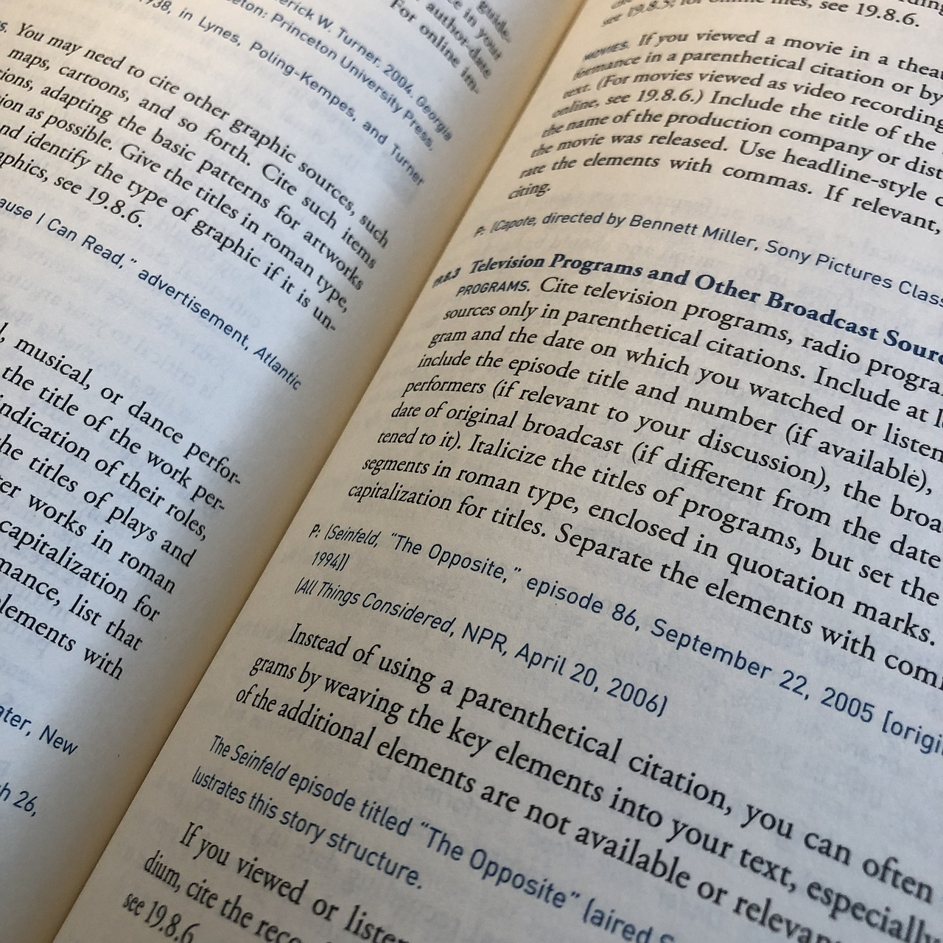
Credits and Acknowledgments
Acknowledging Contributors and Sources
Tips for Proper Citation
Significance of Academic Integrity
Acknowledgments of contributors and sources used in the lesson.
Examples of how to properly cite and reference sources.
Tips for giving credit where credit is due.
Importance of academic integrity and honesty.
Examples of how to properly cite and reference sources.
Importance of academic integrity and honesty.
22
Fitness Fundamentals and Healthy Habits for Active Living

Slide 23

Final Slide: Thank You!
Final Slide: Thank You!
Final message and thank you note
Instructions: The content must follow the the following layout:items: General purpose content without defined structure. Use only if there is no way of making other layout work.
23
Fitness Fundamentals and Healthy Habits for Active Living

