Slide 1
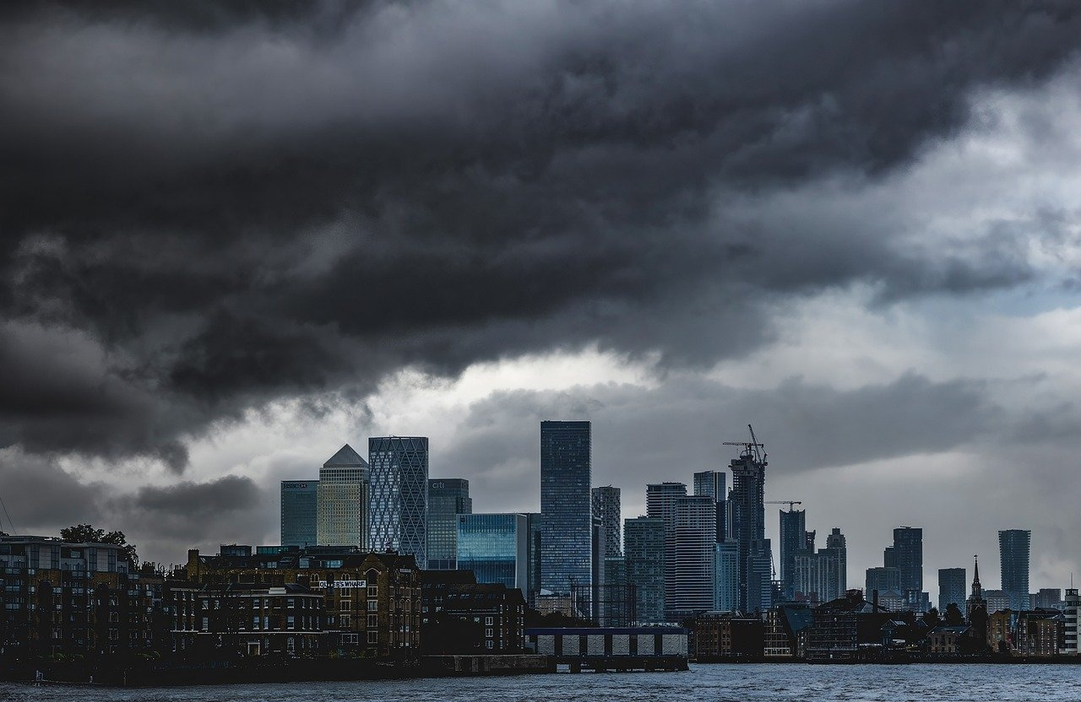
Journey Through 1666: The Great Fire of London
Immersive Exploration of Bravery, Resilience, and Historical Transformation

Slide 2
Table of contents
01
02
03
04
05
06
07
08
09
10
11
Lesson Introduction
Embark on an exciting historical journey
Transport young learners back to 1666 London
Time of wooden buildings, narrow streets
Extraordinary event that changed the city forever
Immerse children in the dramatic story
Great Fire of London
Potentially scary historical event turned engaging
Discover how a small fire grew into a massive conflagration
Themes of bravery, community resilience, historical transfo…
Interactive storytelling and hands-on activities

Slide 3
Table of contents
12
13
14
15
16
17
18
19
20
Imaginative reconstructions of the pivotal moment
Subject Knowledge
Use only English language
Consider types of layouts for the slides
Strongly imply which layout fits the content
List of items layout
Steps or sequential processes layout
SWOT analysis layout
Numerical data layout

Slide 4
1
Lesson Introduction
01
02
03
04
05
Introduction
The Beginning
The Destruction
The Aftermath
Themes
Embark on an exciting historical journey back to 1666 London.
Discover the dramatic story of the Great Fire of London.
The Great Fire of London started in a bakery on Pudding Lane.
It began as a small fire but quickly grew into a massive conflagration.
The fire destroyed a significant portion of the city.
Iconic landmarks like St. Paul's Cathedral were lost.
The event led to new building regulations.
Urban planning in London was transformed.
Bravery and community resilience.
Understanding historical transformation.
Journey Through 1666: The Great Fire of London

Slide 5
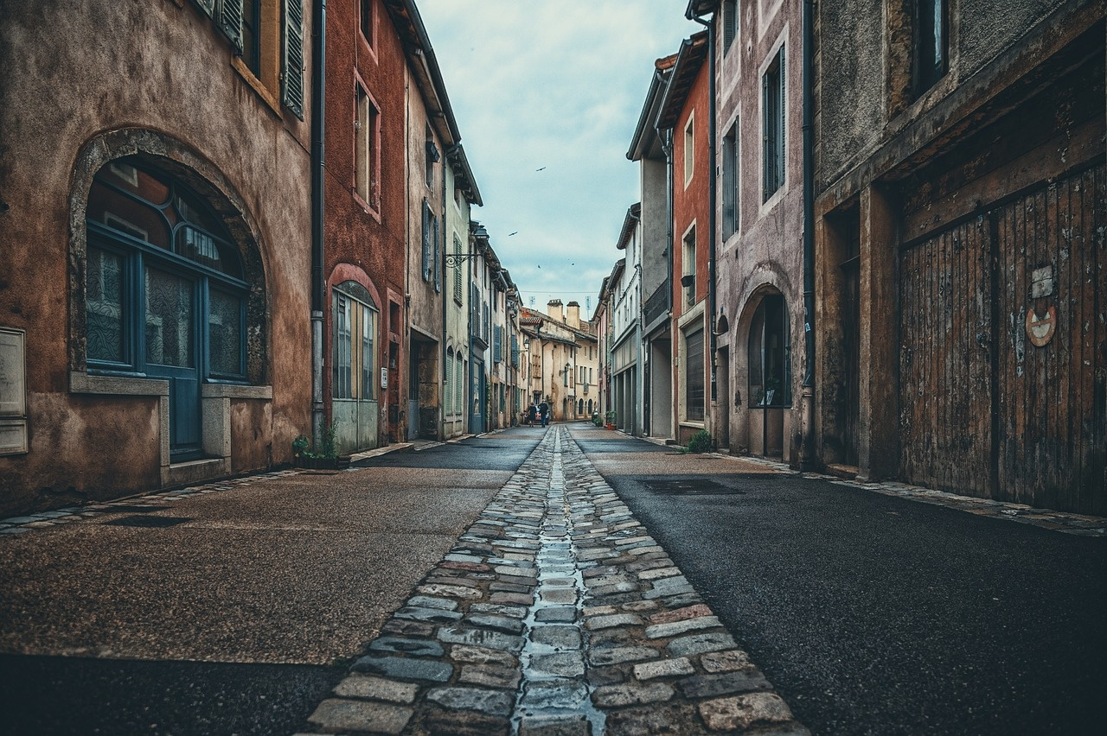
2
Embark on an exciting historical journey
Step back in time
Transport young learners to the year 1666, where they will experience the sights, sounds, and stories of historic London.
Explore the city
Navigate through the narrow streets and wooden buildings of London, setting the scene for the extraordinary events that unfolded.
Discover the spark
Uncover the origins of the Great Fire at a bakery on Pudding Lane, where a small flame ignited a chain of events that would change the city forever.
Witness the blaze
Follow the progression of the fire as it engulfs neighborhoods, showcasing the power and devastation of this historic event.
Learn lessons of resilience
Delve into themes of bravery and community resilience as Londoners come together to combat the flames and rebuild their city.
Journey Through 1666: The Great Fire of London

Slide 6
3
Transport young learners back to 1666 London
01
02
03
04
05
Engaging Introduction
Interactive Storytelling
Hands-On Activities
Imaginative Reconstructions
Reflection and Discussion
Set the scene of 1666 London with visuals of wooden buildings and narrow streets.
Introduce the Great Fire of London as a pivotal event that changed the city forever.
Narrate the story of the small fire in a bakery on Pudding Lane that escalated into a massive conflagration.
Highlight themes of bravery, community resilience, and historical transformation.
Engage children in hands-on activities like building miniature wooden structures to understand the city's architecture.
Encourage role-playing to experience the challenges faced by Londoners during the fire.
Foster creativity by encouraging children to imagine themselves living in 1666 London.
Prompt discussions on how a single event can have a profound impact on a community.
Facilitate a reflective discussion on the lessons learned from the Great Fire of London.
Encourage critical thinking about historical events and their relevance to the present day.
Journey Through 1666: The Great Fire of London

Slide 7
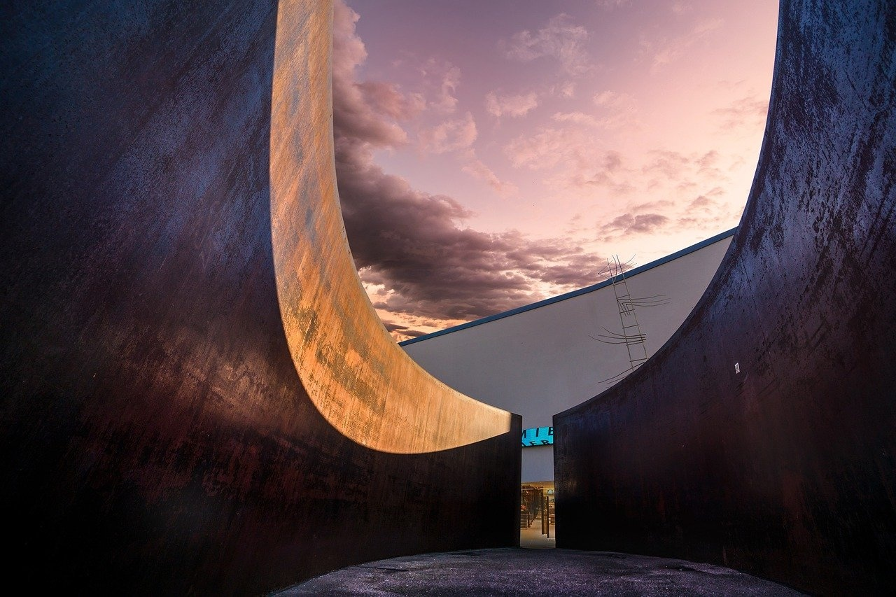
4
Time of wooden buildings, narrow streets
Architecture
Majority of buildings constructed from wood
Close proximity due to limited space
Street Layout
Narrow, winding streets
Lack of proper planning and organization
Fire Hazards
Overhanging upper stories
Thatched roofs prone to catching fire
Challenges for Firefighters
Limited access for fire engines
Lack of coordinated firefighting strategies
Impact on Urban Development
Aftermath led to rebuilding with stone and brick
Introduction of building regulations for fire safety
Journey Through 1666: The Great Fire of London

Slide 8
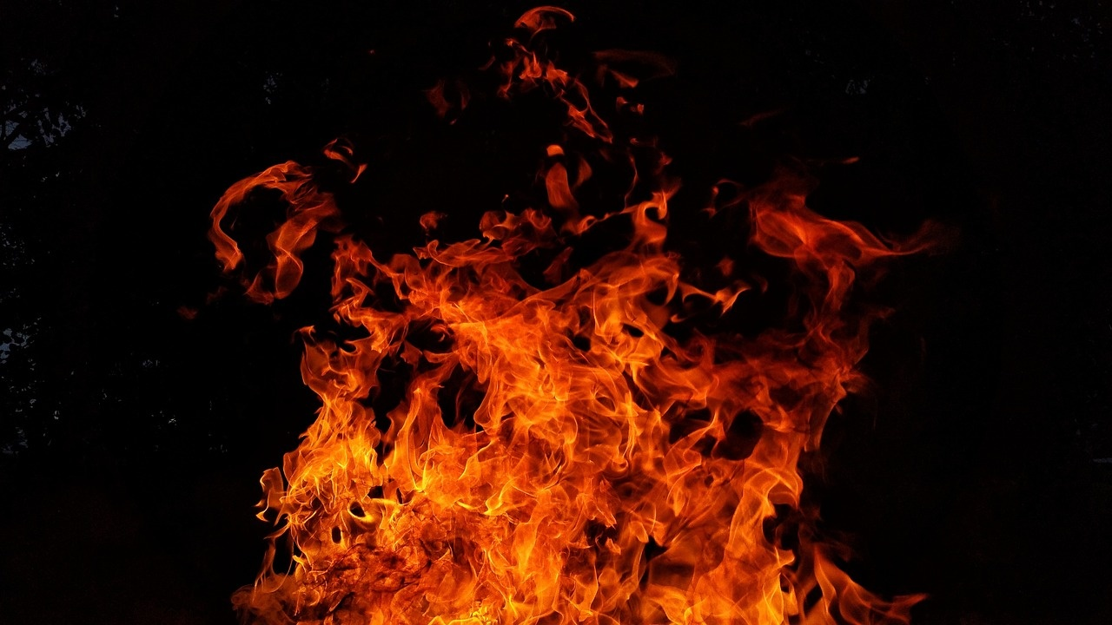
5
Extraordinary event that changed the city forever
The Great Fire of London
Started on September 2, 1666.
Lasted for three days, destroying over 13,000 houses, 87 churches, and iconic landmarks.
Impact on the City
Led to the modernization of London's infrastructure.
Sparked advancements in urban planning and fire safety regulations.
Transformation of Architecture
Shift from timber-framed buildings to brick and stone constructions.
Influenced the iconic skyline of London we see today.
Social and Economic Repercussions
Displacement of thousands of residents.
Economic challenges followed by a period of rebuilding and growth.
Legacy and Resilience
Demonstrated the resilience and spirit of Londoners.
Marked a turning point in the city's history, shaping its future development.
Journey Through 1666: The Great Fire of London

Slide 9
6
Immerse children in the dramatic story
01
02
03
04
05
Step into 1666 London
Witness the Spark
Explore the Spread
Discover Acts of Bravery
Reflect on the Aftermath
Experience the sights and sounds of 17th-century London, with its bustling markets and iconic landmarks.
Follow the events leading up to the Great Fire, starting from a small spark in Thomas Farriner's bakery on Pudding Lane.
Learn how the fire quickly engulfed the city, spreading through wooden structures and causing widespread destruction.
Uncover stories of heroism and bravery as Londoners worked together to combat the flames and save lives.
Reflect on the impact of the Great Fire, including the rebuilding of London and the lasting changes it brought to the cityscape.
Journey Through 1666: The Great Fire of London

Slide 10
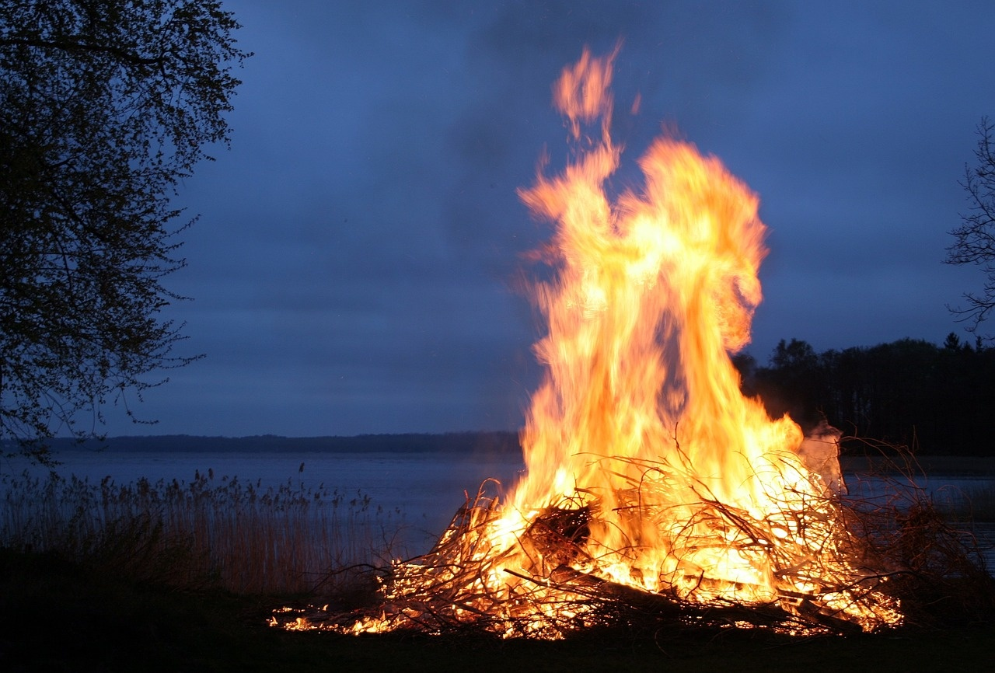
7
Great Fire of London
The Spark
Started in a bakery on Pudding Lane
September 2, 1666
The Spread
Strong winds fueled the flames
Wooden buildings and narrow streets contributed to the rapid spread
Destruction
13,200 houses, 87 churches, and numerous public buildings destroyed
Estimated 70,000 out of 80,000 residents left homeless
Rebuilding
Sir Christopher Wren led the reconstruction efforts
New building regulations introduced to prevent future fires
Legacy
Led to improvements in city planning and fire safety measures
Symbol of London's resilience and ability to rise from the ashes
Journey Through 1666: The Great Fire of London

Slide 11
8
Potentially scary historical event turned engaging
01
02
03
04
05
Introduction to 1666 London
The Spark at Pudding Lane
Rapid Spread of the Fire
Impact on the City
Themes of Bravery and Resilience
Set the scene of wooden buildings and narrow streets.
Discuss the small fire that ignited in a bakery.
Explore how the fire grew into a massive conflagration.
Describe how the Great Fire reshaped London forever.
Highlight the bravery and community resilience displayed during the crisis.
Journey Through 1666: The Great Fire of London

Slide 12
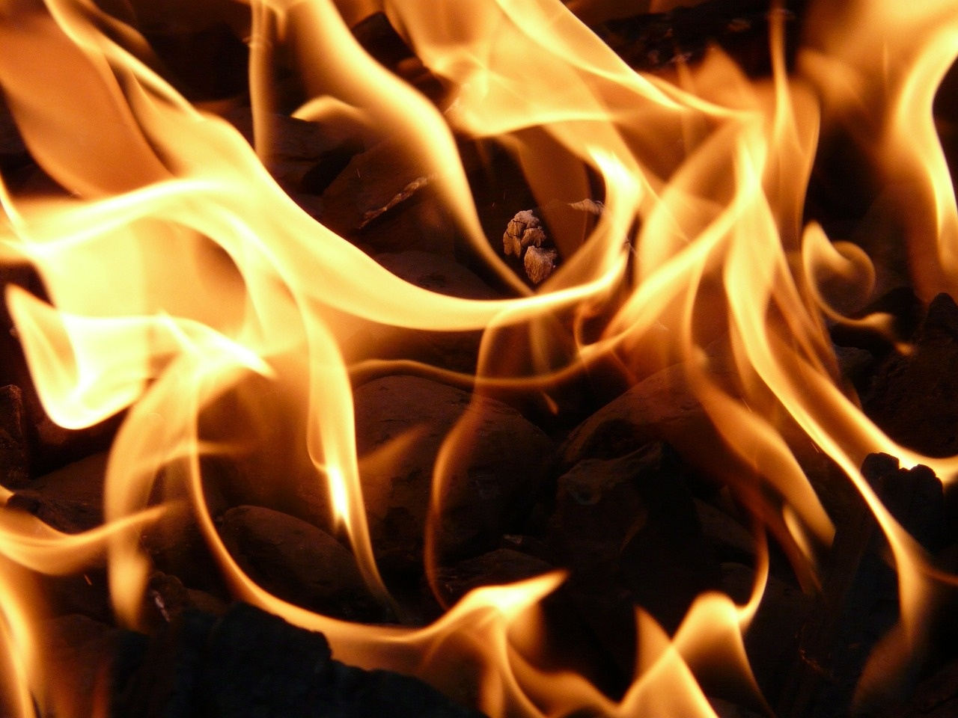
9
Discover how a small fire grew into a massive conflagration
Ignition
A small fire started in Thomas Farriner's bakery on Pudding Lane in the early hours of September 2, 1666.
Spread
Fueled by strong winds and the predominantly wooden structures of London, the fire quickly spread to neighboring buildings.
Chaos
Despite efforts to contain the fire, chaos ensued as the flames engulfed more and more of the city, creating panic and destruction.
Devastation
Over the next few days, the fire ravaged through London, destroying approximately 13,200 houses, 87 churches, and iconic landmarks like St. Paul's Cathedral.
Rebuilding
The Great Fire of London led to significant changes in city planning and architecture, with the rebuilding efforts paving the way for a more modern and fire-resistant London.
Journey Through 1666: The Great Fire of London

Slide 13
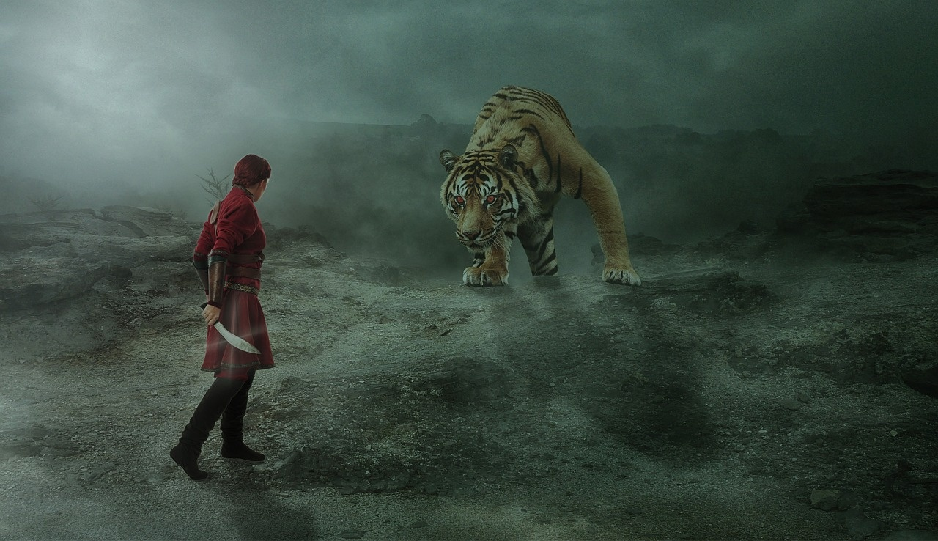
10
Themes of bravery, community resilience, historical transformation
01
Bravery
02
Community Resilience
Highlighting the courageous actions of individuals like Thomas Farriner, the baker whose bakery on Pudding Lane was where the fire started.
Discussing the bravery of the firefighters who worked tirelessly to contain the flames despite limited resources and technology.
Showcasing how the residents of London came together to help one another during and after the fire, displaying a strong sense of community spirit.
Exploring how the city rebuilt itself after the devastation, demonstrating resilience and determination in the face of adversity.
03
Historical Transformation
Illustrating how the Great Fire of London led to significant changes in urban planning and building regulations, shaping the city's architecture for centuries to come.
Examining how the event marked a turning point in London's history, leading to improvements in fire safety measures and disaster preparedness.
Journey Through 1666: The Great Fire of London

Slide 14
11
Interactive storytelling and hands-on activities
01
02
03
04
05
Storytelling Session
Role-Playing
Map Exploration
Building Reconstruction
Firefighting Demonstration
Engage young explorers with a captivating narrative of the events leading up to and during the Great Fire of London
Highlight key moments and characters
Encourage students to step into the shoes of historical figures such as King Charles II, Samuel Pepys, or the Baker of Pudding Lane
Understand different perspectives during the fire
Provide maps of 17th-century London for children to trace the path of the fire
Identify significant locations and understand the extent of the devastation
Allow students to construct miniature wooden buildings similar to those in London at the time
Emphasize the challenges faced due to the city's architecture
Organize a hands-on activity where children can experience using historical firefighting tools like leather buckets and hand pumps
Showcase the methods used to combat fires in the past
Journey Through 1666: The Great Fire of London

Slide 15
12
Imaginative reconstructions of the pivotal moment
01
02
03
04
Virtual Reality Experience
Scale Model of Pudding Lane
Interactive Storytelling
Artistic Renderings
Step into a virtual 1666 London and witness the Great Fire unfold in front of your eyes.
Explore a detailed scale model showcasing the bakery where the fire started, providing a tangible connection to the historical event.
Engage with interactive storytelling sessions that bring to life the experiences of individuals impacted by the fire.
View artistic interpretations of the Great Fire, capturing the chaos and destruction of the event through various mediums.
Journey Through 1666: The Great Fire of London

Slide 16

13
Subject Knowledge
Key Date
The Great Fire of London occurred in September 1666.
Origin
The fire started in a bakery on Pudding Lane owned by Thomas Farriner.
Duration
The fire raged for three days, destroying over 13,000 houses, 87 churches, and numerous public buildings.
Impact
The fire led to significant changes in city planning and architecture, with the introduction of new building regulations and the use of brick instead of wood.
Reconstruction
After the fire, renowned architect Christopher Wren played a key role in redesigning and rebuilding London, including the iconic St. Paul's Cathedral.
Journey Through 1666: The Great Fire of London

Slide 17
14
Use only English language
01
02
03
Lesson Plan Title
Lesson Introduction
Subject Knowledge
The Great Fire of London - A Historical Adventure for Young Explorers
Embark on an exciting historical journey that will transport young learners back to 1666 London, a time of wooden buildings, narrow streets, and an extraordinary event that would change the city forever.
This lesson will immerse children in the dramatic story of the Great Fire of London, transforming a potentially scary historical event into an engaging and age-appropriate learning experience.
Students will discover how a small fire in a bakery on Pudding Lane grew into a massive conflagration that reshaped the entire city.
Exploring themes of bravery, community resilience, and historical transformation.
Through interactive storytelling, hands-on activities, and imaginative reconstructions, children will connect with this pivotal moment in British history, understanding how a single event can dramatically impact an entire community.
Journey Through 1666: The Great Fire of London

Slide 18
15
Consider types of layouts for the slides
STRENTHS
WEAKNESSES
Engaging storytelling techniques to captivate young learners.
Hands-on activities for interactive learning experiences.
Immersive historical reconstructions to bring 1666 London to life.
Potential challenge in balancing historical accuracy with age-appropriate content.
Limited time frame for in-depth exploration of all aspects of the Great Fire of London.
Dependence on resources for hands-on activities and reconstructions.
S
W
O
T
OPPORTUNITIES
THREATS
Collaboration with local museums or historical societies for additional resources.
Integration of technology for virtual tours or interactive simulations.
Extension of learning beyond the classroom through field trips or guest speakers.
Misinterpretation of historical events leading to misconceptions.
Limited attention span of young learners impacting engagement.
External factors such as budget constraints affecting the quality of learning experiences.
Journey Through 1666: The Great Fire of London

Slide 19
16
Strongly imply which layout fits the content
STRENTHS
WEAKNESSES
Engaging and immersive historical storytelling
Hands-on activities for interactive learning
Age-appropriate content for young explorers
Limited historical accuracy due to simplification for children
Potential oversimplification of the impact of the Great Fire of London
Lack of in-depth analysis of historical context
S
W
O
T
OPPORTUNITIES
THREATS
Expansion of lesson to include more historical events
Collaboration with local museums or historical societies for additional resources
Integration of technology for virtual exploration of 1666 London
Misinterpretation of historical facts by young learners
Competition from other educational programs
Limited resources for hands-on activities and materials
Journey Through 1666: The Great Fire of London

Slide 20
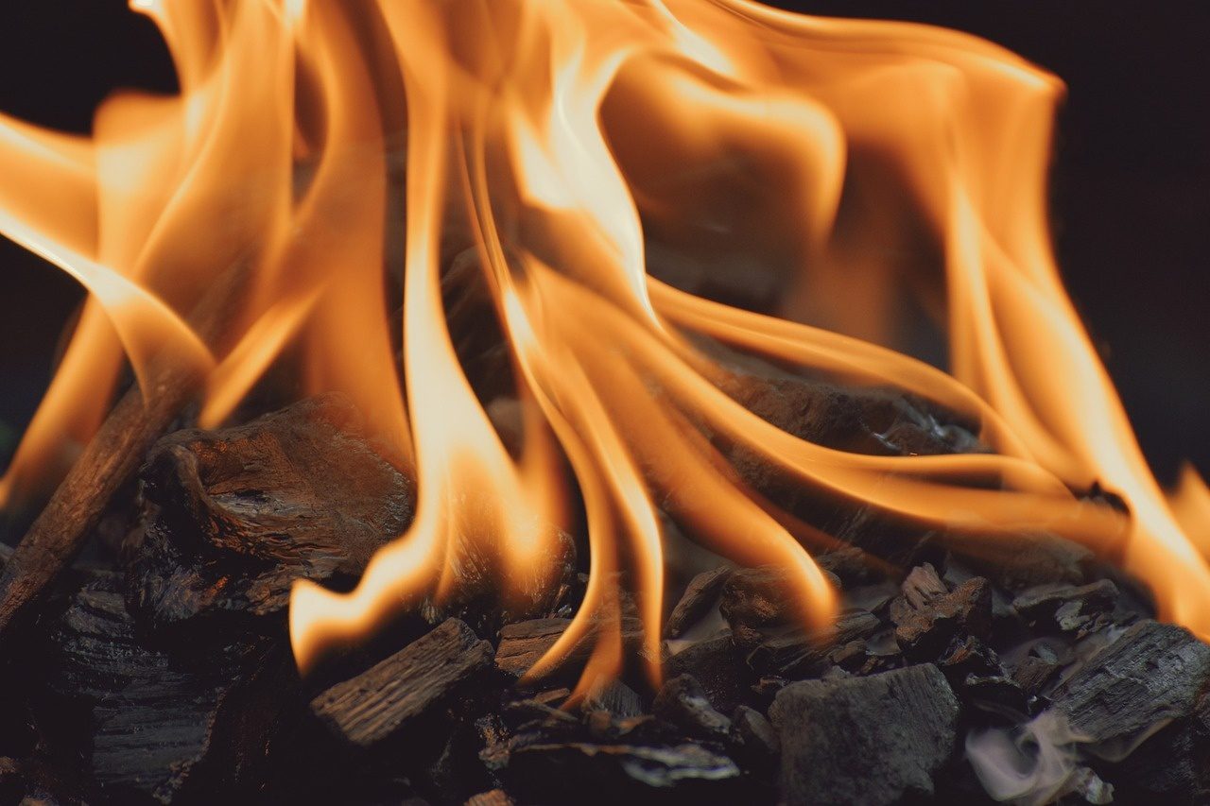
17
List of items layout
The Great Fire of London
The year 1666 marks the occurrence of the Great Fire of London.
The fire started on September 2 in a bakery on Pudding Lane.
It raged for three days, destroying over 13,000 houses, 87 churches, and important buildings like St. Paul's Cathedral.
The fire led to significant changes in city planning and building regulations, including the introduction of brick buildings and wider streets.
Despite the devastation, the Great Fire of London also paved the way for the city's modernization and reconstruction.
Journey Through 1666: The Great Fire of London

Slide 21
18
Steps or sequential processes layout
01
02
03
04
05
Introduction to 1666 London
The Spark at Pudding Lane
City Engulfed in Flames
Destruction and Aftermath
Rebuilding London
Set the historical context of London in 1666.
Describe the wooden buildings and narrow streets characteristic of the era.
Explain how the Great Fire started in a bakery on Pudding Lane.
Discuss the initial response to the fire and its rapid spread.
Detail the progression of the fire throughout the city.
Highlight the challenges faced by residents and firefighters.
Illustrate the extent of the damage caused by the Great Fire.
Explore the impact on the city's infrastructure and population.
Discuss the reconstruction efforts following the Great Fire.
Analyze the architectural changes and improvements made to prevent future disasters.
Journey Through 1666: The Great Fire of London

Slide 22
19
SWOT analysis layout
STRENTHS
WEAKNESSES
Engaging storytelling method
Hands-on activities for interactive learning
Age-appropriate content for young learners
Potential sensitivity to the topic of fire
Limited historical accuracy in reconstructions
Challenges in conveying the scale of the event
S
W
O
T
OPPORTUNITIES
THREATS
Foster a deeper understanding of historical events
Encourage critical thinking and empathy
Spark interest in further historical exploration
Misinterpretation of historical facts
Lack of engagement from some students
Time constraints impacting depth of learning
Journey Through 1666: The Great Fire of London

Slide 23
20
Numerical data layout
1666
13,200
87
3
Year of the Great Fire
Houses Destroyed
Churches Destroyed
Duration of Fire
The year when the Great Fire of London occurred.
The estimated number of houses destroyed during the fire.
The number of churches destroyed, including St. Paul's Cathedral.
The number of days it took for the fire to ravage through the city.
Journey Through 1666: The Great Fire of London

