Slide 1

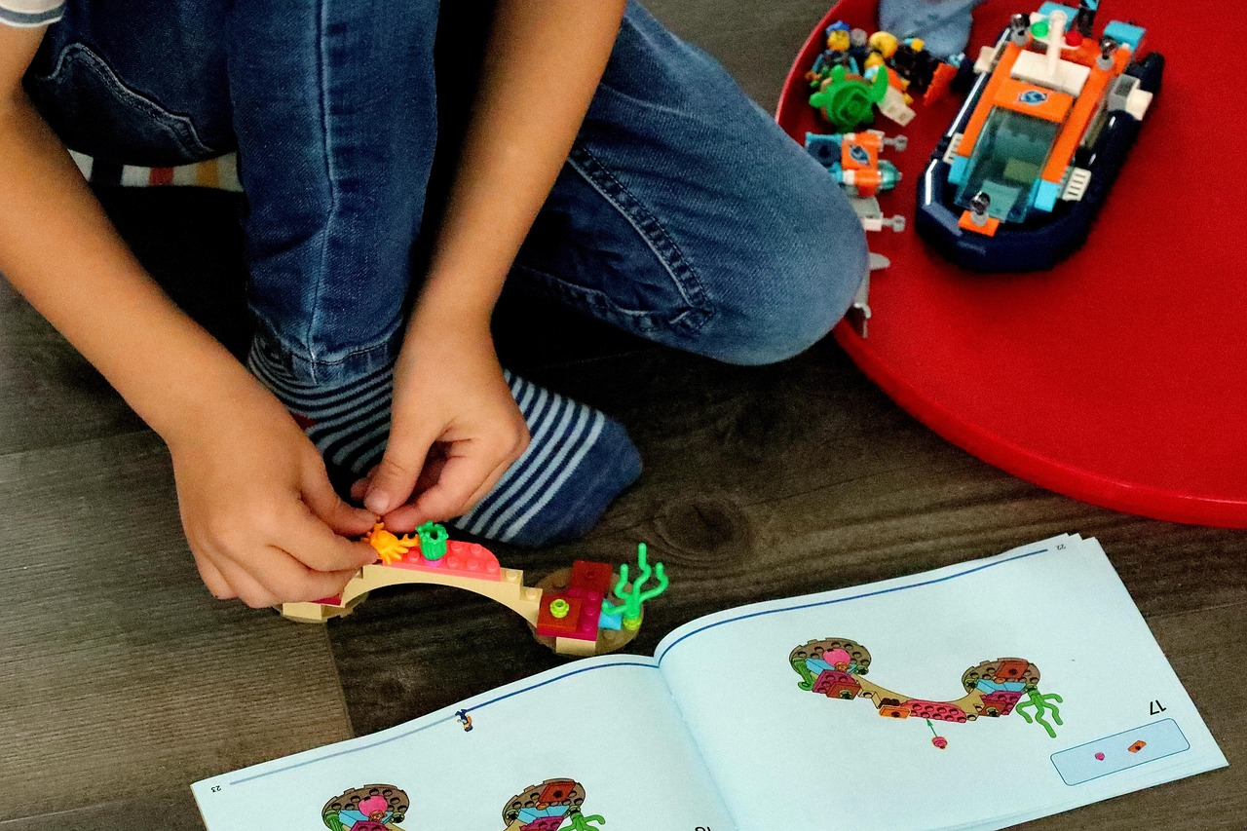
Exploring Patterns and Shapes: A Journey Through Mathematics and Creativity
Understanding, Creating, and Applying Patterns with Blocks and Shapes for Critical Thinking and Real-Life Skills

Slide 2
Table of Contents
Introduction to Exploring Patterns with Blocks…
What is a Pattern?
Types of Patterns
Recognizing Patterns
Creating Patterns with Blocks and Shapes
Pattern Blocks Activity
Shape Patterns Activity
Pattern Sequence Activity
Block Design Challenge
Real-Life Applications of Patterns
Assessment and Evaluation
Conclusion
Teaching Tips and Strategies
04
05
06
07
08
09
10
11
12
13
14
15
16

Slide 3
Table of Contents
Extension Activities
Parent Engagement
Reflection and Next Steps
Conclusion and Final Thoughts
Additional Resources
Final Thoughts and Recommendations
References and Credits
Appendix and Additional Materials
Glossary and Definitions
Index and Table of Contents
Credits and Acknowledgments
Final Slide and Conclusion
17
18
19
20
21
22
23
24
25
26
27
28

Slide 4

Introduction to Exploring Patterns with Blocks and Shapes
Welcome to Patterns and Shapes
Patterns in Nature
Exploring with Blocks and Shapes
Welcome to the world of patterns and shapes!
In this lesson, we will explore the concept of patterns using blocks and shapes.
Patterns are all around us, from the arrangement of leaves on a stem.
They can also be seen in the design on a butterfly's wings.
Blocks and shapes are great tools to understand patterns.
They help us visualize and create repeating designs.
4
Exploring Patterns and Shapes: A Journey Through Mathematics and Creativity

Slide 5
What is a Pattern?
Definition of a Pattern
Importance of Patterns
Patterns in Everyday Life
A pattern is a repeated sequence of objects, colors, or shapes.
Patterns can be found in nature, art, and design.
Understanding patterns is essential for problem-solving.
Patterns play a key role in critical thinking and mathematical reasoning.
Patterns are everywhere, from the natural world to human-made designs.
Recognizing patterns helps us make sense of the world around us.
5
Exploring Patterns and Shapes: A Journey Through Mathematics and Creativity

Slide 6
Types of Patterns
ABAB Pattern
AABB Pattern
ABC Pattern
ABAB pattern: alternating between two objects or events.
This pattern creates a rhythmic and predictable sequence.
AABB pattern: repeating two objects or events.
It emphasizes repetition and grouping of similar elements.
ABC pattern: a sequence of three objects or events.
This pattern introduces variety and progression in the sequence.
6
Exploring Patterns and Shapes: A Journey Through Mathematics and Creativity

Slide 7
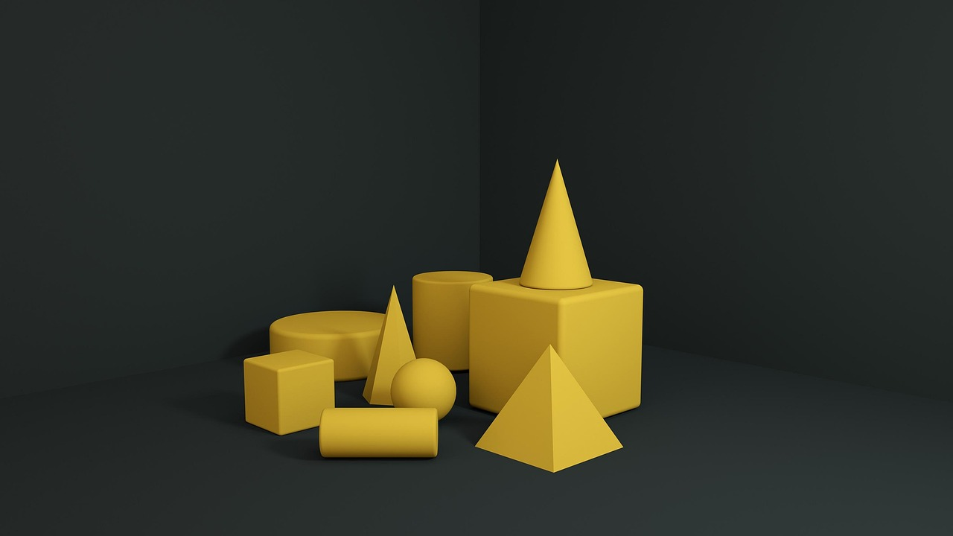
Recognizing Patterns
Understanding Pattern Recognition
Importance in Mathematics
Real-Life Applications
Pattern recognition is the ability to identify and describe patterns.
It involves using mathematical vocabulary to describe the relationships between objects.
Pattern recognition is an essential skill in mathematics.
It helps in understanding and solving mathematical problems effectively.
Pattern recognition is crucial in real-life situations.
It aids in making sense of complex systems and predicting outcomes.
7
Exploring Patterns and Shapes: A Journey Through Mathematics and Creativity

Slide 8

Creating Patterns with Blocks and Shapes
Exploring Patterns
Building Complexity
Describing Patterns
Use blocks and shapes to create and explore different patterns.
Start with simple patterns and gradually increase complexity.
Start with simple patterns and gradually increase complexity.
Encourage students to use mathematical vocabulary to describe their patterns.
Encourage students to use mathematical vocabulary to describe their patterns.
Use blocks and shapes to create and explore different patterns.
8
Exploring Patterns and Shapes: A Journey Through Mathematics and Creativity

Slide 9

Pattern Blocks Activity
Engaging with Pattern Blocks
Provide students with a set of pattern blocks and a challenge card.
This hands-on activity encourages creativity and problem-solving.
Collaborative Learning
Ask students to work in pairs to recreate the pattern using the blocks.
This fosters teamwork and communication skills among students.
Mathematical Vocabulary in Action
Encourage students to use mathematical vocabulary to describe their patterns.
This helps reinforce their understanding of geometric concepts.
9
Exploring Patterns and Shapes: A Journey Through Mathematics and Creativity

Slide 10

Shape Patterns Activity
Shape Preparation
Prepare a set of shapes with different colors, sizes, and textures.
These shapes will serve as the basis for the sorting activity.
Sorting Activity
Ask students to sort the shapes into categories, such as by color, size, or texture.
This activity helps students recognize and organize patterns effectively.
Mathematical Vocabulary
Encourage students to use mathematical vocabulary to describe their patterns.
This practice enhances their ability to articulate observations and reasoning.
10
Exploring Patterns and Shapes: A Journey Through Mathematics and Creativity

Slide 11

Pattern Sequence Activity
Creating Pattern Sequence Cards
Collaborative Pattern Building
Using Mathematical Vocabulary
Create a set of pattern sequence cards with different shapes and colors.
These cards will serve as the primary tools for the activity.
Ask students to work in pairs to create a pattern sequence using the cards.
This encourages teamwork and hands-on learning.
Encourage students to use mathematical vocabulary to describe their patterns.
This helps in reinforcing their understanding of mathematical concepts.
11
Exploring Patterns and Shapes: A Journey Through Mathematics and Creativity

Slide 12

Block Design Challenge
Engaging Challenge Setup
Collaborative Design Activity
Mathematical Vocabulary Emphasis
Provide students with a set of blocks and a challenge card.
Ask students to work in pairs to create a design using the blocks, incorporating patterns and shapes.
Encourage students to work together to explore creative possibilities.
Focus on teamwork and the integration of patterns and shapes in their designs.
Motivate students to describe their designs using mathematical terms.
Highlight the importance of precise language in explaining patterns and shapes.
12
Exploring Patterns and Shapes: A Journey Through Mathematics and Creativity

Slide 13
Real-Life Applications of Patterns
Patterns in Creative Fields
Patterns in Understanding and Prediction
Patterns in Problem-Solving
Patterns are used in art, design, architecture, and engineering.
They serve as a foundation for creating visually appealing and functional designs.
Patterns help us understand relationships between objects and make predictions.
This ability is crucial for analyzing trends and anticipating outcomes.
Understanding patterns is essential for problem-solving and critical thinking in real-life situations.
They enable individuals to identify solutions and make informed decisions.
13
Exploring Patterns and Shapes: A Journey Through Mathematics and Creativity

Slide 14
Assessment and Evaluation
Formative and Summative Assessments
Use formative and summative assessments to evaluate student understanding.
These methods help in identifying areas where students excel or need improvement.
Feedback and Guidance
Provide feedback and guidance to students to improve their understanding.
This ensures students can address their weaknesses effectively.
Rubrics and Criteria
Use rubrics and criteria to assess student work and provide feedback.
This approach ensures consistency and clarity in evaluation.
14
Exploring Patterns and Shapes: A Journey Through Mathematics and Creativity

Slide 15
Conclusion
Interactive Learning
Exploring patterns with blocks and shapes is a fun and interactive way to introduce students to the concept of patterns.
Students develop problem-solving skills, critical thinking, and hand-eye coordination.
Mathematical Foundation
Understanding patterns is essential for success in mathematics.
It also plays a significant role in real-life situations.
Skill Development
Students enhance their ability to recognize and create patterns.
This fosters both creativity and analytical thinking.
15
Exploring Patterns and Shapes: A Journey Through Mathematics and Creativity

Slide 16
Teaching Tips and Strategies
Relating Concepts to Real Life
Interactive Learning Experiences
Fostering Critical Thinking
Use real-life examples to make the concept more relatable.
This approach helps students connect theoretical knowledge to practical applications.
Make the lesson hands-on and interactive.
Engaging activities foster better understanding and retention of the material.
Encourage critical thinking and problem-solving skills.
This strategy empowers students to analyze and address challenges effectively.
16
Exploring Patterns and Shapes: A Journey Through Mathematics and Creativity

Slide 17

Extension Activities
Real-Life Application of Patterns
Creating and Solving Pattern Puzzles
Exploring Patterns with Technology
Provide opportunities for students to apply their knowledge of patterns in real-life scenarios.
This helps them understand the practical relevance and utility of patterns in everyday situations.
Encourage students to create and solve pattern puzzles.
This activity fosters creativity and critical thinking skills while reinforcing their understanding of patterns.
Use technology to create and explore patterns.
Technology provides innovative tools and platforms for students to visualize and experiment with patterns effectively.
17
Exploring Patterns and Shapes: A Journey Through Mathematics and Creativity

Slide 18

Parent Engagement
Encouraging Parental Participation
Encourage parents to participate in the lesson and provide feedback.
This helps create a collaborative learning environment for the child.
Collaborative Pattern Activities
Provide opportunities for parents to work with their child on pattern activities.
This fosters a hands-on approach to learning and strengthens parent-child bonds.
Sharing Learning Resources
Share resources and tips with parents to support their child's learning at home.
This ensures parents are equipped to reinforce educational concepts outside the classroom.
18
Exploring Patterns and Shapes: A Journey Through Mathematics and Creativity

Slide 19
Reflection and Next Steps
Evaluating Lesson Effectiveness
Planning Future Lessons
Encouraging Application of Knowledge
Reflect on the effectiveness of the lesson and identify areas for improvement.
Consider how well students grasped the concept of patterns and pinpoint areas needing enhancement.
Plan next steps and future lessons to build on the concept of patterns.
Develop strategies to deepen students' understanding and engagement with patterns.
Provide opportunities for students to apply their knowledge of patterns in new and challenging ways.
Design activities that challenge students to use patterns creatively and critically.
19
Exploring Patterns and Shapes: A Journey Through Mathematics and Creativity

Slide 20

Conclusion and Final Thoughts
Interactive Learning with Patterns
Exploring patterns with blocks and shapes is a fun and interactive way to introduce students to the concept of patterns.
This hands-on approach engages students and makes learning enjoyable.
Skill Development through Patterns
Students develop problem-solving skills, critical thinking, and hand-eye coordination.
These skills are foundational for academic and personal growth.
Real-Life Importance of Patterns
Understanding patterns is essential for success in mathematics and real-life situations.
Recognizing patterns helps in making predictions and solving complex problems.
20
Exploring Patterns and Shapes: A Journey Through Mathematics and Creativity

Slide 21
Additional Resources
Student Support Resources
Parental Guidance Tips
Exploration of Mathematics
Provide additional resources and support for students who need extra help.
Encourage students to explore and learn more about patterns and mathematics.
Share resources and tips with parents to support their child's learning at home.
Provide additional resources and support for students who need extra help.
Encourage students to explore and learn more about patterns and mathematics.
Share resources and tips with parents to support their child's learning at home.
21
Exploring Patterns and Shapes: A Journey Through Mathematics and Creativity

Slide 22
Final Thoughts and Recommendations
The Joy of Patterns
Exploring patterns with blocks and shapes is a valuable and enjoyable experience for students.
Understanding patterns is essential for success in mathematics and real-life situations.
Encouraging Exploration
Encourage students to continue exploring and learning about patterns and mathematics.
Understanding patterns is essential for success in mathematics and real-life situations.
Patterns in Education
Exploring patterns with blocks and shapes is a valuable and enjoyable experience for students.
Encourage students to continue exploring and learning about patterns and mathematics.
22
Exploring Patterns and Shapes: A Journey Through Mathematics and Creativity

Slide 23
References and Credits
References and Credits Overview
List references and credits for the lesson and activities.
Acknowledge sources and inspirations for the lesson.
Acknowledging Contributions
Provide information for further learning and exploration.
List references and credits for the lesson and activities.
Further Learning Resources
Acknowledge sources and inspirations for the lesson.
Provide information for further learning and exploration.
23
Exploring Patterns and Shapes: A Journey Through Mathematics and Creativity

Slide 24

Appendix and Additional Materials
Additional Materials and Resources
Support for Teachers and Parents
Comprehensive Lesson Enhancements
Provide additional materials and resources for the lesson.
Include appendices and supplementary materials.
Offer support and guidance for teachers and parents.
Provide tools and strategies to enhance learning experiences.
Include diverse resources to cater to different learning needs.
Ensure materials are accessible and beneficial for all stakeholders.
24
Exploring Patterns and Shapes: A Journey Through Mathematics and Creativity

Slide 25

Glossary and Definitions
Key Terms and Vocabulary
Encouraging Mathematical Language
Glossary Utilization
Define key terms and vocabulary related to patterns and mathematics.
Provide a glossary of terms and definitions.
Encourage students to use mathematical vocabulary to describe their patterns.
Foster a deeper understanding through precise language.
Highlight the importance of referring to the glossary for clarity.
Support students in mastering mathematical concepts.
25
Exploring Patterns and Shapes: A Journey Through Mathematics and Creativity

Slide 26

Index and Table of Contents
Index and Table of Contents Overview
Encouraging Exploration
Structured Learning Path
Provide an index and table of contents for the lesson and activities.
Organize and structure the content for easy access and navigation.
Encourage students to explore and learn more about patterns and mathematics.
Organize and structure the content for easy access and navigation.
Provide an index and table of contents for the lesson and activities.
Encourage students to explore and learn more about patterns and mathematics.
26
Exploring Patterns and Shapes: A Journey Through Mathematics and Creativity

Slide 27
Credits and Acknowledgments
Acknowledging Sources and Inspirations
Credits and References
Further Learning Opportunities
Acknowledge sources and inspirations for the lesson.
Highlight the key contributors and ideas that shaped the lesson.
List credits and references for the lesson and activities.
Ensure proper attribution to all referenced materials.
Provide information for further learning and exploration.
Encourage learners to delve deeper into the subject matter.
27
Exploring Patterns and Shapes: A Journey Through Mathematics and Creativity

Slide 28
Final Slide and Conclusion
Key Points and Takeaways
Final Thoughts
Encouragement for Exploration
Summarize the key points and takeaways from the lesson.
Encourage students to continue exploring and learning about patterns and mathematics.
Provide final thoughts and recommendations for future lessons and activities.
Encourage students to apply their knowledge in real-world scenarios.
Motivate students to delve deeper into the subject matter.
Highlight the importance of continuous learning and curiosity.
28
Exploring Patterns and Shapes: A Journey Through Mathematics and Creativity

