Slide 1

Exploring the Periodic Table: A Comprehensive Exploration of Elements
A Colorful Journey Through the World of Chemistry

Slide 2
Table of contents
01
02
03
04
05
06
07
08
09
10
11
Title Slide: Unraveling the Periodic Table: A Colorful Jour…
What is the Periodic Table?
The Periodic Table - A Family Reunion of Elements
Atomic Structure Basics
Periods - Electron Shell Layers
Groups - Element Families
Metals - The Strong Family Members
Non-Metals - The Independent Relatives
Transition Metals - The Versatile Cousins
Predicting Element Behaviors
Real-World Element Applications

Slide 3
Table of contents
12
13
14
15
16
Interactive Element Challenge
Scientific Curiosity Continues
Conclusion
Thank You / Q&A
Design Recommendations

Slide 4
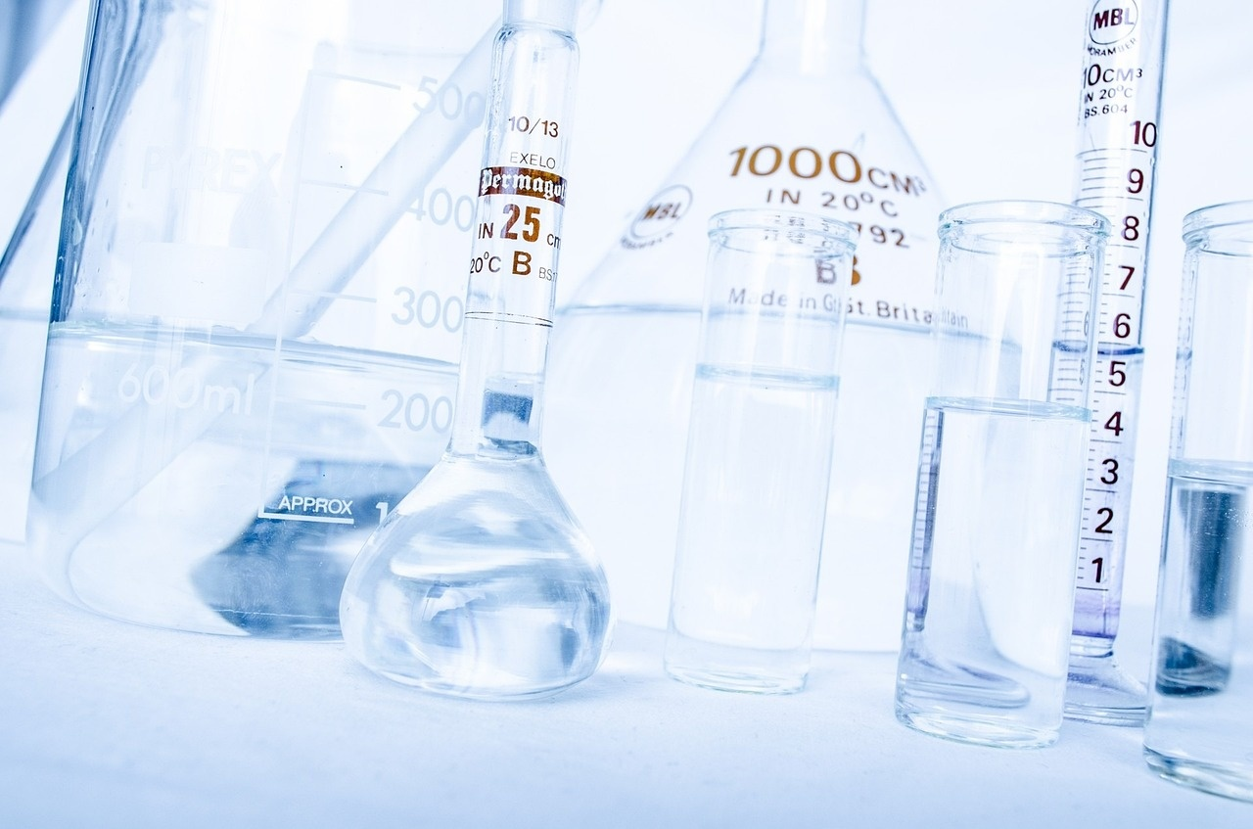
1
Title Slide: Unraveling the Periodic Table: A Colorful Journey Through the Elements
Unraveling the Periodic Table: A Colorful Journey Through the Elements
Exploring the Blueprint of Our Universe for Young Scientists
Exploring the Periodic Table: A Comprehensive Exploration of Elements

Slide 5

2
What is the Periodic Table?
What is the Periodic Table?
The Magical Map of Matter
A systematic organization of all known chemical elements
Reveals the fundamental building blocks of our universe
Shows how elements are related and interact
Exploring the Periodic Table: A Comprehensive Exploration of Elements

Slide 6

3
The Periodic Table - A Family Reunion of Elements
Elements as Family Members
Each element has a unique personality
Rows (periods) show electron generation layers
Columns (groups) represent element 'cousins'
Exploring the Periodic Table: A Comprehensive Exploration of Elements

Slide 7

4
Atomic Structure Basics
01
Building Blocks of Matter
02
Electron Configuration
Atoms consist of protons, neutrons, and electrons
Atomic number determines element identity
Electron configuration influences chemical behavior
Electrons fill from bottom to top
Exploring the Periodic Table: A Comprehensive Exploration of Elements

Slide 8

5
Periods - Electron Shell Layers
01
Understanding Electron Shells
02
Visual Representation
Rows represent electron generation layers
Each period shows a complete electron energy level
Electrons fill from bottom to top
Color-coded electron shell progression diagram
Exploring the Periodic Table: A Comprehensive Exploration of Elements

Slide 9

6
Groups - Element Families
01
Alkali Metals (Group 1)
02
Halogens (Group 17)
Highly reactive metals
Soft, silvery appearance
Examples: Lithium, Sodium, Potassium
Nonmetals with high reactivity
Exist in various states at room temperature
Examples: Fluorine, Chlorine, Bromine
03
Noble Gases (Group 18)
Colorless, odorless gases
Highly stable with full electron shells
Examples: Helium, Neon, Argon
Exploring the Periodic Table: A Comprehensive Exploration of Elements

Slide 10

7
Metals - The Strong Family Members
01
Iron (Fe)
02
Copper (Cu)
Known for its strength and durability
Widely used in construction and manufacturing
Excellent conductor of electricity
Essential in electrical wiring and electronics
03
Aluminum (Al)
04
Gold (Au)
Lightweight yet strong metal
Commonly used in aerospace and transportation industries
Highly malleable and ductile
Valued for its beauty and conductivity
Exploring the Periodic Table: A Comprehensive Exploration of Elements

Slide 11
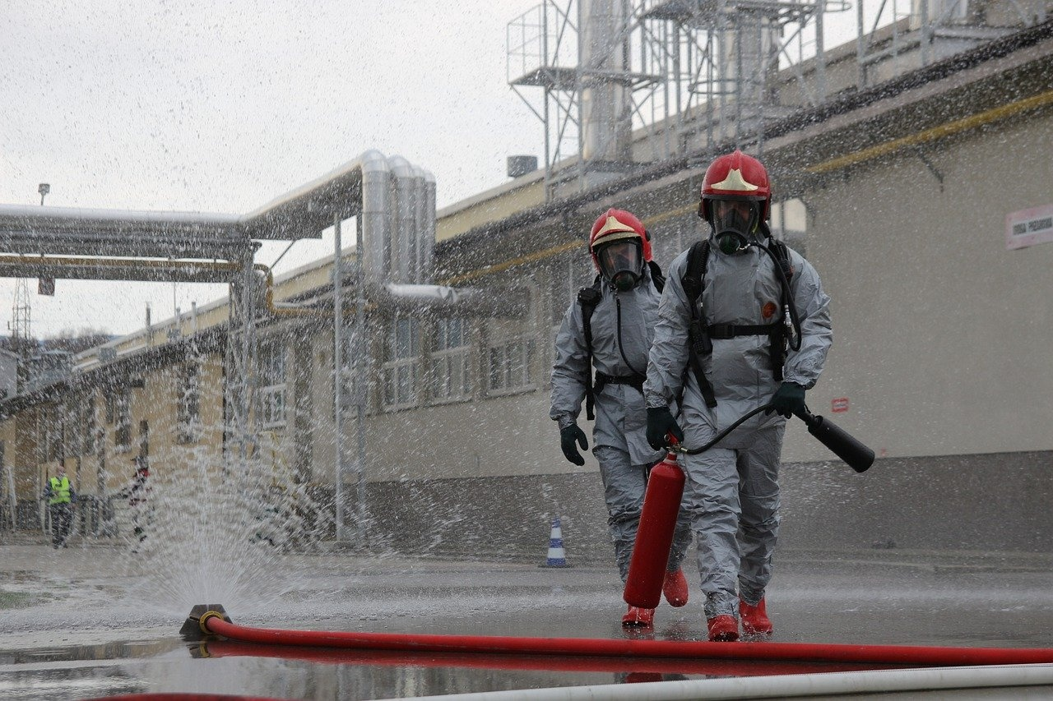
8
Non-Metals - The Independent Relatives
01
Location on the Periodic Table
02
Electrical Conductivity
Positioned on the right side
Separate from metals
Poor conductors of electricity
Insulators in many cases
03
Physical State
Often exist as gases
Some are brittle solids
Exploring the Periodic Table: A Comprehensive Exploration of Elements

Slide 12

9
Transition Metals - The Versatile Cousins
01
Central Location
02
Multiple Oxidation States
Positioned in the center of the periodic table
Exhibit various oxidation states, contributing to their versatility
03
Complex Compounds
Form intricate and colorful compounds, showcasing diverse chemical behaviors
Exploring the Periodic Table: A Comprehensive Exploration of Elements

Slide 13
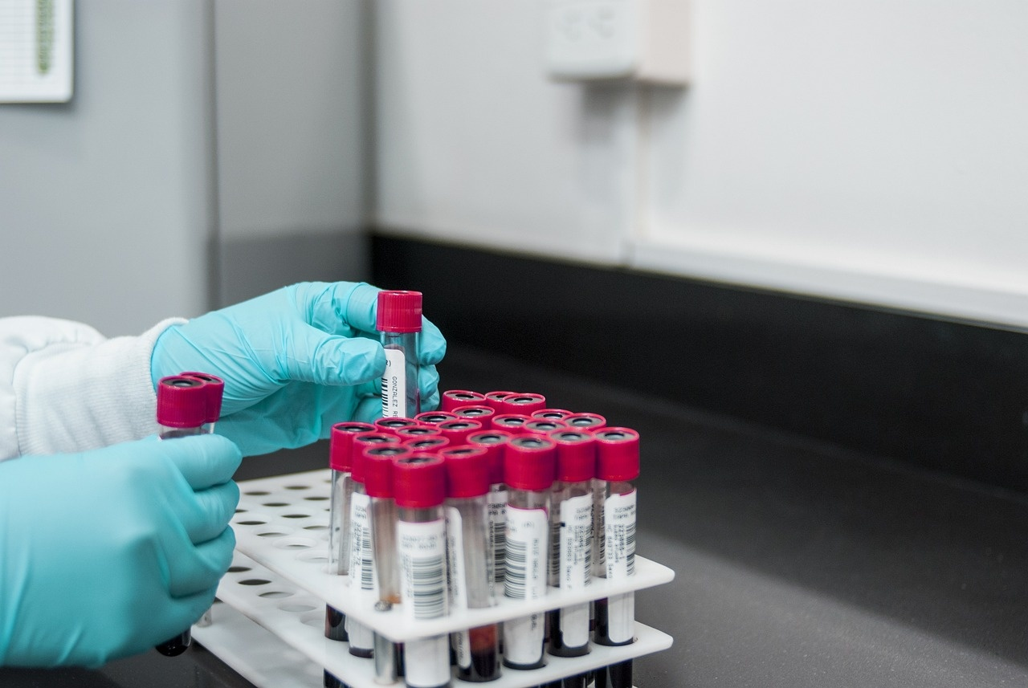
10
Predicting Element Behaviors
01
Positional Insight
02
Understanding Interactions
Elements' properties determined by position
Helps anticipate chemical interactions
Position aids in foreseeing behaviors
Enables prediction of chemical reactions
03
Elemental Patterns
Trends in properties based on location
Facilitates forecasting of element behaviors
Exploring the Periodic Table: A Comprehensive Exploration of Elements

Slide 14
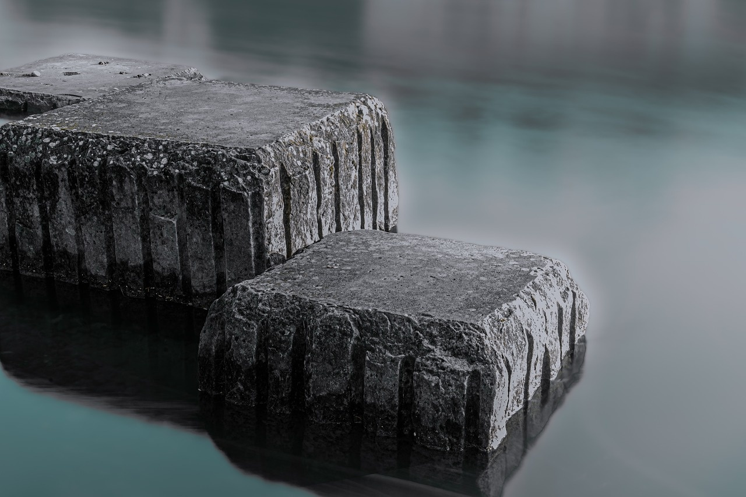
11
Real-World Element Applications
01
Copper in Electrical Wiring
02
Oxygen in Respiration
Copper is an excellent conductor of electricity.
It is used in electrical wiring due to its high conductivity and flexibility.
Copper wiring is durable and resistant to corrosion.
Oxygen is essential for the process of cellular respiration.
It helps in the production of energy (ATP) in cells.
Oxygen is inhaled by living organisms and used to convert glucose into energy.
03
Carbon in Organic Compounds
04
Titanium in Medical Implants
Carbon is the backbone of all organic molecules.
It forms stable bonds with many elements, including itself.
Carbon compounds are found in all living organisms.
Titanium is biocompatible and non-toxic.
It is used in medical implants due to its strength and resistance to corrosion.
Titanium implants are commonly used in joint replacements and dental implants.
Exploring the Periodic Table: A Comprehensive Exploration of Elements

Slide 15
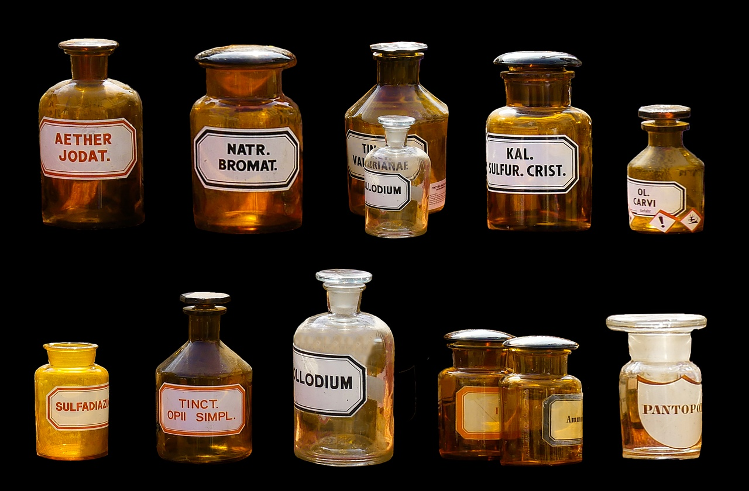
12
Interactive Element Challenge
01
Interactive Element Challenge
02
Research Element Properties
Identify elements in common household objects
Match elements to their symbols on the periodic table
Investigate unique characteristics of specific elements
Explore the uses and applications of different elements
03
Create an Element Family Story
Develop a narrative connecting elements in a group
Showcase the relationships and interactions between elements
Exploring the Periodic Table: A Comprehensive Exploration of Elements

Slide 16

13
Scientific Curiosity Continues
Scientific Curiosity Continues
The periodic table is a living, dynamic tool
Exploring the Periodic Table: A Comprehensive Exploration of Elements

Slide 17

14
Conclusion
Conclusion
Understanding the periodic table is key to unraveling the mysteries of matter.
Exploring the Periodic Table: A Comprehensive Exploration of Elements

Slide 18

15
Thank You / Q&A
Thank You / Q&A
Thank you for joining our exploration of the Periodic Table!
Questions? Let's delve deeper into the world of elements together.
Contact Information: Feel free to reach out for further discussions or inquiries.
Encouragement for further scientific exploration: Keep exploring, learning, and discovering the wonders of science.
Exploring the Periodic Table: A Comprehensive Exploration of Elements

Slide 19
16
Design Recommendations
01
Consistent Color Scheme
02
Incorporate Animated Transitions
03
High-Quality Visuals
Use a harmonious color palette throughout the presentation.
Add subtle animations to enhance engagement and flow.
Utilize clear, high-resolution images and graphics for a professional look.
04
Concise Text
05
Icons and Illustrations
Keep text brief and to the point for easy readability.
Include visual elements like icons to support and enhance text content.
Exploring the Periodic Table: A Comprehensive Exploration of Elements

