Slide 1

Understanding Fractions: A Comprehensive Guide
Exploring Key Concepts, Operations, and Real-World Applications

Slide 2
Table of contents
Introduction to Fractions
Key Concepts
Fraction Operations
Real-World Applications
Equivalent Fractions
Simplifying Fractions
Comparing Fractions
Fractions in Real-World Contexts
Common Errors
FAQs
01
02
03
04
05
06
07
08
09
10

Slide 3
Table of contents
Objectives
Vocabulary
Resources
Conclusion
Reflection Questions
Next Steps
11
12
13
14
15
16

Slide 4

Understanding Fractions: A Comprehensive Guide
1
Introduction to Fractions
Part-Whole Relationships
Comparative Quantities
Mathematical Importance
Fractions represent a part of a whole. They help in understanding how a single piece relates to the entire set.
Fractions can illustrate comparisons between two quantities. They provide a clear way to express ratios and proportions.
Understanding fractions is crucial in mathematics. They are widely used in various real-world applications, from cooking to finance.

Slide 5

Understanding Fractions: A Comprehensive Guide
2
Key Concepts
Numerator
Denominator
The top number in a fraction.
It indicates how many equal parts are being considered.
The bottom number in a fraction.
It shows the total number of equal parts in the whole.
Equivalent Fractions
Simplifying Fractions
Fractions that represent the same value.
They have different numerators and denominators but are equal.
Reducing a fraction to its simplest form.
This is done by dividing both the numerator and denominator by their greatest common divisor.

Slide 6

Understanding Fractions: A Comprehensive Guide
3
Fraction Operations
Adding Fractions
Subtracting Fractions
Multiplying Fractions
Identify a common denominator.
Add the numerators: for example, with 1/4 + 1/4, the common denominator is 4, so add: 1 + 1 = 2, resulting in 2/4, which simplifies to 1/2.
Find a common denominator first.
Subtract the numerators: for instance, with 3/5 - 1/5, the common denominator is 5, so subtract: 3 - 1 = 2, giving you 2/5.
Multiply the numerators and denominators directly.
For example, with 2/3 * 3/4, multiply: 2 * 3 = 6 and 3 * 4 = 12, resulting in 6/12, which simplifies to 1/2.

Slide 7
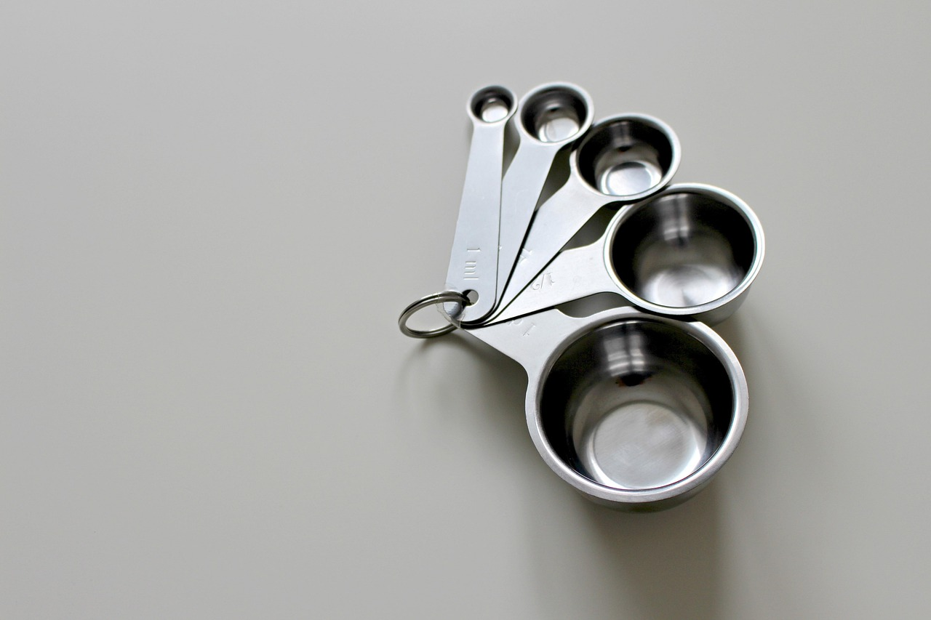
Understanding Fractions: A Comprehensive Guide
4
Real-World Applications
Recipe Measurements
Pizza Portions
Financial Calculations
Fractions are essential for measuring ingredients accurately in cooking.
For example, using 1/4 cup of flour ensures the right texture in baked goods.
Fractions help in dividing a pizza among friends fairly.
For instance, sharing 1/8 of a pizza allows everyone to enjoy a slice.
Fractions are crucial in finance for calculating interest rates and investment returns.
They help in understanding how much profit or loss is made on investments.

Slide 8

Understanding Fractions: A Comprehensive Guide
5
Equivalent Fractions
Same Value
Different Forms
Equivalent fractions have different numerators and denominators, yet they represent the same value.
For example, 1/2 is equivalent to 2/4.
Equivalent fractions can appear in different forms while maintaining the same value.
For instance, 3/4 is equivalent to 6/8.

Slide 9

Understanding Fractions: A Comprehensive Guide
6
Simplifying Fractions
Greatest Common Divisor
Fraction Examples
The GCD is the largest number that evenly divides both parts of a fraction.
To simplify a fraction, divide both the numerator and denominator by their GCD.
For instance, the fractions 4/8 and 6/12 simplify to 1/2 when divided by their GCDs, which are 4 and 6, respectively.

Slide 10
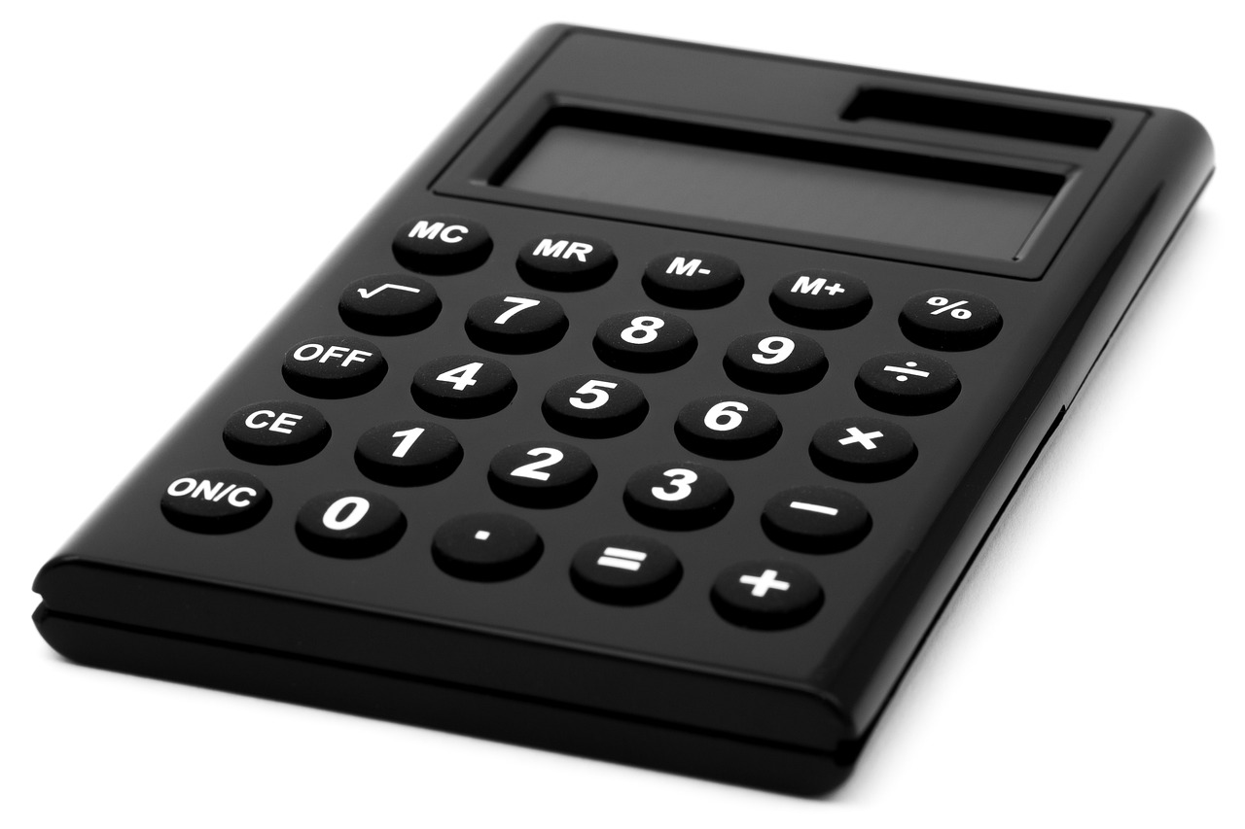
Understanding Fractions: A Comprehensive Guide
7
Comparing Fractions
Decimal Conversion
Numerator Comparison
Convert fractions to decimals.
For instance, 1/2 becomes 0.5 and 3/4 becomes 0.75, indicating that 3/4 is larger.
When comparing fractions, look at both numerators and denominators.
For example, in 2/3 and 3/4, the numerator 2 is less than 3, but the denominator shows that 3/4 is greater overall.

Slide 11
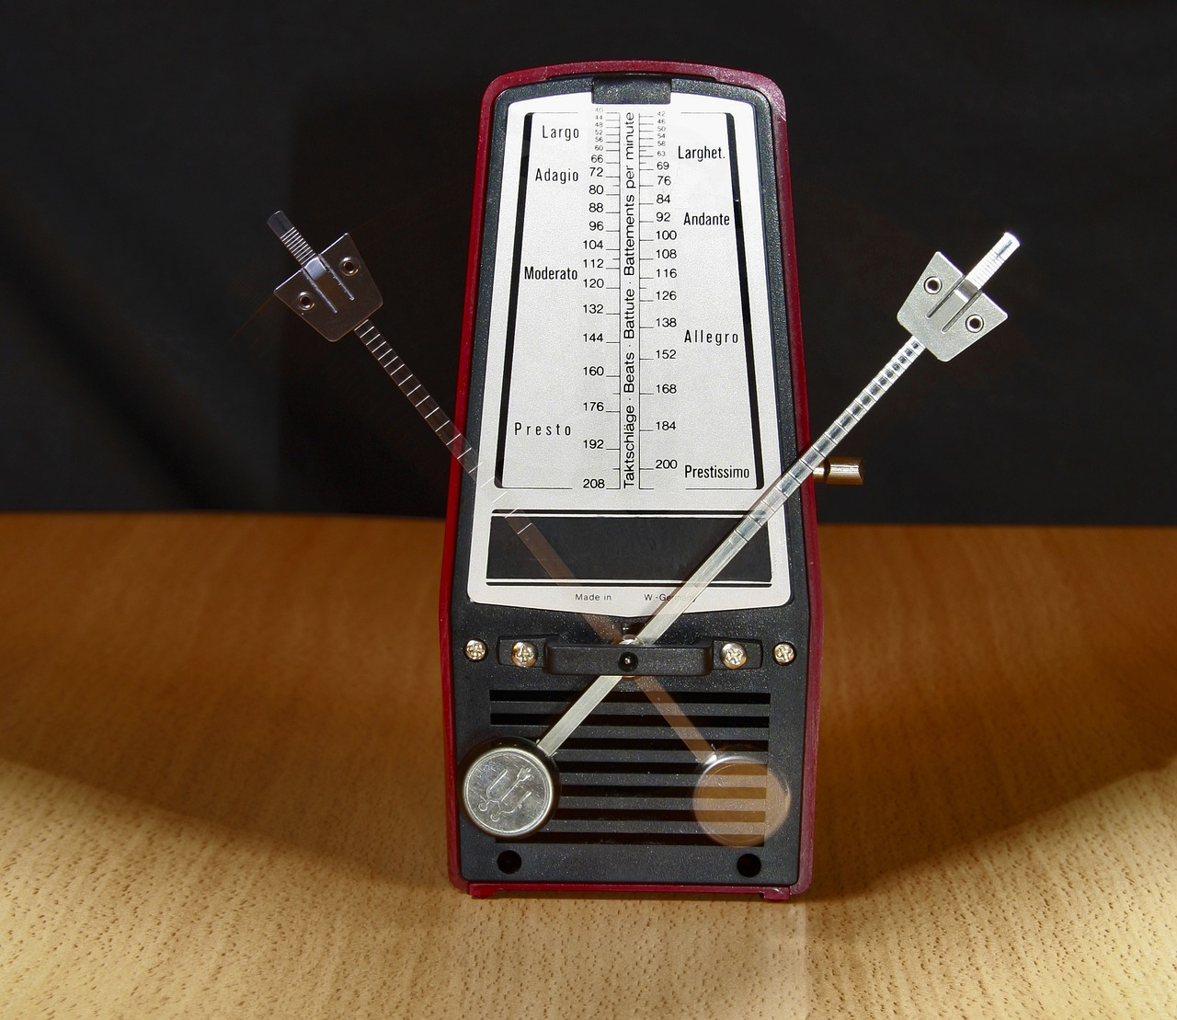
Understanding Fractions: A Comprehensive Guide
8
Fractions in Real-World Contexts
Music Rhythm
Sports Statistics
Scientific Proportions
Fractions are essential in music to represent rhythm and timing.
For example, a quarter note is represented as 1/4 of a whole note.
Fractions are commonly used in sports to represent scores and statistics.
For instance, a player may have a shooting percentage of 3/10, indicating their success rate.
Fractions are crucial in science for representing proportions and concentrations.
In chemistry, a solution might be described as having a concentration of 1/5 solute.

Slide 12
Understanding Fractions: A Comprehensive Guide
9
Common Errors
Direct Addition Error
Simplification Oversight
Assuming that the numerator and denominator can be added or subtracted directly is a common mistake.
This can lead to incorrect results in calculations involving fractions.
Failing to simplify fractions is another frequent error.
Not reducing fractions to their simplest form can cause confusion and inaccuracies.

Slide 13

Understanding Fractions: A Comprehensive Guide
10
FAQs
Fraction vs Decimal
Adding Fractions
Equivalent Ratios
A fraction represents a part of a whole, while a decimal represents a fraction as a numerical value.
To add fractions with different denominators, find the least common multiple (LCM) of the denominators.
Equivalent ratios are fractions that have the same value but different numerators and denominators.

Slide 14
Understanding Fractions: A Comprehensive Guide
11
Objectives
Identify Fractions
Simplify Fractions
Add & Subtract Fractions
Real-World Applications
Students will learn to recognize fractions in various forms.
They will practice creating fractions from given quantities.
Students will understand the concept of simplifying fractions.
They will apply techniques to reduce fractions to their simplest form.
Students will learn how to add and subtract fractions with like denominators.
They will also explore adding and subtracting fractions with unlike denominators.
Students will discover how fractions are used in everyday situations.
They will solve real-world problems involving fractions to enhance understanding.

Slide 15

Understanding Fractions: A Comprehensive Guide
12
Vocabulary
Fraction
Numerator
A way of representing part-whole relationships.
Fractions are used in various mathematical contexts.
The top number in a fraction.
It indicates how many parts are being considered.
Denominator
Equivalent Fractions
The bottom number in a fraction.
It shows the total number of equal parts in the whole.
Fractions that have the same value.
They can have different numerators and denominators.

Slide 16

Understanding Fractions: A Comprehensive Guide
13
Resources
Comprehensive Mathematics Textbook
Visual Fraction Charts
Interactive Online Fraction Games
This textbook serves as a key reference, providing detailed examples and exercises to enhance understanding.
It covers essential concepts in a structured manner, making it easier for students to follow.
These charts offer clear visual representations to help students understand and compare fractions.
They simplify complex concepts, aiding in better comprehension.
These games provide engaging activities that reinforce fraction skills through play.
They encourage practice in a fun and interactive way, making learning enjoyable.

Slide 17
Understanding Fractions: A Comprehensive Guide
14
Conclusion
Importance of Fractions
Mastering Advanced Concepts
Fractions are a fundamental concept in mathematics.
Understanding fractions is essential for problem-solving and real-world applications.
By mastering fractions, students can tackle more advanced mathematical concepts.
This knowledge allows for application in a variety of situations.

Slide 18

Understanding Fractions: A Comprehensive Guide
15
Reflection Questions
Engagement Strategies
Understanding Fractions
Support Needs
Incorporating interactive activities significantly increased student participation.
Utilizing technology tools helped in creating a more dynamic learning environment.
Students showed a solid grasp of basic fraction concepts through assessments.
Real-world applications of fractions were effectively demonstrated in class activities.
Additional resources may be required for students struggling with fraction concepts.
Targeted small group sessions could provide the necessary scaffolding for those in need.

Slide 19
Understanding Fractions: A Comprehensive Guide
16
Next Steps
Decimal Concepts
Fraction Conversion
This lesson focuses on decimals and percentages.
Students will learn to apply these concepts in real-life scenarios such as budgeting and shopping.
Students will learn to convert between fractions, decimals, and percentages.
This skill is crucial for practical applications in cooking, finance, and data analysis.

