Slide 1
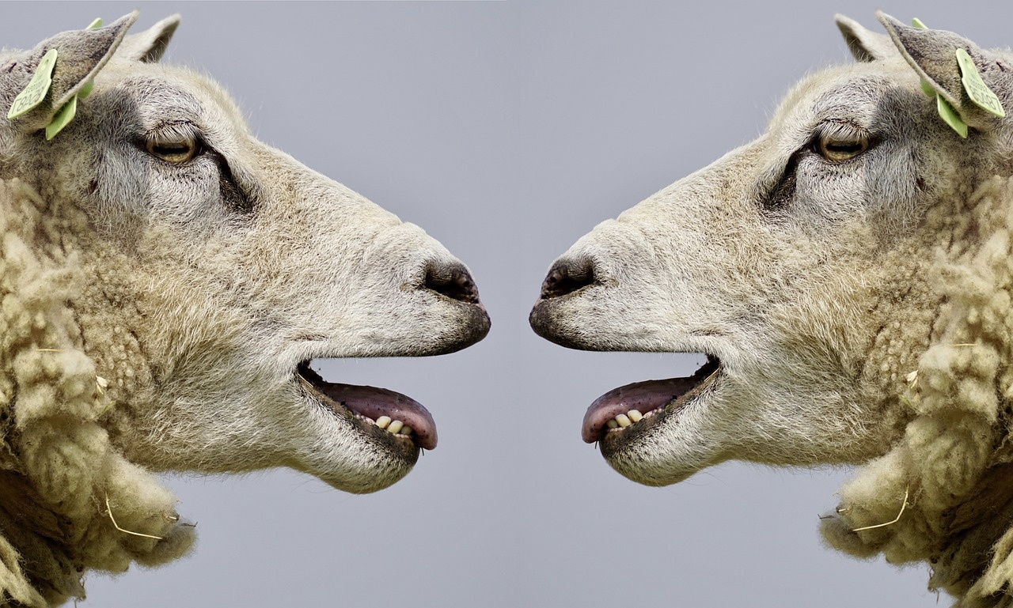
Exploring Language and Culture
A Journey Through Communication and Daily Life

Slide 2
Table of contents
01
02
03
04
Curriculum Map
Overview
Unit 1: Introductions and Greetings
Unit 2: Everyday Activities

Slide 3

1
Curriculum Map
01
Unit 1: Introductions and Greetings (3 weeks)
02
Unit 2: Everyday Activities (4 weeks)
Essential Questions: How can I introduce myself and others? How do I use basic greetings and polite expressions?
Key Concepts and Skills: Introducing oneself, Greeting others, Using polite language, Asking and answering simple questions about personal information
Standards: CEFR A1 - Can introduce themselves and others, can ask and answer questions about personal details
Assessments: Role-play conversations, Self-introduction presentation
Essential Questions: What activities do I do daily? How do I talk about my daily routine?
Key Concepts and Skills: Describing daily activities, Using present simple tense, Vocabulary related to daily routines
Standards: CEFR A1 - Can understand and use familiar everyday expressions and very basic phrases
Assessments: Daily routine diary writing, Pair discussions on daily activities
Exploring Language and Culture

Slide 4
2
Overview
01
02
03
04
Essential Questions
Key Concepts and Skills
Standards
Assessments
How can I introduce myself and others?
How do I use basic greetings and polite expressions?
Introducing oneself, greeting others
Using polite language
Asking and answering simple questions about personal information
CEFR A1 - Can introduce themselves and others, can ask and answer questions about personal details
Role-play conversations
Self-introduction presentation
Exploring Language and Culture

Slide 5
3
Unit 1: Introductions and Greetings
01
02
03
04
05
Introducing Oneself
Greeting Others
Using Polite Language
Asking and Answering Questions
Role-play Conversations
Learn how to introduce yourself using phrases like "Hello, my name is [Name]."
Practice sharing basic personal information such as age, nationality, and hobbies.
Understand common greetings like "Good morning," "Good afternoon," and "Good evening."
Explore cultural variations in greetings and when to use them.
Master polite expressions like "Please," "Thank you," and "Excuse me."
Role-play scenarios to practice using polite language in different situations.
Practice asking simple questions like "How are you?" and "What's your name?"
Learn how to respond appropriately with phrases such as "I'm fine, thank you."
Engage in role-play activities to simulate real-life interactions.
Demonstrate understanding of introductions, greetings, and polite expressions through interactive conversations.
Exploring Language and Culture

Slide 6
4
Unit 2: Everyday Activities
01
02
03
04
Morning Routine
Afternoon Activities
Evening Routine
Weekend Fun
Brush teeth
Eat breakfast
Get dressed
Attend school
Play with friends
Do homework
Have dinner
Take a bath
Read a bedtime story
Visit the park
Watch a movie
Play games with family
Exploring Language and Culture

