Slide 1

Mastering Multiplication: A Comprehensive Guide
Exploring Concepts, Strategies, and Real-World Applications for Effective Learning

Slide 2


Table of contents
Introduction to Practicing Multiplication
What is Multiplication?
Multiplication Tables
Interactive Games
Word Problems
Real-World Applications
Learning Objectives
Key Vocabulary
Resources
Assessment
Conclusion
Next Steps
Reflection Questions
01
02
03
04
05
06
07
08
09
10
11
12
13

Slide 3
Table of contents
Final Thoughts
Additional Resources
Parent Engagement
Safety Considerations
Teaching Tips
Conclusion and Final Thoughts
14
15
16
17
18
19

Slide 4

Introduction to Practicing Multiplication
Interactive Games
Word Problems
Problem-Solving Skills
Engage in fun activities that improve multiplication skills.
These games make learning multiplication enjoyable.
Tackle real-life scenarios that require multiplication.
This practice enhances your ability to apply math in daily life.
Enhance critical thinking with challenging multiplication problems.
Boost confidence in math through effective problem-solving.
1
Mastering Multiplication: A Comprehensive Guide

Slide 5
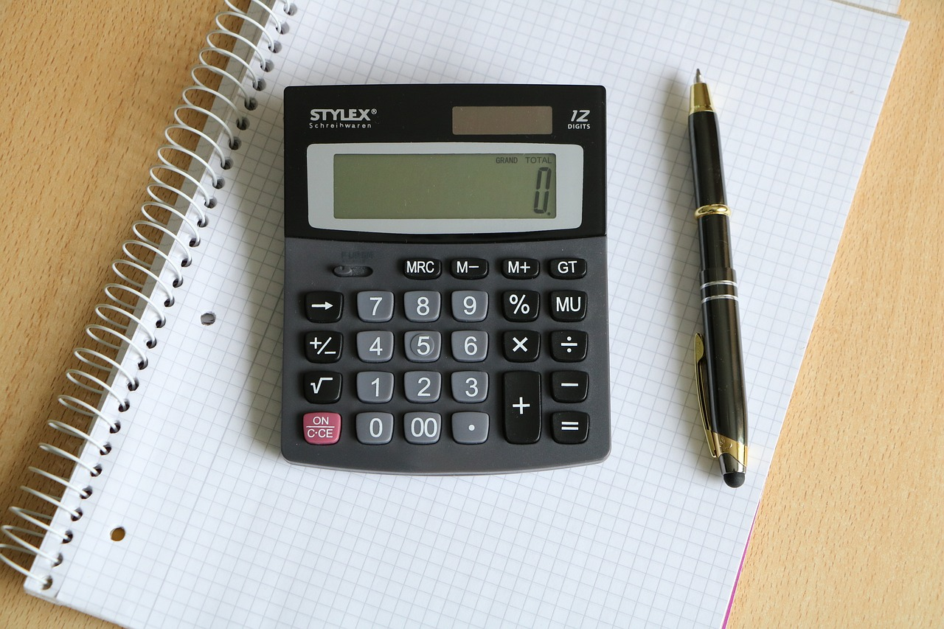
What is Multiplication?
Repeated Addition
Example Calculation
Multiplication is a mathematical operation that represents the repeated addition of a number.
For example, 3 x 4 is equivalent to 3 + 3 + 3 + 3, which equals 12.
2
Mastering Multiplication: A Comprehensive Guide

Slide 6

Multiplication Tables
Memorization Aid
Quick Reference
Accurate Calculations
Multiplication tables help students memorize multiplication facts efficiently.
They provide a structured format for quick recall of products.
These tables act as a convenient reference for fast calculations.
Students can easily access products without needing a calculator.
By mastering multiplication tables, students can compute products rapidly.
This proficiency enhances their overall confidence in math.
3
Mastering Multiplication: A Comprehensive Guide

Slide 7
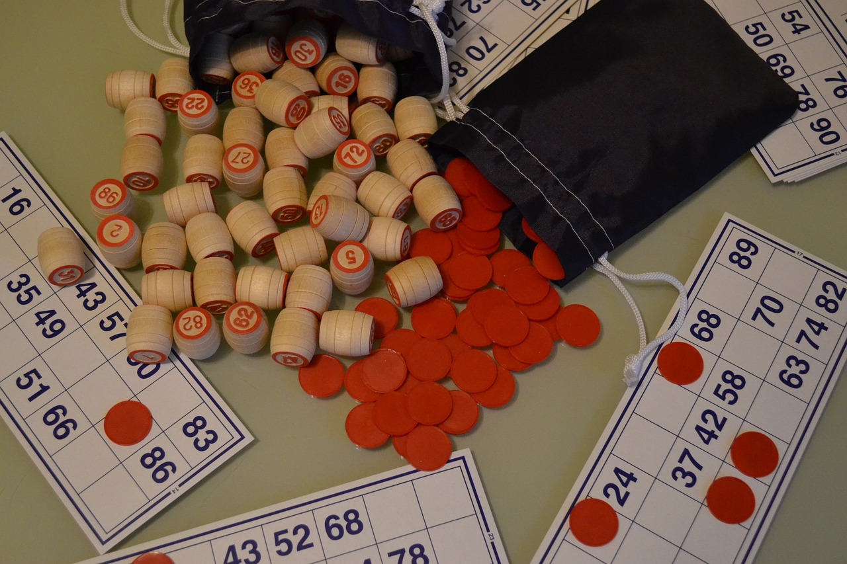
Interactive Games
Multiplication Bingo
Math Scavenger Hunt
Players mark products on their cards as multiplication problems are called. This game reinforces multiplication facts in an engaging manner.
Participants search for items representing multiplication concepts in their environment. This activity fosters teamwork and critical thinking, making math relatable.
4
Mastering Multiplication: A Comprehensive Guide

Slide 8
Word Problems
Multiplication Applications
Real-Life Connections
We will work on word problems that require us to apply multiplication concepts to solve.
These problems will enhance our problem-solving skills and deepen our understanding of multiplication.
These word problems will help us connect mathematical concepts to real-life scenarios.
By relating math to everyday situations, we make the learning experience more meaningful and relevant.
5
Mastering Multiplication: A Comprehensive Guide

Slide 9
Real-World Applications
Cost Calculation
Area Determination
Multiplication determines total cost by multiplying the price of each item by the quantity purchased.
This helps in budgeting expenses effectively.
To calculate the area of a room, multiply its length by its width.
Accurate measurements are crucial for flooring and painting projects.
6
Mastering Multiplication: A Comprehensive Guide

Slide 10

Learning Objectives
Multiplication Mastery
Concept of Repeated Addition
Recall the multiplication tables from 1 to 10 with 100% accuracy. This foundational skill is essential for advanced math concepts.
Explain the concept of multiplication as repeated addition. Understanding this relationship helps in grasping the essence of multiplication.
Word Problem Application
Pattern Analysis
Apply multiplication concepts to solve word problems involving multi-digit numbers. This skill enhances problem-solving abilities in real-life scenarios.
Analyze and identify patterns in multiplication tables. Recognizing these patterns can simplify calculations and improve number sense.
7
Mastering Multiplication: A Comprehensive Guide

Slide 11
Key Vocabulary
Multiplication
Product
Factor
Multiplication is the process of adding equal groups of a number together.
The product is the result obtained when two or more numbers are multiplied.
A factor is a number that can be multiplied with another to get a product.
8
Mastering Multiplication: A Comprehensive Guide

Slide 12
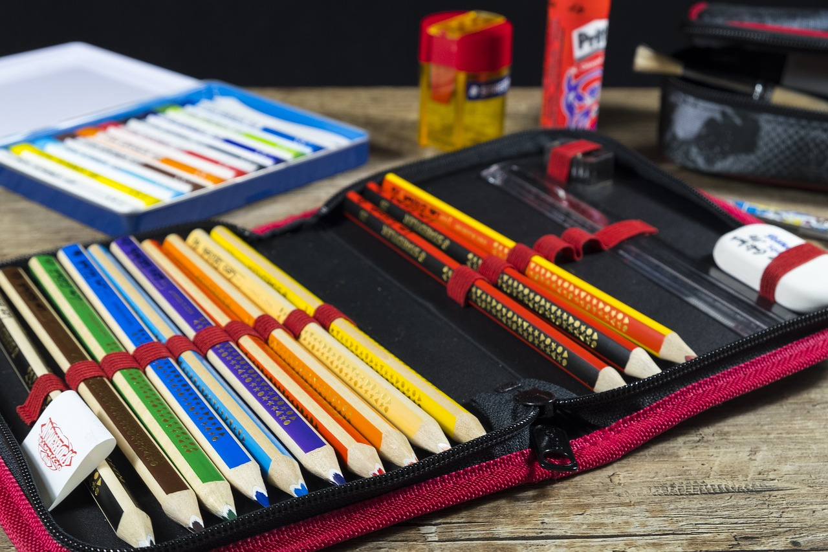
Resources
Worksheets & Games
Online Tools
Multiplication worksheets will be provided to improve multiplication skills.
We will use interactive games that promote teamwork and problem-solving while practicing multiplication.
Students will have access to Khan Academy, which provides tailored practice materials.
Math Playground offers engaging exercises that help reinforce key concepts through fun activities.
9
Mastering Multiplication: A Comprehensive Guide

Slide 13

Assessment
Quiz Assessment
Word Problem Project
At the end of the lesson, we will take a quiz to evaluate our understanding of multiplication concepts.
You will be assigned a project that involves creating word problems to demonstrate how multiplication is used in real-world situations.
10
Mastering Multiplication: A Comprehensive Guide

Slide 14

Conclusion
Engaging Games
Real-World Applications
Interactive games make learning multiplication fun.
These games reinforce multiplication through practice.
Applying multiplication to real-world problems deepens understanding.
This method enhances problem-solving by linking math to daily life.
11
Mastering Multiplication: A Comprehensive Guide

Slide 15
Next Steps
Understanding Division
Applying Multiplication
In the next lesson, we will explore division and its connection to multiplication.
We will use our multiplication knowledge to tackle complex problems, enhancing our critical thinking skills.
12
Mastering Multiplication: A Comprehensive Guide

Slide 16

Reflection Questions
Engagement Effectiveness
Lesson Adjustments
The interactive games effectively fostered teamwork and enhanced problem-solving skills among participants.
Many students expressed that the collaborative nature of the games made learning enjoyable.
Offer extra resources for students who find word problems challenging.
Modify the lesson pace to ensure all students can engage and understand the material.
13
Mastering Multiplication: A Comprehensive Guide

Slide 17

Final Thoughts
Final Thoughts
Multiplication is a key building block in mathematics, essential for understanding more complex operations.
By mastering multiplication, you create a solid foundation for future math studies and enhance your problem-solving skills.
14
Mastering Multiplication: A Comprehensive Guide

Slide 18

Additional Resources
Online Resources
Interactive Practice
Utilize various online platforms for extra practice. These sites offer exercises to improve understanding.
Participate in engaging games and worksheets available in class. These activities reinforce multiplication concepts.
15
Mastering Multiplication: A Comprehensive Guide

Slide 19

Parent Engagement
Home Practice
Real-World Application
Parents can support their child's learning by practicing multiplication concepts with them at home.
Engaging in regular practice helps reinforce understanding and retention.
Parents can encourage their child to apply multiplication concepts to real-world problems.
For example, calculating the cost of groceries or determining the area of a room can make learning relevant.
16
Mastering Multiplication: A Comprehensive Guide

Slide 20

Safety Considerations
Student Safety
Accommodations Needed
Create a safe environment during activities.
Regularly check on students to address concerns quickly.
Recognize students needing accommodations.
Provide support for full participation in all activities.
17
Mastering Multiplication: A Comprehensive Guide

Slide 21

Teaching Tips
Clear Instructions
Encourage Questions
Provide step-by-step guidance to help students understand tasks.
Use demonstrations to clarify complex concepts.
Create a safe environment for students to ask questions.
Encourage sharing of thoughts and solutions during discussions.
18
Mastering Multiplication: A Comprehensive Guide

Slide 22

Conclusion and Final Thoughts
Conclusion and Final Thoughts
Interactive games and word problems engage students in multiplication, enhancing their understanding.
Regular practice reinforces learning, leading to proficiency in multiplication.
19
Mastering Multiplication: A Comprehensive Guide

