Slide 1
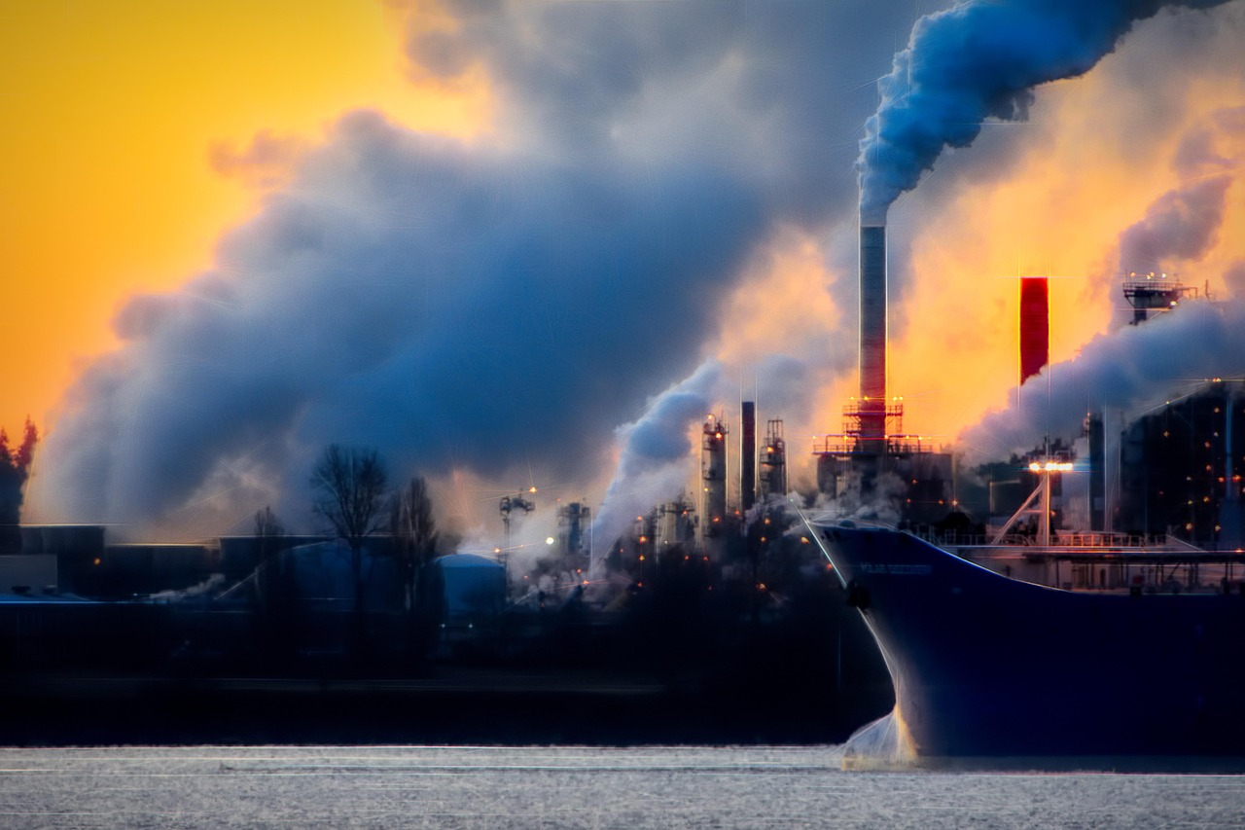

Global Warming: Causes, Consequences, and Solutions
Understanding the Impact and Strategies for a Sustainable Future

Slide 2
Global Warming: Causes, Consequences, and Solutions
2
Table of Contents
Introduction to Global Warming
The Carbon Cycle
The Great Barrier Reef
Rising Sea Levels
Geological Changes
Causes of Global Warming
Effects of Global Warming on Human Societies
Strategies for Mitigation and Adaptation
Individual Actions to Reduce Carbon Footprint
Role of Technology in Addressing Global Warming
Conclusion
Summary
Reflection Questions
04
05
06
07
08
09
10
11
12
13
14
15
16

Slide 3
Global Warming: Causes, Consequences, and Solutions
3
Table of Contents
Next Steps
Additional Resources
Parent Engagement
Extension Activities
Homework
Assessment
17
18
19
20
21
22

Slide 4
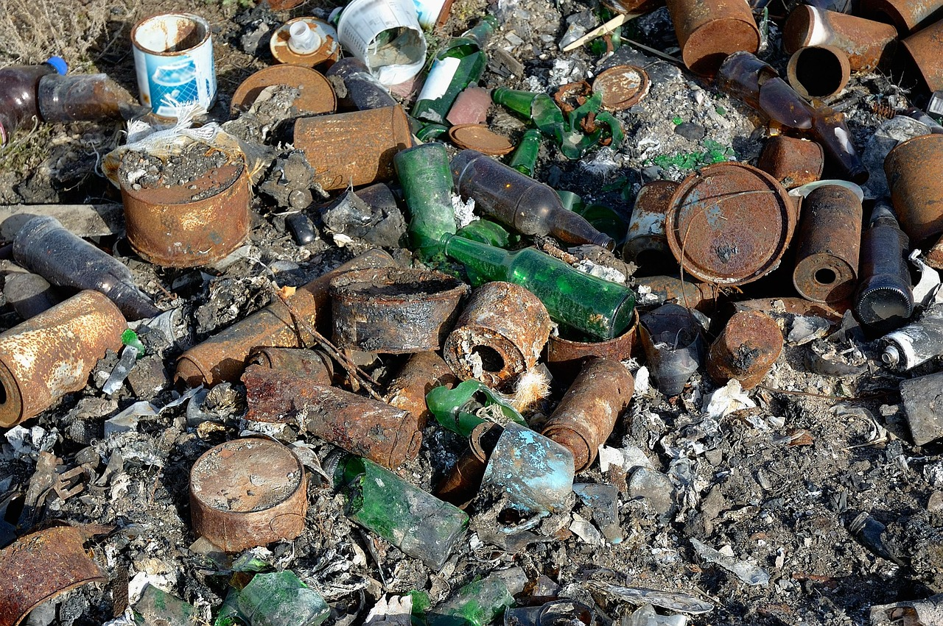
Global Warming: Causes, Consequences, and Solutions
4
Introduction to Global Warming
Definition of Global Warming
Human Contributions to Global Warming
Consequences of Global Warming
Global warming refers to the long-term increase in the average temperature of the Earth's surface.
It is a critical environmental issue affecting the planet.
Human activities, such as burning fossil fuels and deforestation, are significantly contributing to the increase in greenhouse gases in the atmosphere.
These activities intensify the greenhouse effect, trapping more heat in the Earth's atmosphere.
The consequences of global warming include rising sea levels, more frequent natural disasters, and changes in weather patterns.
These impacts pose significant risks to ecosystems, human health, and global economies.

Slide 5
Global Warming: Causes, Consequences, and Solutions
5
The Carbon Cycle
Understanding the Carbon Cycle
Human Impact on the Carbon Cycle
Consequences of Disrupting the Carbon Cycle
Importance of Studying the Carbon Cycle
The carbon cycle refers to the process by which carbon is exchanged between the atmosphere, oceans, land, and living things.
It is a fundamental natural process that maintains the Earth's ecological balance.
Human activities, such as burning fossil fuels and deforestation, disrupt the natural balance of the carbon cycle.
These actions significantly alter the flow of carbon, leading to environmental consequences.
The consequences of disrupting the carbon cycle include increased greenhouse gases in the atmosphere and rising global temperatures.
This disruption contributes to climate change and its associated impacts on ecosystems and human life.
Understanding the carbon cycle is crucial for developing strategies to mitigate the effects of global warming.
It provides insights into how to restore balance and reduce the impact of human activities on the environment.

Slide 6

Global Warming: Causes, Consequences, and Solutions
6
The Great Barrier Reef
Biodiversity of the Great Barrier Reef
The Great Barrier Reef is one of the most biologically diverse ecosystems on the planet.
It supports a vast array of marine life, making it a critical natural habitat.
Impact of Global Warming
The reef is vulnerable to the effects of global warming, including rising sea temperatures and increased ocean acidity.
These changes pose significant threats to its survival and health.
Consequences of Climate Change
The consequences of climate change on the Great Barrier Reef include coral bleaching, reduced biodiversity, and ecosystem disruption.
These impacts highlight the urgent need for conservation efforts.

Slide 7
Global Warming: Causes, Consequences, and Solutions
7
Rising Sea Levels
Causes of Rising Sea Levels
Consequences of Rising Sea Levels
Importance of Understanding Rising Sea Levels
Rising sea levels are caused by the melting of glaciers and ice sheets, and the thermal expansion of seawater as it warms.
These processes are directly linked to global warming and climate change.
The consequences of rising sea levels include coastal erosion, flooding, and saltwater intrusion into freshwater sources.
These impacts threaten ecosystems, infrastructure, and human settlements.
Understanding the causes and consequences of rising sea levels is crucial for developing strategies to adapt to and mitigate the effects of global warming.
This knowledge helps policymakers and communities prepare for future challenges.

Slide 8
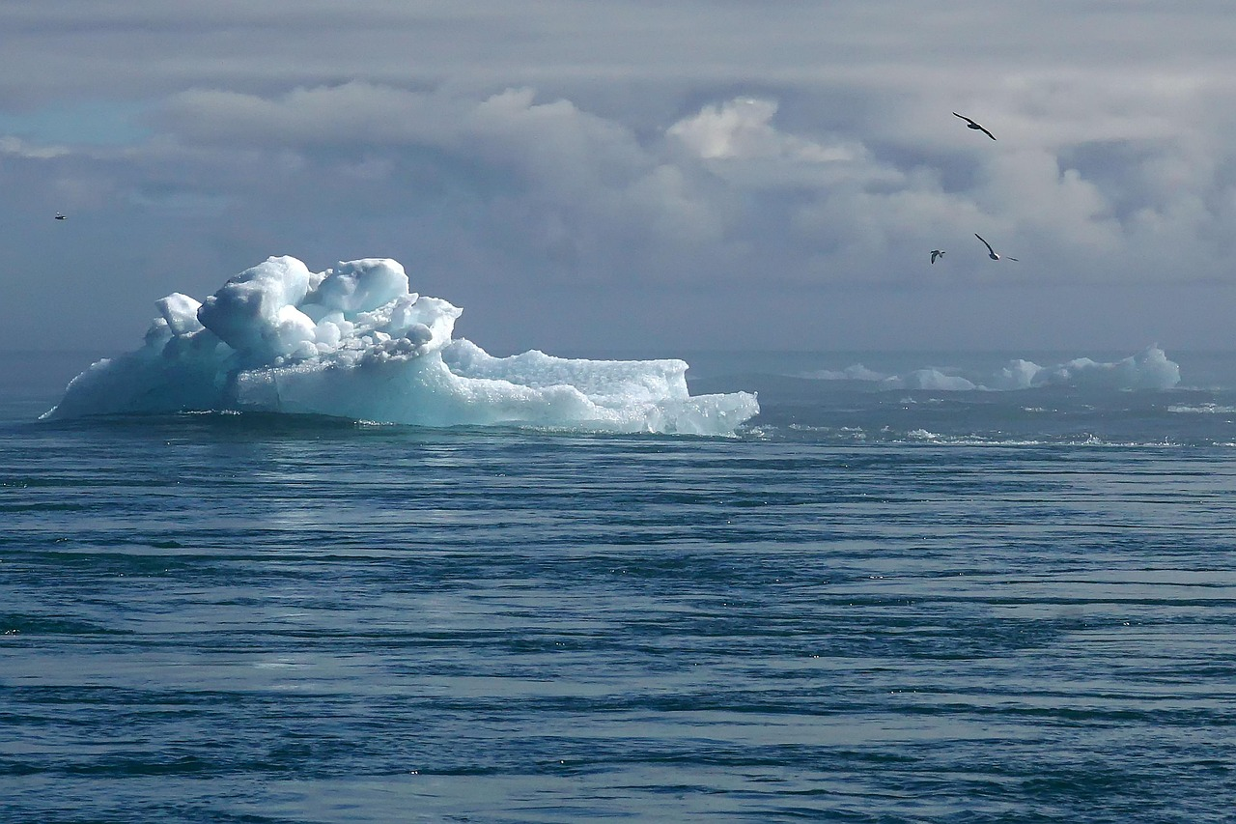
Global Warming: Causes, Consequences, and Solutions
8
Geological Changes
Causes of Geological Changes
Consequences of Geological Changes
Adapting to Geological Changes
Geological changes, such as changes in weather patterns and the water cycle, are caused by global warming.
Understanding these causes is crucial for addressing the effects of global warming.
The consequences of geological changes include more frequent and intense heatwaves, droughts, and storms.
These events pose significant challenges to ecosystems and human societies.
Understanding the causes and consequences of geological changes is crucial for developing strategies to adapt.
Mitigation efforts can help reduce the impact of global warming on geological changes.

Slide 9
Global Warming: Causes, Consequences, and Solutions
9
Causes of Global Warming
Burning Fossil Fuels
Deforestation and Land-Use Changes
Burning fossil fuels, such as coal, oil, and gas, releases greenhouse gases into the atmosphere.
These gases trap heat, contributing significantly to global warming.
Deforestation and land-use changes, such as the clearing of forests for agriculture and urbanization, contribute to global warming.
Forests act as carbon sinks, and their removal increases carbon dioxide levels in the atmosphere.
Methane and Nitrous Oxide Emissions
Importance of Understanding Causes
The production of methane and nitrous oxide, through activities such as agriculture and industrial processes, also contributes to global warming.
These gases are more potent than carbon dioxide in trapping heat in the atmosphere.
Understanding the causes of global warming is crucial for developing strategies to mitigate its effects.
Addressing these causes can help reduce the impact of climate change on the planet.

Slide 10
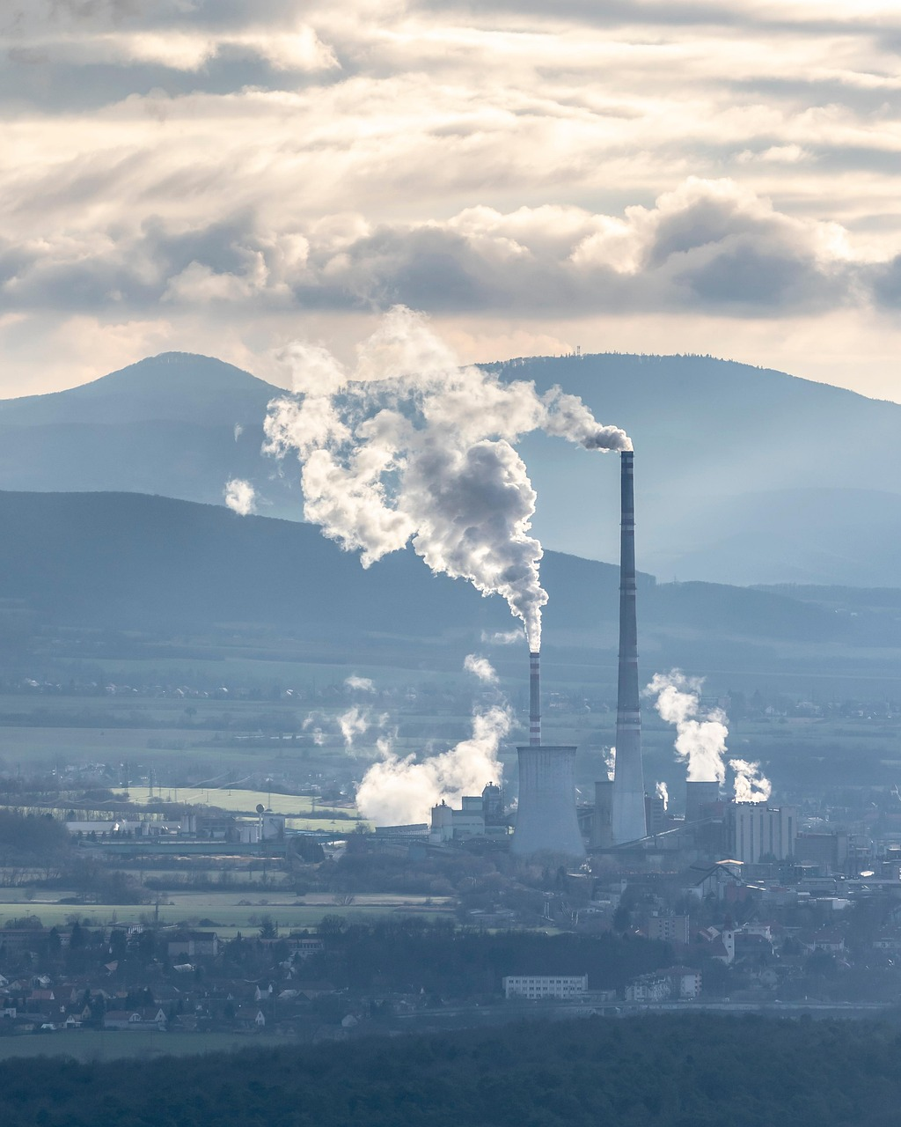
Global Warming: Causes, Consequences, and Solutions
10
Effects of Global Warming on Human Societies
Health Impacts of Global Warming
Societal Consequences of Climate Change
The Importance of Understanding and Action
Global warming has significant implications for human health, including the spread of diseases and heat stress.
These health challenges are becoming more pronounced as temperatures rise globally.
The consequences of global warming for human societies include increased poverty, inequality, and social unrest.
These issues exacerbate existing vulnerabilities and create new challenges for communities worldwide.
Understanding the effects of global warming on human societies is crucial for developing strategies to adapt to and mitigate its effects.
Proactive measures can help reduce the long-term impacts on both human health and societal stability.

Slide 11
Global Warming: Causes, Consequences, and Solutions
11
Strategies for Mitigation and Adaptation
Mitigating Global Warming through Renewable Energy
Carbon Sequestration via Ecosystem Restoration
Reducing greenhouse gas emissions, through the use of renewable energy sources and energy-efficient technologies, can help mitigate the effects of global warming.
This approach focuses on transitioning to sustainable energy systems to lower carbon footprints.
Protecting and restoring natural ecosystems, such as forests and wetlands, can help sequester carbon dioxide and reduce the effects of global warming.
These ecosystems act as natural carbon sinks, playing a vital role in climate regulation.
Building Climate-Resilient Infrastructure
The Importance of Mitigation and Adaptation Strategies
Developing and implementing climate-resilient infrastructure, such as sea walls and levees, can help adapt to the effects of global warming.
Such measures are essential for safeguarding communities against rising sea levels and extreme weather events.
Understanding the strategies for mitigation and adaptation is crucial for developing effective solutions to the challenge of global warming.
This knowledge enables informed decision-making to address both current and future climate challenges.

Slide 12
Global Warming: Causes, Consequences, and Solutions
12
Individual Actions to Reduce Carbon Footprint
Transportation Choices
Using public transport, carpooling, or driving electric or hybrid vehicles can reduce carbon emissions.
These actions contribute significantly to lowering individual carbon footprints.
Energy Efficiency
Reducing energy consumption, by using energy-efficient appliances and turning off lights and electronics when not in use, can reduce carbon emissions.
Such practices are essential for minimizing unnecessary energy waste.
Dietary Changes
Eating a plant-based diet and reducing food waste can reduce carbon emissions.
These adjustments in food habits play a vital role in sustainable living.
Importance of Individual Actions
Understanding the individual actions that can reduce carbon footprint is crucial for developing strategies to mitigate the effects of global warming.
Awareness and proactive measures are key to combating climate change effectively.

Slide 13
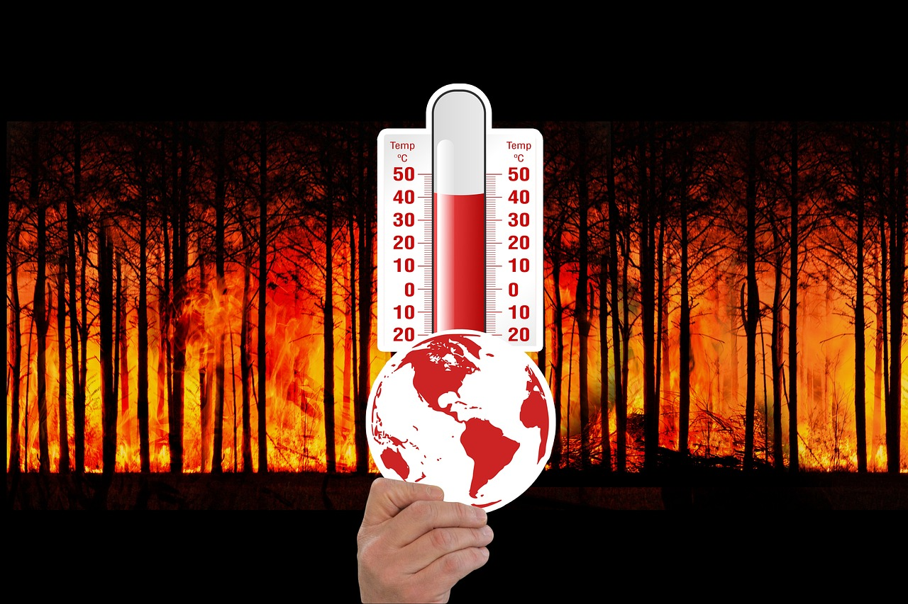
Global Warming: Causes, Consequences, and Solutions
13
Role of Technology in Addressing Global Warming
Technological Solutions for Emission Reduction
Monitoring and Predicting Global Warming Effects
Importance of Technology in Climate Solutions
Technology can provide solutions to reduce greenhouse gas emissions, such as renewable energy sources and energy-efficient technologies.
These innovations are essential for mitigating the impact of human activities on the environment.
Technology can help monitor and predict the effects of global warming, such as sea level rise and extreme weather events.
This capability enables better preparation and response to climate-related challenges.
Understanding the role of technology in addressing global warming is crucial for developing effective solutions to the challenge of global warming.
It highlights the need for integrating technological advancements into global climate strategies.

Slide 14
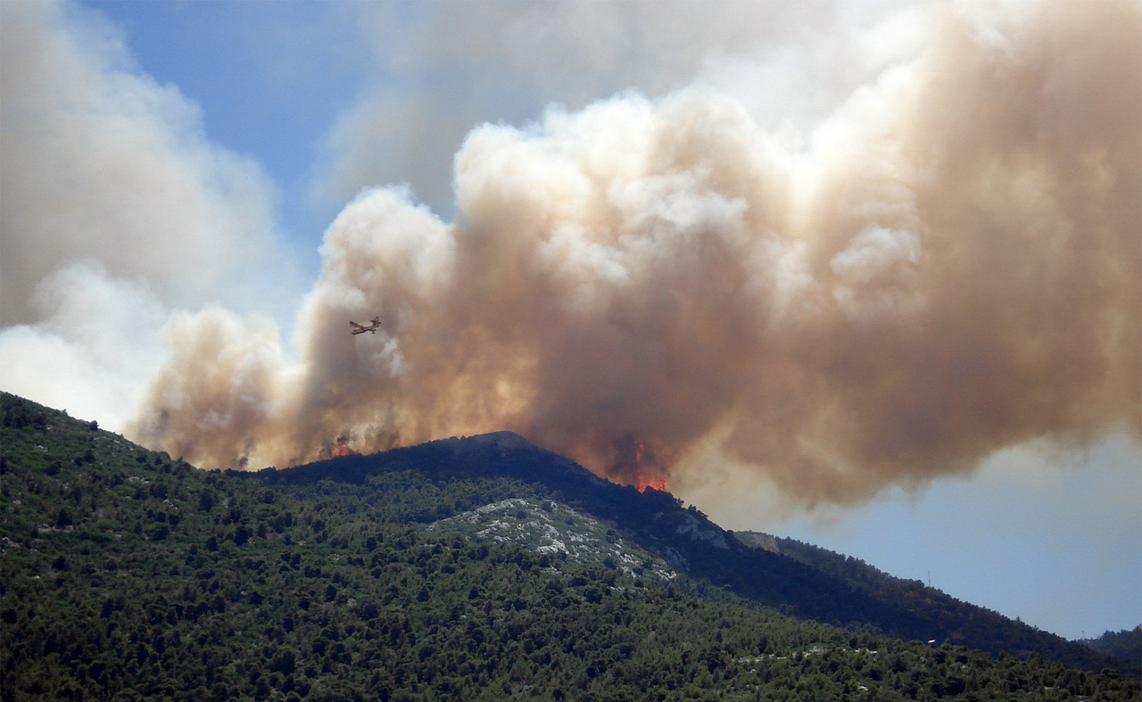
Global Warming: Causes, Consequences, and Solutions
14
Conclusion
Urgency of Addressing Global Warming
Strategies for Mitigation and Adaptation
Global warming is a critical issue that requires immediate attention and action.
Understanding the causes and consequences of global warming is crucial for developing effective solutions.
Strategies for mitigation and adaptation are essential to tackle the challenge of global warming.
These strategies help in reducing the impact and preparing for the consequences of global warming.

Slide 15
Global Warming: Causes, Consequences, and Solutions
15
Summary
Causes of Global Warming
Consequences of Global Warming
Mitigation and Adaptation Strategies
Individual Actions to Combat Global Warming
Global warming is caused by human activities, such as burning fossil fuels and deforestation.
These actions release greenhouse gases into the atmosphere, leading to climate change.
The consequences of global warming include rising sea levels, more frequent natural disasters, and changes in weather patterns.
These impacts threaten ecosystems, economies, and human livelihoods worldwide.
Strategies for mitigation and adaptation, such as reducing greenhouse gas emissions and developing climate-resilient infrastructure, can help address the challenge of global warming.
These approaches aim to minimize damage and prepare societies for future climate-related challenges.
Individual actions, such as reducing energy consumption and eating a plant-based diet, can also contribute to reducing carbon footprint.
Personal choices play a significant role in supporting global efforts to combat climate change.

Slide 16
Global Warming: Causes, Consequences, and Solutions
16
Reflection Questions
Causes and Consequences of Global Warming
Individual Actions to Reduce Carbon Footprint
Strategies for Mitigation and Adaptation
What are the causes and consequences of global warming?
Global warming leads to rising sea levels, extreme weather events, and loss of biodiversity.
How can individual actions contribute to reducing carbon footprint?
Simple actions like using public transport, reducing energy consumption, and recycling can make a significant difference.
What strategies can be implemented to mitigate and adapt to the effects of global warming?
Implementing renewable energy solutions and developing climate-resilient infrastructure are key strategies.

Slide 17
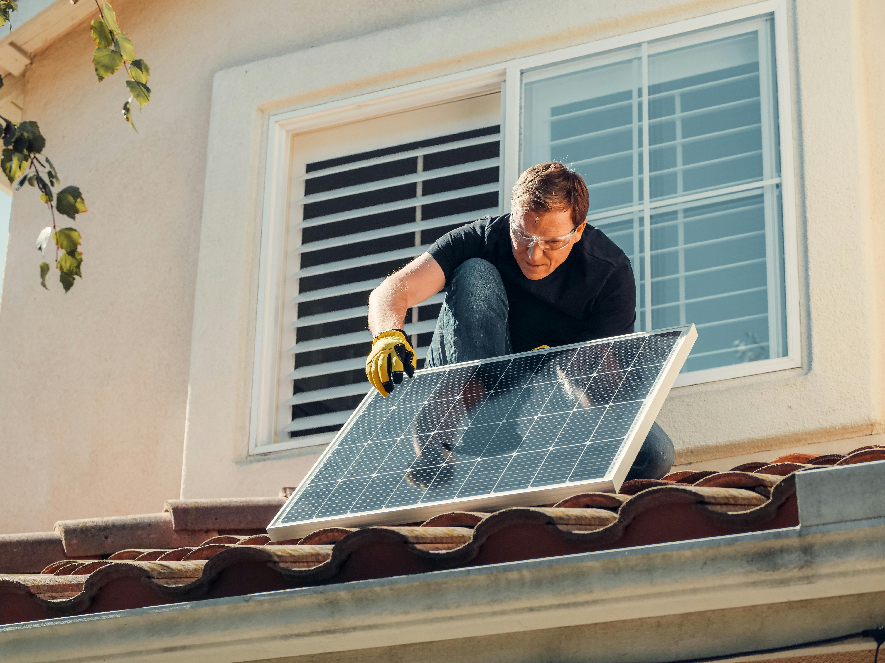
Global Warming: Causes, Consequences, and Solutions
17
Next Steps
Understanding Renewable Energy
Reducing Carbon Footprint
Community Action Plan
Learn more about renewable energy sources and energy-efficient technologies.
This knowledge can help in making informed decisions for a sustainable future.
Explore ways to reduce carbon footprint, such as using public transport and eating a plant-based diet.
These actions contribute to a healthier planet and a more sustainable lifestyle.
Develop a plan to implement strategies for mitigation and adaptation in your community.
Engaging with local stakeholders can amplify the impact of these initiatives.

Slide 18

Global Warming: Causes, Consequences, and Solutions
18
Additional Resources
National Geographic
NASA's Climate Change Insights
IPCC Reports
National Geographic provides extensive resources on climate change.
Explore articles, videos, and interactive content to understand the impact of climate change globally.
NASA offers scientific data and research on climate change.
Discover how space technology is used to monitor Earth's climate systems.
The Intergovernmental Panel on Climate Change (IPCC) publishes comprehensive reports on climate science.
These reports are essential for understanding global climate policies and their implications.

Slide 19
Global Warming: Causes, Consequences, and Solutions
19
Parent Engagement
Encouraging Parental Discussions
Providing Supportive Resources
Inviting Participation in School Activities
Encourage parents to engage with their child's learning by discussing the topic of global warming.
This helps foster a deeper understanding and awareness of environmental issues at home.
Provide parents with resources and tips on how to support their child's learning, such as reducing energy consumption and using public transport.
These actionable steps can make a significant impact on sustainability efforts.
Invite parents to participate in school activities and events related to global warming and sustainability.
This involvement strengthens the school community and promotes collective action.

Slide 20
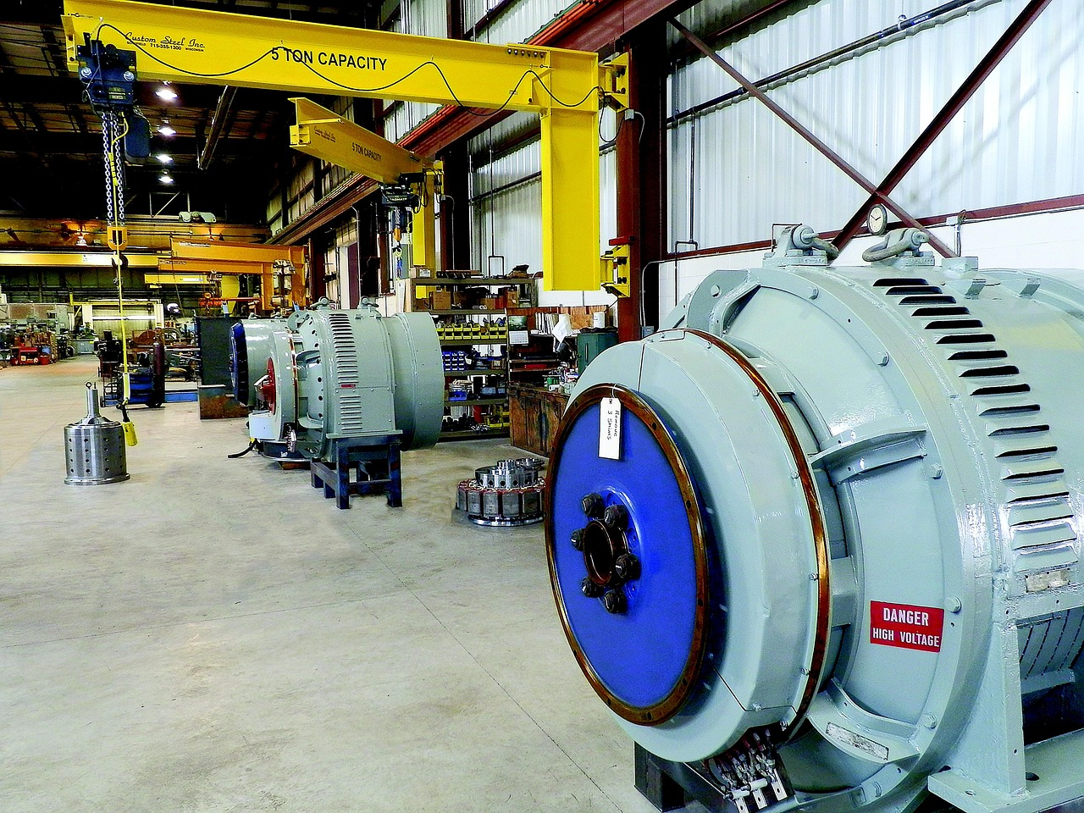
Global Warming: Causes, Consequences, and Solutions
20
Extension Activities
Understanding Environmental Impact
Conduct a carbon footprint calculation to understand the impact of daily activities on the environment.
This activity helps individuals recognize their contribution to global emissions and identify areas for improvement.
Community Sustainability Plan
Develop a plan to reduce energy consumption and implement sustainable practices in your community.
This initiative encourages collaboration and promotes eco-friendly habits within local neighborhoods.
Exploring Global Warming Solutions
Research and create a presentation on a topic related to global warming, such as renewable energy sources or climate-resilient infrastructure.
This task fosters awareness and educates others about innovative approaches to combat climate change.

Slide 21
Global Warming: Causes, Consequences, and Solutions
21
Homework
Essay on Global Warming
Carbon Footprint Reduction Plan
Visual Project on Global Warming
Research and write a short essay on the causes and consequences of global warming.
Explore the scientific, environmental, and societal impacts of this pressing issue.
Develop a plan to reduce your carbon footprint and implement sustainable practices in your daily life.
Focus on actionable steps such as energy conservation, waste reduction, and eco-friendly habits.
Create a visual project, such as a poster or infographic, to illustrate the effects of global warming and strategies for mitigation and adaptation.
Use creative visuals to communicate key information and inspire change.

Slide 22
Global Warming: Causes, Consequences, and Solutions
22
Assessment
Quiz on Global Warming
Carbon Footprint Reduction Project
Global Warming Presentation
Understanding the causes and consequences of global warming.
This activity tests knowledge and comprehension of key environmental issues.
Developing a plan to reduce carbon footprint and implement sustainable practices.
This project encourages actionable solutions for environmental sustainability.
Researching and presenting on a topic related to global warming.
This task promotes in-depth exploration and communication of environmental topics.

