Slide 1
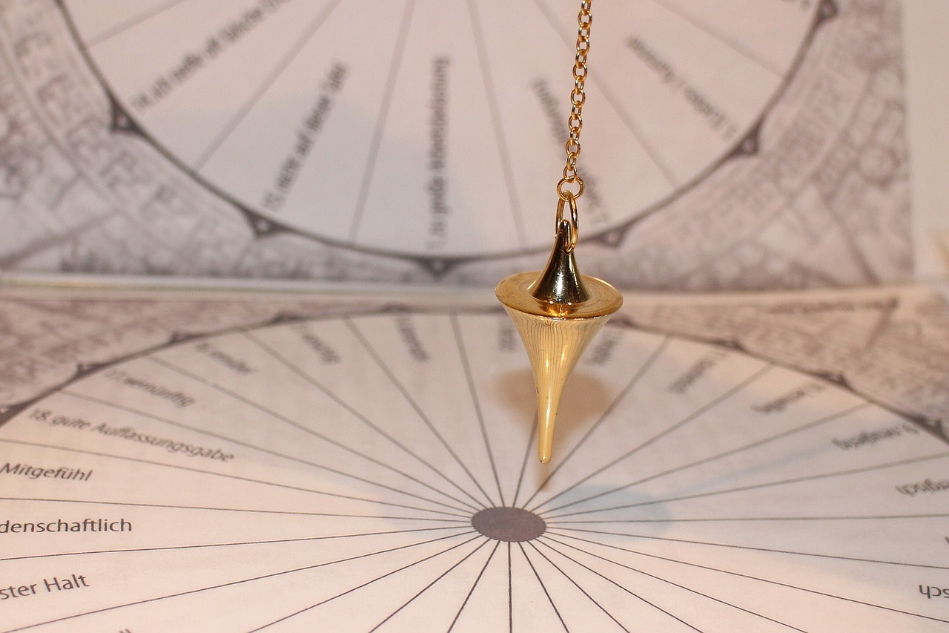
Understanding Newton's Laws of Motion
Exploring the Principles, Applications, and Implications in Physics

Slide 2
Table of Contents
Introduction to Newton's Laws of Motion
What are Newton's Laws of Motion?
The First Law of Motion: Inertia
The Second Law of Motion: Acceleration
The Third Law of Motion: Action and Reaction
Real-Life Applications of Newton's Laws
Key Concepts and Vocabulary
Common Misconceptions and Errors
Assessment and Evaluation
Conclusion
Next Steps
Reflection Questions
Additional Resources
04
05
06
07
08
09
10
11
12
13
14
15
16

Slide 3
Table of Contents
Interactive Activities
Conclusion and Final Thoughts
Final Assessment and Evaluation
Closing Remarks
References and Credits
17
18
19
20
21

Slide 4
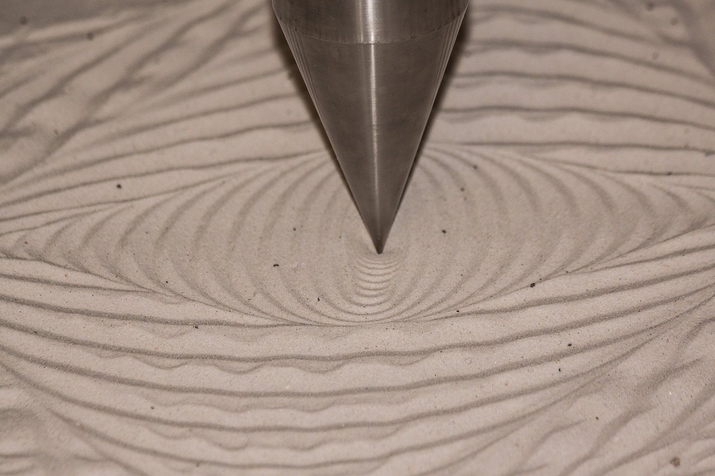
Introduction to Newton's Laws of Motion
Welcome to Physics and Motion
Exploring Newton's Laws
Understanding Object Behavior
Welcome to the world of physics and motion!
This marks the beginning of an exciting journey into understanding motion.
In this lesson, we will explore the fundamental concepts of Newton's Laws of Motion.
These laws are the cornerstone of classical mechanics.
Get ready to learn about the laws that govern the behavior of objects in the physical world!
These principles explain how forces interact with matter.
4
Understanding Newton's Laws of Motion

Slide 5

What are Newton's Laws of Motion?
Introduction to Newton's Laws of Motion
The Law of Inertia
The Law of Action and Reaction
Newton's Laws of Motion are three fundamental principles that describe the relationship between a body and the forces acting upon it.
These laws were formulated by Sir Isaac Newton and are still widely used today to understand and predict the motion of objects.
The Law of Inertia states that an object will remain at rest or in uniform motion unless acted upon by an external force.
This principle explains the resistance of objects to changes in their state of motion.
The Law of Action and Reaction states that for every action, there is an equal and opposite reaction.
This law highlights the interactions between objects and the forces they exert on each other.
5
Understanding Newton's Laws of Motion

Slide 6
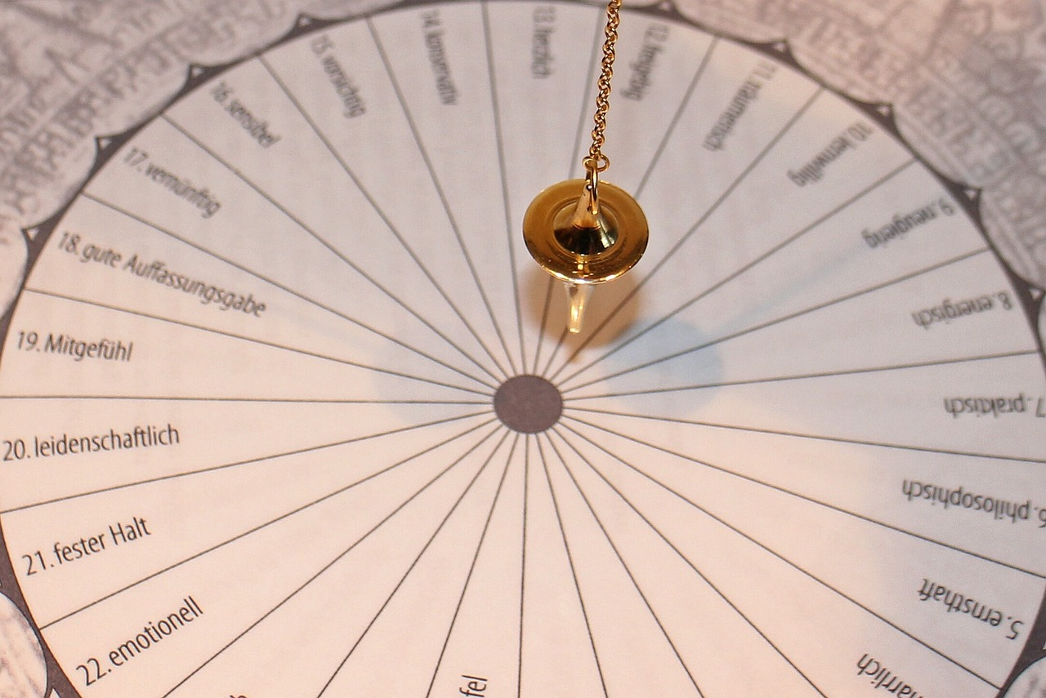
The First Law of Motion: Inertia
1
Definition of the First Law of Motion
The First Law of Motion states that an object at rest will remain at rest, and an object in motion will continue to move, unless acted upon by an external force.
This principle highlights the inherent resistance of objects to changes in their state of motion.
2
The Law of Inertia
The First Law of Motion is also known as the Law of Inertia.
Inertia describes the tendency of objects to resist changes in their motion or rest state.
3
Examples Illustrating Inertia
Examples of inertia include a bowling ball rolling down a lane or a car moving at a constant speed on the highway.
These scenarios demonstrate how objects maintain their motion unless external forces intervene.
6
Understanding Newton's Laws of Motion

Slide 7

The Second Law of Motion: Acceleration
1
Understanding the Second Law of Motion
The Second Law of Motion states that the force applied to an object is equal to the mass of the object multiplied by its acceleration.
This principle is fundamental in understanding how forces influence the motion of objects.
2
Mathematical Representation of the Law
The law is often expressed mathematically as F = ma, where F is force, m is mass, and a is acceleration.
This equation allows for precise calculations of the effects of force on an object's motion.
3
Examples of Acceleration in Everyday Life
Examples of acceleration include a car speeding up or slowing down, or a ball thrown upwards and coming back down.
These scenarios illustrate how the Second Law of Motion applies to real-world situations.
7
Understanding Newton's Laws of Motion

Slide 8

The Third Law of Motion: Action and Reaction
1
2
3
Understanding the Third Law of Motion
Exploring Force Interactions
Examples of Action and Reaction
The Third Law of Motion states that for every action, there is an equal and opposite reaction.
This principle highlights the reciprocal nature of forces between interacting objects.
This law describes the relationship between the forces that act between two objects.
It emphasizes the balance and opposition inherent in physical interactions.
Instances of this law include a rocket launching into space or a person throwing a ball.
These examples illustrate the practical applications of the Third Law of Motion.
8
Understanding Newton's Laws of Motion

Slide 9

Real-Life Applications of Newton's Laws
Practical Implications in Everyday Life
Enhancing Safety through Physics
Advancing Athletic Performance
Newton's Laws of Motion have numerous practical applications in everyday life, from car safety features to sports and athletics.
Understanding these laws can help us design safer cars, improve athletic performance, and even predict the motion of objects in various environments.
Examples of real-life applications include airbags, seatbelts, and roller coasters.
These innovations utilize Newton's principles to ensure safety and efficiency in their operation.
Athletes leverage Newton's Laws to optimize their movements and improve their performance.
This understanding allows for better training techniques and equipment design.
9
Understanding Newton's Laws of Motion

Slide 10

Key Concepts and Vocabulary
Key Concepts in Motion
Vocabulary of Newton's Laws
Importance of Understanding Motion
Key concepts include force, mass, acceleration, inertia, action, and reaction.
These principles form the foundation for understanding physical interactions and dynamics.
Important terms are Newton's Laws of Motion, physics, motion, force, mass, acceleration, inertia, action, and reaction.
These terms are crucial for discussing and analyzing the principles of motion.
Grasping these concepts and vocabulary is essential for a deep understanding of the laws of motion.
This knowledge enables a comprehensive exploration of physical phenomena.
10
Understanding Newton's Laws of Motion

Slide 11

Common Misconceptions and Errors
Misconceptions in Motion
Errors in Understanding
Importance of Clarity
Common misconceptions include the belief that friction is the only force affecting motion, that Newton's Laws are only applicable to large objects, and that an object's velocity remains constant.
These misunderstandings can hinder a proper grasp of physical principles.
Errors such as confusing mass with weight, assuming constant velocity for objects, and neglecting all acting forces are prevalent.
Recognizing and addressing these errors is essential for accurate comprehension.
Addressing these misconceptions and errors is crucial for a clear understanding of the laws of motion.
This ensures a solid foundation in physics and its applications.
11
Understanding Newton's Laws of Motion

Slide 12

Assessment and Evaluation
Assessment Methods
Evaluation Criteria
Feedback for Improvement
Quizzes, tests, and projects will be used to evaluate student understanding.
These tools provide a structured approach to measure learning outcomes.
Student participation, engagement, and understanding will be evaluated throughout the lesson.
This ensures a comprehensive assessment of the learning process.
Feedback will be provided to students to help them improve their understanding and performance.
This supports continuous learning and development.
12
Understanding Newton's Laws of Motion

Slide 13

Conclusion
Fundamental Principles
Practical Applications
Impact on Society
Newton's Laws of Motion are fundamental principles that describe the relationship between a body and the forces acting upon it.
These laws form the basis for understanding the dynamics of physical systems.
Understanding these laws is essential for a deep understanding of the physical world.
They have numerous practical applications in everyday life, influencing technology and safety.
The laws of motion are all around us, influencing various aspects of our daily lives.
Understanding them can help us make the world a better and safer place.
13
Understanding Newton's Laws of Motion

Slide 14

Next Steps
Exploration of the Second Law of Motion
Understanding Motion Calculations
Application to Real-World Scenarios
The next lesson will delve deeper into the Second Law of Motion.
This law explains the relationship between force, mass, and acceleration.
We will learn how to calculate the motion of objects using the Second Law.
This involves applying mathematical formulas to determine acceleration and force.
Prepare to apply the laws of motion to practical problems and situations.
This will help in understanding how physics governs everyday phenomena.
14
Understanding Newton's Laws of Motion

Slide 15

Reflection Questions
Understanding Newton's Laws
Applying Motion Laws
Exploring Further Questions
What did you learn about Newton's Laws of Motion in this lesson?
Reflect on the principles and examples discussed to solidify your understanding.
How can you apply the laws of motion to your everyday life?
Consider practical scenarios where these laws influence your actions and decisions.
What questions do you still have about the laws of motion, and how can you find the answers?
Identify resources or methods to deepen your knowledge and resolve uncertainties.
15
Understanding Newton's Laws of Motion

Slide 16

Additional Resources
Exploring Additional Resources
Additional resources include textbooks, online tutorials, and educational videos.
These materials are designed to help deepen your understanding of the laws of motion and related topics.
The Value of Continuous Learning
Learning is a lifelong process, offering opportunities to explore and discover new knowledge.
Engaging with various resources can enhance your comprehension and broaden your perspective.
Discovering Related Topics
Educational resources provide avenues to explore topics connected to the laws of motion.
They encourage curiosity and facilitate a deeper grasp of scientific principles.
16
Understanding Newton's Laws of Motion

Slide 17

Interactive Activities
Engaging Simulations
Immersive Games
Hands-On Experiments
Interactive activities such as simulations allow you to explore the laws of motion.
These simulations provide a dynamic and engaging way to understand physical principles.
Games designed around the laws of motion make learning fun and interactive.
Through gameplay, you can experience and apply these laws in a practical context.
Experiments offer a direct and immersive way to engage with the laws of motion.
By conducting experiments, you can observe and understand these laws firsthand.
17
Understanding Newton's Laws of Motion

Slide 18

Conclusion and Final Thoughts
Fundamental Principles of Motion
Practical Applications in Daily Life
Impact on Society and Safety
Newton's Laws of Motion are fundamental principles that describe the relationship between a body and the forces acting upon it.
These laws form the basis for understanding the mechanics of the physical world.
Understanding these laws is essential for a deep understanding of the physical world.
They have numerous practical applications in everyday life, influencing technology and safety.
The laws of motion are all around us, influencing various aspects of our environment.
Understanding them can help us make the world a better and safer place.
18
Understanding Newton's Laws of Motion

Slide 19

Final Assessment and Evaluation
Comprehensive Final Assessment
Continuous Evaluation Process
Constructive Feedback for Improvement
A comprehensive quiz or test will be administered to evaluate student understanding.
This assessment aims to measure the knowledge and skills acquired during the lesson.
Student participation, engagement, and understanding will be evaluated throughout the lesson.
This ongoing evaluation ensures that students are actively involved and grasping the material.
Feedback will be provided to students to help them improve their understanding and performance.
This feedback is designed to guide students towards better learning outcomes.
19
Understanding Newton's Laws of Motion

Slide 20

Closing Remarks
Expressing Gratitude
Understanding Newton's Laws
Practical Implications
Thank you for joining me on this journey through Newton's Laws of Motion.
Your participation and interest are greatly appreciated.
I hope you have gained a deeper understanding of the laws of motion and their practical applications.
These principles are fundamental to physics and engineering.
Remember, the laws of motion are all around us, and understanding them can help us make the world a better and safer place.
Their applications range from everyday phenomena to advanced technological innovations.
20
Understanding Newton's Laws of Motion

Slide 21

References and Credits
Sources of Knowledge
Acknowledging Contributions
The Spirit of Collaboration
References include textbooks, online resources, and educational videos.
These materials provide the foundation for the lesson's content and understanding.
Credits go to the authors, creators, and contributors who made this lesson possible.
Their efforts and expertise are invaluable in creating educational materials.
Learning is a collaborative process, emphasizing the importance of working together.
We are all in this together, fostering mutual growth and understanding.
21
Understanding Newton's Laws of Motion

