Slide 1

Exploring the Depths of 'The Gift of the Magi'
A Comprehensive Analysis of Themes, Characters, and Symbolism in O. Henry's Classic Tale

Slide 2
Table of Contents
Introduction to "The Gift of the Magi"
Plot Summary
Themes of the Story
Character Analysis
Symbolism in the Story
Irony in the Story
Discussion Questions
Writing Activity
Conclusion
Summary of Key Points
01
02
03
04
05
06
07
08
09
10

Slide 3
Table of Contents
Assessment and Evaluation
Extension Activities
Teaching Tips and Strategies
Reflection and Evaluation
Conclusion and Final Thoughts
References and Resources
Appendix and Additional Materials
11
12
13
14
15
16
17

Slide 4

Exploring the Depths of 'The Gift of the Magi'
1
Introduction to "The Gift of the Magi"
Love and Sacrifice
Struggling Couple
Ironic Gift-Giving
The Gift of the Magi is a short story by O. Henry that explores the themes of love and sacrifice.
It emphasizes the true meaning of gift-giving through the characters' actions.
The story follows Jim and Della, a young couple struggling to make ends meet during the holiday season.
This situation highlights the depth of their love for each other.
The story's ironic ending showcases the sacrifices people make for their loved ones.
It reveals the true essence of gift-giving beyond material possessions.

Slide 5

Exploring the Depths of 'The Gift of the Magi'
2
Plot Summary
Della's Sacrifice
Jim's Dilemma
Della wants to buy Jim a special Christmas present, but she doesn't have enough money.
She sells her long hair to buy a chain for Jim's watch.
Jim is searching for the perfect gift for Della.
He decides to sell his watch to buy her beautiful combs.
Ironic Gifts
Meaningful Love
The story concludes with an ironic twist about their sacrifices.
Their gifts, though unnecessary, reflect their deep love.
Their actions show the true spirit of giving and selflessness.
The couple's love transcends material possessions.

Slide 6
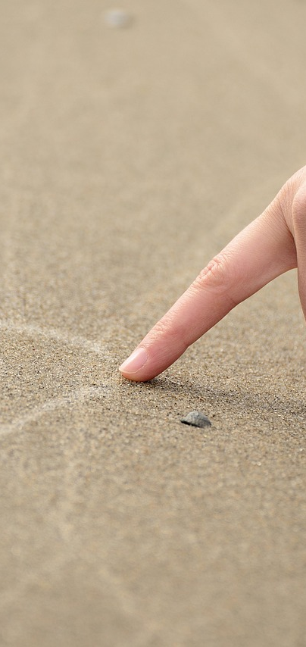
Exploring the Depths of 'The Gift of the Magi'
3
Themes of the Story
Sacrificial Love
Selfless Giving
Value Beyond Price
Jim and Della's sacrifices demonstrate the depth of their love for each other.
Their willingness to give up their most prized possessions shows true devotion.
The story highlights the importance of selfless love.
It emphasizes the willingness to make sacrifices for those we care about.
The true value of a gift lies not in its monetary worth.
It is the thought and love behind the gift that truly matters.

Slide 7
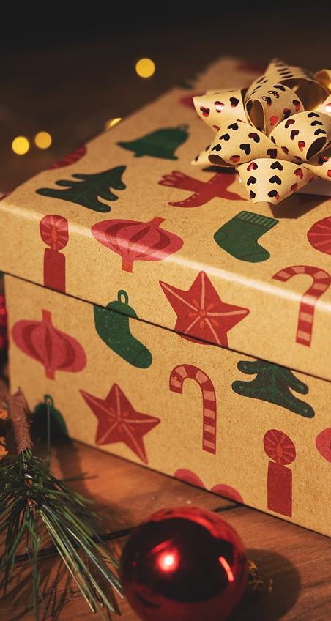
Exploring the Depths of 'The Gift of the Magi'
4
Character Analysis
Jim's Sacrifice
Della's Devotion
Jim wants to give Della the perfect gift, demonstrating his love.
He prioritizes their relationship over material things, willing to make sacrifices for her happiness.
Della aims to give Jim a meaningful gift, showcasing her love.
She values their bond above her own desires, ready to sacrifice for his joy.

Slide 8

Exploring the Depths of 'The Gift of the Magi'
5
Symbolism in the Story
Della's Sacrifice
Jim's Pride
Della's hair symbolizes her beauty, youth, and vitality.
By cutting and selling her hair, Della is making a significant sacrifice for Jim.
Jim's watch symbolizes his pride and possession.
By selling his watch, Jim is making a significant sacrifice for Della.

Slide 9

Exploring the Depths of 'The Gift of the Magi'
6
Irony in the Story
Unnecessary Sacrifices
Meaningful Love
Jim and Della each give up something precious to buy gifts for one another.
Their sacrifices highlight the depth of their love, despite being ultimately unnecessary.
The story's ending reveals the irony of their situation.
Even though their gifts become useless, their actions show that true love transcends material possessions.

Slide 10

Exploring the Depths of 'The Gift of the Magi'
7
Discussion Questions
Della's Motivation
Jim's Character Insight
Della is motivated by her love for Jim and her desire to give him a special Christmas gift.
Her decision to cut and sell her hair shows the depth of her sacrifice.
Jim's decision to sell his watch reveals his selflessness and love for Della.
He values her happiness over his own possessions, highlighting his character strength.
Theme of Sacrifice
Author's Message
The story's ending illustrates the theme of sacrifice through the couple's actions.
Both Della and Jim give up their most prized possessions for each other, emphasizing true love.
The author conveys that love often involves sacrifice and selflessness.
Through Della and Jim's story, we learn that the value of love transcends material possessions.

Slide 11

Exploring the Depths of 'The Gift of the Magi'
8
Writing Activity
Theme Reflection
Creative Inspiration
Reflect on the central themes of the story.
Discuss their significance in your life.
Write a poem or short story inspired by the narrative.
Use the characters or events as your muse.

Slide 12
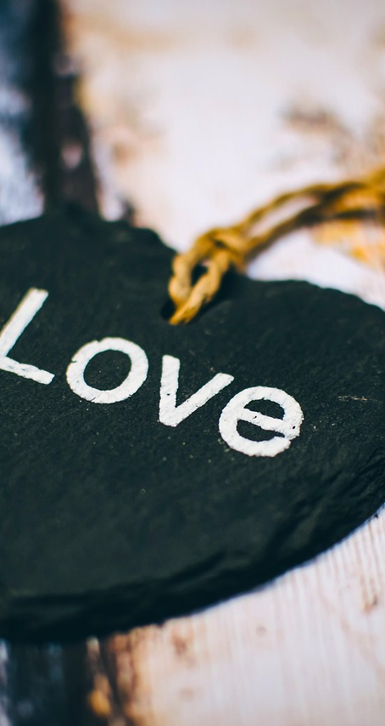
Exploring the Depths of 'The Gift of the Magi'
9
Conclusion
Love and Sacrifice
Ironic Gift-Giving
'The Gift of the Magi' delves into the profound themes of love and sacrifice.
It reveals how true love often involves selfless acts for the happiness of others.
The story's ironic conclusion underscores the depth of sacrifice inherent in true love.
It challenges the notion of material gifts, emphasizing the value of intention over possessions.

Slide 13

Exploring the Depths of 'The Gift of the Magi'
10
Summary of Key Points
Struggling Couple
Sacrificial Gifts
Jim and Della are a young couple facing financial difficulties during the holiday season.
Their love drives them to make significant sacrifices.
Della sells her hair to buy a chain for Jim's watch.
Jim sells his watch to purchase combs for Della.
Ironic Twist
Selfless Love
The story ends with an ironic twist regarding their sacrifices.
Their gifts become useless, highlighting the unexpected outcomes of love.
The narrative emphasizes the importance of selfless love.
It illustrates that true gift-giving lies in thought and sacrifice.

Slide 14

Exploring the Depths of 'The Gift of the Magi'
11
Assessment and Evaluation
Comprehension Quiz
Creative Writing
Class Discussion
Students will take a quiz to evaluate their grasp of the plot and characters.
This will highlight areas that may require additional focus.
Students will craft a personal narrative inspired by the story.
This allows for a deeper connection to the material.
Students will engage in a discussion about the story's themes and messages.
This encourages diverse perspectives and critical analysis.

Slide 15
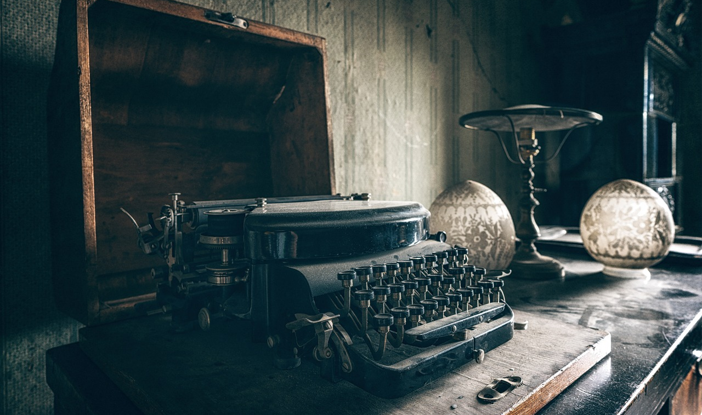
Exploring the Depths of 'The Gift of the Magi'
12
Extension Activities
Creative Writing
Debate on Sacrifice
Book Club Discussion
Students will write a short story or poem inspired by 'The Gift of the Magi'.
This activity encourages creativity and personal expression.
Students will participate in a debate on 'Is sacrifice necessary for true love?'.
This enhances critical thinking and public speaking skills.
Students will discuss 'The Gift of the Magi' and related short stories.
This improves comprehension and analytical skills.

Slide 16
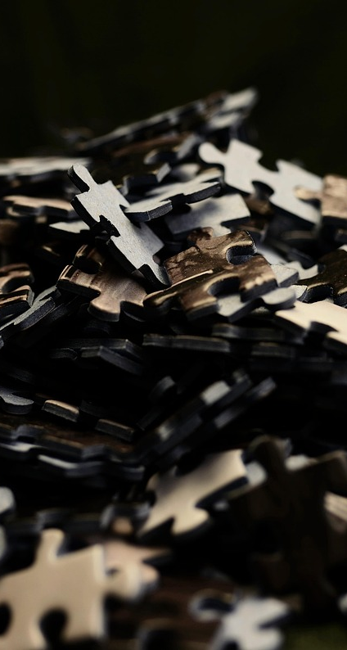
Exploring the Depths of 'The Gift of the Magi'
13
Teaching Tips and Strategies
Activate Prior Knowledge
Enhance Vocabulary
Engage students with pre-reading activities that stimulate their prior knowledge.
Foster interest through dynamic discussions.
Build students' vocabulary using diverse strategies.
Incorporate definitions and visual aids for better understanding.
Improve Comprehension
Foster Critical Thinking
Implement strategies that enhance text understanding.
Focus on key elements such as plot and characters.
Encourage analysis of themes and characters through targeted exercises.
Facilitate discussions of student interpretations.

Slide 17

Exploring the Depths of 'The Gift of the Magi'
14
Reflection and Evaluation
Lesson Effectiveness
Student Engagement
Feedback Utilization
Evaluate the lesson's success in achieving its goals.
Identify specific areas that require improvement.
Assess how well students understood the material presented.
Monitor participation to gauge overall engagement levels.
Incorporate student feedback to enhance future lesson plans.
Adjust instructional methods based on the insights received.

Slide 18

Exploring the Depths of 'The Gift of the Magi'
15
Conclusion and Final Thoughts
Love and Sacrifice
Ironic Gift-Giving
The Gift of the Magi is a thought-provoking story that explores the themes of love and sacrifice.
It reveals the true meaning of gift-giving through the characters' selfless actions.
The story's ironic ending highlights the sacrifices that people make for those they love.
It emphasizes that the essence of gift-giving lies in the love behind the gesture, not the material value.

Slide 19
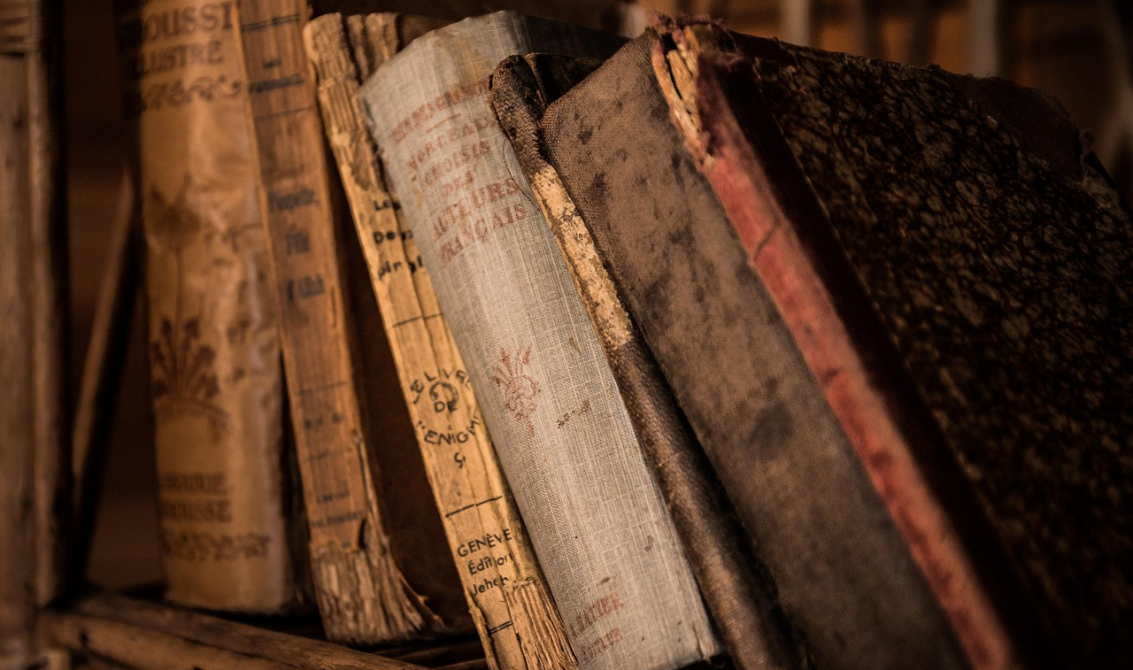
Exploring the Depths of 'The Gift of the Magi'
16
References and Resources
O. Henry's Insight
Critical Perspectives
Teaching Aids
O. Henry's short story, 'The Gift of the Magi', explores themes of love and sacrifice.
The narrative showcases the irony of giving and the true spirit of Christmas.
Literary analysis reveals the depth of character development in O. Henry's work.
Critics often highlight the story's moral lessons and its commentary on materialism.
Online resources provide lesson plans and discussion questions for 'The Gift of the Magi'.
Educational materials include video adaptations and interactive activities for students.

Slide 20
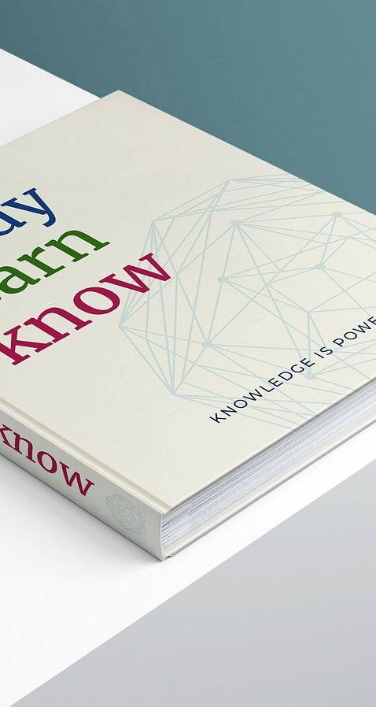
Exploring the Depths of 'The Gift of the Magi'
17
Appendix and Additional Materials
Teaching Strategies
Supplementary Resources
Incorporate storytelling techniques to create a vivid learning experience for students.
Encourage collaborative group discussions that allow students to share their insights and deepen their understanding.
Develop worksheets that provide practice opportunities for the concepts covered in the story.
Create quizzes and assessments that help gauge student comprehension and retention of the material.

