Slide 1

Exploring the Elements: A Journey Through the Periodic Table
An Interactive and Educational Exploration

Slide 2
Table of contents
01
02
03
04
05
06
07
08
09
10
11
Title Slide: Unraveling the Periodic Table
What is the Periodic Table?
Elements as a Family
Periodic Table Structure
Element Families
Atomic Structure Basics
Real-World Element Connections
Interactive Learning Activities
Safety and Exploration
Conclusion
Reflection Questions

Slide 3
Table of contents
12
13
14
15
16
17
18
19
20
21
Next Steps
Clean and Modern Design
Bright and Engaging Colors
High-Quality Scientific Graphics
Consistent Readable Typography
Sparingly Used Animations
Age-Appropriate Visual Style
PowerPoint or Google Slides Software
Export as PDF
Interactive Elements

Slide 4

1
Title Slide: Unraveling the Periodic Table
Unraveling the Periodic Table: A Scientific Family Tree
Exploring Elements for Young Scientists (Ages 11)
Exploring the Elements: A Journey Through the Periodic Table

Slide 5

2
What is the Periodic Table?
The Periodic Table: Nature's Organizational Masterpiece
A systematic arrangement of chemical elements
Organized by atomic structure and properties
Shows how elements are related and interact
Exploring the Elements: A Journey Through the Periodic Table

Slide 6

3
Elements as a Family
01
Unique "Personalities"
02
Interconnected Relationships
Each element possesses distinct characteristics and behaviors.
Hydrogen is the lightest element, while gold is known for its lustrous appearance.
Elements are akin to family members, sharing common traits and properties.
Oxygen and sulfur both belong to the same group and exhibit similar chemical behaviors.
03
Positional Significance
The location of an element in the periodic table reflects its inherent properties.
Sodium and potassium, found in the same group, showcase comparable reactivity levels.
Exploring the Elements: A Journey Through the Periodic Table

Slide 7
4
Periodic Table Structure
01
02
03
Periods (Rows)
Groups (Columns)
Atomic Number
Represent Electron Shell "Generations"
Define Element "Families"
Determines Element's Position
Exploring the Elements: A Journey Through the Periodic Table

Slide 8

5
Element Families
01
Alkali Metals
02
Halogens
Highly reactive
Soft metals
Found in Group 1
Nonmetals
Colorful and reactive
Found in Group 17
03
Transition Metals
04
Noble Gases
Good conductors
Diverse properties
Found in Groups 3-12
Colorless and odorless
Low reactivity
Found in Group 18
Exploring the Elements: A Journey Through the Periodic Table

Slide 9

6
Atomic Structure Basics
01
Atoms as Building Blocks
02
Atomic Number Significance
Atoms are the fundamental units of matter.
Consist of protons, neutrons, and electrons.
Atomic number = Number of protons in the nucleus.
Determines the element's identity on the periodic table.
03
Electron Configurations
Electrons orbit the nucleus in energy levels.
Configurations dictate an element's chemical behavior.
Exploring the Elements: A Journey Through the Periodic Table

Slide 10

7
Real-World Element Connections
01
Oxygen in Breathing
02
Carbon in Living Organisms
Essential for respiration
Supports life processes
Building block of organic molecules
Forms the basis of all life
03
Silicon in Technology
Used in electronics and solar panels
Enables advancements in modern devices
Exploring the Elements: A Journey Through the Periodic Table

Slide 11

8
Interactive Learning Activities
01
Element Family Matching
02
Atomic Structure Modeling
Match elements to their respective families based on properties and characteristics.
Build models of atoms using different materials to understand the arrangement of protons, neutrons, and electrons.
03
Chemical Property Exploration
Conduct experiments to observe and analyze the chemical properties of different elements.
Exploring the Elements: A Journey Through the Periodic Table

Slide 12

9
Safety and Exploration
01
Wear Protective Equipment
02
Follow Instructor Instructions
Safety glasses
Gloves
Listen attentively
Ask questions if unsure
03
Respect Scientific Materials
Handle with care
Proper disposal practices
Exploring the Elements: A Journey Through the Periodic Table

Slide 13

10
Conclusion
Conclusion
The Periodic Table serves as a fundamental tool in understanding the organization of elements.
Exploring the Elements: A Journey Through the Periodic Table

Slide 14
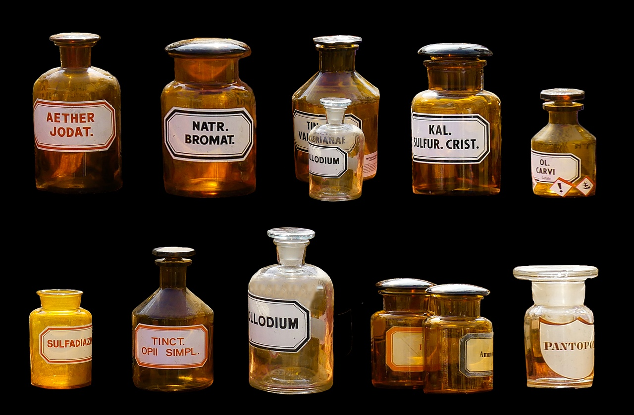
11
Reflection Questions
01
How are elements like family members?
02
What makes each element unique?
Explore the concept of elements having unique characteristics and relationships similar to family members.
Discuss the distinct properties and behaviors that differentiate one element from another on the periodic table.
03
How can we use the periodic table?
Reflect on the practical applications of the periodic table in understanding and predicting chemical behavior.
Exploring the Elements: A Journey Through the Periodic Table

Slide 15

12
Next Steps
01
Element Research Project
02
Home Science Exploration
Choose an element to research in-depth
Explore its properties, uses, and significance
Present findings creatively (e.g., poster, presentation)
Conduct simple experiments with household items
Explore chemical reactions and properties firsthand
Document and share your discoveries with others
03
Further Periodic Table Investigations
Dive deeper into element relationships and trends
Explore advanced concepts like electron configurations
Challenge yourself with periodic table puzzles and quizzes
Exploring the Elements: A Journey Through the Periodic Table

Slide 16

13
Clean and Modern Design
Clean and Modern Design
Minimalist layout with ample white space
Exploring the Elements: A Journey Through the Periodic Table

Slide 17

14
Bright and Engaging Colors
01
Bright and Engaging Colors
02
Colors aid in element identification
Vibrant hues stimulate visual interest
Red, blue, green, and yellow
Each element uniquely color-coded
03
Engage young scientists with colorful visuals
Enhance learning and retention through color psychology
Exploring the Elements: A Journey Through the Periodic Table

Slide 18

15
High-Quality Scientific Graphics
01
Detailed Molecular Structures
02
Interactive 3D Models
Precise labeling
Better visualization
03
Infographics
04
Color-coded Diagrams
Illustrating chemical reactions
Clarity and understanding
Exploring the Elements: A Journey Through the Periodic Table

Slide 19
16
Consistent Readable Typography
01
Font Choice
02
Font Size
03
Text Alignment
Headings: Arial Bold
Subheadings: Arial Regular
Body Text: Calibri Regular
Headings: 36pt
Subheadings: 24pt
Body Text: 18pt
Maintain left alignment for all text
Ensure consistent spacing between lines and paragraphs
04
Color Contrast
05
Consistent Formatting
Use high contrast colors for text and background
Avoid using light text on light backgrounds or dark text on dark backgrounds
Keep text formatting uniform throughout the presentation
Use bold or italics for emphasis, but sparingly
Exploring the Elements: A Journey Through the Periodic Table

Slide 20

17
Sparingly Used Animations
01
Fade In/Out
02
Appear/Disappear
Subtle fade animations can draw attention to key points without being distracting.
Example: Text fading in as it's being discussed.
Elements appearing or disappearing can create a sense of progression.
Example: Bullet points appearing one by one to emphasize each point.
03
Slide Transitions
04
Design Tip
Smooth transitions between slides can maintain audience engagement.
Example: Using a slide swipe effect for seamless transitions.
Remember, animations should enhance understanding and engagement, not overwhelm the audience.
Exploring the Elements: A Journey Through the Periodic Table

Slide 21
18
Age-Appropriate Visual Style
Engaging Colors
Interactive Elements
Utilize bright and vibrant colors to capture young scientists' attention.
Incorporate playful and interactive design elements to enhance learning.
Clear Typography
Imagery
Maintain a consistent and readable font style for easy comprehension.
Include high-quality scientific graphics that are visually appealing and educational.
Exploring the Elements: A Journey Through the Periodic Table

Slide 22
19
PowerPoint or Google Slides Software
Customizable Templates
Collaboration Tools
Both software offer a variety of templates for different themes.
Google Slides allows real-time collaboration with team members.
Exploring the Elements: A Journey Through the Periodic Table

Slide 23

20
Export as PDF
Export as PDF
Save the presentation as a PDF file for easy sharing and viewing.
To export as PDF in PowerPoint, go to "File" > "Save As" > Select PDF format.
PDF files maintain formatting and are accessible on various devices.
Ensure all elements are correctly displayed before finalizing the export.
PDFs are ideal for distributing educational content to students and colleagues.
Exploring the Elements: A Journey Through the Periodic Table

Slide 24
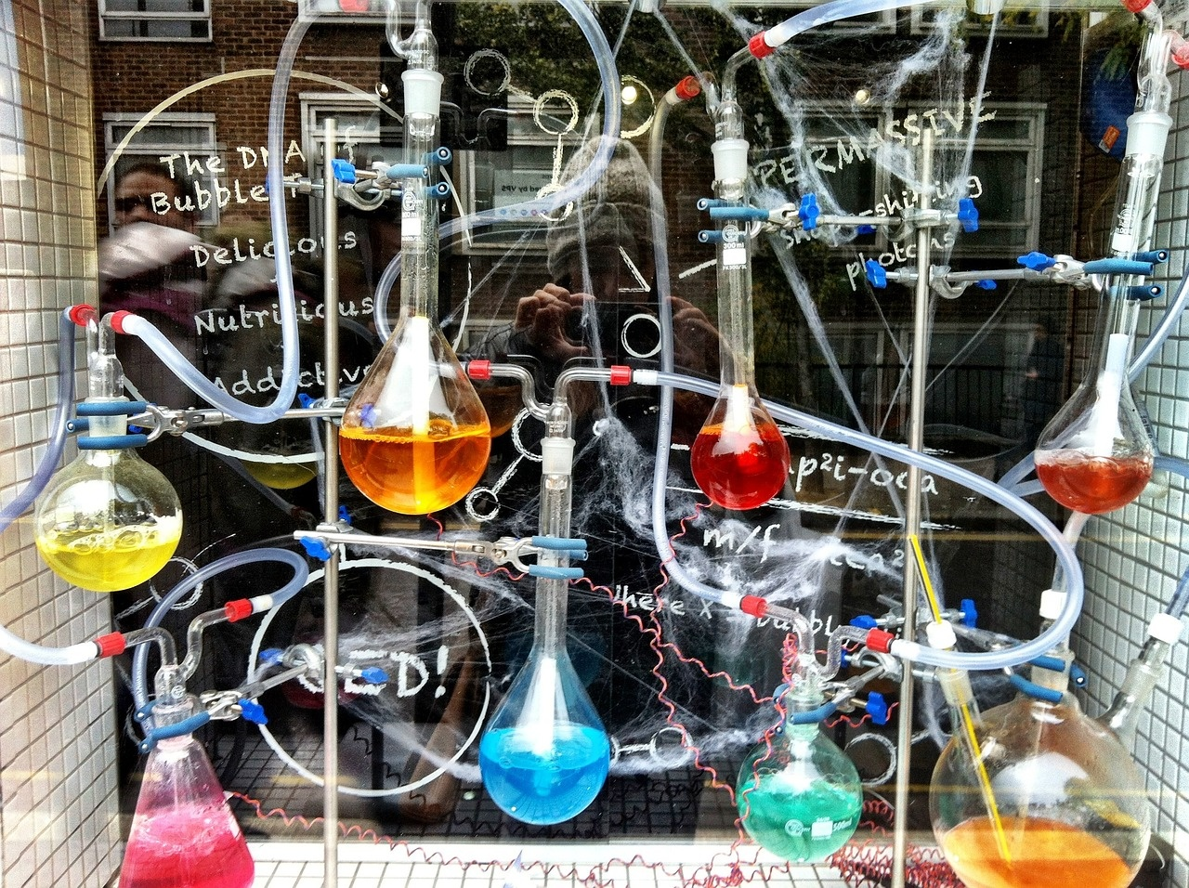
21
Interactive Elements
01
Element Family Matching
02
Atomic Structure Modeling
Engage in a fun activity matching elements to their respective families.
Build models to understand the composition of atoms and their components.
03
Chemical Property Exploration
Explore the unique properties of elements through interactive experiments.
Exploring the Elements: A Journey Through the Periodic Table

