Slide 1
Embracing the Circular Economy: A Pathway to Sustainable Living
Exploring Principles, Benefits, and Practical Applications for a Greener Future

Slide 2
Table of Contents
Introduction to Circular Economy
Benefits of Circular Economy
Principles of Circular Economy
Applying Circular Economy Principles in Daily Life
Designing a Recycling Program
Creating a Product from Recycled Materials
Conducting a Waste Audit
Designing a Public Awareness Campaign
Creating a Business Plan for a Sustainable Product
Common Errors and Misconceptions
01
02
03
04
05
06
07
08
09
10

Slide 3
Table of Contents
FAQs
Objectives
Vocabulary
Resources
Prior Knowledge
Conclusion
Reflection Questions
Next Steps
11
12
13
14
15
16
17
18

Slide 4
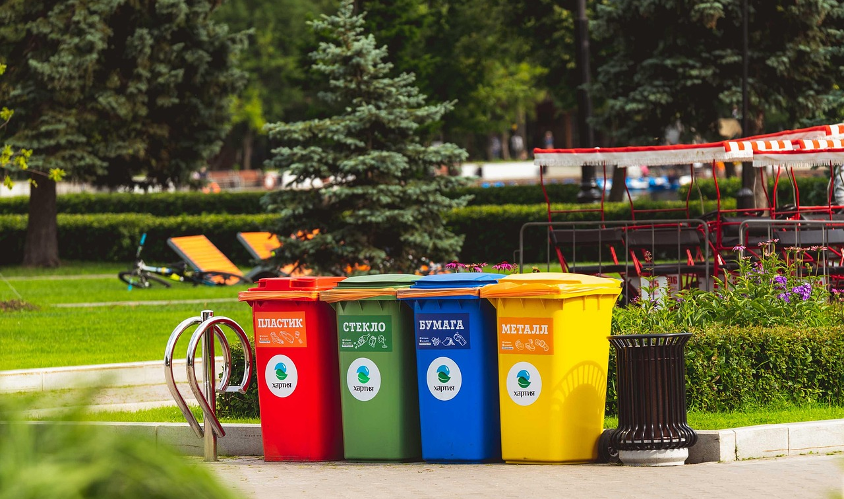
Embracing the Circular Economy: A Pathway to Sustainable Living
1
Introduction to Circular Economy
Waste Reduction
Resource Limitations
Sustainable Impact
The circular economy minimizes waste through sustainable design.
It promotes products that are restorative and regenerative.
The circular economy recognizes that resources are finite and emphasizes the need for wise management.
Addressing waste is essential to mitigate environmental challenges.
Adopting circular economy principles fosters a sustainable future.
It empowers individuals to positively impact the environment.

Slide 5
Embracing the Circular Economy: A Pathway to Sustainable Living
2
Benefits of Circular Economy
Waste Reduction and Sustainable Practices
Conservation of Natural Resources
Sustainable Economic Growth and Job Creation
Mitigation of Greenhouse Gas Emissions
Implementing circular economy principles significantly reduces waste generation.
This approach encourages sustainable consumption and production patterns among businesses and consumers.
The circular economy model emphasizes the importance of conserving natural resources.
By reusing and recycling materials, we can significantly lower the demand for raw materials.
Transitioning to a circular economy fosters sustainable economic growth across various sectors.
This shift can lead to the creation of new job opportunities in recycling, repair, and sustainable product design.
Adopting circular economy practices plays a crucial role in reducing greenhouse gas emissions.
By minimizing waste and promoting resource efficiency, we can effectively combat climate change.

Slide 6
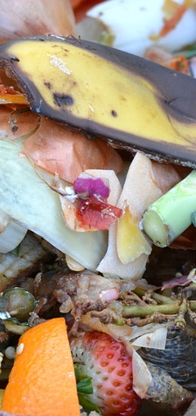
Embracing the Circular Economy: A Pathway to Sustainable Living
3
Principles of Circular Economy
Design for Zero Waste
Maximize Material Lifespan
Restore Natural Ecosystems
Designing out waste and pollution from the start.
This approach ensures that resources are used efficiently and sustainably.
Keeping products and materials in use for as long as possible.
This strategy reduces the need for new resources and minimizes environmental impact.
Regenerating natural systems is essential for a sustainable future.
Promoting sustainable agriculture and forestry practices helps maintain biodiversity.

Slide 7

Embracing the Circular Economy: A Pathway to Sustainable Living
4
Applying Circular Economy Principles in Daily Life
Energy Efficiency
Sustainable Transport
Use energy-efficient appliances.
Always turn off lights and electronics when not in use.
Opt for public transport, walking, or biking.
These choices significantly reduce carbon emissions.
Eco-Friendly Products
Minimize Food Waste
Choose products with minimal packaging.
Select items made from recycled materials.
Plan meals to avoid excess preparation.
Use leftovers to reduce waste.

Slide 8
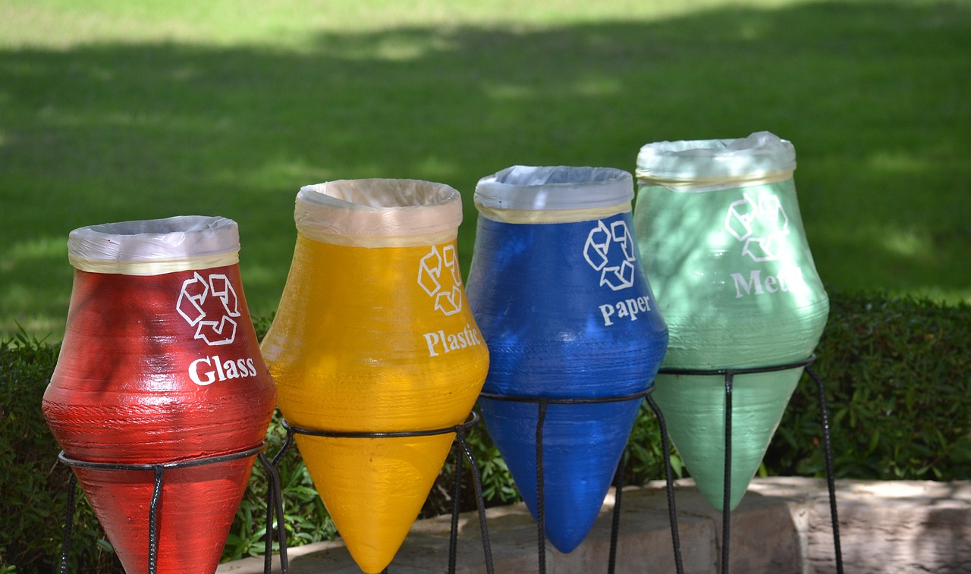
Embracing the Circular Economy: A Pathway to Sustainable Living
5
Designing a Recycling Program
Waste Assessment
Recycling Strategy
Awareness Campaign
Assess the various waste types and their quantities produced within the school or community.
This evaluation will inform tailored recycling initiatives.
Create a comprehensive plan for the collection and processing of recyclable materials.
Ensure the strategy is practical and accessible to all participants.
Promote the significance of recycling through educational initiatives.
Emphasize the benefits of the program to foster community involvement.

Slide 9

Embracing the Circular Economy: A Pathway to Sustainable Living
6
Creating a Product from Recycled Materials
Innovative Recycling Ideas
Product Design Process
Feasibility Assessment
Generate ideas for products made from recycled materials.
Consider specific applications for various recycled materials.
Design a product using recycled components.
Focus on functionality and aesthetics in the design.
Evaluate market demand and production expenses.
Assess the sustainability and impact of the product.

Slide 10
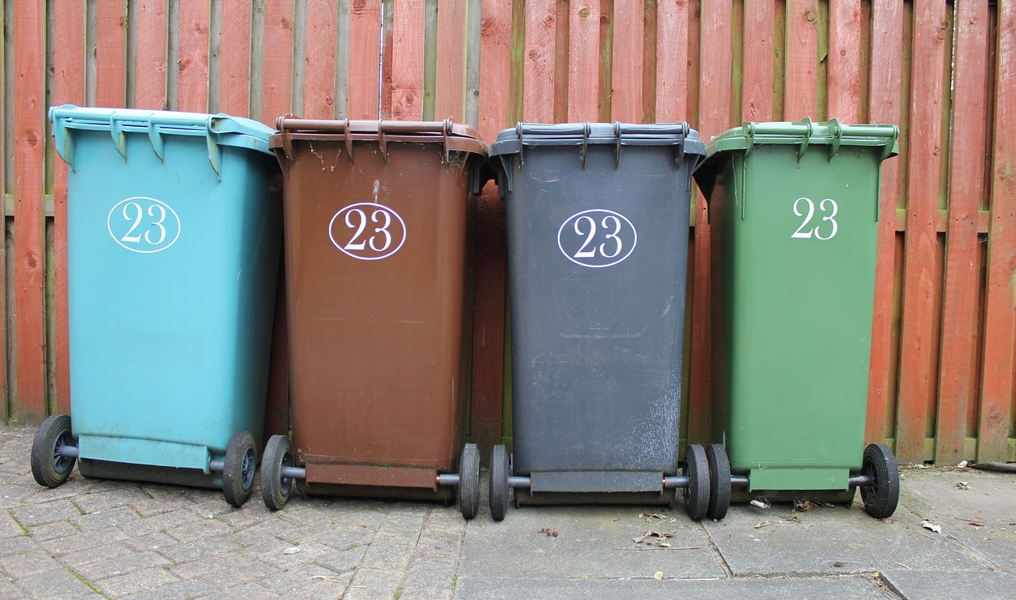
Embracing the Circular Economy: A Pathway to Sustainable Living
7
Conducting a Waste Audit
Waste Identification
Data Analysis
Sustainability Plan
Identify the different types of waste produced in the school or community.
Measure the quantity of each waste type to gauge its impact.
Analyze the waste data to discover trends in generation patterns.
Identify key areas where waste reduction efforts can be focused.
Create a strategic plan to effectively minimize waste generation.
Promote sustainable practices that encourage long-term environmental responsibility.

Slide 11

Embracing the Circular Economy: A Pathway to Sustainable Living
8
Designing a Public Awareness Campaign
Idea Generation
Creative Materials
Campaign Evaluation
Explore unique concepts for a public awareness initiative.
Involve the community through engaging workshops and discussions.
Craft visually striking materials that resonate with the audience.
Utilize various formats, including posters and social media graphics, to spread the message.
Analyze the campaign's effectiveness and pinpoint areas for enhancement.
Solicit community input to refine future initiatives.

Slide 12

Embracing the Circular Economy: A Pathway to Sustainable Living
9
Creating a Business Plan for a Sustainable Product
Sustainable Product Development
Impact Assessment
Implementation Strategy
Identify specific market gaps that can be addressed with sustainable solutions.
Design a business model that integrates eco-friendly practices at its core.
Conduct a thorough analysis of the product's environmental effects from creation to end-of-life.
Evaluate how the product influences local communities and economies.
Outline a strategic approach for launching the product that resonates with target audiences.
Engage stakeholders early to build trust and facilitate smoother adoption.

Slide 13
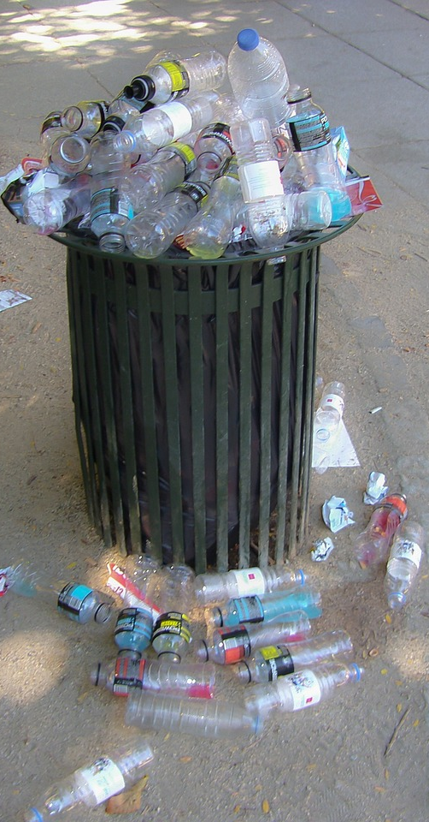
Embracing the Circular Economy: A Pathway to Sustainable Living
10
Common Errors and Misconceptions
Circular Economy for All
More Than Recycling
The circular economy is relevant to businesses of all sizes, not just large-scale industries.
Everyone can contribute to a more sustainable future.
The circular economy encompasses much more than just recycling and waste management.
It includes redesigning products and processes to minimize waste from the start.
Cost Misconceptions
Proven Concept
Many believe that implementing a circular economy is too expensive or time-consuming.
In reality, it can lead to cost savings and efficiency improvements over time.
Some think the circular economy is a new concept, but it has been practiced for decades.
Numerous successful examples demonstrate its effectiveness across various sectors.

Slide 14
Embracing the Circular Economy: A Pathway to Sustainable Living
11
FAQs
What is Circular Economy?
Applying Circular Economy Principles
Benefits of Circular Economy
Schools and Circular Economy
Individual Contributions
A circular economy is a sustainable economic model that contrasts with the traditional linear approach of 'take, make, dispose.'
It focuses on resource efficiency and waste reduction.
Practice circular economy by reducing waste, reusing materials, and choosing durable products.
Every small action contributes to a larger impact on sustainability.
The circular economy reduces environmental impact and conserves resources.
It stimulates economic growth by creating new jobs in sustainable industries.
Schools can integrate circular economy concepts into their programs.
Engaging students in sustainability projects fosters awareness and responsibility.
Individuals can support a circular economy by making informed purchases.
Advocating for sustainable practices helps drive change in communities.

Slide 15
Embracing the Circular Economy: A Pathway to Sustainable Living
12
Objectives
Human Impact Analysis
Waste Reduction Strategies
Community Solutions for Sustainability
Real-World Circular Economy Applications
Examine how human activities influence environmental health.
Identify opportunities for integrating circular economy principles.
Assess specific waste reduction methods like composting and recycling.
Promote actionable zero-waste initiatives in local businesses.
Design programs aimed at reducing waste in schools and neighborhoods.
Encourage community collaboration to adopt sustainable practices.
Investigate practical examples of circular economy implementations.
Deepen understanding of sustainability through relevant case studies.

Slide 16
Embracing the Circular Economy: A Pathway to Sustainable Living
13
Vocabulary
Circular Economy
Sustainable Development
Waste Minimization
Material Recovery
Resource Reuse
An economic model that aims to reduce waste and promote sustainability.
It focuses on the continual use of resources.
The ability to meet the needs of the present without compromising future generations.
It emphasizes a balance between economic growth and environmental protection.
The process of reducing the amount of waste generated by individuals and organizations.
It encourages efficient use of resources and reduction of excess.
The process of collecting and processing materials that would otherwise be discarded.
It transforms waste into new products, reducing the need for virgin materials.
The practice of using an object or material again for its original or a new purpose.
It helps to extend the life cycle of products and reduce waste.

Slide 17

Embracing the Circular Economy: A Pathway to Sustainable Living
14
Resources
Digital Tools
Physical Materials
Utilize online simulation software to create engaging learning experiences.
Access a variety of educational websites and social media platforms for additional resources.
Incorporate diverse recyclable materials to inspire creativity in projects.
Use technology to support interactive and hands-on learning activities.
Textbook Resource
Guest Speakers
Refer to 'Circular Economy: A Guide for Students' for valuable insights on sustainability.
This textbook serves as a key resource for understanding sustainable practices.
Invite local business owners to share their sustainability initiatives and experiences.
Engage with sustainability experts and community leaders to broaden perspectives on environmental issues.

Slide 18
Embracing the Circular Economy: A Pathway to Sustainable Living
15
Prior Knowledge
Environmental Impact
Recycling Concepts
Design Skills
Community Engagement
Students should understand how human activities affect the environment.
Recognizing the consequences of pollution and deforestation is essential.
Students should know the principles of recycling and reuse.
These practices help minimize waste and conserve resources.
Students should develop basic design and problem-solving abilities.
These skills are vital for creating effective environmental solutions.
Students should appreciate the role of community involvement in environmental efforts.
Active participation fosters sustainable and impactful initiatives.

Slide 19
Embracing the Circular Economy: A Pathway to Sustainable Living
16
Conclusion
Engaging Sustainability
Impactful Practices
Waste Reduction Strategies
The lesson plan on circular economy principles engages students in practical applications.
Students learn to apply sustainable practices in their daily lives.
Applying circular economy principles helps create a sustainable future.
Individuals can make a positive impact on the environment through their actions.
Key takeaways include reducing waste, reusing materials, and recycling.
Creative thinking is essential for effective waste reduction.

Slide 20
Embracing the Circular Economy: A Pathway to Sustainable Living
17
Reflection Questions
Challenging Aspects
Understanding Circular Economy
Real-World Application
Students found the concept of circular economy difficult.
Future lessons should incorporate hands-on activities to enhance understanding.
Students demonstrated their understanding by proposing waste reduction strategies in group projects and presentations.
They provided evidence through their proposals and discussions.
Opportunities for real-world application include community clean-up events and sustainability workshops.
Engaging the school and community fosters a culture of sustainability.

Slide 21
Embracing the Circular Economy: A Pathway to Sustainable Living
18
Next Steps
Sustainable Product Design
Waste Reduction Strategies
Community Sustainability Initiatives
Students will learn design thinking principles.
They will apply these principles to create sustainable products.
Students will understand the importance of reducing waste.
They will develop a comprehensive plan for waste reduction in their community.
Students will explore the impact of community engagement on sustainability.
They will outline actionable steps for local sustainability projects.

