Slide 1

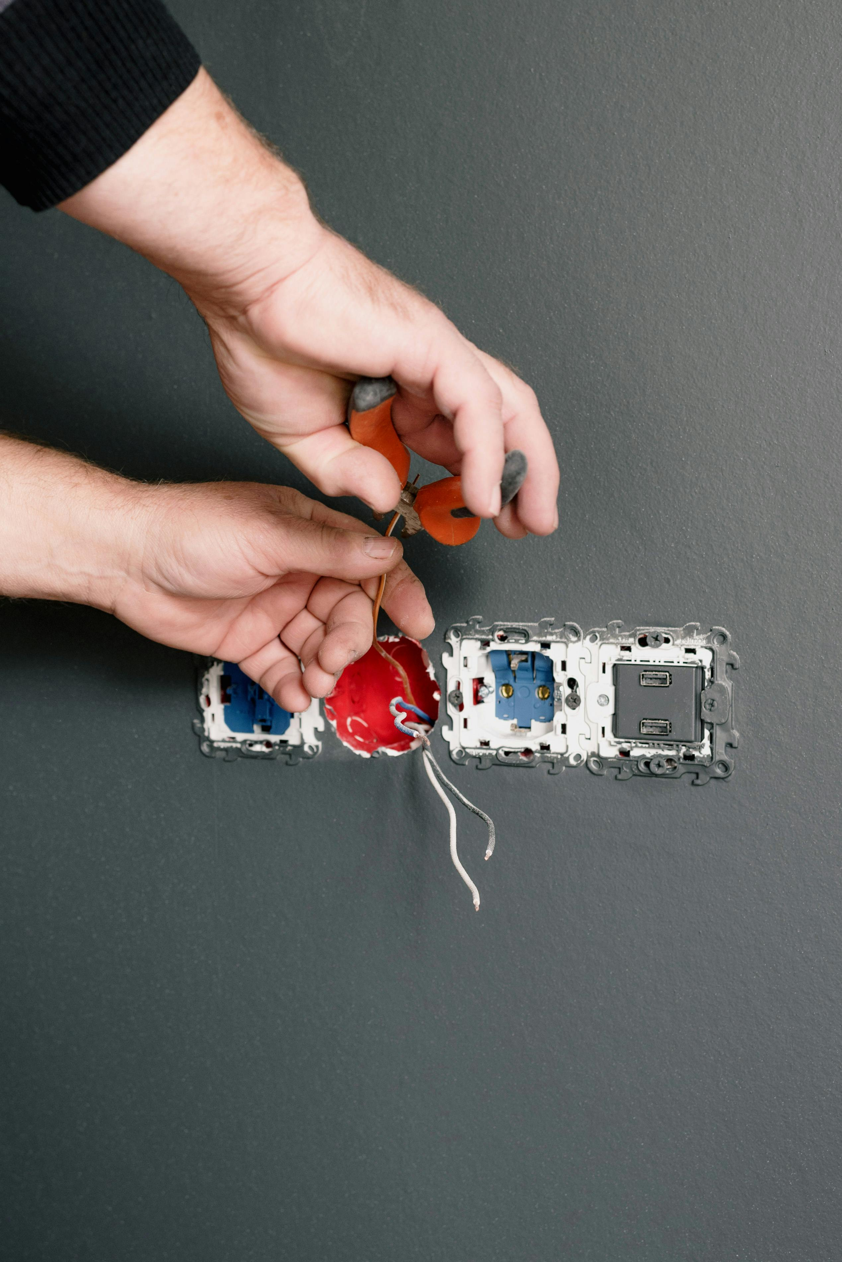
Comprehensive Guide to Electrical Lighting Troubleshooting and Repair
Mastering Safety, Diagnostics, and Hands-On Techniques for Effective Lighting Solutions

Slide 2
Table of Contents
Welcome to Troubleshooting Common Lighting Iss…
Electrical Safety Basics
Common Lighting Issues
Troubleshooting Techniques
Hands-On Repair Techniques
Electrical Safety Tips
Tools and Equipment
Real-World Applications
Case Studies
Group Activity: Lighting Issue Scenarios
Independent Practice: Troubleshooting Challenge
Assessment and Evaluation
Conclusion and Summary
04
05
06
07
08
09
10
11
12
13
14
15
16

Slide 3
Table of Contents
Next Steps and Resources
Reflection and Feedback
Final Thoughts and Encouragement
Additional Resources
FAQs
Glossary of Terms
17
18
19
20
21
22

Slide 4
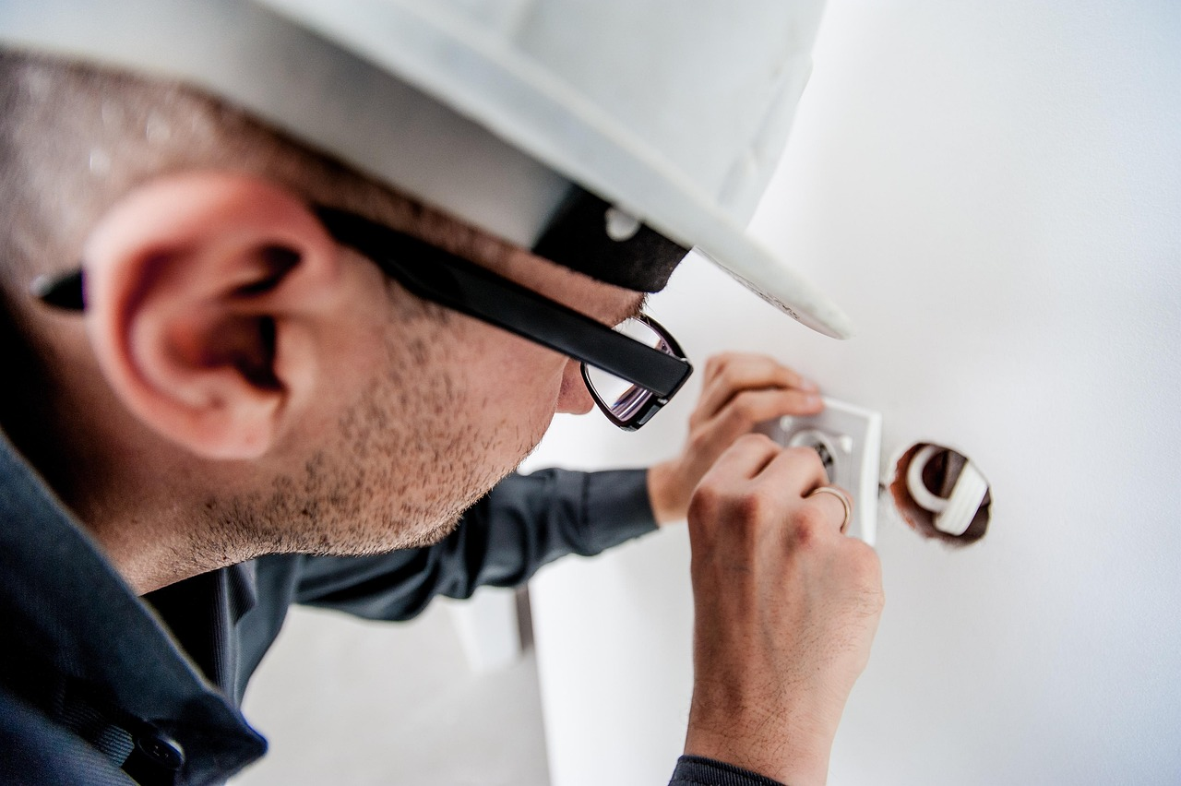
Welcome to Troubleshooting Common Lighting Issues and Hands-On Repair Techniques
Introduction to Electrical Troubleshooting
Lesson Plan Overview
Hands-On Repair Techniques
Introduction to the world of electrical troubleshooting and repair.
Importance of electrical safety and hands-on problem-solving techniques.
Overview of the lesson plan and objectives.
Introduction to the key topics covered in the session.
Focus on practical approaches to lighting issue resolution.
Emphasis on developing problem-solving skills through real-world scenarios.
4
Comprehensive Guide to Electrical Lighting Troubleshooting and Repair

Slide 5

Electrical Safety Basics
Personal Protective Equipment (PPE)
Using Appropriate Tools
Importance of wearing personal protective equipment (PPE).
Ensures safety and minimizes risks when working with electrical systems.
Using the right tools for the job.
Prevents accidents and ensures efficiency in handling electrical tasks.
Adhering to Safety Protocols
Understanding Electrical Systems
Following safety protocols and guidelines.
Critical for preventing electrical hazards and ensuring a safe working environment.
Understanding electrical circuits and components.
Helps in identifying potential issues and performing tasks safely.
5
Comprehensive Guide to Electrical Lighting Troubleshooting and Repair

Slide 6
Common Lighting Issues
01
02
03
04
05
Faulty Light Bulbs
Loose Connections
Circuit Breaker Trips
Overloaded Circuits
Damaged or Corroded Wiring
Faulty light bulbs are a common issue in lighting systems.
They can cause flickering or complete failure of illumination.
Loose connections in the wiring can lead to intermittent lighting problems.
This issue can also pose a fire hazard if not addressed promptly.
Frequent circuit breaker trips can indicate an underlying electrical problem.
This may be caused by short circuits or overloaded circuits.
Overloaded circuits occur when too many devices draw power from the same circuit.
This can lead to overheating and potential damage to the electrical system.
Damaged or corroded wiring can disrupt the flow of electricity.
This issue can result in dimming lights or complete power loss.
6
Comprehensive Guide to Electrical Lighting Troubleshooting and Repair

Slide 7
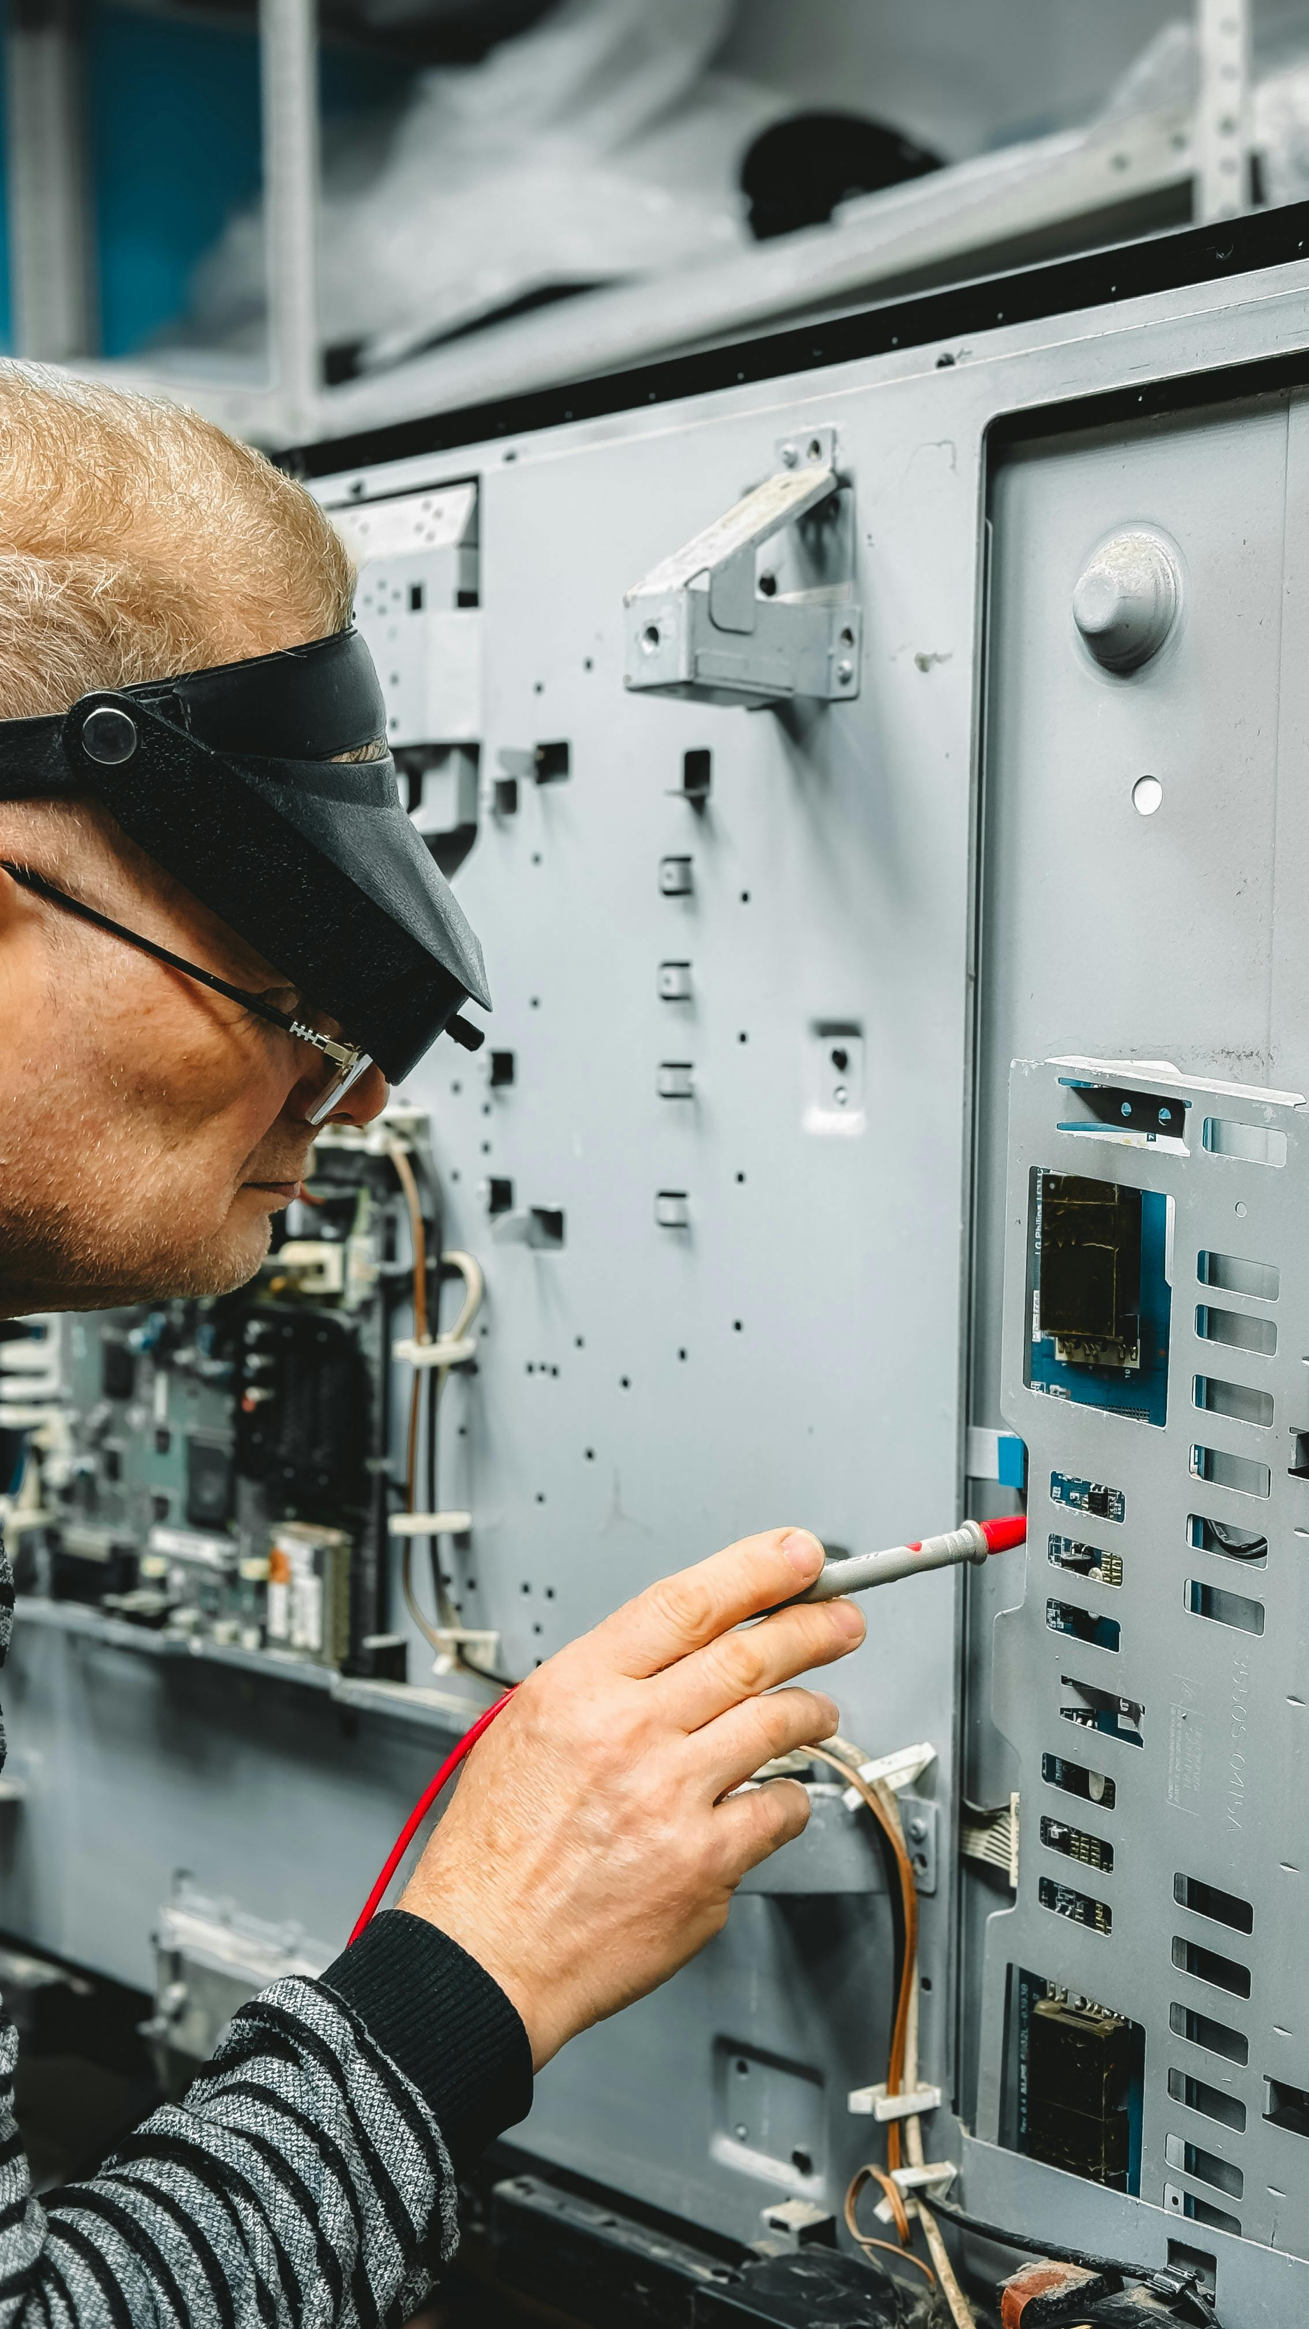
Troubleshooting Techniques
Systematic Problem Identification
Power Source and Circuit Breaker Check
Using a systematic approach to identify the problem.
This ensures that the troubleshooting process is organized and efficient.
Checking the power source and circuit breaker.
This step helps to rule out basic electrical issues early in the process.
Wiring and Connection Inspection
Utilizing Diagnostic Tools
Inspecting the wiring and connections.
This is crucial for identifying any physical damage or loose connections.
Using diagnostic tools such as multimeters and circuit testers.
These tools provide precise measurements to pinpoint electrical faults.
7
Comprehensive Guide to Electrical Lighting Troubleshooting and Repair

Slide 8
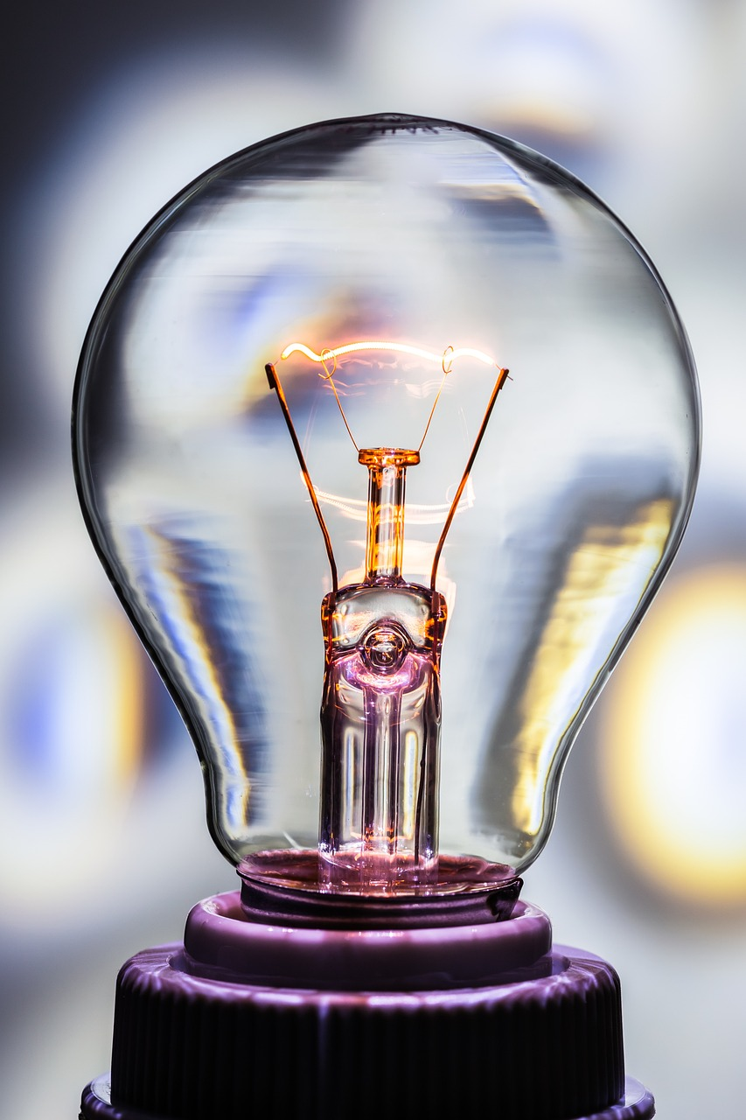
Hands-On Repair Techniques
01
Replacing Faulty Light Bulbs
Learn the steps to safely replace faulty light bulbs in various fixtures.
Understand the importance of using the correct bulb type and wattage for optimal performance.
02
Tightening Loose Connections
Discover techniques to identify and tighten loose electrical connections.
Ensure secure connections to prevent potential hazards and improve system reliability.
03
Resetting Circuit Breakers
Understand the process of safely resetting circuit breakers after a trip.
Learn how to identify the cause of the trip to prevent future occurrences.
04
Repairing or Replacing Damaged Wiring
Explore methods for repairing or replacing damaged electrical wiring.
Gain insights into maintaining wiring integrity for safe and efficient operation.
8
Comprehensive Guide to Electrical Lighting Troubleshooting and Repair

Slide 9
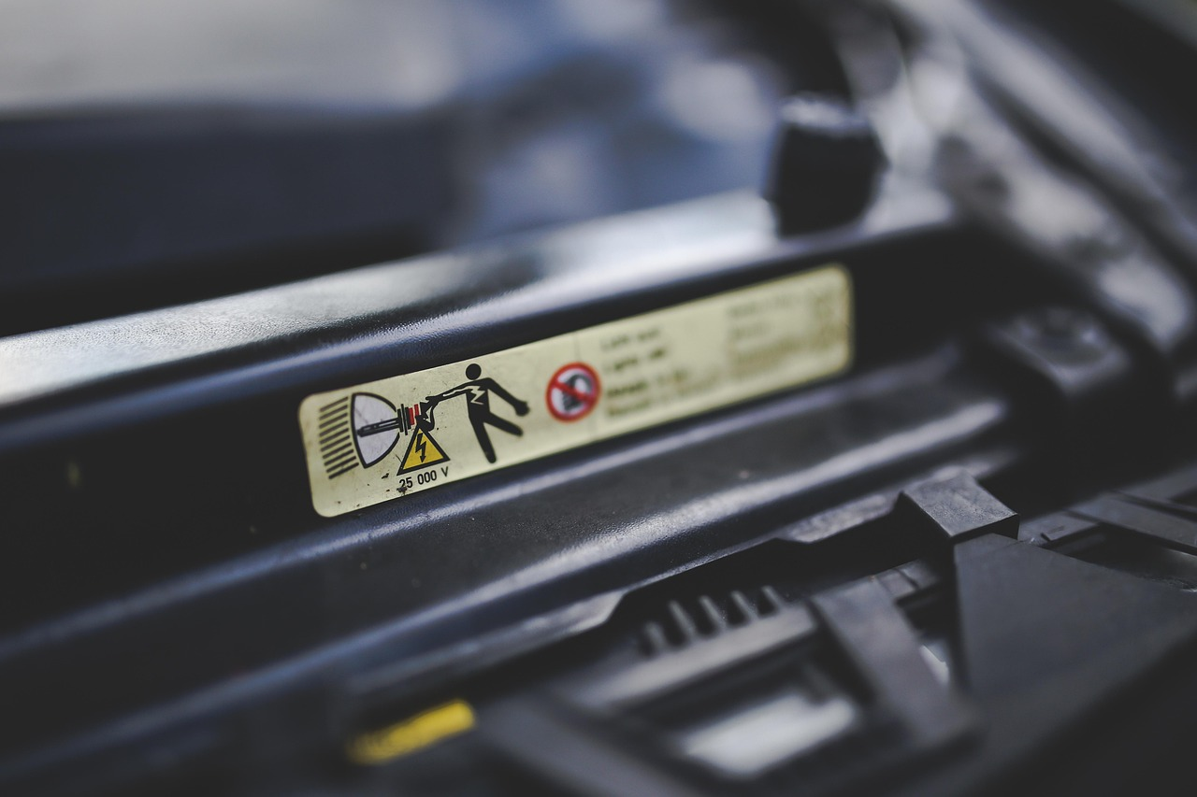
Electrical Safety Tips
Power Off Before Work
Verify Circuit De-Energization
Avoid Bare-Hand Contact
Always turn off the power source before starting work.
This ensures safety and prevents accidental electrical shocks.
Use a non-contact voltage tester to ensure the circuit is de-energized.
This step is crucial to confirm that no electricity is flowing through the circuit.
Never touch electrical components with bare hands.
This reduces the risk of electrical shocks and injuries.
Maintain Safe Distance
Use Insulated Tools
Keep a safe distance from electrical sources.
This precaution minimizes the chances of accidental contact with live wires.
Use insulated tools to handle electrical wires and components.
These tools provide an extra layer of protection against electrical hazards.
9
Comprehensive Guide to Electrical Lighting Troubleshooting and Repair

Slide 10
Tools and Equipment
Essential Diagnostic Tools
Safety and Verification Devices
Basic Hand Tools
Wire Management Tools
Multimeters are indispensable for measuring electrical properties like voltage, current, and resistance.
They are widely used in troubleshooting and ensuring the proper functioning of electrical circuits.
Circuit testers are crucial for verifying the presence of electrical current in a circuit.
They help in identifying live wires and ensuring safety during electrical work.
Pliers and screwdrivers are versatile tools used for gripping, twisting, and fastening tasks.
They are fundamental in assembling and disassembling electrical components.
Wire strippers and cutters are specialized tools for preparing and cutting electrical wires.
They ensure clean and precise wire connections, which are essential for reliable electrical installations.
10
Comprehensive Guide to Electrical Lighting Troubleshooting and Repair

Slide 11

Real-World Applications
Commercial Lighting Systems
Commercial Lighting Systems
Residential lighting systems are designed to enhance the ambiance and functionality of homes.
They include solutions like LED bulbs, smart lighting, and decorative fixtures.
Commercial lighting systems focus on illuminating offices, retail spaces, and public buildings.
These systems prioritize energy efficiency and adaptability to different environments.
Industrial Lighting Systems
Automotive Lighting Systems
Industrial lighting systems are tailored for factories, warehouses, and production facilities.
They emphasize durability and high-intensity illumination to support demanding tasks.
Automotive lighting systems are integral to vehicle safety and aesthetics.
They encompass headlights, taillights, and interior lighting solutions.
11
Comprehensive Guide to Electrical Lighting Troubleshooting and Repair

Slide 12
Case Studies
Residential Lighting Troubleshooting
Commercial Lighting Repair
Industrial Energy-Efficient Design
Troubleshooting a faulty lighting fixture in a residential setting.
This involves identifying and resolving issues to restore proper functionality.
Repairing a commercial lighting system.
This task ensures the lighting system operates efficiently and meets business needs.
Designing an energy-efficient lighting system for an industrial setting.
This focuses on reducing energy consumption while maintaining optimal lighting conditions.
12
Comprehensive Guide to Electrical Lighting Troubleshooting and Repair

Slide 13

Group Activity: Lighting Issue Scenarios
Group Division and Scenario Assignment
Collaborative Troubleshooting
Class Presentation of Findings
Divide into groups and assign a scenario.
Each group will focus on a specific lighting issue.
Work together to troubleshoot and repair the issue.
Use teamwork to identify the root cause and implement a solution.
Present findings and solutions to the class.
Share insights and the steps taken to resolve the issue.
13
Comprehensive Guide to Electrical Lighting Troubleshooting and Repair

Slide 14
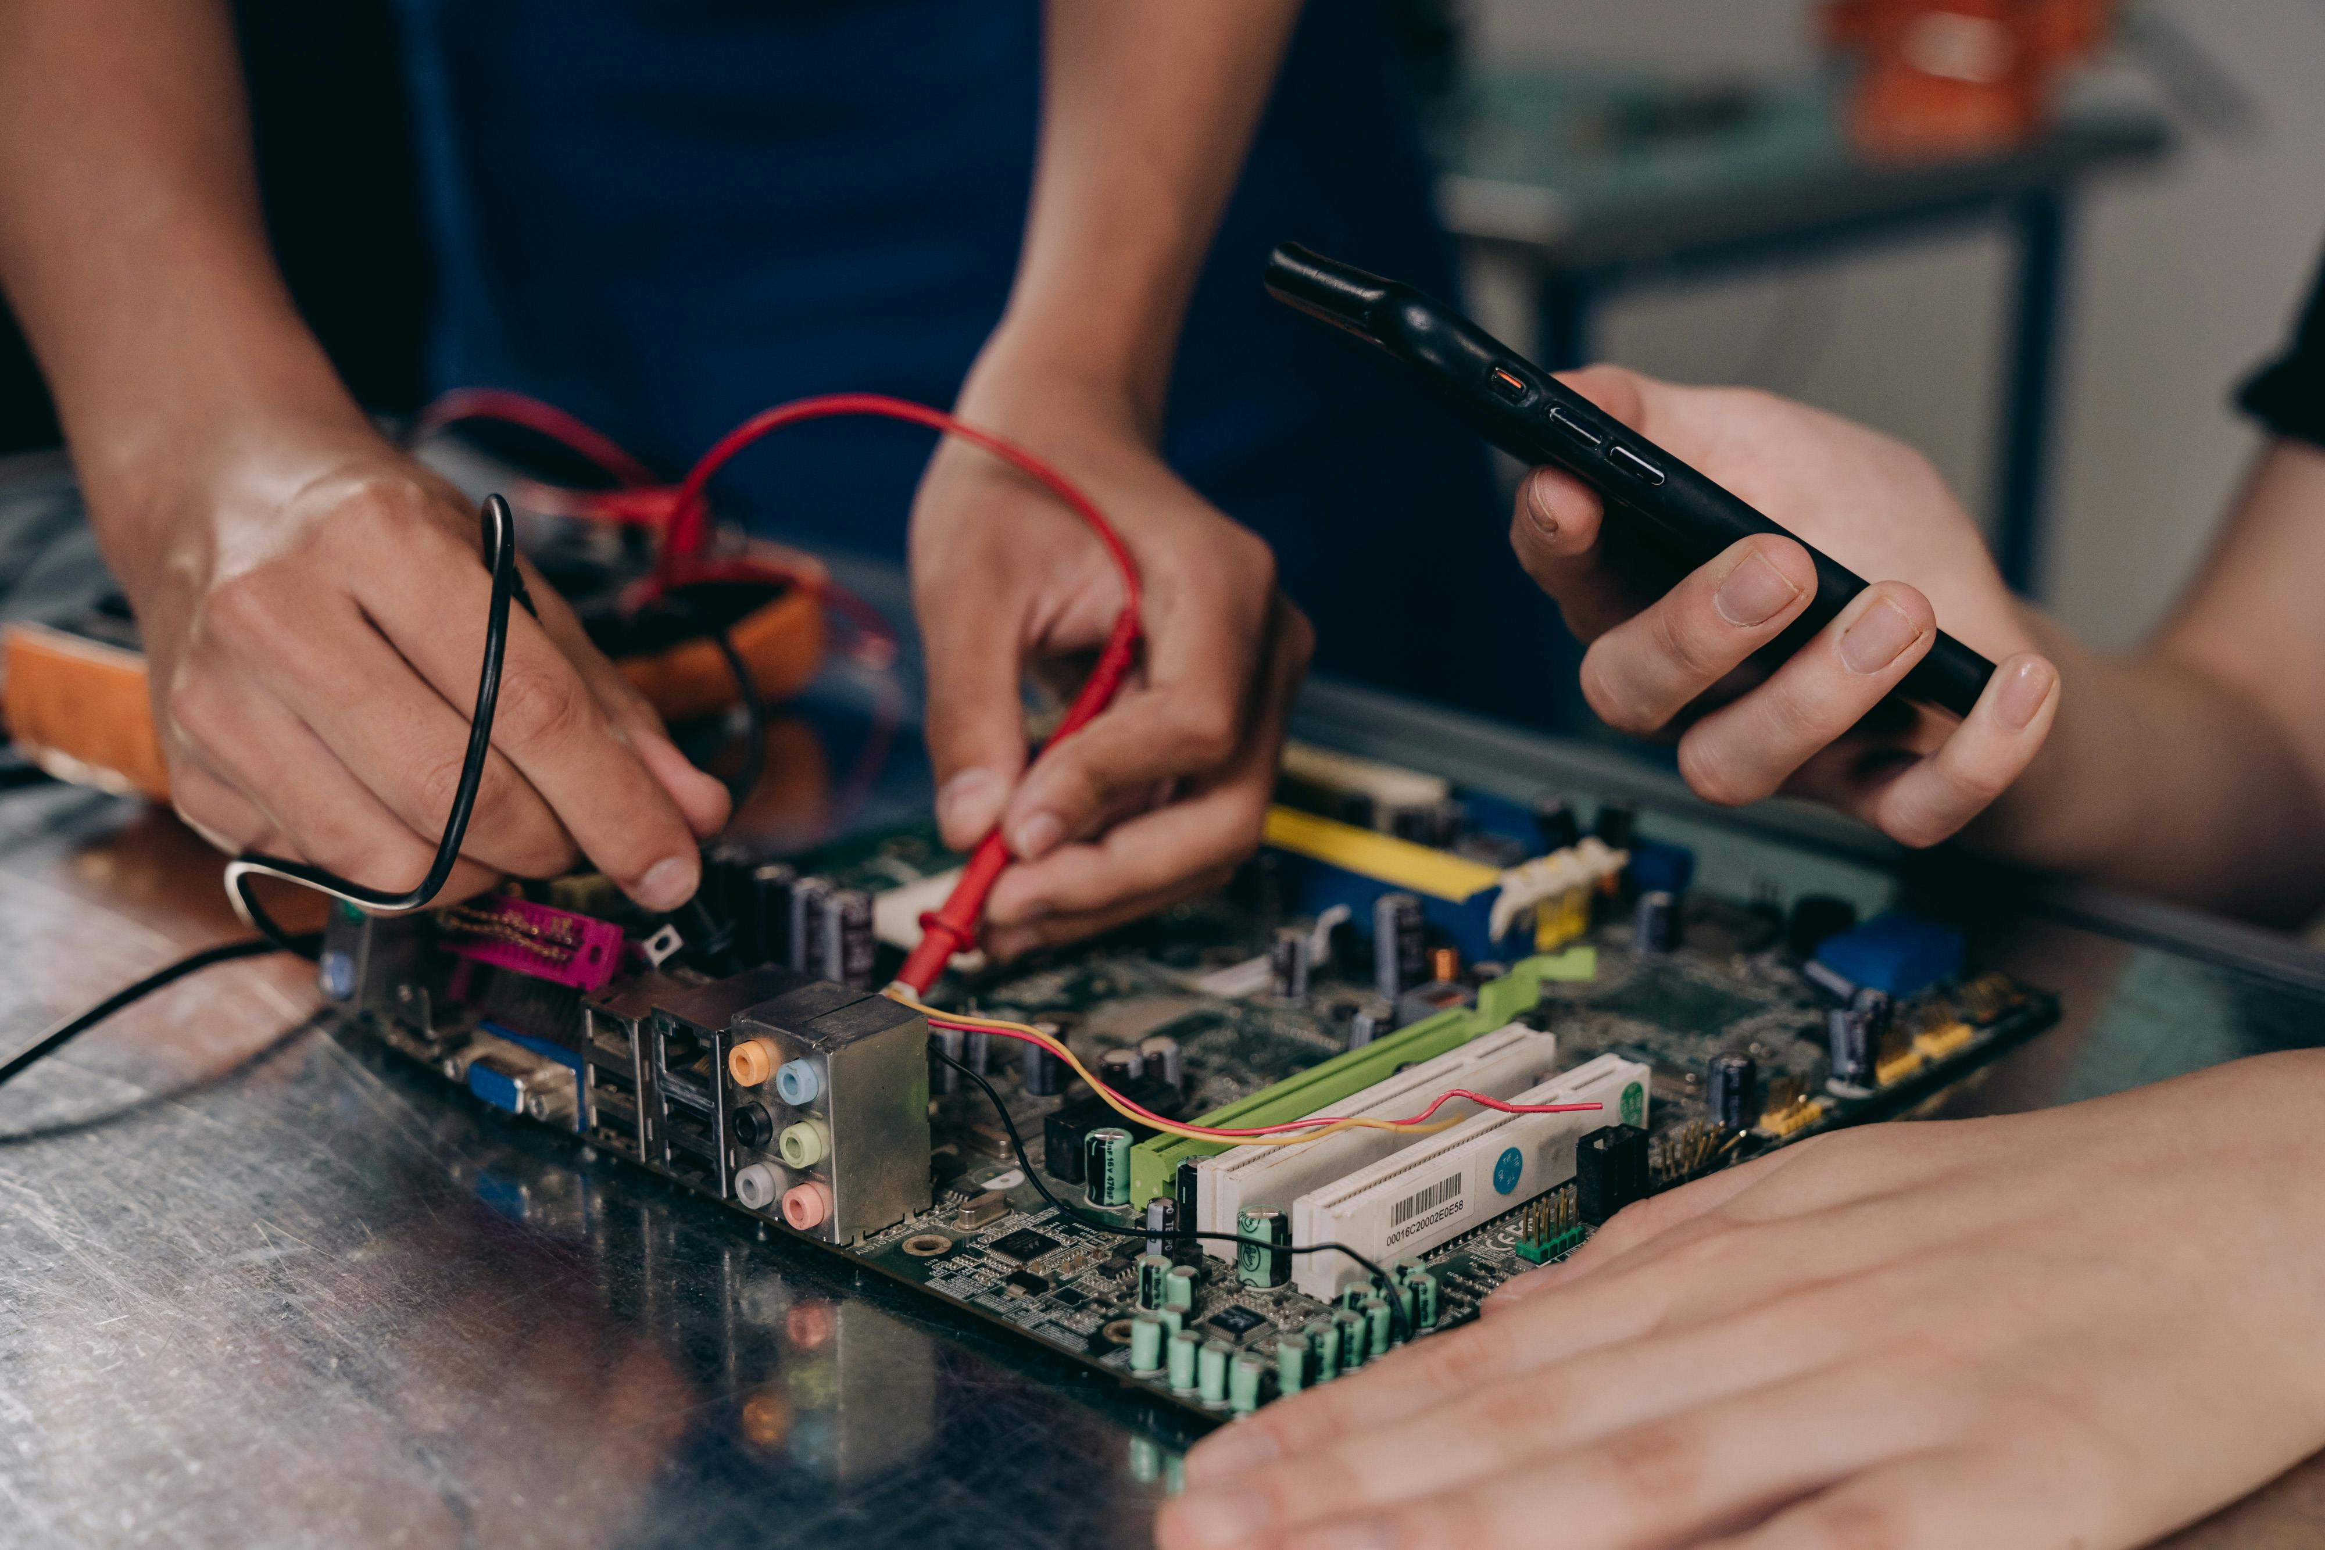
Independent Practice: Troubleshooting Challenge
Individual Troubleshooting Task
Utilizing Diagnostic Tools
Submission and Review
Complete a troubleshooting challenge individually.
Focus on identifying and repairing the issue at hand.
Use diagnostic tools and techniques to pinpoint the problem.
Apply your knowledge to effectively address the issue.
Submit your findings and solutions for evaluation.
Ensure your work is thorough and well-documented.
14
Comprehensive Guide to Electrical Lighting Troubleshooting and Repair

Slide 15

Assessment and Evaluation
01
Knowledge Assessment
Quizzes and tests to assess knowledge and understanding.
These tools help measure the depth of learning and retention.
02
Skill Evaluation
Hands-on activities and projects to evaluate skills and application.
These methods provide insights into practical abilities and creativity.
03
Collaborative Feedback
Peer review and feedback.
This encourages collaborative learning and diverse perspectives.
04
Personal Reflection
Self-assessment and reflection.
These practices foster self-awareness and continuous improvement.
15
Comprehensive Guide to Electrical Lighting Troubleshooting and Repair

Slide 16
Conclusion and Summary
Key Concepts Recap
Career Opportunities
Hands-On Problem Solving
Recap of key concepts and techniques.
Importance of electrical safety and hands-on problem-solving.
Future learning and career opportunities in electrical engineering.
Exploration of technology advancements in the field.
Emphasis on practical applications and real-world problem-solving.
Understanding the significance of electrical safety measures.
16
Comprehensive Guide to Electrical Lighting Troubleshooting and Repair

Slide 17

Next Steps and Resources
Recommended Reading and Resources
Online Tutorials and Videos
Explore curated reading materials and resources to deepen your understanding.
These resources are tailored for those seeking comprehensive knowledge in electrical engineering.
Access a variety of online tutorials and videos for skill enhancement.
These materials provide practical insights and additional practice opportunities.
Local Workshops and Training Programs
Career Guidance and Counseling
Participate in local workshops and training programs for hands-on experience.
These sessions are designed to offer practical exposure and real-world applications.
Seek career guidance and counseling to explore opportunities in electrical engineering.
These services are ideal for individuals aiming to build a career in technology.
17
Comprehensive Guide to Electrical Lighting Troubleshooting and Repair

Slide 18

Reflection and Feedback
Reflection on Learning
Reflect on what was learned and what could be improved.
This involves analyzing the strengths and weaknesses of the learning experience.
Feedback on Lesson Plan
Provide feedback on the lesson plan and instruction.
This includes identifying areas that worked well and those that need adjustment.
Suggestions for Future Topics
Suggestions for future improvements and topics.
These could include new areas of interest or methods to enhance engagement.
18
Comprehensive Guide to Electrical Lighting Troubleshooting and Repair

Slide 19
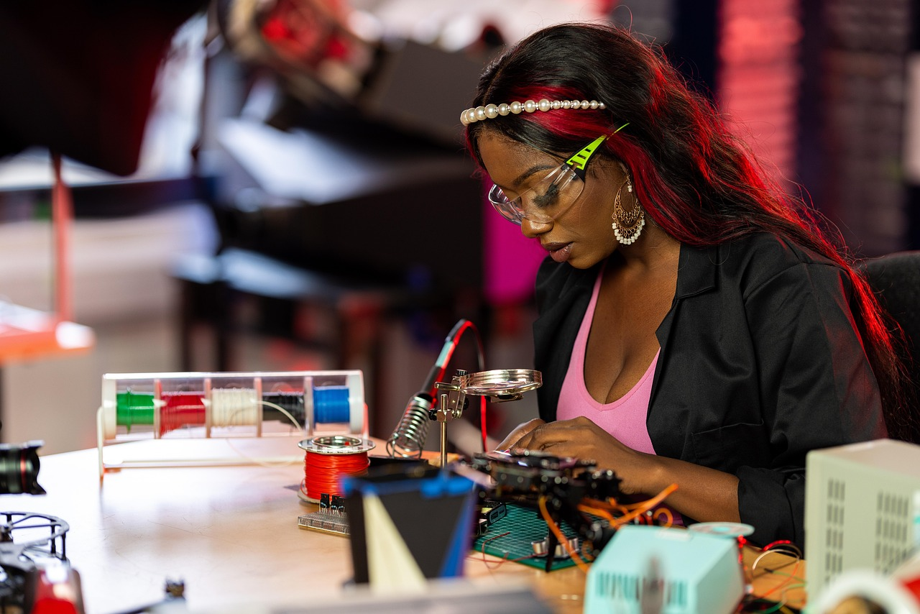
Final Thoughts and Encouragement
Encouragement to Pursue Electrical Engineering
Importance of Safety and Problem-Solving
Encouragement to continue learning and exploring electrical engineering and technology.
Electrical engineering offers endless opportunities for innovation and discovery.
Final thoughts and reminders about the importance of electrical safety and hands-on problem-solving.
Safety and practical skills are essential for success in the field of electrical engineering.
19
Comprehensive Guide to Electrical Lighting Troubleshooting and Repair

Slide 20

Additional Resources
Recommended Books and Online Resources
List of recommended books and online resources.
These resources are curated to enhance your knowledge and skills.
Online Tutorials and Videos
Links to online tutorials and videos.
These materials provide step-by-step guidance on various topics.
Workshops and Training Programs
Information about local workshops and training programs.
These opportunities are designed to offer hands-on experience.
Career Guidance and Counseling
Contact information for career guidance and counseling.
Reach out to professionals for personalized advice and support.
20
Comprehensive Guide to Electrical Lighting Troubleshooting and Repair

Slide 21
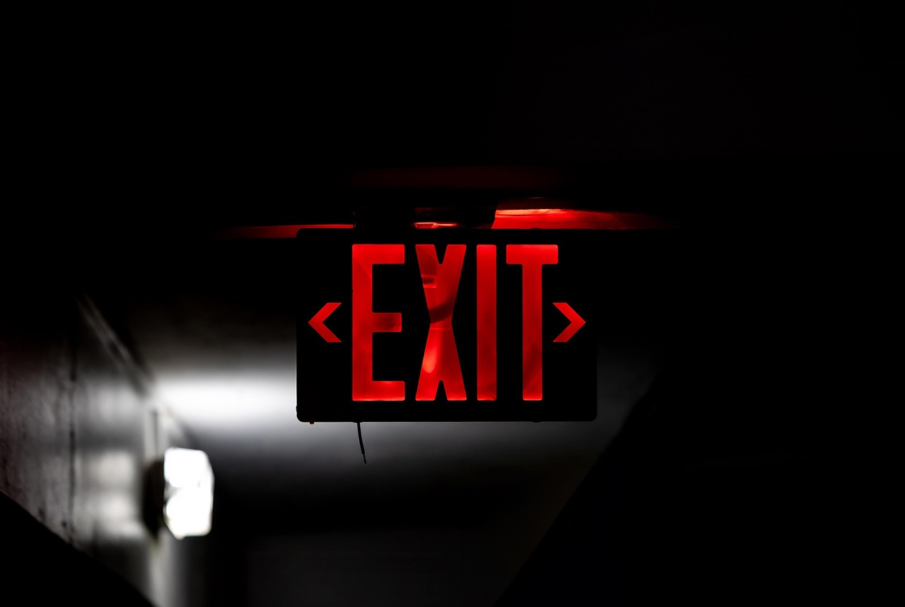
FAQs
Understanding Electrical Safety
Troubleshooting Basics
Safety First
Frequently asked questions about electrical safety and troubleshooting.
Answers and explanations to common questions and concerns.
Answers and explanations to common questions and concerns.
Additional resources and references for further learning.
Frequently asked questions about electrical safety and troubleshooting.
Additional resources and references for further learning.
Common Concerns Addressed
Further Learning Resources
Answers and explanations to common questions and concerns.
Frequently asked questions about electrical safety and troubleshooting.
Additional resources and references for further learning.
Frequently asked questions about electrical safety and troubleshooting.
21
Comprehensive Guide to Electrical Lighting Troubleshooting and Repair

Slide 22

Glossary of Terms
1
Key Definitions
4
Technical Vocabulary
Definitions of key terms and concepts are essential for understanding the subject matter.
They provide clarity and ensure everyone is on the same page.
Explanations of technical vocabulary and jargon help demystify complex ideas.
This ensures accessibility for both experts and novices.
2
Resource References
5
Conceptual Clarity
References to additional resources and references offer avenues for deeper exploration.
They serve as a guide for further learning and research.
Definitions and explanations contribute to conceptual clarity.
They are foundational for effective communication and understanding.
3
Learning Support
Additional resources act as learning support tools.
They enhance comprehension and provide supplementary information.
22
Comprehensive Guide to Electrical Lighting Troubleshooting and Repair

