Slide 1

Exploring the Power of Prefixes and Suffixes
A Comprehensive Guide to Enhancing Language Skills and Instructional Strategies

Slide 2


Table of contents
Introduction to Prefixes and Suffixes
What are Prefixes?
What are Suffixes?
Why are Prefixes and Suffixes Important?
Prefixes and Suffixes in Action
Differentiated Instruction
Digital Learning Tools and Resources
Worksheets and Practice Exercises
Assessment and Evaluation
Conclusion
Extension Activities
Parent Engagement
Safety Considerations
01
02
03
04
05
06
07
08
09
10
11
12
13

Slide 3
Table of contents
Teaching Tips and Tricks
Key Takeaways
Reflection Questions
Next Steps
14
15
16
17

Slide 4

Introduction to Prefixes and Suffixes
Understanding Components
Decoding Skills
Lesson Overview
Prefixes are letters added to the start of a word that change its meaning.
Suffixes are letters added to the end of a word that also change meaning.
Identifying prefixes and suffixes empowers learners to decipher unfamiliar words.
This skill is vital for building vocabulary and enhancing reading comprehension.
We will explore the definitions and examples of prefixes and suffixes.
The lesson will include engaging activities to practice their identification and usage.
1
Exploring the Power of Prefixes and Suffixes

Slide 5

What are Prefixes?
Prefix Definition
Common Examples
Meaning Alteration
Prefixes are affixes that precede a word's root.
They modify the meaning of the base word.
Common prefixes include 'un-' as in 'unhappy', which means not happy.
Another common prefix is 're-', as seen in 'redo,' which means to do something again.
Prefixes can change the meaning of words by negation, repetition, or reversal.
For instance, 'de-' in 'deconstruct' implies taking apart.
2
Exploring the Power of Prefixes and Suffixes

Slide 6

What are Suffixes?
Suffix Definition
Common Examples
Meaning Changes
A suffix is a group of letters added to the end of a word, changing its meaning or grammatical function.
Common suffixes include '-able' (adjective), '-ment' (noun), and '-ly' (adverb).
These suffixes modify words to create different parts of speech.
Suffixes can alter a word's part of speech.
For example, adding '-er' to 'teach' transforms it into the noun 'teacher.'
3
Exploring the Power of Prefixes and Suffixes

Slide 7

Why are Prefixes and Suffixes Important?
Decoding Skills
Comprehension Boost
Word Examples
Prefixes and suffixes are crucial for understanding unfamiliar words.
They empower readers to approach new vocabulary with ease.
Mastering prefixes and suffixes significantly enhances reading comprehension.
This knowledge helps infer meanings and grasp concepts better.
Examples like 'disagree' and 'revisit' highlight the role of prefixes and suffixes.
These words illustrate how they modify meanings and enrich vocabulary.
4
Exploring the Power of Prefixes and Suffixes

Slide 8

Prefixes and Suffixes in Action
Word Examples
Meaning Analysis
Student Practice
Examples of words with prefixes include 'unhappy' and 'rewritable'.
These words illustrate how prefixes and suffixes modify the root word.
To analyze a word, break it into its components.
Understanding each part is crucial for grasping the overall meaning.
Students should identify prefixes and suffixes in various words.
They can also create their own examples for better understanding.
5
Exploring the Power of Prefixes and Suffixes

Slide 9

Differentiated Instruction
Support Strategies
Advanced Modifications
Instruction Examples
Use diagrams and charts to simplify complex ideas for struggling students.
Schedule personalized sessions to address individual learning needs.
Introduce complex tasks that challenge high-achieving students.
Encourage projects that allow for personal interests and creativity.
Design group projects that cater to various learning styles and strengths.
Create assignments that vary in difficulty to match student readiness.
6
Exploring the Power of Prefixes and Suffixes

Slide 10

Digital Learning Tools and Resources
Digital Tools Overview
Incorporation Strategies
Differentiation Tips
Digital tools such as online games make learning prefixes and suffixes engaging.
Interactive quizzes offer instant feedback, enhancing student understanding.
Embed digital tools within lesson plans to create dynamic learning experiences.
Utilize these resources to reinforce key concepts through interactive activities.
Employ digital tools to accommodate diverse learning preferences and paces.
Provide a variety of resources to help every student succeed in mastering prefixes and suffixes.
7
Exploring the Power of Prefixes and Suffixes

Slide 11
Worksheets and Practice Exercises
Worksheet Examples
Using Worksheets Effectively
Creating Effective Exercises
Worksheets can include fill-in-the-blank tasks and matching exercises.
These activities help students practice skills systematically.
Utilize worksheets to strengthen understanding of prefixes and suffixes.
Promote group discussions to improve understanding of the material.
Design worksheets that are straightforward and aligned with educational goals.
Incorporate various question types to address different learning styles.
8
Exploring the Power of Prefixes and Suffixes

Slide 12

Assessment and Evaluation
Understanding Strategies
Evaluation Tools
Instructional Tips
Adopt diverse assessment methods to capture students' grasp of prefixes and suffixes.
Incorporate engaging activities that promote active learning and application of concepts.
Utilize brief assessments to measure students' comprehension of language elements.
Create innovative projects that encourage students to showcase their knowledge creatively.
Regularly review assessment outcomes to shape your teaching strategies.
Provide targeted feedback that empowers students to enhance their language proficiency.
9
Exploring the Power of Prefixes and Suffixes

Slide 13

Conclusion
Key Points Summary
Decoding Skills
Next Steps
We have covered the essential strategies for effective decoding.
Understanding word structure is crucial for vocabulary development.
Recognizing prefixes and suffixes enhances our ability to understand unfamiliar words.
This skill is vital for improving reading comprehension and fluency.
Continue practicing decoding strategies in daily reading activities.
Explore more resources to deepen your understanding of word structures.
10
Exploring the Power of Prefixes and Suffixes

Slide 14

Extension Activities
Word Families
Deepening Understanding
Incorporation Tips
Have students create word families from a given root word.
This activity explores word connections.
Extension activities enhance understanding of prefixes and suffixes.
Students can investigate etymology to see word evolution.
Incorporate extension activities into lessons to boost engagement.
Use clear examples to clarify concepts for students.
11
Exploring the Power of Prefixes and Suffixes

Slide 15

Parent Engagement
Engagement Strategies
Home Support
Effective Communication
Send newsletters to keep parents informed about classroom activities.
Host regular conferences to discuss student progress with parents.
Encourage parents to create a dedicated study space for their children.
Provide activities for parents to engage with their children at home.
Establish clear communication channels, such as email or messaging apps.
Provide regular updates on students' achievements and areas needing improvement.
12
Exploring the Power of Prefixes and Suffixes

Slide 16
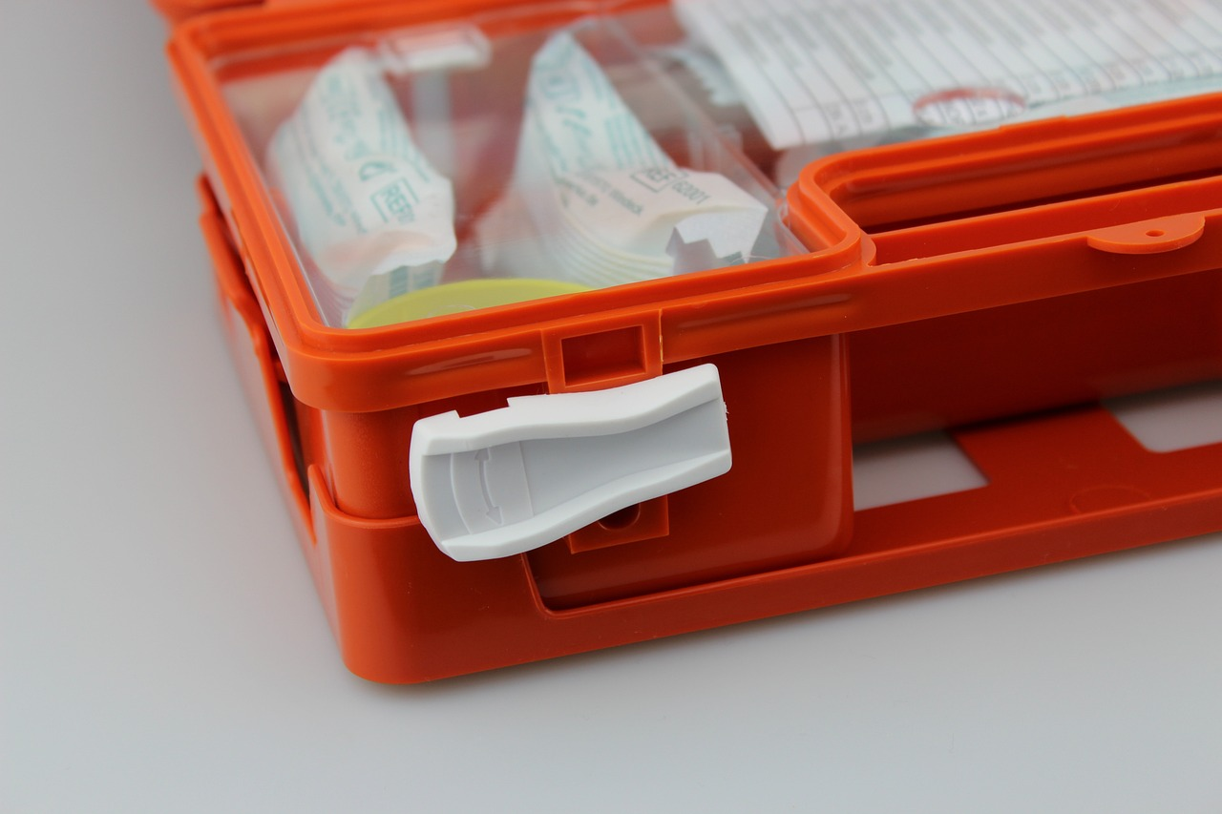
Safety Considerations
Student Safety
Disruption Prevention
Emergency Response
Ensuring student safety is crucial during lessons.
Clear guidelines create a secure environment.
Classroom rules help minimize disruptions.
Engaging activities maintain student focus.
A clear emergency plan is vital for unexpected situations.
Regular drills ensure quick action from students and staff.
13
Exploring the Power of Prefixes and Suffixes

Slide 17

Teaching Tips and Tricks
Teaching Strategies
Visual Aids
Differentiation
Engage students with prefixes and suffixes through interactive activities.
Use games to reinforce learning.
Utilize charts and diagrams to illustrate prefixes and suffixes.
Incorporate educational videos from platforms like YouTube to enhance understanding.
Tailor instruction to meet diverse learner needs with varied resources.
Provide additional support or challenges based on individual progress.
14
Exploring the Power of Prefixes and Suffixes

Slide 18

Key Takeaways
Decoding Skills
Word Structure
Next Steps
Decoding skills are crucial for reading comprehension.
They enable readers to break down unfamiliar words into simpler parts.
Understanding prefixes and suffixes is vital for decoding unfamiliar words.
This helps readers infer the meanings of new words more effectively.
Engage in word games to reinforce your understanding of word structures.
Practice with diverse texts to enhance your decoding abilities.
15
Exploring the Power of Prefixes and Suffixes

Slide 19

Reflection Questions
Evaluate Lesson Impact
Guide Future Teaching
Enhance Reflection Practices
Identify what worked well in the lesson.
Determine areas that need improvement.
Use reflections to shape upcoming lessons.
Adapt strategies based on student insights.
Incorporate student feedback into planning.
Pose specific questions to clarify student needs.
16
Exploring the Power of Prefixes and Suffixes

Slide 20

Next Steps
Follow-Up Activities
Applying Skills
Building Understanding
Organize lessons to reinforce concepts.
Incorporate hands-on activities for engagement.
Encourage real-world application of new skills.
Offer interactive exercises for practice.
Provide resources to deepen understanding of prefixes and suffixes.
Use games and quizzes to enhance learning.
17
Exploring the Power of Prefixes and Suffixes

