Slide 1
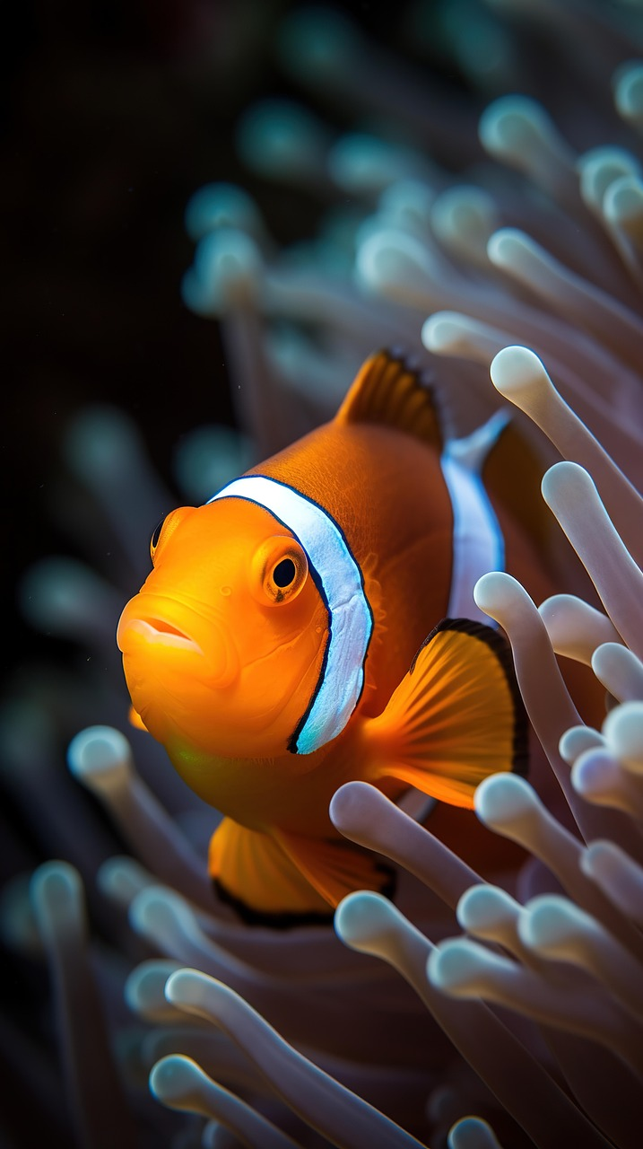

Coral Reefs: Ecosystems, Conservation, and Human Impact
An In-Depth Exploration of Coral Reef Formation, Biodiversity, Threats, and Protection Strategies

Slide 2
Coral Reefs: Ecosystems, Conservation, and Human Impact
2
Table of Contents
Introduction to Coral Reefs
Types of Coral Reefs
Geographic Distribution of Coral Reefs
Importance of Coral Reefs
Formation of Coral Reefs
Human Impacts on Coral Reefs
Conservation and Management of Coral Reefs
Geographic Information Systems (GIS) and Coral…
Coral Reef Case Study: The Great Barrier Reef
Coral Reef Conservation Efforts
Conclusion
Reflection Questions
Next Steps
04
05
06
07
08
09
10
11
12
13
14
15
16

Slide 3
Coral Reefs: Ecosystems, Conservation, and Human Impact
3
Table of Contents
Additional Resources
Assessment and Evaluation
Extension Activities
Parent Engagement
Safety Considerations
17
18
19
20
21

Slide 4
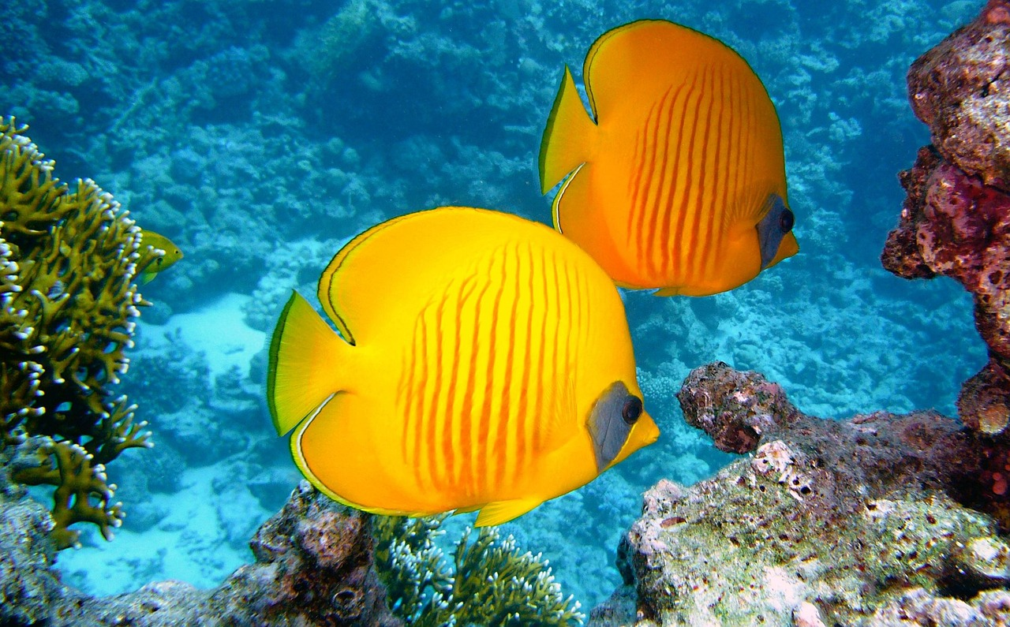
Coral Reefs: Ecosystems, Conservation, and Human Impact
4
Introduction to Coral Reefs
Formation and Composition
Ecosystem Services
Global Distribution
Coral reefs are complex ecosystems formed by coral polyps and other organisms.
They are found in tropical and subtropical regions around the world.
Coral reefs provide important ecosystem services, including shoreline protection and water filtration.
They serve as habitats for a vast array of species.
Coral reefs are predominantly located in tropical and subtropical regions.
These regions support the growth and sustainability of coral reef ecosystems.

Slide 5
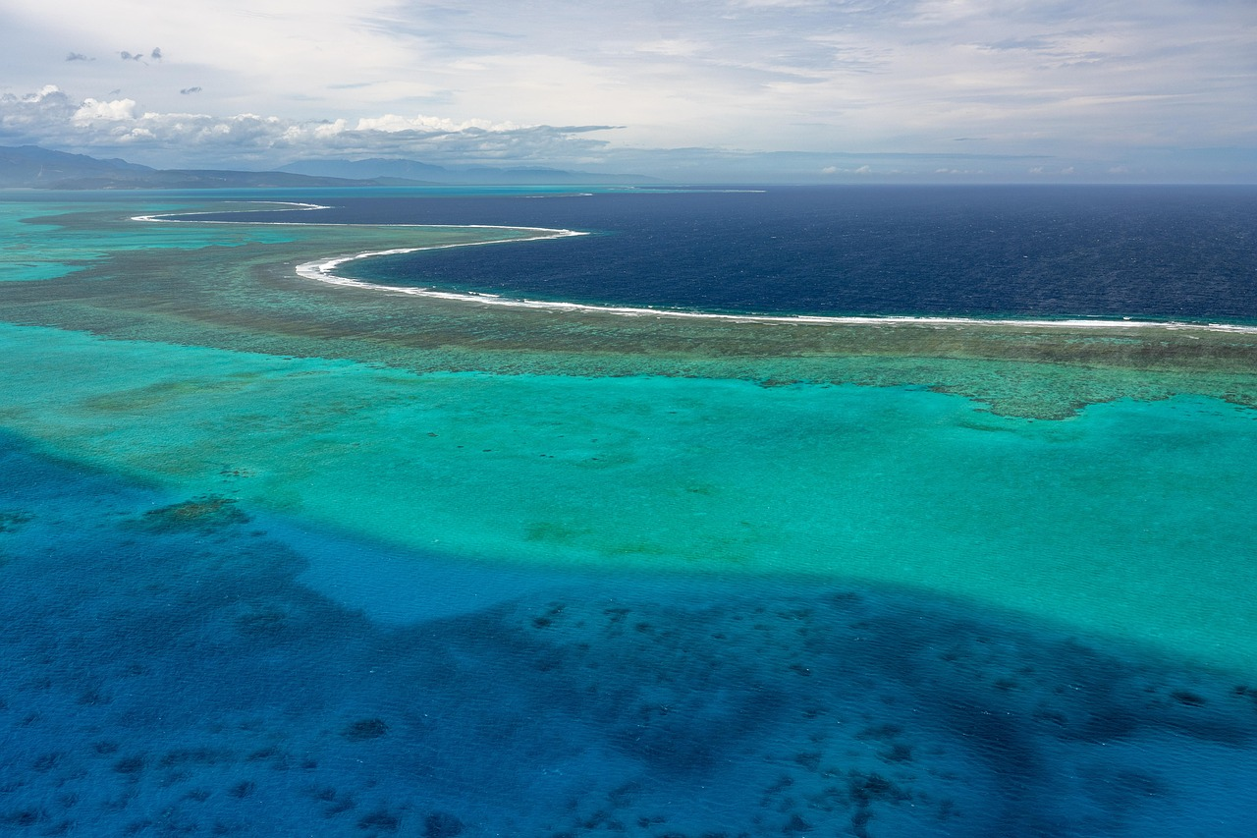
Coral Reefs: Ecosystems, Conservation, and Human Impact
5
Types of Coral Reefs
Fringing Reefs
Barrier Reefs
Fringing reefs are found close to shore and are narrow and linear.
They are the most common type of coral reef and often grow directly from the coastline.
Barrier reefs are located further offshore and are wide and flat.
They are separated from the shore by a lagoon and provide a natural barrier against waves.
Atolls
Formation and Characteristics
Atolls are ring-shaped reefs that form around a lagoon.
They are typically found in the open ocean and are created by the subsidence of volcanic islands.
Each type of coral reef has its own unique characteristics.
They are formed through a combination of geological and biological processes.

Slide 6
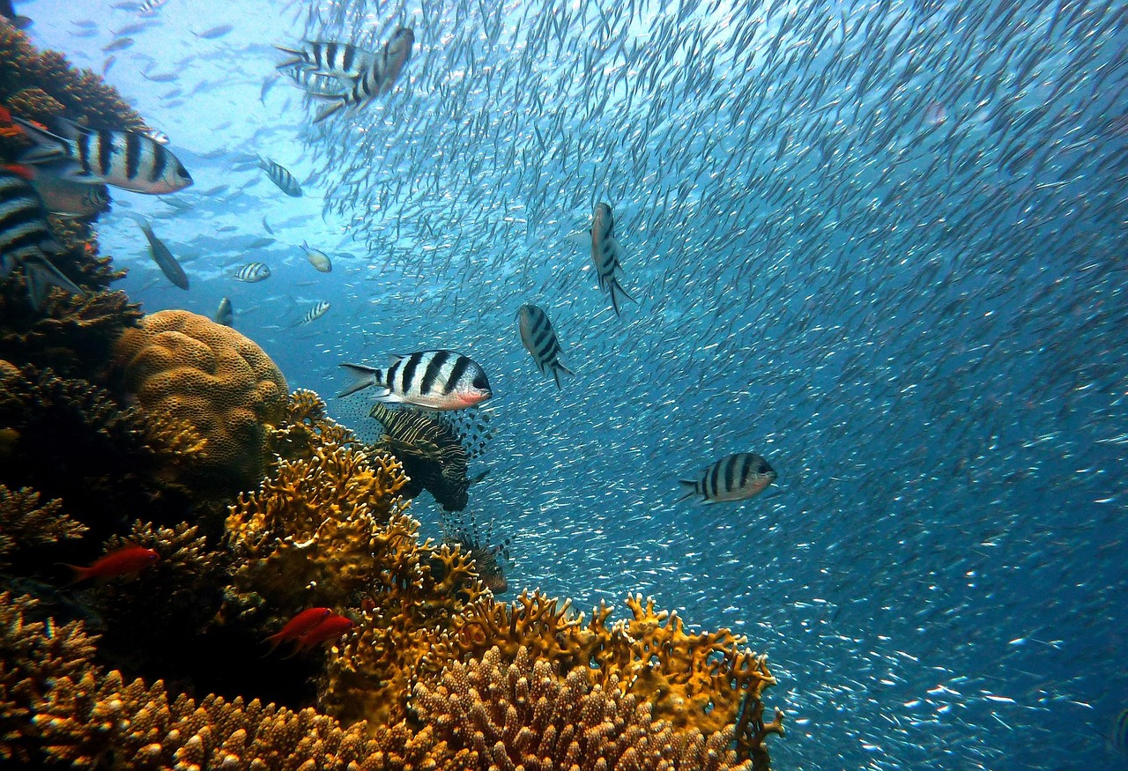
Coral Reefs: Ecosystems, Conservation, and Human Impact
6
Geographic Distribution of Coral Reefs
Global Presence of Coral Reefs
Coral reefs are found in tropical and subtropical regions around the world.
They are vital ecosystems supporting diverse marine life.
Indo-Pacific Coral Reefs
The majority of coral reefs are located in the Indo-Pacific region.
This region is known for its rich biodiversity and extensive reef systems.
Varied Coral Reef Habitats
Coral reefs can be found in shallow, coastal waters, as well as in deeper, offshore waters.
These habitats provide shelter and food for numerous marine species.

Slide 7
Coral Reefs: Ecosystems, Conservation, and Human Impact
7
Importance of Coral Reefs
Marine Biodiversity
Ecosystem Services
Economic Contributions
Cultural Significance
Coral reefs support a vast array of marine life, including fish, invertebrates, and algae.
They are vital habitats for numerous species, contributing to global biodiversity.
Coral reefs provide important ecosystem services, including shoreline protection and water filtration.
These services are essential for maintaining environmental balance and protecting coastal areas.
Coral reefs support commercial fisheries and tourism industries.
They are a source of livelihood for millions of people worldwide.
Coral reefs have significant cultural and spiritual importance for many communities.
They are deeply intertwined with traditions and beliefs in various regions.

Slide 8
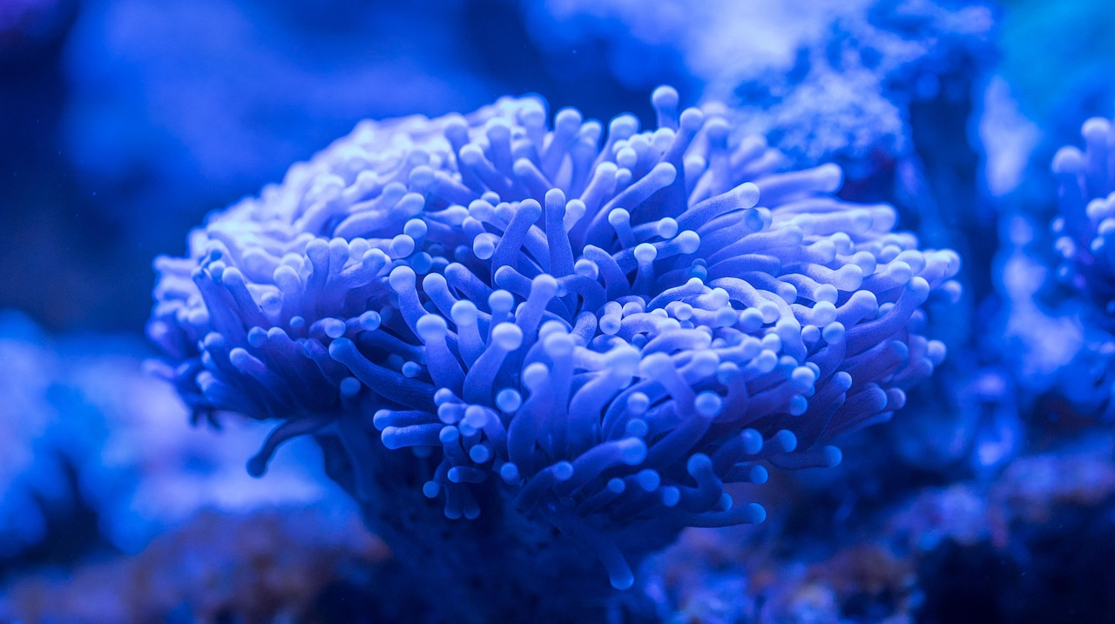
Coral Reefs: Ecosystems, Conservation, and Human Impact
8
Formation of Coral Reefs
Accumulation of Coral Polyps
Settlement of Coral Larvae
Geological Significance
Coral reefs are formed through the accumulation of coral polyps and other organisms over thousands of years.
This process contributes to the creation of diverse marine ecosystems.
The process of coral reef formation begins with the settlement of coral larvae on a suitable substrate.
This initial step is crucial for the development of coral structures.
Coral reefs can take thousands of years to form and are an important component of the Earth's geological history.
They provide valuable insights into past environmental conditions.

Slide 9
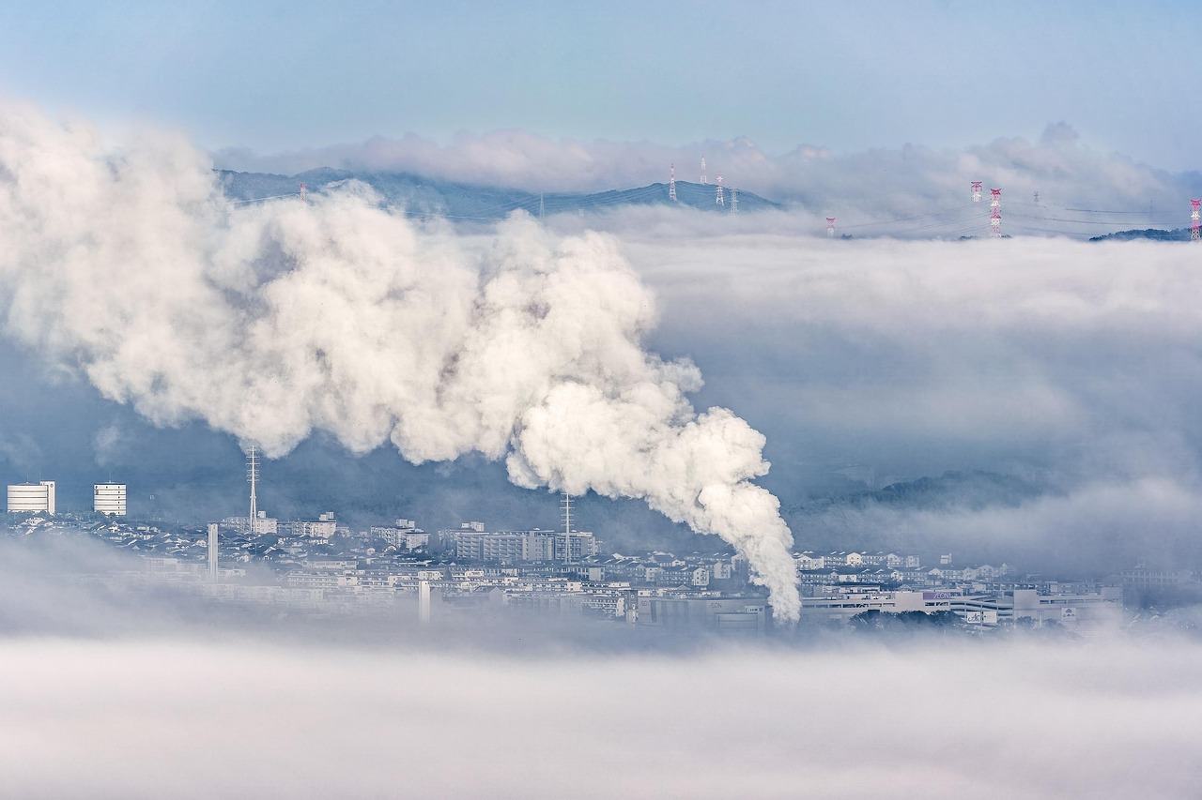
Coral Reefs: Ecosystems, Conservation, and Human Impact
9
Human Impacts on Coral Reefs
Human Activities and Coral Reefs
Climate Change Threats
Human activities, such as overfishing and pollution, can damage coral reefs and impact the marine ecosystem.
These actions disrupt the delicate balance of marine life and threaten biodiversity.
Climate change is a major threat to coral reefs, causing coral bleaching and ocean acidification.
These phenomena weaken coral structures and make it harder for reefs to recover.
Impact of Coastal Development
Call to Action for Coral Protection
Coastal development and tourism can also impact coral reefs, through habitat destruction and pollution.
Such activities degrade the natural environment and reduce the resilience of coral ecosystems.
It is essential to take action to protect coral reefs and mitigate the impacts of human activities.
Conservation efforts are crucial to ensure the survival of these vital marine habitats.

Slide 10
Coral Reefs: Ecosystems, Conservation, and Human Impact
10
Conservation and Management of Coral Reefs
Protected Areas for Coral Reefs
Community-Based Conservation Efforts
Future-Oriented Strategies
National parks and marine protected areas can help to conserve coral reefs and protect them from human impacts.
These areas serve as sanctuaries, reducing the stress on coral ecosystems caused by human activities.
Community-based initiatives, such as reef restoration and marine conservation programs, can also help to protect coral reefs.
These programs engage local communities in active participation to ensure the sustainability of coral ecosystems.
It is essential to develop and implement effective conservation and management strategies to protect coral reefs for future generations.
Such strategies ensure the long-term health and resilience of coral reef ecosystems.

Slide 11
Coral Reefs: Ecosystems, Conservation, and Human Impact
11
Geographic Information Systems (GIS) and Coral Reef Mapping
Mapping Coral Reefs with GIS
Conservation Prioritization through GIS
Monitoring Coral Reef Health
GIS technology can be used to map and analyze the geographic distribution of coral reefs.
This enables researchers to visualize and understand the spatial patterns of coral ecosystems.
GIS can help to identify areas of high conservation value and prioritize conservation efforts.
This ensures that resources are allocated to the most critical areas for coral reef protection.
GIS can also be used to monitor and track changes in coral reef health and habitat over time.
This provides valuable data for assessing the impacts of environmental changes and human activities.

Slide 12
Coral Reefs: Ecosystems, Conservation, and Human Impact
12
Coral Reef Case Study: The Great Barrier Reef
Biodiversity Hotspot
Tourism Significance
Commercial Fisheries
The Great Barrier Reef is one of the most biologically diverse ecosystems on the planet.
The reef is home to over 1,500 species of fish, 600 species of coral, and many other creatures.
The Great Barrier Reef is an important tourist destination.
It attracts millions of visitors annually, contributing significantly to the local economy.
The reef supports a significant commercial fishery.
This provides livelihoods for many and sustains local communities.

Slide 13
Coral Reefs: Ecosystems, Conservation, and Human Impact
13
Coral Reef Conservation Efforts
Marine Protected Areas
Reef 2020 Plan
The Australian Government has established a number of marine protected areas to conserve the Great Barrier Reef.
These areas aim to safeguard the reef's biodiversity and ecological balance.
The Reef 2020 plan aims to protect the reef and its ecosystem for future generations.
It outlines strategies to address threats like climate change and pollution.
Community-Based Initiatives
Individual Actions
Community-based initiatives, such as reef restoration and marine conservation programs, are also underway.
These programs engage local communities in hands-on conservation efforts.
Individuals can also take action to protect coral reefs, by reducing their carbon footprint and supporting conservation efforts.
Simple steps like using eco-friendly products can make a significant difference.

Slide 14
Coral Reefs: Ecosystems, Conservation, and Human Impact
14
Conclusion
01
02
The Importance of Coral Reefs
Call to Action for Coral Reef Protection
Coral reefs are complex and fascinating ecosystems that provide important ecosystem services.
They support marine biodiversity and protect coastlines from erosion.
It is essential to take action to protect coral reefs and mitigate the impacts of human activities.
This ensures the long-term health and sustainability of these ecosystems.

Slide 15
Coral Reefs: Ecosystems, Conservation, and Human Impact
15
Reflection Questions
Threats to Coral Reefs
GIS Technology in Conservation
Individual Actions for Coral Reefs
What are some of the key threats to coral reefs, and how can we mitigate these impacts?
Understanding these threats is crucial for developing effective conservation strategies.
How can GIS technology be used to support coral reef conservation and management?
This technology offers innovative solutions for monitoring and protecting marine ecosystems.
What are some ways that individuals can take action to protect coral reefs and support conservation efforts?
Personal involvement can make a significant difference in preserving these vital ecosystems.

Slide 16
Coral Reefs: Ecosystems, Conservation, and Human Impact
16
Next Steps
01
02
Exploring Coral Reef Conservation
Taking Action for Coral Reefs
Further research and learning about coral reefs and their conservation.
Understanding the importance of coral reefs in marine ecosystems and their role in biodiversity.
Taking action to protect coral reefs and support conservation efforts, through individual or community-based initiatives.
Engaging in activities such as reducing pollution, promoting sustainable practices, and supporting organizations dedicated to coral reef preservation.

Slide 17
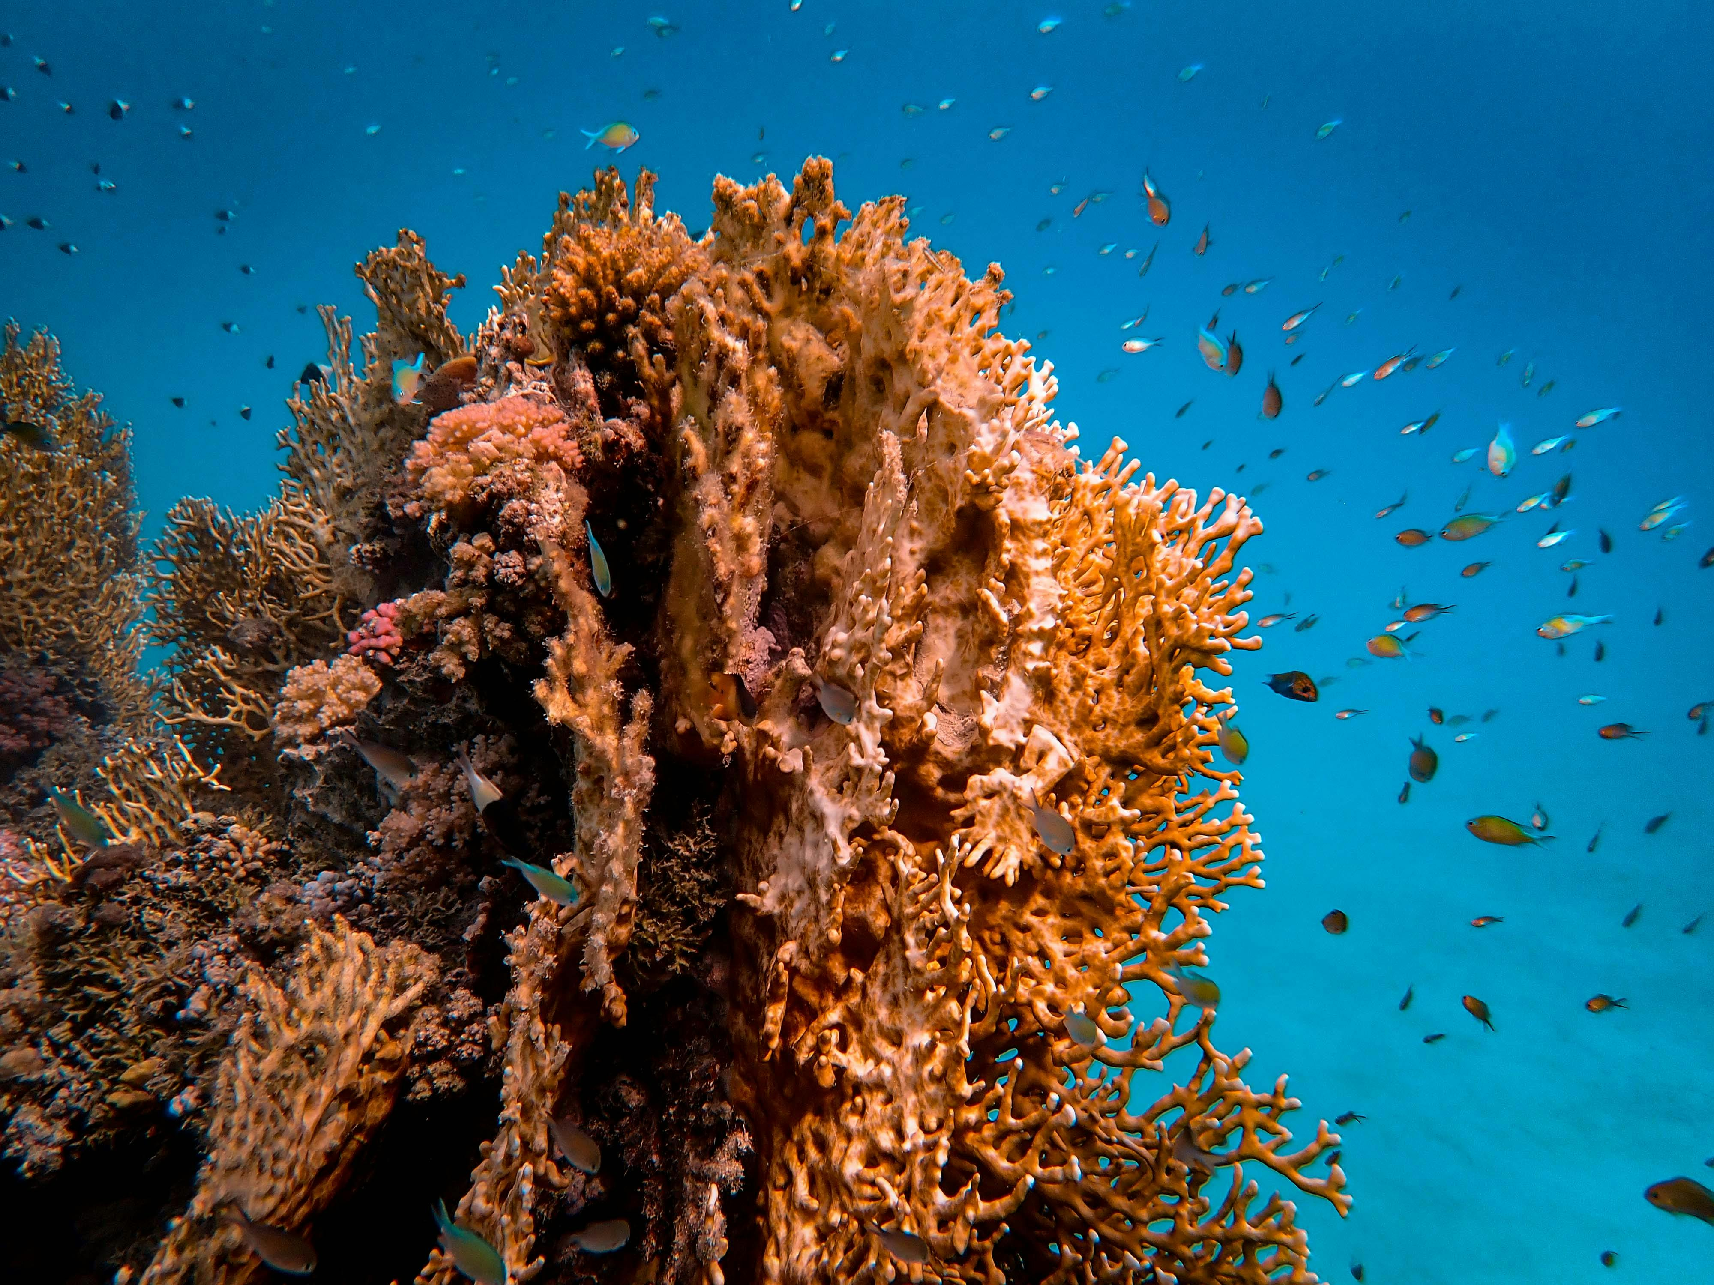
Coral Reefs: Ecosystems, Conservation, and Human Impact
17
Additional Resources
Exploring Coral Reefs with National Geographic
Research by the Australian Institute of Marine Science
The Reef 2020 Plan by the Australian Government
National Geographic offers extensive insights into the vibrant ecosystems of coral reefs.
Their resources provide a global perspective on the importance and challenges facing these marine habitats.
The Australian Institute of Marine Science conducts cutting-edge research on coral reefs.
Their studies focus on understanding reef health and resilience in the face of environmental changes.
The Reef 2020 plan outlines strategies for preserving Australia's coral reefs.
It emphasizes sustainable practices and collaborative efforts to protect marine biodiversity.

Slide 18
Coral Reefs: Ecosystems, Conservation, and Human Impact
18
Assessment and Evaluation
Understanding Coral Reefs
Geographic Skills Application
Critical Thinking and Problem-Solving
Students will be assessed on their understanding of coral reefs and their conservation.
This includes their knowledge of the importance of coral reefs and the threats they face.
Students will be evaluated on their ability to apply geographic skills and knowledge to real-world scenarios.
This involves demonstrating practical applications of geographic concepts in various contexts.
Students will be expected to demonstrate critical thinking and problem-solving skills in their assessment tasks.
These skills are essential for analyzing and addressing complex environmental issues.

Slide 19
Coral Reefs: Ecosystems, Conservation, and Human Impact
19
Extension Activities
Field Trip to Coral Reefs
Citizen Science Participation
Coral Reef Conservation Plan
Conduct a field trip to a coral reef location.
This activity provides hands-on learning about coral reef ecosystems.
Participate in a citizen science project to monitor coral reef health.
This initiative helps gather valuable data while engaging the community.
Develop a conservation plan for a coral reef ecosystem.
This plan aims to protect and sustain coral reef biodiversity.

Slide 20
Coral Reefs: Ecosystems, Conservation, and Human Impact
20
Parent Engagement
01
02
Encouraging Curiosity
Participating in Conservation
Parents can support their child's learning by encouraging them to ask questions and seek out additional information about coral reefs.
This helps children develop a deeper understanding and appreciation for marine ecosystems.
Parents can also participate in conservation efforts and support organizations that work to protect coral reefs.
These actions contribute to the preservation of vital marine habitats for future generations.

Slide 21
Coral Reefs: Ecosystems, Conservation, and Human Impact
21
Safety Considerations
01
02
Supervision and Safety Protocols
Cultural and Emotional Sensitivity
When conducting fieldwork or excursions to coral reef locations, ensure that students are supervised at all times.
Follow proper safety protocols to maintain a secure environment for all participants.
Be aware of students' prior knowledge and experiences related to coral reefs.
Be sensitive to any potential cultural or emotional connections they may have to these ecosystems.

