Slide 1
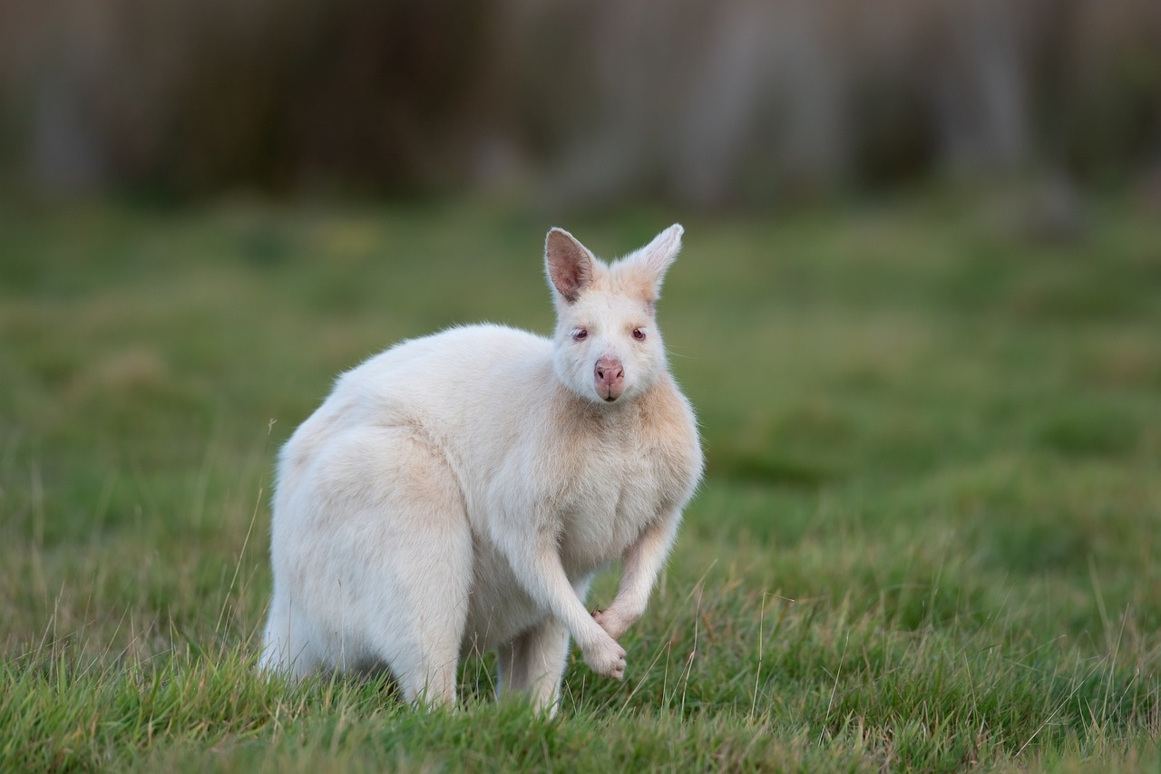
Exploring Genetic Variation: From Blueprint to Adaptation
A Journey Through Cellular Foundations, Natural Selection, and Adaptation Strategies

Slide 2
Table of contents
01
02
03
04
05
06
07
08
09
10
11
Title Slide: Unraveling Life's Blueprint
What is Genetic Variation?
Cellular Foundations
How Genetic Variations Emerge
Natural Selection in Action
Case Study - Peppered Moths
Genetic Variation Simulation
DNA Mutation Mechanisms
Adaptation Strategies
Key Takeaways
Learning Objectives Achieved

Slide 3
Table of contents
12
13
14
15
16
17
18
19
Assessment Overview
Vocabulary Highlights
Future Exploration
Final Slide
Design Recommendations
Questions?
Contact information
Additional resources

Slide 4
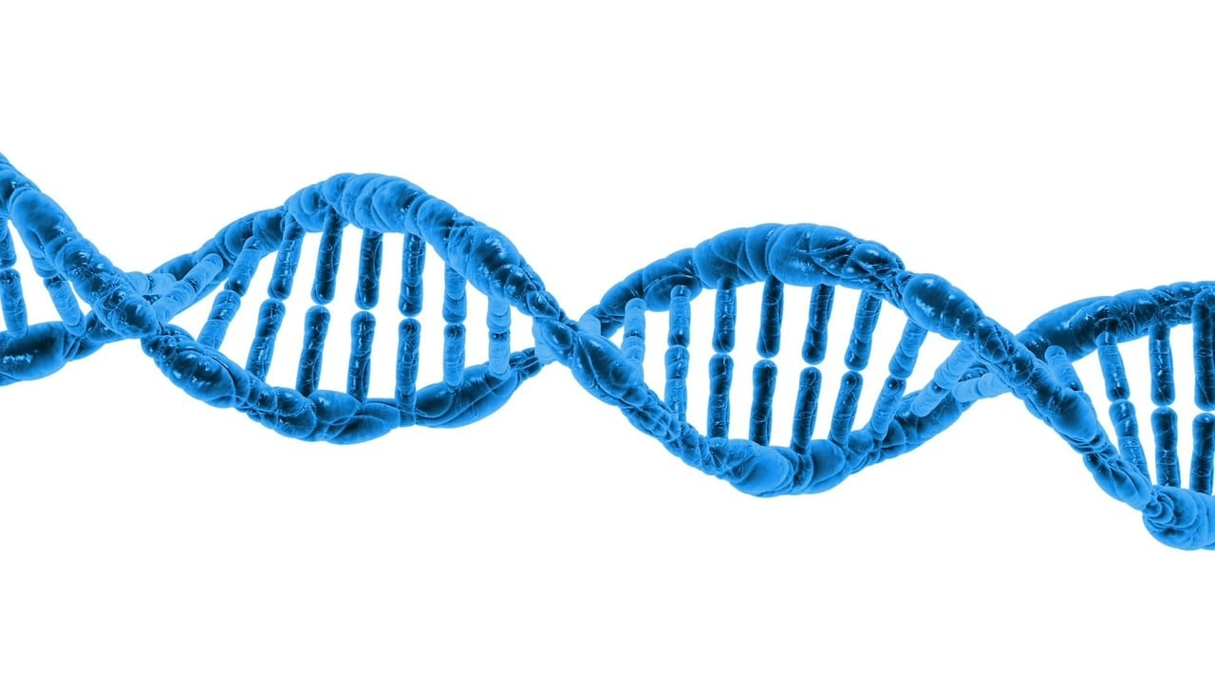
1
Title Slide: Unraveling Life's Blueprint
Unraveling Life's Blueprint
Title: "Unraveling Life's Blueprint: Genetic Variation and Natural Selection"
Subtitle: "Exploring the Cellular Foundations of Evolution"
Visual: Stylized DNA double helix with colorful cellular background
Exploring Genetic Variation: From Blueprint to Adaptation

Slide 5
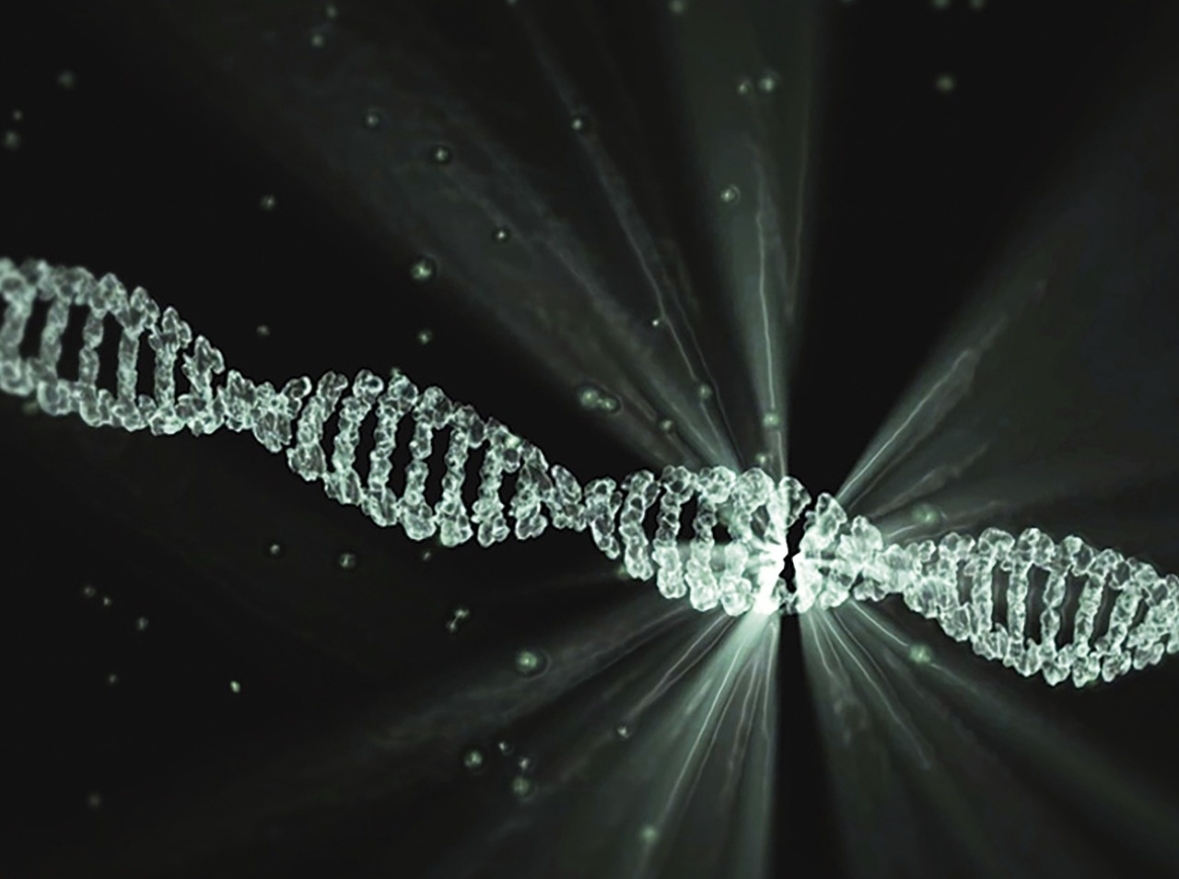
2
What is Genetic Variation?
01
Definition
02
Key Points
The diversity of genetic information within a species
Occurs through mutations
Introduces new traits
Drives evolutionary adaptation
03
Visual
Animated DNA strand with mutation highlights
Exploring Genetic Variation: From Blueprint to Adaptation

Slide 6
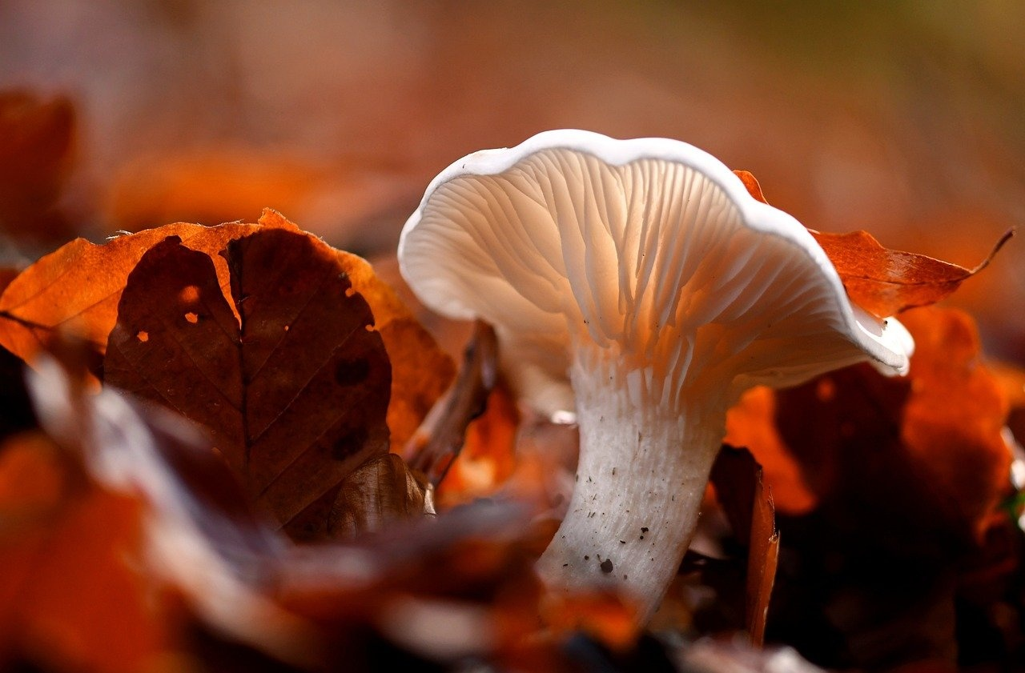
3
Cellular Foundations
01
Cells as the Basic Unit of Life
02
DNA: The Genetic Instruction Manual
Fundamental building blocks of all living organisms
Varied functions based on cell type and structure
Houses genetic information for heredity
Dictates traits and characteristics through gene expression
Exploring Genetic Variation: From Blueprint to Adaptation

Slide 7
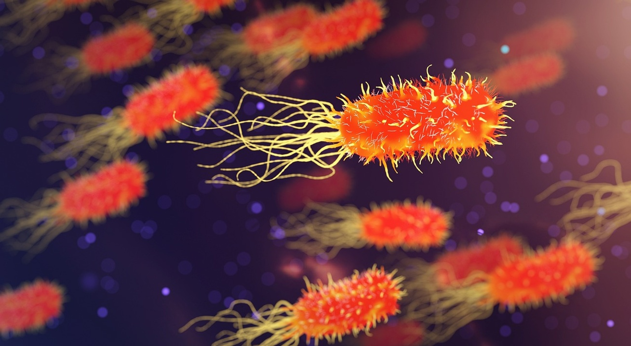
4
How Genetic Variations Emerge
01
Random Mutations
02
Sexual Reproduction
Spontaneous changes in DNA sequence
Can be caused by environmental factors or errors in DNA replication
Combining genetic material from two individuals
Increases genetic diversity within a population
03
Genetic Recombination
04
Environmental Interactions
Exchange of genetic material during cell division
Leads to new combinations of genes in offspring
External factors can influence gene expression
Selective pressures drive adaptation and survival
Exploring Genetic Variation: From Blueprint to Adaptation

Slide 8
5
Natural Selection in Action
Environmental Pressures Drive Adaptation
Illustrative Example
Organisms with advantageous traits survive
Beneficial traits passed to next generation
Continuous adaptation process
Before/after images of species adaptations
Visual representation of survival advantages
Exploring Genetic Variation: From Blueprint to Adaptation

Slide 9
6
Case Study - Peppered Moths
Industrial Revolution Adaptation Example
Light vs. Dark Moth Populations
Peppered moths showcased rapid adaptation.
Light moths thrived pre-Industrial Revolution.
Dark moths gained advantage in polluted areas.
Exploring Genetic Variation: From Blueprint to Adaptation

Slide 10
7
Genetic Variation Simulation
01
02
03
Interactive Learning Approach
Demonstration of Trait Inheritance
Probability and Genetic Transmission
Engage students in hands-on activities
Enhance understanding of genetic concepts
Showcase how traits are passed down
Illustrate genetic transmission processes
Explore the likelihood of trait inheritance
Understand the role of genetics in evolution
Exploring Genetic Variation: From Blueprint to Adaptation

Slide 11
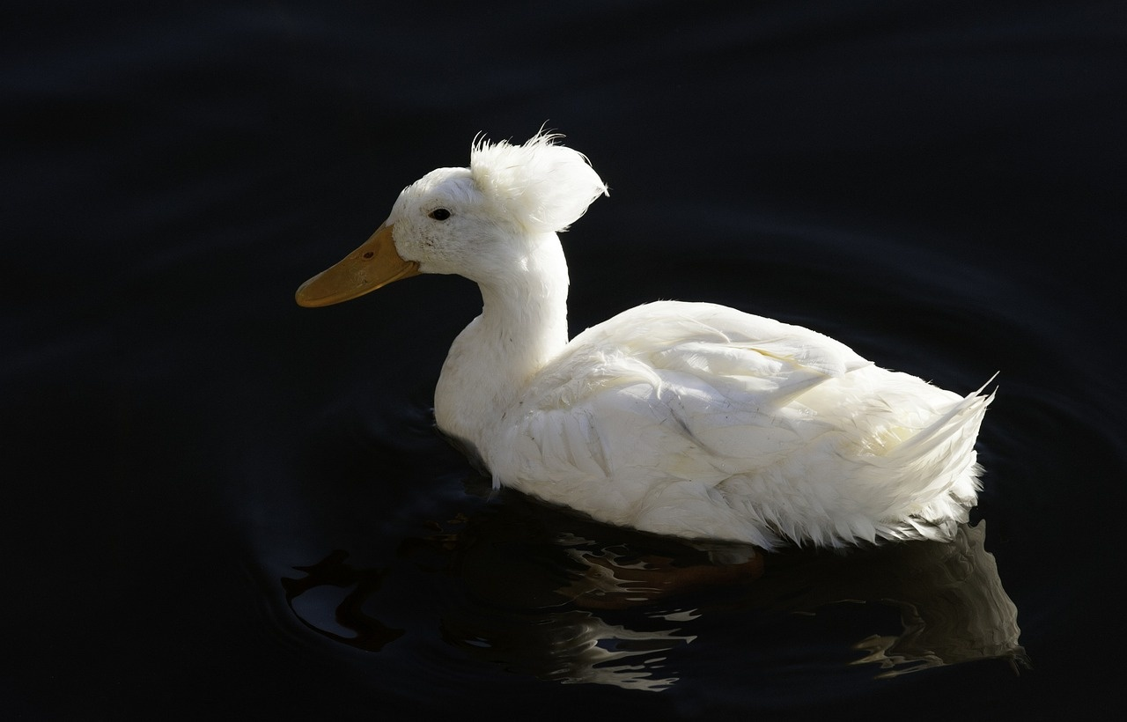
8
DNA Mutation Mechanisms
01
Point Mutations
02
Insertions
Single nucleotide changes in DNA sequence
Types:
Missense: Alters amino acid
Silent: No amino acid change
Nonsense: Premature stop codon
Addition of extra nucleotides
Can disrupt gene function
03
Deletions
04
Chromosomal Rearrangements
Loss of nucleotides in DNA
Causes frameshift mutations
Large-scale changes in chromosome structure
Examples:
Translocations
Inversions
Exploring Genetic Variation: From Blueprint to Adaptation

Slide 12
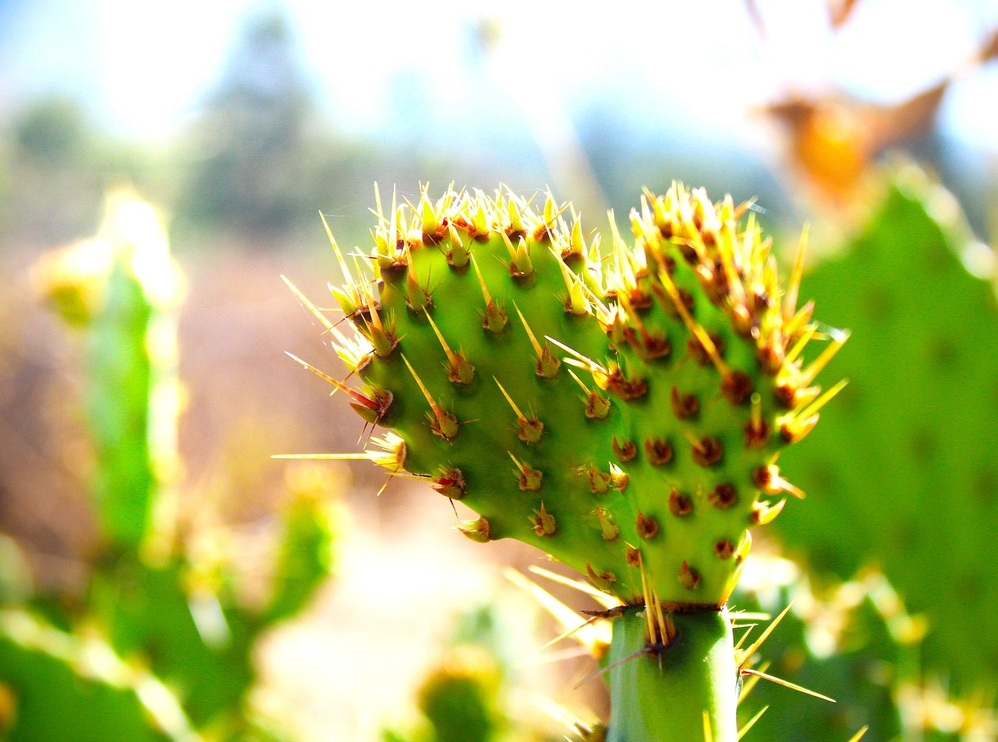
9
Adaptation Strategies
01
Arctic Fox Fur Color Changes
02
Cactus Water Storage Mechanisms
Camouflage in changing environments
White fur for snow, brown fur for summer
Adaptation to arid conditions
Succulent tissues store water for survival
03
Bacterial Antibiotic Resistance
Evolution of resistance to antibiotics
Genetic mutations confer survival advantage
Exploring Genetic Variation: From Blueprint to Adaptation

Slide 13
10
Key Takeaways
Genetic Variation
Environmental Pressures
Essential for evolutionary processes.
Play a crucial role in shaping genetic inheritance.
Cellular DNA
Evolution
Serves as the blueprint for adaptive potential.
A dynamic and ongoing process.
Exploring Genetic Variation: From Blueprint to Adaptation

Slide 14

11
Learning Objectives Achieved
01
Understand cellular structure and DNA's role
02
Analyze genetic variation in adaptation
Recognize cells as the basic unit of life
Comprehend DNA's function as the genetic instruction manual
Define genetic variation and its sources
Explore how mutations drive evolutionary adaptation
03
Evaluate environmental pressures
04
Develop scientific reasoning skills
Discuss how natural selection shapes survival traits
Analyze the impact of environmental changes on genetic selection
Apply knowledge of genetic variation and natural selection
Engage in critical thinking about adaptation strategies
Exploring Genetic Variation: From Blueprint to Adaptation

Slide 15

12
Assessment Overview
Assessment Overview - Quiz Components
Multiple choice
Genetic inheritance mapping
Case study analysis
Exploring Genetic Variation: From Blueprint to Adaptation

Slide 16
13
Vocabulary Highlights
01
DNA
02
Mutation
03
Adaptation
Genetic material that carries hereditary information
Changes in the DNA sequence that can lead to genetic variation
Process by which organisms evolve traits to better survive in their environment
04
Natural Selection
05
Genetic Variation
Mechanism by which advantageous traits are passed on to future generations
Diversity in genetic makeup within a species
Exploring Genetic Variation: From Blueprint to Adaptation

Slide 17

14
Future Exploration
01
Biotechnology Advancements
02
Genomic Research Opportunities
CRISPR gene editing technology
Gene therapy for genetic disorders
Understanding complex genetic diseases
Personalized medicine advancements
03
Ethical Considerations in Genetics
Privacy concerns in genetic testing
Equity in access to genetic technologies
Exploring Genetic Variation: From Blueprint to Adaptation

Slide 18
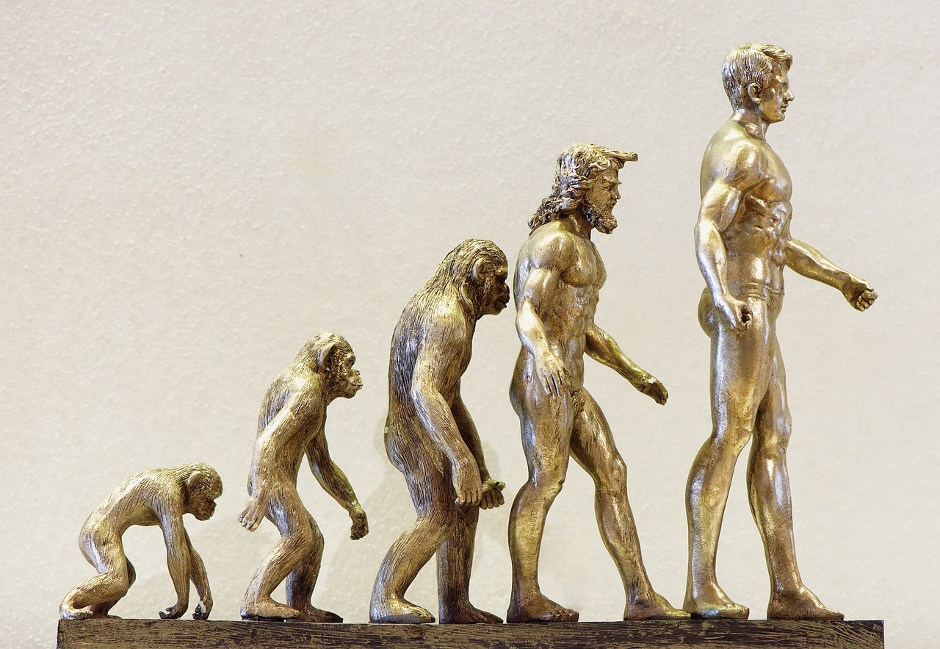
15
Final Slide
Thank you for exploring Genetic Variation and Natural Selection with us!
Questions?
Contact us for more information:
Email: info@genetics.edu
Phone: 123-456-7890
Additional resources for further learning
Exploring Genetic Variation: From Blueprint to Adaptation

Slide 19
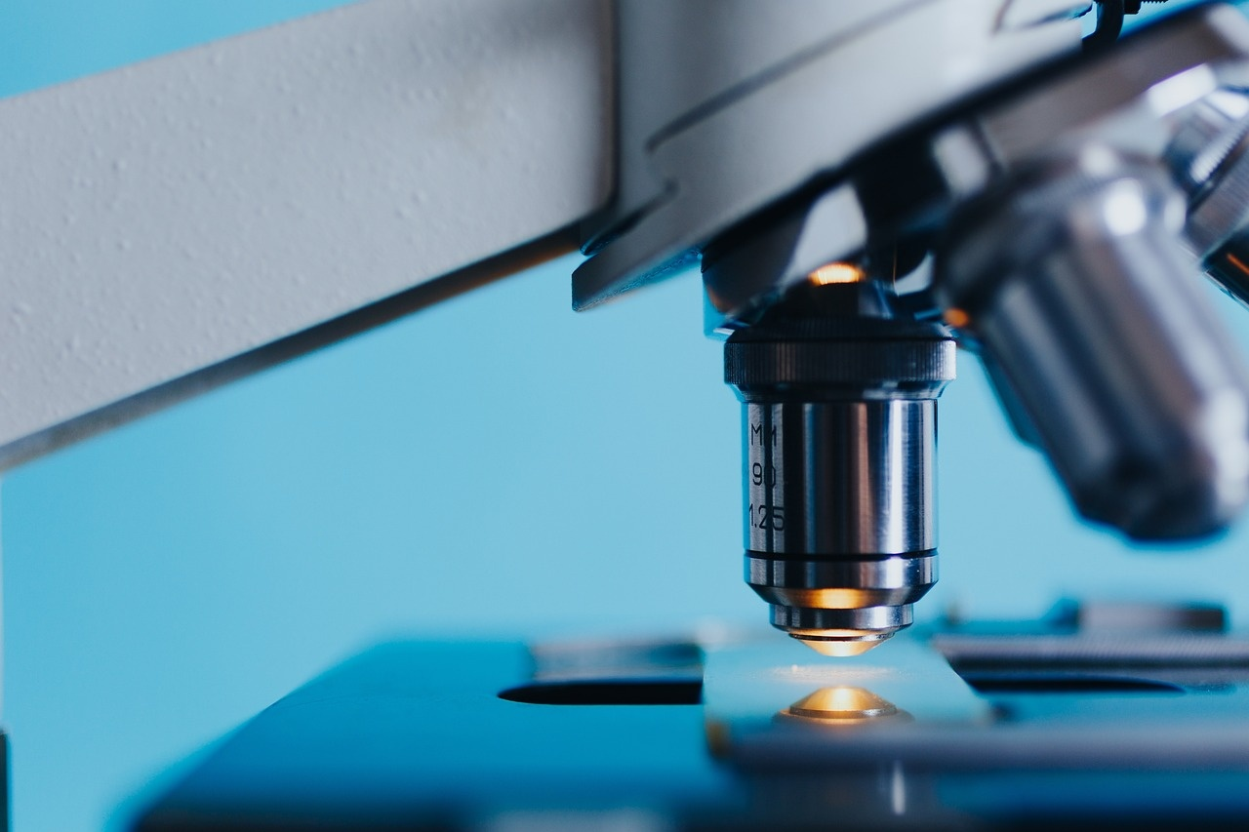
16
Design Recommendations
01
Consistent Color Scheme
02
Scientific Imagery
Utilize blues, greens, and purples for a cohesive visual appeal.
Incorporate high-quality scientific illustrations to enhance understanding.
03
Modern Typography
04
High-Quality Illustrations
Use clean and modern fonts for a professional look.
Include detailed and visually engaging scientific illustrations.
Exploring Genetic Variation: From Blueprint to Adaptation

Slide 20
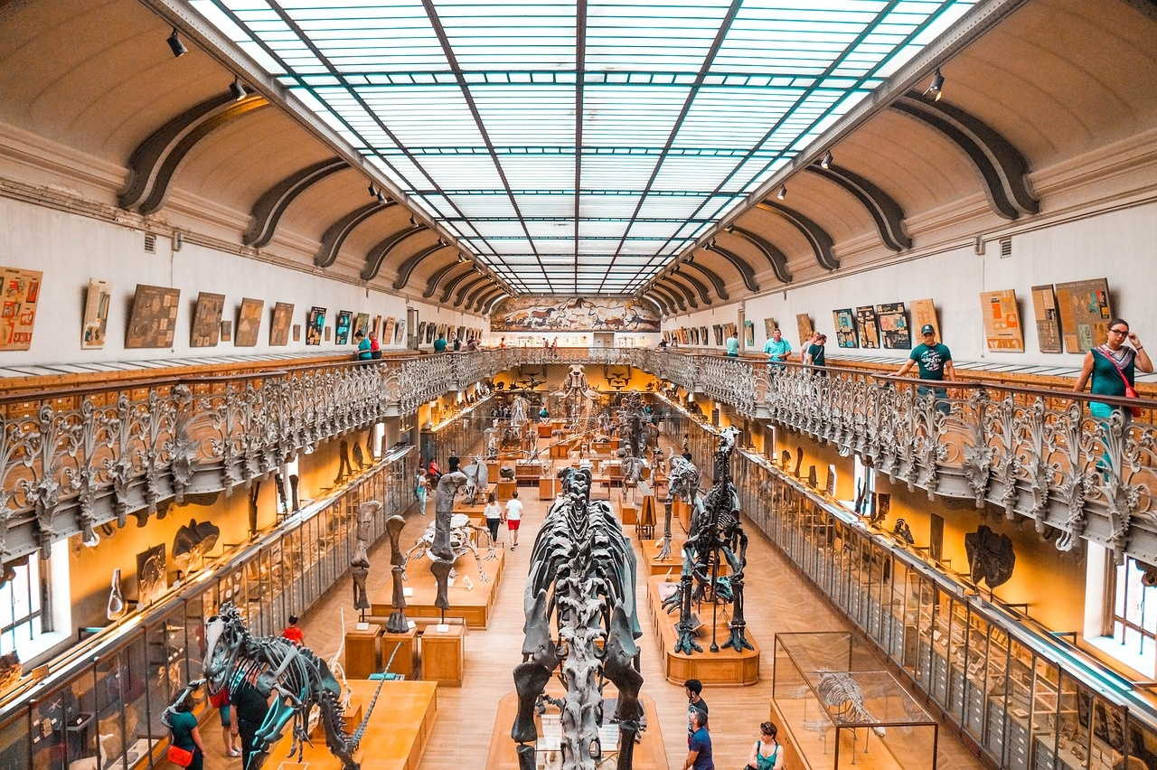
17
Questions?
Genetic Variation and Evolutionary Adaptation
Genetic variation provides the raw material for evolution.
It allows populations to adapt to changing environments.
Individuals with advantageous traits are more likely to survive and reproduce.
Exploring Genetic Variation: From Blueprint to Adaptation

Slide 21

18
Contact information
Contact Information
Email: genetics@scienceinstitute.com
Phone: +1 (555) 123-4567
Office Hours: Monday-Friday, 9am-5pm
Website: www.scienceinstitute.com/genetics
Social Media: @sciencegenetics
Exploring Genetic Variation: From Blueprint to Adaptation

Slide 22
19
Additional resources
01
Genetic Variation and Evolution
02
Understanding Natural Selection
03
Interactive Simulations
Website: National Center for Biotechnology Information (NCBI)
Access to research articles, databases, and tools for genetic studies
Book: "The Beak of the Finch" by Jonathan Weiner
Explores Darwin's theory through the study of Galápagos finches
Online Platform: HHMI Biointeractive
Engaging simulations on genetic variation and natural selection
04
Educational Videos
05
Professional Development
YouTube Channel: CrashCourse Biology
Entertaining videos explaining genetics and evolution concepts
Workshop: Genetic Variation in the Classroom
Enhance teaching strategies for genetics education
Exploring Genetic Variation: From Blueprint to Adaptation

