Slide 1

Empowering Self-Image Through Affirmations
Exploring the Journey of Positive Self-Perception and Personal Growth

Slide 2


Table of contents
Introduction to Positive Self-Image
What is a Positive Self-Image?
What are Affirmations?
Why are Affirmations Important?
How to Use Affirmations
Self-Reflection and Positive Self-Image
Creating a Personal Affirmation Poster
Sharing Our Posters
Conclusion
General Objective
Specific Objectives
Engage: Introduction to Affirmations
Explore: Creating Affirmations
01
02
03
04
05
06
07
08
09
10
11
12
13

Slide 3
Table of contents
Explain: The Power of Affirmations
Elaborate: Self-Reflection and Positive Self-Image
Evaluate: Sharing Our Posters
14
15
16

Slide 4
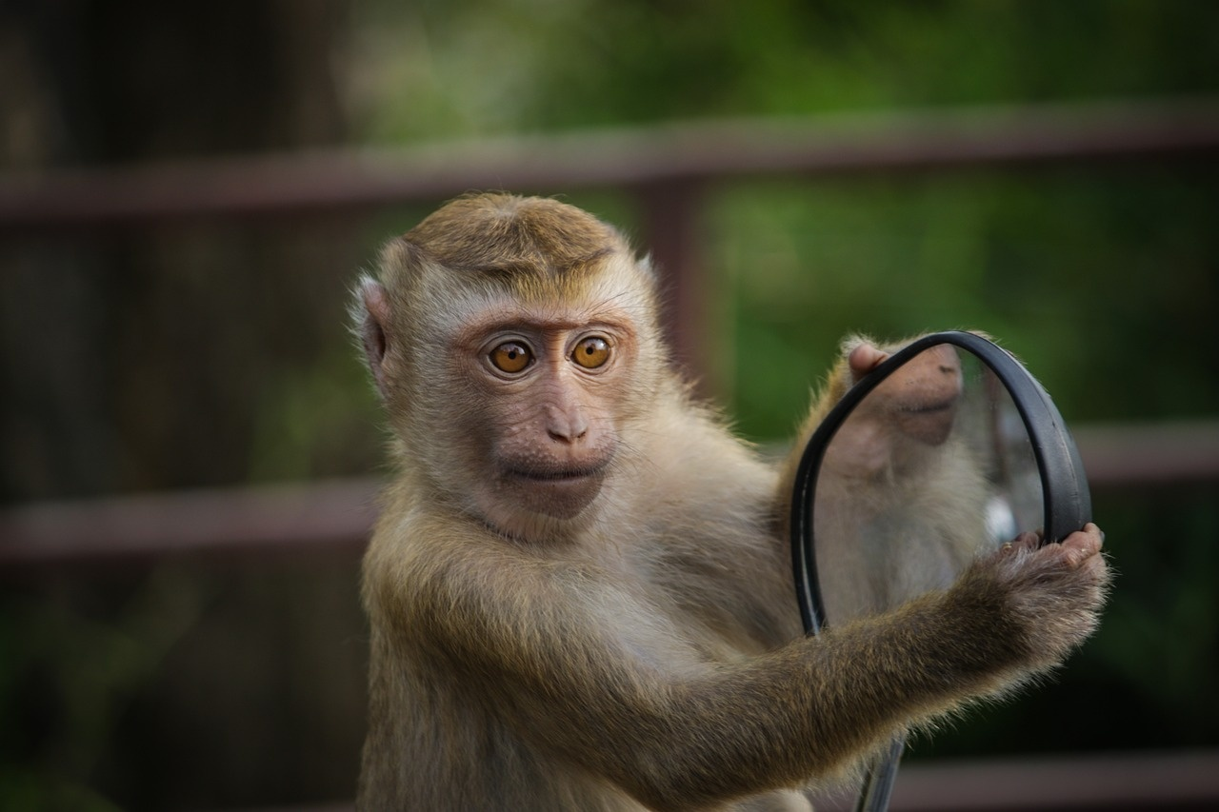
Introduction to Positive Self-Image
Boosting Confidence
Emotional Well-Being
Affirmations & Reflection
A positive self-image enhances our confidence levels.
It empowers us to take on challenges and pursue our goals.
A healthy self-image contributes to our overall emotional health.
It fosters happiness and a sense of pride in who we are.
Using affirmations can reinforce a positive self-view.
Self-reflection helps us identify and appreciate our strengths.
1
Empowering Self-Image Through Affirmations

Slide 5

What is a Positive Self-Image?
Self-Perception
Strengths & Weaknesses
Boosts Confidence
It is the way we view ourselves, encompassing our beliefs and feelings about our identity.
A positive self-perception leads to greater self-acceptance and overall well-being.
Recognizing our strengths allows us to leverage them in various aspects of life.
Acknowledging weaknesses helps us to work on self-improvement and personal growth.
A positive self-image fosters a sense of self-worth and assurance in our abilities.
When we feel good about ourselves, we are more likely to take risks and pursue our goals.
2
Empowering Self-Image Through Affirmations

Slide 6
What are Affirmations?
Boost Confidence
Enhance Self-Esteem
Promote Well-Being
Affirmations help reinforce a positive self-image.
They encourage us to believe in our abilities and potential.
Regularly practicing affirmations can improve how we view ourselves.
They remind us of our worth and value.
Affirmations contribute to a positive mindset and emotional health.
They can reduce stress and anxiety by fostering a sense of calm.
3
Empowering Self-Image Through Affirmations

Slide 7

Why are Affirmations Important?
Focus on Strengths
Combat Negative Self-Talk
Boost Confidence
Affirmations help us recognize and appreciate our positive qualities.
By focusing on strengths, we can build a more positive self-image.
Affirmations serve as a powerful tool to challenge and overcome self-doubt.
They can replace negative thoughts with empowering beliefs.
Regular use of affirmations can significantly enhance self-esteem.
Increased confidence leads to better decision-making and overall well-being.
4
Empowering Self-Image Through Affirmations

Slide 8

How to Use Affirmations
Daily Practice
Visible Reminders
Share with Others
Repeat affirmations every day, especially during stressful moments.
Consistency helps reinforce positive beliefs.
Write down your affirmations and place them in visible areas.
This keeps your goals and intentions at the forefront of your mind.
Discuss your affirmations with a friend or family member.
Having someone to remind you can strengthen your commitment.
5
Empowering Self-Image Through Affirmations

Slide 9
Self-Reflection and Positive Self-Image
Evaluate Thoughts
Identify Improvements
Enhance Well-Being
Reflect on your feelings and behaviors to understand your motivations.
Consider how your thoughts influence your actions and decisions.
Pinpoint specific areas in your life that could benefit from change.
Develop actionable strategies to address these areas effectively.
Engage in regular self-reflection to boost self-awareness and acceptance.
Cultivate a positive self-image through consistent evaluation and growth.
6
Empowering Self-Image Through Affirmations

Slide 10
Creating a Personal Affirmation Poster
Craft Supplies
Inspiring Words
Class Sharing
Gather colorful markers, stickers, and other craft materials.
Choose supplies that resonate with your personal style.
Include affirmations and quotes that uplift you.
Select words that reflect your positive self-image.
Present your poster to the class and share its meaning.
Explain the significance of your chosen affirmations and images.
7
Empowering Self-Image Through Affirmations

Slide 11

Sharing Our Posters
Collaborative Poster Review
Rationale Behind Affirmations
Constructive Peer Feedback
Present your poster to a partner or small group and discuss the key elements of your work.
Explain why you chose specific affirmations and images, highlighting the significance of each choice.
Listen actively to your peers' presentations and provide constructive feedback to improve their work.
8
Empowering Self-Image Through Affirmations

Slide 12

Conclusion
Ongoing Development
Use Affirmations
Visual Reminders
Developing a positive self-image is an ongoing process that takes time and practice. Consistency is key to making lasting changes.
Remember to use affirmations and self-reflection regularly. These practices can significantly boost your confidence and self-esteem.
Keep your poster as a reminder of your positive self-image. It should include affirmations that make you feel good about yourself.
9
Empowering Self-Image Through Affirmations

Slide 13

General Objective
Impact of Affirmations
Growth Mindset
Self-Acceptance
Positive affirmations can significantly enhance self-image and confidence. They help individuals reshape their thoughts and beliefs about themselves.
A growth mindset encourages resilience and a love for learning. It allows students to embrace challenges and view failures as opportunities for growth.
Self-acceptance is crucial for emotional well-being. It involves recognizing and embracing one's strengths and weaknesses without judgment.
Affirmation Poster
Class Sharing
Creating a personal affirmation poster allows students to visualize their goals and positive beliefs. It serves as a daily reminder of their potential.
Sharing affirmations in class fosters a supportive environment. It encourages students to express themselves and learn from each other's experiences.
10
Empowering Self-Image Through Affirmations

Slide 14

Specific Objectives
Impact of Affirmations
Growth Mindset
Affirmation Poster
Students will analyze how positive affirmations influence their self-image.
They will evaluate the effectiveness of affirmations in promoting self-esteem.
Students will recognize the importance of a growth mindset in personal development.
They will demonstrate self-acceptance and resilience in the face of challenges.
Students will create a personal affirmation poster that reflects their values and goals.
They will share their posters with the class to foster a supportive environment.
11
Empowering Self-Image Through Affirmations

Slide 15

Engage: Introduction to Affirmations
Power of Affirmations
Share Your Confidence
Repeat and Reflect
Affirmations are positive statements that help challenge negative thoughts.
They help build a positive self-image and boost self-esteem.
Encourage students to share times when they felt proud and confident.
This sharing creates a supportive environment and reinforces positive thinking.
Display affirmations on the board and have everyone repeat them together.
Regular repetition helps internalize these positive statements.
12
Empowering Self-Image Through Affirmations

Slide 16

Explore: Creating Affirmations
Craft Affirmations
Identify Strengths
Share with Peers
Provide students with paper and markers to create their own affirmations.
Encourage creativity and personal expression in their affirmations.
Ask students to think about their strengths and positive qualities.
Guide them to reflect on past achievements and what makes them unique.
Encourage students to share their affirmations with a partner or in a small group.
Foster a supportive environment for sharing and feedback.
13
Empowering Self-Image Through Affirmations

Slide 17
Explain: The Power of Affirmations
Focus on Strengths
Boost Confidence
Daily Affirmation Practices
Affirmations help us recognize and appreciate our unique strengths.
By repeating positive statements, we shift our focus from weaknesses to our positive qualities.
Regular use of affirmations can significantly enhance self-esteem.
As we affirm our abilities, we become more confident in facing challenges.
Incorporate affirmations into your morning routine for a positive start.
Use sticky notes with affirmations in visible places to reinforce positive thinking throughout the day.
14
Empowering Self-Image Through Affirmations

Slide 18
Elaborate: Self-Reflection and Positive Self-Image
Self-Reflection Benefits
Identify Improvement Areas
Develop Positive Strategies
Enhances self-awareness and understanding of personal values.
Promotes emotional intelligence and better decision-making.
Encourages honest evaluation of thoughts and behaviors.
Helps pinpoint specific areas where growth is needed.
Fosters the creation of actionable plans for self-improvement.
Encourages the adoption of healthy habits and mindsets.
15
Empowering Self-Image Through Affirmations

Slide 19

Evaluate: Sharing Our Posters
Poster Sharing
Affirmation Choices
Feedback & Encouragement
Students will present their posters to the class, showcasing their creativity and understanding of the topic.
Each student will have a few minutes to share their work and engage with their peers.
Students will explain the affirmations they selected and the significance behind each choice.
This discussion will help deepen their understanding of personal values and beliefs.
Classmates and teachers will provide constructive feedback to each presenter.
Encouragement will be emphasized to foster a supportive learning environment.
16
Empowering Self-Image Through Affirmations

