Slide 1

Unveiling the Enigma of Life
A Comprehensive Journey through the Mysteries and Wonders of Living Systems

Slide 2
Table of contents
01
02
03
04
05
06
07
08
09
10
11
Introduction to the Mysteries of Life
The Phenomenon of Life
Journey into Understanding Living Systems
Exploring Molecular Interactions
Complexity of Biological Entities
Philosophical Exploration of Life
Bridging Scientific Disciplines
Fundamental Characteristics of Life
Deconstructing Remarkable Processes
Distinguishing Living Organisms
Key Features of Life

Slide 3
Table of contents
12
13
14
15
16
17
18
19
20
Evolutionary Theory in Life
Genetics and Biological Complexity
Ecological Systems in Life
SWOT Analysis of Life
Challenges in Biological Origins
Timeline of Life's Evolution
Revenue Growth in Biological Studies
Statistics on Biological Complexity
Future Prospects in Biological Research

Slide 4
1
Introduction to the Mysteries of Life
01
02
03
04
05
Life's Origin
Complexity of Biological Systems
Evolutionary Adaptations
Genetic Diversity
Interconnected Ecosystems
Delve into the theories surrounding the origins of life on Earth.
Explore the intricate structures and functions of living organisms.
Understand how species evolve and adapt to their environments over time.
Investigate the role of genetics in shaping the diversity of life forms.
Examine the interconnectedness of living organisms within ecosystems.
Unveiling the Enigma of Life

Slide 5

2
The Phenomenon of Life
01
Complexity of Living Systems
02
Self-Sustaining Nature
Living organisms exhibit remarkable complexity, from the molecular level to entire ecosystems.
Life possesses the ability to maintain and perpetuate itself through various biological processes.
03
Adaptability and Evolution
04
Reproduction and Growth
Living entities have the capacity to adapt to changing environments and evolve over time.
Fundamental characteristics of life include the ability to reproduce and grow, ensuring continuity of species.
Unveiling the Enigma of Life

Slide 6
3
Journey into Understanding Living Systems
01
02
03
04
Exploring the Origins of Life
From Molecules to Organisms
Genetics and Evolution
Ecological Interactions
Delve into the theories and hypotheses surrounding the emergence of life on Earth.
Understand how simple molecular interactions give rise to the complexity of living organisms.
Explore the role of genetics in shaping the diversity of life forms through the process of evolution.
Investigate how living systems interact with their environment, shaping ecosystems and biodiversity.
Unveiling the Enigma of Life

Slide 7

4
Exploring Molecular Interactions
01
Understanding Molecular Interactions
02
Key Players: Proteins and Nucleic Acids
At the core of life's complexity lies the intricate dance of molecular interactions.
Proteins and nucleic acids are essential molecules that drive biological processes.
03
Protein Folding: A Delicate Balance
04
Signaling Pathways: Communication at the Molecular Level
The precise folding of proteins is crucial for their function and interactions.
Signaling pathways regulate cellular activities through complex molecular interactions.
Unveiling the Enigma of Life

Slide 8
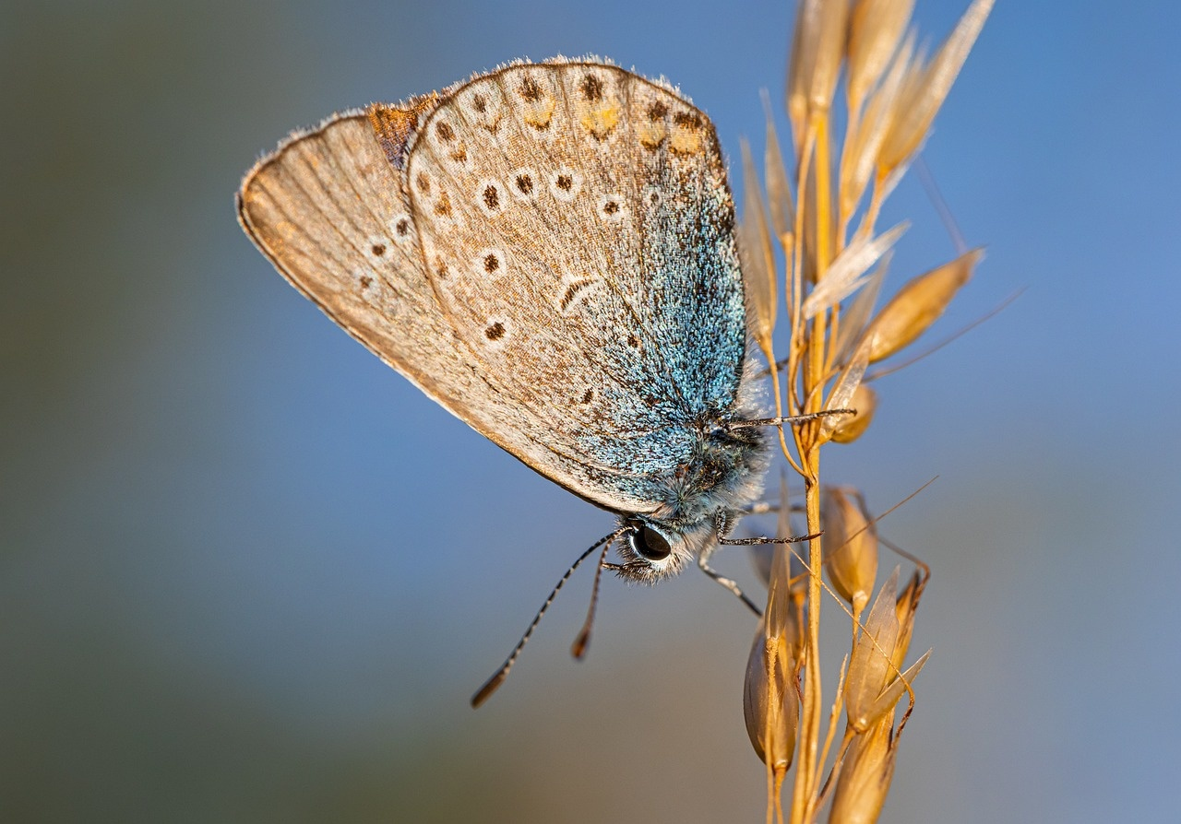
5
Complexity of Biological Entities
Cellular Diversity
The human body consists of trillions of cells, each specialized for specific functions such as nerve signaling, muscle contraction, and hormone production.
Genetic Variation
The human genome contains approximately 20,000-25,000 genes, contributing to the vast diversity seen in biological organisms.
Regulatory Networks
Intricate signaling pathways and gene regulatory networks control the development, growth, and response to environmental stimuli in organisms.
Emergent Properties
Biological entities exhibit emergent properties, where complex interactions between individual components give rise to new characteristics at the organism level.
Unveiling the Enigma of Life

Slide 9
6
Philosophical Exploration of Life
01
02
03
04
Contemplation of Existence
Interconnectedness of All Living Beings
Ethical Considerations
Search for Meaning
Delve into the profound questions surrounding the origins and purpose of life.
Explore how every organism is intricately linked in the web of life.
Reflect on the moral implications of manipulating life forms and ecosystems.
Discuss how individuals find purpose and significance within the context of life's mysteries.
Unveiling the Enigma of Life

Slide 10

7
Bridging Scientific Disciplines
01
Exploring Molecular Biology
02
Delving into Genetics
Understanding the building blocks of life at the molecular level.
Investigating how genes dictate the traits and functions of living organisms.
03
Unraveling Evolutionary Theory
04
Studying Ecological Systems
Tracing the origins and diversification of life forms over time.
Analyzing the interactions between organisms and their environments.
Unveiling the Enigma of Life

Slide 11

8
Fundamental Characteristics of Life
Cellular Organization
Living organisms are composed of one or more cells, which are the basic structural and functional units of life.
Metabolism
Life requires energy to sustain itself, and organisms utilize metabolic processes to acquire, store, and utilize energy.
Homeostasis
Living systems maintain internal stability by regulating their internal environment despite external changes.
Growth and Development
Organisms exhibit growth through an increase in size or number of cells, as well as undergo development to mature into their specific form.
Reproduction
Living organisms have the ability to reproduce, passing on genetic information to offspring to ensure the continuity of life.
Unveiling the Enigma of Life

Slide 12
9
Deconstructing Remarkable Processes
01
02
03
04
Cellular Respiration
DNA Replication
Protein Synthesis
Photosynthesis
The process by which cells convert glucose into energy in the form of ATP.
The intricate mechanism where DNA makes an identical copy of itself during cell division.
The complex process where cells build proteins based on instructions encoded in DNA.
The biochemical process in plants that converts light energy into chemical energy stored in glucose.
Unveiling the Enigma of Life

Slide 13
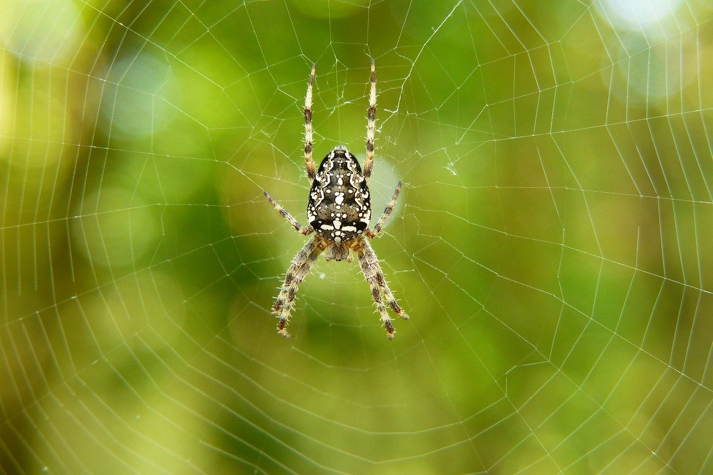
10
Distinguishing Living Organisms
Cellular Structure
Living organisms are composed of one or more cells, which are the basic units of life.
Metabolism
Living organisms exhibit metabolic processes, such as converting food into energy for growth and repair.
Response to Stimuli
Living organisms can respond to external stimuli, such as light, temperature, or touch.
Reproduction
Living organisms have the ability to reproduce and pass on genetic information to offspring.
Homeostasis
Living organisms maintain internal stability through processes like temperature regulation and pH balance.
Unveiling the Enigma of Life

Slide 14
11
Key Features of Life
01
02
03
04
05
Cellular Organization
Homeostasis
Metabolism
Response to Stimuli
Reproduction
Living organisms are composed of one or more cells, which are the basic structural and functional units of life.
Organisms have the ability to regulate and maintain internal conditions despite external changes, ensuring stability for survival.
Life processes involve the conversion of energy and nutrients to sustain vital functions and support growth and development.
Living organisms can detect and respond to environmental stimuli, allowing them to adapt and interact with their surroundings.
The ability to produce offspring ensures the continuity of life and the passing on of genetic information to future generations.
Unveiling the Enigma of Life

Slide 15
12
Evolutionary Theory in Life
01
02
03
04
Charles Darwin's Theory of Evolution
Genetic Variation and Survival
Fossil Record Evidence
Comparative Anatomy
Introduced the concept of natural selection as a mechanism for species adaptation.
Genetic mutations lead to diversity within populations, influencing survival and reproduction.
Fossils provide a timeline of evolutionary changes, showcasing the development of life forms over millions of years.
Similarities in anatomical structures among different species suggest common ancestry and evolutionary relationships.
Unveiling the Enigma of Life

Slide 16
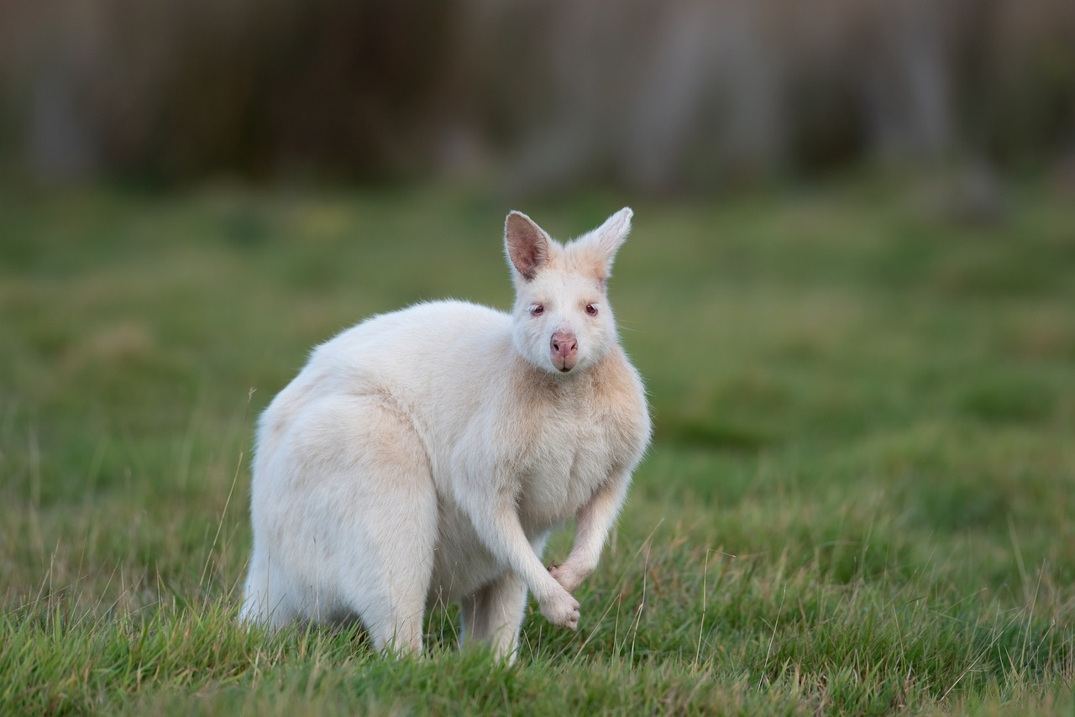
13
Genetics and Biological Complexity
DNA Molecule
DNA, the blueprint of life, contains all the genetic information necessary for the development and functioning of living organisms.
Genetic Variation
Genetic diversity within populations contributes to the complexity and adaptability of species over time.
Gene Expression
The process by which genetic information is used to direct the synthesis of functional gene products, essential for cellular functions and organismal development.
Epigenetics
The study of changes in gene expression or cellular phenotype caused by mechanisms other than changes in the underlying DNA sequence, highlighting the complexity of genetic regulation.
Evolutionary Genetics
Understanding how genetic variation and natural selection drive evolutionary processes, shaping the diversity of life on Earth.
Unveiling the Enigma of Life

Slide 17

14
Ecological Systems in Life
Ecosystems
Interconnected communities of living organisms and their physical environments.
Biodiversity
The variety of life forms within an ecosystem, including species diversity, genetic diversity, and ecosystem diversity.
Trophic Levels
The hierarchical levels in an ecosystem where organisms obtain energy - producers, consumers, and decomposers.
Food Chains and Webs
Illustrations of the transfer of energy through different organisms in an ecosystem.
Nutrient Cycling
The movement and exchange of organic and inorganic matter back into the production of living organisms.
Unveiling the Enigma of Life

Slide 18
15
SWOT Analysis of Life
STRENTHS
WEAKNESSES
Adaptability: Life has shown remarkable resilience and adaptability to changing environments over billions of years.
Reproduction: The ability to reproduce and pass on genetic information ensures the continuity of life forms.
Diversity: Life exhibits incredible diversity in forms, functions, and behaviors, showcasing the richness of biological evolution.
Vulnerability: Life is susceptible to various external factors such as diseases, natural disasters, and environmental changes.
Limited Lifespan: All living organisms have a finite lifespan, making them vulnerable to aging and mortality.
Dependency: Life forms often rely on other organisms or resources for survival, leading to interdependence within ecosystems.
S
W
O
T
OPPORTUNITIES
THREATS
Technological Advancements: Advances in biotechnology and genetic engineering offer new possibilities for enhancing and manipulating life processes.
Environmental Conservation: Opportunities exist to protect and preserve biodiversity, ensuring the sustainability of life on Earth.
Exploration of Space: The exploration of other planets and celestial bodies presents opportunities to discover new forms of life beyond Earth.
Climate Change: Rapid climate change poses a significant threat to various ecosystems and the survival of numerous species.
Biodiversity Loss: The ongoing loss of biodiversity due to habitat destruction and human activities threatens the stability of ecosystems.
Pandemics: Global pandemics, emerging infectious diseases, and antibiotic resistance pose significant threats to human and animal life.
Unveiling the Enigma of Life

Slide 19
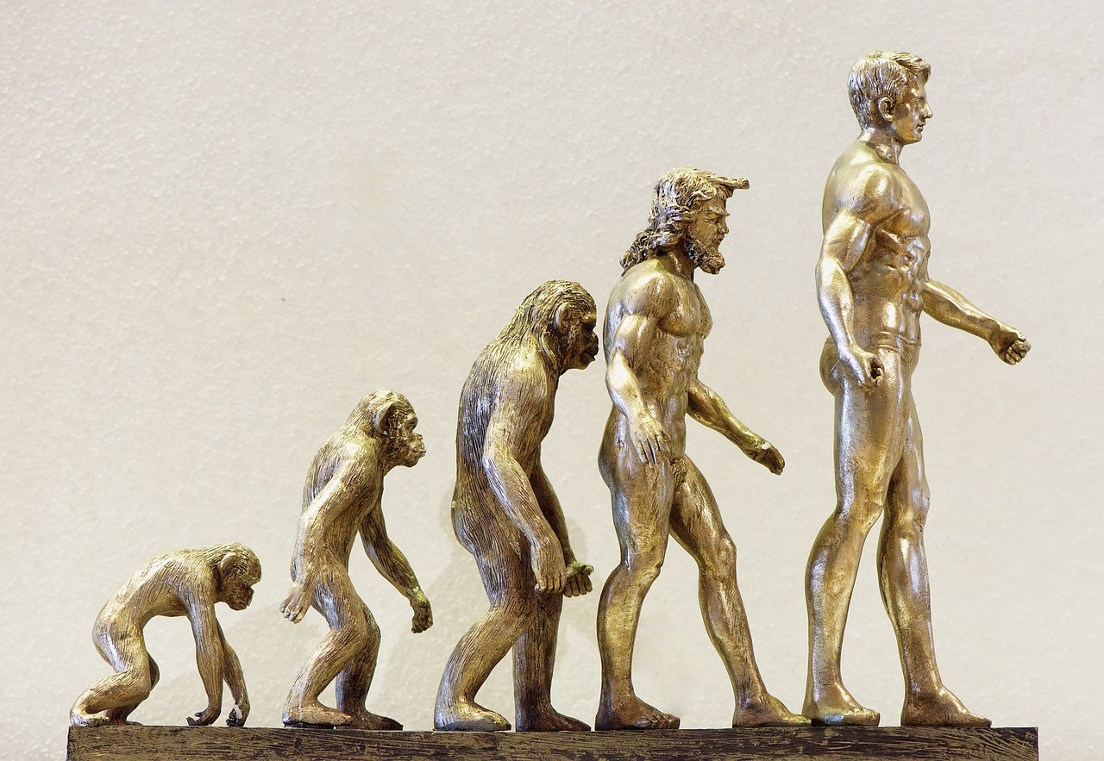
16
Challenges in Biological Origins
Abiogenesis
The origin of life from non-living matter remains a major puzzle in biology.
Complexity
Understanding how simple molecules evolved into complex organisms poses a significant challenge.
Genetic Variation
The mechanisms driving genetic diversity and adaptation are key areas of study.
Environmental Factors
The impact of environmental changes on the evolution and survival of species is a critical aspect to explore.
Origin of Eukaryotic Cells
Investigating the transition from prokaryotic to eukaryotic cells presents a complex evolutionary challenge.
Unveiling the Enigma of Life

Slide 20
17
Timeline of Life's Evolution
01
02
03
04
05
Formation of Earth (4.6 billion years ago)
Origin of Life (3.5 billion years ago)
Photosynthesis (2.7 billion years ago)
Cambrian Explosion (541 million years ago)
Dinosaurs Roam (230 million years ago)
Earth is formed from cosmic dust and gas, creating a suitable environment for life to emerge.
Simple single-celled organisms, such as bacteria and archaea, appear in the primordial soup.
Cyanobacteria evolve the ability to perform photosynthesis, releasing oxygen into the atmosphere.
Rapid diversification of multicellular life forms, leading to the emergence of various complex organisms.
Dinosaurs dominate the Earth, showcasing a wide range of sizes and adaptations.
Unveiling the Enigma of Life

Slide 21
18
Revenue Growth in Biological Studies
$2.5 billion
15%
$500 million
30%
Global revenue
Annual growth rate
Genetic engineering revenue
Personalized medicine growth
Global revenue generated by the biotechnology industry in 2020.
Average annual revenue growth rate of biotech companies over the past decade.
Revenue contribution from genetic engineering research in the life sciences sector.
Projected revenue growth in personalized medicine by 2025.
Unveiling the Enigma of Life

Slide 22
19
Statistics on Biological Complexity
01
Human Genome
02
Largest Genome
The human genome consists of approximately 3.2 billion base pairs.
The genome of the Paris japonica plant is known to be the largest, with over 150 billion base pairs.
03
Human Proteins
04
Human Cell Types
There are estimated to be over 20,000 different proteins in the human body.
The human body is composed of around 200 different types of cells.
Unveiling the Enigma of Life

Slide 23
20
Future Prospects in Biological Research
10
1
2
3
Future Prospects
Genome Editing Advancements
Bioprinting Breakthroughs
Microbiome Research Expansion
In Biological Research
CRISPR-Cas9 technology has revolutionized genetic engineering. Precision editing of DNA sequences holds promise for curing genetic diseases.
3D bioprinting enables the creation of tissues and organs. Potential for personalized medicine and organ transplants.
Understanding the role of gut microbiota in health and disease. Implications for developing novel therapies and probiotics.
Unveiling the Enigma of Life

