Slide 1
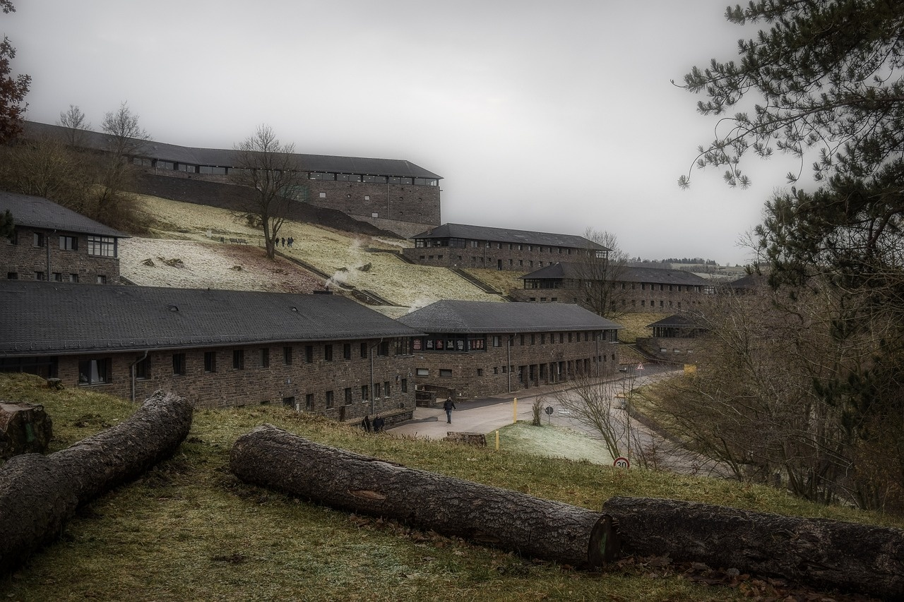
Understanding Fascism: From Historical Roots to Contemporary Relevance
Exploring the Rise, Impact, and Legacy of Fascism in Europe and Beyond

Slide 2
Table of contents
01
02
03
04
05
06
07
08
09
10
11
The Rise of Fascism in Europe
Historical Context: Post-World War I Europe
Economic Collapse: The Perfect Storm
Propaganda: The Psychological Weapon
Leadership Strategies of Fascist Movements
Mechanisms of Democratic Erosion
Psychological Factors of Political Radicalization
Contemporary Relevance
Key Takeaways
Discussion and Reflection
Slide 11

Slide 3
Table of contents
12
13
14
15
16
17
18
19
20
Slide 12
Slide 13
Slide 14
Slide 15
Slide 16
Slide 17
Slide 18
Slide 19
Slide 20

Slide 4
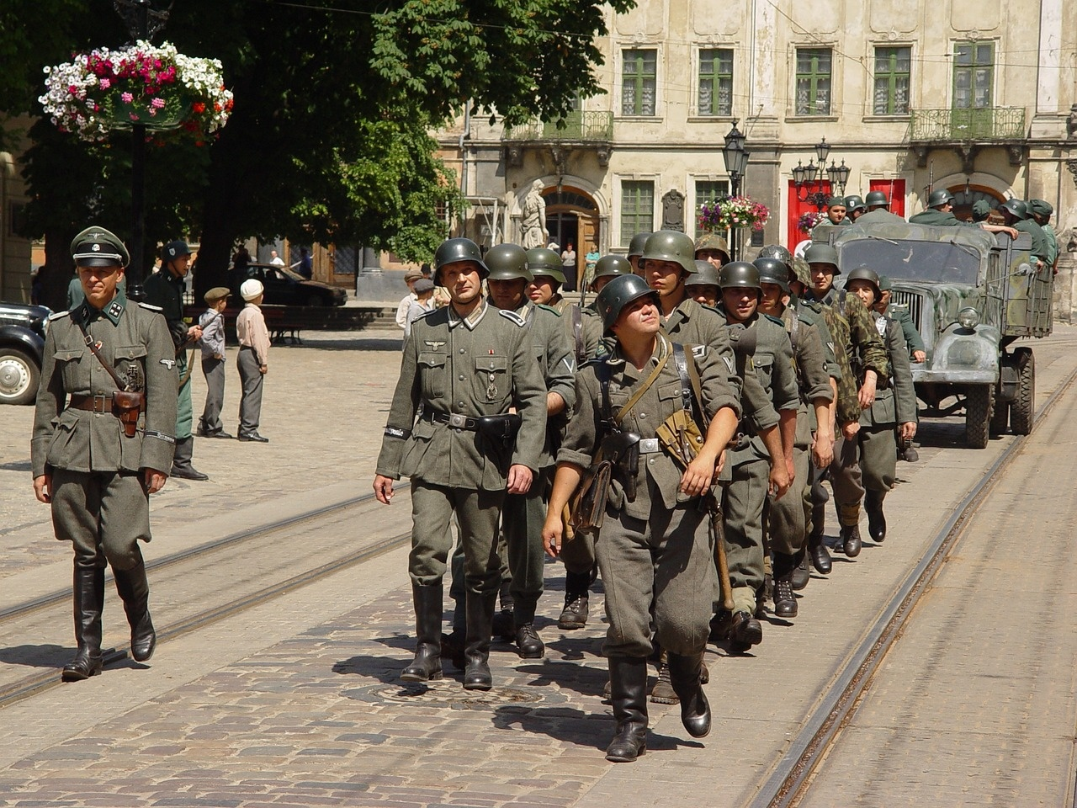
1
The Rise of Fascism in Europe
The Rise of Fascism in Europe
Understanding Political Extremism and Historical Transformation
Understanding Fascism: From Historical Roots to Contemporary Relevance

Slide 5

2
Historical Context: Post-World War I Europe
01
Devastating economic conditions
02
Treaty of Versailles' punitive measures
High unemployment rates
Industrial production decline
War reparations imposed on Germany
Territorial losses and demilitarization
03
National humiliation and economic desperation
Loss of national pride and identity
Severe poverty and social unrest
Understanding Fascism: From Historical Roots to Contemporary Relevance

Slide 6

3
Economic Collapse: The Perfect Storm
01
Hyperinflation
02
Massive unemployment
Germany faced 30,000% inflation by 1923
Joblessness soared, exacerbating economic woes
03
Destroyed middle-class savings
04
Widespread social instability
Savings became worthless due to hyperinflation
Riots and civil unrest gripped the nation
Understanding Fascism: From Historical Roots to Contemporary Relevance

Slide 7
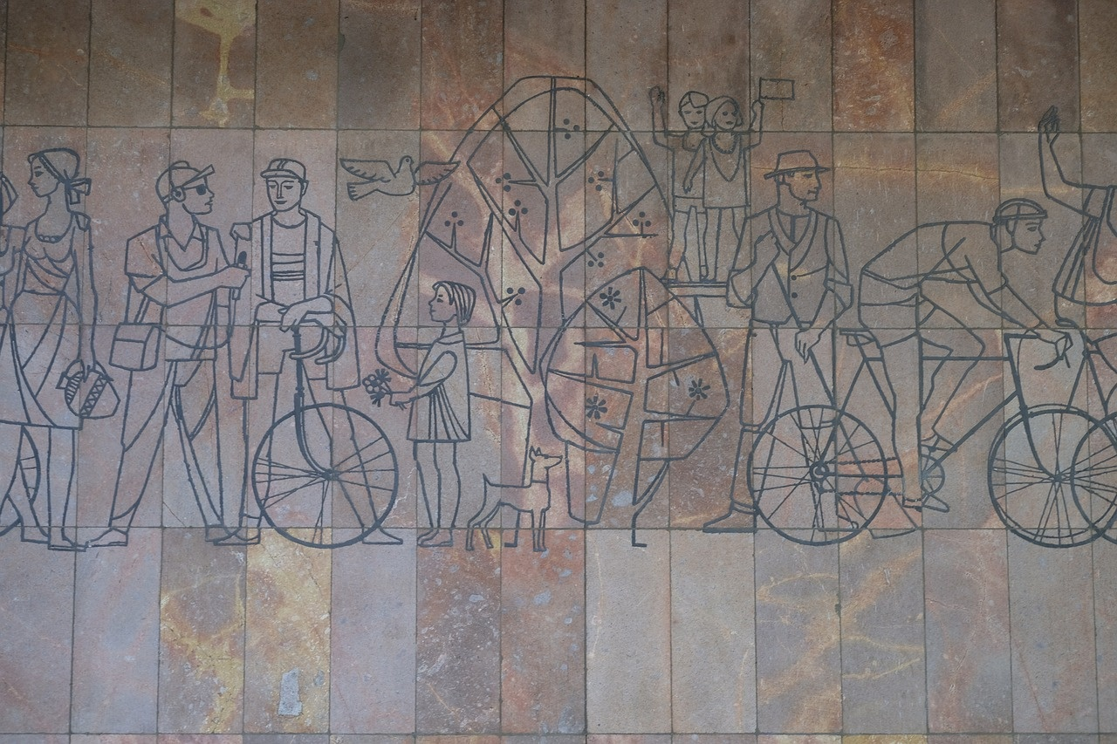
4
Propaganda: The Psychological Weapon
01
Emotional manipulation
02
Nationalist rhetoric
Exploiting fear, anger, and hope to influence beliefs
Using patriotic language to evoke loyalty and unity
03
Scapegoating
04
Mass media control
Blaming specific groups for societal issues to create division
Manipulating information flow to shape public opinion
Understanding Fascism: From Historical Roots to Contemporary Relevance

Slide 8
5
Leadership Strategies of Fascist Movements
Hitler (Nazi Germany)
Mussolini (Fascist Italy)
Charismatic public speaking
Exploited economic desperation
Created narrative of national renewal
Promised economic stability
Emphasized national pride
Systematic elimination of opposition
Understanding Fascism: From Historical Roots to Contemporary Relevance

Slide 9
6
Mechanisms of Democratic Erosion
01
02
03
04
Gradual legal manipulation
Media control
Suppression of opposition
Systematic institutional transformation
Slow changes to laws undermining democratic principles
Manipulation and censorship of information sources
Intimidation or removal of dissenting voices
Alteration of key institutions to consolidate power
Understanding Fascism: From Historical Roots to Contemporary Relevance

Slide 10

7
Psychological Factors of Political Radicalization
01
Collective trauma
02
Economic anxiety
Shared experiences of distress or harm leading to vulnerability
Financial instability fueling discontent and susceptibility to radical ideologies
03
Desire for national restoration
04
Simplified explanatory frameworks
Longing for a return to perceived past glory or power
Propensity to accept black-and-white narratives for complex issues
Understanding Fascism: From Historical Roots to Contemporary Relevance

Slide 11

8
Contemporary Relevance
01
Protecting Democratic Institutions
02
Warning Signs of Democratic Erosion
Implementing checks and balances
Media censorship and suppression of dissent
03
Recognizing Propaganda
Evaluating sources and verifying information
Understanding Fascism: From Historical Roots to Contemporary Relevance

Slide 12

9
Key Takeaways
Key Takeaways
Economic instability enables political extremism
Understanding Fascism: From Historical Roots to Contemporary Relevance

Slide 13

10
Discussion and Reflection
01
What surprised you most about this historical period?
02
How might similar conditions exist today?
The rapid rise of extremist ideologies and their impact on society.
Economic instability, social unrest, and political polarization could create fertile ground for extremist movements.
03
What can we learn to prevent future democratic erosion?
The importance of safeguarding democratic institutions, promoting critical thinking, and actively countering propaganda and manipulation.
Understanding Fascism: From Historical Roots to Contemporary Relevance

Slide 14
11
Slide 11
01
Authoritarianism
02
Nationalism
03
Militarism
Centralized power, suppression of dissent
Emphasis on national identity and unity
Glorification of military strength and aggression
04
Xenophobia
05
Anti-Democratic Values
Fear or hatred of foreigners or outsiders
Rejection of democratic principles and institutions
Understanding Fascism: From Historical Roots to Contemporary Relevance

Slide 15
12
Slide 12
01
Authoritarianism
02
Nationalism
03
Militarism
Centralized power with strict control over society
Emphasis on national unity, often with xenophobic tendencies
Promotion of military values and aggressive foreign policies
04
Anti-Democratic
05
Dictatorship
Rejection of democratic principles and institutions
Rule by a single leader with no tolerance for dissent
Understanding Fascism: From Historical Roots to Contemporary Relevance

Slide 16
13
Slide 13
01
Authoritarianism
02
Nationalism
03
Militarism
Centralized power with strict control over society
Emphasis on national identity and supremacy
Glorification of military strength and aggression
04
Anti-Democratic
05
Dictatorship
Rejection of democratic principles and institutions
Rule by a single leader with no tolerance for dissent
Understanding Fascism: From Historical Roots to Contemporary Relevance

Slide 17

14
Slide 14
01
Authoritarianism
02
Nationalism
Centralized power, suppression of dissent
Emphasis on national identity and unity
03
Militarism
04
Xenophobia
Glorification of military strength and aggression
Fear or hatred of foreigners or outsiders
Understanding Fascism: From Historical Roots to Contemporary Relevance

Slide 18
15
Slide 15
01
Authoritarianism
02
Nationalism
03
Militarism
Centralized power with a dictatorial leader
Emphasis on national unity and pride
Glorification of military strength and aggression
04
Anti-Democratic
05
Extreme Right-Wing Ideology
Rejection of democratic principles and institutions
Opposition to liberalism, socialism, and communism
Understanding Fascism: From Historical Roots to Contemporary Relevance

Slide 19
16
Slide 16
01
Authoritarianism
02
Nationalism
03
Militarism
Centralized power with strict control over society
Emphasis on national unity, often with xenophobic tendencies
Glorification of military strength and aggressive foreign policy
04
Anti-Democratic
05
Dictatorship
Rejection of democratic principles and institutions
Rule by a single leader with no tolerance for dissent
Understanding Fascism: From Historical Roots to Contemporary Relevance

Slide 20
17
Slide 17
1938
Anschluss: Germany annexes Austria
1933
Adolf Hitler appointed Chancellor of Germany
1922
Mussolini's March on Rome and appointment as Prime Minister
1919
Foundation of the Italian Fascist Party by Benito Mussolini
Understanding Fascism: From Historical Roots to Contemporary Relevance

Slide 21
18
Slide 18
1938
Anschluss: Germany annexes Austria
1933
Adolf Hitler appointed Chancellor of Germany
1922
Mussolini's March on Rome and appointment as Prime Minister
1919
Foundation of the Italian Fascist Party by Benito Mussolini
Understanding Fascism: From Historical Roots to Contemporary Relevance

Slide 22
19
Slide 19
P
E
S
T
E
L
Political
Economic
Social
Technological
Environmental
Legal
Centralized authoritarian power
Emphasis on national self-sufficiency
Suppression of dissent and minority groups
Utilization of modern propaganda techniques
Focus on territorial expansion and dominance
Manipulation of legal systems to consolidate power
Understanding Fascism: From Historical Roots to Contemporary Relevance

Slide 23
20
Slide 20
P
E
S
T
E
L
Political
Economic
Social
Technological
Environmental
Legal
Understanding Fascism: From Historical Roots to Contemporary Relevance

