Slide 1


Ancient Egypt: Legacy and Influence
Exploring the Cultural, Architectural, Medical, and Economic Contributions of Ancient Egypt to Modern Society

Slide 2
Table of Contents
Introduction to Ancient Egypt
Ancient Egyptian Architecture
Ancient Egyptian Medicine
Ancient Egyptian Art and Symbolism
Ancient Egyptian Trade and Commerce
Ancient Egyptian Contributions to Modern Socie…
ELL/ESL Support Strategies
Assessment and Evaluation
Conclusion
Reflection Questions
Next Steps
Key Takeaways
Teaching Tips
04
05
06
07
08
09
10
11
12
13
14
15
16

Slide 3
Table of Contents
Parent Engagement
Safety Considerations
Homework Assignments
Extension Activities
17
18
19
20

Slide 4
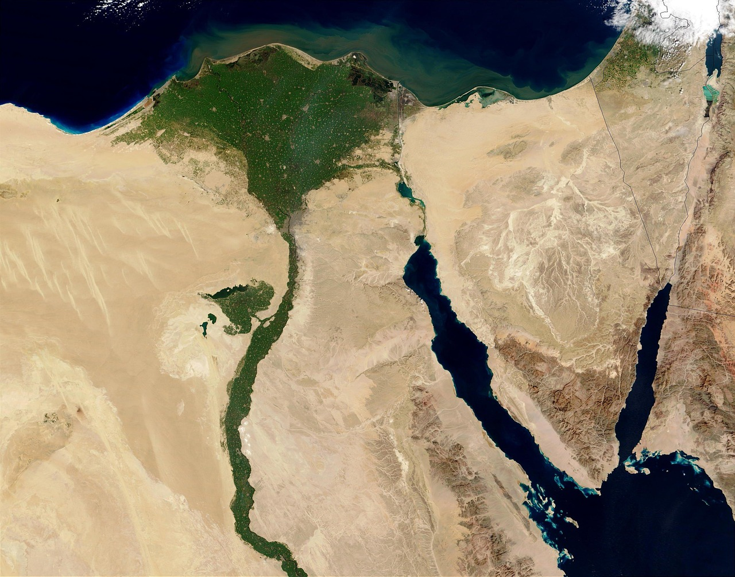
Introduction to Ancient Egypt
Overview of Ancient Egypt
Geographical Context
ELL/ESL Support Tools
Ancient Egypt was a civilization that existed from around 3100 BCE to 30 BCE.
Located in northeastern Africa, it was one of the most advanced and influential civilizations of the ancient world.
Located in northeastern Africa, Ancient Egypt thrived along the Nile River.
This geographical advantage allowed for agricultural prosperity and cultural development.
Provide a map of Ancient Egypt to help students visualize its location.
Include a timeline of its history to aid in understanding the chronological context.
4
Ancient Egypt: Legacy and Influence

Slide 5
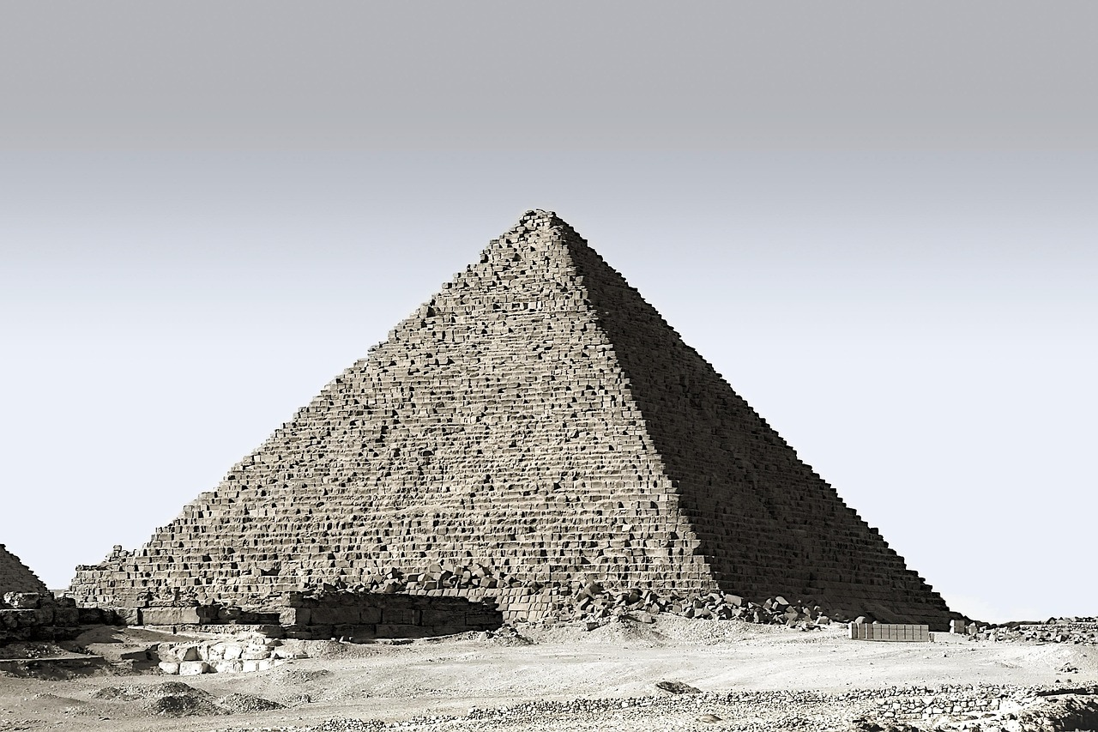
Ancient Egyptian Architecture
The Great Pyramid of Giza
Influence on Modern Architecture
Visual Learning for ELL/ESL Students
The Great Pyramid of Giza, one of the Seven Wonders of the Ancient World, is an example of Ancient Egyptian architectural innovation.
It showcases the advanced engineering and construction techniques of the ancient civilization.
The use of columns, arches, and domes in Ancient Egyptian architecture has influenced modern building techniques.
These elements have also shaped urban planning and architectural design in contemporary times.
ELL/ESL support: Provide images and diagrams of Ancient Egyptian architectural structures to help students visualize the concepts.
Visual aids can enhance understanding and engagement with the subject matter.
5
Ancient Egypt: Legacy and Influence

Slide 6
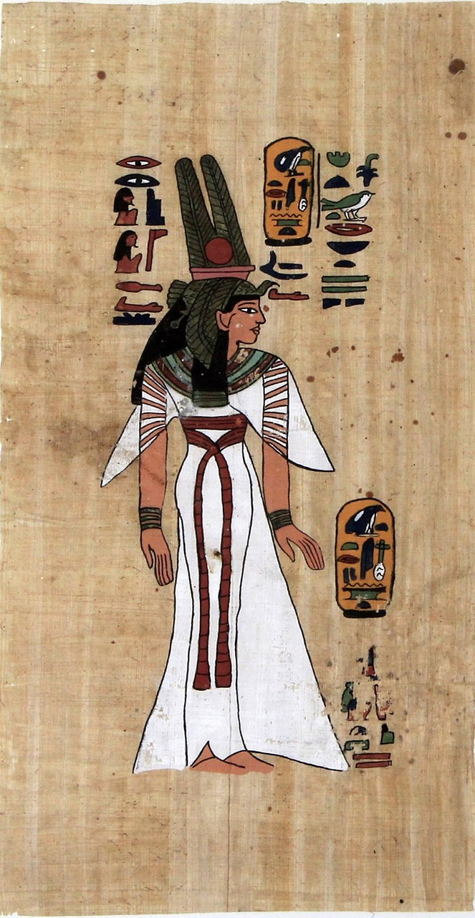
Ancient Egyptian Medicine
1
The Edwin Smith Papyrus
The Edwin Smith Papyrus, one of the oldest known medical texts, contains the oldest known surgical treatise.
It describes treatments for various injuries and illnesses.
2
Contributions to Medical Knowledge
Ancient Egyptian medicine has contributed to our understanding of human anatomy and medical practices.
These contributions have had a lasting impact on the field of medicine.
3
ELL/ESL Support for Learning
ELL/ESL support includes providing a simplified language handout.
This handout contains key vocabulary and concepts related to Ancient Egyptian medicine.
6
Ancient Egypt: Legacy and Influence

Slide 7
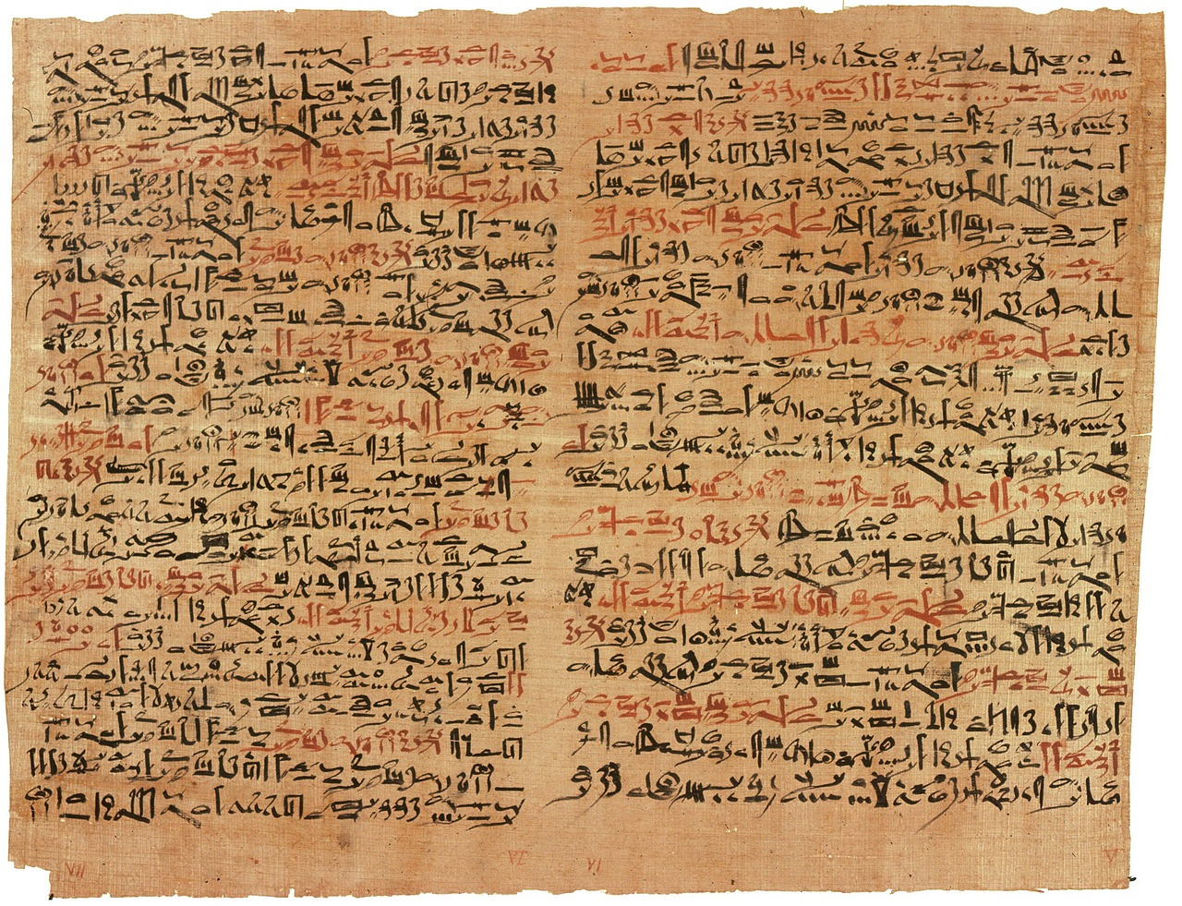
Ancient Egyptian Art and Symbolism
1
Hieroglyphics: The Writing System
Hieroglyphics, a complex system of writing, were used to convey important messages, tell stories, and record historical events.
This intricate script played a crucial role in preserving the history and culture of Ancient Egypt.
2
Influence on Modern Creativity
Ancient Egyptian art and symbolism have influenced modern art, literature, and design.
Their timeless motifs continue to inspire contemporary creators across various disciplines.
3
ELL/ESL Support Through Visuals
ELL/ESL support: Provide images and examples of Ancient Egyptian art and symbolism to help students understand the concepts.
Visual aids can bridge language barriers and enhance comprehension for diverse learners.
7
Ancient Egypt: Legacy and Influence

Slide 8

Ancient Egyptian Trade and Commerce
1
2
3
The Role of the Nile River
Legacy of Ancient Egyptian Trade
ELL/ESL Support Tools
The Nile River played a crucial role in Ancient Egyptian trade and commerce, facilitating the exchange of goods with other civilizations.
It served as a vital transportation route, enabling the movement of goods and fostering economic connections.
Ancient Egyptian trade and commerce have contributed to the development of modern international trade and globalization.
Their practices laid the groundwork for economic systems that connect diverse cultures today.
Provide a map of the Ancient Egyptian trade routes and a graphic organizer to help students understand the concepts.
These tools can enhance comprehension and make the historical content more accessible for learners.
8
Ancient Egypt: Legacy and Influence

Slide 9

Ancient Egyptian Contributions to Modern Society
Architectural Legacy
Cultural and Artistic Influence
Educational Support for ELL/ESL
Ancient Egyptian contributions to modern society include architecture, medicine, art, and trade.
These contributions have had a lasting impact on modern society, shaping the way we live, work, and interact with one another.
Ancient Egyptian contributions to modern society include architecture, medicine, art, and trade.
These contributions have had a lasting impact on modern society, shaping the way we live, work, and interact with one another.
ELL/ESL support: Provide a graphic organizer to help students identify and describe the contributions of Ancient Egypt to modern society.
These contributions have had a lasting impact on modern society, shaping the way we live, work, and interact with one another.
9
Ancient Egypt: Legacy and Influence

Slide 10

ELL/ESL Support Strategies
Visual Aids for Engagement
Simplified Language and Organizers
Sentence Stems and Vocabulary Support
Provide visual aids, such as images and diagrams, to support student understanding and engagement.
These tools help make abstract concepts more concrete and accessible for ELL/ESL learners.
Use simplified language and graphic organizers to help students access and engage with the content.
This approach ensures clarity and helps students structure their learning effectively.
Encourage students to use sentence stems and vocabulary lists to support their writing and presentation.
These resources empower students to express themselves more confidently and accurately.
10
Ancient Egypt: Legacy and Influence

Slide 11

Assessment and Evaluation
1
Formative Assessments
Formative assessments, such as quizzes and class discussions, will be used to monitor student progress and understanding.
These tools help educators identify areas where students may need additional support.
2
Summative Assessments
Summative assessments, such as a project-based assessment and a written test, will be used to evaluate student learning and understanding.
These assessments provide a comprehensive measure of students' mastery of the material.
3
ELL/ESL Support
Provide accommodations, such as extra time and support, for students who require it.
These measures ensure equitable access to learning for all students.
11
Ancient Egypt: Legacy and Influence

Slide 12

Conclusion
1
Cultural Achievements of Ancient Egypt
Ancient Egypt's cultural achievements and contributions to modern society are a testament to the ingenuity and creativity of the ancient civilization.
These achievements continue to inspire and influence various aspects of contemporary life.
2
Educational Value of Studying Ancient Egypt
The study of Ancient Egypt can help students develop a deeper understanding of history, culture, and the interconnectedness of human societies.
It provides valuable insights into the evolution of civilizations and their lasting impact.
3
Support for ELL/ESL Students
ELL/ESL support includes providing a summary of the key points and a graphic organizer to help students reflect on their learning.
These tools ensure that all students can engage meaningfully with the material.
12
Ancient Egypt: Legacy and Influence

Slide 13
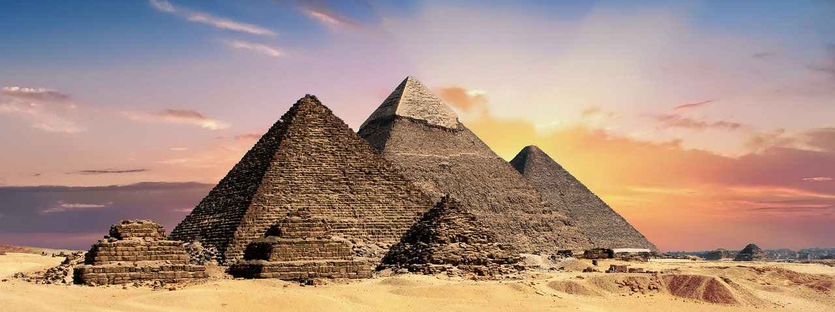
Reflection Questions
1
2
3
Cultural Achievements of Ancient Egypt
Modern Influence of Ancient Egypt
Lessons from Ancient Egypt
What were some of the most significant cultural achievements of Ancient Egypt?
How have Ancient Egyptian contributions influenced modern society?
How have Ancient Egyptian contributions influenced modern society?
What can we learn from the study of Ancient Egypt about the importance of cultural exchange and trade?
What can we learn from the study of Ancient Egypt about the importance of cultural exchange and trade?
What were some of the most significant cultural achievements of Ancient Egypt?
13
Ancient Egypt: Legacy and Influence

Slide 14
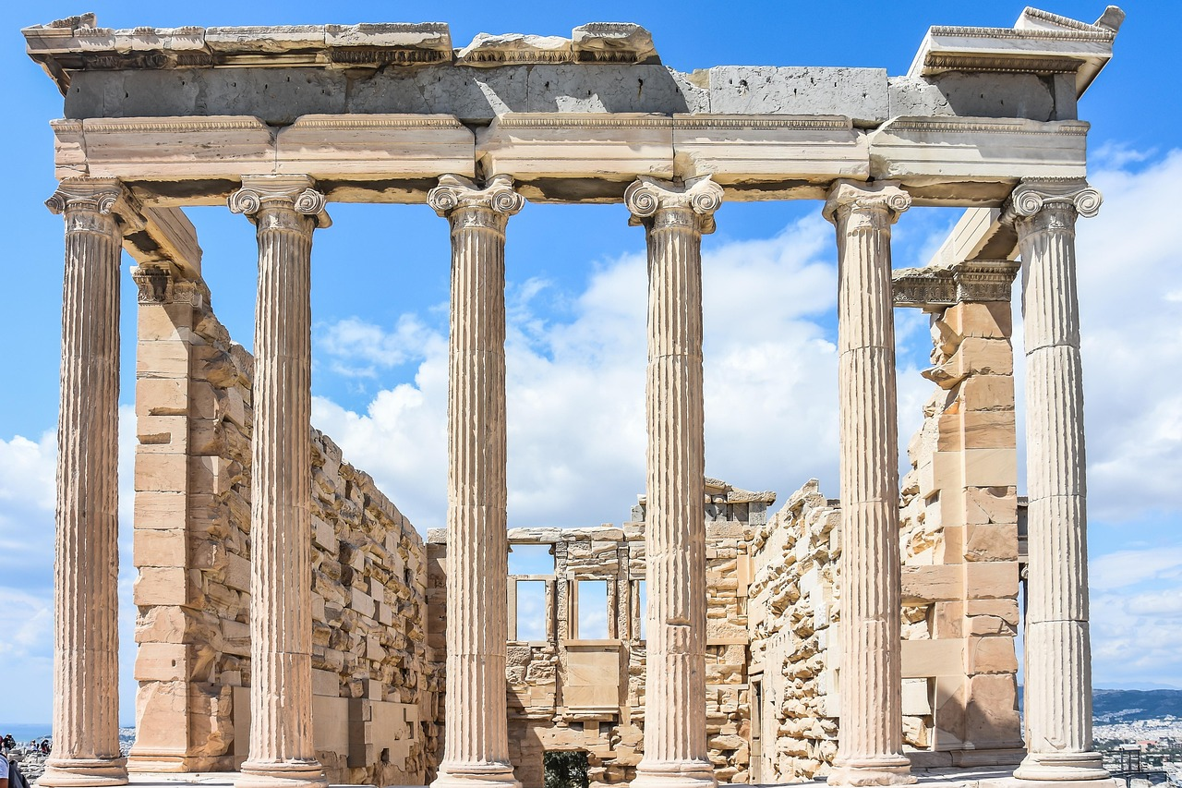
Next Steps
Exploring Ancient Greece's Cultural Achievements
Cultural Exchange and Trade Networks of the Ancient World
Modern Applications of Ancient Technologies
A lesson on Ancient Greece's cultural achievements, which will explore the contributions of Ancient Greece to modern democracy, philosophy, and the arts.
This lesson will delve into how these contributions have shaped contemporary society and continue to influence modern thought.
A lesson on the cultural exchange and trade networks of the ancient world, which will examine the ways in which different civilizations interacted and influenced one another.
Students will learn about the interconnectedness of ancient societies and the lasting impact of these exchanges on global history.
A lesson on the modern-day applications of ancient technologies and innovations, which will challenge students to think creatively about how ancient achievements can be adapted and improved upon to address contemporary challenges.
This lesson will encourage critical thinking and innovation by connecting historical advancements to present-day solutions.
14
Ancient Egypt: Legacy and Influence

Slide 15
Key Takeaways
Cultural Achievements of Ancient Egypt
Educational Value of Studying Ancient Egypt
Lasting Impact on Modern Society
Ancient Egypt's cultural achievements and contributions to modern society are a testament to the ingenuity and creativity of the ancient civilization.
These achievements continue to inspire and influence various aspects of contemporary life.
The study of Ancient Egypt can help students develop a deeper understanding of history, culture, and the interconnectedness of human societies.
This exploration fosters a greater appreciation for the complexities of human development.
Ancient Egyptian contributions have had a lasting impact on modern society, shaping the way we live, work, and interact with one another.
Their innovations in areas such as architecture, governance, and art remain relevant today.
15
Ancient Egypt: Legacy and Influence

Slide 16

Teaching Tips
Using Visual Aids
Simplified Language and Organizers
Supporting Writing and Presentation
Use visual aids, such as images and diagrams, to support student understanding and engagement.
These tools can make abstract concepts more tangible and relatable for learners.
Provide simplified language and graphic organizers to help students access and engage with the content.
This approach ensures that complex ideas are broken down into manageable parts for better comprehension.
Encourage students to use sentence stems and vocabulary lists to support their writing and presentation.
These resources can help students articulate their thoughts more clearly and confidently.
16
Ancient Egypt: Legacy and Influence

Slide 17

Parent Engagement
1
Cultural Sharing Night
Invite parents to participate in a cultural sharing night, where they can share their own cultural heritage and traditions.
This event fosters a sense of community and appreciation for diverse backgrounds.
2
Home Learning Support
Encourage parents to support their child's learning by providing additional resources and activities at home.
This involvement helps reinforce classroom learning and strengthens the parent-child bond.
3
Parental Guidance for Engagement
Provide parents with a guide on how to support their child's learning and engagement with the content.
The guide offers practical tips and strategies to enhance their child's educational experience.
17
Ancient Egypt: Legacy and Influence

Slide 18
Safety Considerations
1
2
3
Classroom Environment
Respectful Introduction
Cultural Sensitivity
Ensure that the classroom is free from any hazards or distractions that may interfere with the lesson.
This helps create a safe and focused learning space for all students.
Provide a clear and respectful introduction to the topic, avoiding any cultural or historical sensitivities that may be offensive or misleading.
This ensures the lesson is inclusive and considerate of diverse perspectives.
Be aware of any students who may have personal or cultural connections to Ancient Egypt and be sensitive to their perspectives and feelings.
This approach fosters an empathetic and supportive classroom environment.
18
Ancient Egypt: Legacy and Influence

Slide 19
Homework Assignments
1
Timeline of Ancient Egypt
Create a timeline of Ancient Egypt's major events and achievements.
This will help in understanding the chronological development of its civilization.
2
Cultural Contributions Research
Research and describe a specific cultural contribution of Ancient Egypt to modern society.
This task will highlight the enduring influence of Ancient Egyptian culture.
3
Visual Project on Achievements
Create a visual project, such as a poster or infographic, that showcases Ancient Egypt's cultural achievements and contributions to modern society.
This will provide a creative way to present the information effectively.
19
Ancient Egypt: Legacy and Influence

Slide 20

Extension Activities
1
Museum Exhibit on Ancient Egypt
Create a museum exhibit showcasing Ancient Egypt's cultural achievements and contributions to modern society.
This exhibit will highlight the enduring legacy of Ancient Egyptian innovations and their relevance today.
2
Simulation of Daily Life in Ancient Egypt
Host a simulation of daily life in Ancient Egypt, where students can take on roles and participate in activities such as farming, trading, and building.
This interactive experience will immerse participants in the routines and challenges of Ancient Egyptian society.
3
Debate on Ancient Egypt's Cultural Impact
Host a debate on the significance and impact of Ancient Egypt's cultural achievements and contributions to modern society.
This discussion will encourage critical thinking and exploration of Ancient Egypt's influence on contemporary culture.
20
Ancient Egypt: Legacy and Influence

