Slide 1

Mastering Exponents: Foundations and Applications
Understanding the Laws, Importance, and Real-World Uses of Exponents

Slide 2
Mastering Exponents: Foundations and Applications
2
Table of Contents
Introduction to Exponents
What are Exponents?
The Two Laws of Exponents
Product of Powers Law
Quotient of Powers Law
Real-Life Applications of Exponents
Why are Exponents Important?
Common Errors with Exponents
Practice Exercises
Conclusion
Summary
Assessment
Extension Activities
04
05
06
07
08
09
10
11
12
13
14
15
16

Slide 3
Mastering Exponents: Foundations and Applications
3
Table of Contents
Resources
Lesson Plan
Teaching Tips
Reflection Questions
Next Steps
17
18
19
20
21

Slide 4

Mastering Exponents: Foundations and Applications
4
Introduction to Exponents
Understanding Exponents
The Role of Exponents in Mathematics
Importance of Learning Exponents
Exponents are a shorthand way of writing repeated multiplication.
Understanding exponents is crucial for problem-solving and critical thinking.
Exponents are essential in many areas of mathematics and science.
They simplify complex calculations and expressions.
Understanding exponents enhances problem-solving skills.
It also fosters critical thinking in mathematical contexts.

Slide 5
Mastering Exponents: Foundations and Applications
5
What are Exponents?
Understanding Exponents
Illustrating Exponents
Exponents are numbers that indicate the power to which a base is raised.
For example, in the expression 2^3, 2 is the base and 3 is the exponent.
Exponents simplify repeated multiplication of the same number.
For instance, 2^3 means multiplying 2 by itself three times: 2 × 2 × 2.

Slide 6

Mastering Exponents: Foundations and Applications
6
The Two Laws of Exponents
Product of Powers Law
Quotient of Powers Law
The product of powers law states that when multiplying two powers with the same base, the exponents are added.
This rule simplifies the process of working with exponential expressions.
The quotient of powers law states that when dividing two powers with the same base, the exponents are subtracted.
This principle is essential for simplifying division involving exponents.

Slide 7
Mastering Exponents: Foundations and Applications
7
Product of Powers Law
Understanding the Law
Mathematical Representation
Practical Application
The product of powers law is used to simplify expressions such as 2^3 * 2^4.
This law helps to simplify complex expressions and make calculations easier.
The law states that 2^3 * 2^4 = 2^(3+4).
This simplifies further to 2^7.
By applying this law, calculations involving exponents become more manageable.
It is especially useful in algebra and higher-level mathematics.

Slide 8
Mastering Exponents: Foundations and Applications
8
Quotient of Powers Law
Understanding the Quotient of Powers Law
Applying the Law to Simplify Expressions
Benefits of Using the Quotient of Powers Law
The quotient of powers law is used to simplify expressions such as 2^7 / 2^3.
This law helps to simplify complex expressions and make calculations easier.
The law states that 2^7 / 2^3 = 2^(7-3) = 2^4.
This demonstrates how exponents can be subtracted when dividing powers with the same base.
Simplifying expressions using this law reduces computational complexity.
It provides a systematic approach to handling powers in mathematical calculations.

Slide 9

Mastering Exponents: Foundations and Applications
9
Real-Life Applications of Exponents
Scientific Applications
Technological Uses
Engineering Optimization
Exponents are used in science to describe the behavior of physical systems.
They help in understanding phenomena like radioactive decay and population growth.
Exponents are used in technology to represent large numbers and perform calculations.
They are essential in fields like computer science and cryptography.
Exponents are used in engineering to design and optimize systems.
They play a role in analyzing forces, energy, and material properties.

Slide 10

Mastering Exponents: Foundations and Applications
10
Why are Exponents Important?
Simplifying Complex Expressions
Critical Thinking and Problem-Solving
Applications in Math and Science
Exponents help to simplify complex expressions and make calculations easier.
This makes them a powerful tool in mathematics and everyday problem-solving.
Exponents are essential for problem-solving and critical thinking.
They allow for efficient handling of large numbers and intricate equations.
Exponents are used in many areas of mathematics and science.
They play a key role in fields like physics, engineering, and computer science.

Slide 11
Mastering Exponents: Foundations and Applications
11
Common Errors with Exponents
Understanding Product and Quotient of Powers
Simplifying Expressions Incorrectly
Misapplying Laws of Exponents
One common error is not understanding the difference between the product of powers and the quotient of powers.
This misunderstanding can lead to incorrect calculations and results.
Another common error is not simplifying expressions correctly using the laws of exponents.
This often results in overly complex or incorrect expressions.
A third common error is not applying the laws of exponents to solve problems correctly.
This can cause significant mistakes in problem-solving and final answers.

Slide 12
Mastering Exponents: Foundations and Applications
12
Practice Exercises
Simplify Using Product of Powers Law
Simplify Using Quotient of Powers Law
Solve Using Laws of Exponents
Simplify the expression 2^3 * 2^4 using the product of powers law.
Combine the exponents to find the result.
Simplify the expression 2^7 / 2^3 using the quotient of powers law.
Subtract the exponents to determine the answer.
Solve the problem 2^3 * 2^x = 2^7 using the laws of exponents.
Find the value of x that satisfies the equation.

Slide 13
Mastering Exponents: Foundations and Applications
13
Conclusion
Importance of Exponents
Exponents are a fundamental concept in mathematics and science.
They play a key role in understanding complex problems and equations.
Significance of Exponent Laws
Understanding the two laws of exponents is crucial for problem-solving.
These laws enhance critical thinking and analytical skills.

Slide 14

Mastering Exponents: Foundations and Applications
14
Summary
Understanding Exponents
Laws of Exponents
Importance of Exponents
Exponents are a shorthand way of writing repeated multiplication.
They simplify complex calculations and expressions in mathematics.
The two laws of exponents are the product of powers and the quotient of powers.
These laws are fundamental for solving mathematical problems efficiently.
Exponents are essential for problem-solving and critical thinking.
They play a crucial role in many areas of mathematics and science.

Slide 15

Mastering Exponents: Foundations and Applications
15
Assessment
Understanding Exponents
Applying Laws of Exponents
Students will be assessed on their understanding of the concept of exponents.
Students will be assessed on their understanding of the two laws of exponents.
Students will be assessed on their ability to apply the laws of exponents to simplify expressions.
Students will be assessed on their ability to solve problems using the laws of exponents.

Slide 16

Mastering Exponents: Foundations and Applications
16
Extension Activities
Exploring Real-Life Applications
Research and present on a real-life application of exponents.
This activity encourages understanding of how exponents are used in practical scenarios.
Designing Exponent-Based Games
Create a game or puzzle that involves exponents.
This task combines creativity with mathematical concepts to make learning engaging.
Solving Complex Exponent Problems
Solve a complex problem that involves exponents and present the solution.
This exercise develops problem-solving skills and deepens comprehension of exponent rules.

Slide 17
Mastering Exponents: Foundations and Applications
17
Resources
Textbook
Online Resources
Calculator
The primary textbook for the course is 'Mathematics for Grade 8'.
This book serves as the foundational resource for understanding key concepts.
Khan Academy and Mathway are recommended online platforms.
These resources provide additional practice and interactive learning tools.
The Texas Instruments TI-84 calculator is suggested for computations.
It is a reliable tool for solving complex mathematical problems.

Slide 18
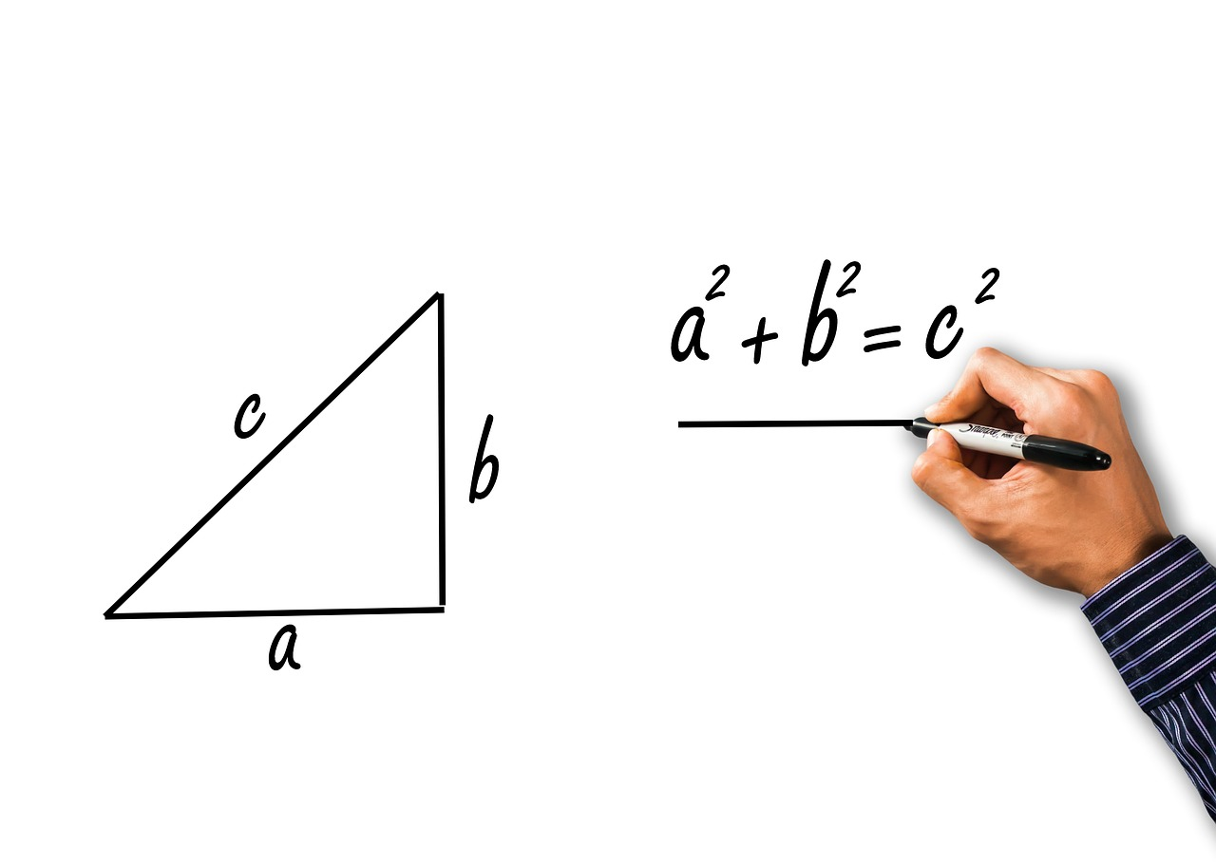
Mastering Exponents: Foundations and Applications
18
Lesson Plan
Introduction to Exponents
Laws of Exponents
Practice Activities
Introduction to exponents (10 minutes)
This section provides a foundational understanding of exponents.
Direct instruction on the two laws of exponents (15 minutes)
This part focuses on teaching the rules governing exponents.
Guided practice and independent practice (20 minutes)
Students apply their knowledge through structured and self-led exercises.

Slide 19

Mastering Exponents: Foundations and Applications
19
Teaching Tips
Real-Life Examples
Practice and Feedback
Visual Aids and Technology
Use real-life examples to illustrate the concept of exponents.
This helps students connect abstract ideas to practical applications.
Provide opportunities for practice and feedback.
This ensures students can apply their knowledge and improve over time.
Use visual aids and technology to support instruction.
These tools can make learning more engaging and accessible.

Slide 20

Mastering Exponents: Foundations and Applications
20
Reflection Questions
Clarity of Learning Objectives
Were the learning objectives clearly communicated to students?
This question focuses on the transparency and effectiveness of the objectives shared with students.
Effectiveness of Teaching Strategies
Were the teaching strategies and activities effective in engaging students and promoting understanding?
This question evaluates the impact of teaching methods on student engagement and comprehension.
Differentiation for Diverse Learning Needs
Were the differentiation strategies effective in meeting the needs of students with varying learning abilities?
This question examines how well the strategies addressed the diverse abilities of students.

Slide 21

Mastering Exponents: Foundations and Applications
21
Next Steps
Exploring Logarithms
Understanding Exponential Functions
Applications of Exponents and Logarithms
Lesson on logarithms
Understanding the properties and applications of logarithms
Lesson on exponential functions
Exploring the behavior and significance of exponential growth and decay
Lesson on applications of exponents and logarithms
Real-world scenarios and problem-solving using exponents and logarithms

