Slide 1
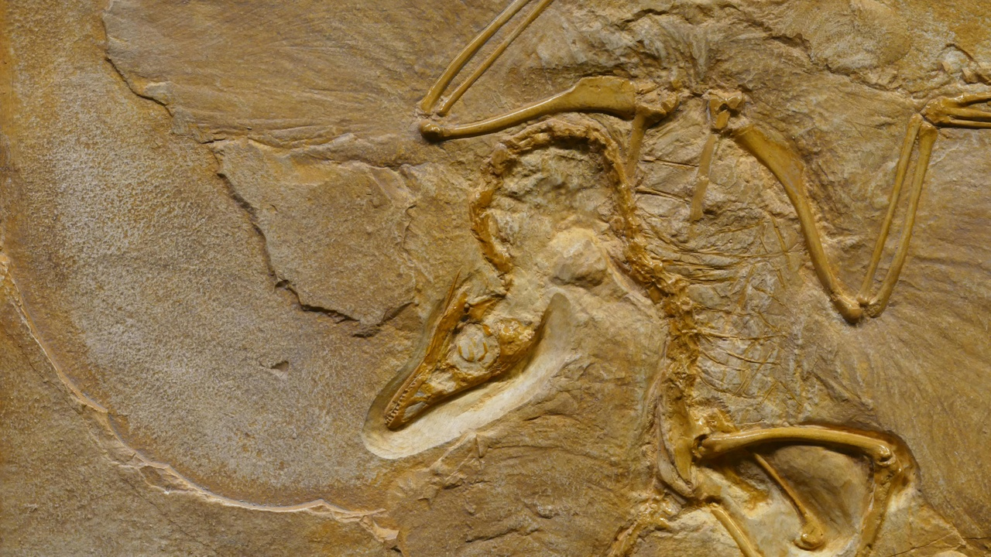
Exploring Evolution: Unveiling Nature's Genetic Journey
A Dive into Genetic Variation, Natural Selection, and Evolutionary Adaptations

Slide 2
Table of contents
01
02
03
04
05
06
07
08
Unraveling Nature's Blueprint: Genetic Variation and Evolut…
What is Natural Selection?
Core Concepts
Fascinating Evolutionary Adaptations
How Genetic Variations Occur
Interactive Exploration
Key Takeaways
Evolution: Nature's Remarkable Journey

Slide 3
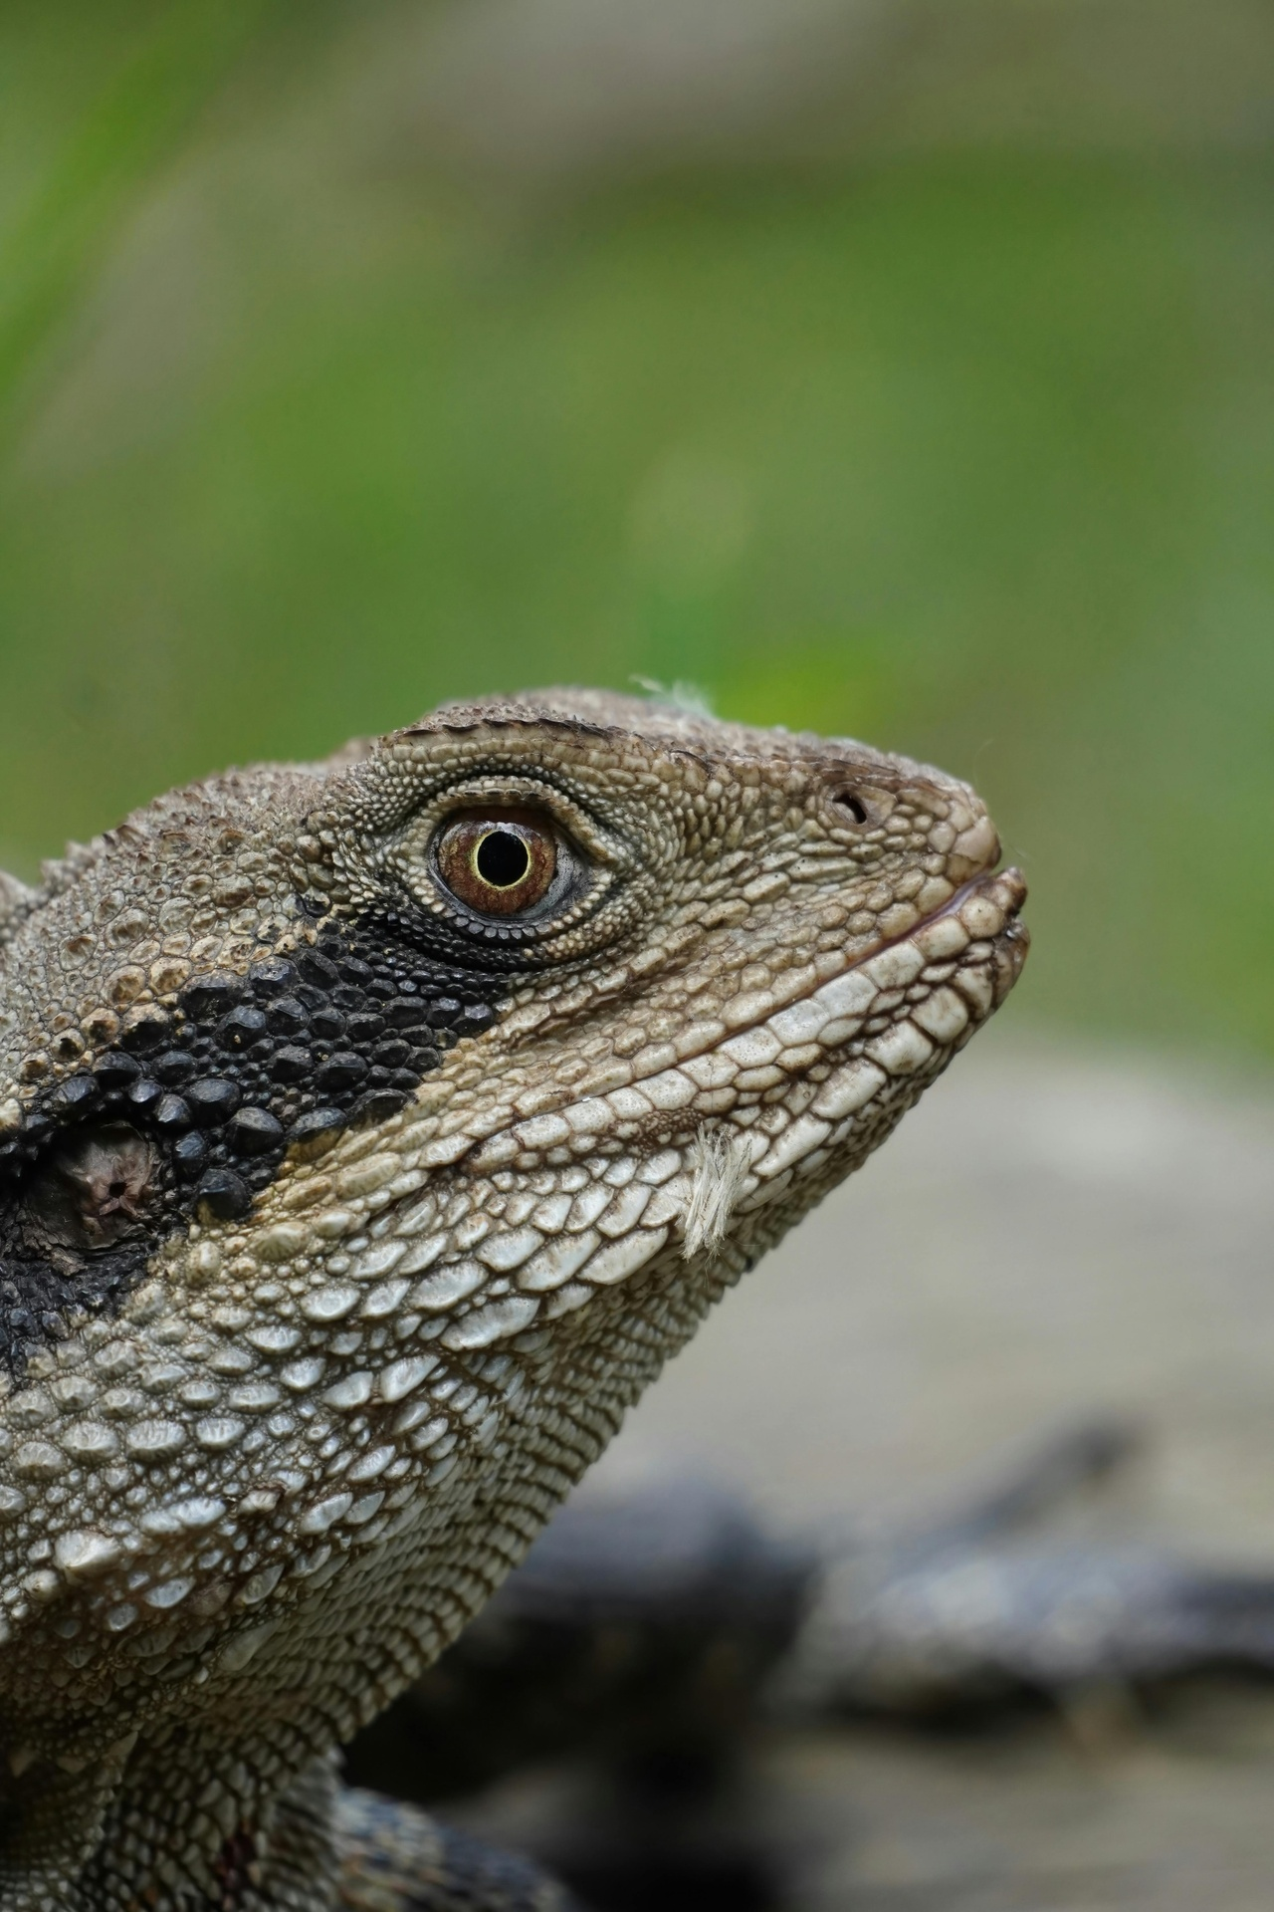
1
Unraveling Nature's Blueprint: Genetic Variation and Evolutionary Adaptation
01
Genetic Variation
02
Environmental Pressure
Diverse genetic combinations within populations
External factors influencing survival and reproduction
03
Survival Advantage
Traits that enhance organism's ability to survive and reproduce
Exploring Evolution: Unveiling Nature's Genetic Journey

Slide 4
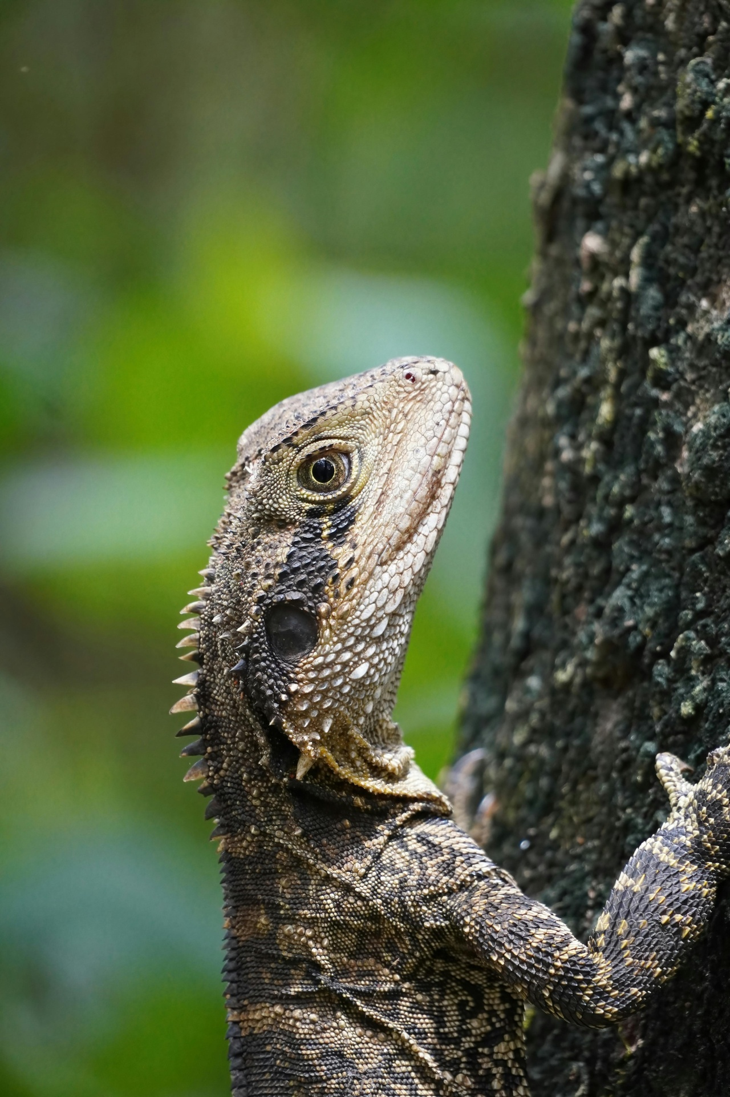
2
What is Natural Selection?
What is Natural Selection?
A biological process where organisms with favorable genetic traits survive and reproduce
Drives evolutionary adaptation in living systems
Explains how species transform over generations
Exploring Evolution: Unveiling Nature's Genetic Journey

Slide 5

3
Core Concepts
01
Genetic Variation
02
Environmental Pressure
Diverse genetic combinations within populations
External factors influencing survival and reproduction
03
Survival Advantage
Traits that enhance organism's ability to survive and reproduce
Exploring Evolution: Unveiling Nature's Genetic Journey

Slide 6
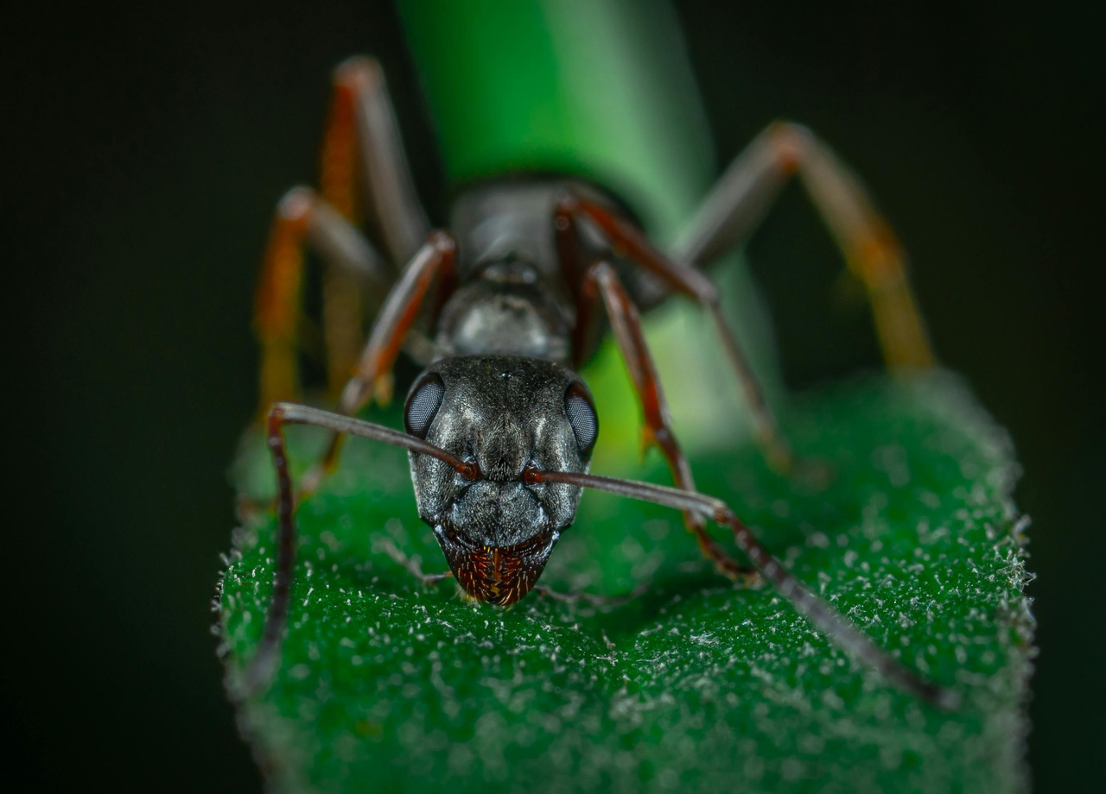
4
Fascinating Evolutionary Adaptations
01
Peppered Moths
02
Galapagos Finches
Color adaptation during Industrial Revolution
Light moths vulnerable due to pollution
Dark moths gained survival advantage
Population shifted dramatically within decades
Beak shape evolution based on food sources
Different islands, different food sources
Beak shapes adapted to specific nutritional needs
Demonstrates precise environmental adaptation
Exploring Evolution: Unveiling Nature's Genetic Journey

Slide 7
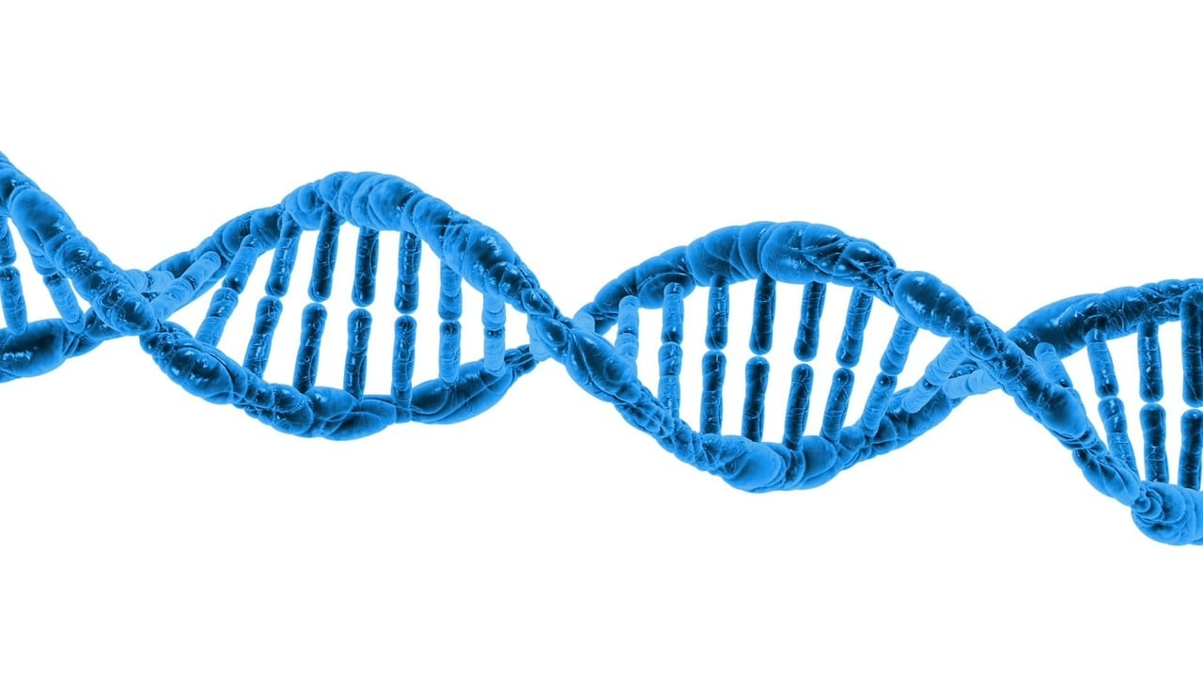
5
How Genetic Variations Occur
How Genetic Variations Occur
Random Mutations
Sexual Reproduction
Chromosomal Recombination
Environmental Interactions
Exploring Evolution: Unveiling Nature's Genetic Journey

Slide 8

6
Interactive Exploration
01
Genetic Trait Simulation
02
Adaptation Challenge
Model inheritance patterns
Design survival strategies
03
Environmental Pressure Game
Experience selection mechanisms
Exploring Evolution: Unveiling Nature's Genetic Journey

Slide 9

7
Key Takeaways
Key Takeaways
Genetic variation is the foundation of evolution
Environment shapes genetic inheritance
Adaptation is a continuous, incremental process
Exploring Evolution: Unveiling Nature's Genetic Journey

Slide 10

8
Evolution: Nature's Remarkable Journey
Evolution: Nature's Remarkable Journey
Genetic Variation: Diverse genetic combinations within populations
Environmental Pressure: External factors influencing survival and reproduction
Survival Advantage: Traits that enhance organism's ability to survive and reproduce
Exploring Evolution: Unveiling Nature's Genetic Journey

