Slide 1


Mastering Fractions and Decimals: Comparing, Ordering, and Real-World Applications
A Comprehensive Guide to Understanding, Teaching, and Applying Fractions and Decimals in Everyday Life and Education

Slide 2
Table of Contents
Introduction to Comparing and Ordering Fractio…
Importance of Fractions and Decimals
Real-World Scenarios
Comparing Fractions
Comparing Decimals
Ordering Fractions and Decimals
Differentiated Activities
Technology Integration
Assessment Strategies
Conclusion
Extension Activities
Parent Engagement
Safety Considerations
04
05
06
07
08
09
10
11
12
13
14
15
16

Slide 3
Table of Contents
Reflection Questions
Next Steps
Key Takeaways
Teaching Tips
17
18
19
20

Slide 4
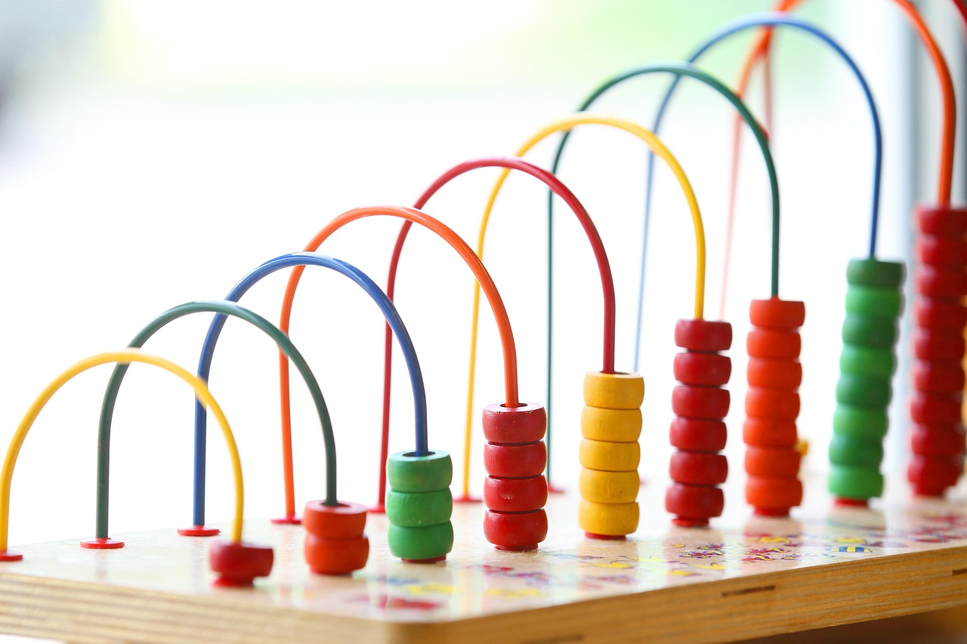
Introduction to Comparing and Ordering Fractions and Decimals
Importance of Comparing and Ordering
Real-World Applications
Catering to Diverse Needs
Comparing and ordering fractions and decimals is a crucial skill in mathematics.
It helps in understanding numerical relationships and solving real-world problems.
Real-world scenarios make the concepts more relatable and applicable.
These examples help students see the relevance of math in everyday life.
Differentiated activities cater to the diverse needs of mixed-ability groups.
This ensures that all students can engage and learn effectively.
4
Mastering Fractions and Decimals: Comparing, Ordering, and Real-World Applications

Slide 5
Importance of Fractions and Decimals
Daily Life Applications
Real-World Examples
Career Relevance
Critical Thinking Skills
Fractions and decimals are used in everyday life, such as cooking and finance.
Understanding these concepts is essential for problem-solving and critical thinking.
Real-world applications include measuring ingredients, calculating costs, and determining distances.
These tasks rely heavily on the accurate use of fractions and decimals.
Fractions and decimals are used in various careers, such as science, engineering, and economics.
Professionals in these fields depend on these concepts for precision and accuracy.
Understanding fractions and decimals enhances problem-solving abilities.
It also fosters critical thinking, which is valuable in both personal and professional contexts.
5
Mastering Fractions and Decimals: Comparing, Ordering, and Real-World Applications

Slide 6
Real-World Scenarios
Measuring Ingredients
Calculating Sale Costs
Determining Distances
Measuring ingredients for a recipe: 1/4 cup vs. 0.25 cups.
This highlights the use of fractions and decimals in everyday cooking.
Calculating the cost of items on sale: $15.99 vs. $16.00.
This demonstrates the importance of precision in financial transactions.
Determining the distance between two locations: 3/4 mile vs. 0.75 miles.
This showcases the practical application of fractions and decimals in navigation.
6
Mastering Fractions and Decimals: Comparing, Ordering, and Real-World Applications

Slide 7
Comparing Fractions
01
Understanding Equivalent Fractions
Equivalent fractions represent the same value despite having different numerators and denominators.
Examples include 1/2, 2/4, and 3/6, which are all equal in value.
02
Comparing Fractions with Like Denominators
Fractions with the same denominators can be compared by looking at their numerators.
For instance, 1/4 is smaller than 3/4 because 1 is less than 3.
03
Comparing Fractions with Unlike Denominators
Fractions with different denominators require finding a common denominator or using other methods to compare.
For example, 1/4 is larger than 1/6 when converted to a common denominator.
04
Using Visual Aids for Fraction Comparison
Visual tools like number lines or diagrams help in understanding and comparing fractions.
These aids provide a clear representation of fraction sizes and relationships.
7
Mastering Fractions and Decimals: Comparing, Ordering, and Real-World Applications

Slide 8
Comparing Decimals
1
Understanding Equivalent Decimals
2
Comparing Decimals with Same Decimal Places
Equivalent decimals represent the same value despite having different appearances.
For example, 0.5 is equal to 0.50 and 0.500.
Decimals with the same number of decimal places can be compared directly.
For instance, 0.5 is greater than 0.3.
3
Comparing Decimals with Different Decimal Places
4
Using Visual Aids for Decimal Comparison
Decimals with varying decimal places require careful comparison.
For example, 0.5 is greater than 0.34.
Visual tools like number lines or diagrams can simplify decimal comparisons.
These aids help in understanding the relative sizes of decimals.
8
Mastering Fractions and Decimals: Comparing, Ordering, and Real-World Applications

Slide 9

Ordering Fractions and Decimals
Ordering Fractions
Ordering Decimals
Using Visual Aids
Ordering fractions from least to greatest: 1/4, 1/2, 3/4.
This involves comparing the values of fractions to determine their sequence.
Ordering decimals from least to greatest: 0.1, 0.5, 0.9.
Decimals are arranged by their numerical value from smallest to largest.
Using visual aids, such as number lines or diagrams, to order fractions and decimals.
These tools help in understanding and comparing numerical values effectively.
9
Mastering Fractions and Decimals: Comparing, Ordering, and Real-World Applications

Slide 10
Differentiated Activities
01
02
Support for Struggling Students
Challenges for Advanced Students
Visual aids, such as number lines or diagrams, are provided to help compare and order fractions and decimals.
These tools aim to simplify complex concepts and enhance understanding.
Advanced students engage with challenging problems, including multi-step calculations and word problems.
These activities are designed to push their critical thinking and problem-solving skills.
03
04
Modified Activities for Learning Difficulties
Resources for English Language Learners
Students with learning difficulties benefit from modified activities, such as using assistive technology or receiving extra support.
These adjustments ensure accessibility and cater to individual needs.
English language learners are supported with bilingual resources or visual aids to aid comprehension.
These tools help bridge language barriers and facilitate learning.
10
Mastering Fractions and Decimals: Comparing, Ordering, and Real-World Applications

Slide 11
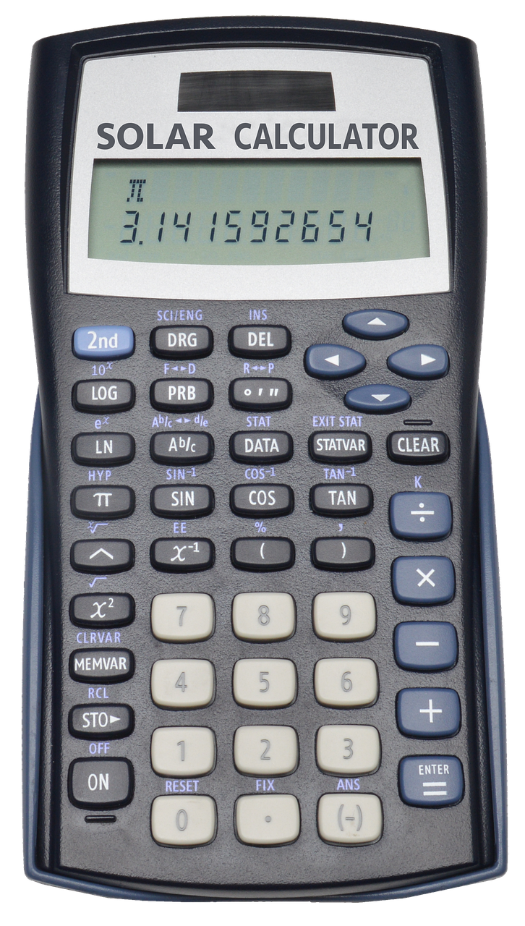
Technology Integration
1
Interactive Online Resources
Online resources, such as interactive worksheets or games, to practice comparing and ordering fractions and decimals.
These tools provide engaging ways for students to enhance their understanding of mathematical concepts.
2
Calculators and Software
Calculators or computer software to perform calculations and visualize concepts.
These resources simplify complex computations and help in better conceptual visualization.
3
Digital Graphing Tools
Digital tools, such as graphing calculators or online graphing tools, to explore and analyze data.
These tools enable students to interact with data in a dynamic and visual manner.
11
Mastering Fractions and Decimals: Comparing, Ordering, and Real-World Applications

Slide 12
Assessment Strategies
Class Discussions and Group Work
Projects and Presentations
Self and Peer Assessment
Self and Peer Assessment
Quizzes or tests are effective tools to assess understanding of concepts.
They provide a structured way to evaluate knowledge retention and comprehension.
Class discussions or group work help assess problem-solving and critical thinking skills.
These activities encourage collaboration and the exchange of diverse perspectives.
Projects or presentations assess the application of concepts to real-world scenarios.
They allow learners to demonstrate creativity and practical understanding.
Self-assessment or peer-assessment promotes reflection and self-directed learning.
These methods encourage learners to evaluate their own progress and that of their peers.
12
Mastering Fractions and Decimals: Comparing, Ordering, and Real-World Applications

Slide 13

Conclusion
Importance of Fraction and Decimal Skills
Real-World Applications
Catering to Diverse Learning Needs
Comparing and ordering fractions and decimals is a crucial skill in mathematics.
These skills form the foundation for understanding more complex mathematical concepts.
Real-world scenarios make the concepts more relatable and applicable.
They help students see the relevance of mathematics in everyday life.
Differentiated activities cater to the diverse needs of mixed-ability groups.
This approach ensures that every student can engage and succeed in learning.
13
Mastering Fractions and Decimals: Comparing, Ordering, and Real-World Applications

Slide 14
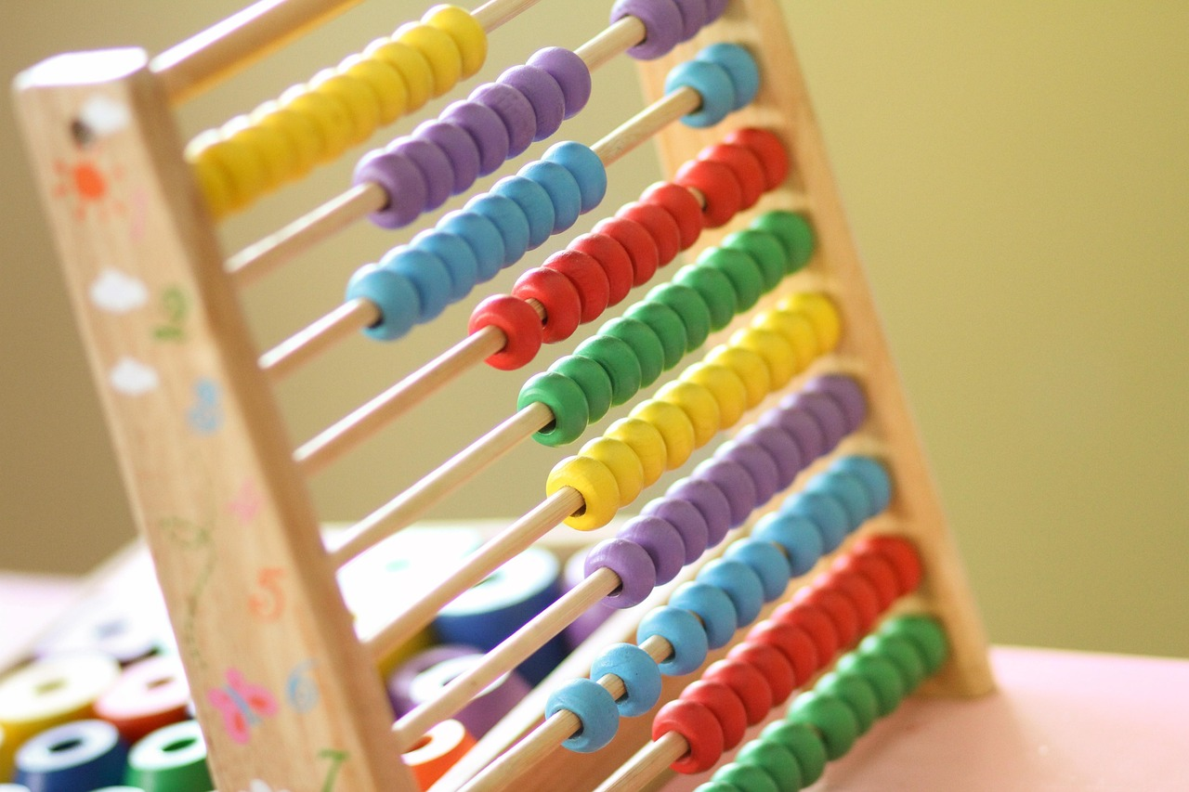
Extension Activities
1
Creating a Recipe Book
Use fractions and decimals to measure ingredients accurately.
Compile recipes to form a comprehensive book showcasing mathematical applications in cooking.
2
Designing a Budget Plan
Utilize fractions and decimals to calculate costs effectively.
Create a detailed budget plan to manage expenses and savings.
3
Developing a Game or Simulation
Practice comparing and ordering fractions and decimals through interactive activities.
Design engaging games or simulations to enhance mathematical understanding.
14
Mastering Fractions and Decimals: Comparing, Ordering, and Real-World Applications

Slide 15

Parent Engagement
Supporting Learning at Home
Engaging in Lesson Discussions
Participating in Classroom Activities
Provide parents with resources and guidance on how to support their child's learning at home.
This ensures that parents are equipped to reinforce classroom concepts effectively.
Encourage parents to ask their child questions about the concepts learned in the lesson.
This fosters meaningful conversations and deeper understanding of the material.
Invite parents to participate in class activities or volunteer in the classroom.
This creates a collaborative environment and strengthens the school community.
15
Mastering Fractions and Decimals: Comparing, Ordering, and Real-World Applications

Slide 16

Safety Considerations
1
2
3
Equipment Maintenance
Group Work Guidelines
Accommodations for Special Needs
Ensure all equipment is in good working condition.
Students should be aware of proper handling and usage procedures.
Establish clear guidelines for students to follow when working in pairs or groups.
This ensures a safe and organized environment for collaborative tasks.
Be aware of any students with special needs or disabilities.
Provide necessary accommodations to ensure their safety and participation.
16
Mastering Fractions and Decimals: Comparing, Ordering, and Real-World Applications

Slide 17

Reflection Questions
Engagement and Understanding
Supporting Struggling Students
Catering to Mixed-Ability Groups
How well did the real-world scenarios engage students and promote their understanding of fractions and decimals?
What adjustments can be made to the lesson to better support students who struggled with comparing and ordering fractions and decimals?
What adjustments can be made to the lesson to better support students who struggled with comparing and ordering fractions and decimals?
How can the lesson be modified to cater to the diverse needs of mixed-ability groups?
How can the lesson be modified to cater to the diverse needs of mixed-ability groups?
How well did the real-world scenarios engage students and promote their understanding of fractions and decimals?
17
Mastering Fractions and Decimals: Comparing, Ordering, and Real-World Applications

Slide 18
Next Steps
Assessing Student Understanding
Introducing Advanced Concepts
Applying Math to Real-World Scenarios
Review and assess student understanding of fractions and decimals.
This step ensures foundational knowledge is solid before introducing new concepts.
Introduce new skills and concepts, such as adding and subtracting fractions and decimals.
These advanced topics build upon prior knowledge to deepen mathematical understanding.
Provide opportunities for students to apply mathematical concepts to real-world scenarios.
This approach helps students see the practical relevance of their learning.
18
Mastering Fractions and Decimals: Comparing, Ordering, and Real-World Applications

Slide 19
Key Takeaways
Fractions and Decimals
Comparing and Ordering
Real-World Applications
Fractions and decimals are different ways of representing the same value.
Understanding their equivalence is fundamental in mathematics.
Comparing and ordering fractions and decimals is a crucial skill in mathematics.
This skill helps in solving problems and making informed decisions.
Real-world scenarios make the concepts more relatable and applicable.
These applications demonstrate the importance of fractions and decimals in daily life.
19
Mastering Fractions and Decimals: Comparing, Ordering, and Real-World Applications

Slide 20
Teaching Tips
1
2
3
Differentiated Activities for Mixed-Ability Groups
Visual Aids for Enhanced Understanding
Visual Aids for Enhanced Understanding
Use real-world examples to illustrate the concepts of fractions and decimals.
This approach helps students relate mathematical ideas to everyday situations.
Provide differentiated activities to cater to the diverse needs of mixed-ability groups.
This ensures that all students can engage with the material at their own level.
Use visual aids, such as number lines or diagrams, to support understanding.
These tools make abstract concepts more tangible and accessible for learners.
20
Mastering Fractions and Decimals: Comparing, Ordering, and Real-World Applications

