Slide 1
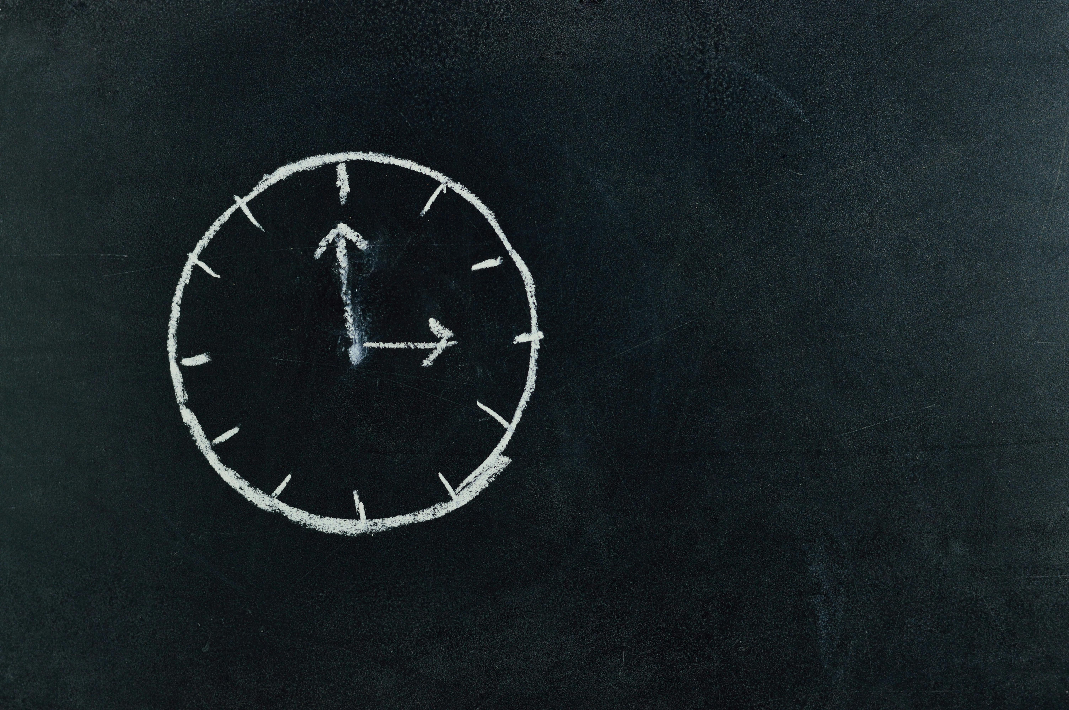

Understanding and Managing Time
Exploring Time Concepts, Vocabulary, Measurement, and Practical Applications

Slide 2
Understanding and Managing Time
2
Table of Contents
Introduction to Time Concepts
Understanding Time Vocabulary
Using Simple Time-Measuring Devices
Comparing Lengths of Time
Time Sequence
Time Line
Time Problem-Solving
Mixed Ability Differentiation
English as a Second Language Support
Neurodiverse Learner Support
Conclusion
Assessment
Extension Activities
04
05
06
07
08
09
10
11
12
13
14
15
16

Slide 3
Understanding and Managing Time
3
Table of Contents
Parent Engagement
Reflection Questions
Next Steps
17
18
19

Slide 4
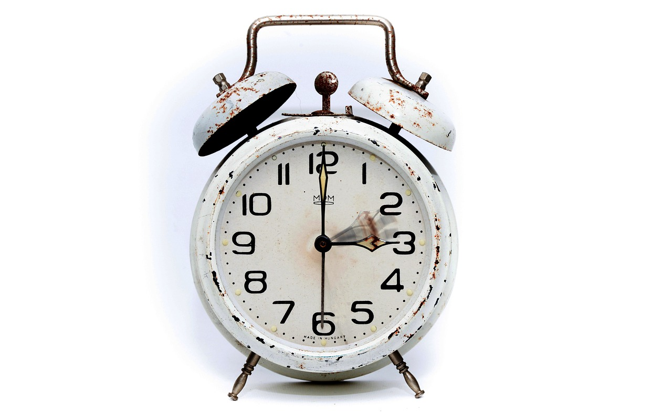
Understanding and Managing Time
4
Introduction to Time Concepts
Understanding Time
Everyday Time Examples
Practical Time Awareness
Introduce the concept of time and its importance in daily life.
Explain that time can be measured in minutes and hours.
Use everyday language to describe lengths of time, such as 'I have 30 minutes to finish my breakfast'.
Highlight how time is a part of daily routines.
Discuss how understanding time helps in planning and organizing tasks.
Emphasize the role of time in achieving goals efficiently.

Slide 5
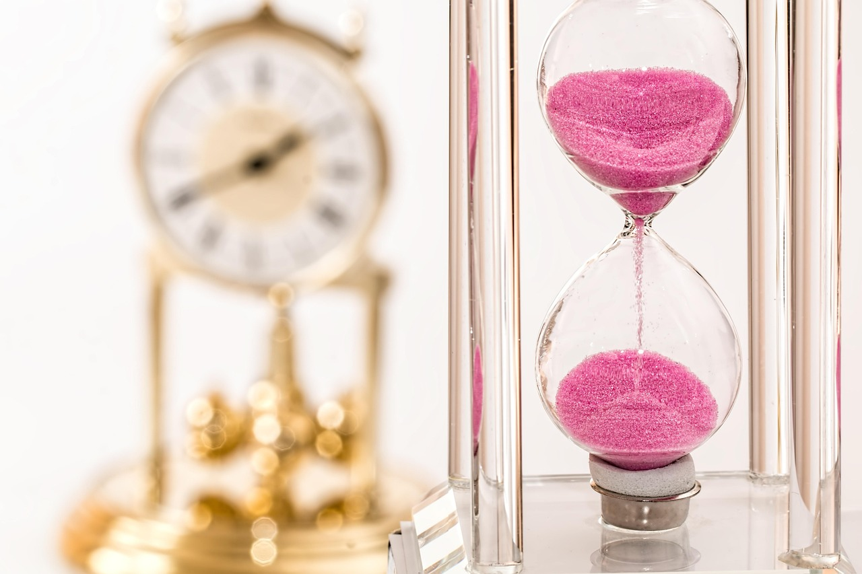
Understanding and Managing Time
5
Understanding Time Vocabulary
Key Time Vocabulary
Visual Aids for Understanding
Define key time-related vocabulary, such as 'minute', 'hour', and 'duration'.
Provide clear definitions to help students grasp these concepts.
Use visual aids, such as pictures of clocks and schedules, to support students' understanding.
These tools make abstract concepts more tangible and relatable.
Real-Life Examples
Encouraging Practical Usage
Provide examples of how time vocabulary is used in everyday life, such as 'I have a 30-minute recess'.
This helps students connect vocabulary to their daily experiences.
Encourage students to use time vocabulary in their own sentences.
This practice reinforces learning and builds confidence in using new terms.

Slide 6
Understanding and Managing Time
6
Using Simple Time-Measuring Devices
Introduction to Time-Measuring Devices
Demonstrating Time Measurement
Hands-On Practice for Students
Introduce simple time-measuring devices, such as clocks and timers.
Explain their importance in everyday life and how they help in managing time.
Demonstrate how to use these devices to measure time.
Provide examples, such as setting a timer for specific durations.
Have students practice using the devices to measure time.
Encourage activities like setting a timer for 10 minutes to understand their functionality.

Slide 7
Understanding and Managing Time
7
Comparing Lengths of Time
Understanding Time Comparisons
Practical Applications
Engaging Examples
Introduce the concept of comparing lengths of time, such as 'It takes 30 minutes to walk to school, but only 10 minutes to ride a bike.'
Use real-life scenarios to illustrate the concept, such as scheduling a daily routine.
Have students practice comparing lengths of time, such as 'If it takes 30 minutes to walk to school, and you leave your house at 8:00 am, what time will you arrive at school?'
Encourage students to think critically about how time management affects their daily activities.
Use relatable examples to make the concept of time comparisons more engaging for students.
Discuss how different modes of transportation or activities can impact the time taken to complete tasks.

Slide 8

Understanding and Managing Time
8
Time Sequence
Understanding Time Sequence
Practicing Sequencing Skills
Enhancing Comprehension
Introduce the concept of time sequence, such as 'first', 'next', and 'then'.
Use visual aids, such as pictures or diagrams, to support students' understanding.
Have students practice sequencing events, such as 'What do you do first in the morning?'.
Encourage them to think about the order of actions in their daily routines.
Use engaging activities to reinforce the concept of sequencing.
Incorporate storytelling or role-playing to make learning interactive.

Slide 9
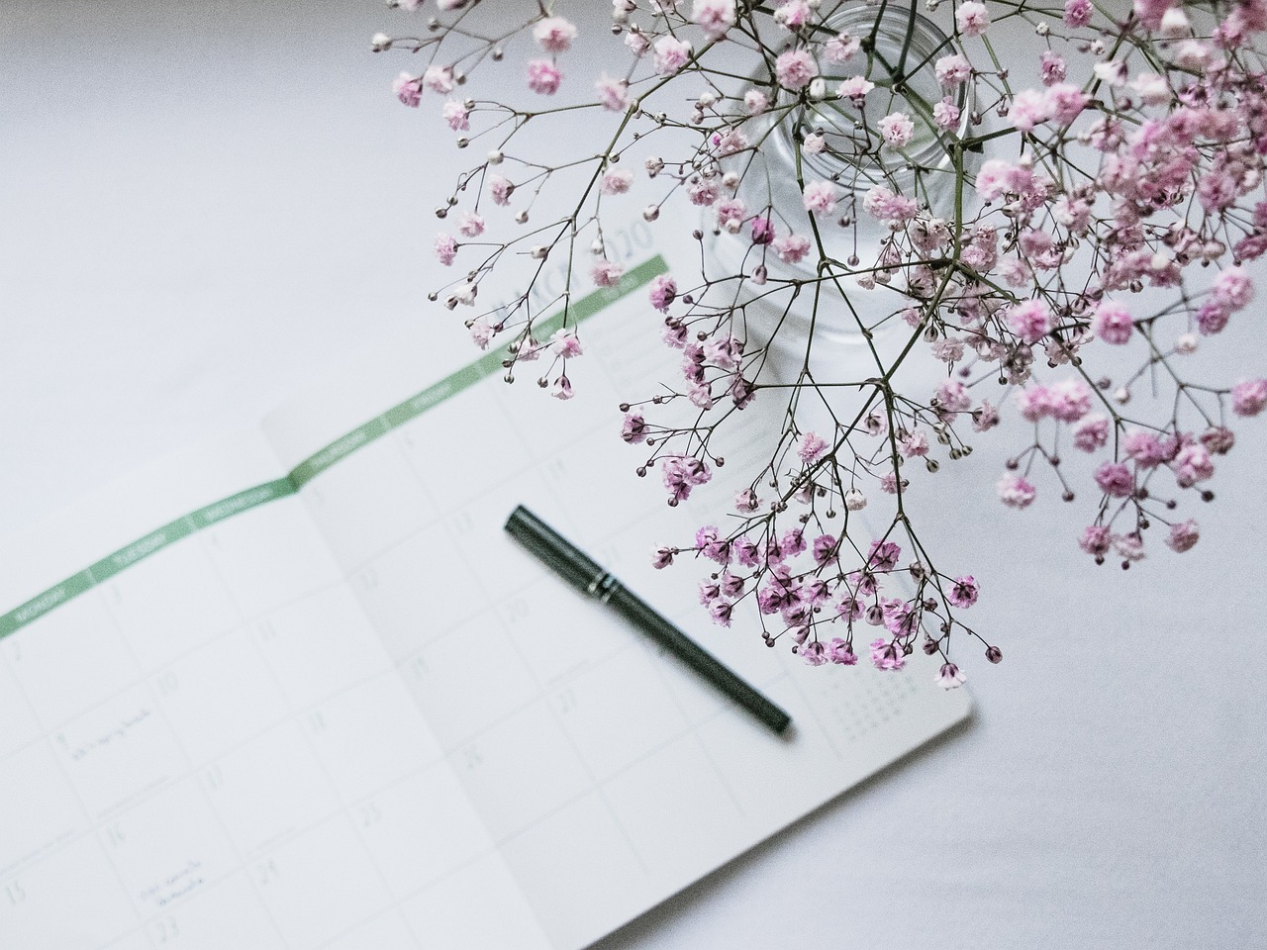
Understanding and Managing Time
9
Time Line
Understanding Time Lines
Introduce the concept of a time line, such as a schedule or a calendar.
Use visual aids, such as pictures or diagrams, to support students' understanding.
Creating Personal Time Lines
Have students practice creating their own time line, such as a daily schedule.
This activity helps students apply the concept to their own lives.
Visual Learning Tools
Use diagrams and pictures to make the concept of time lines more engaging.
These tools enhance comprehension and retention of the material.

Slide 10

Understanding and Managing Time
10
Time Problem-Solving
Understanding Time Problem-Solving
Practical Applications of Time Problems
Engaging Students in Time Problem-Solving
Introduce the concept of time problem-solving, such as 'If it takes 30 minutes to walk to school, and you leave your house at 8:00 am, what time will you arrive at school?'
Use real-life scenarios to illustrate the concept, such as scheduling a daily routine.
Have students practice solving time problems, such as 'If it takes 45 minutes to ride a bike to the park, and you leave your house at 9:00 am, what time will you arrive at the park?'
Encourage students to apply these skills to their own daily schedules for better time management.
Use interactive activities to make learning time problem-solving fun and engaging.
Provide opportunities for students to collaborate and discuss their approaches to solving time problems.

Slide 11

Understanding and Managing Time
11
Mixed Ability Differentiation
Support for Struggling Students
Challenges for Advanced Learners
Provide additional support for students who may be struggling with the concept of time, such as visual aids or one-on-one instruction.
These methods aim to simplify the learning process and address individual challenges effectively.
Offer challenges for students who are advanced, such as creating their own time problems or schedules.
This approach encourages creativity and deeper engagement with the subject matter.
Technology Integration in Learning
Collaborative Learning Opportunities
Use technology, such as digital clocks or timers, to support students' learning.
Technology provides interactive and practical tools to enhance understanding of time concepts.
Encourage students to work in pairs or small groups to promote social interaction and shared learning.
This strategy fosters teamwork and helps students learn from each other's perspectives.

Slide 12

Understanding and Managing Time
12
English as a Second Language Support
Visual Aids for Time Vocabulary
Simplified Language for Time Concepts
Encouraging Practical Usage
Provide visual aids, such as pictures or diagrams, to support students' understanding of time vocabulary.
These aids help students connect abstract concepts to concrete examples.
Use simple language and sentence structures to explain time concepts.
This approach ensures clarity and accessibility for learners.
Encourage students to use time vocabulary in their own sentences, such as 'I have a 30-minute recess'.
This practice reinforces learning and builds confidence in using new terms.

Slide 13
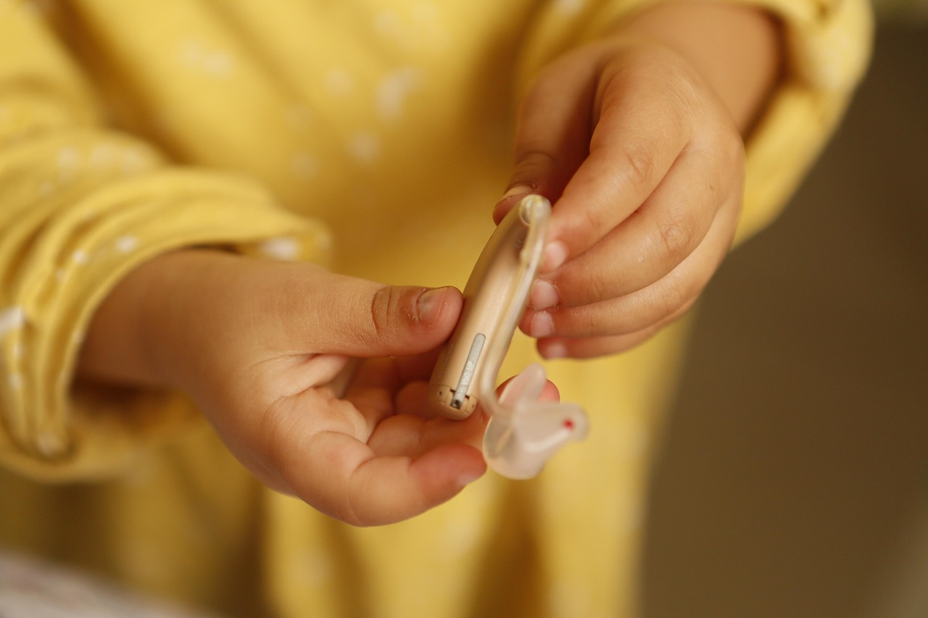
Understanding and Managing Time
13
Neurodiverse Learner Support
Hands-On Learning Tools
Visual Aids for Understanding
Individualized Support Strategies
Provide hands-on activities, such as using clocks or timers, to support students' learning.
These tools help students engage actively with the concept of time.
Use visual aids, such as pictures or diagrams, to support students' understanding of time concepts.
These aids make abstract ideas more concrete and accessible.
Offer additional support, such as one-on-one instruction or visual aids, for students who may be struggling with the concept of time.
This ensures that all learners can grasp the material effectively.

Slide 14
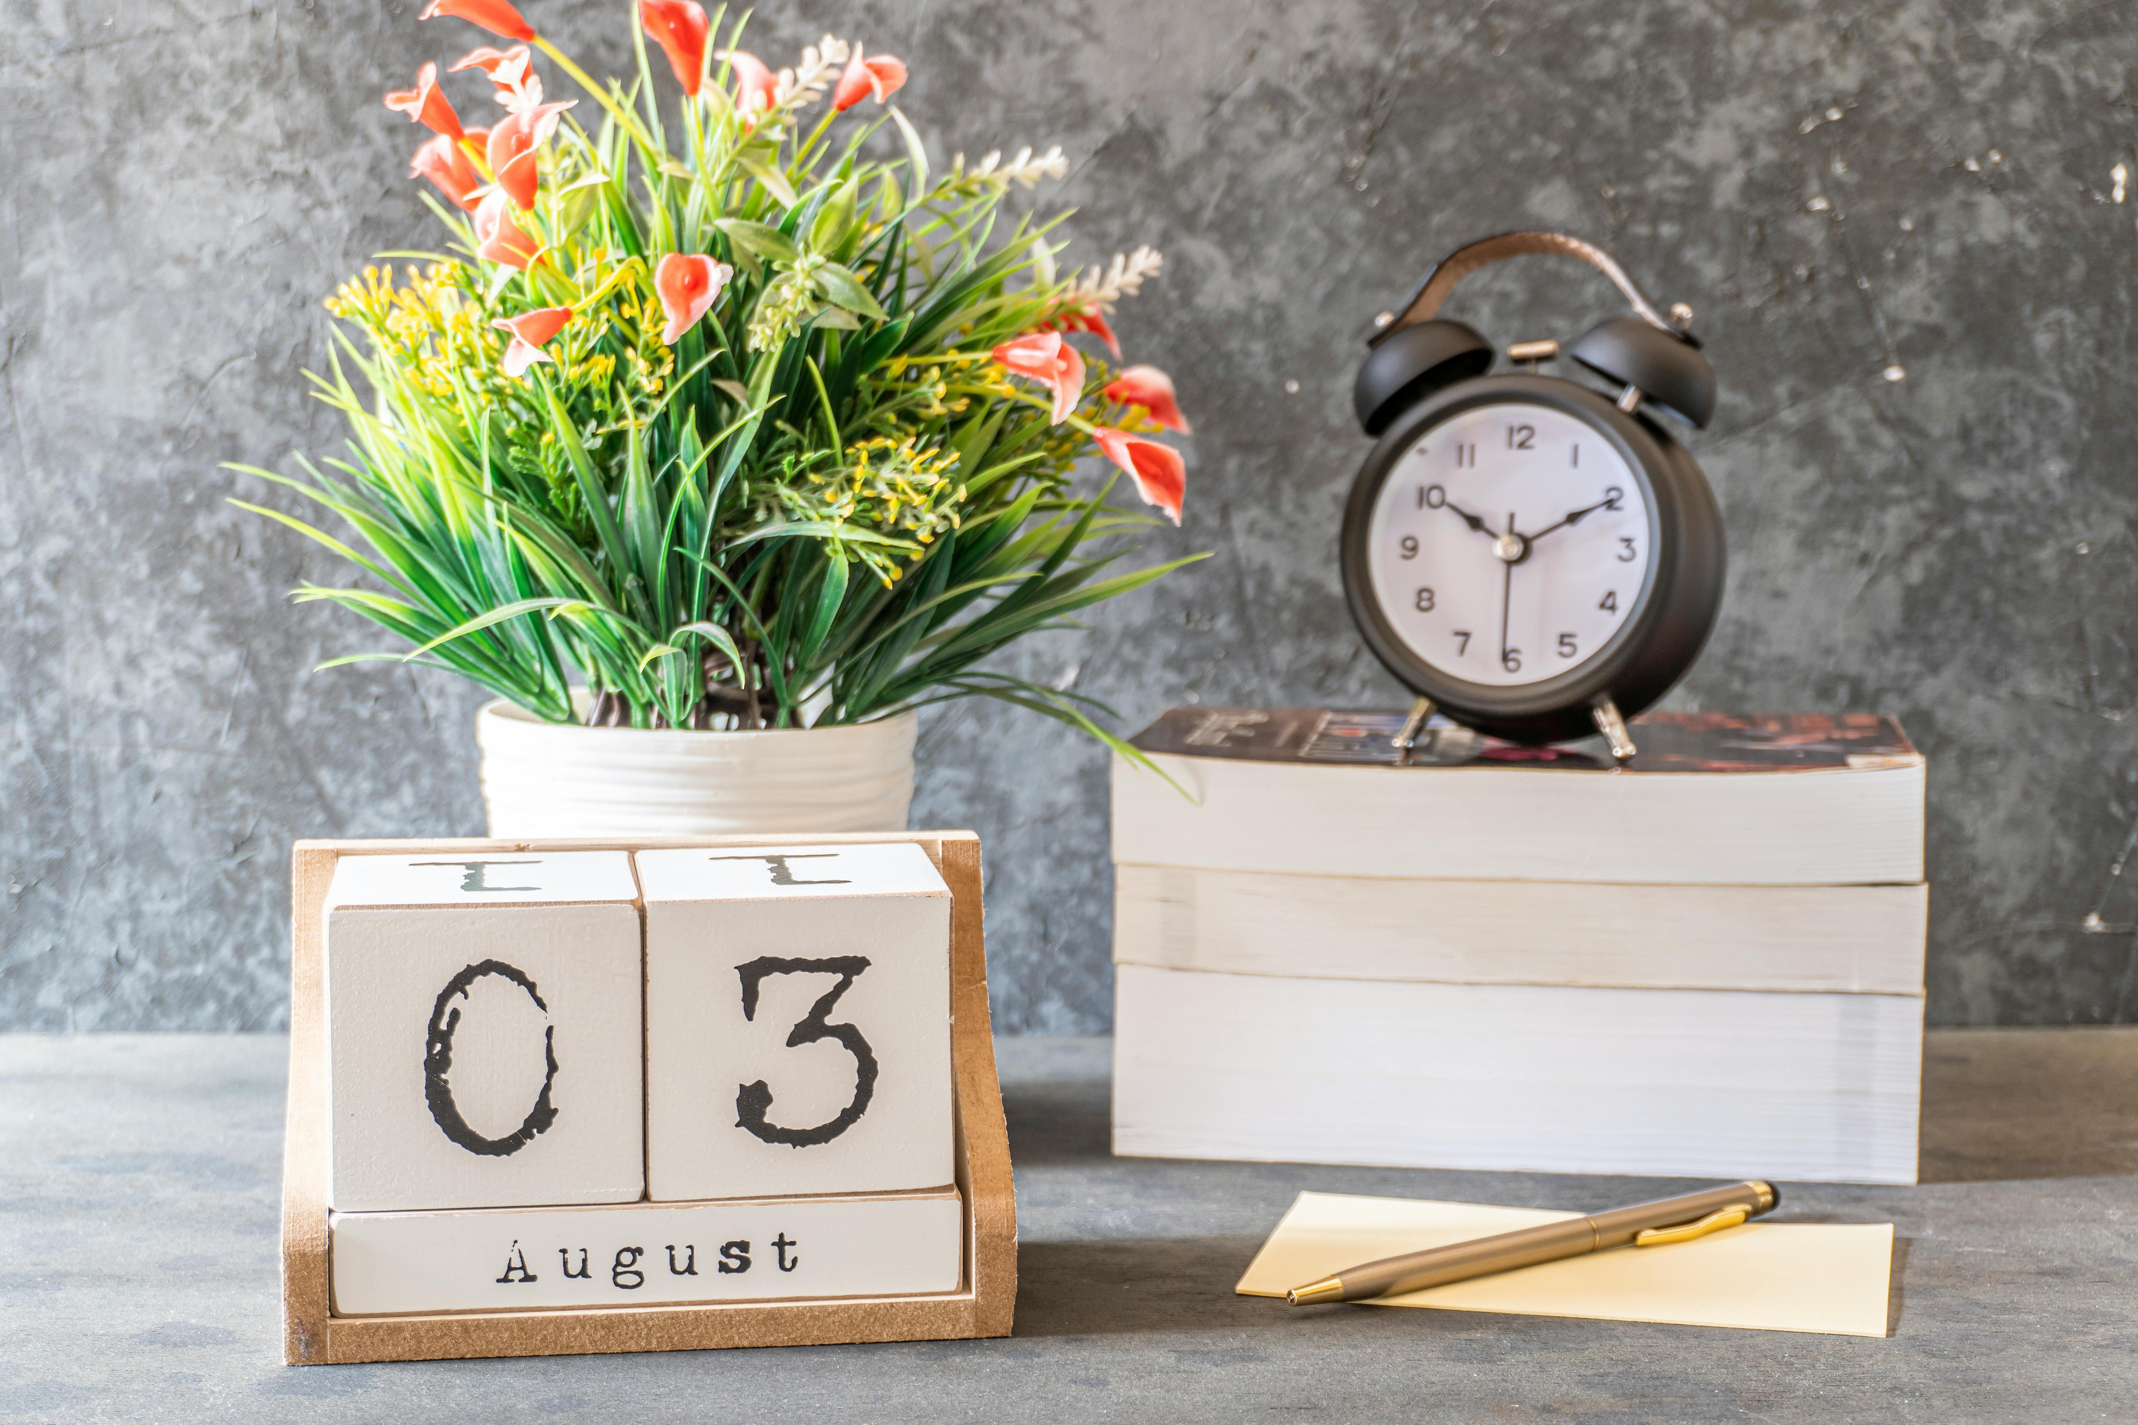
Understanding and Managing Time
14
Conclusion
Key Concepts Recap
Applying Time Knowledge
Summarize the key concepts learned in the lesson, such as time vocabulary and time-measuring devices.
Encourage students to apply their knowledge of time to their daily lives, such as scheduling a daily routine.
Encourage students to apply their knowledge of time to their daily lives, such as scheduling a daily routine.
Summarize the key concepts learned in the lesson, such as time vocabulary and time-measuring devices.

Slide 15
Understanding and Managing Time
15
Assessment
Formative Assessments
Summative Assessments
Feedback for Progress
Use formative assessments, such as quizzes or class discussions, to evaluate students' understanding of time concepts.
These methods help in identifying areas where students need more support.
Use summative assessments, such as a final test or project, to evaluate students' mastery of time concepts.
These assessments provide a comprehensive measure of students' learning outcomes.
Provide feedback to students on their progress and understanding of time concepts.
This helps students recognize their strengths and areas for improvement.

Slide 16

Understanding and Managing Time
16
Extension Activities
Advanced Challenges
Creative Time-Themed Games
Research on Time Topics
Provide additional challenges, such as creating their own time problems or schedules, for students who are advanced.
This encourages critical thinking and problem-solving skills tailored to their level.
Encourage students to create their own time-themed games or activities, such as a time-themed board game.
This fosters creativity and allows students to engage with the concept of time in a fun way.
Have students research and present on different time-related topics, such as the history of time-keeping.
This activity promotes independent learning and enhances their presentation skills.

Slide 17
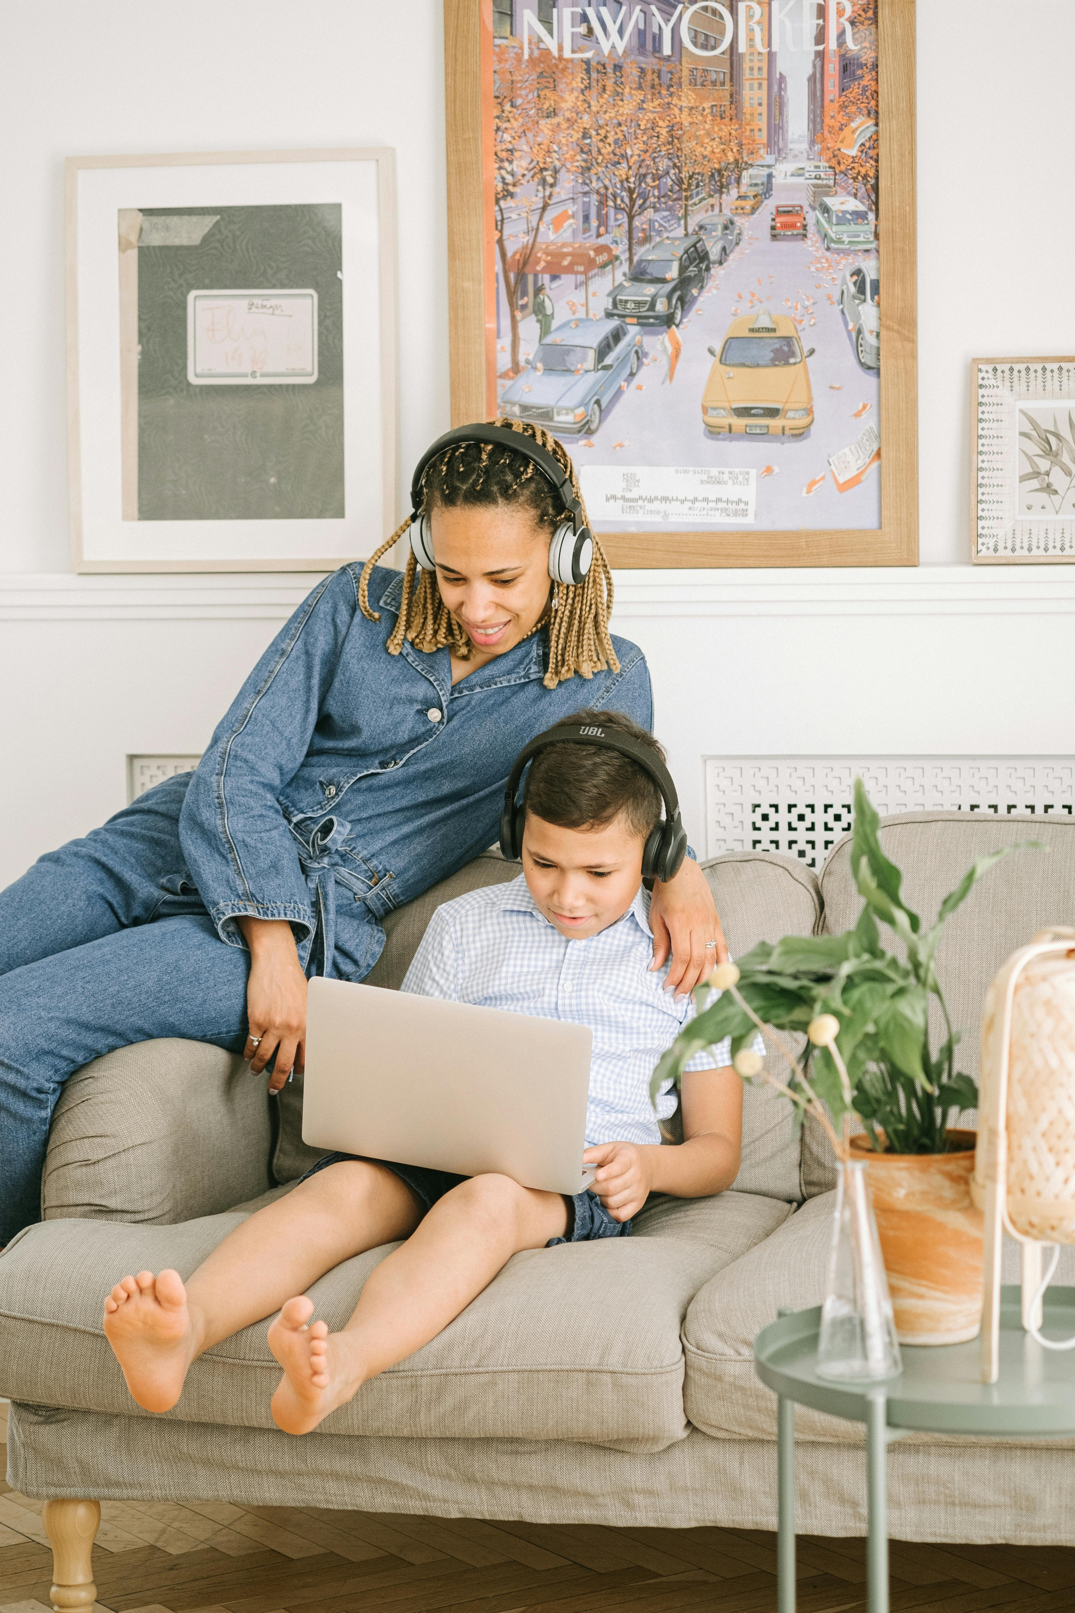
Understanding and Managing Time
17
Parent Engagement
Fostering Conversations
Providing Learning Resources
Inviting Participation
Encourage parents to engage in conversations with their child about time, such as asking open-ended questions.
This helps build a deeper understanding and connection to the concept of time.
Provide parents with resources, such as worksheets or activities, to support their child's learning at home.
These tools can make learning about time more interactive and enjoyable.
Invite parents to participate in class activities or events, such as a time-themed party.
This creates opportunities for parents to be actively involved in their child's education.

Slide 18

Understanding and Managing Time
18
Reflection Questions
Catering to Diverse Needs
How effectively did the lesson cater to the diverse needs of the students, including those with English as a second language and neurodiverse learners?
This question encourages reflection on inclusivity and adaptability in teaching methods.
Hands-On Learning Opportunities
What opportunities were provided for students to engage in hands-on learning and explore time-measuring devices?
This question highlights the importance of interactive and experiential learning in understanding concepts.
Adapting for Struggling Students
How can the lesson be adapted to meet the needs of students who may be struggling with the concept of time?
This question focuses on strategies to support learners facing challenges with the subject matter.

Slide 19
Understanding and Managing Time
19
Next Steps
Introducing Advanced Time Concepts
Applying Time Knowledge to Real-Life Scenarios
Supporting Struggling Students
Introduce more complex time concepts, such as telling time to the minute or understanding time intervals.
This will help students deepen their understanding of time and its practical applications.
Have students apply their knowledge of time to real-life scenarios, such as scheduling a daily routine.
This encourages practical learning and helps students see the relevance of time concepts in everyday life.
Provide additional challenges and support for students who may be struggling with the concept of time.
This ensures that all students have the opportunity to succeed and master the topic.

