Slide 1
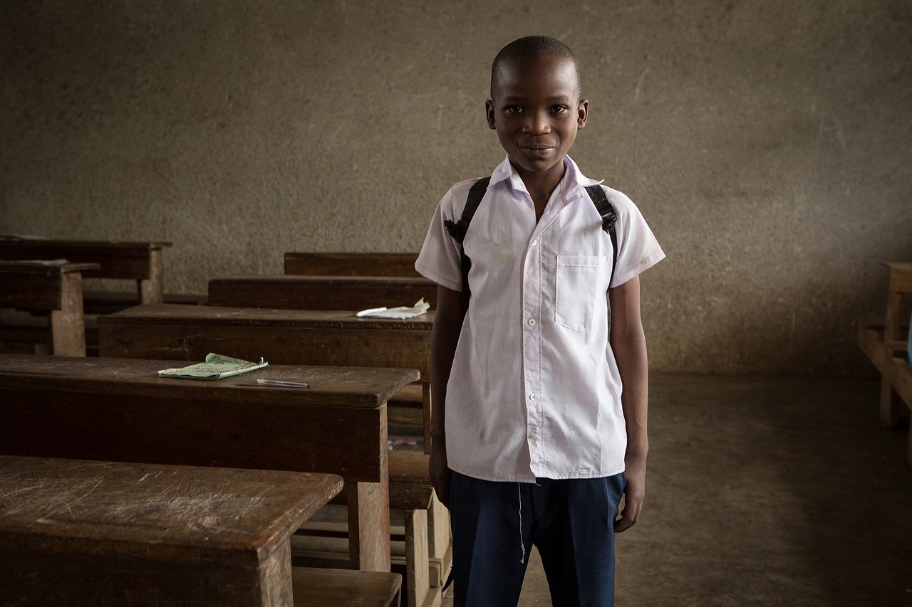
Creating Simple Sentences with Pictures and Word Cards
A Fun and Interactive Approach to Language Learning for Young Children

Slide 2
Table of Contents
Welcome to Creating Simple Sentences using Pic…
Introduction to Sentence Building
Using Pictures to Tell a Story
Building Vocabulary with Word Cards
Creating Sentences with Actions
Using Prepositions to Create Simple Sentences
Creating Simple Sentences with Emotions
Common Errors to Avoid
Frequently Asked Questions
Objectives
Vocabulary
Resources
Prior Knowledge
04
05
06
07
08
09
10
11
12
13
14
15
16

Slide 3
Table of Contents
Conclusion
Teaching Tips
Key Takeaways
Reflection Questions
Next Steps
Parent Engagement
Safety Considerations
Homework Assignments
Extension Activities
17
18
19
20
21
22
23
24
25

Slide 4

Welcome to Creating Simple Sentences using Pictures and Word Cards
Introduction to Sentence Construction
Learning Objectives
Engaging and Interactive Approach
This lesson plan is designed to introduce young learners to the basics of sentence construction using visual aids and interactive word cards.
The topic is tailored to meet the learning needs of 5-year-olds, focusing on developing their language skills in a fun and engaging manner.
By the end of this lesson, students will be able to create simple sentences using pictures and word cards.
This activity enhances their communication skills and builds a strong foundation in language arts.
The use of visual aids and word cards makes the learning process enjoyable and effective.
This method ensures active participation and helps in better understanding of sentence construction.
4
Creating Simple Sentences with Pictures and Word Cards

Slide 5
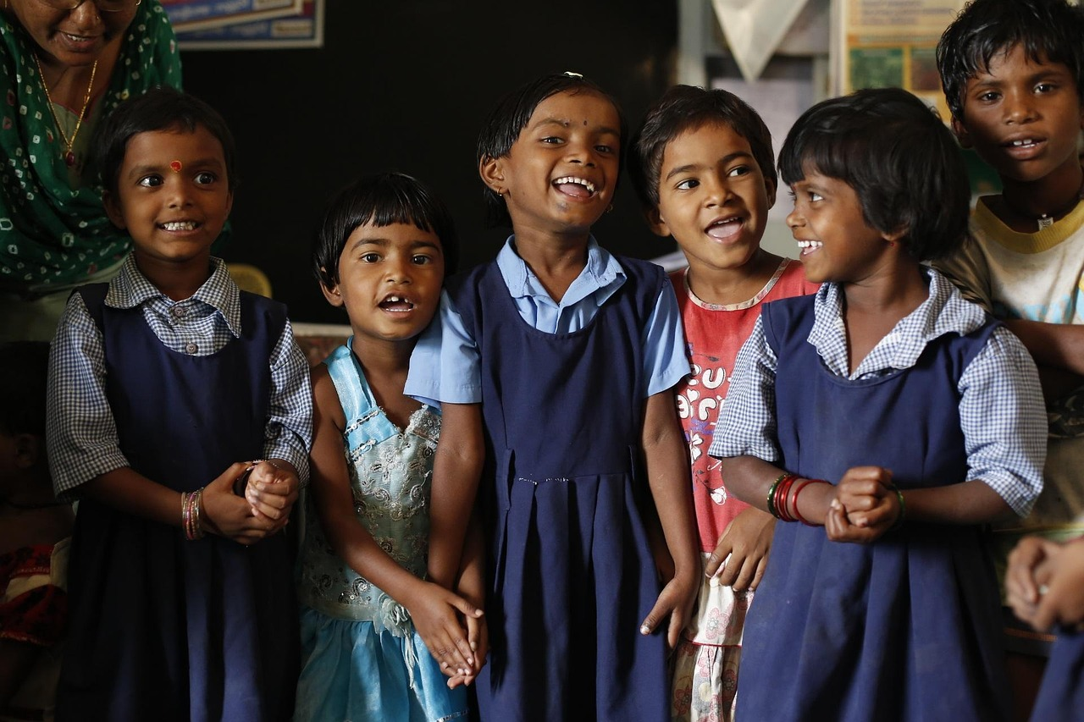
Introduction to Sentence Building
Importance of Sentence Building
Interactive Learning Approach
Developing Critical Thinking
Sentence building is a fundamental skill that forms the basis of effective communication.
By mastering this skill, students will be able to express themselves more clearly, both in writing and speaking.
This lesson will use pictures and word cards to make learning fun and interactive.
These tools aim to engage students and make the process enjoyable.
The activities are designed to help students develop their critical thinking skills.
This will enhance their ability to construct meaningful sentences effectively.
5
Creating Simple Sentences with Pictures and Word Cards

Slide 6
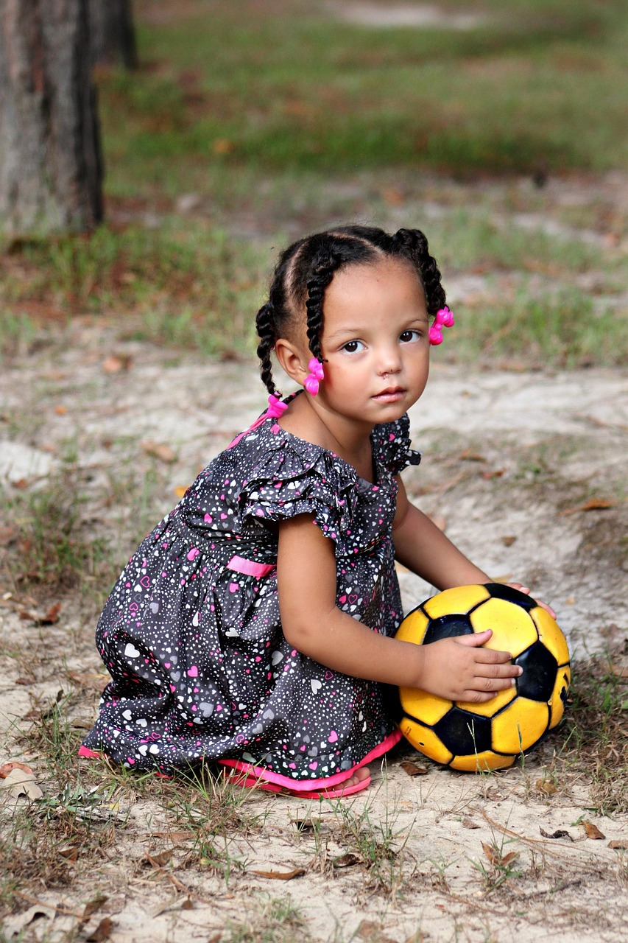
Using Pictures to Tell a Story
Creating Simple Sentences
Using Word Cards
Storytelling with Pictures
One way to create simple sentences is to tell a story using pictures.
For example, you can show a picture of a cat, followed by a picture of a ball, and then a picture of the cat playing with the ball.
You can then use word cards to create sentences like 'The cat is playing with the ball.'
This method helps in connecting visuals with written language effectively.
Pictures provide a visual context that makes storytelling engaging.
They allow learners to associate images with words and actions.
6
Creating Simple Sentences with Pictures and Word Cards

Slide 7
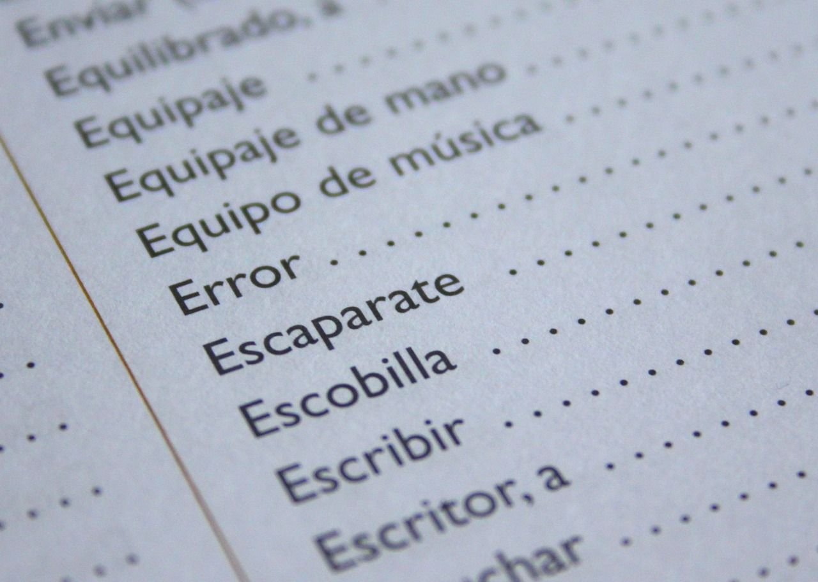
Building Vocabulary with Word Cards
Using Word Cards for Vocabulary
Creating Adjective Word Cards
Forming Sentences with Word Cards
Word cards can be used to build vocabulary and create simple sentences.
They are a versatile tool for language learning.
You can create word cards with different adjectives like 'big,' 'small,' 'happy,' and 'sad.'
These cards help in understanding and using descriptive words effectively.
Word cards can be combined to create sentences like 'The big dog is happy.'
This practice enhances sentence construction skills.
7
Creating Simple Sentences with Pictures and Word Cards

Slide 8

Creating Sentences with Actions
Using Visual Aids for Sentence Formation
Pictures and word cards can be used to create sentences that describe actions.
For example, you can show a picture of a child running, and then use word cards to create a sentence like 'The child is running.'
Learning Through Action Descriptions
This activity helps children learn about different actions.
It also teaches them how to use verbs to describe these actions effectively.
Enhancing Verb Usage Skills
By engaging in this activity, children improve their understanding of verbs.
They also develop the ability to construct meaningful sentences.
8
Creating Simple Sentences with Pictures and Word Cards

Slide 9

Using Prepositions to Create Simple Sentences
1
Introduction to Prepositions
Prepositions like 'in,' 'on,' and 'under' can be used to create simple sentences using pictures and word cards.
This helps children understand how to describe locations effectively.
2
Interactive Learning Activity
For example, you can show a picture of a cat in a box.
Then, use word cards to create a sentence like 'The cat is in the box.'
3
Educational Benefits
This activity helps children learn about prepositions.
It also teaches them how to use these words to describe locations.
9
Creating Simple Sentences with Pictures and Word Cards

Slide 10

Creating Simple Sentences with Emotions
1
Using Visual Aids
Pictures and word cards can be used to create simple sentences that describe emotions.
For example, you can show a picture of a child smiling, and then use word cards to create a sentence like 'The child is happy.'
2
Learning About Emotions
This activity helps children learn about different emotions.
It provides a way for them to connect visual cues with emotional vocabulary.
3
Expressing Emotions with Words
Children practice expressing emotions using vocabulary.
They build sentences that reflect their understanding of feelings.
10
Creating Simple Sentences with Pictures and Word Cards

Slide 11

Common Errors to Avoid
Incorrect Word Order
Missing Articles
For example, 'Ball the is red' instead of 'The ball is red.'
This error disrupts the natural flow of a sentence.
For example, 'Dog is big' instead of 'The dog is big.'
Articles are essential for clarity and specificity in sentences.
Incorrect Verb Tense
Lack of Punctuation
For example, 'The dog go to the park' instead of 'The dog goes to the park.'
Using the wrong tense can confuse the timeline of events.
For example, 'The dog is big and happy' instead of 'The dog is big, and happy.'
Proper punctuation ensures the sentence is easy to read and understand.
11
Creating Simple Sentences with Pictures and Word Cards

Slide 12
Frequently Asked Questions
Introducing Pictures and Word Cards
Teaching Word Order
Supporting Struggling Learners
Expanding Language Skills
Assessing Progress
Start with simple vocabulary and gradually increase the difficulty level.
This approach helps beginners build confidence and understanding.
Use word cards to demonstrate the correct word order.
Have children practice creating sentences with the correct word order.
Provide additional support by using visual aids like pictures and word cards.
This helps demonstrate the concept and makes it easier for children to grasp.
Pictures and word cards can be used to teach vocabulary, grammar, and comprehension.
They are versatile tools for enhancing various language skills.
Observe a child's ability to create sentences with correct word order, vocabulary, and punctuation.
This provides insight into their progress and areas needing improvement.
12
Creating Simple Sentences with Pictures and Word Cards

Slide 13
Objectives
Knowledge
Comprehension
Application
Synthesis
Identify and name basic vocabulary words related to everyday objects and actions.
This forms the foundation for understanding and communication.
Demonstrate an understanding of basic sentence structures by combining two or more words to convey meaning.
This skill helps in forming coherent and meaningful expressions.
Apply knowledge of vocabulary and sentence structures to create simple sentences using pictures and word cards.
This encourages practical usage of learned concepts in a creative way.
Create new sentences by combining different words and pictures, demonstrating an ability to think creatively and generate new ideas.
This fosters innovation and deeper understanding of language.
13
Creating Simple Sentences with Pictures and Word Cards

Slide 14
Vocabulary
Noun
Verb
Adjective
Sentence
Word Card
A person, place, or thing, such as 'cat,' 'house,' or 'book.'
Nouns are fundamental building blocks of language.
An action or activity, such as 'run,' 'jump,' or 'read.'
Verbs describe what someone or something does.
A word that describes a noun, such as 'happy,' 'big,' or 'red.'
Adjectives add detail and specificity to nouns.
A group of words that express a complete thought, such as 'I see a cat' or 'The dog is big.'
Sentences are essential for clear communication.
A card with a word written on it, used to build sentences and create stories.
Word cards are tools for learning and creativity.
14
Creating Simple Sentences with Pictures and Word Cards

Slide 15

Resources
Picture Cards
Word Cards
Sentence-Building Worksheets
A set of cards with images of everyday objects and actions.
These cards help students recognize and associate words with visuals.
A set of cards with basic vocabulary words written on them.
These cards are useful for building foundational language skills.
Worksheets with sentence frames and word cards, allowing students to practice building simple sentences.
These worksheets encourage creativity and sentence construction.
Digital Word Card App
Picture Sorting Game
A digital tool that allows students to create and manipulate word cards on a tablet or computer.
This app provides an interactive way to learn vocabulary.
A game where students sort pictures into categories, such as animals or objects.
This activity enhances categorization and critical thinking skills.
15
Creating Simple Sentences with Pictures and Word Cards

Slide 16
Prior Knowledge
Vocabulary Building
Sentence Structure
Phonological Awareness
Fine Motor Skills
Students should have a basic understanding of common nouns, verbs, and adjectives.
This foundational knowledge supports language development and comprehension.
Students should have a basic understanding of simple sentence structures, such as subject-verb-object.
This helps in constructing meaningful and grammatically correct sentences.
Students should have a basic understanding of phonological awareness, including rhyming, word families, and beginning sounds.
This skill is essential for early reading and spelling development.
Students should have developed their fine motor skills, including the ability to hold a pencil, cut with scissors, and manipulate small objects.
These skills are crucial for writing and other classroom activities.
16
Creating Simple Sentences with Pictures and Word Cards

Slide 17

Conclusion
Interactive Learning for Young Minds
In conclusion, teaching 5-year-olds to create simple sentences using pictures and word cards is a fun and interactive way to introduce them to the basics of language and communication.
By following the lesson plan and incorporating engaging activities, teachers can help their students develop essential skills in reading, writing, and speaking.
Hands-On Approach to Language
The use of pictures and word cards provides a hands-on approach to learning.
This method makes it easier for students to understand and retain the information.
Building Essential Skills
Teachers can help students develop essential skills in reading, writing, and speaking.
Engaging activities ensure that learning is both effective and enjoyable.
17
Creating Simple Sentences with Pictures and Word Cards

Slide 18
Teaching Tips
Engaging Real-Life Examples
Interactive Learning Activities
Encouraging Feedback
Use real-life examples to make learning more meaningful and engaging.
This helps students connect lessons to their everyday experiences.
Make it interactive by incorporating games and activities into the lesson.
Interactive methods keep students actively involved and interested.
Provide feedback and encouragement to students as they learn to create simple sentences.
Positive reinforcement builds confidence and motivates further learning.
Visual Learning Tools
Tailored Instruction
Use visual aids such as pictures, flashcards, and diagrams to support student learning.
These tools help clarify concepts and make lessons more memorable.
Differentiate instruction to meet the needs of different learners.
Adapting teaching methods ensures all students can succeed.
18
Creating Simple Sentences with Pictures and Word Cards

Slide 19

Key Takeaways
Understanding Basic Sentence Structure
Vocabulary Building
Confidence in Communication
Students will be able to identify and create simple sentences using a subject, verb, and object.
This foundational skill is essential for effective communication and language learning.
Students will have been introduced to new vocabulary words through the use of pictures and word cards.
This approach helps in associating words with visual cues, enhancing memory retention.
Students will have built confidence in their ability to express themselves.
They will be more willing to participate in future language activities, fostering growth in communication skills.
19
Creating Simple Sentences with Pictures and Word Cards

Slide 20

Reflection Questions
1
2
3
Student Sentence Creation
Engagement in Activities
Skill Reinforcement Opportunities
Were the students able to successfully create simple sentences using pictures and word cards?
This question evaluates their ability to connect visual aids with language skills.
How did the students respond to the interactive activities, and were they able to stay engaged throughout the lesson?
This reflects their level of interest and sustained participation during the session.
What opportunities were provided for students to practice and reinforce their new skills, and how can these opportunities be built upon in future lessons?
This focuses on the strategies for skill application and future lesson planning.
20
Creating Simple Sentences with Pictures and Word Cards

Slide 21
Next Steps
Lesson 2: Creating Compound Sentences
Lesson 3: Using Adjectives to Describe Pictures
Lesson 4: Creating Short Stories using Pictures and Word Cards
Students will learn how to create compound sentences using conjunctions such as 'and' and 'but.'
This lesson focuses on combining ideas to form more complex sentences.
Students will learn how to use adjectives such as 'big,' 'little,' 'happy,' and 'sad' to describe pictures.
This lesson emphasizes enhancing descriptive language skills.
Students will use pictures and word cards to create short stories, practicing combining simple sentences to create a short narrative.
This lesson encourages creativity and narrative development.
21
Creating Simple Sentences with Pictures and Word Cards

Slide 22

Parent Engagement
Reading Together
Conversational Opportunities
Making it Fun
Encourage parents to read with their child on a regular basis, using the pictures and word cards provided in the lesson to create simple sentences.
This activity helps build a strong foundation for language development and fosters a love for reading.
Encourage parents to create conversational opportunities with their child, using everyday situations to practice simple sentence structure.
This approach helps children apply language skills in real-life contexts and enhances their communication abilities.
Encourage parents to make learning fun by incorporating games and activities into their daily routine, using the pictures and word cards provided in the lesson.
This method keeps children engaged and makes the learning process enjoyable and effective.
22
Creating Simple Sentences with Pictures and Word Cards

Slide 23

Safety Considerations
Safe Learning Environment
Rules and Guidelines
Ensure the learning environment is safe and free from any hazards.
This includes removing obstacles and maintaining a clean and organized space.
Establish clear rules and guidelines for students to follow.
These rules help maintain order and ensure everyone's safety.
First Aid Preparedness
Emergency Evacuation Plan
Provide a first aid kit and know how to administer basic first aid.
Being prepared can make a critical difference in emergencies.
Have a plan in place for evacuating the classroom in the event of a fire or other emergency.
This ensures a quick and organized response to potential dangers.
23
Creating Simple Sentences with Pictures and Word Cards

Slide 24

Homework Assignments
Picture Sentence Matching
Word Card Sentence Building
Sentence Writing
Create a set of pictures and simple sentences.
Ask the child to match the pictures with the correct sentences.
Provide the child with a set of word cards, including nouns, verbs, and adjectives.
Ask them to build simple sentences using the word cards.
Provide the child with a set of pictures.
Ask them to write a simple sentence about each picture.
24
Creating Simple Sentences with Pictures and Word Cards

Slide 25
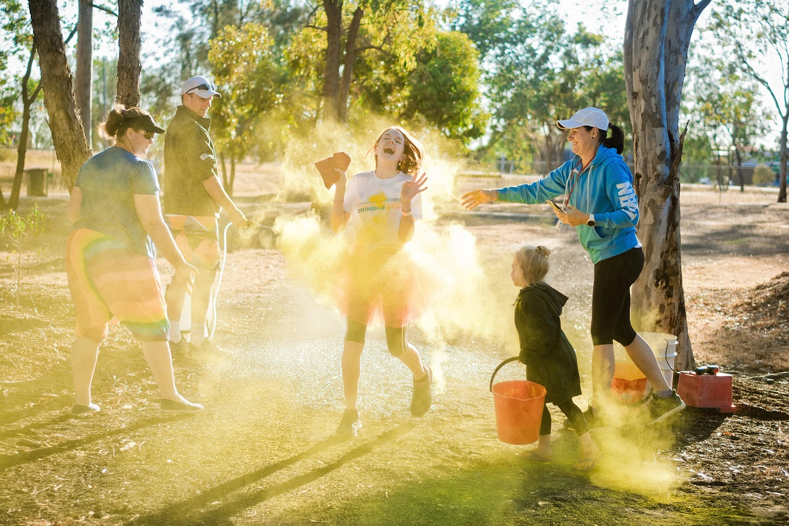
Extension Activities
Sentence Building Challenge
Picture Storytelling
Word Card Games
Create a set of word cards with more complex vocabulary.
Ask the child to build simple sentences using the word cards.
Provide the child with a set of pictures that tell a story.
Ask them to use the pictures to create a short story.
Create a set of word cards with different parts of speech.
Ask the child to play a game where they have to match the word cards with the correct part of speech.
25
Creating Simple Sentences with Pictures and Word Cards

