Slide 1
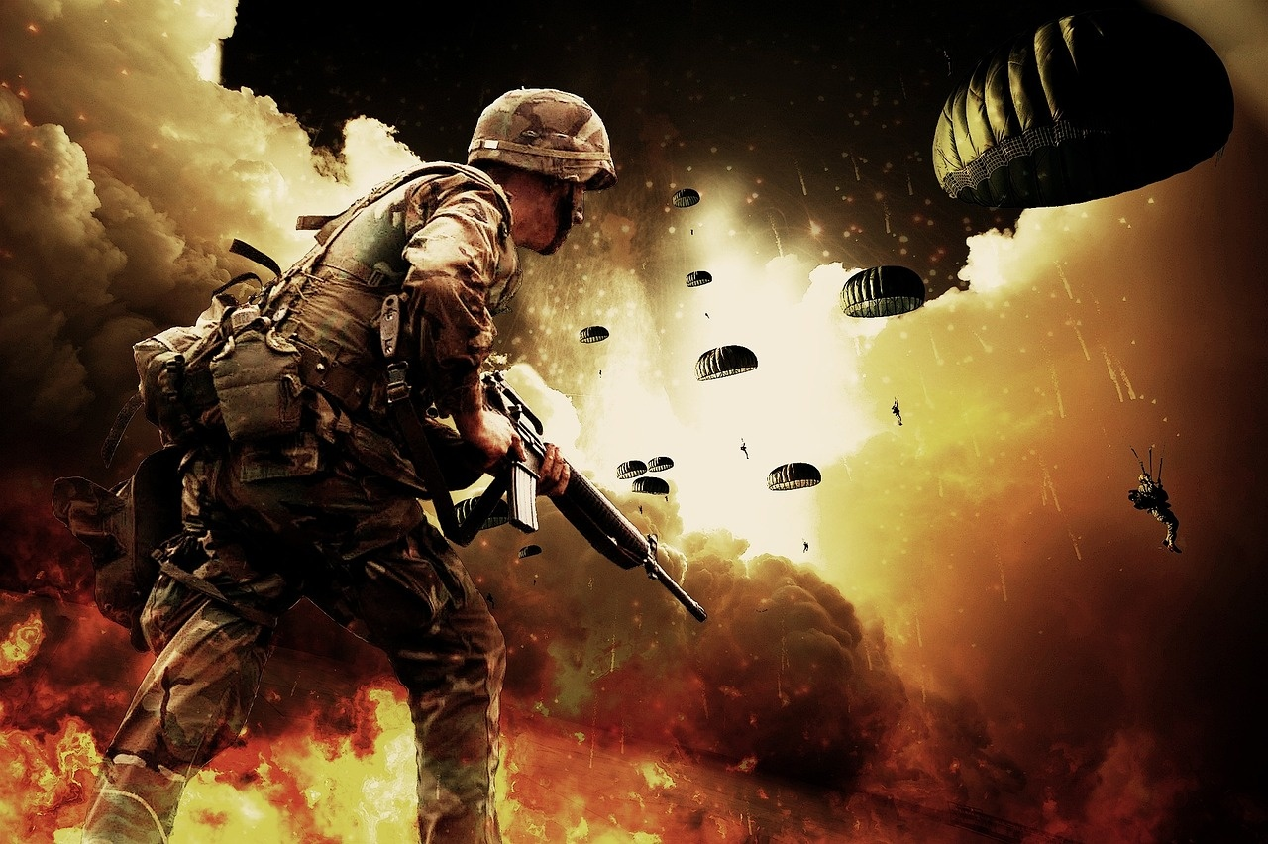
Global Conflict: Shaping History
An In-depth Exploration of World War II

Slide 2
Table of contents
01
02
03
04
05
06
07
08
09
10
11
Title Slide
Context and Overview
European Theater - Strategic Overview
Turning Point - Battle of Stalingrad
Pacific Theater Dynamics
Technological Innovations
D-Day Invasion - Strategic Coordination
Military Leadership and Decision Making
Technological Arms Race
Geopolitical Consequences
Human Experience in Warfare

Slide 3
Table of contents
12
13
14
15
16
17
18
19
20
Key Turning Points
Technological Legacy
Critical Thinking Challenges
Conclusion
Reflection Questions
Additional Resources
Thank You / Q&A Slide
Slide 19: Strategic Communication Strategies
Slide 20: Post-War Reconstruction Efforts

Slide 4
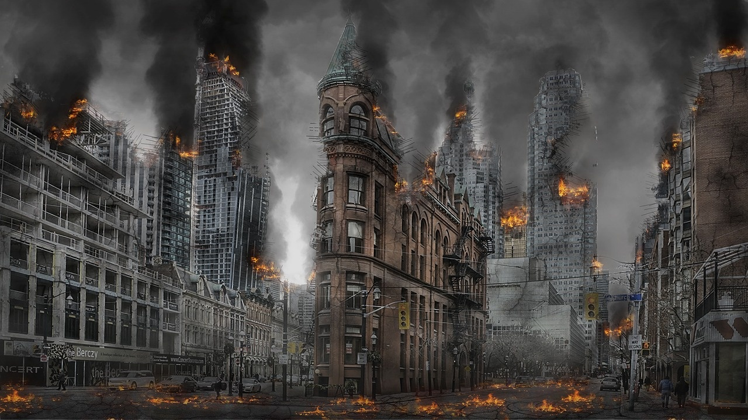
1
Title Slide
World War II Military Campaigns: Strategic Turning Points and Global Conflict
A Journey Through the Most Transformative Conflict in Human History
Global Conflict: Shaping History

Slide 5
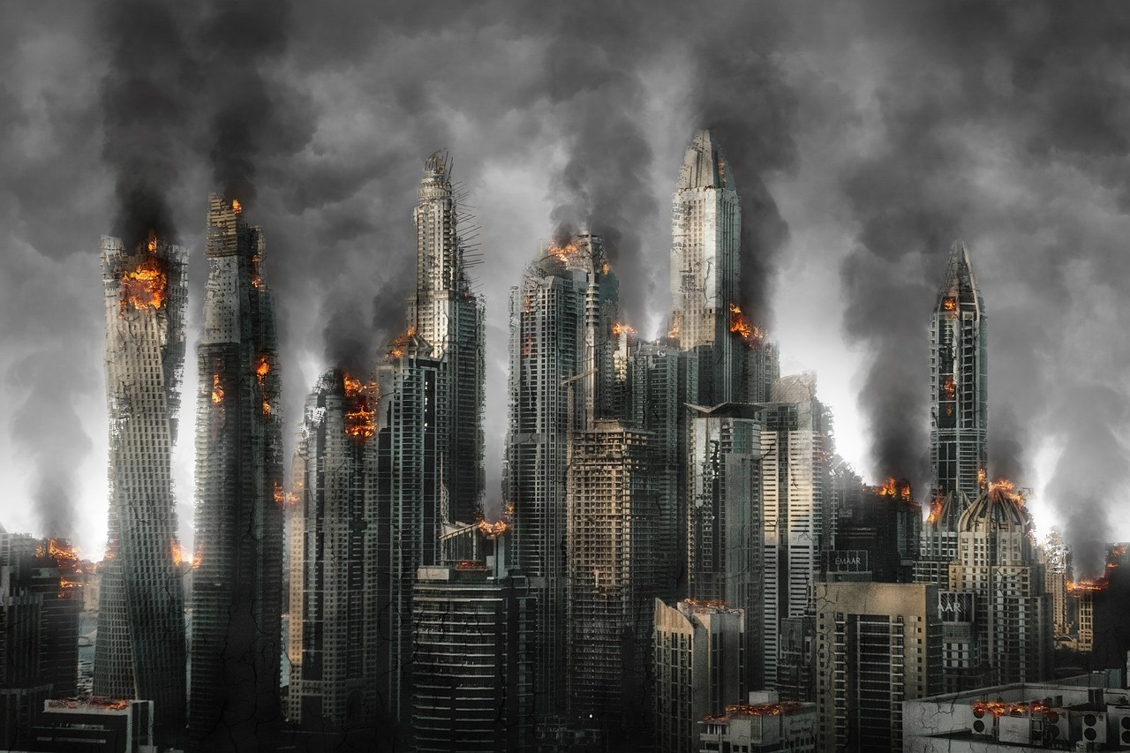
2
Context and Overview
01
Global Conflict Landscape of 1930s-1940s
02
Key Players
Era marked by significant geopolitical tensions and conflicts.
Major global powers divided into two primary alliances.
Axis Powers: Germany, Italy, Japan
Allied Powers: United States, United Kingdom, Soviet Union
03
Central Theme
Technological Innovation and Strategic Complexity
Rapid advancements in military technology.
Complex strategies and alliances shaped the course of conflicts.
Global Conflict: Shaping History

Slide 6
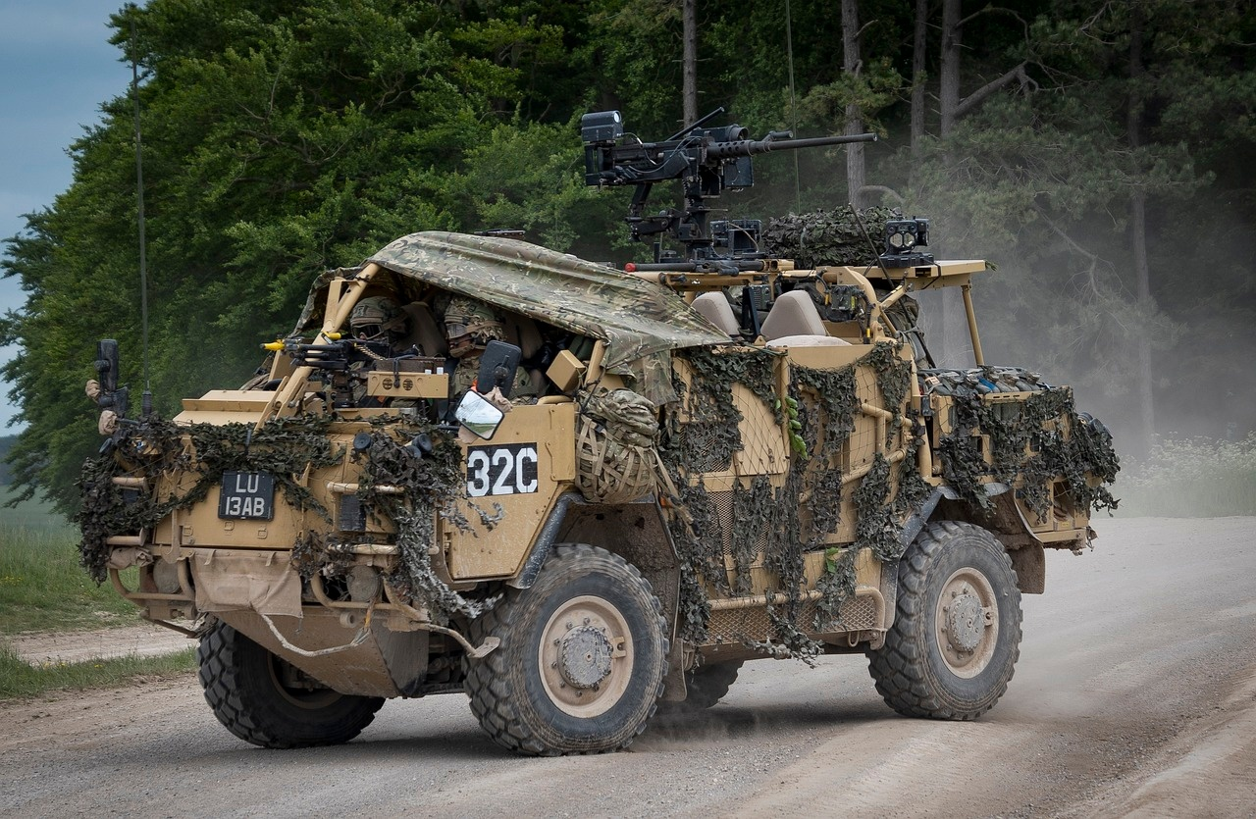
3
European Theater - Strategic Overview
01
German Invasion Strategies
02
Initial Axis Successes
Blitzkrieg tactics
Focus on rapid advancement and encirclement
Fall of Poland and France
Establishment of puppet governments
03
Challenges Faced by Allied Powers
04
Key Regions
Lack of coordination
Strategic setbacks
Poland: September 1939
France: May-June 1940
Eastern Front: Barbarossa Operation, June 1941
Global Conflict: Shaping History

Slide 7
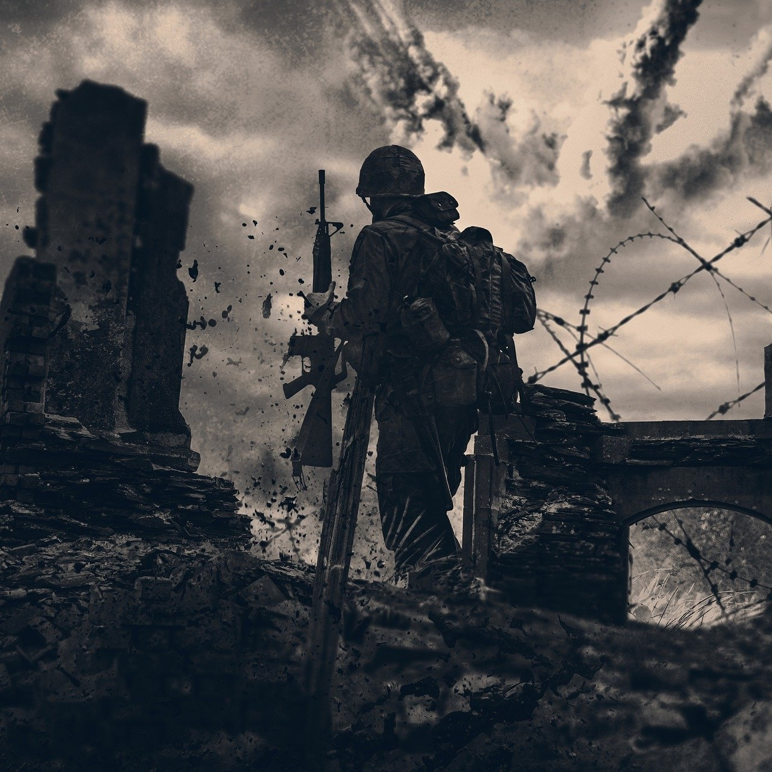
4
Turning Point - Battle of Stalingrad
01
Location
02
Strategic Significance
Soviet Union, August 1942 - February 1943
Massive Soviet Resistance
Turning Point on Eastern Front
03
Human Cost and Psychological Impact
04
Detailed Troop Movement Map
Global Conflict: Shaping History

Slide 8
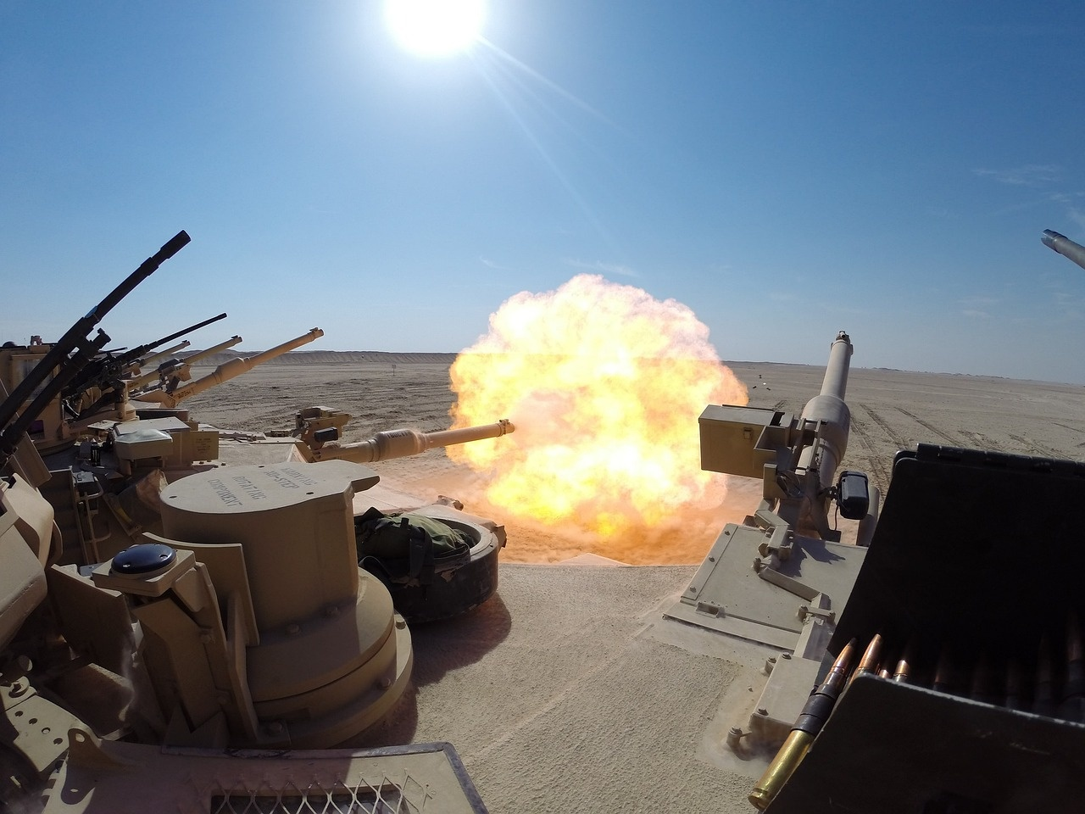
5
Pacific Theater Dynamics
Japanese Expansion Strategy
Rapid conquest of Southeast Asia and Pacific Islands
Focus on establishing a Greater East Asia Co-Prosperity Sphere
Global Conflict: Shaping History

Slide 9
6
Technological Innovations
01
Radar Technology
02
Advanced Cryptography
03
Mechanized Warfare
Revolutionized detection capabilities
Enhanced early warning systems
Secured communication channels
Enabled secure transmission of sensitive information
Introduction of tanks and armored vehicles
Increased mobility and firepower on the battlefield
04
Aerial Reconnaissance
05
Impact on Military Strategies
Utilized aircraft for intelligence gathering
Improved strategic decision-making and target identification
Shifted focus towards combined arms tactics
Altered battlefield dynamics and operational planning
Global Conflict: Shaping History

Slide 10
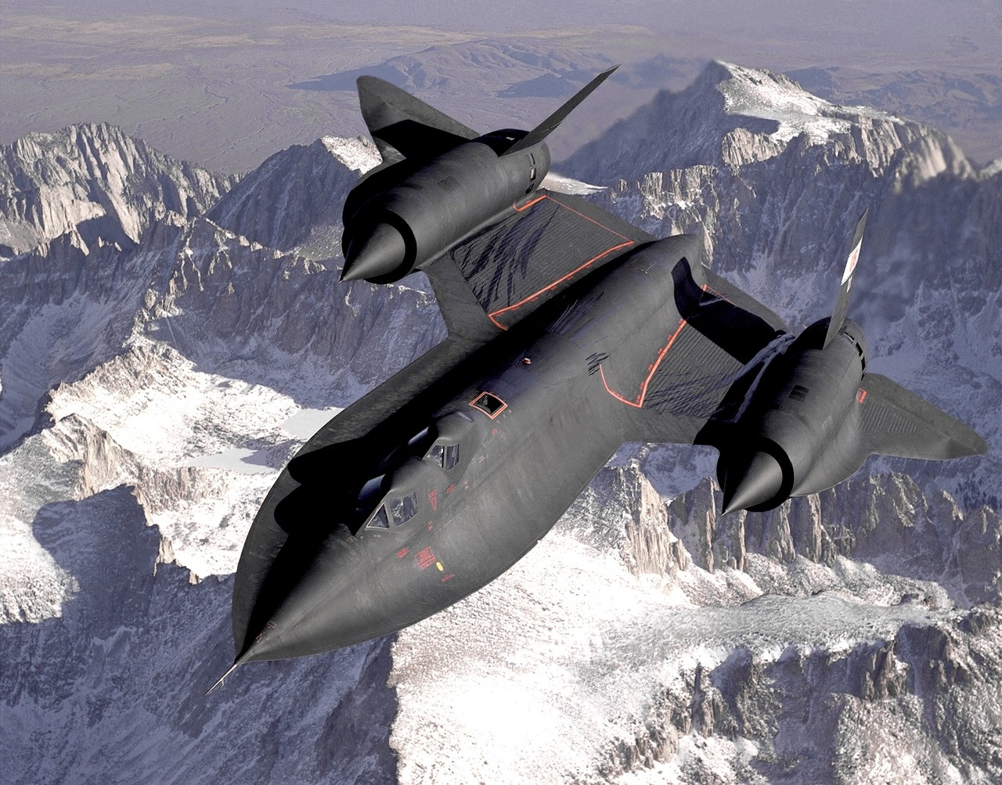
7
D-Day Invasion - Strategic Coordination
156,000
5,000
Troops
Ships
The number of troops involved in the D-Day invasion.
The number of ships used during the Normandy Landings.
11,000
June 6, 1944
Aircraft
D-Day
The number of aircraft deployed for the operation.
The pivotal day of the Normandy Landings.
Global Conflict: Shaping History

Slide 11

8
Military Leadership and Decision Making
01
Profiles of Key Military Leaders
02
Strategic Decision-Making Process
General Dwight D. Eisenhower
Marshal Georgy Zhukov
Field Marshal Erwin Rommel
Assessing intelligence reports
Evaluating tactical options
Considering logistical constraints
03
Impact of Individual Choices
Eisenhower's leadership in D-Day invasion
Zhukov's strategies at the Battle of Stalingrad
Rommel's tactics in North Africa
Global Conflict: Shaping History

Slide 12
9
Technological Arms Race
01
Manhattan Project
02
Enigma Code Breaking
03
Radar Development
Development of the first nuclear weapons
Led by the United States with support from the United Kingdom and Canada
Resulted in the atomic bombings of Hiroshima and Nagasaki
Deciphering of the German Enigma machine
Led by British cryptanalysts at Bletchley Park
Significantly contributed to the Allied victory in World War II
Advancements in radio detection and ranging technology
Crucial for detecting enemy aircraft and ships
Enhanced the effectiveness of air and naval operations
04
Jet Aircraft Technology
05
Transformative Military Research
Introduction of jet engines in military aircraft
Increased speed and altitude capabilities
Pioneered by Germany with the Messerschmitt Me 262
Innovations that changed the nature of warfare
Included developments in rocketry, computing, and materials science
Laid the groundwork for post-war technological advancements
Global Conflict: Shaping History

Slide 13
10
Geopolitical Consequences
Dismantling of Colonial Structures
Rise of New Superpowers
Impact on European colonial empires
Rise of independence movements in colonized regions
Emergence of the United States and Soviet Union as global superpowers
Shift in global power dynamics
Global Conflict: Shaping History

Slide 14
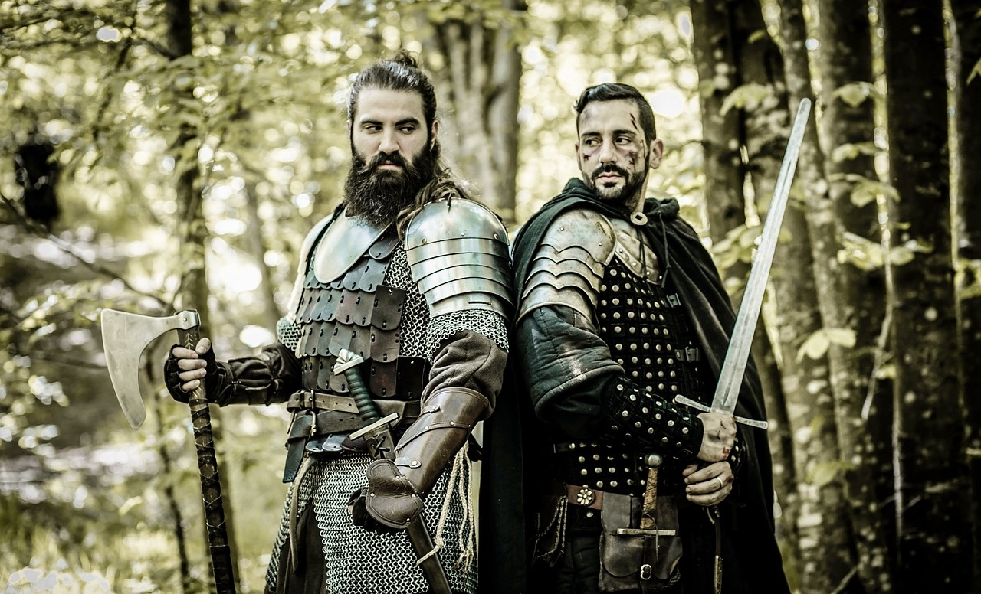
11
Human Experience in Warfare
01
Personal Narratives
02
Civilian Impact
Stories of individuals impacted by war
Soldiers, civilians, resistance fighters
Effects on non-combatants
Bombings, displacement, rationing
03
Psychological Dimensions of Conflict
04
Resilience and Adaptation
Mental toll on individuals
PTSD, trauma, resilience
How people cope and adjust during wartime
Innovation, community support
Global Conflict: Shaping History

Slide 15
12
Key Turning Points
Location: Soviet Union, August 1942 - February 1943
Dates: August 6 and 9, 1945
Battle of Stalingrad
D-Day Invasion
Atomic Bombings
Date: June 6, 1944
Global Conflict: Shaping History

Slide 16
13
Technological Legacy
01
Radar Technology
02
Advanced Cryptography
03
Mechanized Warfare
Revolutionized air defense and early warning systems.
Enigma machine decryption led to crucial intelligence breakthroughs.
Tanks and armored vehicles transformed ground combat tactics.
04
Aerial Reconnaissance
05
Impact on Military Strategies
Enhanced surveillance capabilities for strategic planning.
Shifted focus towards combined arms operations.
Global Conflict: Shaping History

Slide 17

14
Critical Thinking Challenges
01
Analyzing Strategic Decision-Making in Key Military Campaigns
02
Assessing the Role of Technological Innovation in Warfare
Evaluate the rationale behind pivotal decisions made by military leaders.
Consider the impact of alternative strategies on the outcomes of battles.
Examine how advancements in technology influenced military tactics and outcomes.
Compare the effectiveness of different technological developments during World War II.
03
Understanding the Geopolitical Implications of Global Conflict
Explore how alliances, treaties, and territorial ambitions shaped the course of the war.
Analyze the long-term consequences of World War II on international relations.
Global Conflict: Shaping History

Slide 18

15
Conclusion
01
World War II: A Transformative Global Event
02
Interconnectedness of Military Campaigns
Redefined global power structures
Led to the establishment of the United Nations
Accelerated technological and medical advancements
Allied and Axis powers' strategies influenced each other
Global theaters of war: Europe, Pacific, Africa
Impact of intelligence and espionage
03
Lessons for Contemporary Global Understanding
Importance of international cooperation
Dangers of totalitarian regimes
Need for vigilance against human rights violations
Global Conflict: Shaping History

Slide 19

16
Reflection Questions
01
Technology and Military Outcomes
02
Human Costs of Strategic Decisions
Advancements in radar improved detection of enemy aircraft and ships.
Cryptography, including the breaking of the Enigma code, provided crucial intelligence.
Mechanized warfare, such as tanks and aircraft, revolutionized combat strategies.
Massive civilian casualties due to bombings and battles.
High soldier mortality and injury rates.
Psychological trauma experienced by both soldiers and civilians.
03
Reshaping Global Relationships and Power Dynamics
Geopolitical shifts with the rise of the US and USSR as superpowers.
Decolonization movements accelerated in Asia and Africa.
Establishment of the United Nations aimed at preventing future conflicts.
Global Conflict: Shaping History

Slide 20

17
Additional Resources
01
Recommended Reading
02
Documentary Suggestions
"The Second World War" by Antony Beevor
"The Guns at Last Light: The War in Western Europe, 1944-1945" by Rick Atkinson
"The World at War" (1973)
"Apocalypse: The Second World War" (2009)
03
Museum Visits
04
Online Historical Archives
Imperial War Museum (London, UK)
National WWII Museum (New Orleans, USA)
National Archives and Records Administration (NARA)
United States Holocaust Memorial Museum (USHMM)
Global Conflict: Shaping History

Slide 21
18
Thank You / Q&A Slide
Presentation Summary
Contact Information
Invitation for Further Discussion
A comprehensive exploration of World War II Military Campaigns focusing on strategic turning points and global conflict.
Feel free to reach out for further discussions or inquiries.
Let's continue the conversation and delve deeper into the impact of World War II on history and global dynamics.
Global Conflict: Shaping History

Slide 22
19
Slide 19: Strategic Communication Strategies
01
Clear Messaging
02
Audience Segmentation
03
Utilize Multiple Channels
Ensure concise and understandable communication.
Tailor messages to different target groups for maximum impact.
Employ a mix of traditional and digital platforms for broader reach.
04
Feedback Mechanisms
05
Crisis Communication Plan
Establish systems to gather and analyze audience responses.
Develop strategies to address unexpected challenges effectively.
Global Conflict: Shaping History

Slide 23
20
Slide 20: Post-War Reconstruction Efforts
01
Marshall Plan Implementation
02
United Nations Formation
03
Berlin Airlift
Year: 1948
Description: Economic aid to rebuild Western European economies after WWII
Year: 1945
Description: International organization to promote peace and cooperation
Year: 1948-1949
Description: Massive airlift to supply West Berlin during Soviet blockade
04
Nuremberg Trials
05
Rebuilding Infrastructure
Year: 1945-1946
Description: Trials of Nazi leaders for war crimes and crimes against humanity
Efforts: Repairing cities, roads, and industries devastated by war
Global Conflict: Shaping History

