Slide 1
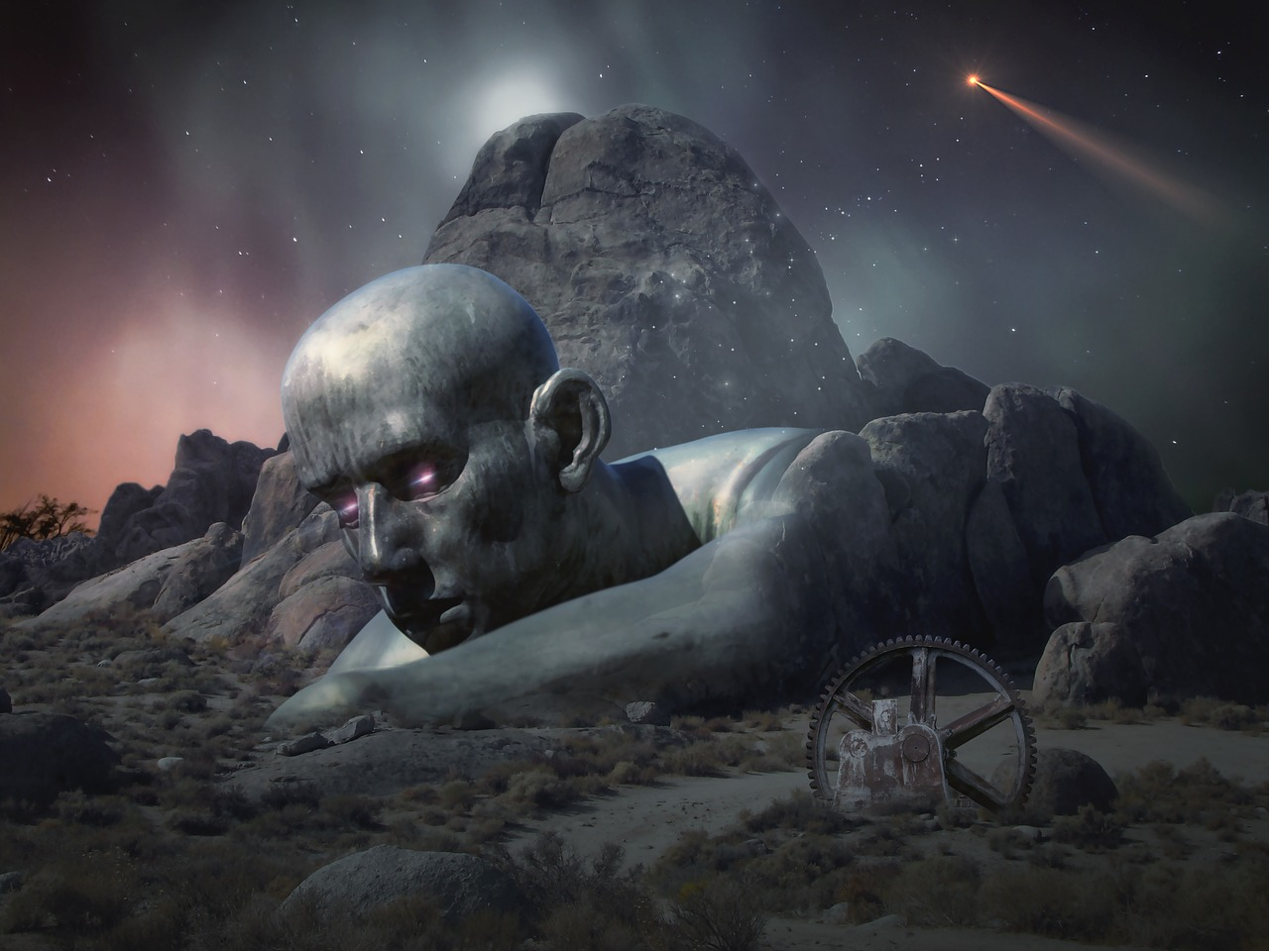
战争世界的启示：帝国主义、科学与人性的交织
通过《世界大战》小说探讨19世纪末的社会变革与文学表现手法

Slide 2
战争世界的启示：帝国主义、科学与人性的交织
2
Table of Contents
Introduction to War of the Worlds
Historical Context
Literary Devices
Themes
Character Analysis
Plot Summary
Symbolism
Imagery
Foreshadowing
Historical Context and Literary Devices
Character Development
Themes and Literary Devices
Conclusion
04
05
06
07
08
09
10
11
12
13
14
15
16

Slide 3
战争世界的启示：帝国主义、科学与人性的交织
3
Table of Contents
Assessment
Extension Activities
Reflection Questions
Next Steps
17
18
19
20

Slide 4
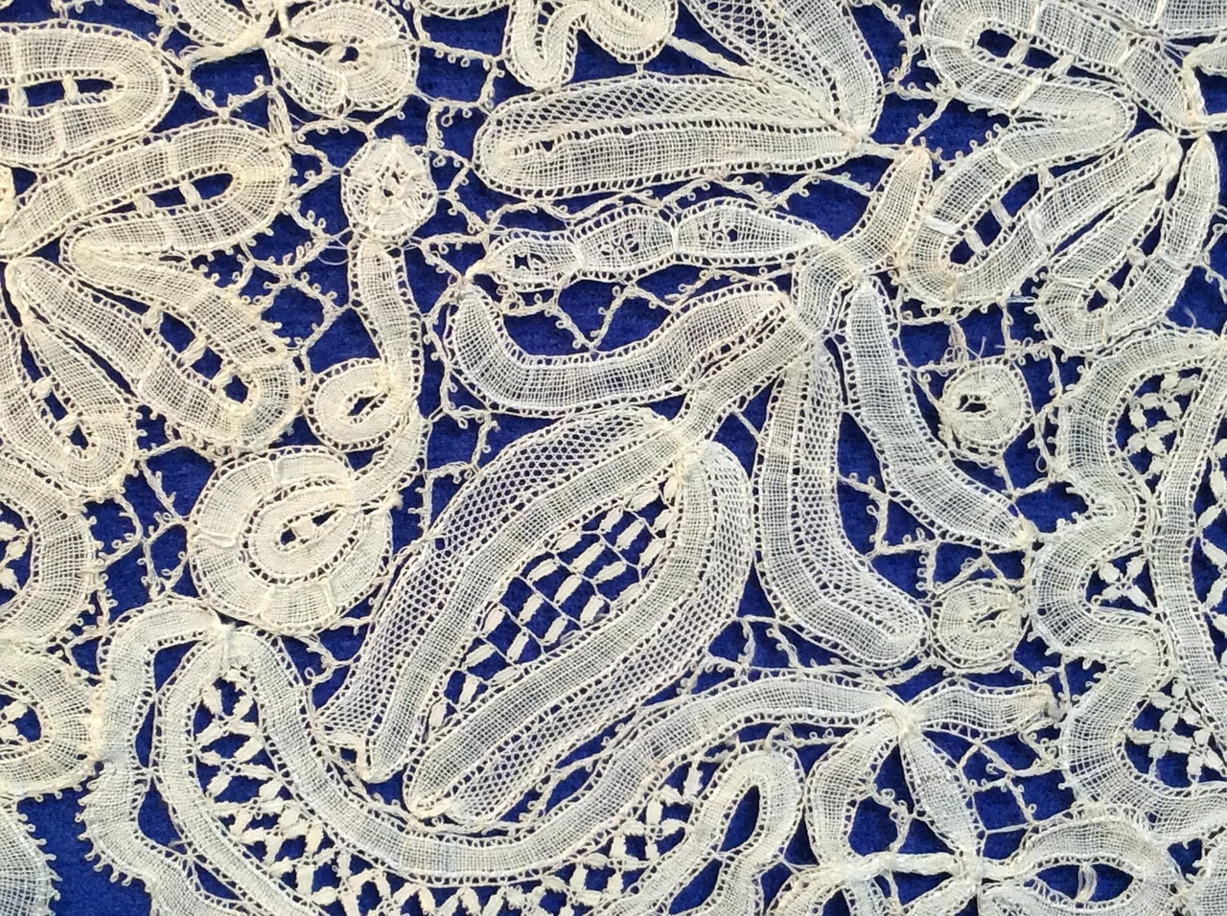
战争世界的启示：帝国主义、科学与人性的交织
4
Introduction to War of the Worlds
Overview of the Novel
Historical Context
Lesson Plan Focus
War of the Worlds is a classic science fiction novel written by H.G. Wells in 1898.
The novel tells the story of a Martian invasion of Earth and explores themes of imperialism, science, and humanity.
The novel was published during a time of rapid scientific discovery and imperial expansion.
It reflects the anxieties and ambitions of the late 19th century.
This lesson plan is designed to introduce 14-year-old students to the novel and its historical context.
Students will explore the themes and significance of the story in relation to its time.

Slide 5
战争世界的启示：帝国主义、科学与人性的交织
5
Historical Context
Social and Political Change
Expansion of the British Empire
Fears and Anxieties of the Era
Importance of Historical Context
The novel was written during a time of great social and political change in the late 19th century.
This period was marked by significant shifts in societal norms and governance.
The British Empire was expanding its colonies and territories, leading to concerns about imperialism and the treatment of colonized peoples.
This expansion raised questions about ethics and power dynamics.
The novel reflects the fears and anxieties of the time, including the threat of invasion and the rise of science and technology.
These concerns were deeply embedded in the cultural consciousness of the period.
The historical context is essential to understanding the novel's themes and literary devices.
It provides a lens through which the narrative and its implications can be fully appreciated.

Slide 6

战争世界的启示：帝国主义、科学与人性的交织
6
Literary Devices
Imagery in the Novel
Symbolism and Themes
Imagery is used to describe the Martian invasion and the destruction of London.
This creates a vivid and immersive experience for the reader.
Symbolism is used to represent the themes of imperialism and science, such as the Martian tripod and the black smoke.
These symbols deepen the narrative's exploration of its central ideas.
Foreshadowing Impending Disaster
Literary Devices in Action
Foreshadowing is used to hint at the impending disaster and the consequences of the invasion.
This technique builds tension and prepares the reader for the unfolding events.
The novel uses literary devices such as imagery, symbolism, and foreshadowing.
These elements work together to create a compelling and thought-provoking story.

Slide 7
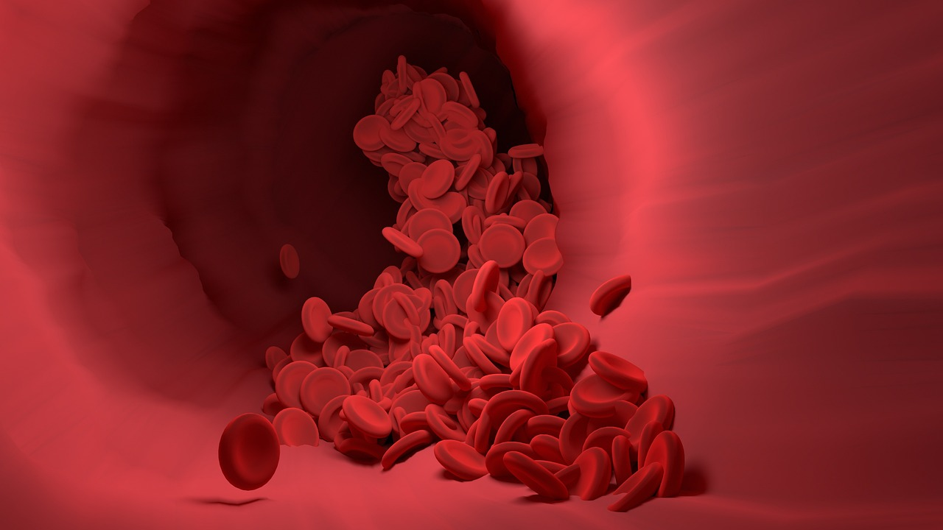
战争世界的启示：帝国主义、科学与人性的交织
7
Themes
Imperialism
Science
Imperialism is represented through the Martian invasion and the treatment of colonized peoples.
The novel explores themes of imperialism, science, and humanity.
Science is represented through the Martian technology and the human response to the invasion.
The novel explores themes of imperialism, science, and humanity.
Humanity
Themes Overview
Humanity is represented through the characters' experiences and relationships during the invasion.
The novel explores themes of imperialism, science, and humanity.
The novel explores themes of imperialism, science, and humanity.
These themes are interwoven to provide a compelling narrative.

Slide 8

战争世界的启示：帝国主义、科学与人性的交织
8
Character Analysis
The Narrator's Role
The Artilleryman's Perspective
The narrator is the protagonist of the novel and provides a firsthand account of the invasion.
Their perspective shapes the reader's understanding of the events and themes.
The artilleryman represents the voice of reason and humanity in the face of the invasion.
His actions and thoughts offer a grounded approach to survival and resilience.
The Curate's Response
Interpersonal Dynamics
The curate represents the spiritual and emotional response to the invasion.
His character highlights the struggle between faith and despair during crises.
The characters' relationships and interactions are essential to understanding the novel's themes and literary devices.
These dynamics reveal deeper insights into human behavior and societal impact during the invasion.

Slide 9
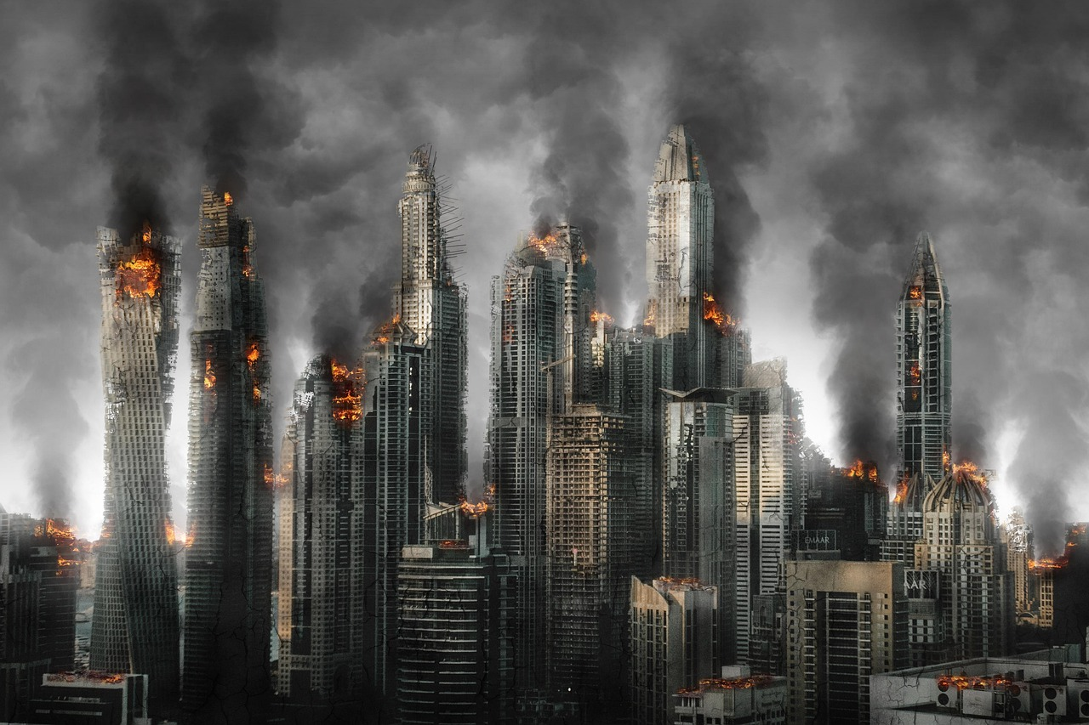
战争世界的启示：帝国主义、科学与人性的交织
9
Plot Summary
Martians' Arrival and Initial Attacks
Destruction of London
Exploration of Themes
Defeat of the Martians
The novel begins with the arrival of the Martians on Earth and their initial attacks on human populations.
This sets the stage for the conflict and chaos that follows.
The narrator describes the destruction of London and the human response to the invasion.
This highlights the scale of devastation and the struggle for survival.
The novel explores the themes of imperialism, science, and humanity through the characters' experiences and relationships.
These themes provide depth and context to the unfolding events.
The novel ends with the defeat of the Martians and the rebuilding of human society.
This resolution brings closure to the story and reflects on human resilience.

Slide 10

战争世界的启示：帝国主义、科学与人性的交织
10
Symbolism
Martian Power and Technology
The Martian tripod represents the power and technology of the Martians.
It symbolizes their advanced capabilities and dominance over humanity.
Destruction and Chaos
The black smoke represents the destruction and chaos caused by the invasion.
It serves as a metaphor for the overwhelming force and devastation brought by the Martians.
Martian Influence
The red weed represents the spread of the Martian influence and the destruction of human society.
It highlights the invasive and transformative impact of the Martian presence.
Symbolism in Themes
Symbolism is used throughout the novel to represent the themes and literary devices.
It enriches the narrative by providing deeper meaning and connections to the story's events.

Slide 11
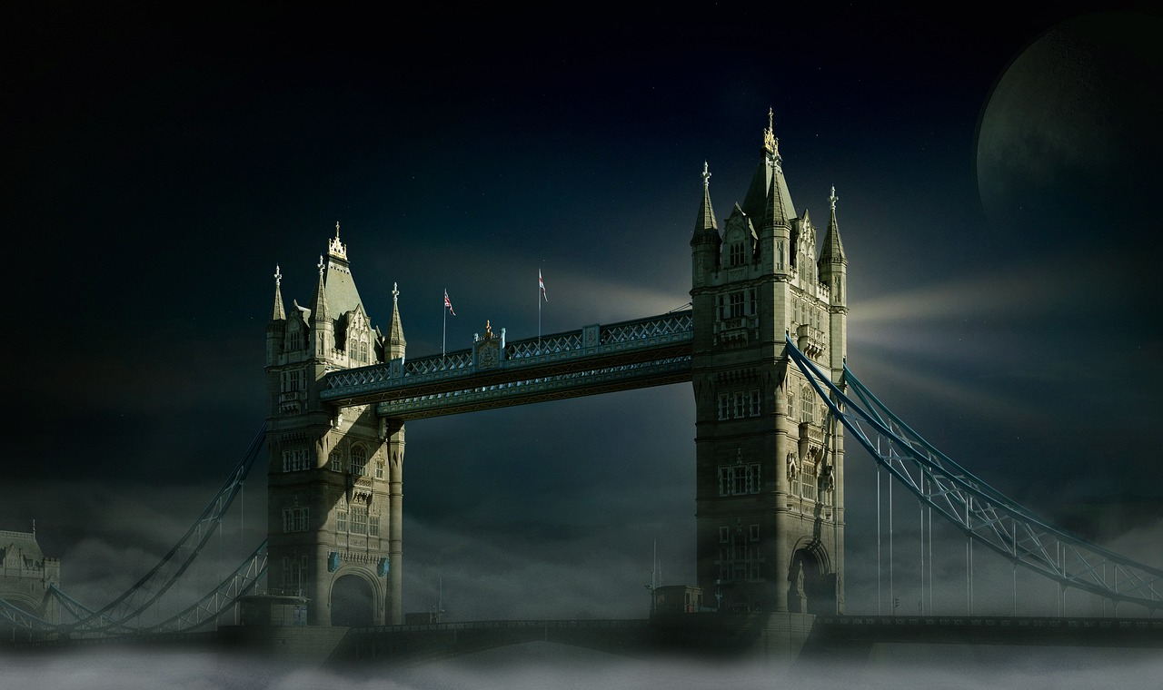
战争世界的启示：帝国主义、科学与人性的交织
11
Imagery
Martian Invasion Imagery
Themes Represented Through Imagery
Imagery is used to describe the Martian invasion and the destruction of London.
The author uses vivid and descriptive language to create a sense of realism and immersion.
Imagery is used to represent the themes of imperialism, science, and humanity.
These themes are intricately woven into the narrative through detailed descriptions.
Tension and Suspense
Realism and Immersion
The use of imagery helps to create a sense of tension and suspense throughout the novel.
This technique keeps readers engaged and heightens the emotional impact of the story.
The vivid language employed by the author enhances the realism of the Martian invasion.
It immerses readers into the catastrophic events unfolding in the story.

Slide 12

战争世界的启示：帝国主义、科学与人性的交织
12
Foreshadowing
Hinting at Impending Disaster
Themes Representation
Foreshadowing is used to hint at the impending disaster and the consequences of the invasion.
The author uses foreshadowing to create a sense of tension and suspense throughout the novel.
Foreshadowing is used to represent the themes of imperialism, science, and humanity.
The use of foreshadowing helps to create a sense of inevitability and tragedy.
Creating Tension and Suspense
Sense of Inevitability
The author uses foreshadowing to create a sense of tension and suspense throughout the novel.
Foreshadowing is used to hint at the impending disaster and the consequences of the invasion.
The use of foreshadowing helps to create a sense of inevitability and tragedy.
Foreshadowing is used to represent the themes of imperialism, science, and humanity.

Slide 13

战争世界的启示：帝国主义、科学与人性的交织
13
Historical Context and Literary Devices
Historical Context's Role
Reflection of Societal Fears
Interplay of Context and Devices
Complex Narrative Creation
The historical context of the novel is essential to understanding the literary devices and themes.
The novel reflects the fears and anxieties of the time, including the threat of invasion and the rise of science and technology.
The novel reflects the fears and anxieties of the time, including the threat of invasion and the rise of science and technology.
The literary devices used in the novel, such as imagery and symbolism, are influenced by the historical context.
The literary devices used in the novel, such as imagery and symbolism, are influenced by the historical context.
The historical context and literary devices work together to create a rich and complex narrative.
The historical context and literary devices work together to create a rich and complex narrative.
The historical context of the novel is essential to understanding the literary devices and themes.

Slide 14
战争世界的启示：帝国主义、科学与人性的交织
14
Character Development
Complex and Well-Developed Characters
Firsthand Account of the Invasion
Diverse Perspectives on the Invasion
Relationships and Themes
The characters in the novel are well-developed and complex.
Their depth adds richness to the narrative and engages the reader.
The narrator provides a firsthand account of the invasion and its effects on human society.
This perspective immerses the reader in the unfolding events and their consequences.
The artilleryman and the curate represent different perspectives on the invasion and its consequences.
These contrasting viewpoints highlight the varied human responses to crisis.
The characters' relationships and interactions are essential to understanding the novel's themes and literary devices.
These dynamics reveal deeper insights into the story's message and structure.

Slide 15
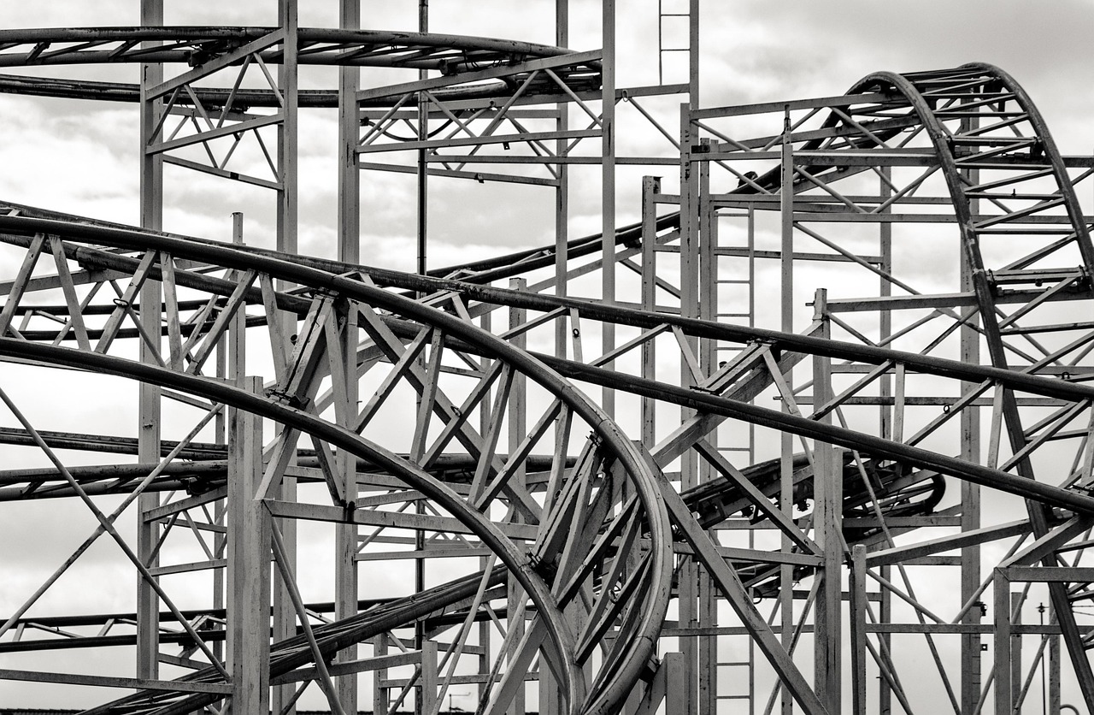
战争世界的启示：帝国主义、科学与人性的交织
15
Themes and Literary Devices
Exploration of Themes
The novel explores themes of imperialism, science, and humanity.
These themes provide a foundation for the narrative's depth and complexity.
Use of Literary Devices
The literary devices used in the novel, such as imagery and symbolism, represent these themes.
These devices enhance the storytelling and bring the themes to life.
Interplay of Themes and Devices
The themes and literary devices work together to create a rich and complex narrative.
This interplay adds layers of meaning to the novel.
Social and Political Commentary
The novel provides a commentary on the social and political issues of the time, including imperialism and the rise of science and technology.
This commentary reflects the historical context in which the novel was written.

Slide 16

战争世界的启示：帝国主义、科学与人性的交织
16
Conclusion
Themes Explored
War of the Worlds is a classic science fiction novel that explores themes of imperialism, science, and humanity.
The novel provides a commentary on the social and political issues of the time, including imperialism and the rise of science and technology.
Literary Devices
The literary devices used in the novel, such as imagery and symbolism, represent the themes.
These devices create a rich and complex narrative that enhances the reader's experience.
Social Commentary
The novel provides a commentary on the social and political issues of the time.
It highlights the impact of imperialism and the rise of science and technology on society.

Slide 17

战争世界的启示：帝国主义、科学与人性的交织
17
Assessment
Historical Context and Literary Devices
Themes and Characters Analysis
Students will be assessed on their understanding of the novel's historical context and literary devices.
This includes recognizing the significance of the time period and the techniques used by the author.
Students will be assessed on their ability to analyze the themes and characters of the novel.
They must demonstrate a deep understanding of the narrative and its underlying messages.
Critical Thinking and Contemporary Connections
Effective Communication of Ideas
Students will be assessed on their ability to think critically and make connections between the novel and contemporary society.
This involves drawing parallels and understanding the relevance of the novel in today's world.
Students will be assessed on their ability to communicate their ideas and analysis effectively.
Clear articulation and structured arguments are key components of this assessment.

Slide 18

战争世界的启示：帝国主义、科学与人性的交织
18
Extension Activities
Visual Representation Projects
Creative Writing Inspired by the Novel
Students can create a visual project, such as a graphic novel or a video, to represent the novel's themes and literary devices.
This activity encourages creativity and a deeper understanding of the novel's core elements.
Students can write a creative piece, such as a short story or a poem, inspired by the novel.
This allows them to explore their own interpretations and connections to the text.
Research and Presentation Topics
Debates and Discussions
Students can research and present on a topic related to the novel, such as the history of science fiction or the impact of imperialism.
This activity fosters critical thinking and contextual understanding of the novel's themes.
Students can participate in a debate or discussion on a topic related to the novel, such as the ethics of scientific discovery or the consequences of imperialism.
This encourages analytical skills and engagement with complex issues presented in the novel.

Slide 19

战争世界的启示：帝国主义、科学与人性的交织
19
Reflection Questions
Major Themes and Literary Devices
Social and Political Commentary
Contemporary Implications
Teaching Critical Thinking
What are the major themes of the novel, and how are they represented through the literary devices?
How does the novel provide a commentary on the social and political issues of the time?
How does the novel provide a commentary on the social and political issues of the time?
What are the implications of the novel's themes and literary devices for contemporary society?
What are the implications of the novel's themes and literary devices for contemporary society?
How can the novel be used to teach critical thinking and analysis skills?
How can the novel be used to teach critical thinking and analysis skills?
What are the major themes of the novel, and how are they represented through the literary devices?

Slide 20
战争世界的启示：帝国主义、科学与人性的交织
20
Next Steps
Exploring Themes and Devices
Applying Critical Thinking
Students can continue to explore the themes and literary devices of the novel through further reading and analysis.
This allows for a deeper understanding of the novel's complexities and its broader implications.
Students can apply the critical thinking and analysis skills developed through the study of the novel to other texts and topics.
This skillset is transferable and enhances their ability to engage with diverse materials.
Researching Related Topics
Creating a Final Project
Students can use the novel as a starting point for further research and exploration of related topics, such as the history of science fiction or the impact of imperialism.
This encourages interdisciplinary learning and a broader perspective on the novel's context.
Students can create a final project, such as a presentation or a written essay, to demonstrate their understanding of the novel and its themes.
This provides an opportunity to synthesize their insights and showcase their analytical abilities.

