Slide 1

Introduction to Nouns and Verbs
Understanding the Building Blocks of Language: Nouns and Verbs in Sentence Structure

Slide 2
Introduction to Nouns and Verbs
2
Table of Contents
Introduction to Nouns and Verbs
What is a Noun?
What is a Verb?
Nouns and Verbs in Sentence Structure
Identifying Nouns and Verbs
Guided Practice: Noun Sorting
Guided Practice: Verb Charades
Independent Practice: Sentence Building
Game Activity: Noun and Verb Match
Conclusion
03
04
05
06
07
08
09
10
11
12

Slide 3
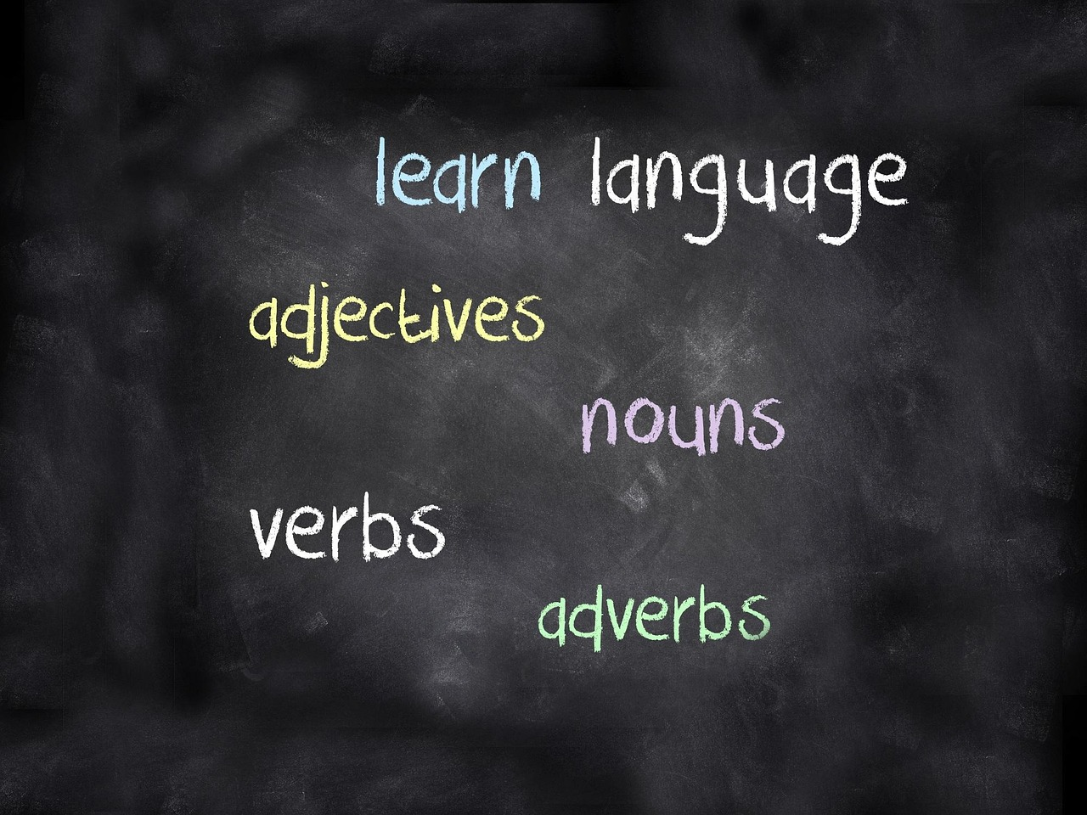
Introduction to Nouns and Verbs
3
Introduction to Nouns and Verbs
Building Blocks of Language
Importance of Understanding
Lesson Overview
Nouns and verbs are the building blocks of language.
They form the foundation for constructing meaningful sentences.
Understanding nouns and verbs is essential for effective communication.
They help convey clear and precise messages.
This lesson will introduce the basics of nouns and verbs.
It will explain their roles in sentence structure.

Slide 4
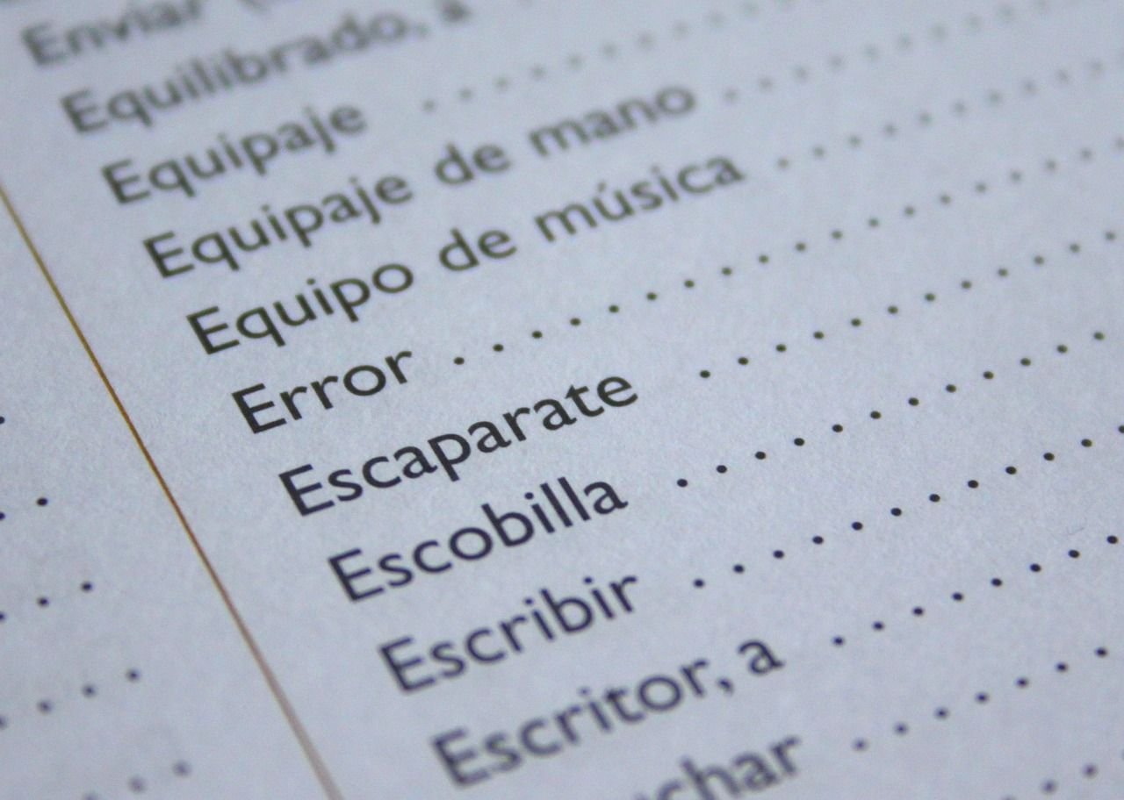
Introduction to Nouns and Verbs
4
What is a Noun?
Definition of a Noun
Examples of Nouns
A noun is a word that refers to a person, place, thing, or idea.
It serves as a fundamental building block in language.
Examples include dog, city, and happiness.
These illustrate the diverse range of entities nouns can represent.
Types of Nouns
Singular and Plural Forms
Nouns can be categorized as proper, common, concrete, abstract, or collective.
Each type serves a specific function in identifying and describing entities.
Nouns can exist in singular or plural forms.
This distinction helps in specifying quantity or number.

Slide 5

Introduction to Nouns and Verbs
5
What is a Verb?
Definition of a Verb
Examples of Verbs
A verb is a word that expresses action or a state of being.
It is a fundamental part of speech in language.
Examples of verbs include run, jump, and read.
These words demonstrate actions or states of being.
Types of Verbs
Verb Tenses
Verbs can be categorized into action, linking, and helping types.
Each type serves a unique function in sentence construction.
Verbs can appear in different tenses such as past, present, and future.
Tenses indicate the timing of the action or state described by the verb.

Slide 6
Introduction to Nouns and Verbs
6
Nouns and Verbs in Sentence Structure
Role of Nouns in Sentences
Function of Verbs in Sentences
Illustrative Example
Nouns serve as subjects or objects in sentences.
They are essential for identifying the main entities involved in actions or states.
Verbs express the actions or states of being of the subjects.
They provide the dynamic element that drives the sentence forward.
Example: 'The dog (noun) runs (verb) quickly'.
This demonstrates how nouns and verbs interact to form meaningful sentences.

Slide 7
Introduction to Nouns and Verbs
7
Identifying Nouns and Verbs
Understanding Sentence Components
Illustrative Examples
Visual Learning Techniques
Practical Exercises
Read a sentence and identify the nouns and verbs.
Use visual aids such as diagrams or charts to help identify nouns and verbs.
Examples: 'The teacher (noun) writes (verb) on the board'.
Practice identifying nouns and verbs in different sentences.
Use diagrams or charts to visually distinguish nouns and verbs.
These aids can simplify the process of identifying sentence components.
Engage in activities to identify nouns and verbs in various sentences.
This practice enhances understanding and application of grammar rules.

Slide 8

Introduction to Nouns and Verbs
8
Guided Practice: Noun Sorting
Sorting Words into Categories
Examples of Nouns
Examples of Non-Nouns
Sort a set of words into nouns and non-nouns.
Use a visual sorting mat to help categorize words.
Examples include: dog, city, happiness.
These are categorized as nouns.
Examples include: run, jump, read.
These are categorized as non-nouns.

Slide 9

Introduction to Nouns and Verbs
9
Guided Practice: Verb Charades
Interactive Activity
Examples of Verbs
Purpose of the Game
Act out a verb without speaking.
Peers guess the verb being acted out.
Examples include run, jump, and read.
These verbs can be acted out for others to guess.
The activity helps in understanding and practicing verbs.
It encourages teamwork and creativity.

Slide 10

Introduction to Nouns and Verbs
10
Independent Practice: Sentence Building
Building Sentences with Word Cards
Examples of Simple Sentences
Independent Practice Activity
Use a set of word cards to build simple sentences.
Include a noun and a verb in each sentence.
Examples: 'The dog runs', 'The teacher writes'.
These sentences demonstrate the use of nouns and verbs.
This activity focuses on sentence building skills.
It encourages creativity and understanding of sentence structure.

Slide 11

Introduction to Nouns and Verbs
11
Game Activity: Noun and Verb Match
Game Objective
Match nouns with corresponding verbs.
Use a game board or online resource to play the game.
Example Pairing
Examples: dog (noun) and runs (verb).
This helps in understanding the relationship between nouns and verbs.
Interactive Learning
Engage in a fun and educational activity.
Enhance grammar skills through gameplay.

Slide 12

Introduction to Nouns and Verbs
12
Conclusion
Key Concepts Recap
Student Reflections
Feedback and Encouragement
Review the key concepts learned in the lesson.
Ensure students understand the main ideas discussed.
Ask students to share one thing they learned about nouns and verbs.
Encourage participation to reinforce learning.
Provide feedback and encouragement for future lessons.
Motivate students to continue their learning journey.

