Slide 1

Mastering Your Reading Journey
Exploring Styles, Goals, and Strategies for Lifelong Learning

Slide 2


Table of contents
Welcome to Understanding Your Reading Style and Set…
What is Your Reading Style?
Why Set Reading Goals?
What are SMART Goals?
Creating a Personalized Reading Plan
Reading Comprehension Strategies
Overcoming Reading Challenges
The Importance of Reflection
Technology and Reading
Creating a Reading Community
Setting Up a Home Reading Environment
Parental Involvement
Conclusion
01
02
03
04
05
06
07
08
09
10
11
12
13

Slide 3
Table of contents
Next Steps
Reflection Questions
Final Thoughts
Additional Resources
14
15
16
17

Slide 4

Welcome to Understanding Your Reading Style and Setting Goals
Reading Styles
Effective Reading
Lesson Overview
Reading styles are the unique approaches individuals take when engaging with text.
Recognizing your reading style can significantly enhance comprehension and retention.
Effective reading involves strategies that match your reading style.
By leveraging your strengths, you can boost your reading efficiency.
We will explore different reading styles and their effects on comprehension.
Our objectives include setting personal goals to improve your reading experience.
1
Mastering Your Reading Journey

Slide 5

What is Your Reading Style?
Visual Readers
Auditory Readers
They prefer to see information presented visually, such as through charts, graphs, and images.
Visual aids help them understand and retain information better.
They learn best through listening and verbal communication.
Audiobooks and discussions enhance their comprehension and retention.
Kinesthetic Readers
Identify Your Style
They prefer a hands-on approach to learning, engaging with materials physically.
Activities like writing or using models help them grasp concepts effectively.
Recognizing your reading style can significantly enhance your reading experience.
Tailoring your approach to match your style can improve comprehension and enjoyment.
2
Mastering Your Reading Journey

Slide 6

Why Set Reading Goals?
Direction & Motivation
Track Progress
Enhance Literacy
Setting reading goals provides a clear direction for your reading journey.
It serves as a source of motivation to keep you engaged and focused.
Establishing goals allows you to monitor your reading progress over time.
Celebrating small achievements boosts your confidence and encourages further reading.
Reading goals can significantly enhance your overall reading experience.
They help improve literacy skills by encouraging diverse reading materials.
3
Mastering Your Reading Journey

Slide 7

What are SMART Goals?
Clear Objectives
Trackable Progress
Realistic Targets
Define what you want to achieve in specific terms. This clarity helps in focusing efforts effectively.
Establish criteria for measuring progress. This allows for adjustments to be made as needed.
Set goals that are attainable based on current resources and time. This ensures motivation and reduces frustration.
Aligned Interests
Set Deadlines
Ensure that the goals resonate with your personal or professional interests. This alignment increases commitment and engagement.
Assign a specific timeframe for achieving each goal. Deadlines create urgency and help prioritize tasks.
4
Mastering Your Reading Journey

Slide 8

Creating a Personalized Reading Plan
Reading Goals
Text Selection
Identify specific objectives for your reading journey, such as improving comprehension or exploring new genres.
Set measurable targets, like reading a certain number of books per month.
Choose texts that resonate with your interests and align with your reading goals.
Consider varying genres and formats to keep your reading experience engaging.
Dedicated Time
Overcoming Challenges
Establish a regular reading schedule that fits into your daily routine.
Aim for uninterrupted time to fully immerse yourself in the material.
Identify potential obstacles, such as distractions or time constraints, and plan accordingly.
Develop strategies, like setting small reading milestones, to stay motivated.
5
Mastering Your Reading Journey

Slide 9

Reading Comprehension Strategies
Summarizing
Visualizing
Questioning
Paraphrase the core concepts in your own words for better retention.
Highlight the essential points to capture the main ideas.
Visualize concepts to foster a deeper grasp of the material.
Create mental images that represent the key ideas.
Pose inquiries regarding the text to enrich your understanding.
Challenge the content by asking about its implications.
Connecting
Evaluating
Link the material to your existing knowledge or personal experiences for greater engagement.
Draw parallels between the text and real-life situations.
Critically evaluate the information for its trustworthiness and significance.
Examine the arguments presented for their validity and impact.
6
Mastering Your Reading Journey

Slide 10

Overcoming Reading Challenges
Identify Challenges
Develop Strategies
Recognize specific reading difficulties and evaluate their contributing factors.
Create a targeted plan to tackle identified challenges.
Seek Support
Stay Motivated
Engage with teachers for guidance and collaborate with peers to enhance learning.
Acknowledge progress to enhance confidence and set realistic goals for continuous growth.
7
Mastering Your Reading Journey

Slide 11
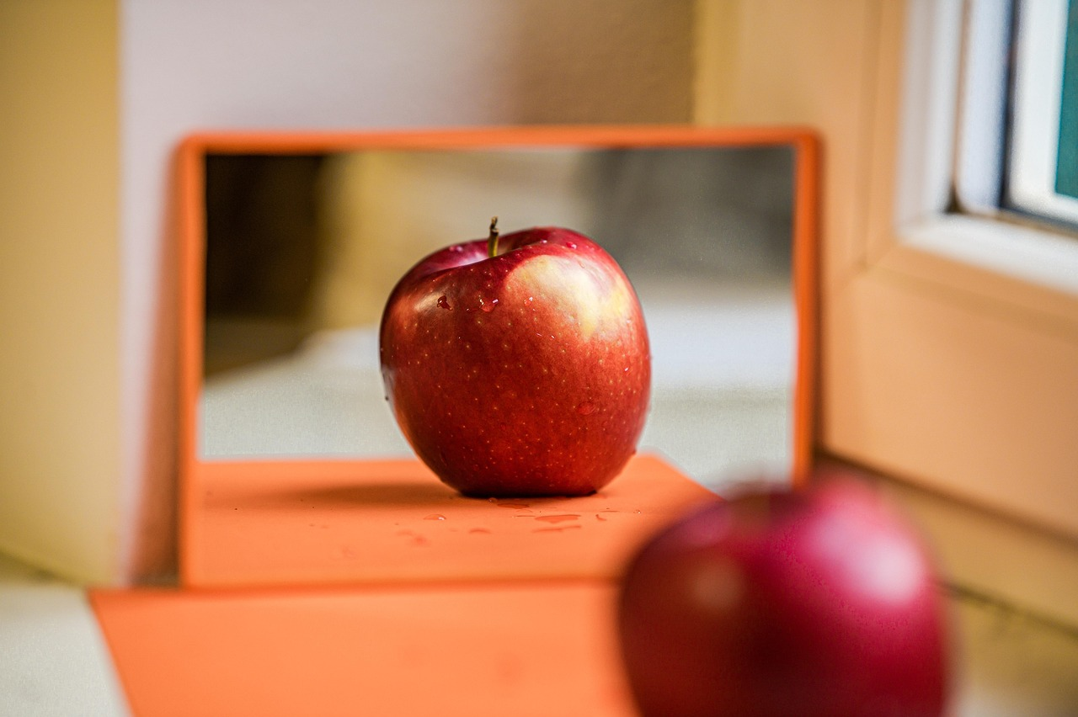
The Importance of Reflection
Learning Insights
Improvement Areas
Strategy Adjustments
Reflecting on reading experiences helps in understanding what was learned.
It encourages deeper engagement with the material.
Identifying areas for improvement allows for targeted growth.
Recognizing what needs to be worked on enhances future reading efforts.
Adjusting reading strategies can lead to a more effective reading experience.
Making changes based on reflection can improve comprehension and retention.
8
Mastering Your Reading Journey

Slide 12
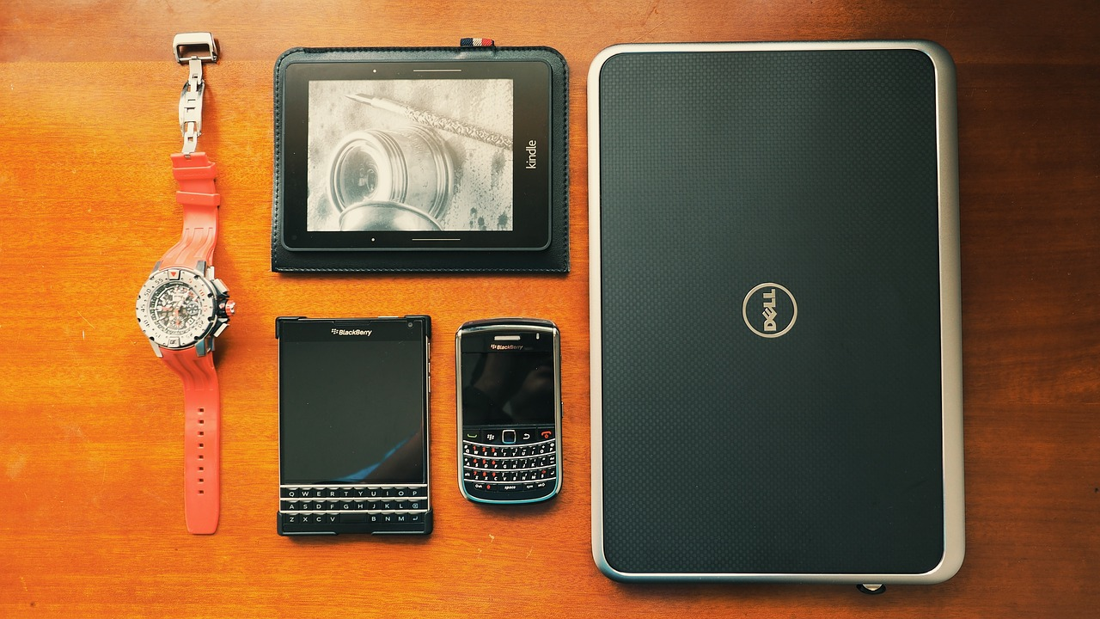
Technology and Reading
E-Readers & Audiobooks
Reading Apps
Access texts in various formats, including digital and audio.
Enhance reading experiences with features like adjustable text size and narration.
Utilize digital tools to support and enhance reading habits.
Track progress, highlight text, and take notes easily.
Online Resources
Digital Communities
Access a wide range of reading materials and educational support online.
Find articles, e-books, and study guides at your fingertips.
Connect with other readers through online platforms and forums.
Share recommendations, reviews, and engage in discussions about books.
9
Mastering Your Reading Journey

Slide 13

Creating a Reading Community
Book Clubs
Reading Buddies
Online Forums
Join a group to discuss and analyze books together.
Share insights and different perspectives on various genres.
Pair up with a partner to share your reading journey.
Exchange thoughts and recommendations to enhance your experience.
Engage with a community of readers from around the world.
Participate in discussions and share reviews on various platforms.
10
Mastering Your Reading Journey

Slide 14
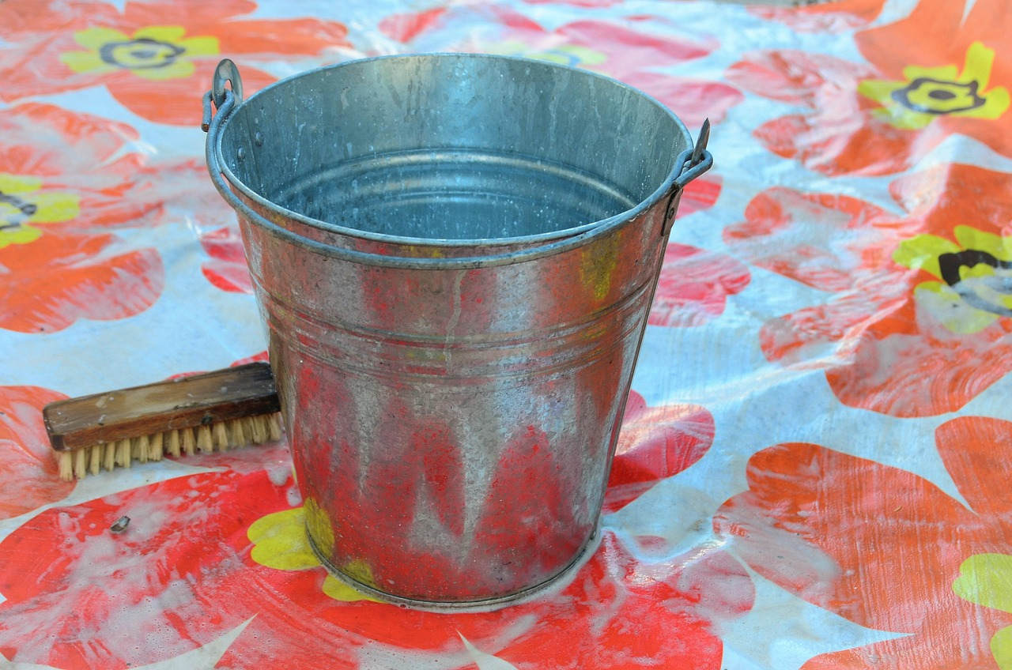
Setting Up a Home Reading Environment
Reading Nook
Screen Limits
Create a dedicated space for reading, free from distractions.
Ensure the area is comfortable with good lighting and seating.
Set clear boundaries for screen time to encourage reading.
Use timers or schedules to manage device usage effectively.
Home Support
Book Access
Encourage daily reading habits by setting aside time for books.
Discuss stories and characters to enhance comprehension and interest.
Provide a variety of reading materials, including books and magazines.
Visit libraries or bookstores regularly to keep the reading selection fresh.
11
Mastering Your Reading Journey

Slide 15
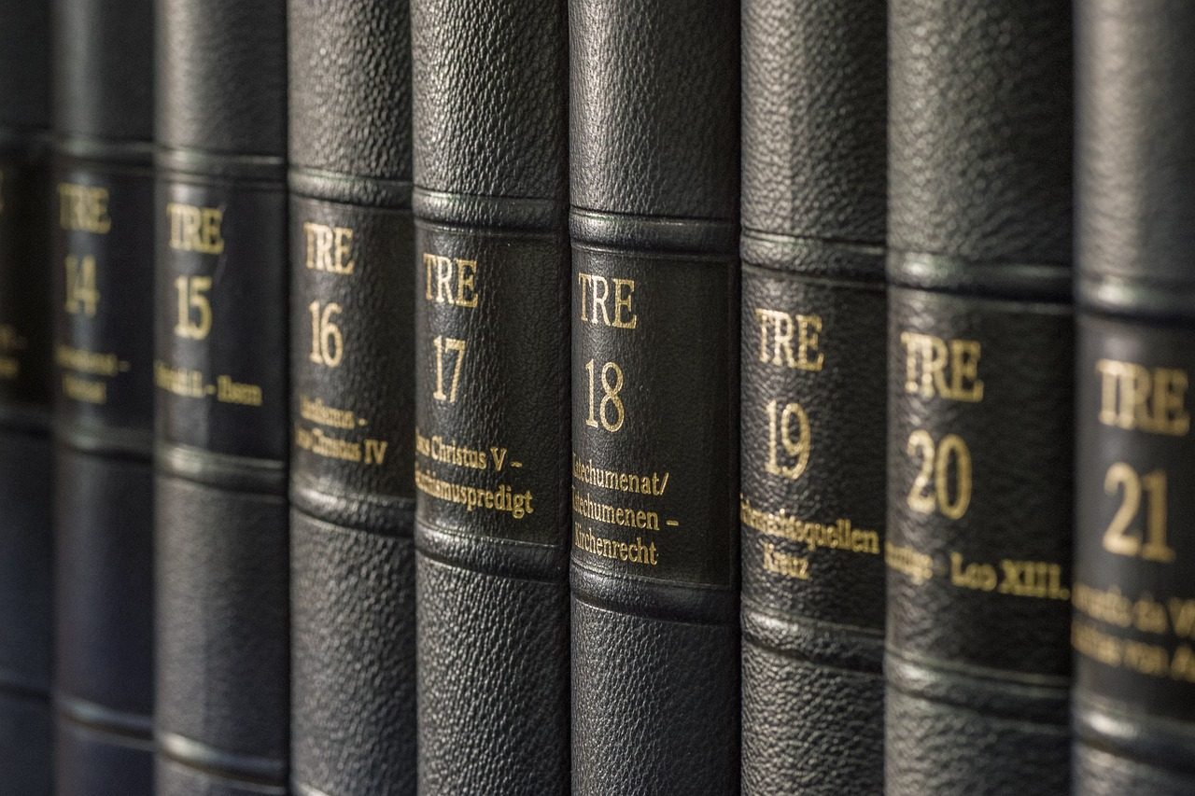
Parental Involvement
Shared Reading
Reading Goals
Reading Space
Engage in reading together to enhance comprehension and enjoyment.
Discuss the story and characters to deepen understanding.
Set achievable reading goals to motivate your child.
Regularly review progress and celebrate achievements.
Create a cozy and inviting reading nook at home.
Ensure access to a variety of books to spark interest.
12
Mastering Your Reading Journey

Slide 16

Conclusion
Reading Styles
Goal Setting
Understanding your reading style can enhance comprehension and retention.
Adapting your approach to reading can lead to more effective learning.
Setting clear goals provides direction and motivation for your reading journey.
Regularly reviewing and adjusting your goals can help maintain progress and engagement.
13
Mastering Your Reading Journey

Slide 17
Next Steps
Genre Exploration
Comprehension Strategies
Reading Communities
Explore various genres to broaden your reading horizons.
Discover new authors and styles that resonate with you.
Implement reading strategies to enhance understanding and retention.
Practice summarizing and questioning to improve skills.
Join book clubs to connect with fellow readers and share insights.
Engage in discussions to deepen your appreciation of literature.
14
Mastering Your Reading Journey

Slide 18

Reflection Questions
Reading Style Insights
Application Strategies
I discovered that I tend to skim through texts rather than read them thoroughly.
This insight will help me focus on comprehension rather than speed.
I plan to implement active reading techniques, such as note-taking and summarizing.
These strategies will enhance my understanding and retention of the material.
Anticipated Challenges
Reading Goals
I anticipate distractions that may hinder my focus during reading sessions.
To overcome this, I will create a dedicated reading environment free from interruptions.
My goal is to read at least one book per month to broaden my knowledge.
I will set aside specific times each week to ensure I stay on track.
15
Mastering Your Reading Journey

Slide 19
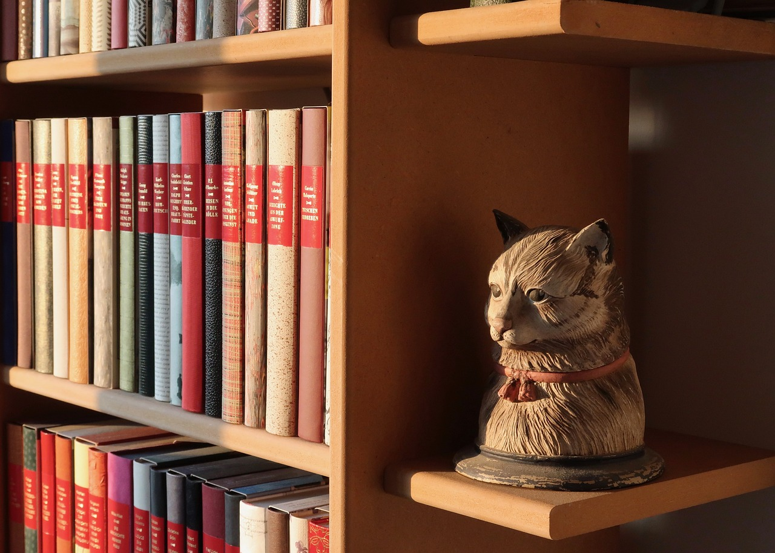
Final Thoughts
Reading Journey
Ongoing Support
Reading is a journey that involves embracing the process of learning and growing.
Each book opens new perspectives and opportunities for personal development.
Continued support is essential for encouraging ongoing reading and learning.
Engaging with communities and resources can enhance the reading experience.
16
Mastering Your Reading Journey

Slide 20
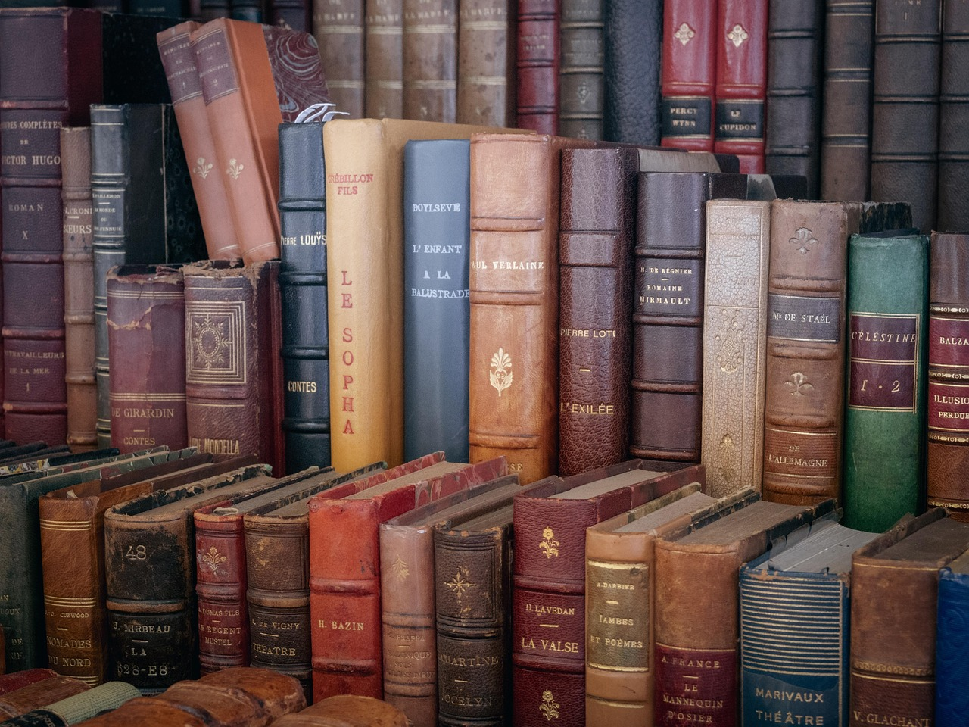
Additional Resources
Reading Lists
Online Resources
Reader Communities
Discover essential book lists that deepen your knowledge on various subjects.
These selections include both timeless classics and modern must-reads.
Access a variety of digital materials, from insightful articles to comprehensive e-books.
These resources serve as valuable supplements to your reading journey.
Engage with fellow book lovers through online platforms and local meetups.
Sharing insights and experiences can greatly enhance your reading adventure.
17
Mastering Your Reading Journey

