Slide 1

Solving Simple Word Problems with Real-Life Scenarios
Engaging 8-Year-Old Students in Practical Math through Critical Thinking and Visual Aids

Slide 2
Table of Contents
Welcome to Solving Simple Word Problems with R…
What are Word Problems?
Why are Word Problems Important?
How to Solve Word Problems
Example Word Problem
Solution to Example Word Problem
Real-Life Scenarios
Activity 1: Word Problem Sorting
Activity 2: Real-Life Scenario Mapping
Activity 3: Word Problem Solving
Activity 4: Math Charades
Activity 5: Word Problem Creation
Independent Practice
04
05
06
07
08
09
10
11
12
13
14
15
16

Slide 3
Table of Contents
Assessment and Evaluation
Conclusion
Next Steps
Reflection Questions
Parent Engagement
Safety Considerations
Teaching Tips
17
18
19
20
21
22
23

Slide 4
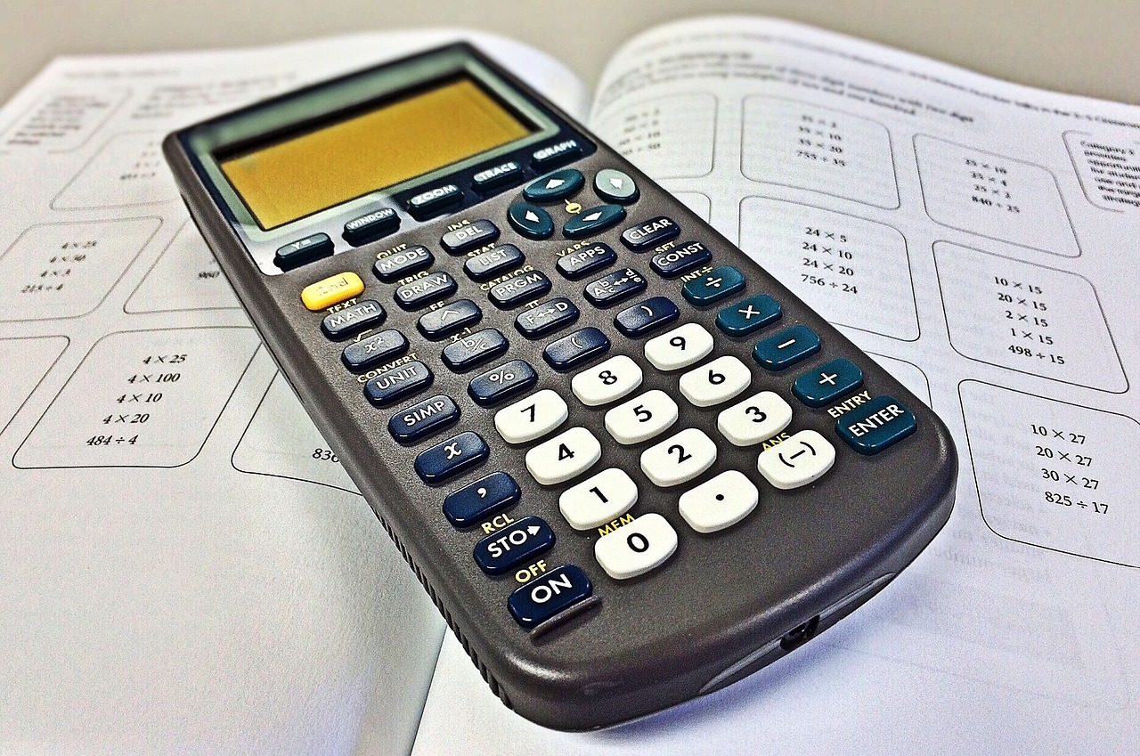
Welcome to Solving Simple Word Problems with Real-Life Scenarios
Introduction to Word Problems
Practical Application of Math
Importance of Real-Life Scenarios
This lesson plan is designed to introduce 8-year-old students to the concept of solving simple word problems using real-life scenarios.
The topic is crucial for this age group as it lays the foundation for more complex mathematical concepts.
The lesson helps students understand the practical application of math in everyday life.
By using real-life scenarios, students will be able to relate to the problems and develop a deeper understanding of the subject matter.
Real-life scenarios make the learning process engaging and relatable for students.
This approach fosters a deeper connection to the subject matter and enhances comprehension.
4
Solving Simple Word Problems with Real-Life Scenarios

Slide 5

What are Word Problems?
Definition of Word Problems
Importance in Education
Word problems are a type of mathematical problem that uses real-life scenarios to model mathematical concepts.
They are an essential part of mathematics education, as they help students develop problem-solving skills and apply mathematical concepts to everyday situations.
Word problems are a type of mathematical problem that uses real-life scenarios to model mathematical concepts.
They are an essential part of mathematics education, as they help students develop problem-solving skills and apply mathematical concepts to everyday situations.
5
Solving Simple Word Problems with Real-Life Scenarios

Slide 6
Why are Word Problems Important?
Critical Thinking and Problem-Solving
Real-Life Application of Math
Communication and Reasoning Skills
Word problems help students develop critical thinking and problem-solving skills.
They encourage analytical thinking and the ability to approach challenges logically.
They help students apply mathematical concepts to real-life situations, making math more relevant and interesting.
This connection to everyday life enhances engagement and understanding.
Word problems also help students develop communication skills, as they need to explain their solutions and reasoning.
This fosters clarity in expressing mathematical ideas and justifications.
6
Solving Simple Word Problems with Real-Life Scenarios

Slide 7

How to Solve Word Problems
Understanding the Problem
Applying Mathematical Operations
Read the problem carefully and identify the key information.
Use visual aids, such as diagrams and charts, to help understand the problem.
Apply basic mathematical operations, such as addition and subtraction, to solve the problem.
Ensure the calculations are accurate and align with the problem's requirements.
Checking the Solution
Using Visual Aids
Check the answer to ensure it makes sense in the context of the problem.
Verify that the solution addresses all aspects of the problem effectively.
Visual aids, such as diagrams and charts, can simplify complex problems.
They help in identifying relationships and patterns within the problem.
7
Solving Simple Word Problems with Real-Life Scenarios

Slide 8

Example Word Problem
Example Word Problem
Tom has 5 pencils in his pencil case.
He gives 2 to his friend. How many pencils does Tom have left?
8
Solving Simple Word Problems with Real-Life Scenarios

Slide 9
Solution to Example Word Problem
Step-by-Step Solution
Final Outcome
To solve this problem, we need to subtract 2 from 5.
The answer is 3, so Tom has 3 pencils left.
The answer is 3, so Tom has 3 pencils left.
To solve this problem, we need to subtract 2 from 5.
9
Solving Simple Word Problems with Real-Life Scenarios

Slide 10

Real-Life Scenarios
Practical Applications of Math
Enhancing Understanding Through Real-Life Examples
Connecting Math to Everyday Life
Real-life scenarios can include shopping, cooking, traveling, and more.
These scenarios help students understand the practical application of math in everyday life.
By using real-life scenarios, students can develop a deeper understanding of mathematical concepts.
These examples allow students to apply math to real-life situations effectively.
Real-life scenarios bridge the gap between theoretical math and its practical use.
This approach makes learning math more relatable and engaging for students.
10
Solving Simple Word Problems with Real-Life Scenarios

Slide 11
Activity 1: Word Problem Sorting
01
02
Sorting Word Problems
Activity Title
Sort word problems into different categories, such as addition, subtraction, multiplication, and division.
Use visual aids, such as diagrams and charts, to help sort the word problems.
Activity 1: Word Problem Sorting
This activity focuses on categorizing mathematical word problems effectively.
11
Solving Simple Word Problems with Real-Life Scenarios

Slide 12

Activity 2: Real-Life Scenario Mapping
Visual Representation Task
Activity Title
Create a visual representation of a real-life scenario, such as a map or a diagram.
Identify the mathematical operations involved in the scenario and solve the problem.
Activity 2: Real-Life Scenario Mapping
12
Solving Simple Word Problems with Real-Life Scenarios

Slide 13
Activity 3: Word Problem Solving
01
Real-Life Word Problems
Solve a set of word problems using real-life scenarios.
Use visual aids, such as diagrams and charts, to help solve the problems.
02
Activity 3: Word Problem Solving
Solve a set of word problems using real-life scenarios.
Use visual aids, such as diagrams and charts, to help solve the problems.
13
Solving Simple Word Problems with Real-Life Scenarios

Slide 14

Activity 4: Math Charades
Engaging Word Problem Activity
Interactive Learning Approach
Act out a word problem and have classmates solve it.
Use visual aids, such as diagrams and charts, to help act out the problem.
Encourage creativity and teamwork through acting.
Enhance understanding with visual aids and collaborative problem-solving.
14
Solving Simple Word Problems with Real-Life Scenarios

Slide 15
Activity 5: Word Problem Creation
01
02
Creating Real-Life Word Problems
Activity Title: Word Problem Creation
Create a word problem using a real-life scenario.
Use visual aids, such as diagrams and charts, to help create the word problem.
Activity 5: Word Problem Creation.
Focus on integrating real-life scenarios and visual aids.
15
Solving Simple Word Problems with Real-Life Scenarios

Slide 16

Independent Practice
Workbook Practice
Real-Life Project
Interactive Math Games
Complete a workbook of simple word problems using real-life scenarios.
This activity helps reinforce problem-solving skills in a practical context.
Create a project that uses real-life scenarios to solve word problems.
This encourages creativity and application of math in everyday situations.
Play online math games that provide interactive and engaging word problems.
These games make learning math fun and improve critical thinking skills.
16
Solving Simple Word Problems with Real-Life Scenarios

Slide 17

Assessment and Evaluation
Methods of Assessment
Purpose of Evaluation
Assess student understanding through quizzes, class discussions, and observations.
Evaluate student progress and provide feedback to adjust instruction.
Assess student understanding through quizzes, class discussions, and observations.
Evaluate student progress and provide feedback to adjust instruction.
17
Solving Simple Word Problems with Real-Life Scenarios

Slide 18
Conclusion
Importance of Real-Life Scenarios
Skill Development Through Practical Examples
Solving simple word problems with real-life scenarios is an essential skill for 8-year-old students to develop.
By using real-life scenarios, students can relate to the problems and develop a deeper understanding of mathematical concepts.
Real-life scenarios help students connect mathematical concepts to everyday situations.
This approach fosters critical thinking and problem-solving skills in young learners.
18
Solving Simple Word Problems with Real-Life Scenarios

Slide 19
Next Steps
Lesson 2 Overview
Exploring Fractions and Decimals
Crafting Your Own Problems
Lesson 2: Multi-Step Word Problems
This lesson focuses on solving complex problems that require multiple steps.
Lesson 3: Word Problems with Fractions and Decimals
Students will tackle problems involving fractions and decimals to enhance their mathematical understanding.
Lesson 4: Creating Word Problems
This lesson encourages creativity by guiding students to design their own word problems.
19
Solving Simple Word Problems with Real-Life Scenarios

Slide 20
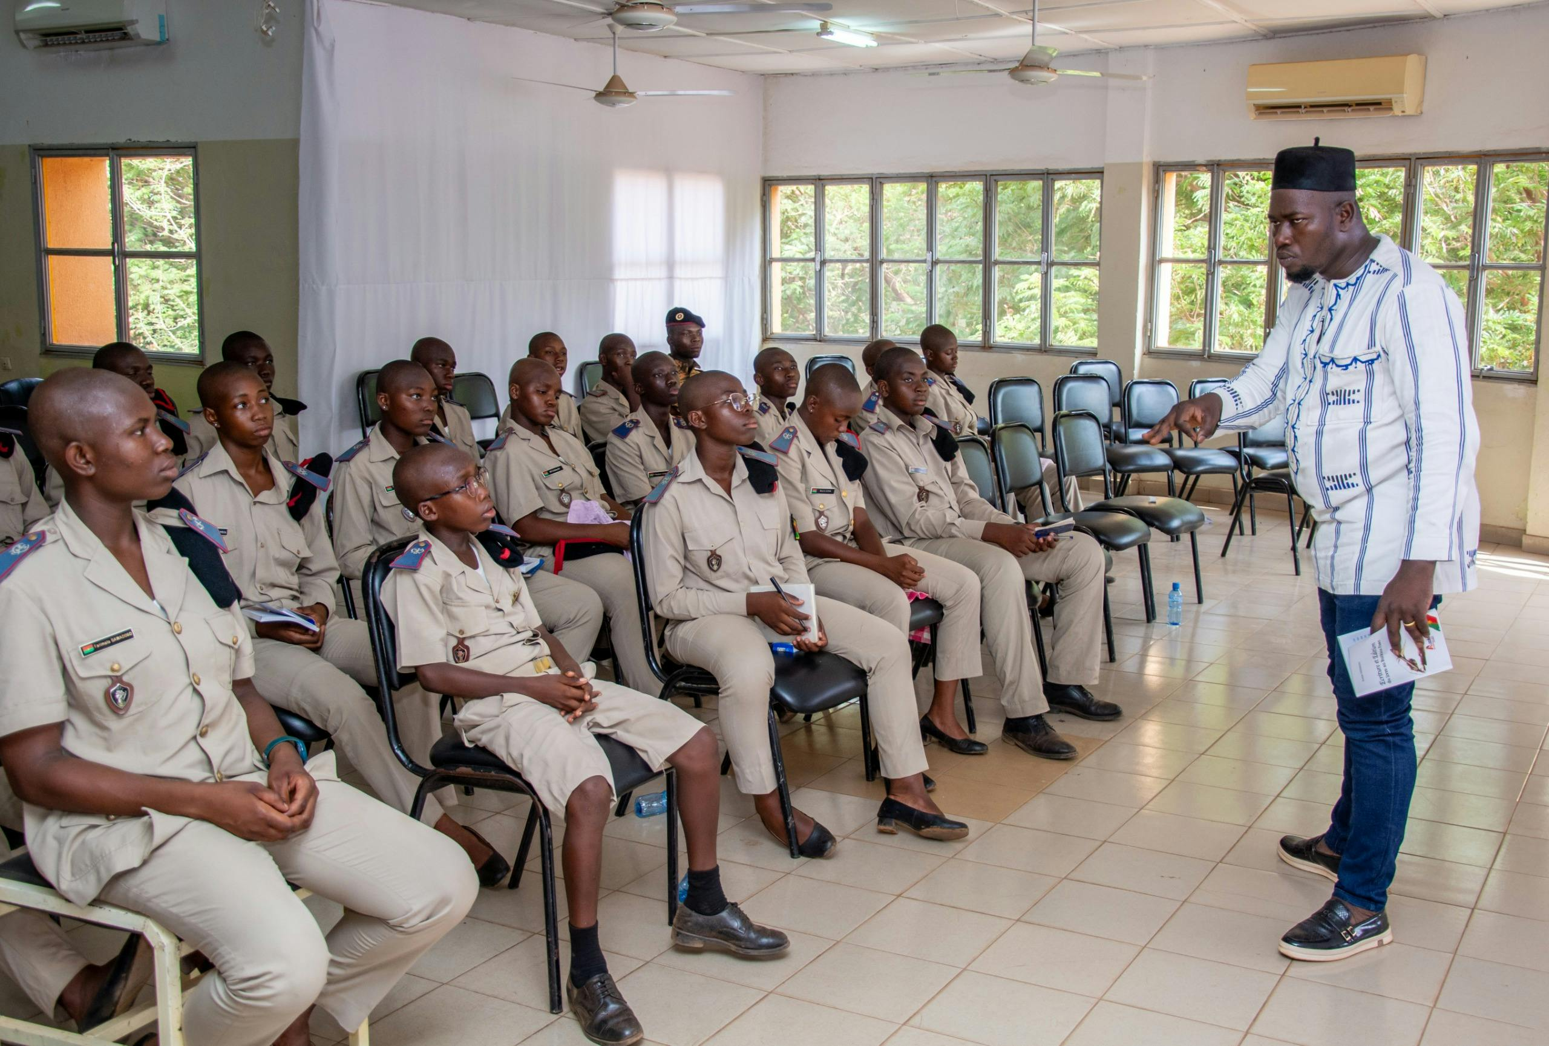
Reflection Questions
Student Engagement
Concept Understanding
Lesson Adjustments
Were students actively engaged throughout the lesson?
This question evaluates the level of participation and interest shown by students during the lesson.
Did students demonstrate a clear understanding of the concepts?
This question assesses whether the students grasped the key ideas and objectives of the lesson.
What adjustments can be made to the lesson to better meet the needs of the students?
This question focuses on identifying areas for improvement to enhance the lesson's effectiveness.
20
Solving Simple Word Problems with Real-Life Scenarios

Slide 21

Parent Engagement
Collaborative Word Problems
Encourage parents to create word problems with their child.
This activity fosters collaboration and enhances problem-solving skills.
Interactive Math Night
Host a math night at school to engage parents and students in math activities.
This event promotes family involvement and makes learning math enjoyable.
Regular Progress Updates
Provide regular progress updates to parents to keep them informed of their child's learning.
This ensures transparency and helps parents support their child's education effectively.
21
Solving Simple Word Problems with Real-Life Scenarios

Slide 22

Safety Considerations
Classroom Environment
Material Handling Guidelines
Ensure the classroom is free from distractions and hazards.
Maintain a safe and focused learning space for all students.
Provide guidelines on how to handle materials and equipment, such as calculators and pencils.
Ensure proper usage to prevent accidents and maintain efficiency.
22
Solving Simple Word Problems with Real-Life Scenarios

Slide 23
Teaching Tips
Relating to Real-Life Scenarios
Visual Aids for Better Understanding
Collaborative Learning
Use real-life scenarios that students can relate to.
This approach helps students connect theoretical concepts to practical applications.
Provide visual aids, such as diagrams and charts, to help students understand the problems.
Visual tools simplify complex ideas and enhance comprehension.
Encourage students to work collaboratively and share their solutions.
Group activities foster teamwork and improve problem-solving skills.
23
Solving Simple Word Problems with Real-Life Scenarios

