Slide 1


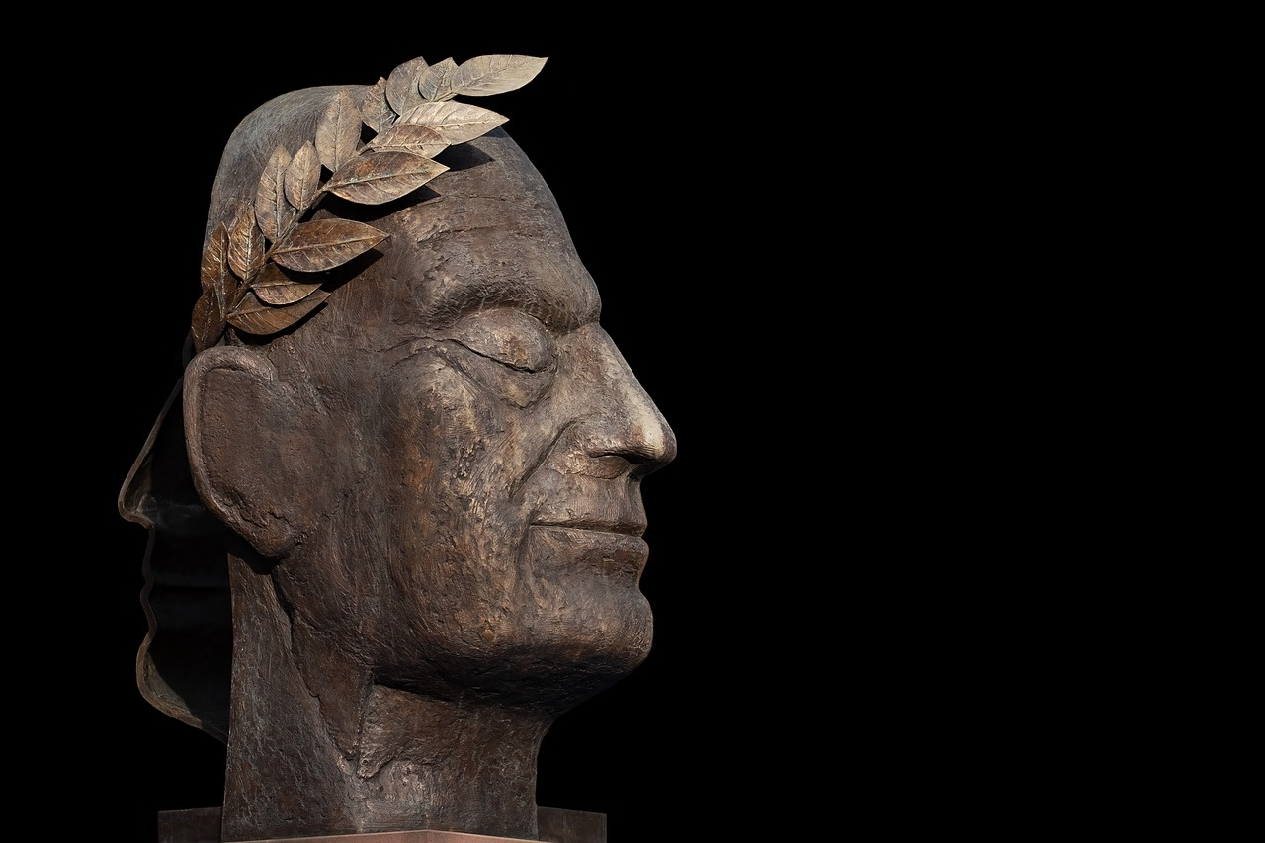
Exploring the Legacy of the Mighty Roman Empire
A Journey Through Ancient History and Culture

Slide 2
Table of contents
Title Slide: The Mighty…
What is an Empire?
Where Was the Roman Emp…
Roman Daily Life
Roman Family Structure
Roman Technology and In…
Roman Military
Roman Architecture
Roman Language and Writ…
Roman Gods and Mythology
01
02
03
04
05
06
07
08
09
10

Slide 3
Table of contents
Roman Entertainment
Roman Food and Cooking
Roman Clothing
Roman Achievements
Roman Empire Timeline
Comparing Roman and Mod…
Roman Empire Quiz Slide
At-Home Learning Activi…
Dyslexia-Friendly Learn…
Conclusion and Further …
11
12
13
14
15
16
17
18
19
20

Slide 4
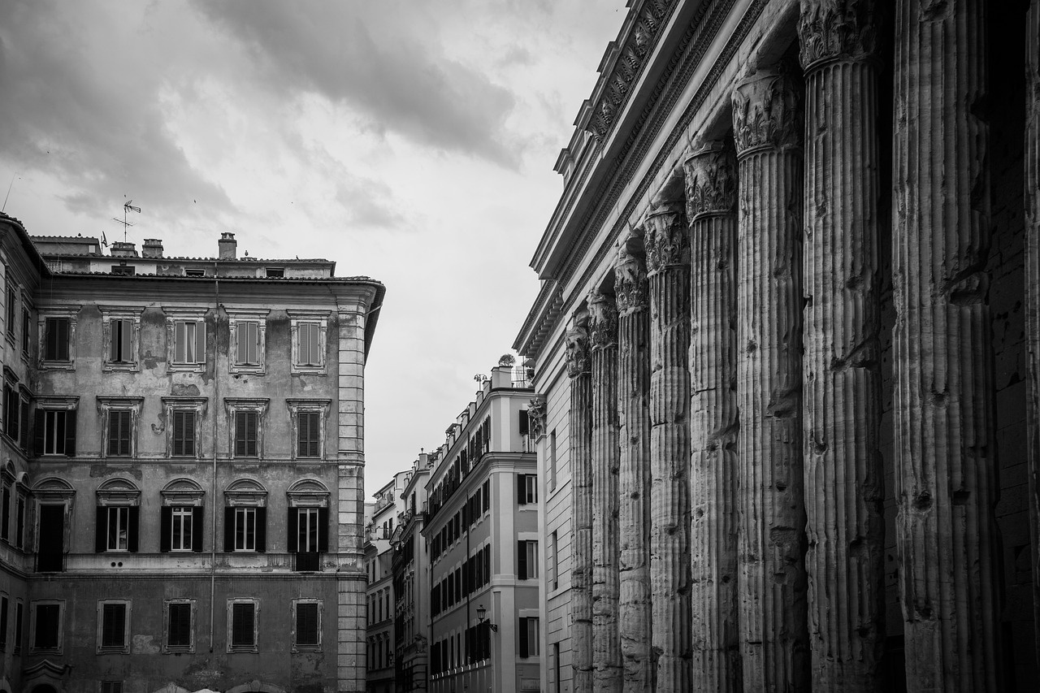
Title Slide: The Mighty Roman Empire: An Adventure Through Ancient History
The Mighty Roman Empire
An Exciting Journey for Young Explorers
Exploring the Legacy of the Mighty Roman Empire
1

Slide 5
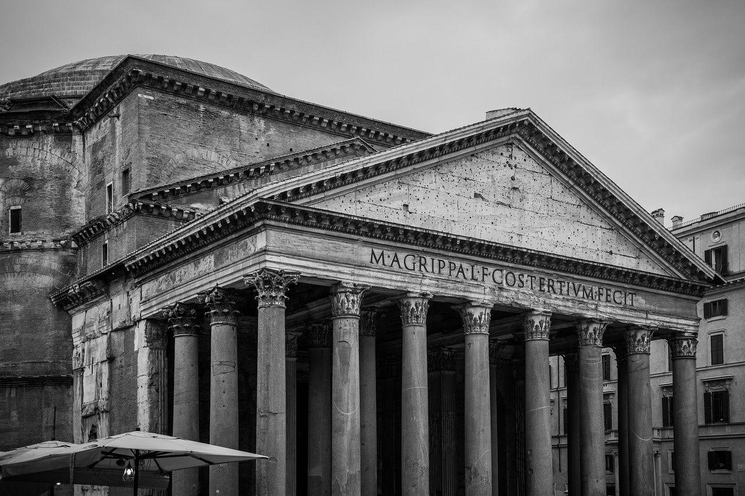
What is an Empire?
Definition of an empire
Roman territorial expansion
Size and influence of the Roman Empire
An empire is a vast territory ruled by a single authority, often encompassing diverse cultures and regions.
The Roman Empire grew through conquests, expanding across Europe, Africa, and Asia.
At its peak, the Roman Empire covered over 2 million square miles and influenced art, architecture, language, and governance.
Exploring the Legacy of the Mighty Roman Empire
2

Slide 6
Where Was the Roman Empire?
Geographical Overview
Interactive Map Highlighting Key Territories
The Roman Empire was located in Southern Europe, encompassing present-day Italy, Spain, France, Greece, and parts of North Africa and the Middle East.
Explore the vast territories controlled by the Romans through an interactive map showcasing major cities like Rome, Alexandria, and Carthage.
Comparison Between Ancient and Modern Boundaries
Fun Fact Boxes with Child-Friendly Language
See how the boundaries of the Roman Empire compare to modern-day countries, understanding the historical significance of Roman conquests.
Discover interesting facts about the Roman Empire, such as how it was one of the largest empires in history and influenced Western civilization significantly.
Exploring the Legacy of the Mighty Roman Empire
3

Slide 7
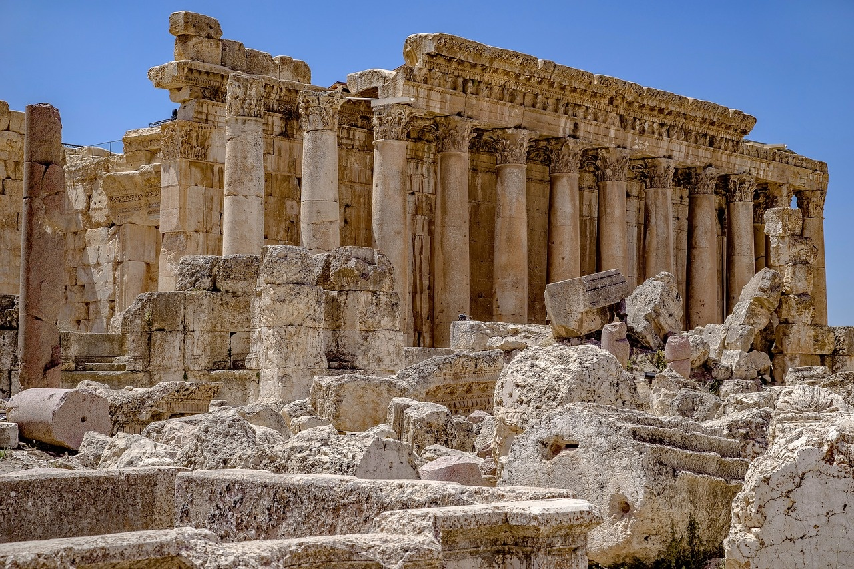
Roman Daily Life
Social Classes
Daily Routine
Clothing and Fashion
Patricians: Wealthy elite class
Plebeians: Commoners, majority of the population
Wake up early for breakfast
Work or attend school
Lunch break in the afternoon
Dinner with family in the evening
Togas for formal occasions
Tunics for everyday wear
Sandals or boots depending on social status
Food and Dining
Living Conditions
Bread, olives, and wine were staples
Meals often included fruits and vegetables
Dining on couches while reclining
Houses varied from simple apartments to grand villas
Public baths were popular for hygiene
Streets were bustling with vendors and activities
Exploring the Legacy of the Mighty Roman Empire
4

Slide 8
Roman Family Structure
Family Hierarchy
Roles of Parents and Children
Patriarch (father) at the head of the family
Matriarch (mother) responsible for household affairs
Parents provided guidance and discipline
Children expected to respect and obey parents
Interesting Cultural Practices
Child-Friendly Illustrations
Emphasis on family unity and loyalty
Celebrations of family festivals and rituals
Visual representations of Roman family dynamics
Engaging drawings of daily family life
Exploring the Legacy of the Mighty Roman Empire
5

Slide 9
Roman Technology and Innovations
Aqueducts
Road Systems
Structures used to transport water across long distances.
Well-built roads for efficient travel and communication.
Engineering Marvels
Interactive Technology Comparison
Innovative construction techniques in architecture and infrastructure.
Contrasting Roman technology with modern advancements.
Exploring the Legacy of the Mighty Roman Empire
6

Slide 10
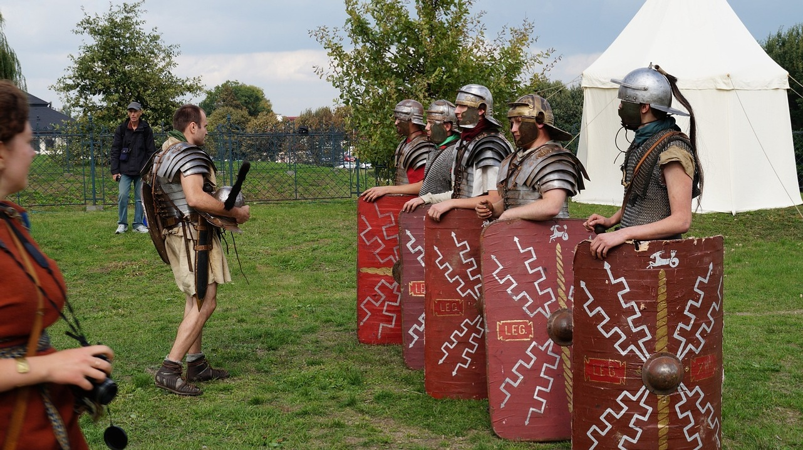
Roman Military
Legion Structure
Divided into cohorts
Each cohort had centuries
Exploring the Legacy of the Mighty Roman Empire
7

Slide 11
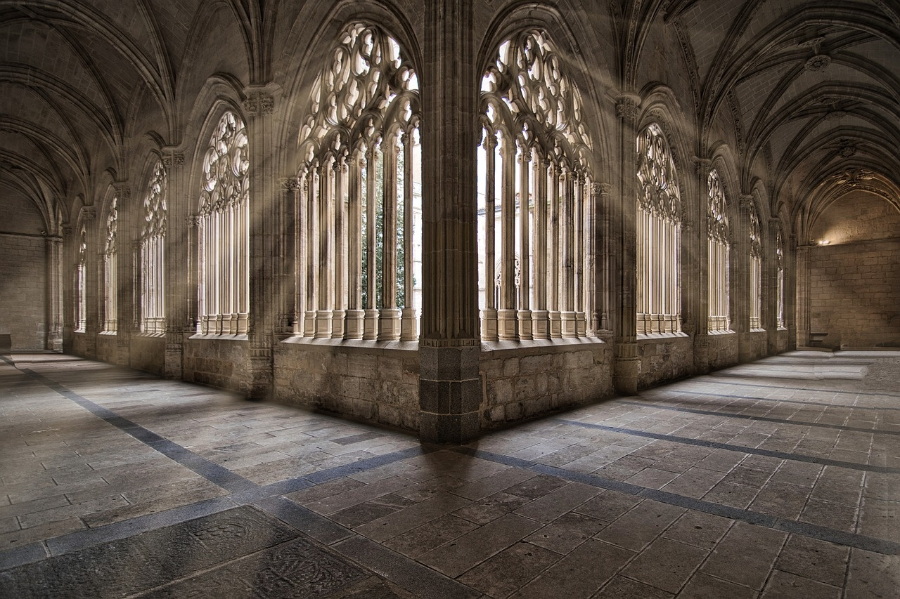
Roman Architecture
Famous Buildings
Building Techniques
Architectural Innovations
Colosseum
Pantheon
Roman Forum
Use of arches and columns
Concrete construction
Domed roofs
Aqueducts
Amphitheaters
Thermae (public baths)
Exploring the Legacy of the Mighty Roman Empire
8

Slide 12
Roman Language and Writing
Introduction to Latin
Writing systems
Latin was the language spoken by the ancient Romans.
Romans used the Latin alphabet, which is similar to the one we use today.
Alphabet comparisons
Interactive learning elements
The Latin alphabet had 23 letters, while the English alphabet has 26.
Fun activities to learn Latin words and phrases.
Exploring the Legacy of the Mighty Roman Empire
9

Slide 13
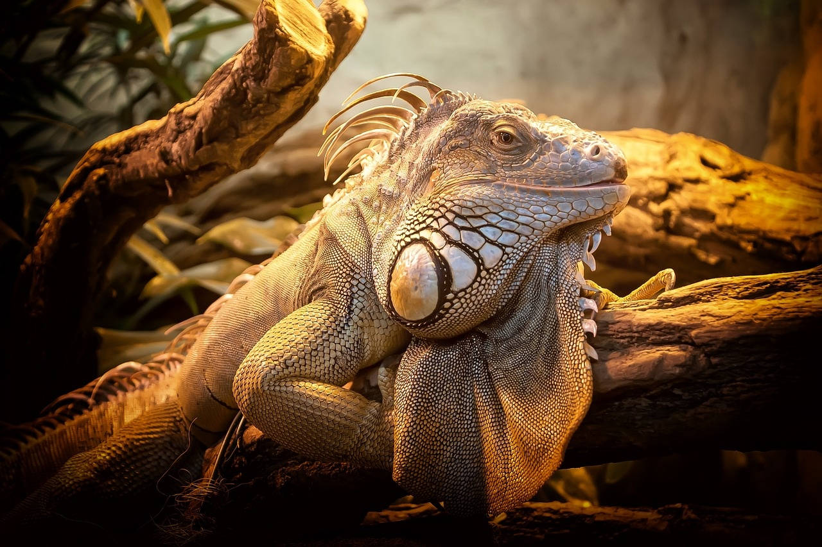
Roman Gods and Mythology
Major Roman Deities
Storytelling Approach
Mythological Creature Illustrations
Jupiter: King of the gods
Juno: Goddess of marriage and queen of the gods
Neptune: God of the sea
Minerva: Goddess of wisdom and warfare
Romans believed in myths to explain natural phenomena
Myths were passed down through generations
Gods and goddesses had human-like qualities and emotions
Centaurs: Half-human, half-horse beings
Griffins: Creatures with the body of a lion and the head and wings of an eagle
Cyclops: One-eyed giants from Greek mythology
Sirens: Enchanting creatures who lured sailors with their songs
Exploring the Legacy of the Mighty Roman Empire
10

Slide 14
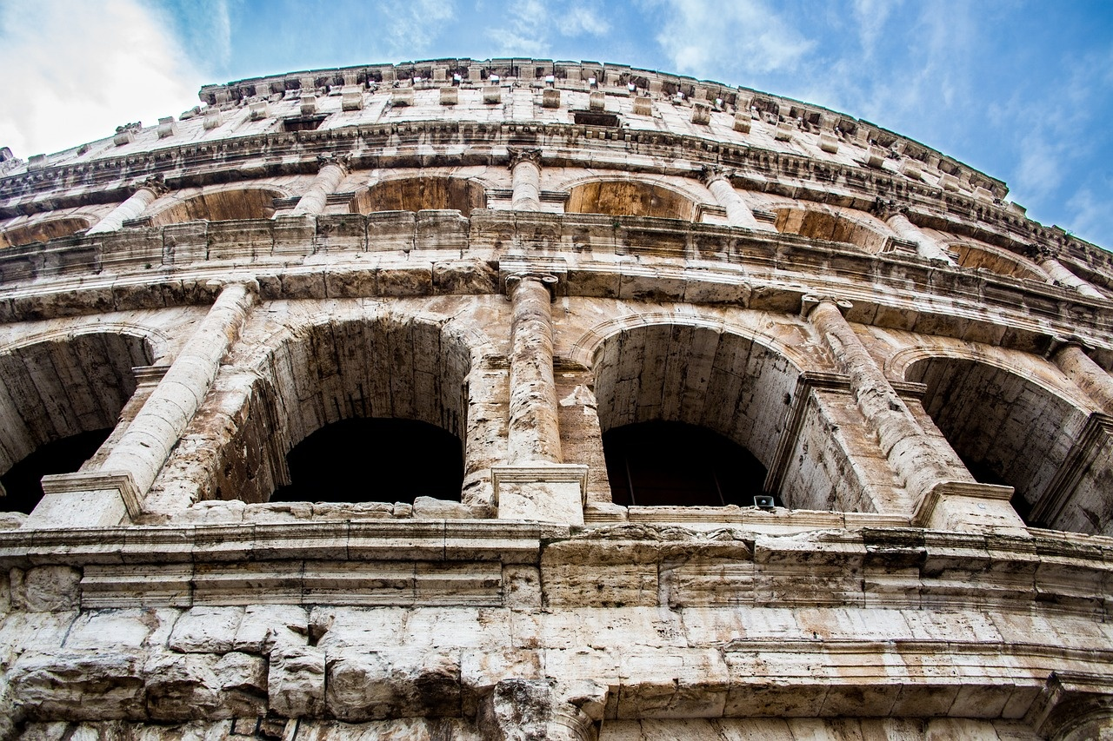
Roman Entertainment
Gladiator games
Theater and performances
Sports and leisure activities
Fought in large arenas like the Colosseum
Involved combat between gladiators, animals, and condemned criminals
Highly popular among Roman citizens
Included tragedies, comedies, and pantomimes
Performed in open-air theaters
Actors were often slaves or freedmen
Chariot racing in the Circus Maximus
Public baths for socializing and relaxation
Board games and athletic competitions
Exploring the Legacy of the Mighty Roman Empire
11

Slide 15
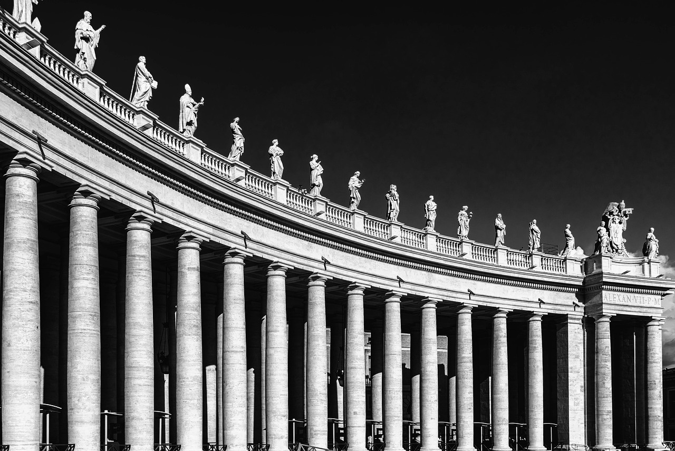
Roman Food and Cooking
Common Foods
Cooking Techniques
Dining Customs
Bread: Staple food made from wheat
Olives: Used in cooking and for oil
Grapes: Eaten fresh or made into wine
Roasting: Meat cooked over an open flame
Boiling: Vegetables and grains cooked in water
Frying: Food cooked in hot oil
Meals: Romans had three main meals a day
Banquets: Lavish feasts with entertainment
Etiquette: Eating with hands, reclining on couches
Exploring the Legacy of the Mighty Roman Empire
12

Slide 16

Roman Clothing
Tunica
Subligaculum
Stola
Basic garment worn by all Romans, made of wool or linen.
Undergarment worn by men, similar to modern underwear.
Long, sleeveless dress worn by Roman women, often belted at the waist.
Palla
Toga
Rectangular shawl worn over the stola for warmth or modesty.
Formal garment worn by Roman citizens for public events.
Exploring the Legacy of the Mighty Roman Empire
13

Slide 17
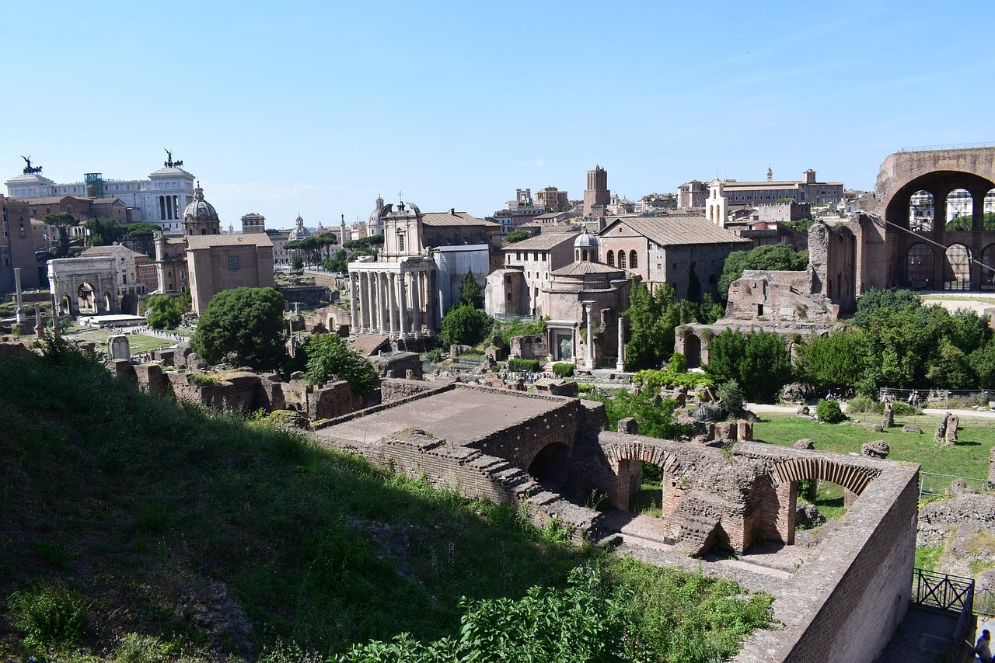
Roman Achievements
Legal Systems
Cultural Innovations
Architectural Advancements
The Roman Empire established a sophisticated legal system that influenced modern legal principles.
Romans made significant contributions to art, literature, and philosophy, shaping Western culture.
Roman engineers built impressive structures like aqueducts, amphitheaters, and temples.
Technological Innovations
Military Strategies
Romans developed advanced engineering techniques for roads, bridges, and urban planning.
The Roman military was renowned for its disciplined legions and strategic warfare tactics.
Exploring the Legacy of the Mighty Roman Empire
14

Slide 18
Roman Empire Timeline
Legendary founding of Rome by Romulus and Remus.
Rome conquers Greece, becoming a dominant power in the Mediterranean.
Octavian becomes Augustus, the first Roman Emperor.
Rome reaches its greatest territorial extent under Emperor Trajan.
753 BC
509 BC
146 BC
44 BC
27 BC
79 AD
117 AD
313 AD
Establishment of the Roman Republic.
Assassination of Julius Caesar.
Eruption of Mount Vesuvius, burying Pompeii and Herculaneum.
Edict of Milan grants religious tolerance to Christians.
Exploring the Legacy of the Mighty Roman Empire
15

Slide 19
Comparing Roman and Modern Life
Housing
Transportation
Roman: Lived in villas or insulae.
Modern: Houses or apartments with modern amenities.
Roman: Used chariots and walked on Roman roads.
Modern: Cars, buses, and trains for transportation.
Exploring the Legacy of the Mighty Roman Empire
16

Slide 20
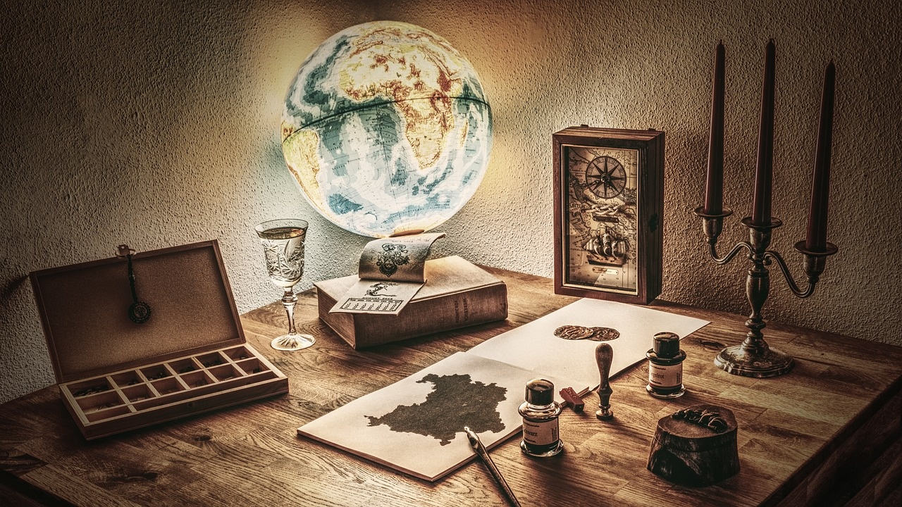
Roman Empire Quiz Slide
Roman Empire Quiz
1. Who was the first Roman Emperor? - A) Julius Caesar - B) Augustus - C) Nero - D) Constantine
2. What famous structure in Rome was used for gladiator contests and public spectacles? - A) Pantheon - B) Roman Forum - C) Colosseum - D) Circus Maximus
3. Which Roman god was the ruler of the gods and the god of the sky and thunder? - A) Jupiter - B) Mars - C) Neptune - D) Apollo
4. What was the name of the famous Roman road network that connected the empire? - A) Via Appia - B) Silk Road - C) Route 66 - D) Great Wall
5. Which ancient civilization heavily influenced Roman art and culture? - A) Greek - B) Egyptian - C) Persian - D) Chinese
Exploring the Legacy of the Mighty Roman Empire
17

Slide 21
At-Home Learning Activities
01
02
03
04
05
Create a Roman Empire Map
Roman Dress-Up Day
Roman Numeral Math
Build a Mini Colosseum
Roman Recipe Cooking
Use colored pencils to mark key territories and cities on a map of the Roman Empire.
Engage in discussions about the significance of these locations.
Dress up as a Roman citizen, soldier, or emperor using household items like sheets and belts.
Act out scenes from daily Roman life for a fun learning experience.
Practice addition and subtraction using Roman numerals.
Challenge family members to solve Roman numeral math problems together.
Use craft materials like cardboard and paper to construct a miniature version of the iconic Colosseum.
Learn about the history of the Colosseum and its role in Roman entertainment.
Prepare a simple Roman dish like "Moretum" (a herb and cheese spread) with adult supervision.
Explore Roman culinary traditions and ingredients.
Exploring the Legacy of the Mighty Roman Empire
18

Slide 22
Dyslexia-Friendly Learning Tips
01
02
03
04
05
Use Multisensory Learning
Break Tasks into Smaller Steps
Provide Clear Instructions
Encourage Regular Breaks
Utilize Color Coding
Engage multiple senses like sight, sound, and touch for better retention.
Incorporate hands-on activities and interactive games.
Divide learning tasks into manageable chunks.
Use visual aids and checklists to track progress.
Use simple language and visual cues to enhance understanding.
Offer verbal explanations alongside written instructions.
Allow time for rest and movement to maintain focus.
Include short physical activities or stretching exercises.
Use color to organize information and highlight key points.
Assign specific colors to different subjects or tasks.
Exploring the Legacy of the Mighty Roman Empire
19

Slide 23
Conclusion and Further Exploration
Recap of Key Learnings
Encouragement for Continued Curiosity
We have journeyed through the fascinating world of the Roman Empire, learning about its vast territories, daily life, family structure, technology, military, architecture, language, gods, entertainment, food, clothing, achievements, and more.
Keep exploring the wonders of ancient history! Dive deeper into the legacy of the Roman Empire and discover how it continues to influence our world today.
Additional Resources
Inspiring, Motivational Message
Check out books, documentaries, and online resources for more exciting adventures into the history of the Roman Empire.
Remember, curiosity is the key to unlocking new worlds of knowledge. Keep asking questions, seeking answers, and embracing the joy of learning!
Exploring the Legacy of the Mighty Roman Empire
20

