Slide 1
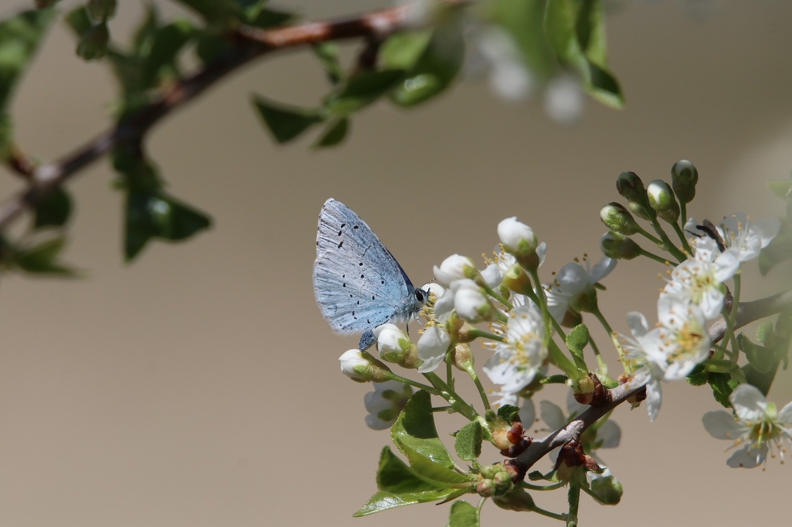
Exploring Species Diversity
A Journey Through Classification, Identification, and Research

Slide 2
Table of contents
01
02
03
04
05
06
07
08
09
10
11
Title Slide: Species Exploration and Classification
Learning Objectives
What is a Species?
Five Biological Kingdoms
Taxonomic Hierarchy
Species Identification Criteria
Classification Challenges
Research Methodology
Interactive Classification Activity
Technology in Species Research
Ecological Significance

Slide 3
Table of contents
12
13
14
15
16
17
18
19
20
21
22
Career Connections
Key Takeaways
Assessment Overview
Reflection and Next Steps
Q&A and Credits
Design Recommendations
Recommended PowerPoint Design Themes
Export Requirements
Professional scientific template
Minimalist design with bold visuals
Color scheme: Blues, greens, whites

Slide 4
Table of contents
23
24
25
Clean, modern typography
Ample white space
Engaging transition effects

Slide 5
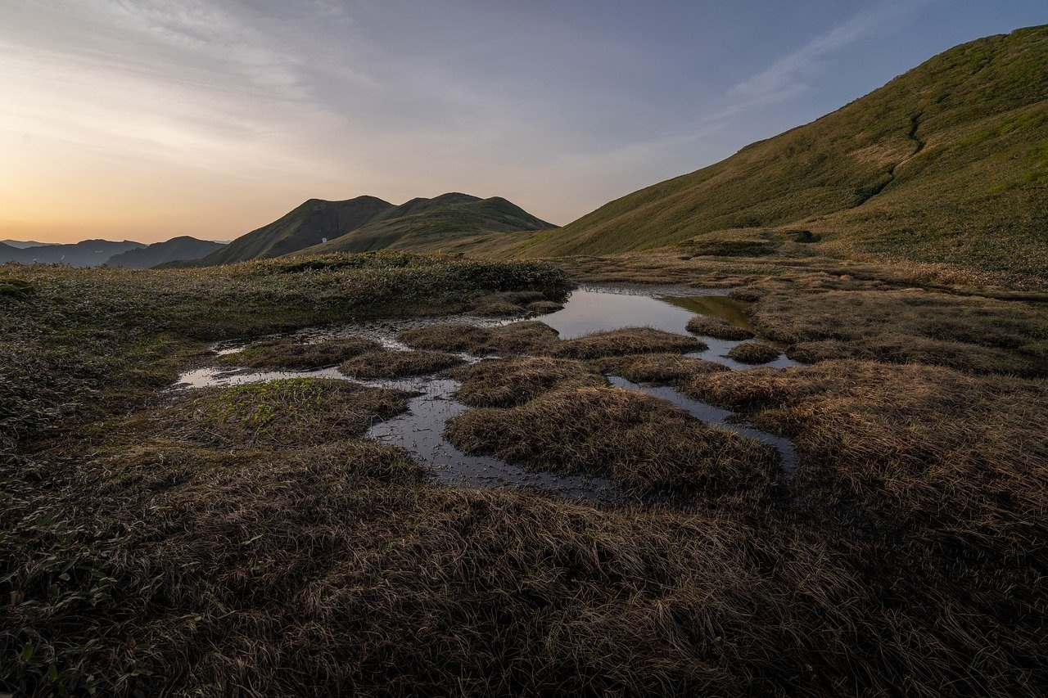
1
Title Slide: Species Exploration and Classification
Species Exploration and Classification
Understanding Biological Diversity
Exploring Species Diversity

Slide 6
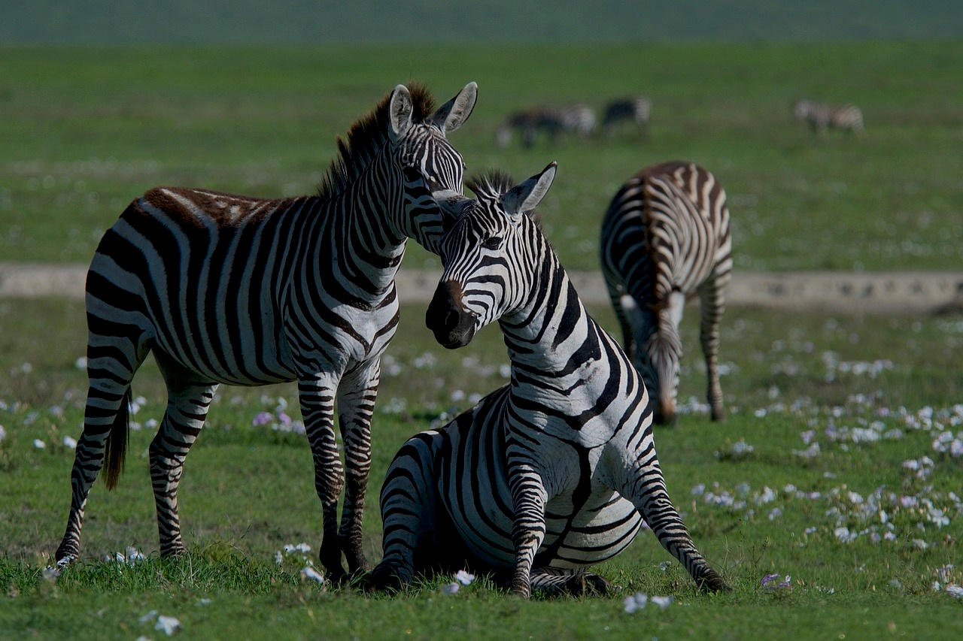
2
Learning Objectives
01
Understand species as fundamental biological classification unit
02
Identify and distinguish between biological kingdoms
Define the concept of a species in biology
Explain the importance of species in the classification of living organisms
List the five main biological kingdoms
Describe the characteristics that differentiate each kingdom
03
Develop scientific observation and classification skills
04
Use research sources to investigate biological diversity
Practice observing and categorizing different species
Learn how to use scientific tools for classification
Explore various resources for studying different species
Understand the importance of research in expanding knowledge of species diversity
Exploring Species Diversity

Slide 7
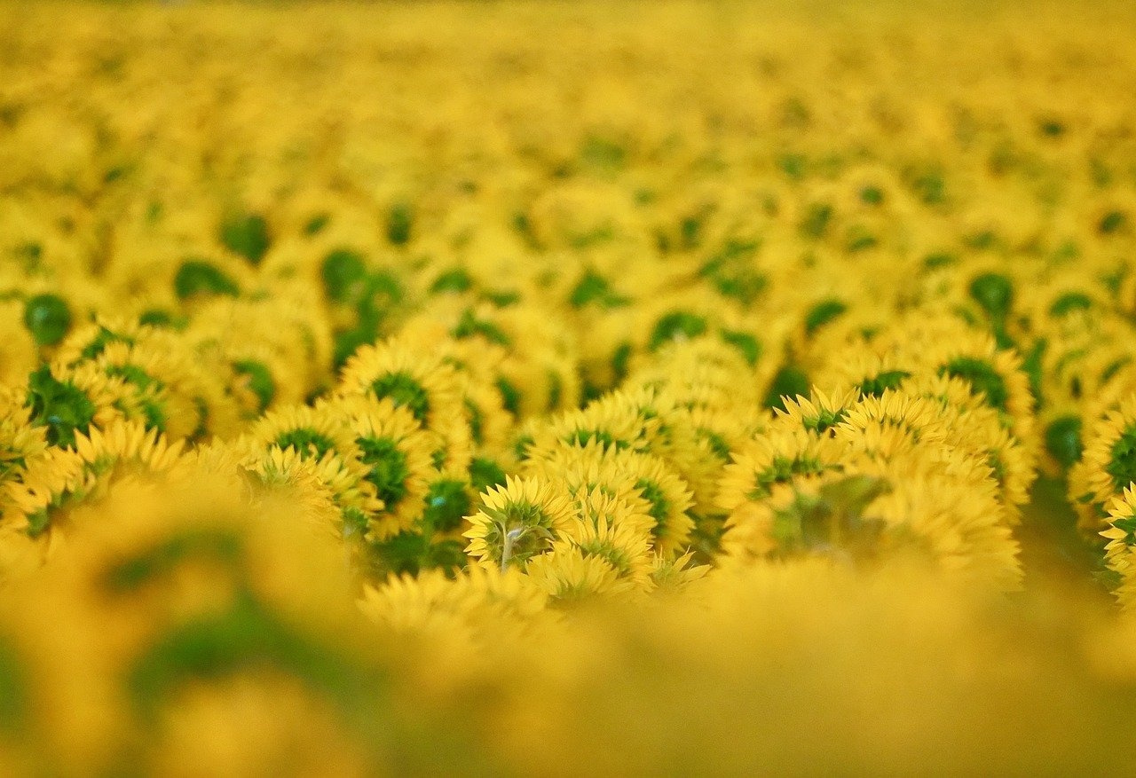
3
What is a Species?
01
Definition
02
Key Characteristics
A group of organisms capable of interbreeding.
Genetic compatibility
Reproductive potential
Shared physical traits
Exploring Species Diversity

Slide 8
4
Five Biological Kingdoms
01
Animalia
02
Plantae
03
Fungi
Multicellular organisms
Heterotrophic
Lack cell walls
Examples: Mammals, Birds, Fish
Multicellular organisms
Autotrophic
Have cell walls made of cellulose
Examples: Trees, Flowers, Algae
Can be unicellular or multicellular
Heterotrophic
Have cell walls made of chitin
Examples: Mushrooms, Yeasts, Molds
04
Protista
05
Monera
Mostly unicellular organisms
Can be autotrophic or heterotrophic
Diverse group including algae and protozoa
Examples: Amoeba, Paramecium, Euglena
Unicellular organisms
Prokaryotic
Can be autotrophic or heterotrophic
Examples: Bacteria, Cyanobacteria
Exploring Species Diversity

Slide 9
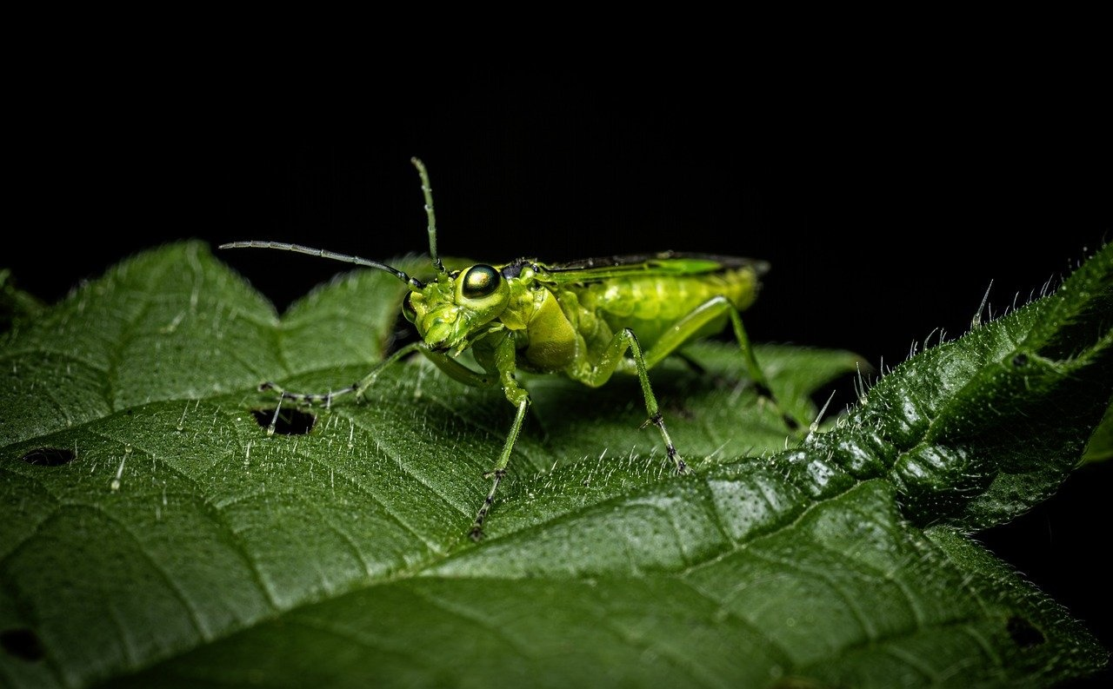
5
Taxonomic Hierarchy
Kingdom
Phylum
Class
Order
Family
Exploring Species Diversity

Slide 10
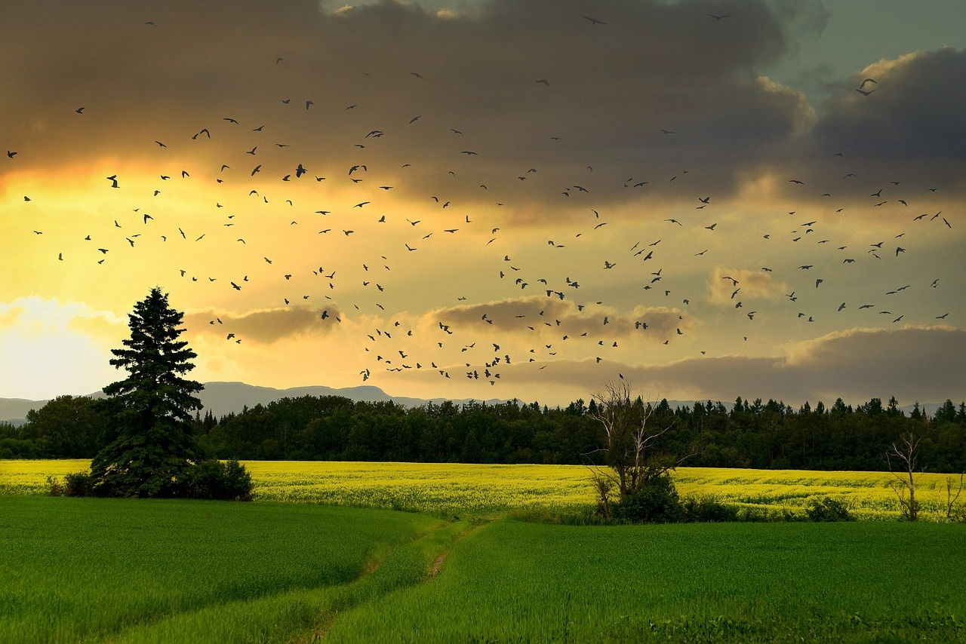
6
Species Identification Criteria
01
Genetic Markers
02
Morphological Characteristics
Utilizing DNA sequencing to identify unique genetic markers within species.
Observing physical traits such as size, shape, color, and structure for species differentiation.
03
Reproductive Compatibility
04
Behavioral Patterns
Assessing the ability of organisms to interbreed and produce viable offspring.
Studying behavioral traits and interactions within species for identification purposes.
Exploring Species Diversity

Slide 11

7
Classification Challenges
Common Misconceptions
Misunderstanding of genetic compatibility
Overreliance on visual similarity
Exploring Species Diversity

Slide 12

8
Research Methodology
01
Selecting Credible Sources
02
Observation Techniques
Utilize peer-reviewed journals and reputable scientific publications
Consider academic databases and research institutions for reliable information
Conduct field observations to study species in their natural habitats
Utilize advanced imaging technologies for detailed analysis
03
Data Collection
04
Analysis Strategies
Gather quantitative and qualitative data on species characteristics
Record observations systematically to ensure accuracy and consistency
Employ statistical analysis to identify patterns and trends in species diversity
Use comparative methods to understand relationships between different species
Exploring Species Diversity

Slide 13
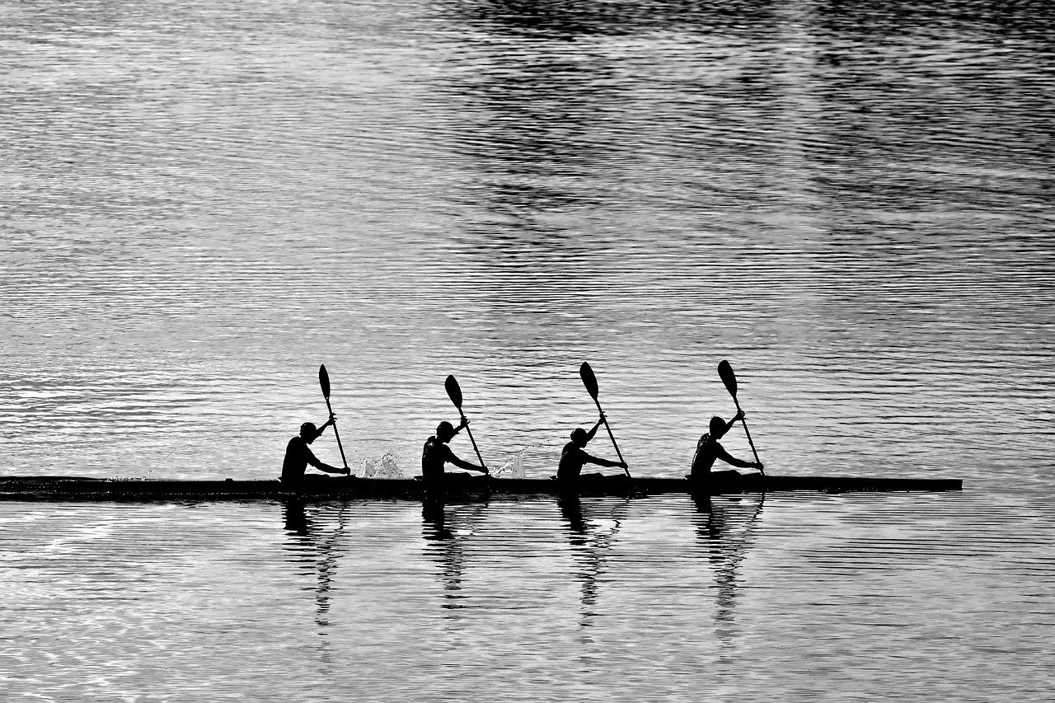
9
Interactive Classification Activity
01
Interactive Classification Activity
02
Team-Based Species Identification
Engage participants in a hands-on activity to classify different species based on key characteristics.
Encourage teamwork to identify and categorize species using observation and research skills.
03
Collaborative Learning Approach
Foster collaboration among participants to discuss and debate the classification of various organisms.
Exploring Species Diversity

Slide 14

10
Technology in Species Research
01
Digital Mapping Tools
02
Virtual Microscopy
Used for tracking species distribution
Helps in habitat analysis
Assists in conservation planning
Allows detailed examination of specimens
Enables remote collaboration
Facilitates education and training
03
Genetic Sequencing
04
Augmented Reality Applications
Helps in understanding genetic diversity
Aids in species identification
Supports evolutionary studies
Enhances field research
Provides interactive learning experiences
Assists in data visualization
Exploring Species Diversity

Slide 15
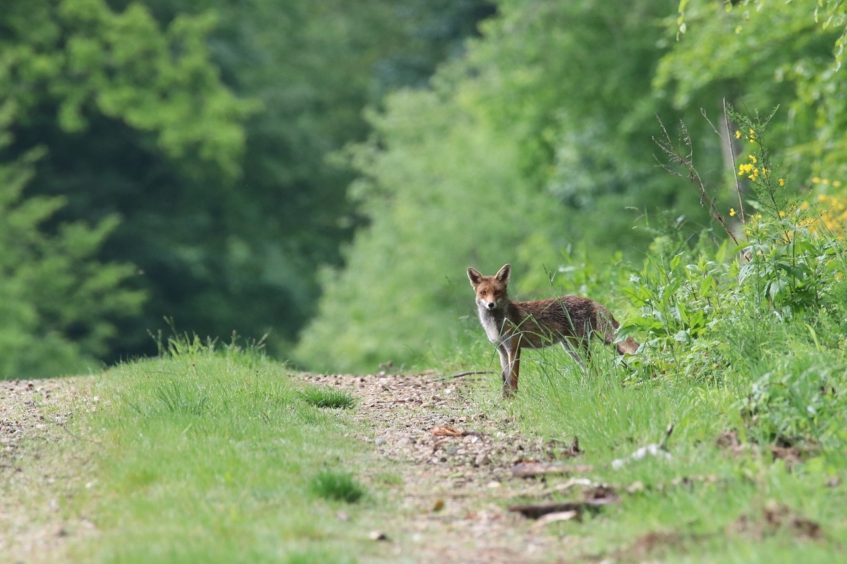
11
Ecological Significance
01
Biodiversity Support
02
Conservation Implications
Diverse species contribute to ecosystem stability
Different species play unique roles in maintaining ecological balance
Protecting species diversity is crucial for ecosystem health
Loss of species can have cascading effects on entire ecosystems
03
Species Interactions
04
Environmental Adaptation
Interconnected relationships between species drive ecosystem functions
Predation, competition, and mutualism shape species dynamics
Species diversity allows for adaptation to changing environmental conditions
Genetic diversity within species enhances resilience to environmental stressors
Exploring Species Diversity

Slide 16
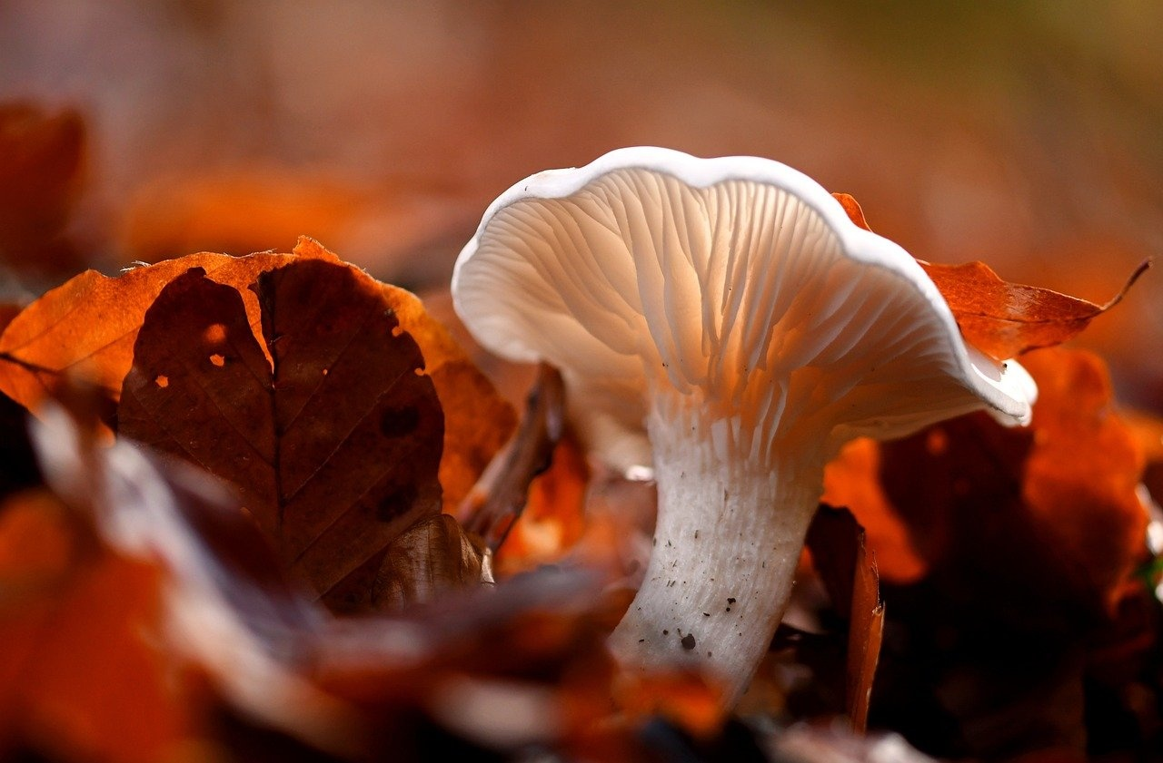
12
Career Connections
01
Biological Research
02
Conservation Biology
Study of living organisms
Understanding biological processes
Application in medicine and agriculture
Protection of biodiversity
Habitat preservation
Species conservation
03
Environmental Science
04
Genetic Research
Study of the environment
Impact of human activities
Sustainable solutions
Study of genes and heredity
Genetic engineering
Medical and agricultural applications
Exploring Species Diversity

Slide 17
13
Key Takeaways
01
Understanding the fundamental role of species in biological classification
02
Importance of genetic compatibility, reproductive potential, and shared physical traits in defining a species
03
Appreciating the interconnectedness of species within ecosystems
04
Recognizing the significance of species identification criteria in scientific research
05
Acknowledging the challenges and misconceptions in species classification
Exploring Species Diversity

Slide 18

14
Assessment Overview
01
Research Portfolio
02
Practical Classification Exam
Compilation of species research findings
Includes data analysis and interpretation
Assessment of species identification skills
Application of taxonomic knowledge
03
Multimedia Presentation
04
Written Comprehensive Test
Creative showcase of species diversity
Utilizes various media formats
Evaluation of theoretical understanding
Covers species classification principles
Exploring Species Diversity

Slide 19
15
Reflection and Next Steps
Reflection on the Journey
Impact of Understanding Classification
Explored various biological kingdoms
Enhanced scientific observation skills
Areas for Further Research
Importance of Ongoing Curiosity
Interested in studying marine ecosystems
Continuous learning deepens understanding
Exploring Species Diversity

Slide 20

16
Q&A and Credits
01
Q&A and Credits
02
Additional Resources
Questions from the Audience
Encourage interactive discussion
Address queries with clarity and depth
Recommended reading materials
Online sources for further exploration
03
Image Credits
04
Presentation Acknowledgments
Acknowledge sources of visuals used
Respect copyright and attribution
Thank audience for participation
Recognize contributors and collaborators
Exploring Species Diversity

Slide 21

17
Design Recommendations
01
Color Palette
02
Image Quality
Utilize a clean, scientific color palette
Incorporate blues, greens, and whites for a professional look
Include high-quality, diverse species images
Ensure visuals are engaging and relevant to the content
03
Typography
04
Visual Elements
Maintain consistent typography throughout the presentation
Use clean, modern fonts for readability
Incorporate infographics and diagrams to enhance understanding
Use engaging visual elements to support the content
Exploring Species Diversity

Slide 22
18
Recommended PowerPoint Design Themes
01
Professional Scientific Template
02
Minimalist Design with Bold Visuals
03
Color Scheme: Blues, Greens, Whites
Designed for scientific presentations
Includes data visualization elements
Structured layout for clarity
Focus on key information
Use of high-quality images
Avoids clutter and distractions
Conveys trust and professionalism
Creates a calming effect
Ensures readability and contrast
04
Clean, Modern Typography
05
Ample White Space
Sans-serif fonts for readability
Consistent font usage
Appropriate font sizes for headings and body text
Improves readability
Creates a balanced layout
Highlights key content
Exploring Species Diversity

Slide 23

19
Export Requirements
01
Compliance with International Trade Regulations
02
Documentation and Permitting
Understanding of CITES regulations
Knowledge of specific export restrictions for endangered species
Completion of export permits
Verification of species origin and legality
03
Packaging and Shipping Guidelines
Proper handling and packaging of live specimens
Selection of reputable shipping carriers
Exploring Species Diversity

Slide 24

20
Professional scientific template
Professional Scientific Template
Clean and modern design
Bold visuals for engagement
Consistent typography for readability
Infographics and diagrams for clarity
Engaging transition effects for seamless flow
Exploring Species Diversity

Slide 25

21
Minimalist design with bold visuals
Minimalist Design with Bold Visuals
Clean and modern design
High contrast color scheme
Bold typography
Striking imagery
Simple and impactful visuals
Exploring Species Diversity

Slide 26
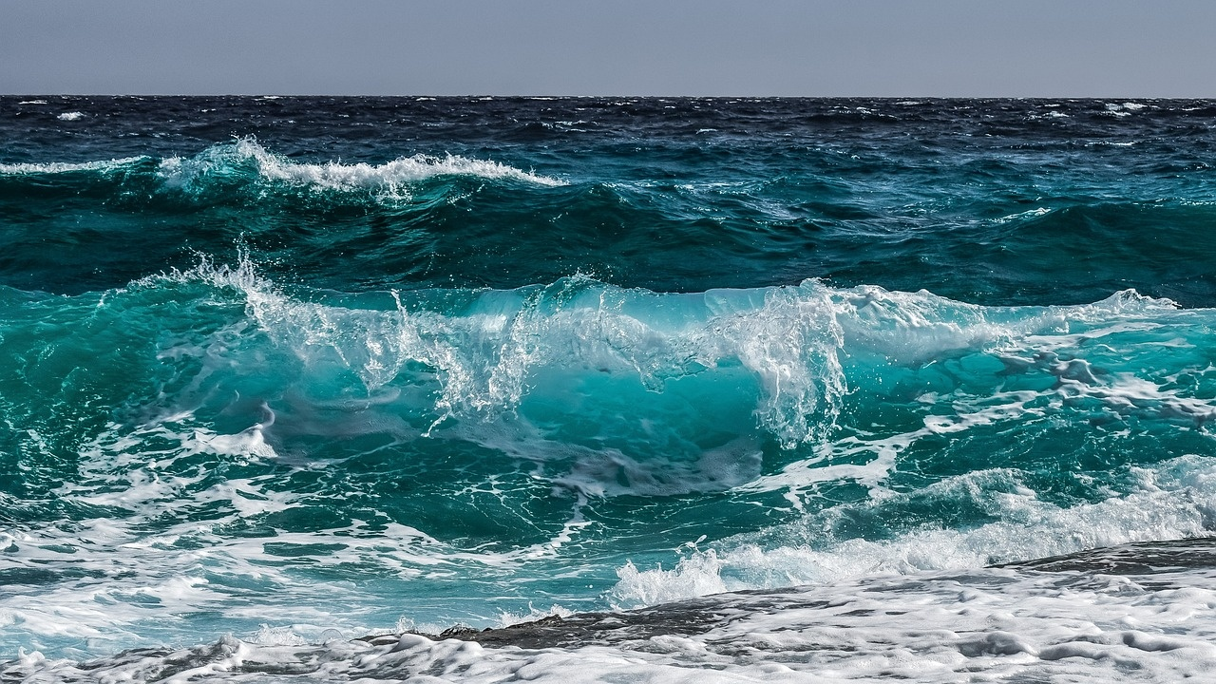
22
Color scheme: Blues, greens, whites
Color scheme: Blues, greens, whites
Shades of blue, green, and white evoke a sense of tranquility and nature
Blue symbolizes depth and stability, while green represents growth and harmony
White signifies purity and clarity in the context of species diversity exploration
Exploring Species Diversity

Slide 27
23
Clean, modern typography
Sans-serif Fonts
Consistent Font Sizes
Contrast
Opt for clean and modern sans-serif fonts like Arial, Helvetica, or Calibri for a sleek look.
Maintain a consistent font size hierarchy to ensure readability and visual appeal.
Use contrasting font weights (bold, regular, light) to emphasize key points and create visual interest.
Whitespace
Alignment
Utilize ample whitespace around text elements for a clean and uncluttered design.
Align text elements neatly to create a polished and professional look.
Exploring Species Diversity

Slide 28
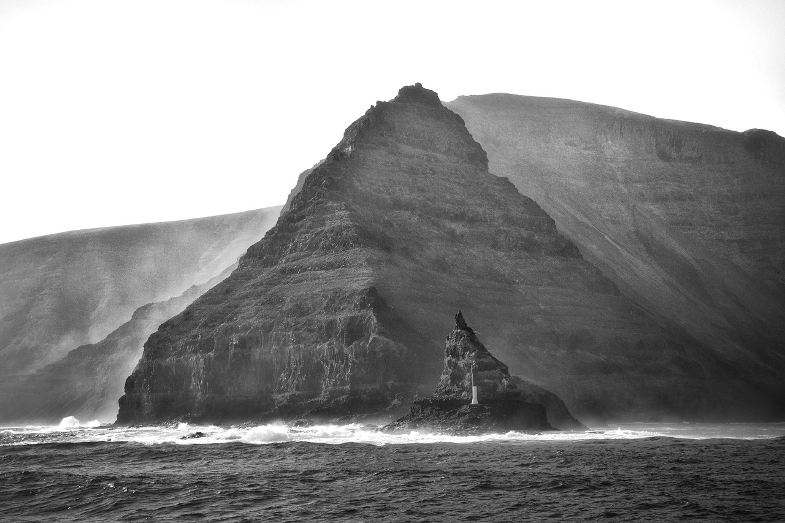
24
Ample white space
Ample White Space
Purpose: Enhances visual clarity and focus
Benefits:
* Improves readability
* Emphasizes key elements
* Creates a sense of elegance
Exploring Species Diversity

Slide 29

25
Engaging transition effects
01
Engaging Transition Effects
02
Choose the transition effect that best suits your presentation style and content!
Fade: Smoothly transitions from one slide to the next by gradually fading out the current slide and fading in the next.
Zoom: Creates a dynamic effect by zooming in on the content of the current slide before transitioning to the next slide.
Flip: Adds a playful touch by flipping the current slide like a page to reveal the next slide underneath.
Dissolve: Offers a subtle transition effect by dissolving the current slide into tiny particles before revealing the next slide.
Slide: Simulates a physical slide movement, where the current slide slides out to the side to make way for the next slide.
Exploring Species Diversity

