Slide 1

Mastering Comparison and Contrast Essays
A Comprehensive Guide to Understanding, Structuring, and Teaching Effective Writing Techniques

Slide 2
Table of Contents
Welcome to Comparison and Contrast Essays
What are Comparison and Contrast Essays?
Why are Comparison and Contrast Essays Importa…
Real-Life Examples of Comparison and Contrast
Structuring a Comparison and Contrast Essay
Using Transitional Phrases and Words
Analyzing Real-Life Examples
Common Errors to Avoid
Frequently Asked Questions
Objectives and Outcomes
Vocabulary and Key Terms
Resources and Tools
Prior Knowledge and Prerequisites
04
05
06
07
08
09
10
11
12
13
14
15
16

Slide 3
Table of Contents
Differentiation Strategies
Cross-Curricular Links
Group Activities and Discussions
Digital Integration and Technology
Review and Assessment Strategies
Conclusion and Final Thoughts
Teaching Tips and Reflection Questions
Parent Engagement and Safety Considerations
17
18
19
20
21
22
23
24

Slide 4

Welcome to Comparison and Contrast Essays
Introduction to Comparison and Contrast Essays
Importance of Comparison and Contrast
Overview of Lesson Plan and Objectives
Comparison and contrast essays explore similarities and differences between subjects.
They are a fundamental tool for understanding and analyzing various topics.
Comparison and contrast are essential in real-life scenarios for decision-making.
They help individuals evaluate options and make informed choices.
This lesson plan outlines the key aspects of writing comparison and contrast essays.
Objectives include understanding structure, developing arguments, and enhancing critical thinking skills.
4
Mastering Comparison and Contrast Essays

Slide 5

What are Comparison and Contrast Essays?
Definition of Comparison and Contrast Essays
Purpose of Comparison and Contrast Essays
Comparison and contrast essays are a type of academic writing.
They explore similarities and differences between two or more subjects.
The purpose is to analyze and evaluate subjects.
This helps readers understand them from a new perspective.
Structure of Comparison and Contrast Essays
Key Elements of Comparison and Contrast Essays
These essays typically include an introduction, body paragraphs, and a conclusion.
This structure organizes the analysis effectively.
Important elements include a thesis statement, transitional phrases, and evidence.
These components ensure clarity and coherence in the essay.
5
Mastering Comparison and Contrast Essays

Slide 6

Why are Comparison and Contrast Essays Important?
Critical Thinking Enhancement
Improved Decision-Making
Effective Communication Development
Comparison and contrast essays enhance critical thinking and analytical skills.
They encourage individuals to evaluate similarities and differences effectively.
These essays improve decision-making by weighing pros and cons.
They help individuals make informed choices based on comparative analysis.
Writing comparison and contrast essays develops effective communication and writing skills.
They enable individuals to articulate their thoughts clearly and persuasively.
6
Mastering Comparison and Contrast Essays

Slide 7

Real-Life Examples of Comparison and Contrast
Choosing the Right University
Assessing Job Offers
Comparing universities to choose the best fit.
This involves evaluating factors such as academic programs, campus facilities, and location.
Evaluating job offers based on salary, benefits, and work environment.
This helps in making an informed decision for career advancement.
Selecting Travel Destinations
Understanding Social Media Impacts
Deciding between different travel destinations.
Considerations include cost, attractions, and personal preferences.
Analyzing the pros and cons of social media.
This includes examining its effects on communication, privacy, and mental health.
7
Mastering Comparison and Contrast Essays

Slide 8

Structuring a Comparison and Contrast Essay
Introduction Components
Body Paragraph Structures
Conclusion Elements
The introduction of a comparison and contrast essay includes a hook to engage the reader.
It also provides background information and a thesis statement to outline the essay's focus.
The body paragraphs can be organized using a point-by-point or subject-by-subject comparison.
This structure helps in systematically presenting similarities and differences.
The conclusion summarizes the main points discussed in the essay.
It also provides final thoughts to leave a lasting impression on the reader.
Transitional Phrases Usage
Thesis Statement Significance
Transitional phrases are essential for maintaining coherence throughout the essay.
They guide the reader smoothly from one idea to the next.
A clear and focused thesis statement is crucial for directing the essay's argument.
It ensures that the essay remains structured and on-topic.
8
Mastering Comparison and Contrast Essays

Slide 9

Using Transitional Phrases and Words
Common Transitional Words
Phrases for Comparison
Transitional words such as 'however', 'in addition', and 'nevertheless' are essential for connecting ideas.
They help in maintaining the logical flow of thoughts within a text.
Comparison phrases like 'similarly', 'likewise', and 'in the same way' are used to draw parallels.
These phrases assist in highlighting similarities between concepts or arguments.
Phrases for Contrast
Importance of Transitional Phrases
Contrast phrases such as 'on the other hand', 'in contrast', and 'however' emphasize differences.
Using these phrases effectively can clarify opposing viewpoints or distinctions.
Transitional phrases are crucial for ensuring the smooth progression of ideas in an essay.
They contribute to the overall coherence and readability of the text.
9
Mastering Comparison and Contrast Essays

Slide 10

Analyzing Real-Life Examples
1
Understanding Similarities and Differences
Identifying similarities and differences is a fundamental skill.
It helps in recognizing patterns and making connections between various elements.
2
Making Informed Decisions
Evaluating information is crucial for making informed decisions.
This process involves analyzing data and considering multiple perspectives.
3
Applying Skills to Real-Life Scenarios
Comparison and contrast skills are essential in real-life applications.
They enable individuals to approach situations critically and effectively.
10
Mastering Comparison and Contrast Essays

Slide 11

Common Errors to Avoid
01
Lack of Clear Thesis Statement
A clear thesis statement is essential for guiding the reader through the argument.
Without it, the purpose and direction of the writing can become unclear.
02
Insufficient Evidence or Examples
Providing adequate evidence and examples strengthens the credibility of the argument.
Failure to do so can lead to weak and unconvincing claims.
03
Poor Organization and Lack of Transitional Phrases
Organizing ideas logically and using transitional phrases ensures smooth flow of the argument.
Disorganization can confuse the reader and disrupt the coherence of the writing.
04
Failure to Address Counterarguments
Acknowledging and addressing counterarguments demonstrates a thorough understanding of the topic.
Ignoring them can make the argument appear one-sided and less persuasive.
11
Mastering Comparison and Contrast Essays

Slide 12

Frequently Asked Questions
Purpose of Comparison and Contrast Essays
Choosing Subjects for Comparison
Key Elements of the Essay
The primary purpose of a comparison and contrast essay is to analyze the similarities and differences between two subjects.
This helps readers understand the subjects better and make informed decisions or insights.
Selecting subjects for a comparison and contrast essay involves identifying two items that share a common category or theme.
The subjects should have enough similarities and differences to provide meaningful analysis.
A comparison and contrast essay includes an introduction, body paragraphs, and a conclusion.
The body paragraphs should systematically address the similarities and differences between the subjects.
Organizing the Essay
Role of Transitions
Organizing a comparison and contrast essay can be done using either the block method or the point-by-point method.
Each method ensures clarity and logical flow of ideas for the reader.
Transitions in a comparison and contrast essay help connect ideas and maintain coherence.
They guide the reader through the analysis, highlighting the relationships between the subjects.
12
Mastering Comparison and Contrast Essays

Slide 13

Objectives and Outcomes
01
Understanding Comparison and Contrast Essays
Analyze the structure and purpose of comparison and contrast essays.
This involves identifying key elements that define these types of essays.
02
Evaluating Real-Life Examples
Evaluate real-life examples to determine suitable topics.
This helps in understanding practical applications and relevance.
03
Creating an Essay Outline
Create a basic outline for a comparison and contrast essay.
This step is crucial for organizing ideas and structuring the essay effectively.
04
Reflecting on Learning
Reflect on learning and identify areas for improvement.
This encourages self-assessment and continuous development.
13
Mastering Comparison and Contrast Essays

Slide 14

Vocabulary and Key Terms
1
Comparison
4
Contrast
Comparison involves identifying similarities between two or more subjects.
This process helps in understanding commonalities and shared characteristics.
Contrast focuses on identifying differences between subjects.
It aids in distinguishing unique features and opposing aspects.
2
Thesis Statement
5
Transitional Phrases
A thesis statement represents the main argument or point of an essay.
It serves as the foundation for the essay's structure and content.
Transitional phrases are words or phrases that connect ideas within writing.
They ensure smooth flow and coherence between sentences and paragraphs.
3
Essay Structure
Essay structure typically includes an introduction, body, and conclusion.
This format organizes ideas systematically for effective communication.
14
Mastering Comparison and Contrast Essays

Slide 15
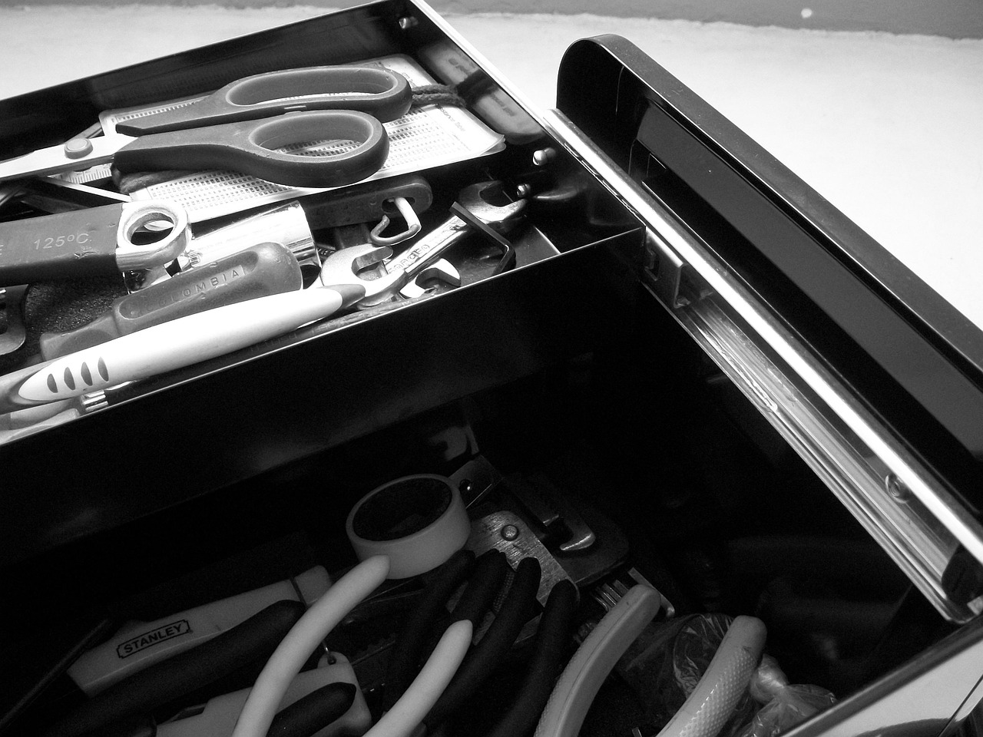
Resources and Tools
01
Digital Tools
03
Online Resources
Grammarly is a tool for enhancing writing quality and checking grammar.
Online collaborative documents facilitate teamwork and sharing ideas effectively.
The Purdue Online Writing Lab offers comprehensive writing guides and tutorials.
Educational websites provide a wealth of information for various learning needs.
02
Physical Materials
04
Textbooks
Whiteboards and markers are essential for brainstorming and visual presentations.
Printed examples provide tangible references for study and discussion.
'The Elements of Style' by William Strunk Jr. and E.B. White is a classic guide to writing style.
Textbooks serve as foundational resources for structured learning and reference.
15
Mastering Comparison and Contrast Essays

Slide 16

Prior Knowledge and Prerequisites
Understanding Essay Structure
Analyzing Themes and Topics
Critical Thinking and Literary Devices
Understanding the structure of an essay is crucial for effective writing.
This includes knowledge of introduction, body, and conclusion components.
The ability to identify and analyze themes and topics is essential for literary comprehension.
This skill allows for deeper engagement with the material and its underlying messages.
Critical thinking and familiarity with basic literary devices enhance interpretation and argumentation.
These skills are foundational for evaluating and discussing literary works.
16
Mastering Comparison and Contrast Essays

Slide 17

Differentiation Strategies
Learning Centers for Diverse Styles
Technology Integration in Education
Learning centers cater to various learning styles, ensuring personalized educational experiences.
These centers provide resources and activities tailored to individual preferences and needs.
Integrating technology enhances interactive learning opportunities for students.
It allows for dynamic and engaging educational experiences through digital tools.
Tiered Assignments for Skill Levels
Peer Mentoring for Collaboration
Tiered assignments address the varying skill levels of students within a classroom.
This approach ensures that each student is challenged appropriately while achieving learning goals.
Peer mentoring fosters collaborative learning and mutual support among students.
It encourages teamwork and the sharing of knowledge and skills within the learning environment.
17
Mastering Comparison and Contrast Essays

Slide 18

Cross-Curricular Links
1
Literature Connections
4
Historical Analysis
Exploring literature involves comparing characters, themes, or plot developments.
This fosters critical thinking and understanding of narrative structures.
History provides a platform for analyzing historical events or periods.
This helps in understanding the context and impact of past occurrences.
2
Scientific Comparisons
5
Language Arts Skills
Science encourages comparing data, theories, or species.
Such comparisons enhance comprehension of scientific principles and phenomena.
Language arts focus on teaching writing skills, vocabulary, and grammar.
These are essential for effective communication and expression.
3
Social Studies Perspectives
Social studies involve comparing cultures, economies, or political systems.
This broadens awareness of global diversity and societal structures.
18
Mastering Comparison and Contrast Essays

Slide 19

Group Activities and Discussions
Comparison Matrix Creation
Debates on Controversial Topics
This activity involves creating a matrix to compare various elements or options.
Participants analyze and organize information systematically to draw conclusions.
Engage in structured debates to explore different perspectives on controversial issues.
This fosters critical thinking and enhances communication skills among participants.
Case Study Analysis
Peer Review Workshops
Participants examine real-world scenarios through detailed case studies.
This activity helps in understanding practical applications and problem-solving techniques.
Collaborative workshops where participants review each other's work.
This promotes constructive feedback and improves the quality of outputs.
19
Mastering Comparison and Contrast Essays

Slide 20

Digital Integration and Technology
Online Collaborative Documents
Virtual Debates
Interactive Quizzes and Games
Online collaborative documents enable multiple users to work on the same document simultaneously.
This fosters teamwork and ensures real-time updates and contributions.
Virtual debates provide a platform for participants to discuss and argue on various topics.
They encourage critical thinking and effective communication skills.
Interactive quizzes and games make learning engaging and enjoyable.
They help reinforce knowledge through active participation.
Digital Mind Maps
Podcast Discussions
Digital mind maps allow users to visually organize and connect ideas.
This tool is effective for brainstorming and planning.
Podcast discussions offer an audio-based medium for sharing and exploring ideas.
They are accessible and can be consumed on-the-go.
20
Mastering Comparison and Contrast Essays

Slide 21

Review and Assessment Strategies
Formative Quizzes
Peer Review Sessions
Formative quizzes are designed to provide immediate feedback to learners.
They help identify areas of improvement and reinforce learning objectives.
Peer review sessions encourage collaborative learning and critical thinking.
Participants evaluate each other's work, fostering a deeper understanding of the subject matter.
Self-Assessment Checklists
Reflective Journaling
Self-assessment checklists empower learners to evaluate their own progress.
They promote self-reflection and accountability in the learning process.
Reflective journaling allows learners to document their thoughts and experiences.
This practice enhances self-awareness and aids in personal and academic growth.
21
Mastering Comparison and Contrast Essays

Slide 22

Conclusion and Final Thoughts
Key Takeaways Recap
Future Learning Progression
Final Thoughts
Recap of key takeaways.
Importance of practice and application.
Future lessons and next steps in learning progression.
Importance of practice and application.
Recap of key takeaways.
Future lessons and next steps in learning progression.
22
Mastering Comparison and Contrast Essays

Slide 23

Teaching Tips and Reflection Questions
Using Relatable Examples
Encouraging Peer Review
Relatable examples help students connect new concepts to their existing knowledge.
This approach enhances understanding and retention of the material taught.
Peer review fosters collaboration and critical thinking among students.
It allows learners to provide and receive constructive feedback, improving their skills.
Incorporating Technology
Reflecting on Lesson Effectiveness
Technology integration in teaching can make lessons more engaging and interactive.
Tools like educational apps and online resources support diverse learning styles.
Reflection on lesson effectiveness helps educators identify areas for improvement.
Evaluating student engagement provides insights into the success of teaching strategies.
23
Mastering Comparison and Contrast Essays

Slide 24

Parent Engagement and Safety Considerations
Regular Progress Updates
Homework Assistance
Providing parents with regular updates on their child's progress fosters engagement.
These updates can include academic achievements, areas for improvement, and overall development.
Encouraging parents to assist with homework strengthens the learning process.
This involvement helps children understand concepts better and builds a supportive environment.
Discussion Prompts
Respectful and Inclusive Environment
Offering discussion prompts enables parents to engage in meaningful conversations with their children.
These prompts can cover academic topics, social issues, or personal development.
Ensuring a respectful and inclusive learning environment is crucial for student success.
This involves promoting diversity, equity, and mutual respect among all participants.
24
Mastering Comparison and Contrast Essays

