Slide 1

Exploring Shapes and Geometry
A Comprehensive Lesson Plan for 2D and 3D Shape Recognition and Differentiation

Slide 2
Table of contents
01
02
03
04
05
06
07
08
09
10
11
Shapes and Geometry Lesson Plan
Learning Objectives
Warm-up Activity (10 minutes)
Introduction to New Content (15 minutes)
Guided Practice (10 minutes)
Independent Practice (10 minutes)
Wrap-up and Assessment (5 minutes)
Materials and Resources
Learning Extensions
Assessment Considerations
Potential Accommodations

Slide 3
Table of contents
12
13
14
15
16
17
18
19
20
21
22
Curriculum Connection
2D and 3D Shape Recognition
Identify and name basic 2D and 3D shapes
Distinguish between flat and solid shapes
Recognize shapes in the environment
Differentiation Strategies
Teaching Strategies
Learning Activities
Assessment Activities
Closing Activities
Home shape hunt

Slide 4
Table of contents
23
24
25
26
27
28
29
30
31
32
33
Family shape identification game
Online shape learning resources
Formative observation
Shape identification accuracy
Verbal shape description
Creative shape representation
Visual aids
Tactile learning supports
Extended time
Individualized instruction
Supports foundational geometry skills

Slide 5
Table of contents
34
35
36
Develops spatial reasoning
Enhances early mathematical thinking
Provides multi-sensory learning experiences

Slide 6
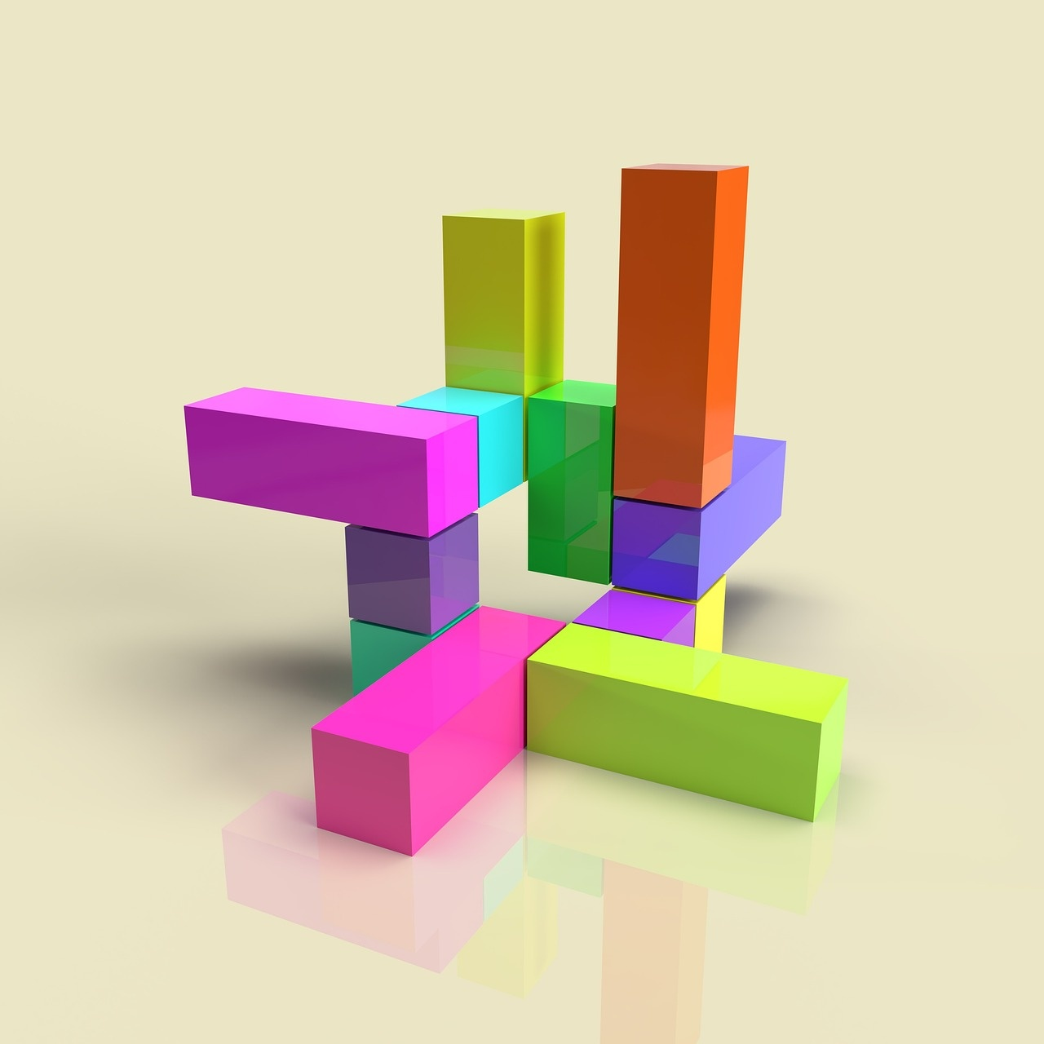
1
Shapes and Geometry Lesson Plan
Shapes and Geometry Lesson Plan
Title: 2D and 3D Shape Recognition
Grade Level: Kindergarten/Early Elementary
Lesson Duration: 45 minutes
Exploring Shapes and Geometry

Slide 7

2
Learning Objectives
01
Identify and name basic 2D and 3D shapes
02
Distinguish between flat and solid shapes
Learn the names of common 2D shapes like circles, squares, and triangles.
Learn the names of common 3D shapes like cubes, spheres, and cylinders.
Understand the difference between 2D (flat) shapes and 3D (solid) shapes.
Identify examples of flat and solid shapes in everyday life.
03
Recognize shapes in the environment
Find and name shapes in the classroom, at home, and outdoors.
Understand how shapes are used in different contexts and objects.
Exploring Shapes and Geometry

Slide 8

3
Warm-up Activity (10 minutes)
Shape Sorting with Large, Colorful Manipulatives
Provide students with various large, colorful shapes to sort based on their attributes.
Matching Simple Shape Puzzles
Engage students in matching puzzles where they connect 2D shapes to their corresponding 3D shapes.
One-on-One Teacher Guidance
Offer individualized support for students who may need extra assistance in recognizing and identifying shapes.
Exploring Shapes and Geometry

Slide 9

4
Introduction to New Content (15 minutes)
01
Interactive Digital Shape Presentation
02
3D Shape Exploration Station
Engage students with a digital presentation of various shapes.
Use interactive elements to allow students to manipulate and explore shapes.
Set up a station with physical 3D shapes for hands-on exploration.
Encourage students to touch, rotate, and compare different shapes.
03
Visual Shape Comparison Chart
Create a chart comparing different shapes visually.
Highlight key characteristics and differences between shapes.
Exploring Shapes and Geometry

Slide 10

5
Guided Practice (10 minutes)
01
Guided Practice (10 minutes)
02
Differentiation Options
Shape tracing
Playdough shape building
Shape recognition technology games
Below Grade Level:
Larger shape templates
Hand-over-hand tracing support
Simplified shape building
At Grade Level:
Exploring Shapes and Geometry

Slide 11

6
Independent Practice (10 minutes)
Independent Practice (10 minutes)
Complete the shape identification worksheet
Work on your individual shape portfolio
Take the digital shape recognition quiz
Exploring Shapes and Geometry

Slide 12

7
Wrap-up and Assessment (5 minutes)
01
Shape Sharing Circle
02
Quick Shape Review Game
Students share one new thing they learned about shapes today.
Engage students in a fun review game where they have to identify shapes quickly.
03
Individual Shape Reflection
Each student reflects on their favorite shape and explains why they like it.
Exploring Shapes and Geometry

Slide 13

8
Materials and Resources
Shape Manipulatives
Hands-on tools for exploring shapes
Enhances spatial understanding
Digital Shape Presentation
Interactive digital slides
Visual and engaging
Worksheets
Printable sheets for practice
Reinforces learning
Playdough
Moldable material for creating shapes
Encourages creativity
Shape Tracing Templates
Guides for tracing shapes
Improves fine motor skills
Exploring Shapes and Geometry

Slide 14

9
Learning Extensions
01
Home Shape Hunt
02
Family Shape Identification Game
Encourage students to find and identify shapes in their homes.
Provide a checklist of shapes for them to search for.
Create a fun game where family members take turns identifying shapes.
Use everyday objects to make it interactive and engaging.
03
Online Shape Learning Resources
Recommend educational websites or apps that focus on shapes and geometry.
Provide links for interactive activities and videos to reinforce learning.
Exploring Shapes and Geometry

Slide 15

10
Assessment Considerations
01
Formative Observation
02
Shape Identification Accuracy
Regularly observe students during shape activities.
Assess students' ability to correctly identify 2D and 3D shapes.
03
Verbal Shape Description
04
Creative Shape Representation
Evaluate students' capability to describe shapes using words.
Encourage students to express shapes in unique ways.
Exploring Shapes and Geometry

Slide 16
11
Potential Accommodations
Visual aids
Utilize charts, diagrams, and images to support understanding of shapes and geometry concepts.
Tactile learning supports
Provide hands-on materials like shape manipulatives or textured shapes for tactile learners.
Extended time
Allow students who need extra time to process information or complete tasks at their own pace.
Individualized instruction
Offer personalized guidance and support tailored to each student's learning needs.
Exploring Shapes and Geometry

Slide 17

12
Curriculum Connection
01
Reinforces foundational geometry skills
02
Develops spatial reasoning abilities
03
Enhances early mathematical thinking
04
Provides multi-sensory learning experiences
Exploring Shapes and Geometry

Slide 18

13
2D and 3D Shape Recognition
01
Identify and name basic 2D and 3D shapes
02
Distinguish between flat and solid shapes
Learn the names of common 2D shapes such as circles, squares, triangles, and rectangles.
Learn the names of common 3D shapes such as cubes, spheres, cones, and cylinders.
Understand that 2D shapes are flat and have only length and width.
Understand that 3D shapes are solid and have length, width, and height.
03
Recognize shapes in the environment
Identify 2D and 3D shapes in everyday objects.
Practice finding shapes in the classroom, at home, and outdoors.
Exploring Shapes and Geometry

Slide 19

14
Identify and name basic 2D and 3D shapes
01
2D Shapes
02
3D Shapes
Circle
Square
Triangle
Rectangle
Sphere
Cube
Cone
Cylinder
Exploring Shapes and Geometry

Slide 20

15
Distinguish between flat and solid shapes
Flat Shapes
Two-dimensional (2D)
Examples: Circle, Triangle, Square
Found on paper or screens
Solid Shapes
Three-dimensional (3D)
Examples: Sphere, Cube, Cylinder
Occupies space in all directions
Exploring Shapes and Geometry

Slide 21

16
Recognize shapes in the environment
Identify basic 2D shapes in everyday objects
Spot 3D shapes in the classroom and playground
Discuss how shapes are used in architecture and design
Point out geometric patterns in nature
Recognize shapes in artwork and illustrations
Exploring Shapes and Geometry

Slide 22
17
Differentiation Strategies
01
Below Grade Level
02
At Grade Level
03
Above Grade Level
Shape sorting with large, colorful manipulatives
Matching simple shape puzzles
One-on-one teacher guidance
Classroom shape scavenger hunt
Interactive shape identification game
Shape sorting trays
Create complex shape drawings
Verbal description of shape properties
Find advanced shape examples
Exploring Shapes and Geometry

Slide 23
18
Teaching Strategies
Hands-On Activities
Engage students with shape sorting using colorful manipulatives.
Encourage matching simple shape puzzles for tactile learning.
Provide one-on-one teacher guidance for personalized support.
Interactive Games
Conduct a classroom shape scavenger hunt for active participation.
Utilize an interactive shape identification game for visual learners.
Implement shape sorting trays for practical shape recognition.
Advanced Challenges
Encourage students to create complex shape drawings for creativity.
Prompt verbal description of shape properties to enhance communication skills.
Challenge students to find advanced shape examples in their surroundings.
Exploring Shapes and Geometry

Slide 24
19
Learning Activities
01
Shape tracing
02
Playdough shape building
03
Shape recognition technology games
Enhances fine motor skills
Helps in understanding shapes
Improves hand-eye coordination
Encourages creativity
Develops spatial awareness
Strengthens hand muscles
Interactive learning
Boosts cognitive skills
Engages children with fun activities
Exploring Shapes and Geometry

Slide 25

20
Assessment Activities
Shape Identification Worksheet
Students will be asked to identify and name various 2D and 3D shapes.
Individual Shape Portfolio
Each student will create a portfolio showcasing their understanding of different shapes through drawings and descriptions.
Digital Shape Recognition Quiz
An interactive quiz will be conducted to test students' ability to recognize shapes using technology.
Exploring Shapes and Geometry

Slide 26

21
Closing Activities
01
Shape Sharing Circle
02
Quick Shape Review Game
Students share their favorite shape and explain why they like it.
A fun game where students identify shapes quickly to reinforce learning.
03
Individual Shape Reflection
Students write or draw about their understanding of different shapes.
Exploring Shapes and Geometry

Slide 27

22
Home shape hunt
Home Shape Hunt
Encourage students to search for shapes in their homes
Provide a list of shapes to find (circle, square, triangle, rectangle)
Have students take photos or draw the shapes they find
Discuss findings in the next class session
Exploring Shapes and Geometry

Slide 28
23
Family shape identification game
Family Shape Identification Game
Gather various 2D and 3D shape objects at home.
Invite family members to participate in a shape scavenger hunt.
Encourage children to identify and name the shapes they find.
Make it a fun and interactive learning experience for the whole family.
Exploring Shapes and Geometry

Slide 29

24
Online shape learning resources
PBS Kids Shapes Games
Interactive games for shape recognition and identification.
ABCmouse Shapes Songs
Fun songs and activities to learn about 2D and 3D shapes.
National Geographic Kids Shape Videos
Educational videos exploring shapes in nature and the environment.
Khan Academy Geometry Lessons
Online tutorials for older elementary students to delve deeper into geometry concepts.
IXL Shape Practice
Adaptive learning platform with shape exercises for various skill levels.
Exploring Shapes and Geometry

Slide 30

25
Formative observation
01
Monitor Student Engagement
02
Distinguish Between 2D and 3D Shapes
Track participation during shape identification activities
Identify students who are actively engaged
Observe students' ability to differentiate between 2D and 3D shapes
Record instances of correct identification
03
Recognize Shapes in the Environment
Note individual progress in recognizing shapes in everyday surroundings
Highlight students who show improvement over time
Exploring Shapes and Geometry

Slide 31

26
Shape identification accuracy
01
Observation
02
Assessment Tools
Monitor students' ability to correctly identify and name basic 2D and 3D shapes during activities.
Utilize shape identification worksheets to evaluate individual shape recognition accuracy.
03
Feedback
04
Tracking Progress
Provide constructive feedback to guide students in improving their shape identification skills.
Keep records of each student's shape identification accuracy for further analysis and support.
Exploring Shapes and Geometry

Slide 32

27
Verbal shape description
Circle
A round shape with no corners or edges.
Triangle
A shape with three sides and three angles.
Square
A shape with four equal sides and four right angles.
Rectangle
A shape with four sides where opposite sides are equal and parallel, and all angles are right angles.
Pentagon
A shape with five sides and five angles.
Exploring Shapes and Geometry

Slide 33

28
Creative shape representation
01
Below Grade Level
02
At Grade Level
Shape collage using pre-cut shapes
Shape stamping with large foam shapes
Shape drawing with guided templates
Shape sculpture using various materials
Shape mosaic art project
Shape shadow tracing activity
03
Above Grade Level
Shape tessellation design challenge
Shape origami creations
Shape-inspired 3D modeling project
Exploring Shapes and Geometry

Slide 34

29
Visual aids
Large, colorful manipulatives
Engage students in shape sorting activities.
Simple shape puzzles
Enhance shape recognition through interactive matching.
Interactive shape identification game
Utilize technology for hands-on learning experiences.
Shape sorting trays
Provide a tactile and visual way for students to explore shapes.
Visual shape comparison chart
Aid in distinguishing between 2D and 3D shapes effectively.
Exploring Shapes and Geometry

Slide 35

30
Tactile learning supports
01
Shape Sensory Bins
02
Texture Matching
Fill bins with various shapes for tactile exploration.
Match shapes to corresponding textured cards for sensory engagement.
03
Playdough Shape Modeling
04
Braille Shape Cards
Mold playdough into different shapes for hands-on learning.
Introduce Braille shape cards for tactile recognition.
Exploring Shapes and Geometry

Slide 36

31
Extended time
01
Extended Time for Shape Identification Worksheet
02
Extended Support for Shape Portfolio
Provide additional time for students to complete the shape identification worksheet.
Ensure that students who need more time are given the opportunity to finish without feeling rushed.
Offer extended support for students who need more time to work on their shape portfolio.
Provide one-on-one guidance to help students understand and complete their portfolio tasks.
03
Extra Time and Guidance for Digital Shape Recognition Quiz
Allow extra time for students to complete the digital shape recognition quiz.
Offer additional guidance and support during the quiz to ensure students understand the questions and can answer them accurately.
Exploring Shapes and Geometry

Slide 37
32
Individualized instruction
Individualized Instruction
Visual aids tailored to specific learning styles
Tactile learning supports for hands-on engagement
Extended time for students requiring additional processing
Personalized teaching strategies to address unique needs
Exploring Shapes and Geometry

Slide 38

33
Supports foundational geometry skills
01
Shape recognition
02
Differentiating flat and solid shapes
Developing the ability to identify and name basic 2D and 3D shapes.
Understanding the distinction between two-dimensional and three-dimensional shapes.
03
Recognizing shapes in the environment
Applying knowledge of shapes by identifying them in real-world settings.
Exploring Shapes and Geometry

Slide 39

34
Develops spatial reasoning
Develops spatial reasoning
Engages students in hands-on shape manipulation activities.
Encourages students to visualize and mentally rotate shapes.
Promotes understanding of spatial relationships between shapes.
Enhances problem-solving skills through geometric puzzles and challenges.
Exploring Shapes and Geometry

Slide 40

35
Enhances early mathematical thinking
Enhances early mathematical thinking
Encourages spatial awareness
Promotes problem-solving skills
Develops critical thinking abilities
Fosters understanding of shape properties
Exploring Shapes and Geometry

Slide 41

36
Provides multi-sensory learning experiences
01
Hands-on exploration of shape manipulatives
02
Interactive digital shape presentations with audio cues
03
Tactile shape tracing activities
04
Visual shape comparison charts
Exploring Shapes and Geometry

