Slide 1

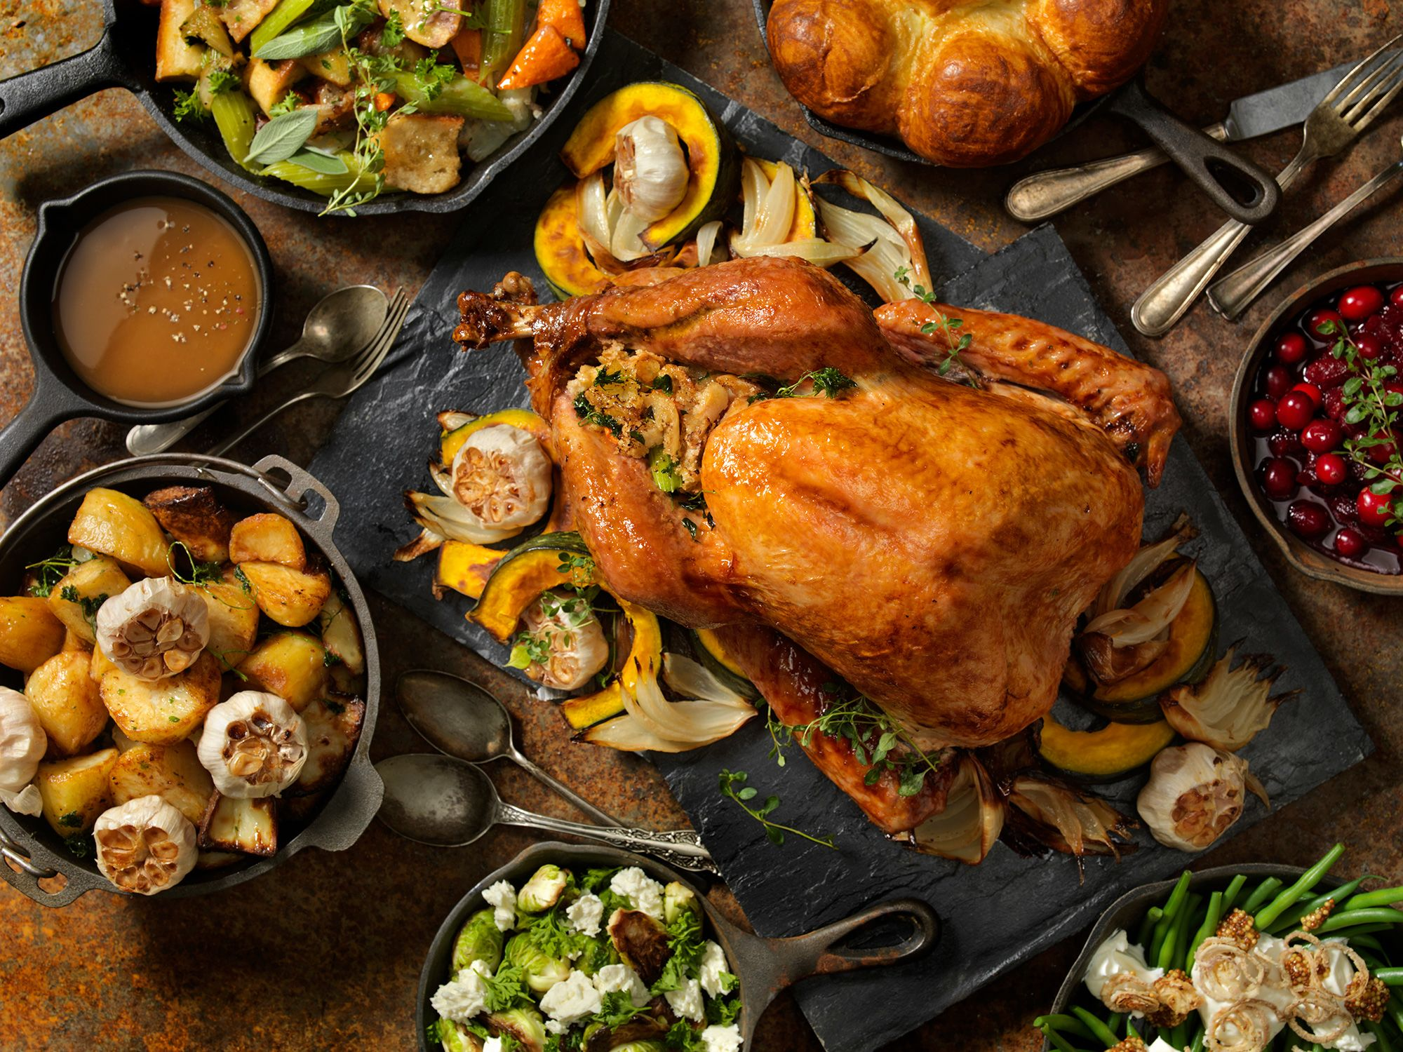
Canadian Thanksgiving: A Celebration of Heritage, Gratitude, and Community
Exploring Traditions, Foods, Activities, and Cultural Significance

Slide 2
Table of Contents
Welcome to Canadian Thanksgiving
History of Canadian Thanksgiving
Traditional Canadian Thanksgiving Foods
Decorations and Ambiance
Games and Activities
Expressing Gratitude
Common Errors to Avoid
Frequently Asked Questions
Objectives and Outcomes
Vocabulary Building
Resources and Materials
Assessment and Evaluation
Extension Activities
04
05
06
07
08
09
10
11
12
13
14
15
16

Slide 3
Table of Contents
Conclusion and Reflection
Teaching Tips and Strategies
Key Takeaways
Reflection Questions
Next Steps and Follow-up
17
18
19
20
21

Slide 4
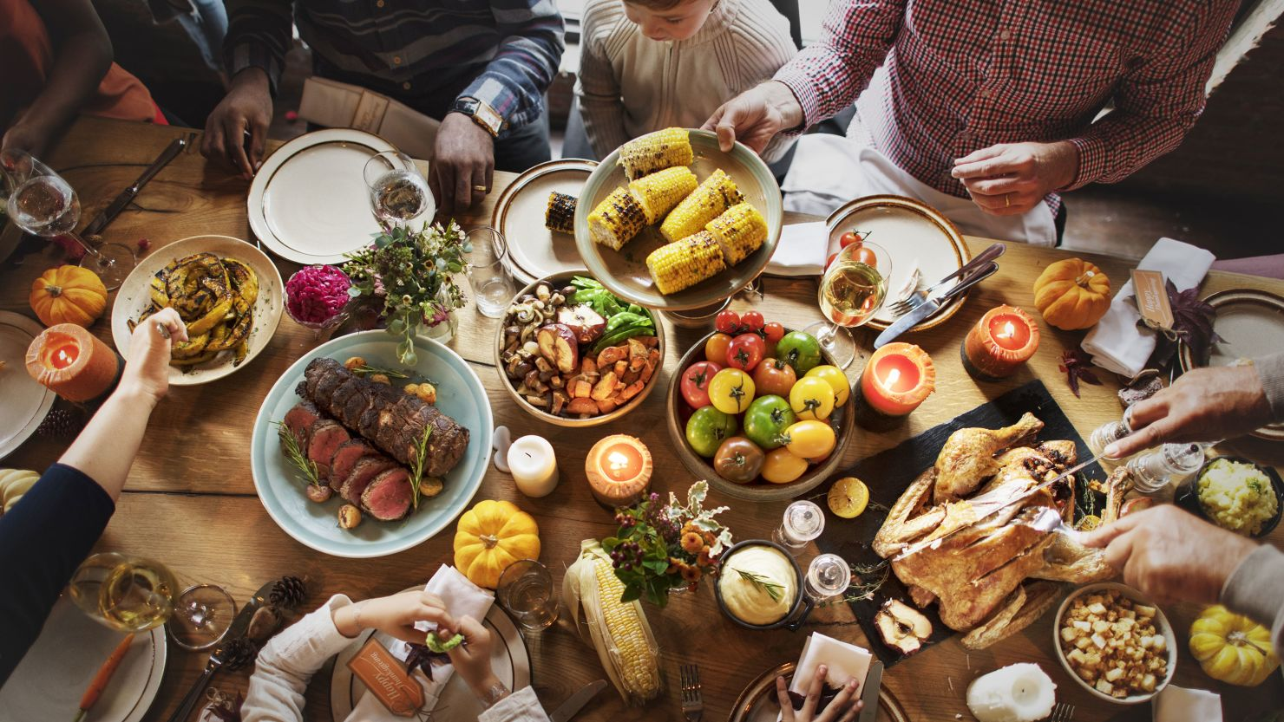
Welcome to Canadian Thanksgiving
Introduction to Canadian Thanksgiving
Importance of Family and Community
Brief Overview of the Presentation
Introduction to Canadian Thanksgiving
Importance of family and community
Brief overview of the presentation
4
Canadian Thanksgiving: A Celebration of Heritage, Gratitude, and Community

Slide 5
History of Canadian Thanksgiving
Origins of Canadian Thanksgiving
Evolution Over Time
European and Indigenous Influences
Modern-Day Celebrations
Origins of Canadian Thanksgiving
Evolution over time
Influence of European and Indigenous traditions
Modern-day celebrations
5
Canadian Thanksgiving: A Celebration of Heritage, Gratitude, and Community

Slide 6
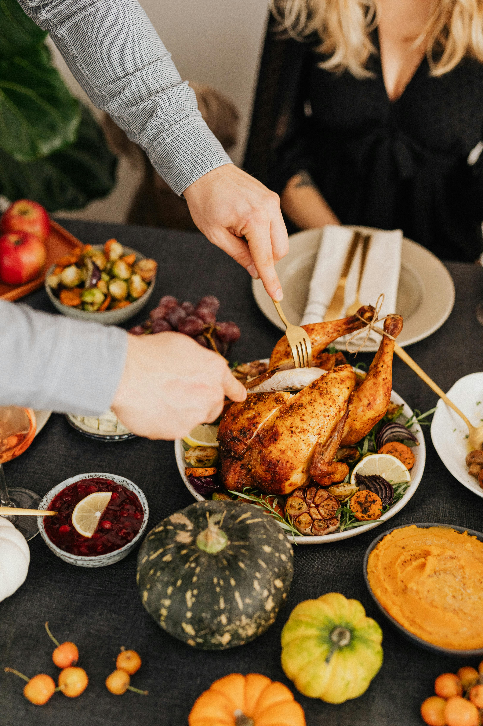
Traditional Canadian Thanksgiving Foods
Roasted Turkey
Mashed Potatoes
Stuffing
Roasted turkey is the centerpiece of a traditional Canadian Thanksgiving meal.
Mashed potatoes are a classic side dish, often served with gravy.
Stuffing is a flavorful mixture typically cooked inside the turkey or baked separately.
Cranberry Sauce
Pumpkin Pie
Cranberry sauce adds a sweet and tangy flavor to the Thanksgiving plate.
Pumpkin pie is a beloved dessert that completes the Thanksgiving feast.
6
Canadian Thanksgiving: A Celebration of Heritage, Gratitude, and Community

Slide 7
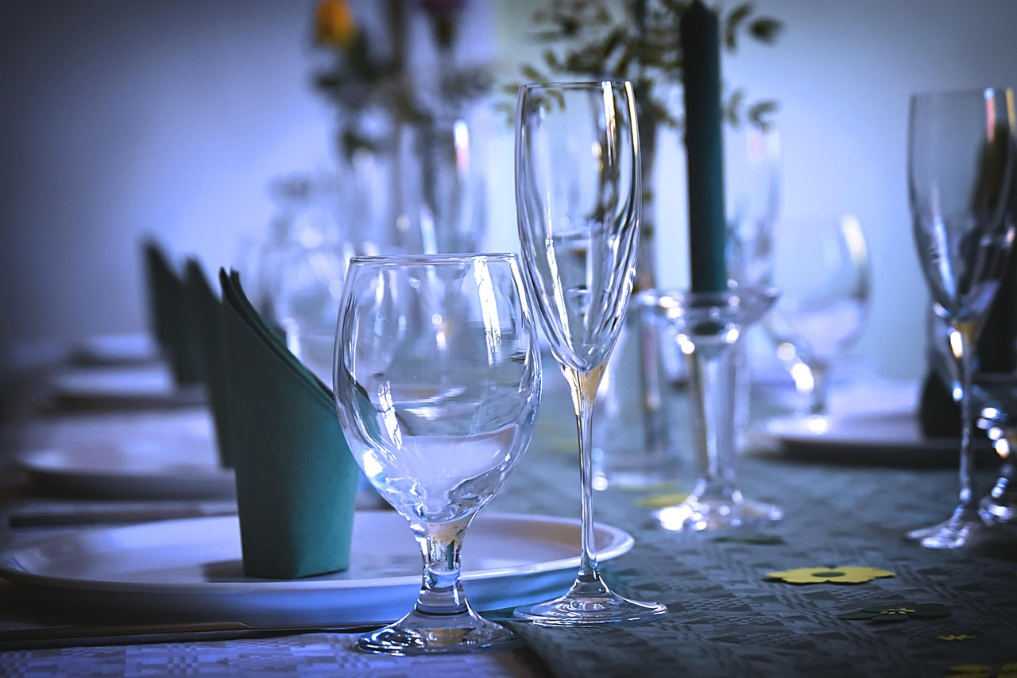
Decorations and Ambiance
Fall-themed Decorations
Maple Leaves and Inuit Artwork
Fall-themed decorations
Use of maple leaves and Inuit artwork
Table Centerpiece
Autumn-colored Tableware
Setting the table with a centerpiece
Autumn-colored tableware
7
Canadian Thanksgiving: A Celebration of Heritage, Gratitude, and Community

Slide 8
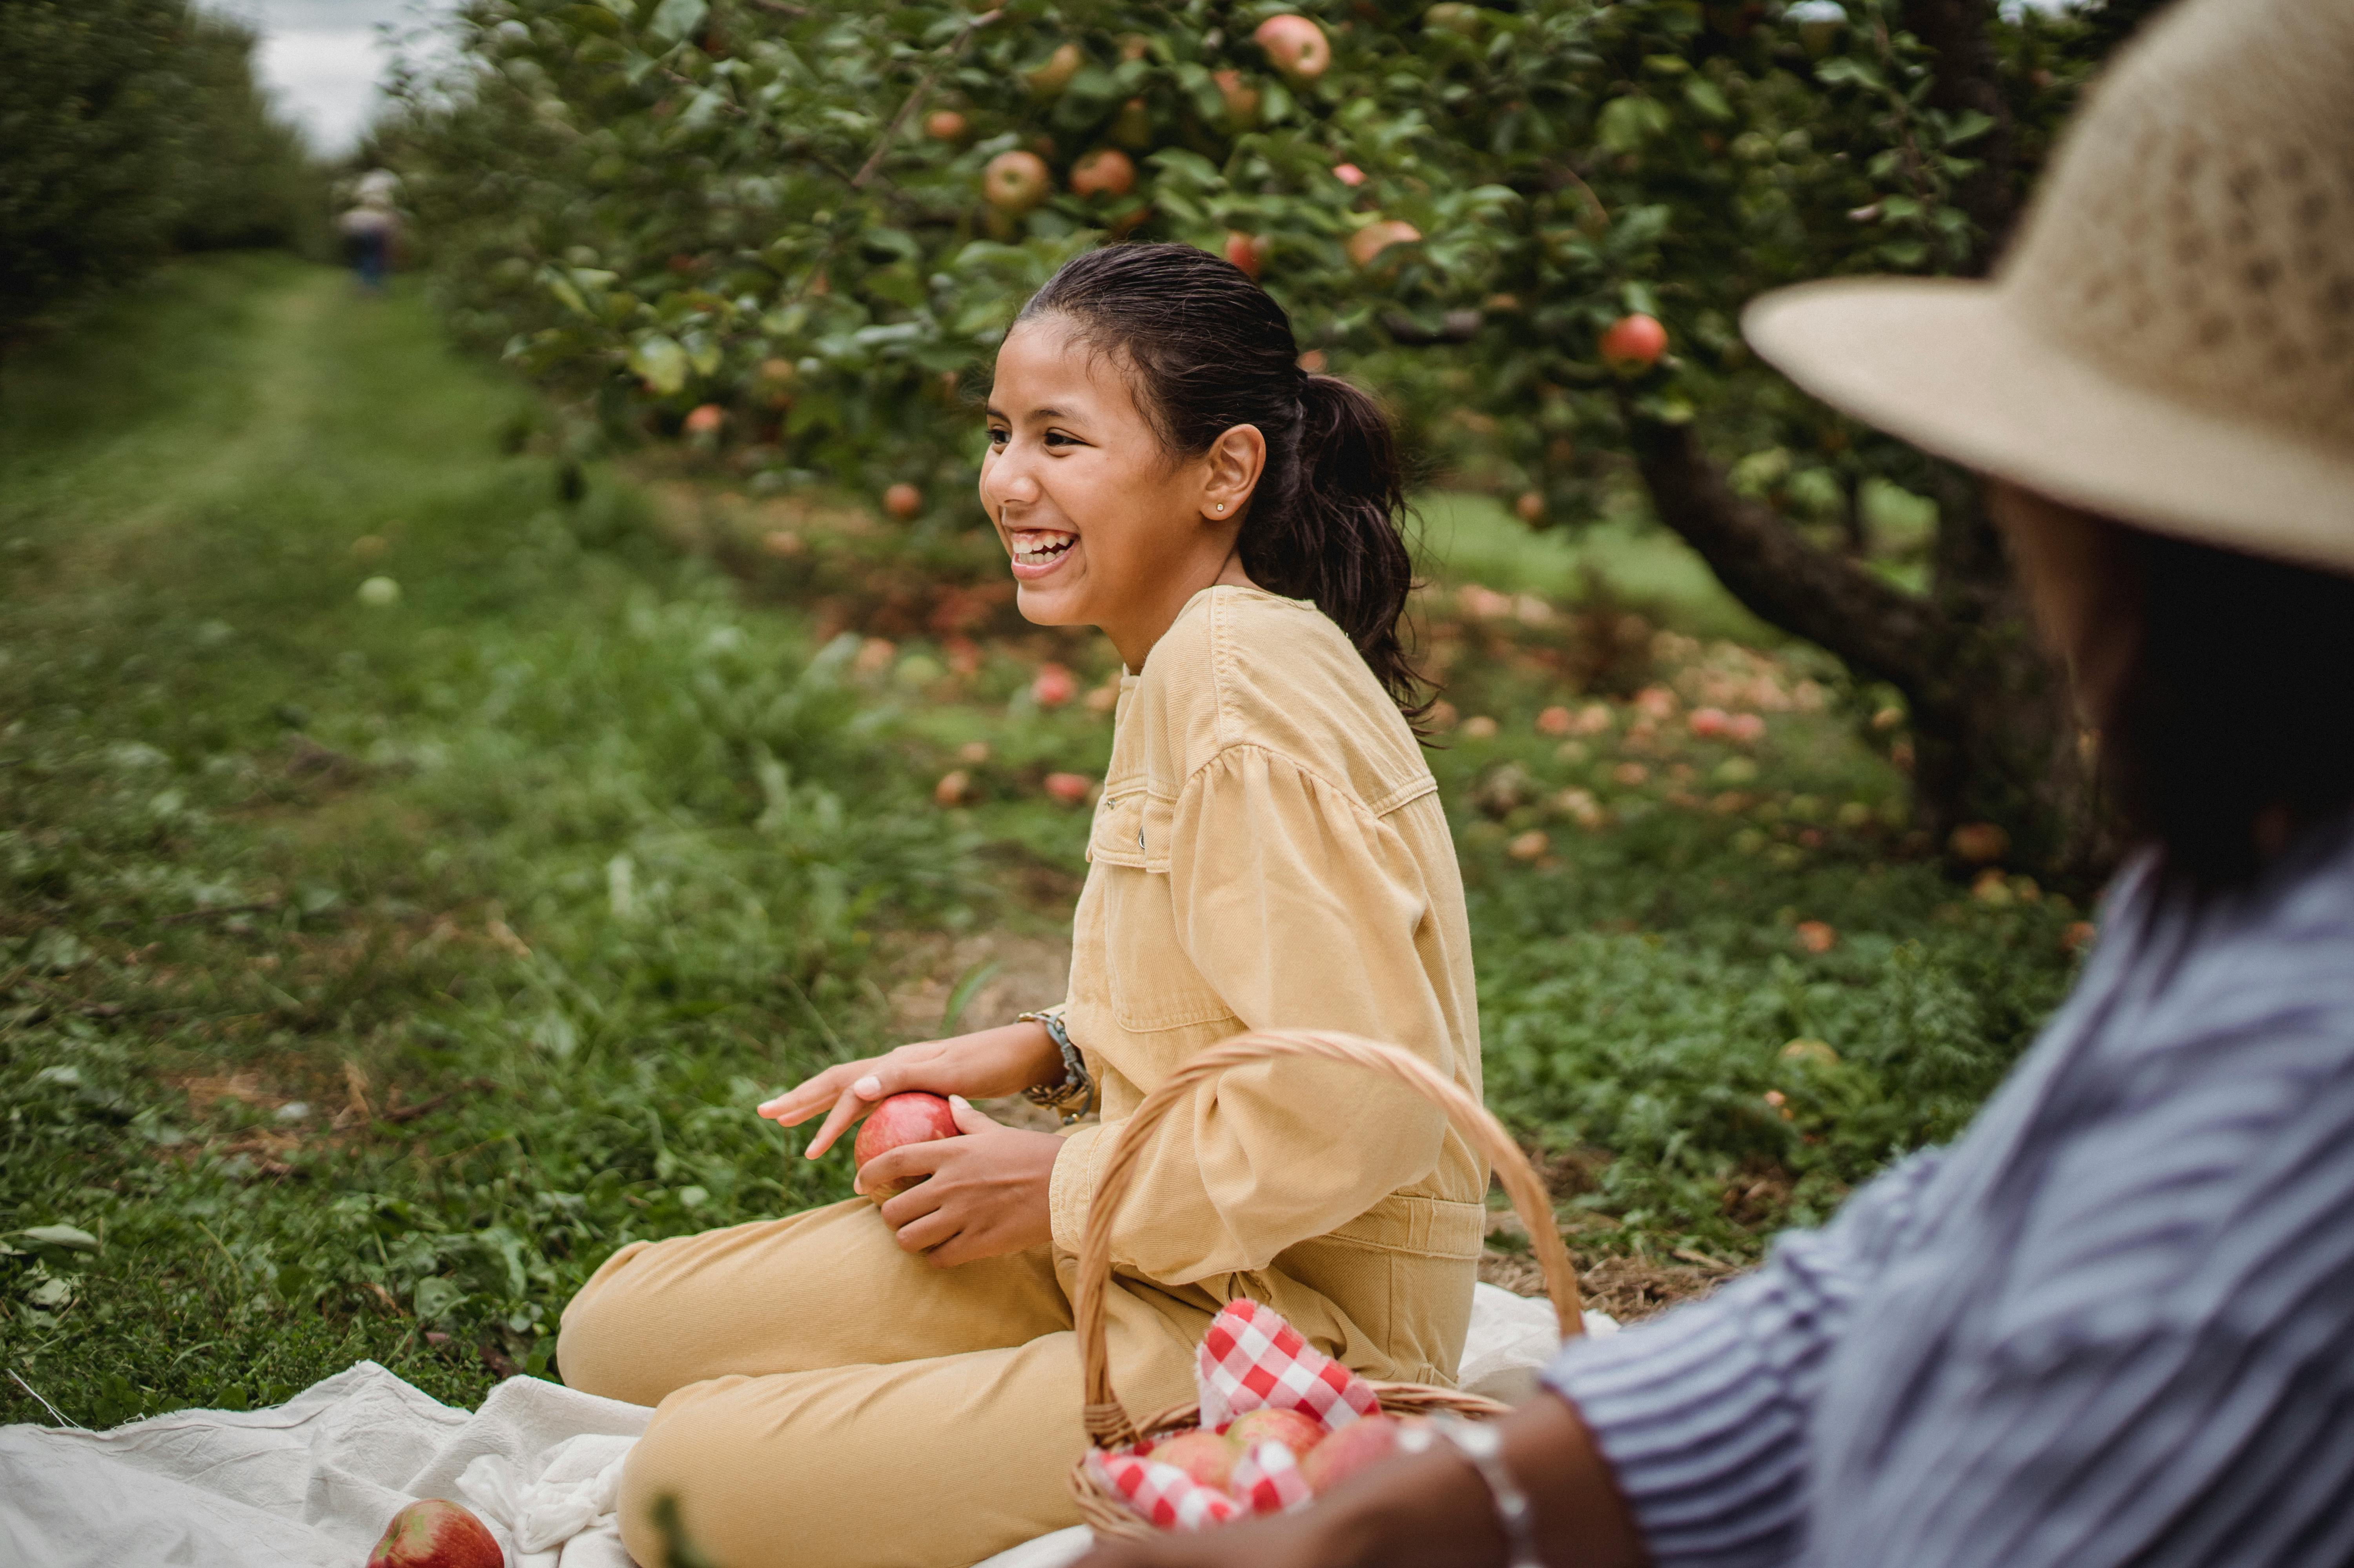
Games and Activities
Apple Picking
Hayrides
Nature Walks
Enjoy the seasonal activity of picking fresh apples from orchards.
Experience the charm of hayrides, a fun-filled activity for all ages.
Explore the beauty of nature through guided or self-paced walks.
Board Games and Puzzles
Crafting Sessions
Engage in indoor fun with a variety of board games and puzzles.
Unleash creativity with hands-on crafting activities suitable for everyone.
8
Canadian Thanksgiving: A Celebration of Heritage, Gratitude, and Community

Slide 9
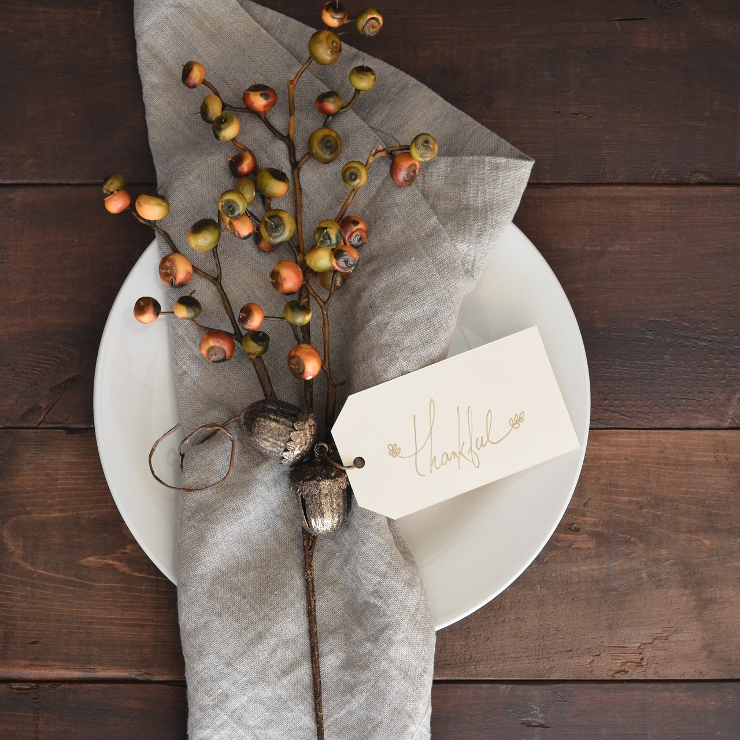
Expressing Gratitude
Sharing Gratitude
Gratitude Journals
Gratitude Jar
Sharing things you're thankful for
Writing gratitude journals
Creating a gratitude jar
9
Canadian Thanksgiving: A Celebration of Heritage, Gratitude, and Community

Slide 10
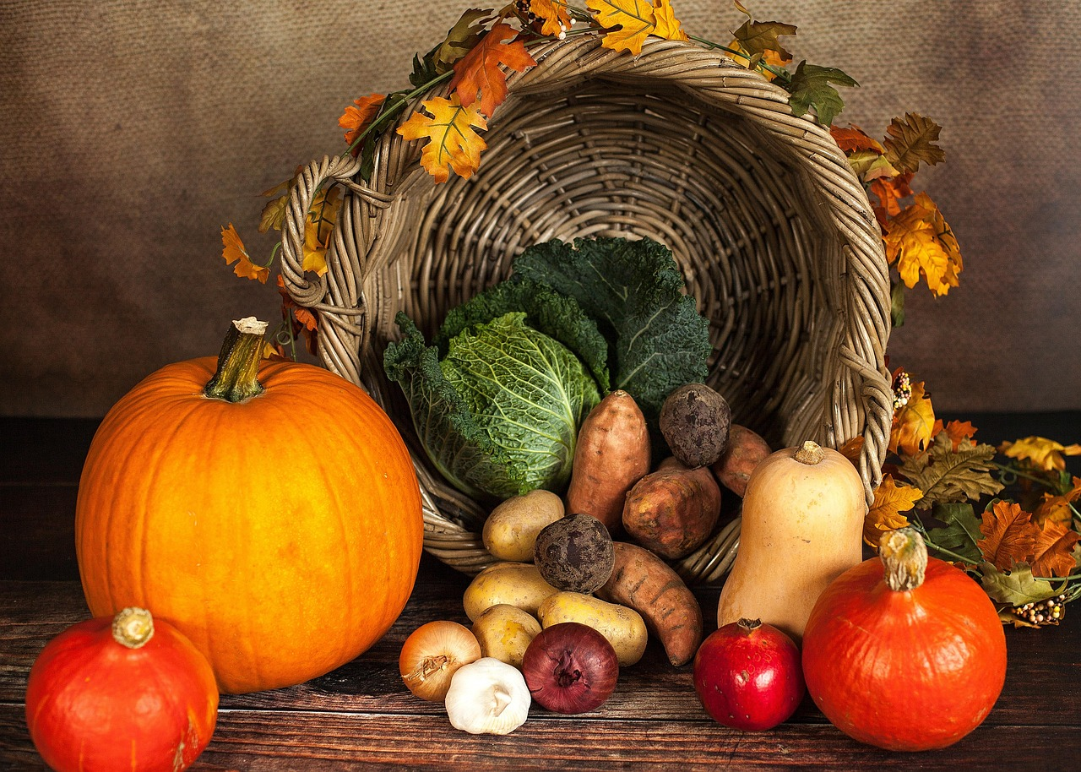
Common Errors to Avoid
Confusing Canadian and American Thanksgiving
Overlooking Indigenous perspectives
Confusing Canadian and American Thanksgiving
Overlooking Indigenous perspectives
Focusing too much on food
Not making it interactive
Focusing too much on food
Not making it interactive
10
Canadian Thanksgiving: A Celebration of Heritage, Gratitude, and Community

Slide 11
Frequently Asked Questions
When is Canadian Thanksgiving celebrated?
What are traditional Canadian Thanksgiving foods?
How can we make our celebration more authentic?
What activities can we do besides eating?
How can we teach children the true meaning of Thanksgiving?
Can we celebrate Thanksgiving if we're not Canadian?
Canadian Thanksgiving is celebrated on the second Monday of October each year.
Traditional foods include turkey, stuffing, mashed potatoes, cranberry sauce, and pumpkin pie.
Incorporate Canadian traditions such as serving local dishes, expressing gratitude, and enjoying time with family and friends.
Activities include watching football, going for a nature walk, playing board games, or volunteering in the community.
Teach children about gratitude, the history of Thanksgiving, and the importance of sharing and helping others.
Yes, Thanksgiving can be celebrated by anyone as a way to express gratitude and enjoy time with loved ones.
11
Canadian Thanksgiving: A Celebration of Heritage, Gratitude, and Community

Slide 12
Objectives and Outcomes
History and Significance
Understand the history and significance of Canadian Thanksgiving
Traditional Practices and Symbols
Appreciate traditional practices and symbols
Teamwork and Creativity
Develop skills in teamwork and creativity
Community and Gratitude
Foster a sense of community and gratitude
12
Canadian Thanksgiving: A Celebration of Heritage, Gratitude, and Community

Slide 13
Vocabulary Building
Thanksgiving
Harvest
Tradition
Culture
Family Gathering
Turkey
Thanksgiving
Harvest
Tradition
Culture
Family gathering
Turkey
13
Canadian Thanksgiving: A Celebration of Heritage, Gratitude, and Community

Slide 14
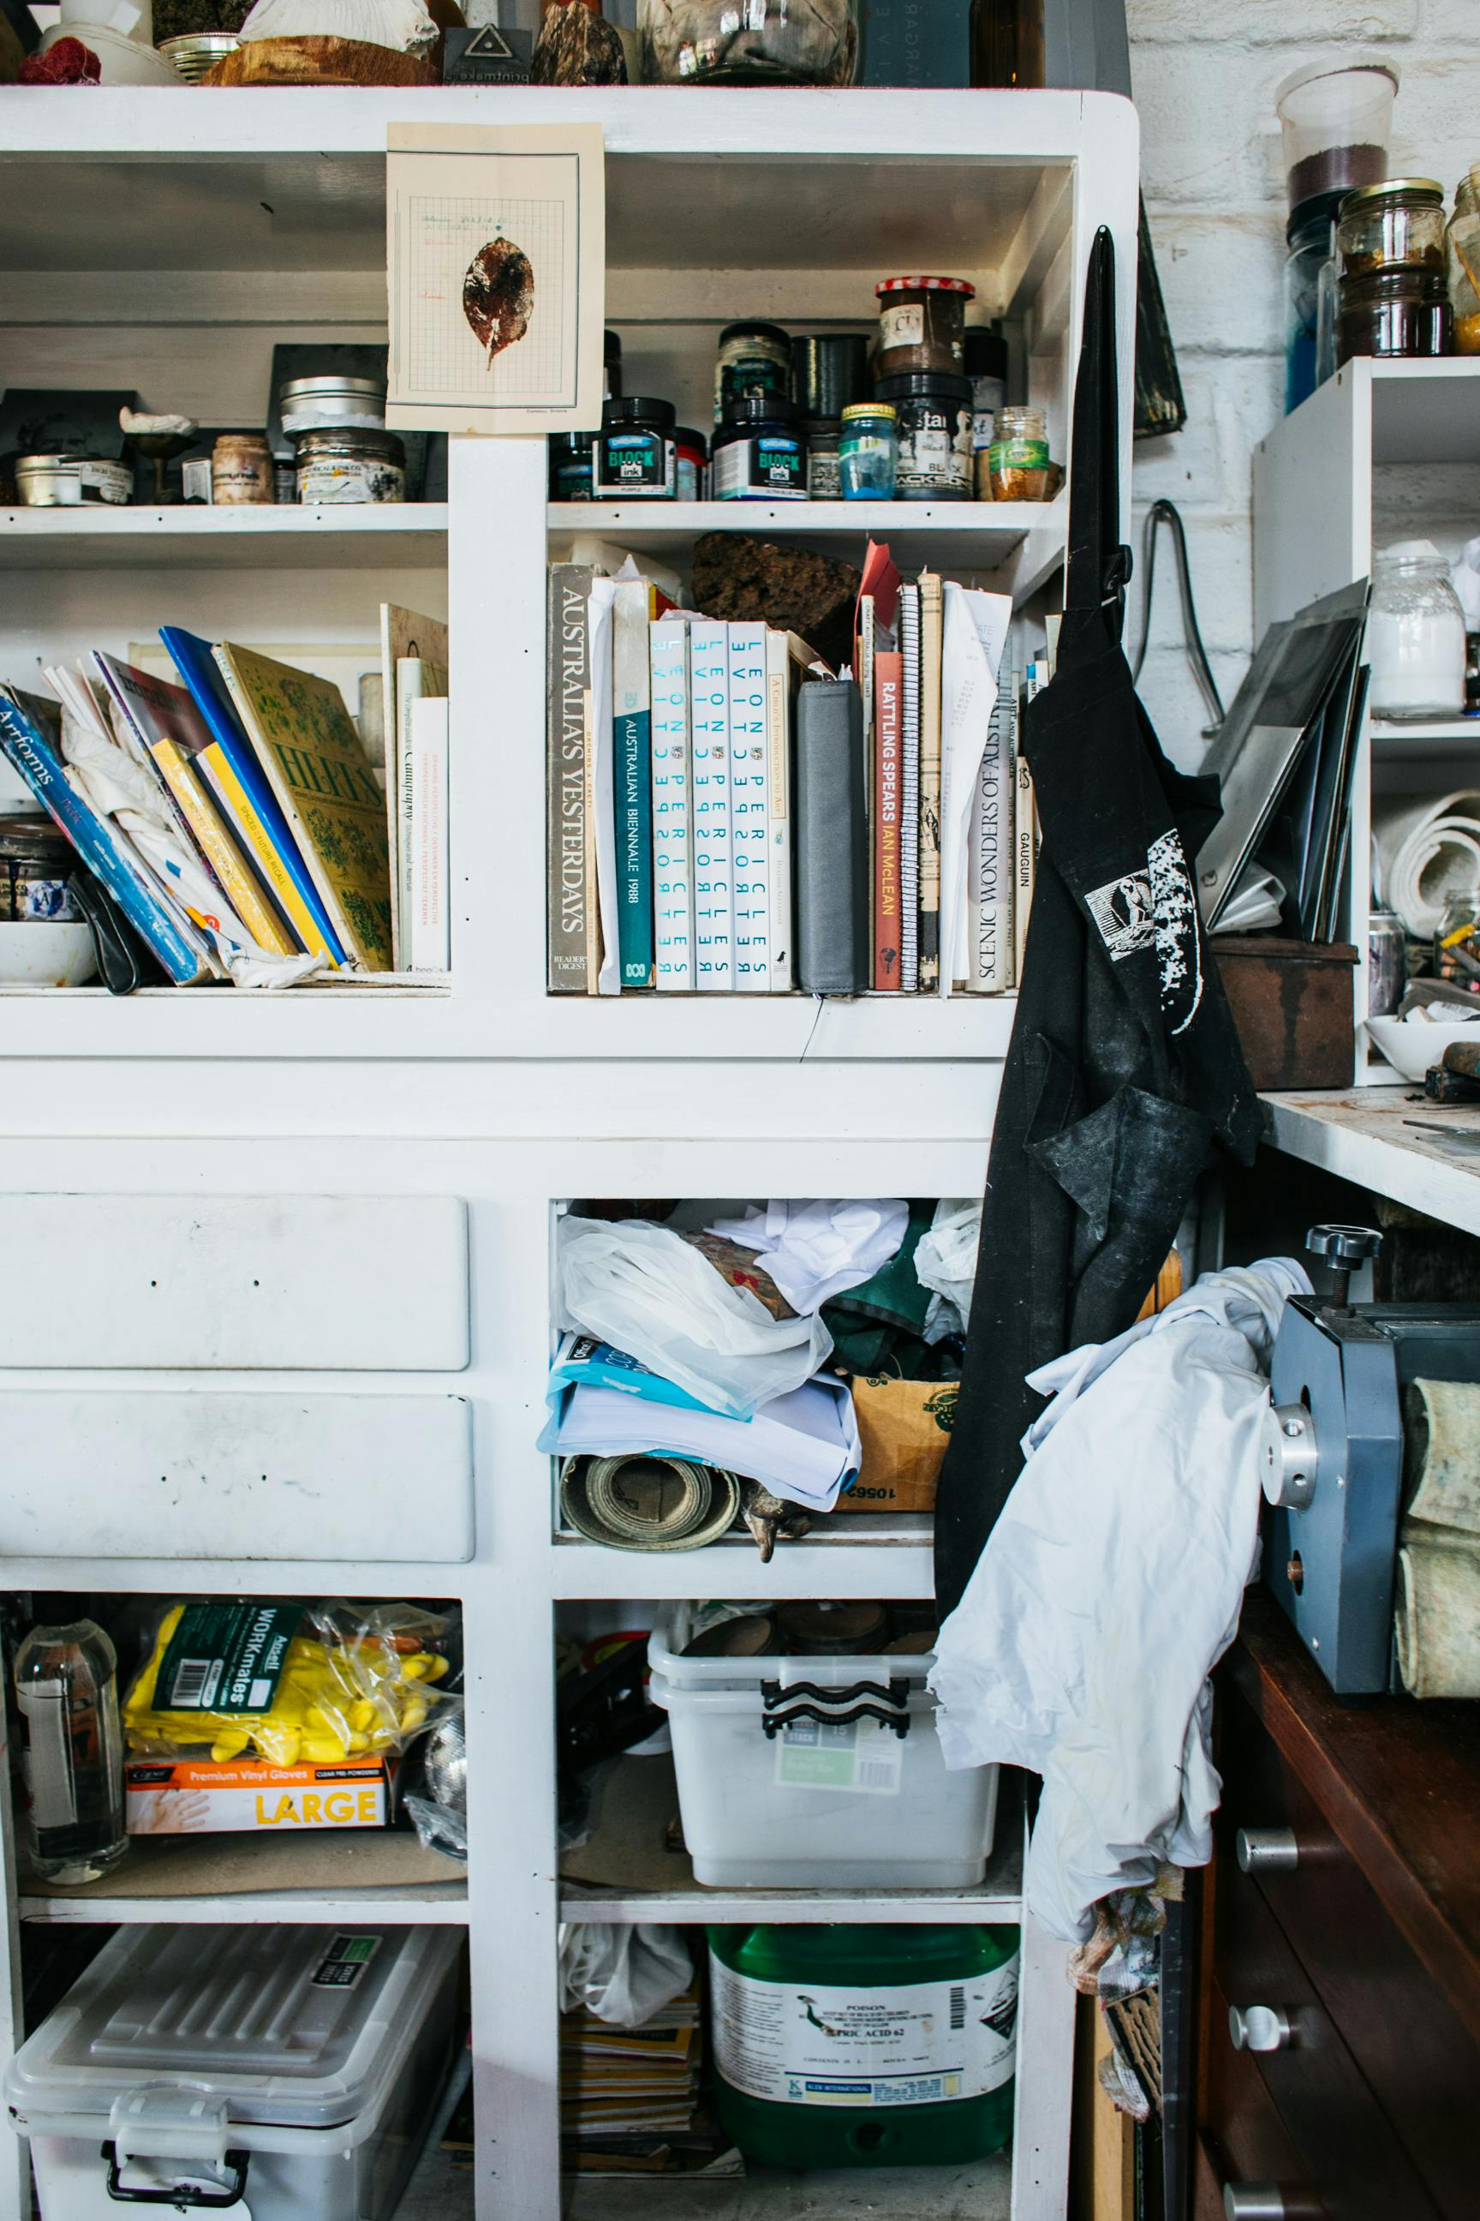
Resources and Materials
Digital Tools and Apps
Books and Articles
Videos and Documentaries
Digital tools and apps
Books and articles
Videos and documentaries
Craft Supplies
Traditional Canadian Music and Decorations
Guest Speakers and Community Resources
Craft supplies
Traditional Canadian music and decorations
Guest speakers and community resources
14
Canadian Thanksgiving: A Celebration of Heritage, Gratitude, and Community

Slide 15
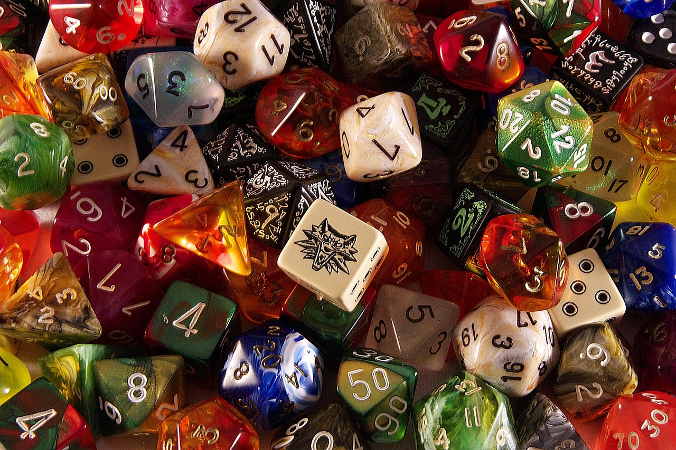
Assessment and Evaluation
Project-based Assessment
Project-based assessment
Written Reflections
Written reflections
Role-playing Presentations
Role-playing presentations
Quizzes and Games
Quizzes and games
15
Canadian Thanksgiving: A Celebration of Heritage, Gratitude, and Community

Slide 16
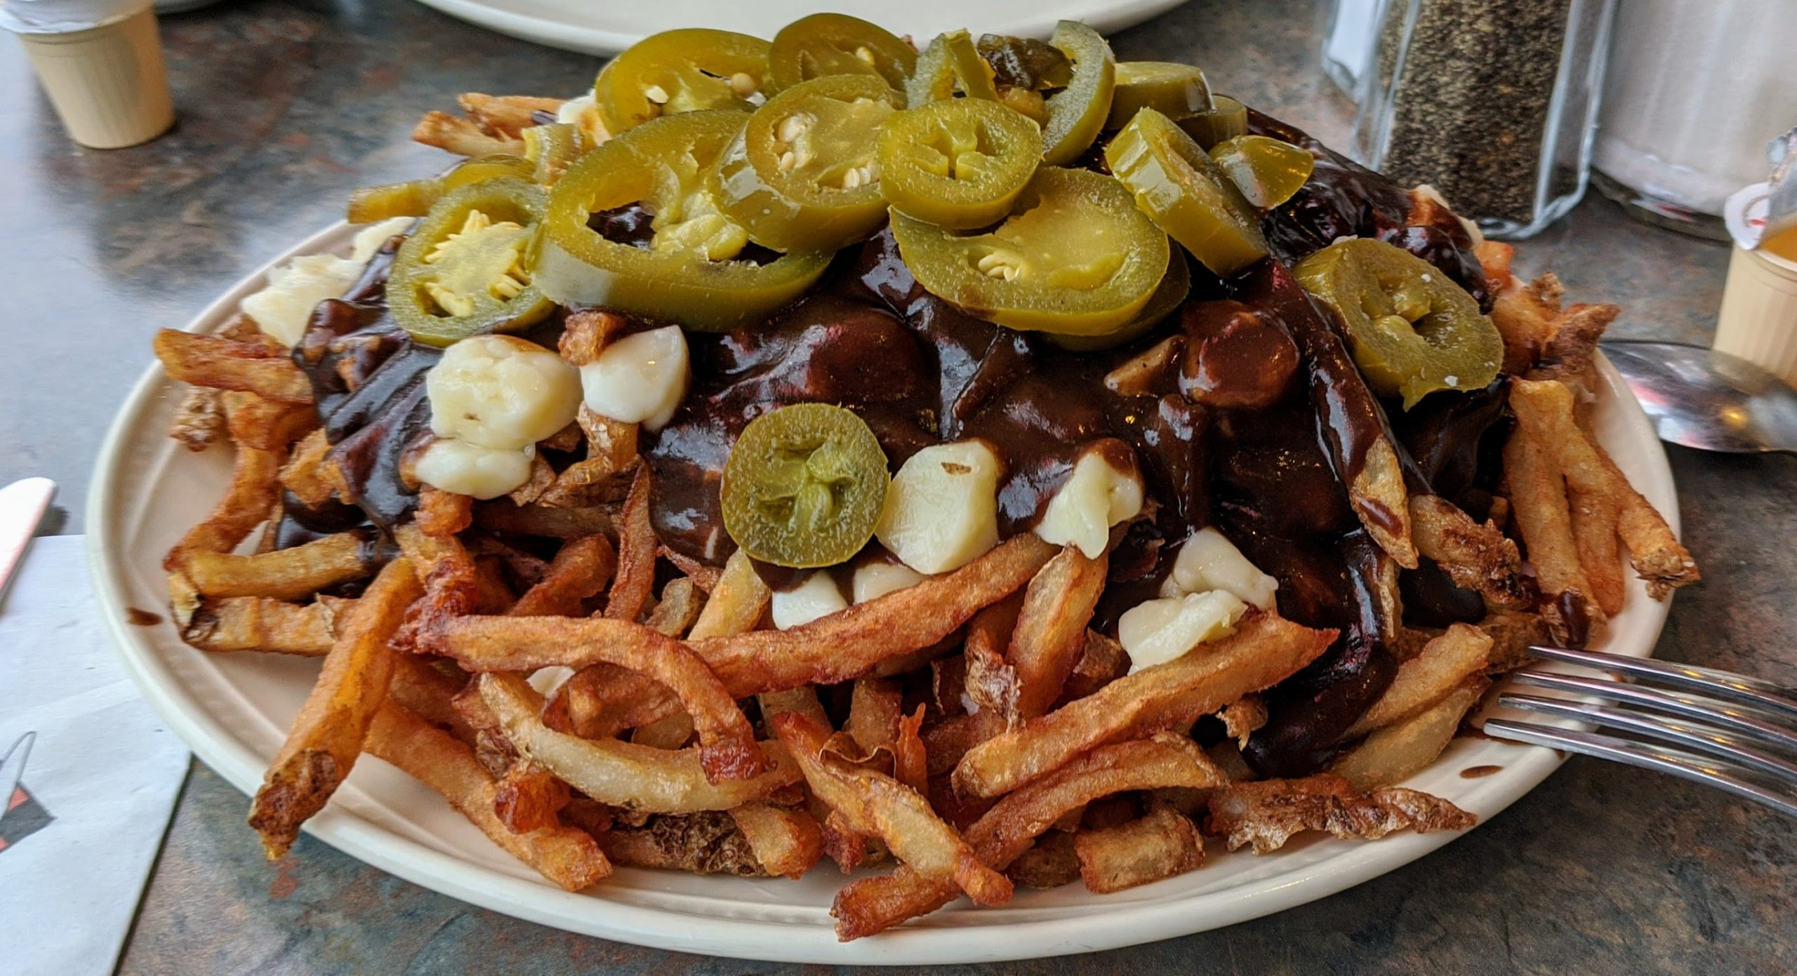
Extension Activities
Traditional Canadian Foods
Lesson on traditional Canadian foods
Canadian Fall Festivals
Exploring Canadian fall festivals and celebrations
Community Service Project
Community service project - giving back
16
Canadian Thanksgiving: A Celebration of Heritage, Gratitude, and Community

Slide 17

Conclusion and Reflection
Key Takeaways
Summary of key takeaways
Reflection on Gratitude and Community
Reflection on the importance of gratitude and community
Final Thoughts and Next Steps
Final thoughts and next steps
17
Canadian Thanksgiving: A Celebration of Heritage, Gratitude, and Community

Slide 18

Teaching Tips and Strategies
Storytelling in Teaching
Visual Aids for Engagement
Interactive Learning
Use storytelling
Incorporate visual aids
Make it interactive
Participation Encouragement
Real-Life Examples
Assessment and Reflection
Encourage participation
Use real-life examples
Assess and reflect
18
Canadian Thanksgiving: A Celebration of Heritage, Gratitude, and Community

Slide 19
Key Takeaways
History and Significance
Traditional Practices and Symbols
Gratitude and Community
Understanding the history and significance of Canadian Thanksgiving
Appreciation for traditional practices and symbols
Importance of gratitude and community
19
Canadian Thanksgiving: A Celebration of Heritage, Gratitude, and Community

Slide 20
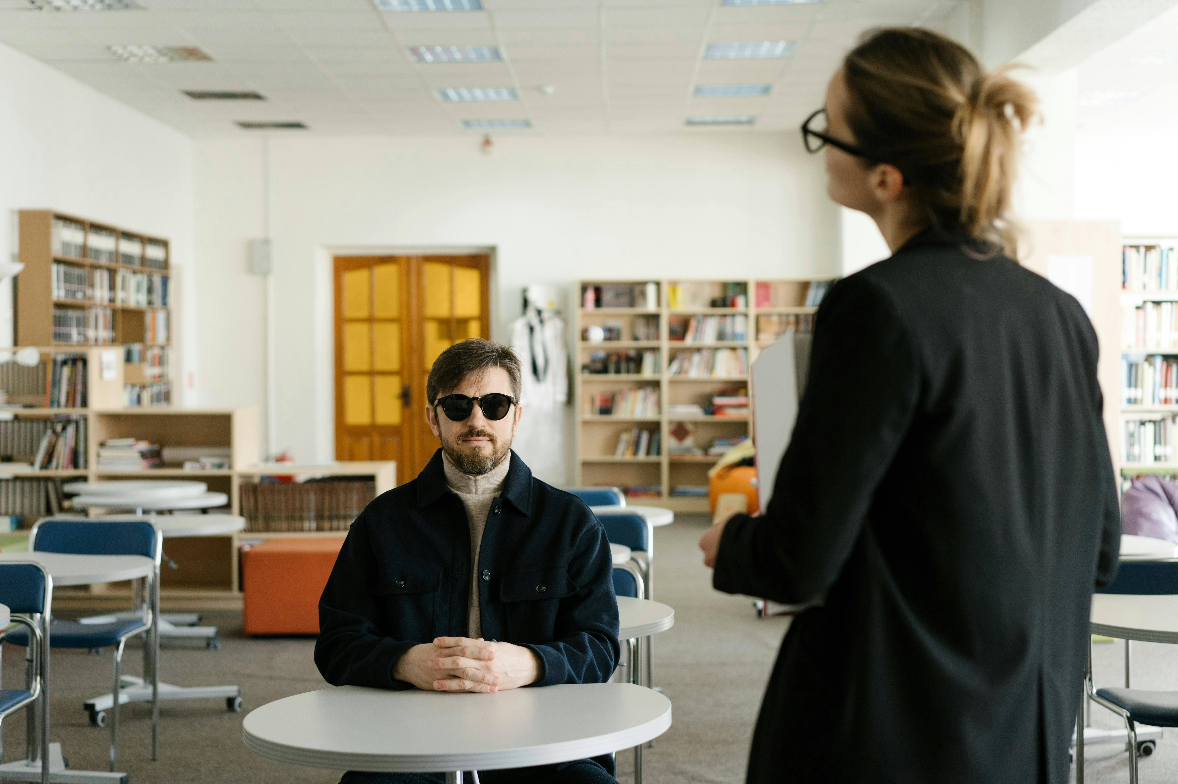
Reflection Questions
Engagement Effectiveness
Adapting for Diversity
Planning Follow-Up
How effectively did the lesson engage students?
How can the lesson be adapted for diverse needs?
What follow-up lessons can be planned?
20
Canadian Thanksgiving: A Celebration of Heritage, Gratitude, and Community

Slide 21
Next Steps and Follow-up
Lesson on Traditional Canadian Foods
Exploring Canadian Fall Festivals
Community Service Project
Lesson on traditional Canadian foods
Exploring Canadian fall festivals and celebrations
Community service project - giving back
21
Canadian Thanksgiving: A Celebration of Heritage, Gratitude, and Community

