Slide 1

Understanding Fractions and Decimals: A Comprehensive Guide
Exploring Concepts, Conversions, Applications, and Common Misconceptions

Slide 2


Table of contents
Introduction to Fractions and Decimals
What are Fractions?
What are Decimals?
Converting Fractions to Decimals
Converting Decimals to Fractions
Real-Life Applications of Fractions
Real-Life Applications of Decimals
Common Errors and Misconceptions
FAQs
Objectives
Vocabulary
Resources
Conclusion
01
02
03
04
05
06
07
08
09
10
11
12
13

Slide 3
Table of contents
Reflection Questions
Next Steps
Final Thoughts
Thank You
14
15
16
17

Slide 4
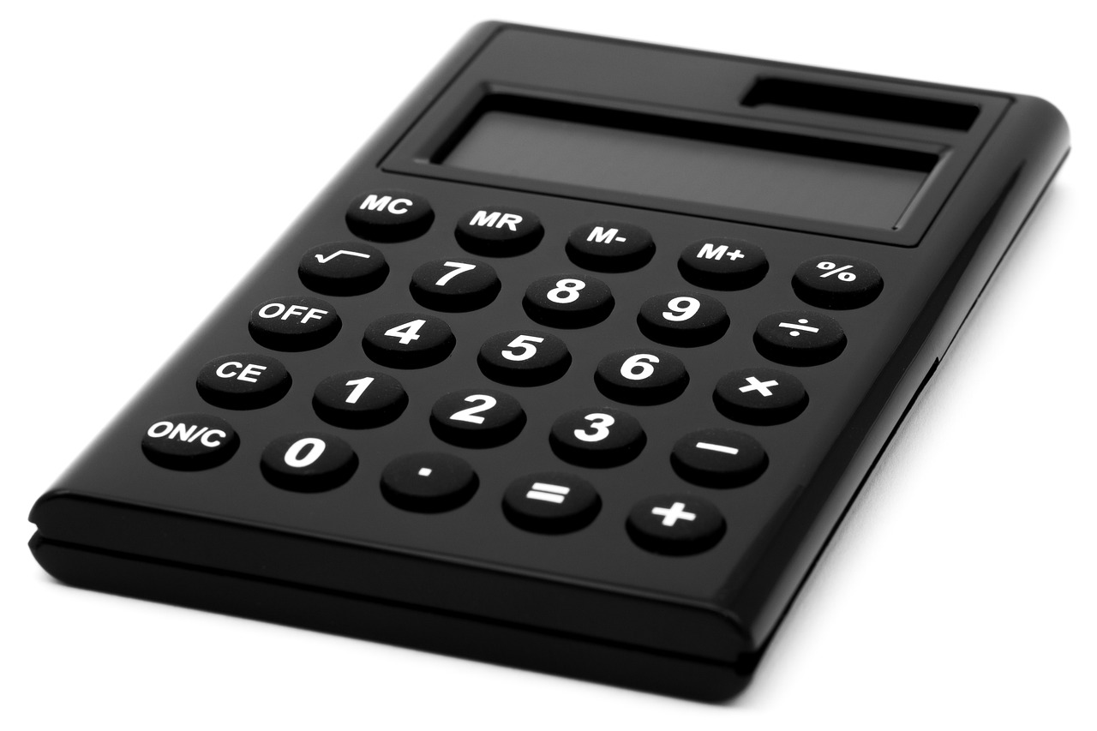
Introduction to Fractions and Decimals
Everyday Applications
Problem-Solving Skills
Basics and Conversions
Fractions and decimals are essential mathematical concepts used in everyday life.
They help us in tasks like budgeting, cooking, and measuring.
Understanding fractions and decimals is crucial for problem-solving and decision-making.
These skills enable us to analyze situations and make informed choices.
This presentation will cover the basics of fractions and decimals, their conversion, and real-life applications.
Mastering these concepts will enhance your mathematical proficiency.
1
Understanding Fractions and Decimals: A Comprehensive Guide

Slide 5

What are Fractions?
What are Fractions?
Numerator and Denominator
Fraction Examples
A fraction represents a part of a whole, expressed as a ratio of two integers.
Understanding fractions is crucial for grasping various mathematical concepts.
The top number in a fraction is called the numerator.
The bottom number is called the denominator.
Common fractions include 1/2 (one half), 3/4 (three quarters), and 2/3 (two thirds).
Each fraction illustrates a different portion of a whole.
2
Understanding Fractions and Decimals: A Comprehensive Guide

Slide 6

What are Decimals?
Definition
Convenience
Examples
A decimal expresses a fraction with a denominator of 10 or a power of 10.
It provides a simpler way to represent parts of a whole.
Decimals simplify calculations and comparisons.
They make numerical values easier to interpret.
Examples of decimals include 0.5, 0.25, and 0.75.
These decimals correspond to the fractions 1/2, 1/4, and 3/4, respectively.
3
Understanding Fractions and Decimals: A Comprehensive Guide

Slide 7

Converting Fractions to Decimals
Division Method
Example Conversions
Importance of Conversion
To convert a fraction to a decimal, divide the numerator by the denominator.
This straightforward method is widely used in mathematics.
1/2 converts to 0.5.
3/4 translates to 0.75.
Converting fractions to decimals is vital for solving various mathematical problems.
This skill improves overall numerical literacy.
4
Understanding Fractions and Decimals: A Comprehensive Guide

Slide 8
Converting Decimals to Fractions
Decimal to Fraction
Example Conversions
Simplified Expression
To convert a decimal to a fraction, identify the last digit's place value.
Use that place value as the denominator.
Convert 0.5 to 1/2.
Convert 0.25 to 1/4.
A simplified expression means reducing the fraction to its lowest terms.
This helps in comparing fractions more easily.
5
Understanding Fractions and Decimals: A Comprehensive Guide

Slide 9
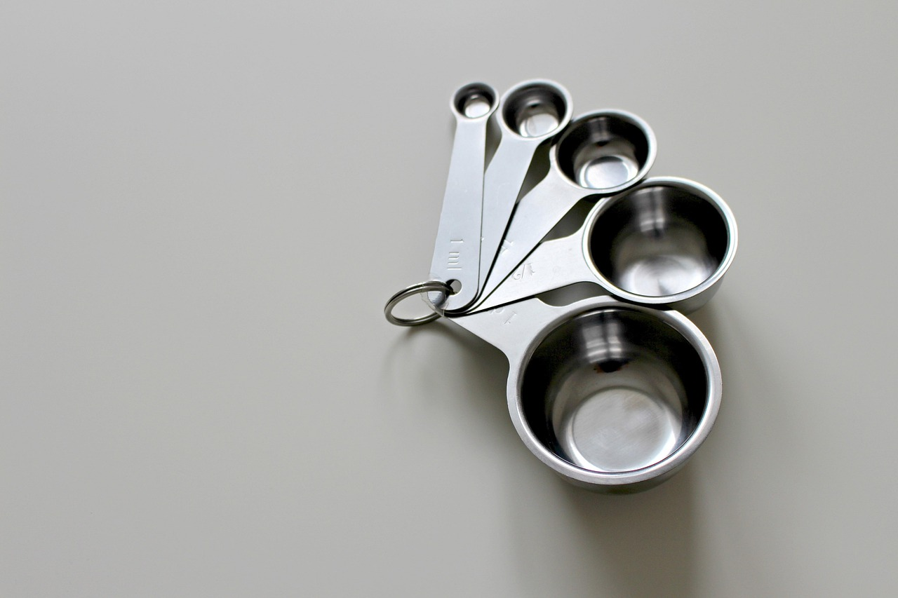
Real-Life Applications of Fractions
Cooking Measurements
Financial Calculations
Scientific Ratios
Fractions are used to measure ingredients in cooking and baking.
For instance, a recipe might require 1/2 cup of sugar.
Fractions are crucial for calculating interest rates and investment returns.
They assist in evaluating profit margins on investments.
Fractions are used to quantify measurements in scientific experiments.
They are essential for determining concentrations in solutions.
6
Understanding Fractions and Decimals: A Comprehensive Guide

Slide 10
Real-Life Applications of Decimals
Finance Usage
Scientific Measurement
Everyday Pricing
Decimals express monetary values and percentages.
They allow for accurate budgeting and investment calculations.
Decimals are essential for measuring quantities and ratios.
They enhance precision in experiments and data analysis.
Decimals indicate prices and discounts in daily transactions.
They help clarify costs and savings for consumers.
7
Understanding Fractions and Decimals: A Comprehensive Guide

Slide 11

Common Errors and Misconceptions
Interchangeable Use
Mathematics Misconception
Understanding Differences
Many people mistakenly use fractions and decimals interchangeably without converting them.
This can lead to incorrect calculations.
Some people think fractions and decimals are limited to math.
In reality, they are used in various real-life situations.
Understanding the differences between fractions and decimals is essential.
This knowledge aids in making informed decisions, such as budgeting or cooking.
8
Understanding Fractions and Decimals: A Comprehensive Guide

Slide 12
FAQs
Fraction Definition
Decimal Definition
Conversion Method
A fraction represents a part of a whole as a ratio of two integers.
For example, 1/2 means one part out of two equal parts.
A decimal represents a part of a whole as a fraction with a denominator of 10 or a power of 10.
For instance, 0.5 is equivalent to 1/2.
To convert a fraction to a decimal, divide the numerator by the denominator.
For example, to convert 1/4, divide 1 by 4 to get 0.25.
9
Understanding Fractions and Decimals: A Comprehensive Guide

Slide 13

Objectives
Define Fractions & Decimals
Convert Between Forms
Real-Life Applications
Fractions represent parts of a whole, while decimals are fractions in a base-10 format.
Real-world examples help illustrate these concepts.
Learn to convert fractions to decimals accurately.
Practice converting decimals back to fractions.
Explore how fractions and decimals are used in everyday situations.
Apply your knowledge to solve practical problems.
10
Understanding Fractions and Decimals: A Comprehensive Guide

Slide 14
Vocabulary
Fraction
Decimal
Numerator and Denominator
A fraction signifies a segment of a whole, represented as a ratio of two integers.
For example, in the fraction 3/4, the number 3 indicates three parts out of a total of four.
A decimal expresses a fraction where the denominator is a power of 10, simplifying calculations.
For instance, 0.75 is the decimal form of the fraction 3/4, making it easier to use in everyday math.
The numerator is the upper part of a fraction, showing how many parts are being considered.
Conversely, the denominator is the lower part, indicating the total number of equal segments in the whole.
11
Understanding Fractions and Decimals: A Comprehensive Guide

Slide 15
Resources
Khan Academy: Interactive Learning for Math Concepts
Mathway: Your Online Math Problem Solver
Fraction and Decimal Practice Worksheets: Flexible Learning Tools
Khan Academy provides resources for mastering fractions and decimals.
Students can engage with interactive exercises and instructional videos.
Mathway assists users in solving problems related to fractions and decimals.
It offers clear, step-by-step solutions to enhance understanding.
These worksheets come in both printable and digital formats for easy access.
They are designed to reinforce understanding and provide additional practice.
12
Understanding Fractions and Decimals: A Comprehensive Guide

Slide 16

Conclusion
Everyday Applications
Critical for Decision-Making
Confidence in Problem-Solving
Fractions and decimals play a vital role in our daily activities.
They assist us in tasks such as budgeting, cooking, and measuring accurately.
Mastering fractions and decimals is essential for effective problem-solving.
They help us analyze data for informed choices.
With this knowledge, you can confidently face and overcome challenges.
Applying these concepts will enhance your ability to tackle real-life problems.
13
Understanding Fractions and Decimals: A Comprehensive Guide

Slide 17
Reflection Questions
Learnings on Fractions
Real-Life Applications
Overcoming Challenges
Fractions are essential for understanding parts of a whole.
Recognizing how fractions relate to decimals enhances numerical literacy.
Fractions are crucial in cooking, such as adjusting recipes based on servings.
In finance, they help in calculating discounts and interest rates.
I found converting fractions to decimals challenging at first.
Utilizing online resources and practice problems helped me improve.
14
Understanding Fractions and Decimals: A Comprehensive Guide

Slide 18
Next Steps
Understanding Percentages and Ratios
Incorporating Fractions in Algebra
Solving Real-World Problems
Understand the importance of percentages and ratios in daily calculations.
These concepts are essential for making informed financial decisions.
Learn to effectively use fractions and decimals in algebraic expressions.
This knowledge will enhance your analytical skills and problem-solving capabilities.
Engage in practical exercises that involve fractions and decimals.
This practice will help you see their relevance in everyday situations.
15
Understanding Fractions and Decimals: A Comprehensive Guide

Slide 19

Final Thoughts
Powerful Tools
Mastery Benefits
Real-Life Application
Fractions and decimals are vital for effective problem-solving.
They facilitate clear data analysis and interpretation.
Gaining proficiency in fractions and decimals empowers you to solve intricate problems.
This expertise sharpens your analytical skills and boosts confidence.
Apply your knowledge of fractions and decimals in everyday situations.
Regular practice will deepen your understanding and retention.
16
Understanding Fractions and Decimals: A Comprehensive Guide

Slide 20

Thank You
Appreciation
Engagement
Learning
Thank you for participating in this presentation on fractions and decimals.
Your engagement and insights were invaluable.
Your active participation made the discussion lively.
We appreciate your contributions to the topic.
We hope you gained a deeper understanding of fractions and decimals.
The examples provided clarified complex concepts.
Participation
Collaboration
Your questions enriched the session.
We encourage you to explore these topics further.
Working together enhances our learning experience.
We value the diverse perspectives shared.
17
Understanding Fractions and Decimals: A Comprehensive Guide

